Slide 1
Mic Prediction using Gene Annotation
By: Cory Kromer-Edwards

Slide 2
Intro
Takes too long, up to 72 hours, currently to prescribe antibiotics in the hospital
Bacteria to become leading cause of death by 2050
Machine Learning, along with Next Gen Sequences (NGS), can make shorten that time

Slide 3
Data
Labels: Minimum Inhibitory Concentration (MIC) values
Input:
Annotated Amino Acid (AA) sequences for 3 genes
3 genes are for Outer Membrane Protein (OMP) genes OMPK35, OMPK36, OMPK37
Species genes were retrieved from: Klebsiella Pneumoniae (KPN)
Each AA position was a feature
403 features AA positions combined for all 3 genes
2,864 isolates used

Slide 4
Preprocessing
AA sequences:
AA characters were converted to integers by index
EX: let a species have AA’s [A: 0, B: 1, C: 2], then the AA sequence “ACBCCA” would become “021220”
MIC values:
All MICs, regardless of antibiotic, were put together and indexed (like AA sequences)
The indecies were then used to convert MIC values (like 0.01) into indecies (like 2)
Missing MIC values were replaced with a -1 (which had index of 0)

Slide 5
Algorithms used
XGBoost
Random Forest (RF)
Neural Network (NN)

Slide 6
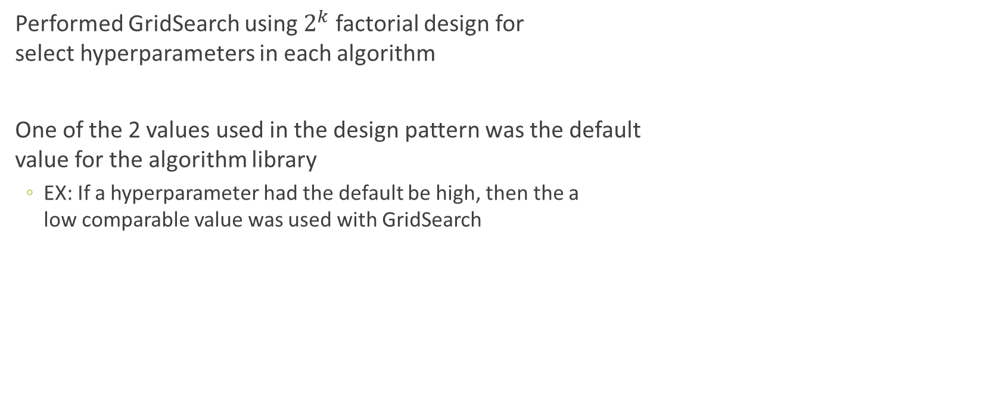
Tuning
Performed GridSearch using $2^{k}$ factorial design for select hyperparameters in each algorithm
One of the 2 values used in the design pattern was the default value for the algorithm library
EX: If a hyperparameter had the default be high, then the a low comparable value was used with GridSearch

Slide 7
Training
Each algorithm was evaluated using 5-fold Cross Validation (CV)
CV performance metric used: F1-micro Score
80% of data was used for training

Slide 8
Testing
20% of the data was used for testing
All graphs and results show test results

Slide 9
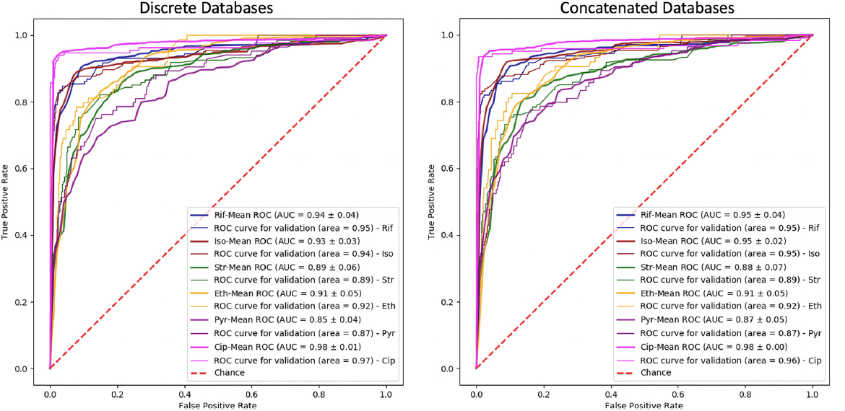
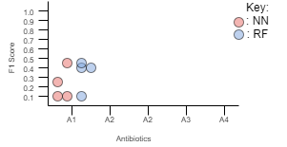
Graphs to reproduce
Plot showing the individual F1 scores for each MIC value by algorithm/antibiotic pair
Receiver Operating Characteristic (ROC) Curve plots

Slide 10
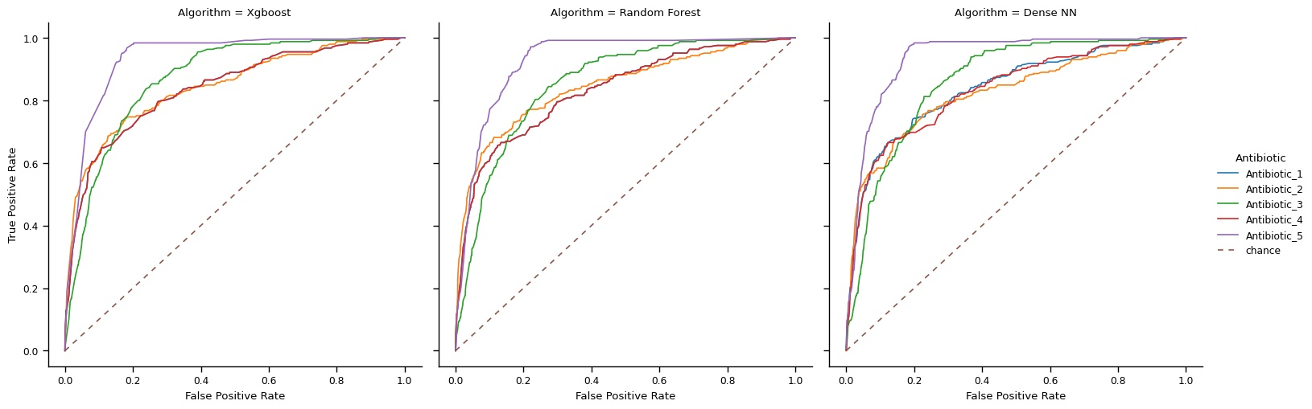
Graphs & Results

Slide 11
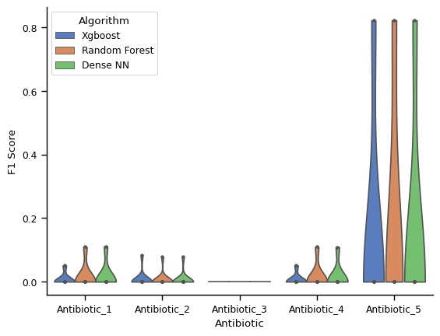
Graphs & Results
Antibiotic 5 performed best
Antibiotic 3 could not predict any MIC value with all F1 scores being 0.0
All antibiotics could only perform well on a single MIC value. All other MICs had F1 score of 0.
Looking at ROC plots, all algorithms seemed to perform well, but plot with F1 scores shows different story
ROC plot from D. Aytan-Aktug, et. al. nearly matched ROC plot made in this study

Slide 12
Acknowledgements
All data was obtained from JMI Laboratories
Pipeline made, and used, to get data was made in collaboration with JMI Laboratories

