Slide 1
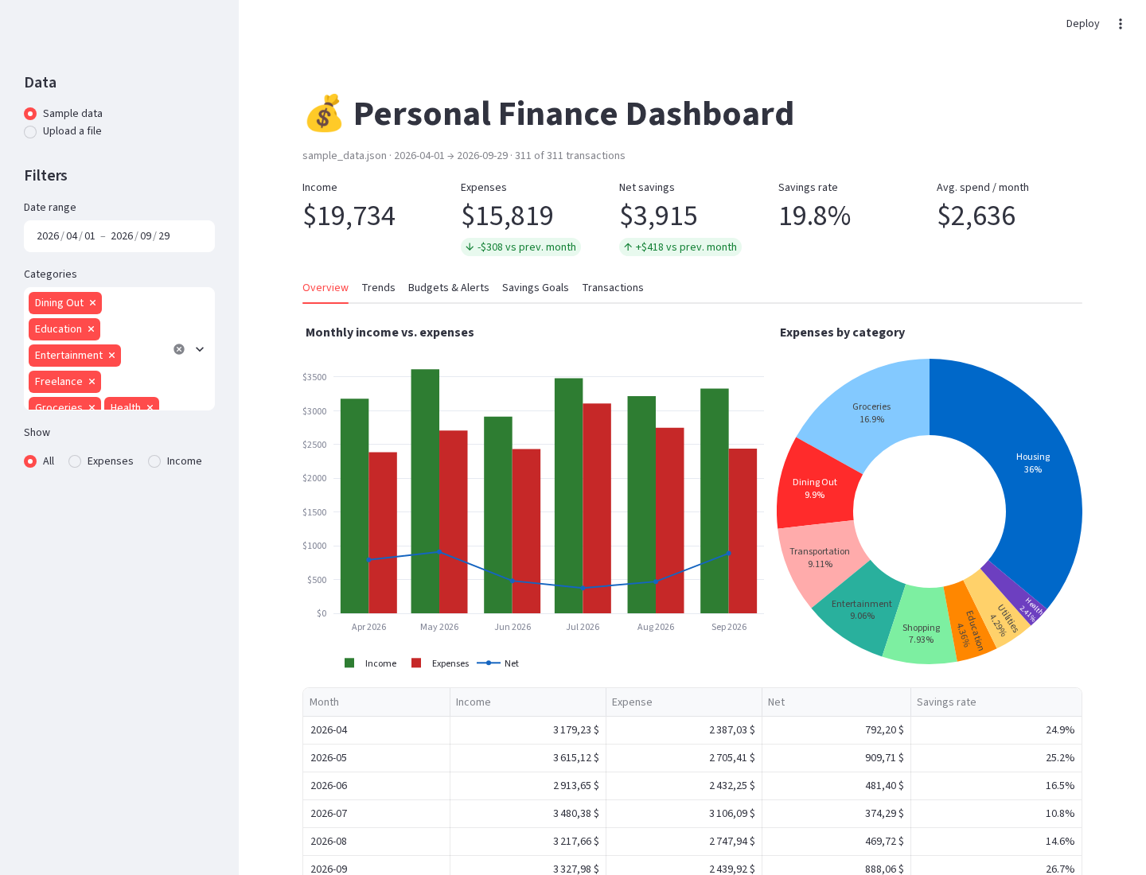
$
Personal Finance Tracker
Track, analyse and visualise personal finances with Python, pandas, Tkinter and Streamlit
DATA 333 – Data Management & Analysis · Bellevue College
[Student Name] · [Date]
Notes:
Introduce yourself and the project: a Python personal finance tracker built for DATA 333. It has three interfaces — console, desktop and web dashboard — on top of one shared core.

Slide 2
Project overview
The problem. Students rarely know where their money goes each month.
The solution. Record income and expenses, categorise them, and turn them into summaries, trends, budget alerts and savings-goal progress.
Three ways in. A console menu, a Tkinter desktop app and a Streamlit dashboard — plus a demo mode that runs everything non-interactively.
Realistic data. A seeded generator creates 311 fictional transactions over six months, so every run and screenshot is reproducible.
311
3 + 1
sample transactions
interfaces + demo mode
100
97 %
automated tests
test coverage
Notes:
Explain the goal and the scope: all course requirements plus the four enhancements (Tkinter GUI, JSON and CSV storage, budget alerts, Streamlit dashboard).

Slide 3
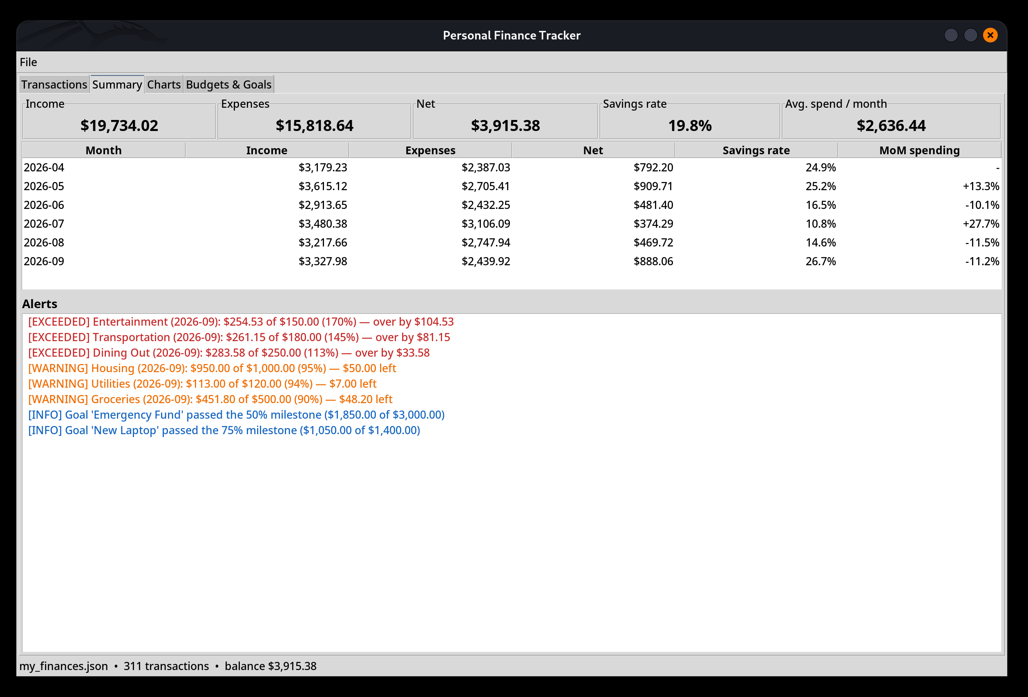
Key features
+
Transactions
%
Analysis
Add, edit, delete, search and filter — with validated input.
Monthly summary, category shares, rolling trend, top expenses.
!
Budget alerts
★
Savings goals
Warning at 80 %, exceeded at 100 % — shown instantly.
Targets, deadlines, contributions and 25/50/75/100 % milestones.
Tkinter GUI — Summary tab with colour-coded alerts
⇅
JSON + CSV
▦
Charts
Atomic saves, CSV import/export, corrupted-file recovery.
matplotlib PNGs in the GUI; interactive Plotly on the web.
Notes:
Walk through the six feature groups. Point at the GUI screenshot: KPIs at the top, the monthly table, and alerts in red (exceeded) and orange (warning).

Slide 4
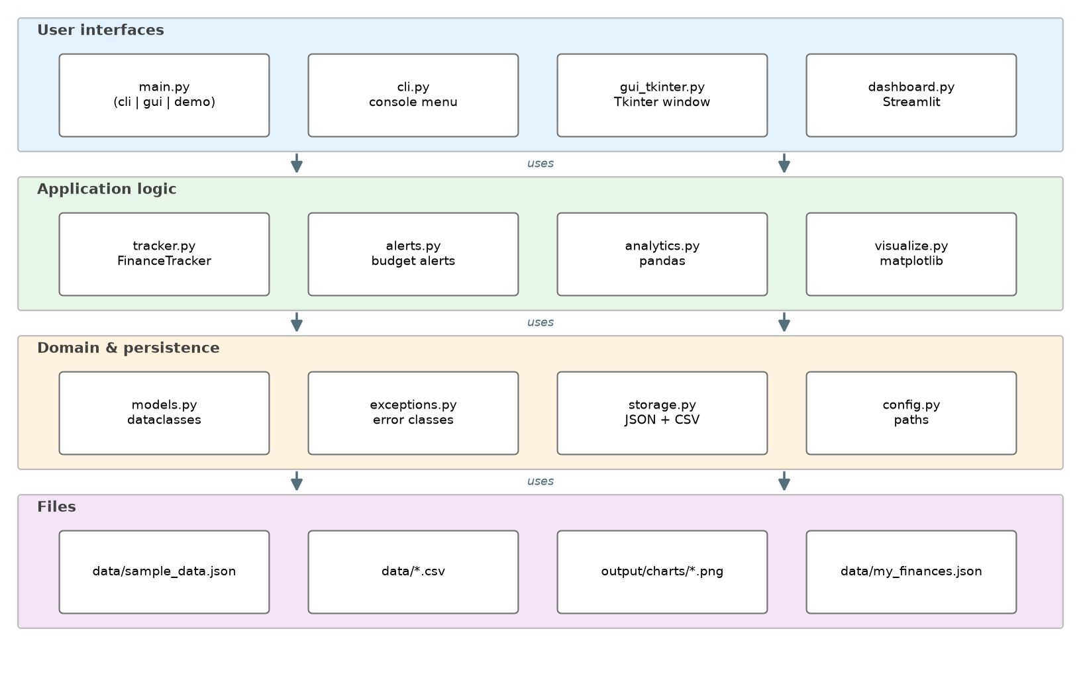
Architecture: one core, three interfaces
Layers. Interfaces call the application logic, which relies on validated models and a single storage module.
Reuse. The same analytics and chart functions feed the CLI, GUI, dashboard and demo.
Testable. No logic lives in the UI, so it is unit tested without a screen.
Portable. All paths come from pathlib in config.py — nothing hard-coded.
Notes:
Explain the layers from top to bottom and why separating the UI from the logic made adding the GUI and dashboard easy.

Slide 5
Course concepts in the code
Input / output
Decisions
Loops
cli.py — prompts, aligned tables
alerts.budget_level — if / elif / else
re-prompt until a valid amount
Functions
Files
Exceptions
parse_amount, analytics.*
storage.py — json, csv, pathlib
custom classes, corrupted-file recovery
Lists
Dictionaries
Sets
FinanceTracker.transactions
budgets, goals, menu dispatch
unique categories, missing CSV columns
OOP
pandas
Each one is tagged with a # Concept: comment in the source.
dataclasses + FinanceTracker class
pivot_table, groupby, rolling, pct_change
Notes:
Every requirement from the brief is labelled in the code. Open one file, for example storage.py, to show a concept comment next to the try/except that recovers a corrupted JSON file.

Slide 6
Challenges and solutions
PROBLEM
SOLUTION
Money text turned into math
"$1,850 / $3,000" rendered as LaTeX in matplotlib and Streamlit.
Escape the dollar signs; regression tests.
1
Exception caught by the wrong handler
Our StorageError is an OSError, so a generic handler re-wrapped it.
Re-raise it first — handlers match in order.
2
Unreadable GUI on a HiDPI screen
Tk scaled fonts but not row heights; chart text was tiny.
Scale factor from the real font height; chart dpi.
3
Notes:
Pick one challenge to tell as a story — the dollar-sign bug is the most visual: it was only found by looking at the real rendered chart, not by the unit tests.

Slide 7
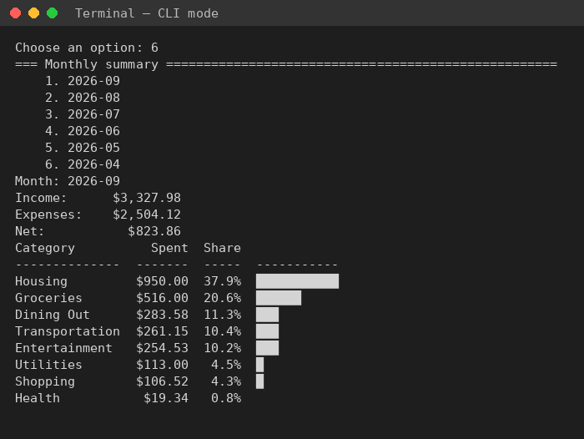
What I learned
✓
Validate once, at the boundary
__post_init__ checks every value, so the rest of the code can trust its data.
{}
Pick the right data structure
List for order, dictionary for lookup by name, set for uniqueness.
▤
pandas replaces loops
One groupby or pivot_table does what dozens of lines used to — but handle empty data.
◉
Look at the real output
Screenshots found bugs that 100 passing unit tests did not.
CLI mode — monthly summary with category shares
Notes:
Share the main takeaways; connect each one to a concrete moment in the project.

Slide 8
Conclusion
Complete. Every course requirement and all four enhancements are implemented.
Reliable. 100 tests, 97 % coverage, ruff-clean code, graceful error handling.
Reusable. One tested core powers the console, desktop and web interfaces.
Next. Recurring transactions, bank-statement import, spending forecasts.
Try it
python main.py demo
python main.py cli
python main.py gui
streamlit run finance_tracker/dashboard.py
Thank you — questions?
Notes:
Summarise, show the four commands, and invite questions.

