Slide 1

Pennant Technologies Private Limited
JDBC

Slide 4
What is API
API (Application programming interface) is a document that contains a description of all the features of a product or software.
It represents classes and interfaces that software programs can follow to communicate with each other.
An API can be created for applications, libraries, operating systems, etc.
Why Should We Use JDBC
Before JDBC, ODBC API was the database API to connect and execute the query with the database.
But, ODBC API uses ODBC driver which is written in C language (i.e. platform dependent and unsecured).
That is why Java has defined its own API (JDBC API) that uses JDBC drivers (written in Java language).
We can use JDBC API to handle database using Java program and can perform the following activities:
Connect to the database
Execute queries and update statements to the database
Retrieve the result received from the database.

Slide 5
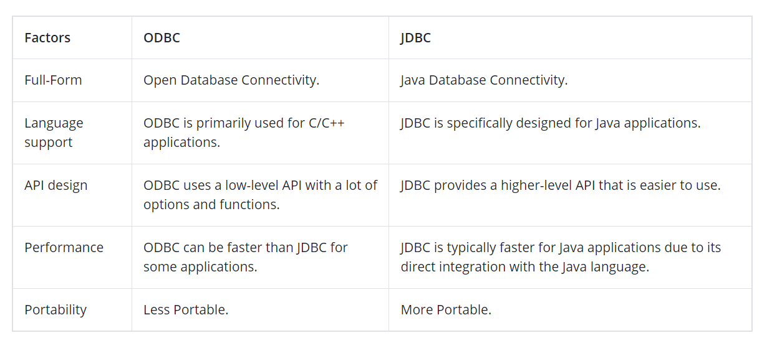

Slide 6
What is JDBC
JDBC stands for Java Database Connectivity. JDBC is a Java API to connect and execute the query with the database.
It is a part of JavaSE (Java Standard Edition). JDBC is an API(Application programming interface) used in java programming to interact with databases.
The classes and interfaces of JDBC allow the application to send requests made by users to the specified database.
Purpose of JDBC
Enterprise applications created using the JAVA EE technology need to interact with databases to store application-specific information.
So, interacting with a database requires efficient database connectivity, which can be achieved by using the ODBC(Open database connectivity) driver.
This driver is used with JDBC to interact or communicate with various kinds of databases such as Oracle, MS Access, Mysql, and SQL server database.

Slide 7
Components of JDBC
There are generally four main components of JDBC through which it can interact with a database. They are as mentioned below:
1. JDBC API: It provides various methods and interfaces for easy communication with the database. It provides two packages as follows, which contain the java SE and Java EE platforms to exhibit WORA(write once run anywhere) capabilities.
java.sql.*;
It also provides a standard to connect a database to a client application.
2. JDBC Driver manager: It loads a database-specific driver in an application to establish a connection with a database. It is used to make a database-specific call to the database to process the user request.
3. JDBC Test suite: It is used to test the operation(such as insertion, deletion, updation) being performed by JDBC Drivers.
4. JDBC-ODBC Bridge Drivers: It connects database drivers to the database. This bridge translates the JDBC method call to the ODBC function call. It makes use of the sun.jdbc.odbc package which includes a native library to access ODBC characteristics.

Slide 8
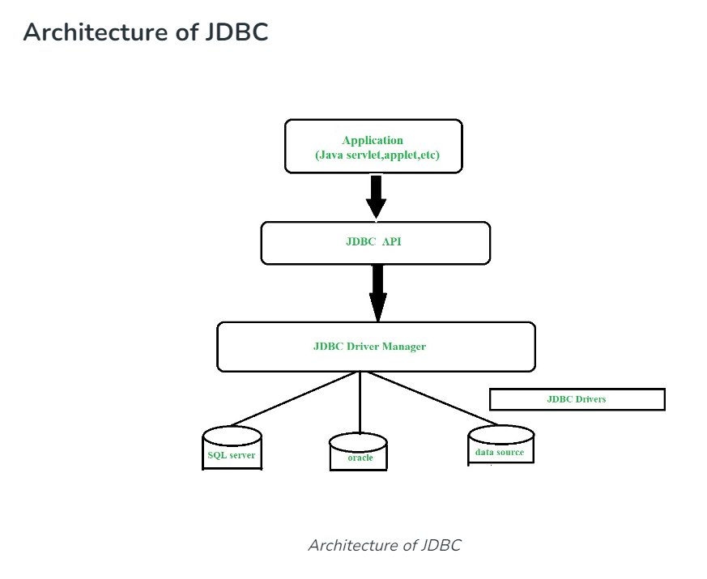

Slide 9
Description:
Application: It is a java applet or a servlet that communicates with a data source.
The JDBC API: The JDBC API allows Java programs to execute SQL statements and retrieve results. Some of the important classes and interfaces defined in JDBC API are as follows:
DriverManager: It plays an important role in the JDBC architecture. It uses some database-specific drivers to effectively connect enterprise applications to databases.
JDBC drivers: To communicate with a data source through JDBC, you need a JDBC driver that intelligently communicates with the respective data source.
The current version of JDBC is 4.3. It is the stable release since 21st September, 2017. It is based on the X/Open SQL Call Level Interface.
The java.sql package contains classes and interfaces for JDBC API.

Slide 10
A list of popular interfaces of JDBC API are given below:
Driver interface
Connection interface
Statement interface
PreparedStatement interface
CallableStatement interface
ResultSet interface
ResultSetMetaData interface
DatabaseMetaData interface
RowSet interface
A list of popular classes of JDBC API are given below:
DriverManager class
Blob class
Clob class
Types class

Slide 11
JDBC Drivers
JDBC drivers are client-side adapters (installed on the client machine, not on the server) that convert requests from Java programs to a protocol that the DBMS can understand. There are 4 types of JDBC drivers:
Type-1 driver or JDBC-ODBC bridge driver
This driver connects to the database via the ODBC driver. It is the most fundamental sort of JDBC driver, and it is commonly used for testing and prototyping.
Type-2 driver or Native-API driver
This driver uses a library written in the same language as the database to transform JDBC calls into database-specific calls. It outperforms the JDBC-ODBC Bridge driver but is restricted to a single database.
Type-3 driver or Network Protocol driver(Middleware Driver)
This driver interfaces with the database using a database-independent network protocol that is subsequently converted into database-specific calls. This driver has the benefit of being able to access numerous databases, but it needs the installation of a middleware component.
Type-4 driver or Thin driver (Pure Java Driver)
This driver is fully written in Java and connects with the database directly via a database-specific interface. It has the best performance and is the recommended driver for usage in production.

Slide 12
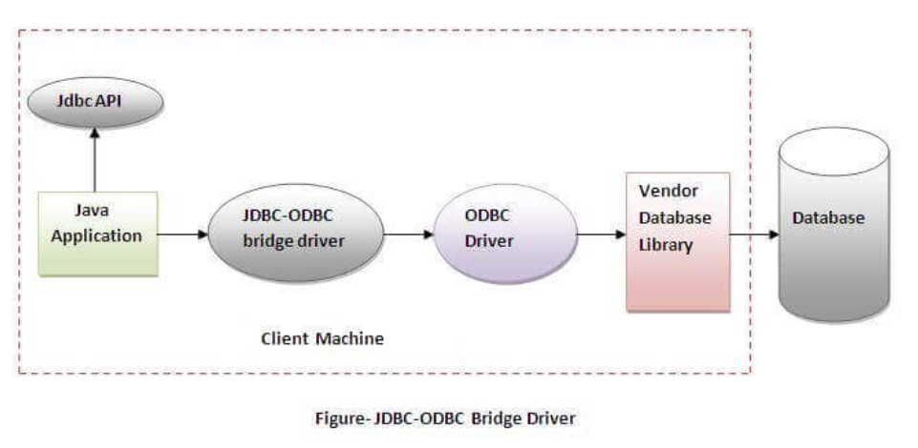
JDBC-ODBC bridge driver
The JDBC-ODBC bridge driver uses ODBC driver to connect to the database. The JDBC-ODBC bridge driver converts JDBC method calls into the ODBC function calls. This is now discouraged because of thin driver.
Oracle does not support the JDBC-ODBC Bridge from Java 8. Oracle recommends that you use JDBC drivers provided by the vendor of your database instead of the JDBC-ODBC Bridge.
Advantages:
easy to use.
can be easily connected to any database.
Disadvantages:
Performance degraded because JDBC method call is converted into the ODBC function calls.
The ODBC driver needs to be installed on the client machine.

Slide 13
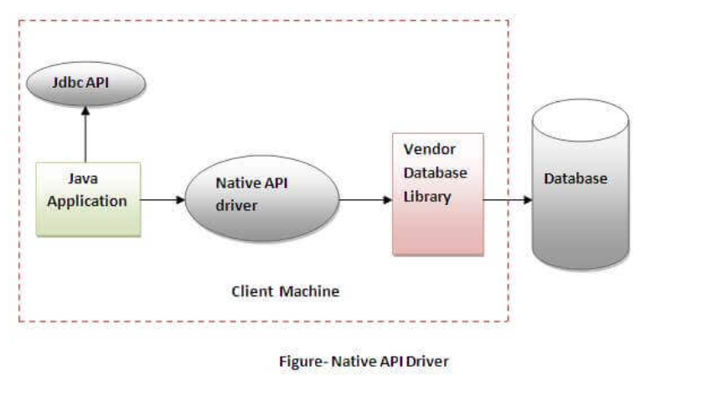
Native-API driver
The Native API driver uses the client-side libraries of the database. The driver converts JDBC method calls into native calls of the database API. It is not written entirely in java.
Advantage:
performance upgraded than JDBC-ODBC bridge driver.
Disadvantage:
The Native driver needs to be installed on the each client machine.
The Vendor client library needs to be installed on client machine.

Slide 14
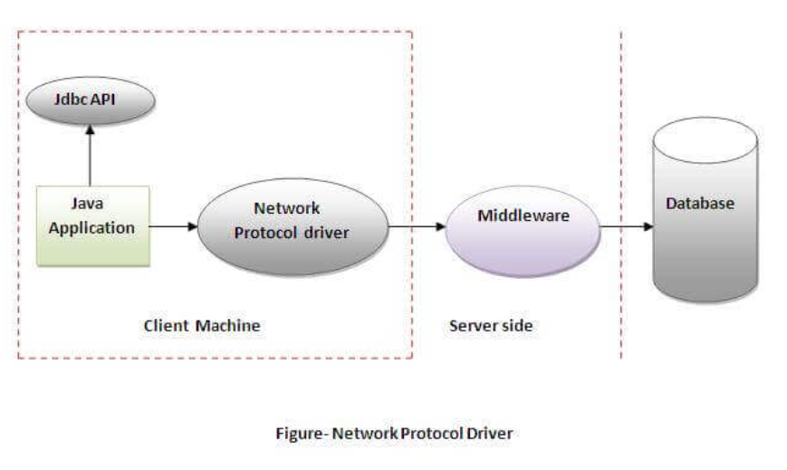
Network Protocol driver
The Network Protocol driver uses middleware (application server) that converts JDBC calls directly or indirectly into the vendor-specific database protocol. It is fully written in java.
Advantage:
No client side library is required because of application server that can perform many tasks like auditing, load balancing, logging etc.
Disadvantages:
Network support is required on client machine.
Requires database-specific coding to be done in the middle tier.
Maintenance of Network Protocol driver becomes costly because it requires database-specific coding to be done in the middle tier.

Slide 15
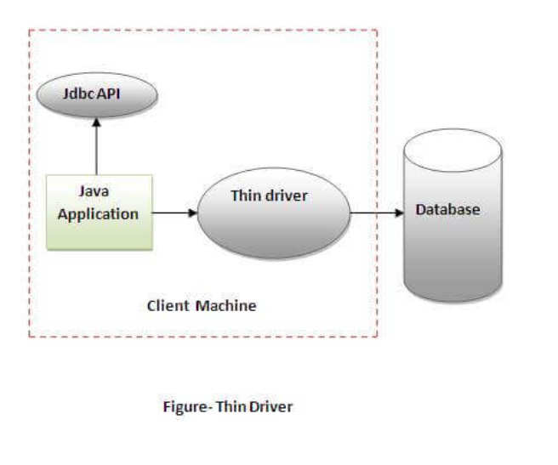
Thin driver
The thin driver converts JDBC calls directly into the vendor-specific database protocol. That is why it is known as thin driver. It is fully written in Java language.
Advantage:
Better performance than all other drivers.
No software is required at client side or server side.
Disadvantage:
Drivers depend on the Database.

Slide 16
Types of JDBC Architecture(2-tier and 3-tier)
The JDBC architecture consists of two-tier and three-tier processing models to access a database. They are as described below:
Two-tier model: A java application communicates directly to the data source. The JDBC driver enables the communication between the application and the data source. When a user sends a query to the data source, the answers for those queries are sent back to the user in the form of results.
The data source can be located on a different machine on a network to which a user is connected. This is known as a client/server configuration, where the user’s machine acts as a client, and the machine has the data source running acts as the server.
Three-tier model: In this, the user’s queries are sent to middle-tier services, from which the commands are again sent to the data source. The results are sent back to the middle tier, and from there to the user.
This type of model is found very useful by management information system directors.

Slide 17
JDBC Steps
The following are the steps required in connecting to a database using JDBC (Java Database Connectivity). These are the fundamental steps for connecting to a database and performing CRUD tasks with JDBC.
Load the JDBC driver: Before a Java program can connect to a database, it must first load the suitable JDBC driver. JDBC drivers are classified into four types: JDBC-ODBC bridge driver, Native-API driver, and Network Protocol driver, and Thin driver. The driver you require is determined by the database to which you are connected and your requirements.
Establish a connection: Once the JDBC driver is loaded, you can connect to the database by calling the DriverManager.getConnection() function and inputting the database’s URL and credentials.
Build a statement: Once a connection has been established, you may create a statement object to run SQL instructions. A statement might be a basic SQL query or a series of SQL instructions.
Execute the SQL statement: Depending on the kind of SQL command, you may execute the statement by invoking the executeQuery(), executeUpdate(), or execute() methods. ExecuteQuery() is used for SELECT statements, executeUpdate() is used for INSERT, UPDATE, DELETE, and other data manipulation operations, and execute() is used for any form of SQL command.
Process the result: If the SQL command is a SELECT statement, the result set returned by the executeQuery() function may be processed using a ResultSet object. To obtain data from the result set, you may use methods such as next(), getInt(), getString(), and so on.
Close the connection: When you’re through working with the database, call the terminate() function on the connection object to close the connection.

Slide 18
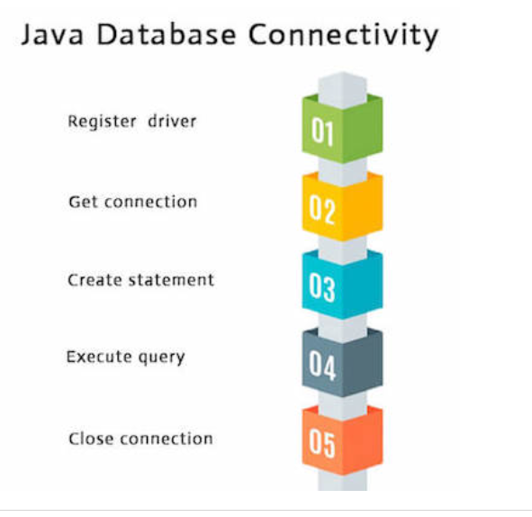
Java Database Connectivity with 5 Steps
There are 5 steps to connect any java application with the database using JDBC.
1) Register the driver class
The forName() method of Class class is used to register the driver class. This method is used to dynamically load the driver class.
Syntax of forName() method
public static void forName(String className)throws ClassNotFoundException
Example to register the OracleDriver class
Here, Java program is loading oracle driver to esteblish database connection.
Class.forName("oracle.jdbc.driver.OracleDriver");

Slide 19
Create the connection object
The getConnection() method of DriverManager class is used to establish connection with the database.
Syntax of getConnection() method
1) public static Connection getConnection(String url)throws SQLException
2) public static Connection getConnection(String url,String name,String password) throws SQLException
Example to establish connection with the Oracle database
Connection con=DriverManager.getConnection( "jdbc:oracle:thin:@localhost:1521:xe","system","password");

Slide 20
Create the Statement object
The createStatement() method of Connection interface is used to create statement. The object of statement is responsible to execute queries with the database.
Syntax of createStatement() method
public Statement createStatement()throws SQLException
Example to create the statement object
Statement stmt=con.createStatement();
4) Execute the query
The executeQuery() method of Statement interface is used to execute queries to the database. This method returns the object of ResultSet that can be used to get all the records of a table.
Syntax of executeQuery() method
public ResultSet executeQuery(String sql)throws SQLException
Example to execute query
ResultSet rs=stmt.executeQuery("select * from emp");
while(rs.next()){ System.out.println(rs.getInt(1)+" "+rs.getString(2)); }

Slide 21
Close the connection object
By closing connection object statement and ResultSet will be closed automatically. The close() method of Connection interface is used to close the connection.
Syntax of close() method
public void close()throws SQLException
Example to close connection
con.close();
Note: Since Java 7, JDBC has ability to use try-with-resources statement to automatically close resources of type Connection, ResultSet, and Statement.
It avoids explicit connection closing step.
Note: Since JDBC 4.0, explicitly registering the driver is optional. We just need to put vender's Jar in the classpath, and then JDBC driver manager can detect and load the driver automatically.

