Slide 1
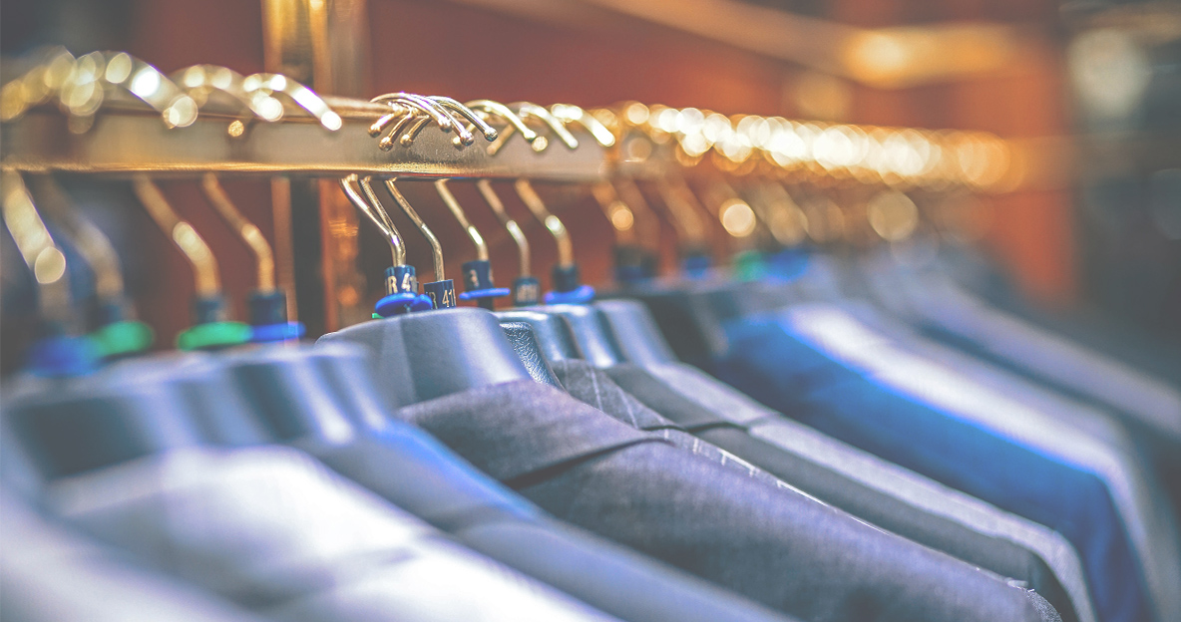
Product Review
JAMES NG
06 Sep 2019

Slide 2
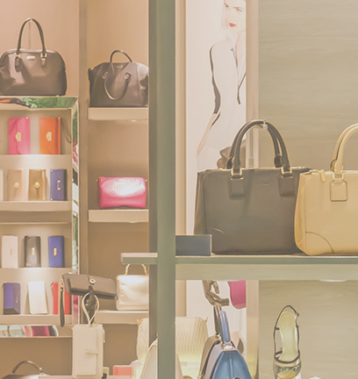
Project Goals
Business objective
Topic modelling for ratings
Ratings prediction
Product recommendation
Algorithm
NLP Unsupervised Learning
NLP Supervised Learning
Cosine Similarity

Slide 3
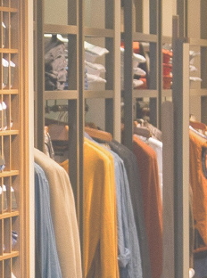
About this data set
id
brand
categories
dateAdded
dateUpdated
ean
keys
manufacturer
manufacturerNumber
name
reviews.date
reviews.dateAdded
reviews.dateSeen
reviews.didPurchase
reviews.doRecommend
reviews.id
reviews.numHelpful
reviews.rating
reviews.sourceURLs
reviews.text
reviews.title
reviews.userCity
reviews.userProvince
reviews.username
upc
71,045 reviews
1,000 products
Kaggle
Datafiniti's Product Database

Slide 4
About this data set
id
brand
categories
dateAdded
dateUpdated
ean
keys
manufacturer
manufacturerNumber
name
reviews.date
reviews.dateAdded
reviews.dateSeen
reviews.didPurchase
reviews.doRecommend
reviews.id
reviews.numHelpful
reviews.rating
reviews.sourceURLs
reviews.text
reviews.title
reviews.userCity
reviews.userProvince
reviews.username
upc
71,045 reviews
1,000 products
Kaggle
Datafiniti's Product Database

Slide 5

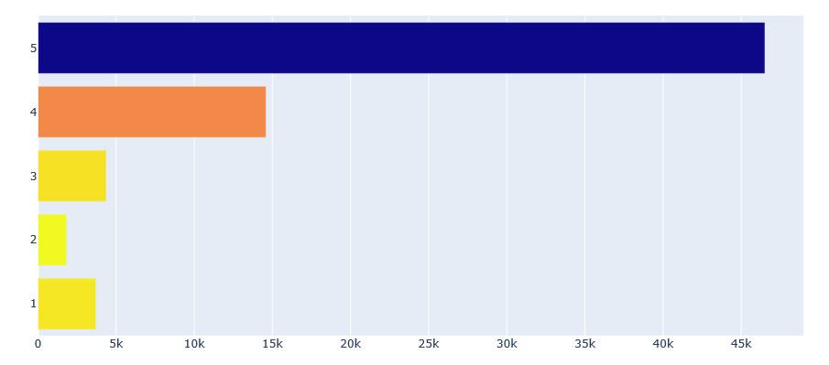
Ratings distribution
5
4
3
2
1
66%
20%
6%
Satisfied customers
3%
5%

Slide 6

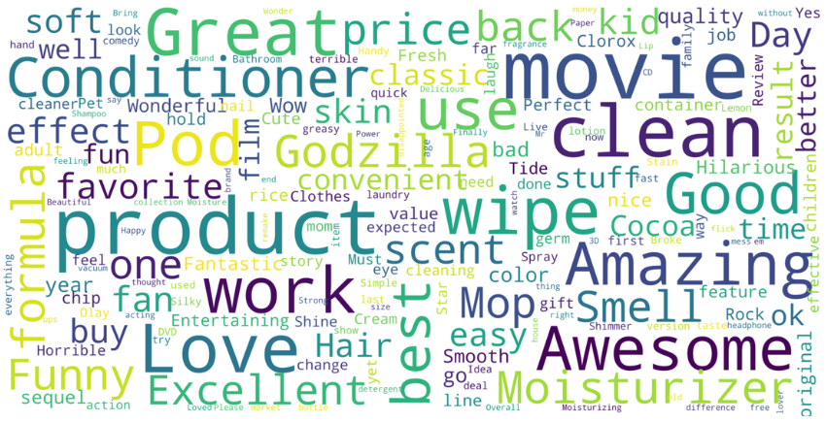
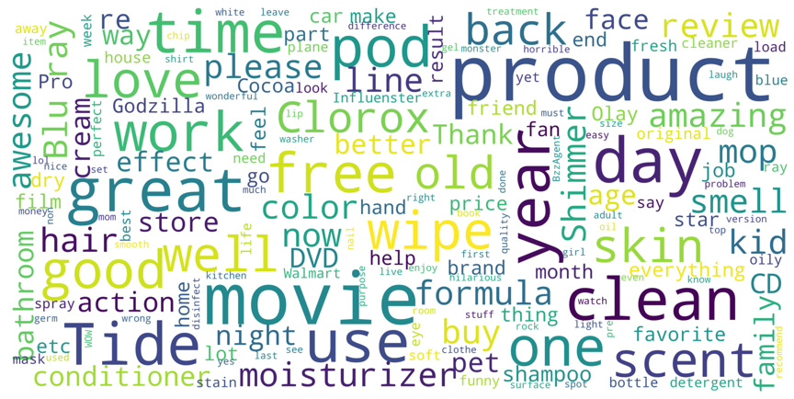
Product review description
words used in shoppers’ reviews on products
Title
Description

Slide 7
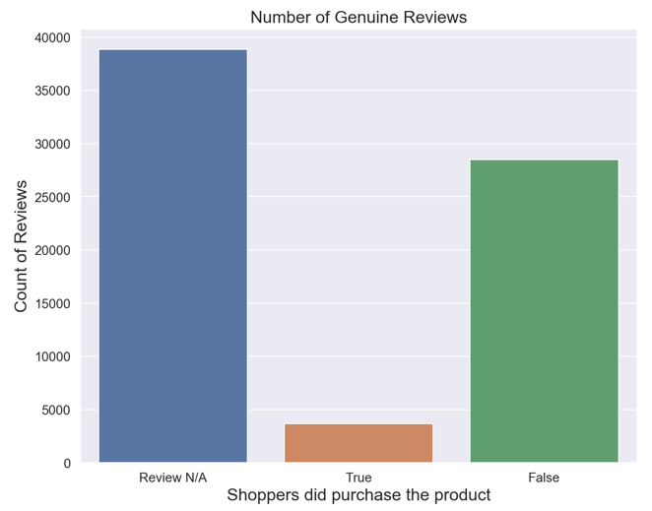
Genuine reviews
only 3,681 products are genuinely purchased by shoppers
5%

Slide 8
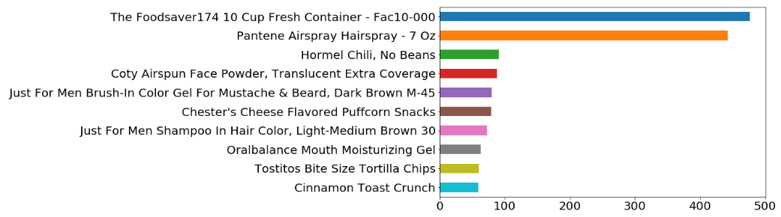
Rating: 5
Latent Semantic Analysis (LSA)
Sample size: 410 / 477 (86%)
Model: Count Vectorizer
Why do people like it?
Topic 1
containers, food, fresh, use, container, seal, foodsaver, love, vacuum, saver, great, food saver, longer, like, bought, one, new, much, review, used
Topic 2
containers, vacuum, seal, foodsaver, review, lid, storage, much, sizes, little, make, also, canisters, would, received, sealer, collected, part, collected part promotion, review collected
Topic 3
one, fresh, foodsaver, days, bought, long, new, still, salad, celery, time, week, peppers, weeks, bell, bell peppers, dry, like, washed, lettuce

Slide 9
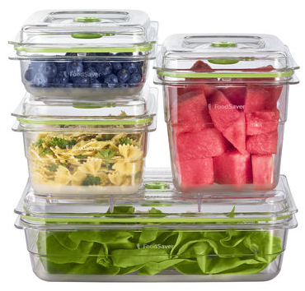
Rating: 5
Latent Semantic Analysis (LSA)
Sample size: 410 / 477 (86%)
Model: Count Vectorizer
Why do people like it?
Topic 1
containers, food, fresh, use, container, seal, foodsaver, love, vacuum, saver, great, food saver, longer, like, bought, one, new, much, review, used
Topic 2
containers, vacuum, seal, foodsaver, review, lid, storage, much, sizes, little, make, also, canisters, would, received, sealer, collected, part, collected part promotion, review collected
Topic 3
one, fresh, foodsaver, days, bought, long, new, still, salad, celery, time, week, peppers, weeks, bell, bell peppers, dry, like, washed, lettuce
Product: The Foodsaver174 10 Cup Fresh Container - Fac10-000
Category: food and household items

Slide 10
Rating: 5
Latent Semantic Analysis (LSA)
Sample size: 410 / 477 (86%)
Model: Count Vectorizer
Why do people like it?
Topic 1
containers, food, fresh, use, container, seal, foodsaver, love, vacuum, saver, great, food saver, longer, like, bought, one, new, much, review, used
Topic 2
containers, vacuum, seal, foodsaver, review, lid, storage, much, sizes, little, make, also, canisters, would, received, sealer, collected, part, collected part promotion, review collected
Topic 3
one, fresh, foodsaver, days, bought, long, new, still, salad, celery, time, week, peppers, weeks, bell, bell peppers, dry, like, washed, lettuce
vacuum seal
promotion sale
keeps vegetables fresh
Product: The Foodsaver174 10 Cup Fresh Container - Fac10-000
Category: food and household items

Slide 11
Rating: 1
Non-Negative Matrix Factorization (NMF)
Sample size: 44 / 477 (9%)
Model: TF-IDF Vectorizer
Why the poor rating?
Topic 1
vacuum, containers, work, bought, hold vacuum, lids, tried, hold, use, dont, one, sealed, hold vacuum one, vacuum one, even, day, stay, expensive, sealing, container
Topic 2
seal, hold seal, container, containers, get, hold, get seal, able get seal, able get, able, square, day, held, stay sealed 12, purchased, get seal last, last one day, last one, last, seal last

Slide 12
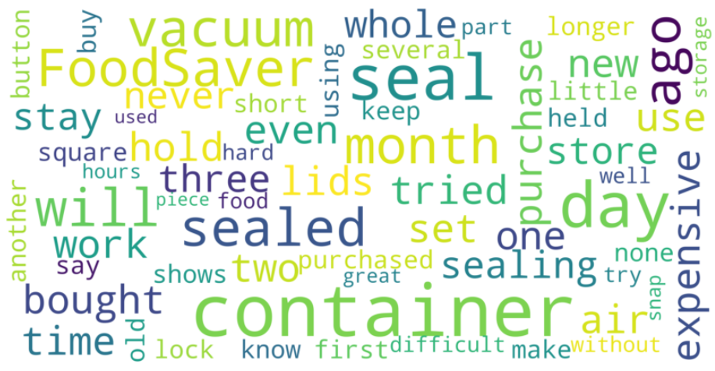
Rating: 1
Non-Negative Matrix Factorization (NMF)
Sample size: 44 / 477 (9%)
Model: TF-IDF Vectorizer
Why the poor rating?
Topic 1
vacuum, containers, work, bought, hold vacuum, lids, tried, hold, use, dont, one, sealed, hold vacuum one, vacuum one, even, day, stay, expensive, sealing, container
Topic 2
seal, hold seal, container, containers, get, hold, get seal, able get seal, able get, able, square, day, held, stay sealed 12, purchased, get seal last, last one day, last one, last, seal last
vacuum feature is not working
seal lasted 1 day

Slide 13
Ratings prediction
Can a machine learning model use natural language processing to predict ratings?
Yes, using Logistic Regression Model
Accuracy: 73%
1
2
3
4
5
Did not work
Disappointed
Fresh
Good movie
Unbelievable!
Found it would not rinse as well as regular product and had musty smell. Clothes smelled bad after use. Switched back to reg detergent. Would like to try again. maybe i did something wrong.
I bought this and was really excited to use it, since it was larger in size. But I put celery in it and the celery went bad after a few days. I did everything right when I put the celery in the container but it still went bad.
Love the look and that they stack on top of each other. Very hard to seal, have to push down very hard to get a tight seal.
A lot of sequels are not as good as the original but, this one was great.
I am very pleased with all of the New FoodSaver Fresh containers that I have purchased. They really keep things much fresher than the round older containers that FoodSaver makes.

Slide 14
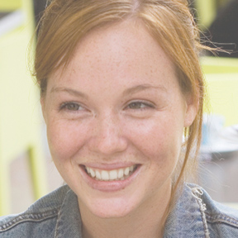




Product Recommendation
Business can recommend products based on shoppers’ purchase history and ratings given
Shopper 1
Shopper 2
Shopper 3
Product 1
Product 2
Product 3
Product 4
Product 5
Product 1
Product 2
Product 3
Product 5
Product 1
Product 2
Product 3
Product 4
Product 5

Slide 15

Online shopper: “Jess”
Kidz Bop - Kidz Bop 26 (cd)
The Jungle Book (blu-Ray/dvd + Digital)
The Secret Life Of Pets (4k/uhd + Blu-Ray + Digital)
Independence Day Resurgence (4k/uhd + Digital)
Storks (blu-Ray)
Products recommended:
The Resident Evil Collection 5 Discs (blu-Ray)
Sausage Party (4k/uhd + Digital)

Slide 16
Summary
Natural Language Processing machine learning model can be used for:
Prescriptive Analytics
Predictive Analytics
Similarity algorithms
Descriptive Analytics
Supervised learning
to recommend “white space” products to shoppers based on purchase history
Unsupervised learning
to predict product ratings based on explicit reviews
topic modelling to find principal components on the ratings

Slide 17

Thank you!
JAMES NG
https://www.linkedin.com/in/jnyh/

Slide 18




Product Categories
some examples
Cleaners & Disinfectants
Movies & Music
Clorox Disinfecting Wipes Value Pack Scented 150 Ct Total
Tide Original Liquid Laundry Detergent - 100 Oz
Clorox Disinfecting Bathroom Cleaner
Tide Pods Detergent, Botanical Rain, 61ct
The Secret Life Of Pets (4k/uhd + Blu-Ray + Digital)
Independence Day Resurgence (4k/uhd + Blu-Ray + Digital)
Godzilla 3d Includes Digital Copy Ultraviolet 3d/2d Blu-Ray/dvd
The Jungle Book (blu-Ray/dvd + Digital)
Personal Care
Household Essentials
L'oreal Paris Revitalift Triple Power Deep-Acting Moisturizer
Nexxus Exxtra Gel Style Creation Sculptor
Olay Regenerist Deep Hydration Regenerating Cream
Head & Shoulders Dry Scalp Care Conditioner
Just For Men Brush-In Color Gel For Mustache & Beard, Dark Brown M-45
Rubbermaid174 Reveal Spray Mop
Quilted Northern Ultra Plush Toilet Paper - 18 Mega Rolls
The Foodsaver174 10 Cup Fresh Container - Fac10-000
Hoover174 Platinum Collection153 Lightweight Bagged Upright Vacuum With Canister - Uh30010com

Slide 19
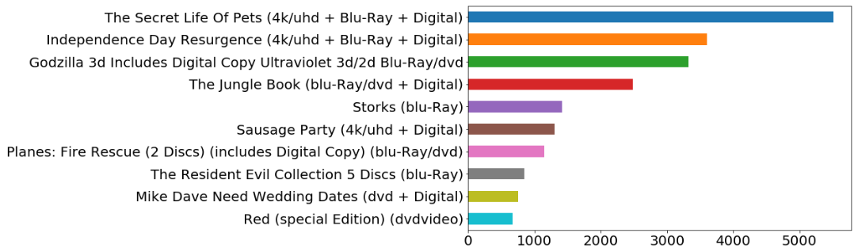
Category: movies and music
N = 25,441
Number of shoppers = 13,278
The Secret Life Of Pets (4k/uhd + Blu-Ray + Digital)
Rating: 5
N = 4084 / 5510 (74%)

Slide 20

Pitch Deck Title Slide
Pitch Deck Tagline
JAMES NG

