Slide 1
ASSIGNMENT SUBMISSION- DATA SCIENCE INTERN POSTMAN
Name- Shreyansh Jain
E-mail- 14shreyansh@gmail.Com
Contact- 7597835744

Slide 2
Overview of the data
Sales_data file:
This dataset provided the information regarding each transaction that took place over the time period from December 2010 to December 2011.
Initial observations that I could get seeing the data was –
I can use transaction id , product id, quantity sold, transaction timestamp, unit price, customer id, and transaction country to get insights and analyse the performance of the company on date level, month level, product level, and country level.
Looking at transaction id, I can compute number of successful transactions and number of cancelled transaction so as to get an Idea of how much RTO(Return to Origin) is happening each month.

Slide 3
Combining quantity sold and unit price, I can get total amount of each transaction and using which, I can get an average amount of each shopping cart.
Using transaction country, I can know from which country company gets maximum traffic and maximum profit.
From customer id, we can get those customers which are most active and purchase frequently. Using which, company can send some offers to their loyal customers.
Also, I can find Customer acquisition Rate i.e., how many new customers company get every month. Then, we can find Customer retention rate, that is how many customers buy again within 3 months. (Customer loyalty can be judged from this)
Using product id, I can get to know which are top purchased products. Further this information can be used in Recommending products to other users.(Improving their feed)

Slide 4
Date_file-
After left join Sales_data file with this file and removing duplicate values , I can get some additional information-
I can get the information of date and time of each transaction.
Using days information, I can infer weekdays and weekend trend of the sell.
Using time of the day, I can know the peak time of the day when most of the sell happens. This can be used to give away the offers/sell during those hours. Or make those hours as Happy hours.
Data cleansing and feature engineering-
There were missing values in customer id, which I assumed to be fake customers or bots introduced from backend. I removed those rows having such missing values for the entire analysis.
There were negative values also, but those represented cancelled transactions. So, I let them be as it is.
I introduced new columns on my own for my analysis like Amount(Unit price * quantity sold), extract month from time stamp as Month.
Converted data types of the variables- Character to Date.

Slide 5
Questionnaire
Q1- How many transaction occur on daily basis?
Q2- How many transaction occur on monthly basis?
Q3- How much revenue company is generating from selling all those products on daily and monthly basis?
Q4- What are the top selling products of each month?(Top 3 products of each Month)
Q5- Which all products are generating maximum revenue?
Q6- What is cancellation rate of transaction? (RTO Rate)
Q7- What is Customer acquisition rate?
Q8- What is Customer retention rate?
Q9- Which country produces maximum revenue?

Slide 6
Q10- Is there any specific day of the week when maximum revenue is generated?
Q11- Is there any peak time of the day when maximum transaction take place?
Q12- What is the average size of a shopping cart?
Q13- What is month over month growth of the company?

Slide 7
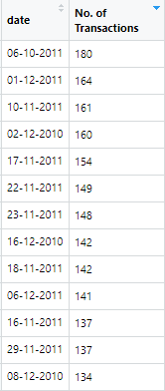
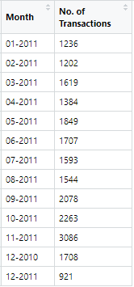
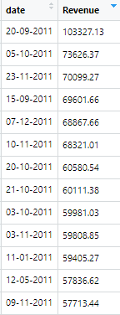
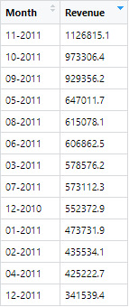
Output Metrics:
1- Transaction detail on daily level and monthly level-
Snapshot of the metric- showing daily and monthly trend.
We can infer from this data that, lately company is able to get more number of transactions compared to initial months and this can be seen in revenue generation as well.

Slide 8
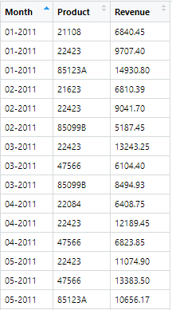
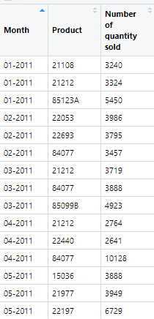
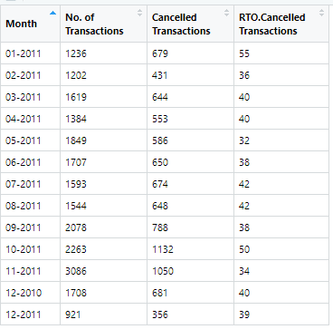
2- Top selling products 3– Cancelled Transactions
From this metric, we can look at products which are sold maximum number of times and due to those maximum revenue is generated.
We can use this data to improve User feed on the app/website using machine learning.
This metric gives us the number of cancelled transactions and RTO rate of each month. We can see that lately, in Jan’11 RTO was 55% which drop down 34% in Nov’11.

Slide 9
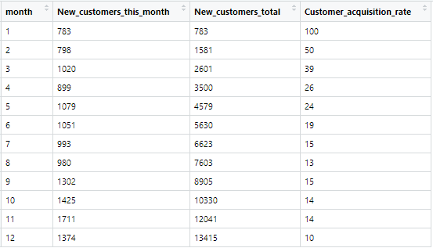
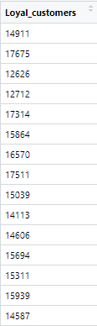
4- Customer acquisition and retention rate:
These metric gives us new customers company is able to acquire every month and the customers who are frequent buyers, I call them as Loyal customers.
Customer retention rate= 54% (Number of loyal customers / Total customers)

Slide 10
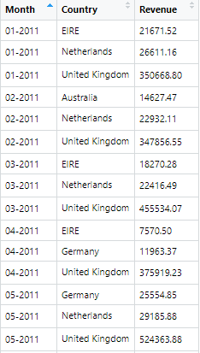
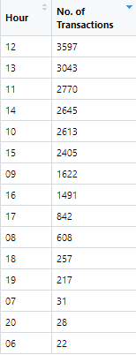
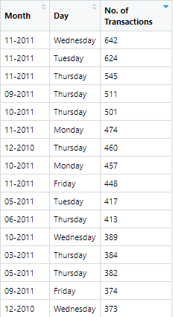
5- Country Level, Day Level and Hour Level metrics:
From the country Level data, we can clearly see that more than 70% revenue and customers come from United Kingdom.
From hour level data, it is clear that during day time i.e., from 11 am to 3 pm customers make transactions more frequently.
From Day level data, there is not much of a difference in transactions happening at a particular day.

Slide 11
Visualization
Daily trend suggest there has been increment in number of transactions lately.
Monthly trend suggest company is getting more traffic by each month and October being the top selling month.

Slide 12
As number of transactions trend suggested, it can be seen in revenue generation as well that there is increment in growth of company.
Seeing the daily trend, we can say there is somewhat increment on daily basis and in October and November company has got huge traffic and hence got a good revenue as well.

Slide 13
This graph shows there are less number of new customers purchasing every month but good thing is customer retention rate is up to the level. Hence, company should roll out some offers/features to bring in new customers on the platform.
There is decrement in RTO rate as number of cancelled transactions are less compared to initial months. This depicts, customers are not facing any issues in their purchasing journey and they are not cancelling their transactions.

Slide 14
We can say that there is no particular day when there is maximum sale but if we have to pick a day then it has to be Thursday as it has maximum percentage of transactions.
It is clearly visible from the chart that United Kingdom is the country from where maximum transaction occur.

Slide 15
As I depicted earlier that daytime has most of the transactions, it can be seen from the graph as well. Also, at 12pm company get maximum transactions.

Slide 16
Approach to solve all the questions
Ans 1 and 2- To find daily and monthly level transactions trend, I made a transaction metric, which gave count of number of unique transactions happened each day of a month and one more metric which gave count of number of unique transactions happened in a month.
Columns used- transaction id and timestamp
Ans 3- This analysis was also done on daily level as well as monthly level, I calculated Amount (unit_price*quantity_sold) . Then, I calculated the sum of the amount of each transaction.
Columns used- Unit_price, Quantity_sold, timestamp
Ans 4- I calculated sum of the quantity sold for each product group by month and product id. Then I picked top 3 products of each month.
Columns used- quantity_sold, timestamp, product_id
Ans 5- I calculated sum of the amount for each product group by month and product id. Then I picked top 3 products of each month.
Columns used- amount, timestamp, product_id

Slide 17
Ans 6- To calculate cancellation rate, I created a column “Cancelled” which depicted 0 or 1. If it was a cancelled transaction, it gave 1 otherwise 0. I used regular expression to look at transaction id being cancelled or successful. Then, I summed up this column to find cancellation rate.
Columns used- transaction_id, cancelled
Ans 7- Customer acquisition rate- count of new customers in every month- I created a new table having month value, count of new customer in that month, count of total customers in that month. Applying for loop over the month values, I found both the column values and then divide each other to get the Acquisition Rate.
Columns used- timestamp, customer_id
Ans 8- Customer retention rate- count of those customers who purchased more than once within 3 months. To calculate this, I created a table having customer id and their month of purchase. Then I created a column having difference of the month of current purchase and previous purchase. All those customers wo had this difference less then or equal to 3, I chose them as loyal customers and they accounted for retention rate.
Columns used- customer_id, timestamp

Slide 18
Ans 9- To calculate this, I summed up the amount column and group by transaction country. I have done this on monthly level.
Columns Used: Amount, transaction_country, timestamp
Ans 10- I took day_name column and calculated sum of amount for each day.
Columns Used: day_name, amount
Ans 11- I took hour from time_of_day column and count number of unique transactions group by hour.
Columns used: time_of_day, transaction_id
Ans 12- I first calculated sum of the quantity sold of each transaction and then found average of these number to get average size of a shopping cart.
Columns used: quantity_sold, transaction_id
Ans 13- For each month, I calculated number of total unique transactions, number of cancelled transactions, number of products sold, number of customers- These trend gave my month over month analysis.
Columns used: transaction_id, timestamp, customer_id

Slide 19
INSIGHTS FROM THE ANALYSIS
After analysis monthly trend, it is clear that company is performing better than previous months.
Company need to focus more on acquiring new customers as acquisition rate is not increasing every month.
United Kingdom has been the top performing country, so company can focus on other countries to get 25% of how much it gets from UK. It can start some campaign in various countries.
To avoid out of stock situation, we have the list of top selling products. So, what company can do is keep more stock of at least top selling products.
Based on top selling products, company can improve user feed and recommend better products to the users. Also, they can start showing these products on shopping carts as suggested products.
If there is out of stock situation, company can recommend other similar products to the users.

Slide 20
To further increase the sale, company can roll out offers to their loyal customers. It can start happy hours concept according to the hour analysis.
To further decrease the RTO, company can make sure there is no technical glitches from the backend from showing products to the completion of payment.
It is necessary to track these metrics daily, as these will show daily trend and will help in doing RCA(Root Cause Analysis) if anything drops down.
THANK YOU!

