Slide 1
Bank Marketing Analysis

Slide 2
Objective:
Build ML model to predict if the client will subscribe to a term deposit.. Implement exploratory data analysis tools and techniques to investigate, analyze, and summarize the main characteristics of datasets, often utilizing data visualization methodologies.

Slide 3
Data Sharing Agreement:
This dataset contains 4 files:
1) bank-additional-full.csv with all examples (41188) and 20 inputs, ordered by date (from May 2008 to November 2010)
2) bank-additional.csv with 10% of the examples (4119), randomly selected from 1), and 20 inputs.
3) bank-full.csv with all examples and 17 inputs, ordered by date (older version of this dataset with fewer inputs).
4) bank.csv with 10% of the examples and 17 inputs, randomly selected from 3 (older version of this dataset with fewer inputs).

Slide 4
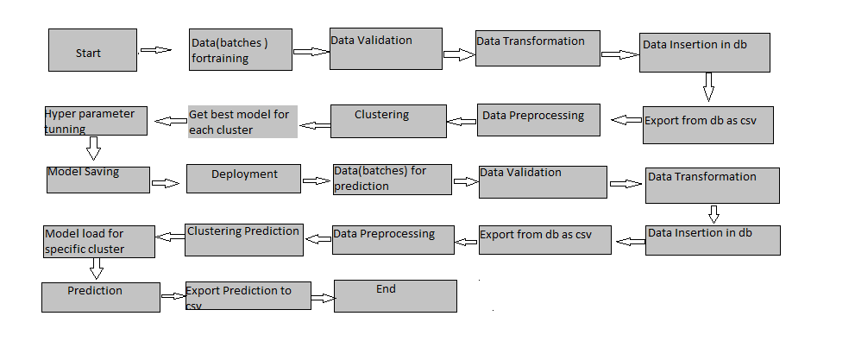
Architecture

Slide 5
Data Insertion in Database:
Table creation :- Table name “bank_full” is created in the database for inserting the data. If the table is already present then new data is inserted in the same table.

Slide 6
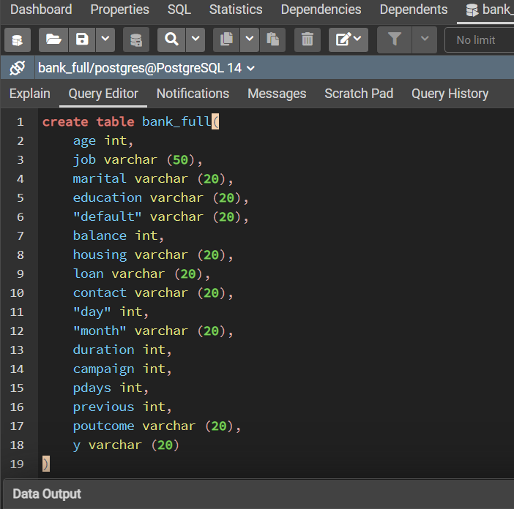
Create table

Slide 7
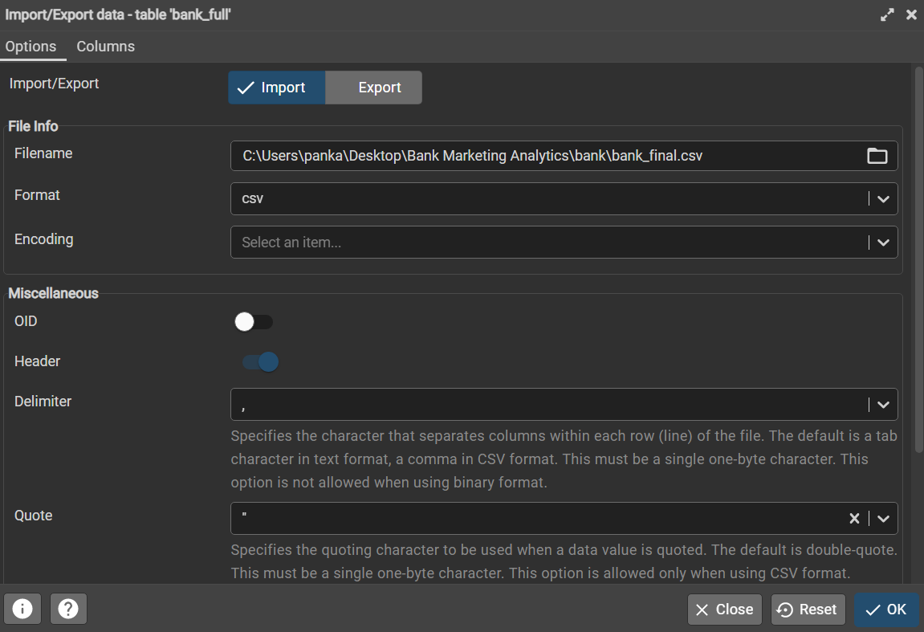
Import Data

Slide 8
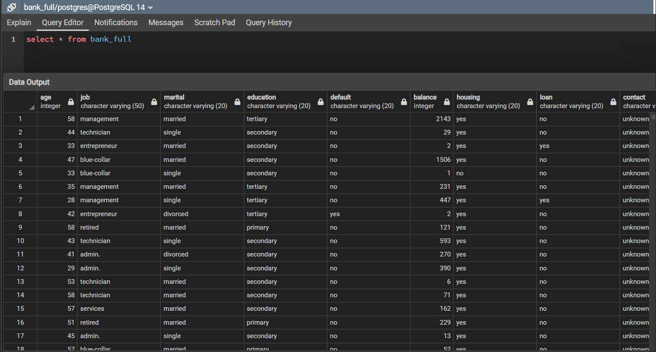

Slide 9
Process Flow
1. Exploratory data analysis
2. Missing and duplicate value analysis
3. Outlier analysis
4. Visualization
5. Correlation analysis
5. Feature engineering
6. Grid Search/Modeling
7. Regression Analysis/Predictions
8. Conclusion

Slide 10
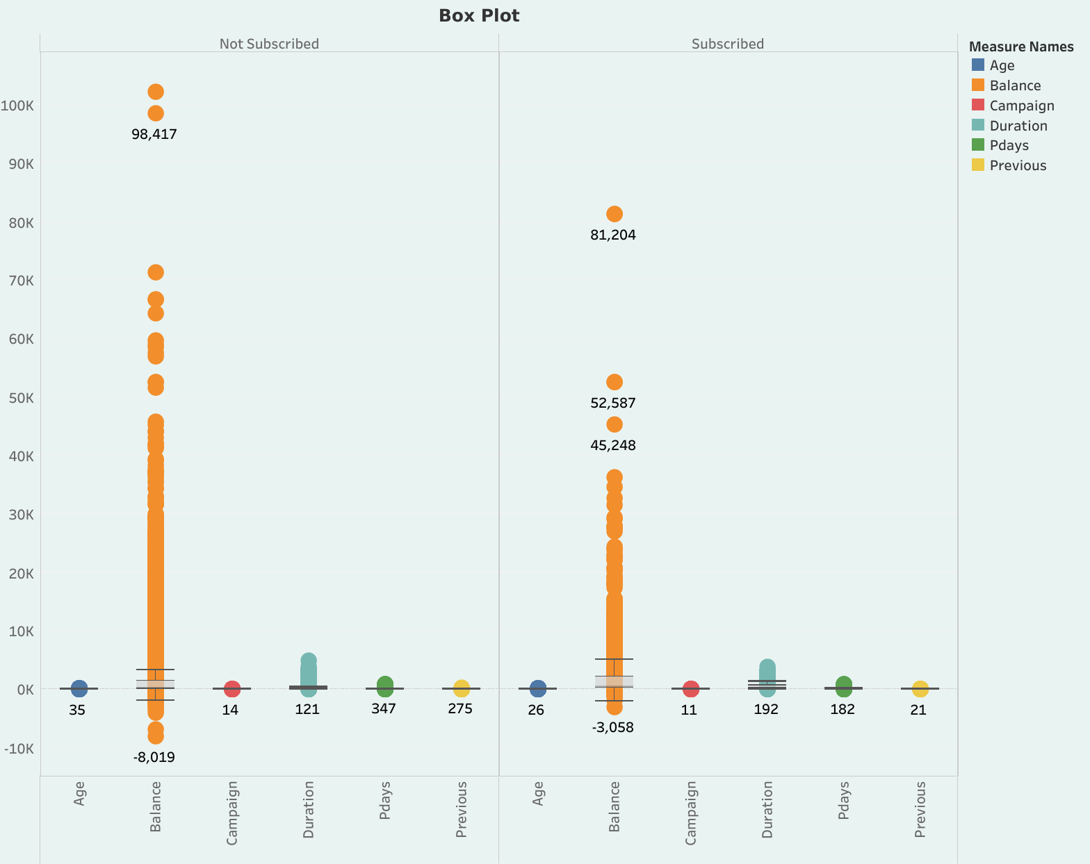
Outlier Analysis using Box Plot

Slide 11
Correlation Analysis
Range: [-1, 1]
No correlation r=0
Very weak correlation: r<20
Weak correlation: between 0.20-0.49
Moderate correlation: between 0.5-0.79
Strong correlation: between 0.8-0.99
Perfect correlation: r=1

Slide 12
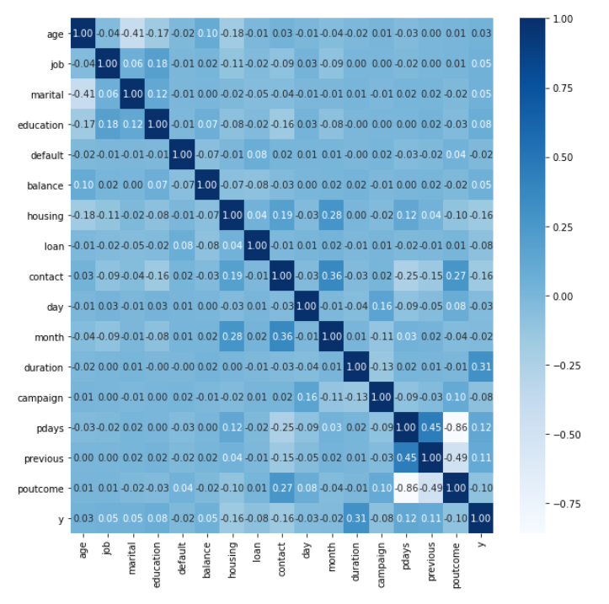
Heatmap to represent the correlation between the feature columns

Slide 13
Model Training:
Data Export from Db :
The accumulated data from PostgreSQL is exported in csv format for model training
Data Preprocessing :
Performing EDA to get insight of data like identifying distribution, outliers, trend among data etc.
Check for null values in the columns. If present impute the null values.
Encode the categorical values with numeric values.
Perform Standard Scalar to scale down the values.

Slide 14
Logistic Regression –
Logistic regression is one such regression algorithm which can be used for performing classification problems. It calculates the probability that a given value belongs to a specific class. If the probability is more than 50%, it assigns the value in that particular class else if the probability is less than 50%, the value is assigned to the other class. Therefore, we can say that logistic regression acts as a binary classifier.
XGBoost –
In XGBoost, decision trees are created in sequential form. Weights play an important role in XGBoost. Weights are assigned to all the independent variables which are then fed into the decision tree which predicts results. The weight of variables predicted wrong by the tree is increased and these variables are then fed to the second decision tree. These individual classifiers/predictors then ensemble to give a strong and more precise model. It can work on regression, classification, ranking, and user-defined prediction problems.

Slide 15
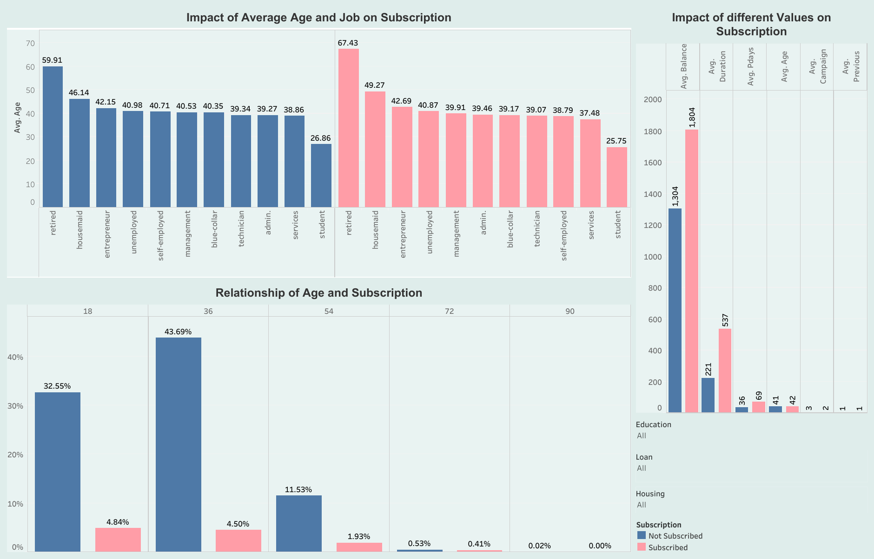
Tableau Dashboard

Slide 16
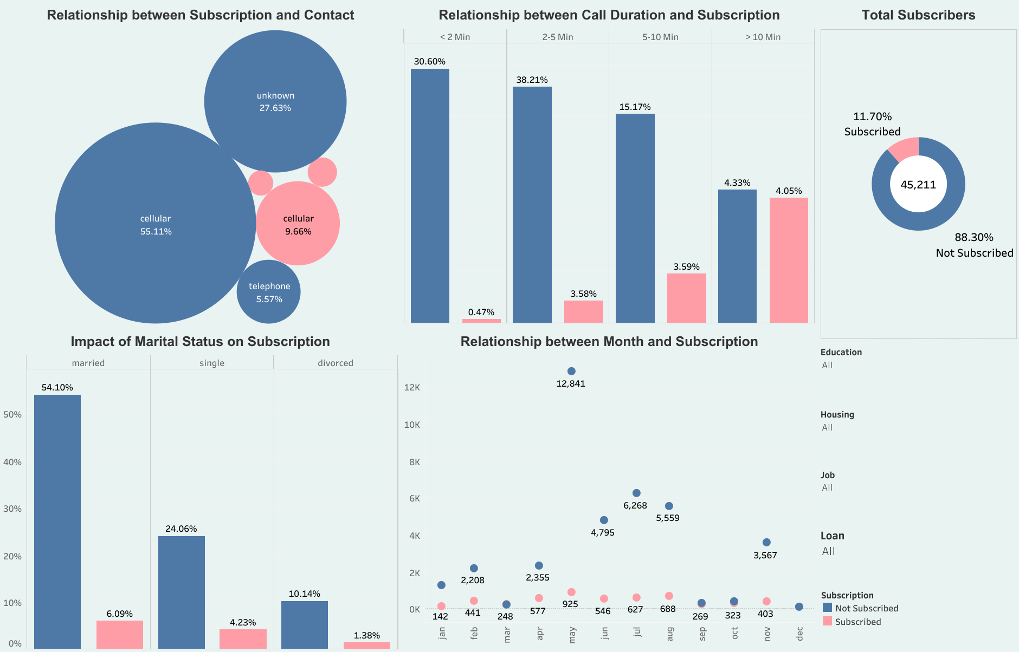

Slide 17
Conclusion
The dataset consists of categorical and numerical features.
The dataset has 16 independent features, out of these only half of them are important.
People who are under 36 are more likely to subscribe to the term deposit of the bank.
People who have some kind of loan i.e., personal or house loan are unlikely to subscribe.
Education plays an important role, as management, technician, blue-collar and admin professionals are more likely to subscribe.
Most of the people who subscribed to the term deposit spent more than 10 minutes on the call.
Married people seemed more interested in term deposits, unlike divorced people.
During May, July and August, most people subscribed to the term deposit. Hence, the targeted audience should be addressed during the summer.
Most people made up their minds within the next 3 months after the last campaign.
The targeted audience should be contacted at least 3 times.

Slide 18
Q & A:
Q1) What’s the source of data?
Dataset is available on UC Irvine Machine Learning Repository: https://archive.ics.uci.edu/ml/machine-learning-databases/00222/
Q 2) What was the type of data?
The data was the combination of numerical and Categorical values.
Q 3) What’s the complete flow you followed in this Project?
Refer slide 8th for better Understanding

Slide 19
Q 4) What techniques were you using for data pre-processing?
Removing unwanted attributes.
Visualizing relation of independent variables with each other and output variables.
Checking and changing Distribution of continuous values.
Removing outliers.
Cleaning data and imputing if null values are present.
Converting categorical data into numeric values.
Scaling the data.

Slide 20
Q 5) How training was done or what models were used?
Before scaling the data we split it into training and testing sets to prevent overfitting.
The scaling was performed over training and testing data.
After scaling the data, we checked for multicollinearity using Variation Inflation Factor.
Best parameters were found using Grid Search CV.
Algorithms like Logistic Regression and XGBoost were used.
Q 6) How Prediction was done?
The testing files are shared by the client. We performed various evaluation metrices such as accuracy score, recall score, precision score and f score.

