Slide 1
Project SafeWalk
A mobile application for commuters

Slide 2
Project Roles
Project Manager
Back-End Developer
Front-End Developer
UI/UX Designer
Quality Assurance
Front-End Developer
Paramvir Toor
Alfredo Gonzalez
Julian Prater
Yengtaova Yuatongjerxiong
Mayuka Nozaki
Aaron Anthony Cantu

Slide 3
Introduction
A mobile application designed to improve user safety during commutes, especially in unfamiliar or unsafe environments. By offering real-time location tracking, emergency notifications, and user-friendly interfaces, the application empowers individuals to feel more secure when walking alone.

Slide 4
Updates
Updated Use Case diagram, State Chart, and UML Diagram
Added Google Authentication (Sign in)
Added panic button to send coordinates
Added Push Notifications

Slide 5
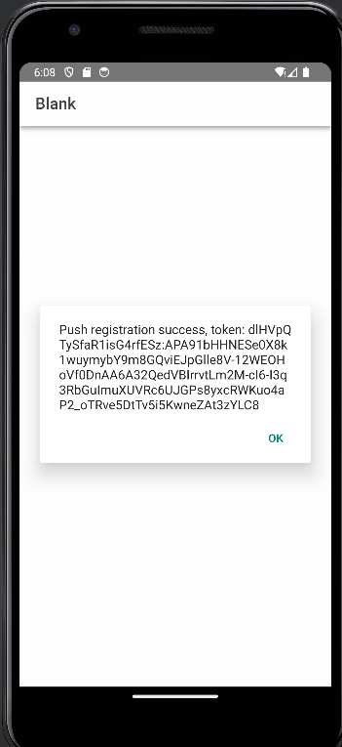
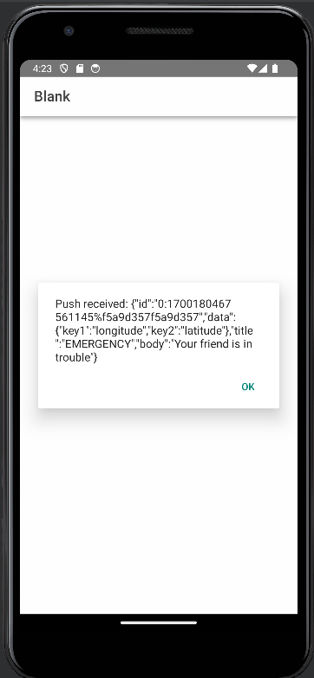
Push notification
Client side requests unique push notification token from firebase api.
Client can send token to backend and send push notification to specific device using cloud messaging

Slide 6
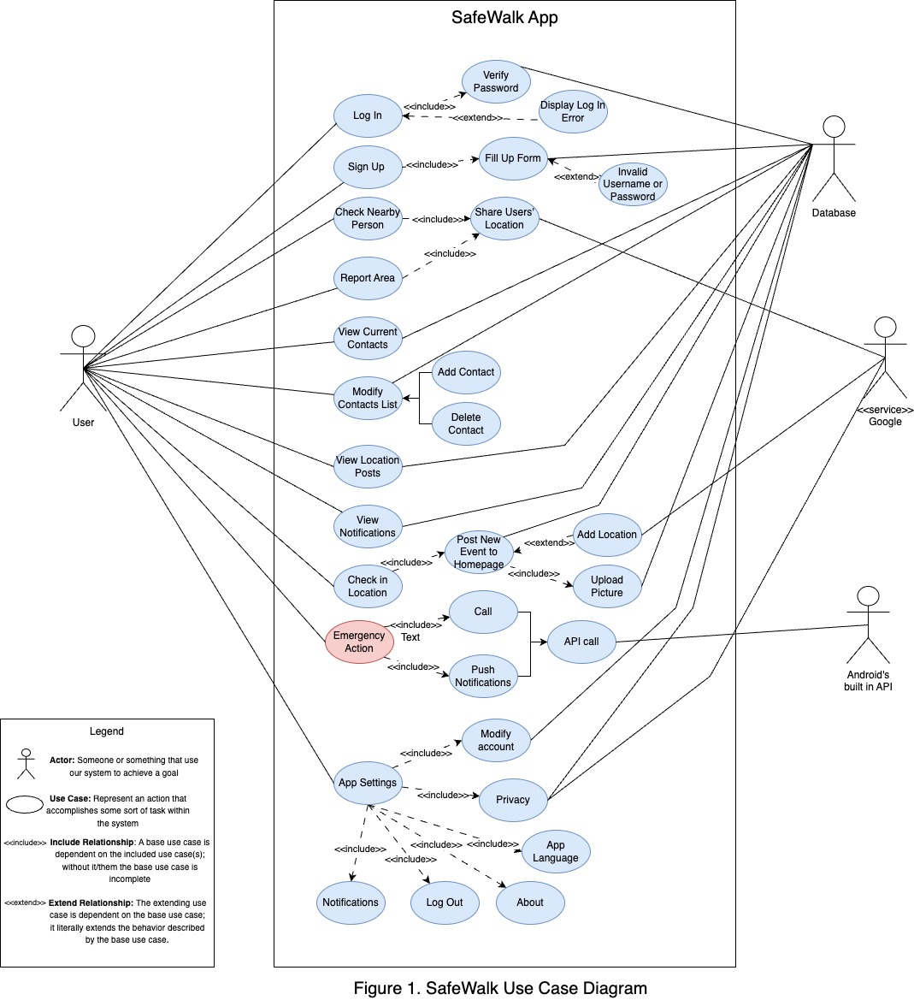
Use Case Diagram

Slide 7
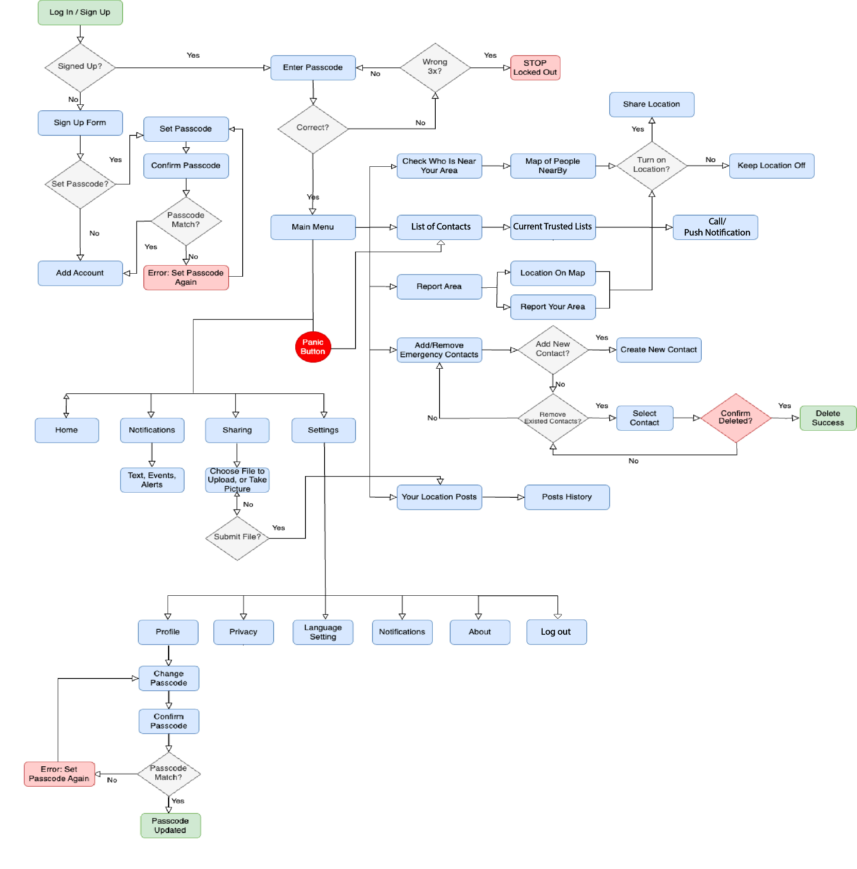
State Chart Diagram

Slide 8
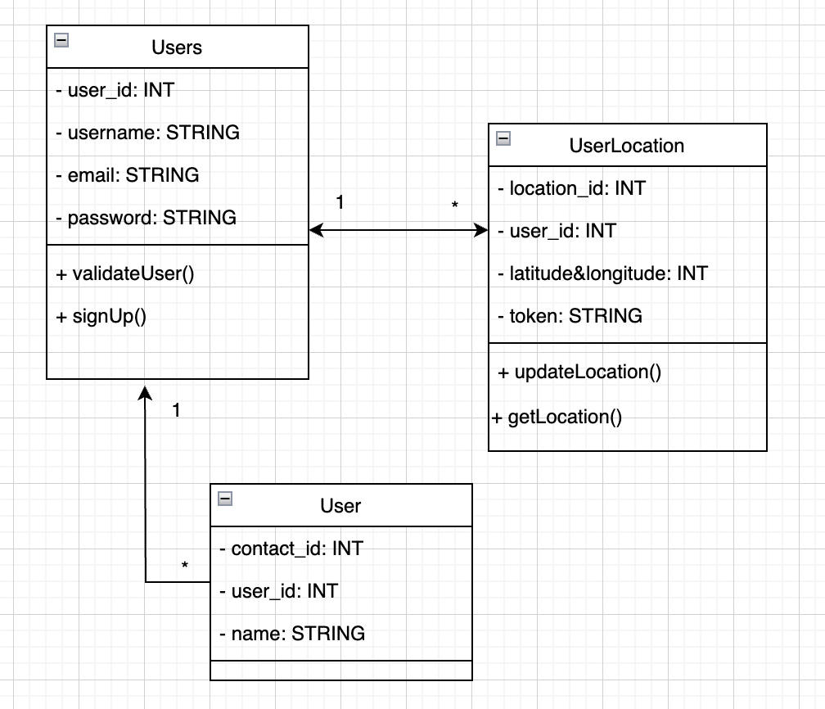
UML diagram

Slide 9
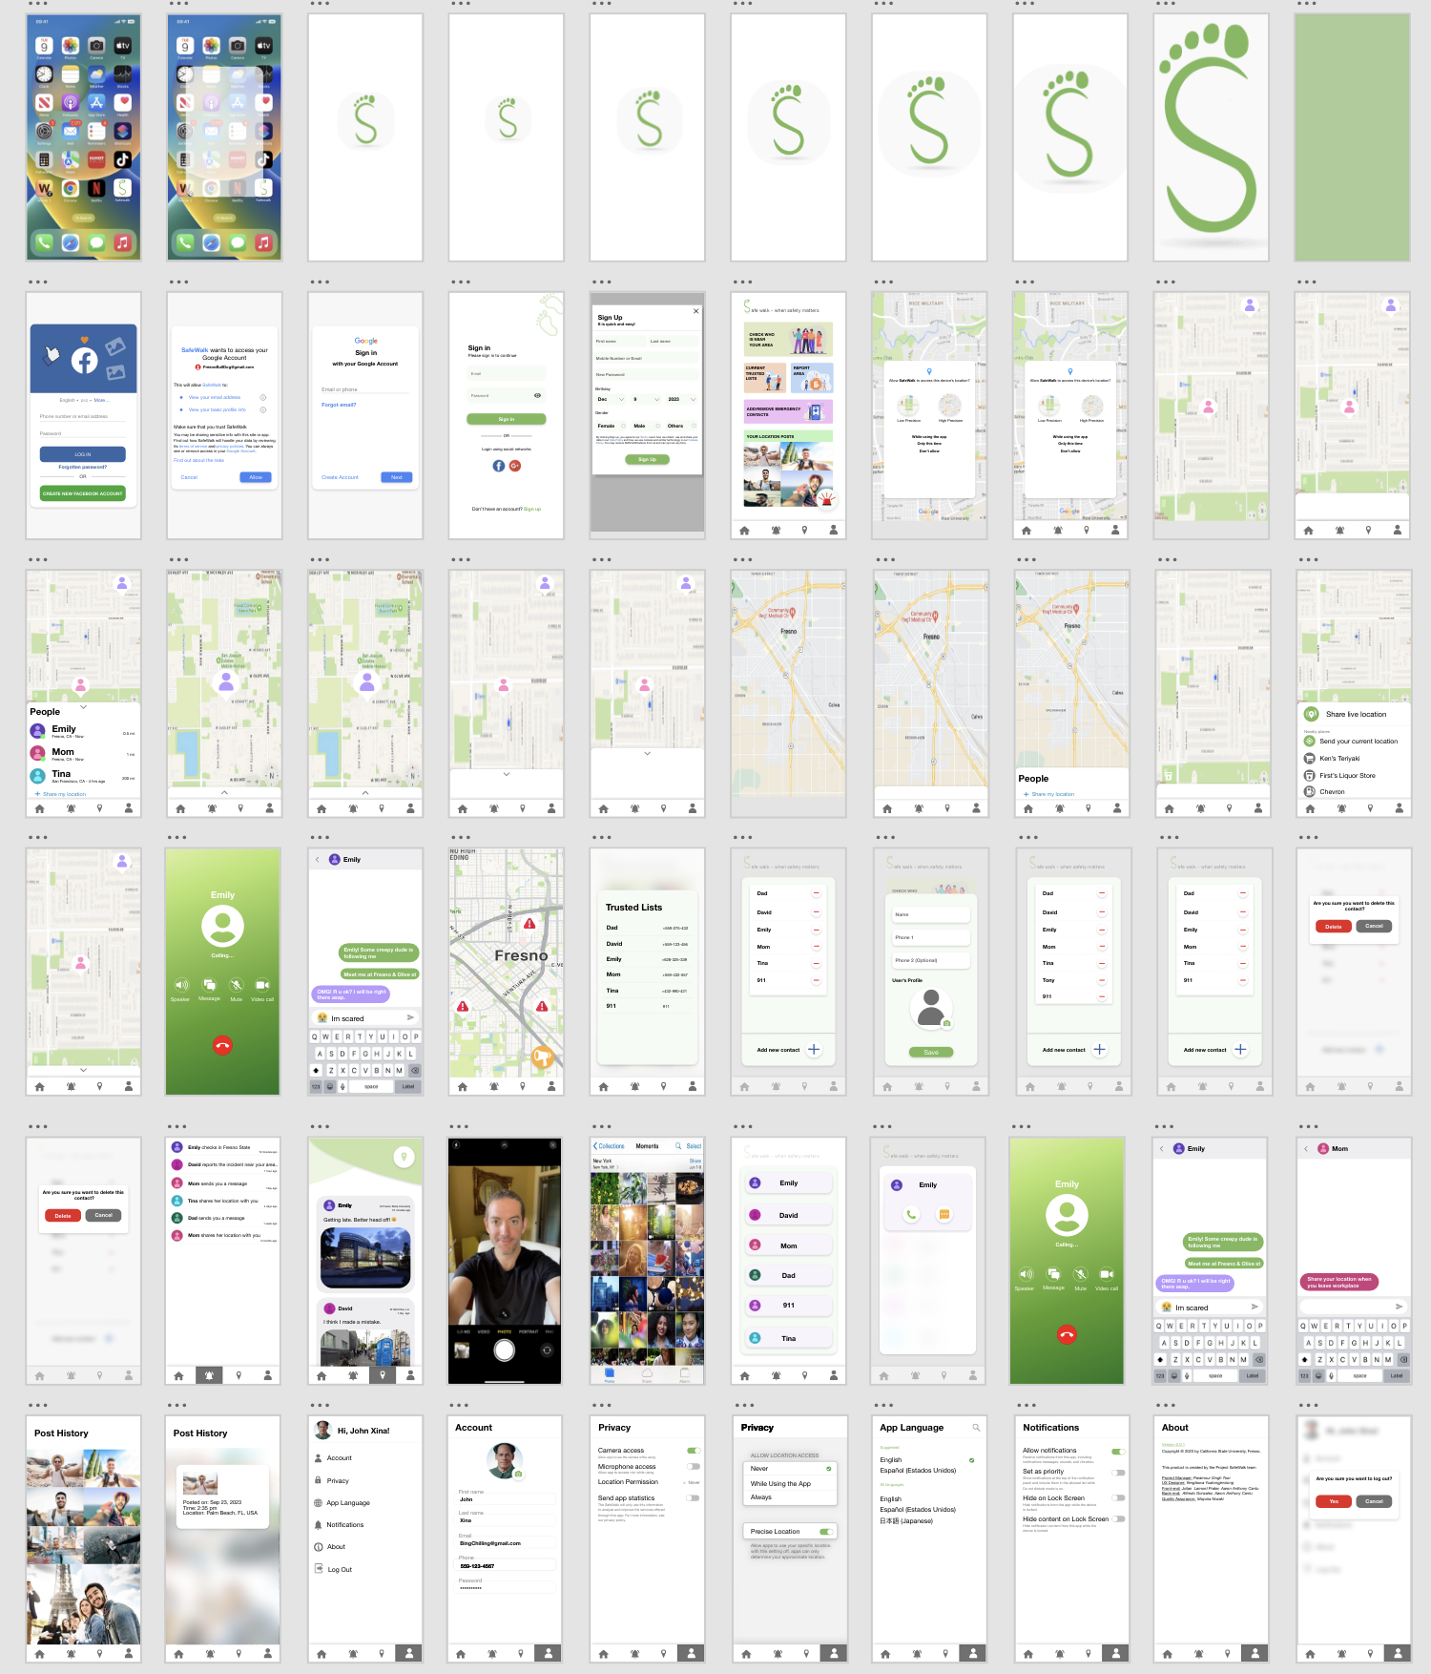
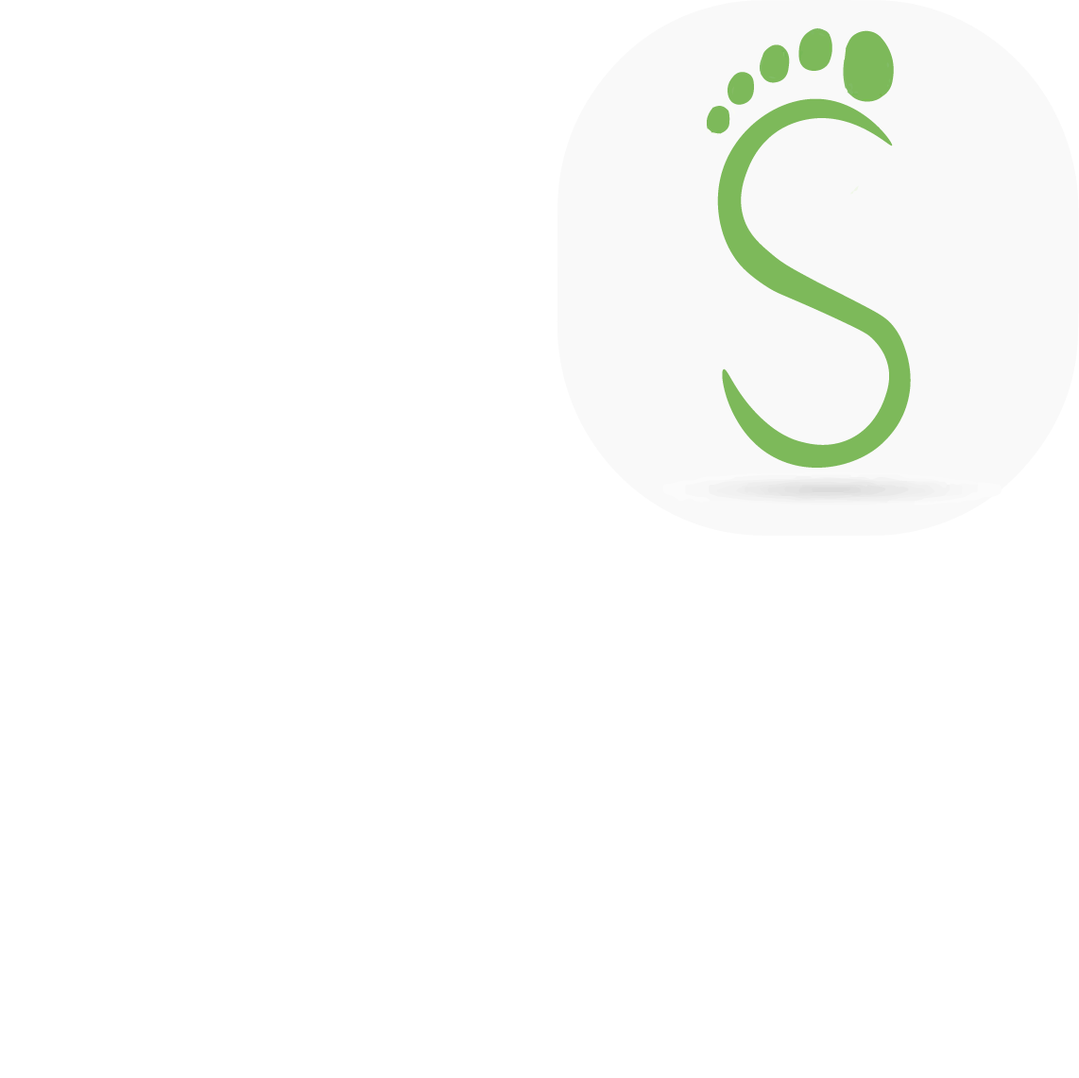
UX/UI
https://xd.adobe.com/view/e1c95501-a29a-4c0d-8f70-89b5c9f1e0da-b49a/grid
Footprint as an S shape to represent the name of the app.
Green color to represent the meaning of safety.

Slide 10
QA - Testing
https://github.com/150-lab2/Project_SafeWalk/issues

