Slide 1
Introducing "Oslo"
SOA209
David Chappell
Principal
Chappell and Associates
www.davidchappell.com

Slide 2
What is "Oslo"? Defining terms
"Oslo" refers to a wave of forthcoming Microsoft products and technologies
It's not the code name for a single new product or new release of a product
The "Oslo" technologies this talk focuses on are
A new repository with a visual editor
A new version of Windows Workflow Foundation (WF)
A new process server for WF, BizTalk, and other applications

Slide 3
Where is "Oslo"? A status report
Microsoft says they'll tell us more about "Oslo" later this year
No release dates have yet been announced
The goal today
Describe some of the main problems “Oslo” addresses
Give you a big-picture view of the technology
Don’t be surprised if there are changes before the first “Oslo” release
Some things are sure to change, e.g., screen shots

Slide 4
The "Oslo" Repository And Visual Editor

Slide 5

IT Today Working in a complex world
Business Process
SLA
Service
Activity
Computer
Application
Data Center
Workflow
Notes:
Imagine the business comes to you complaining that a service level agreement isn’t being met. How do you determine where the problem is? First, you’ve got to figure out which application supports this part of the process—not always an easy thing to do.
Once the app is identified, you might first suspect that the problem is in the data center. This means that you’ve got to find the right computer in the right data center, talk to the right person—its admin—and work things out. How easy is this?
If this doesn’t help, the problem might actually be in the app itself. Perhaps the logic of the workflow is wrong—we’ve misunderstood something when we implemented it—and the business analyst who defined this workflow might be able to help. Sadly, she can’t read C#--she defines workflows using Visio—so she can’t really be helpful.
Or maybe, in this brave new service-oriented world, one of the activities in the workflow exposes a service, and there’s a problem with this service. An architect with a global knowledge of our organization’s services might be able to help us here, but again, he’s got his own descriptions of the architecture. He also can’t help.
Does this sound like your world?

Slide 6

Who Cares About What? Different people, different concerns
Business Analyst
IT Pro
Enterprise Architect
Developer
Notes:
Right now, the information needed to solve this problem is fragmented, stored in different ways and accessed by different tools. There usually aren't connections between these information silos, and so it's tough to do things like track a problem or make a change across the entire environment.
Suppose, for example, that this business process changes so that the SLA on this service gets more stringent, or perhaps another business process wants to use this service. How in the world can anybody figure this out? What has to change to make this happen? Today we rely on email or Word documents or human contact—it’s a difficult process.

Slide 7
Improving This Situation
The challenge
Help people in diverse roles work with diverse information across different domains
Make IT simpler, more effective, and less expensive
The “Oslo” approach
Provide a common repository for all of this information
Provide a visual editor for working with repository information
And allow other tools to be used as well

Slide 8
The "Oslo" Repository A common store for diverse information
Provides one place to find information about the IT environment
Examples of what the repository allows
People in different roles can see and modify a common set of information
About applications, business processes, or anything else
Relationships between information can be made apparent
Problems can be tracked from end to end
Workflow
Activity
Service
Business
Process
SLA
Application
Computer
Data Center
Notes:
Microsoft sometimes refers to this information as “models”.

Slide 9
The "Oslo" Visual Editor A tool for working with that information
Provides a useful tool to create, read, update, and delete the repository's information
Examples of what the visual editor allows
People in different roles can see the information they care about in the way they want to see it
They can have better conversations with one other
Relationships between information can be examined visually
People can make connections across the environment

Slide 10
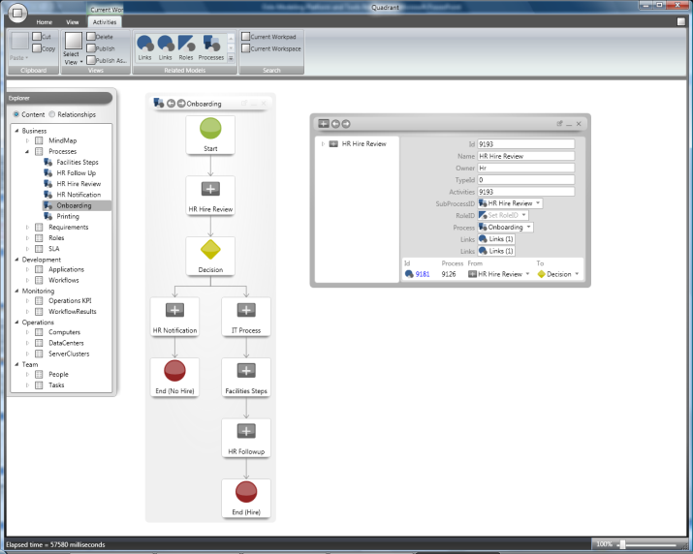
The Repository And Visual Editor An illustration
Visual Editor
Information about applications, computers, business processes, etc.
Repository

Slide 11
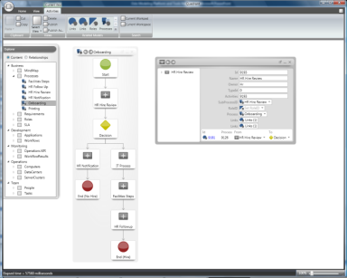
The Repository A closer look
Schemas
Instances
Defined using the "Oslo" schema language
Repository
Notes:
A schema is a definition of some category (kind) of information. A schema for a computer, for instance, would specify the various sorts of information you might like to track about computers: name, administrator’s name, installed memory, the cluster it belongs to, etc.
Making the repository successful depends on getting lots of useful content in it and keeping that content up to date.

Slide 12
What's In The Repository Some examples of pre-defined schemas
Schema
What It Describes
The steps in a process, e.g., a business process
Process
Workflow
A WF workflow
Activity
A specific activity in a WF workflow
A service provided by an application; can run locally or remotely
Service
Application
A (possibly composite) application
Computer
A physical computer
ServiceLevelAgreement
Requirements defined by an SLA
Notes:
Some examples of why this is useful:
An architect new on a project can use all of this to understand the app, why it was designed as it is, how it operates, etc.
I T pros live with a deployed app, and they need to do root cause analysis.
The repository can also contain an endpoint for an external service

Slide 13
Defining Schemas The "Oslo" schema language
"Oslo" introduces a new language for defining schemas
All schemas in the repository are defined using this language
The language generates SQL
The repository can be accessed using standard SQL and common database tools
Many (most?) people won't need to use this language explicitly
They'll rely on schemas defined by others
Notes:
There might be a person in a firm who can create and modify schemas, but knowing this schema language isn’t a pre-requisite to using this stuff.

Slide 14
Extending The Repository Customizing your world
Microsoft will ship a set of schemas with the repository
Customers and ISVs are free to add their own
Defined by Microsoft
Defined by others
Schemas
Instances
Notes:
This means that third parties are also free to create tools that work with the repository. For example, an ISV that’s really good at making business analysts tools could build one (or extend an existing product) to work with the “Oslo” repository.

Slide 15
Federating Information The "Oslo" repository and other stores
Other Microsoft products also store useful information, including
Team Foundation Server (TFS) in Visual Studio Team System
Various stores in System Center
Such as the Operations Manager operational database
The “Oslo” repository will (eventually) be federated with these other stores
It will provide a common way to describe, find, and access information across them
But TFS, System Center, etc. will continue to store their own data
Notes:
This federation will allow relating a TFS work item to a business process diagram to something in an application to the deployment map, for example. You’ll be able to examine and link information about all kinds of things in your environment.

Slide 16
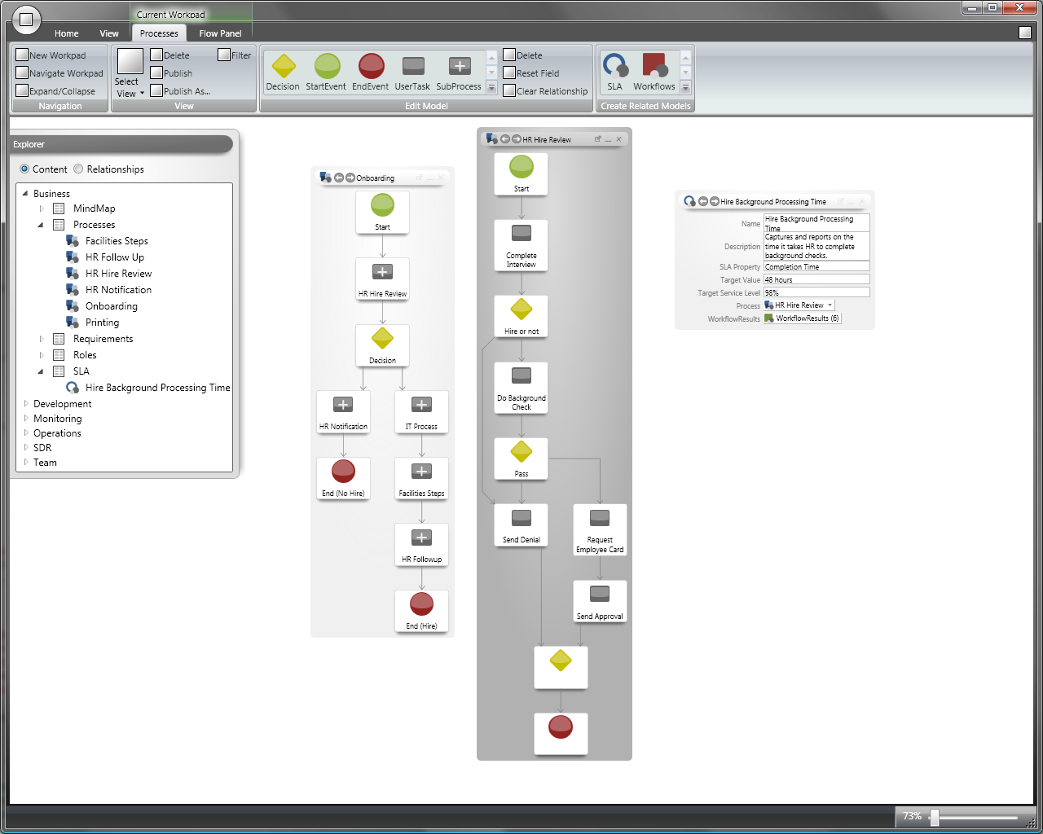
The "Oslo" Visual Editor A closer look
Repository
Notes:
The visual editor lets people create, look at, modify, and delete instances and schemas in the repository.
The editor uses the Office ribbon for all views—the goal was to be easily usable by everybody.
The tool has no built-in schemas. Rather, it’s a generalized editor for schematized data stored in the repository.

Slide 17
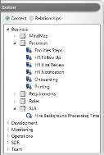
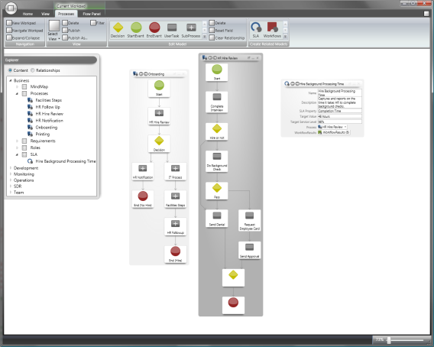
The "Oslo" Visual Editor Exploring the repository: Content
Note to reviewers: The final version will use high-resolution screen shots throughout.
Category
Looking at schemas and instances in the repository
Schema
Instance
Notes:
Notice the categories here:
Business data: Processes, SLAs, etc.
Development data: Applications and workflows
Monitoring data: Operations KPIs
Operations data: Computers, data centers, etc.
Teams: People, tasks, etc.

Slide 18
The "Oslo" Visual Editor Examining the Onboarding process
HR Hire Review
sub-process
Notes:
A business process can contain applications or it can be part of applications—it depends on what granularity you have in mind for the business process. The business process and workflow schemas are similar; the BP schema has the ability to have non-executable steps, though, more like documentation.

Slide 19

The "Oslo" Visual Editor Examining the HR Hire Review sub-process

Slide 20

The "Oslo" Visual Editor Examining an SLA for this sub-process
Values can be read or modified
Notes:
A key point is that the repository can store all kinds of data, including business-oriented things like service level agreements

Slide 21
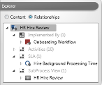
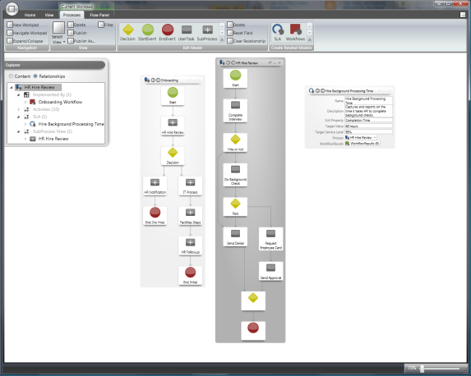
The "Oslo" Visual Editor Exploring the repository: Relationships
Looking at relationships among instances
HR Hire Review sub-process
WF workflow that implements this sub-process
SLA for this sub-process

Slide 22

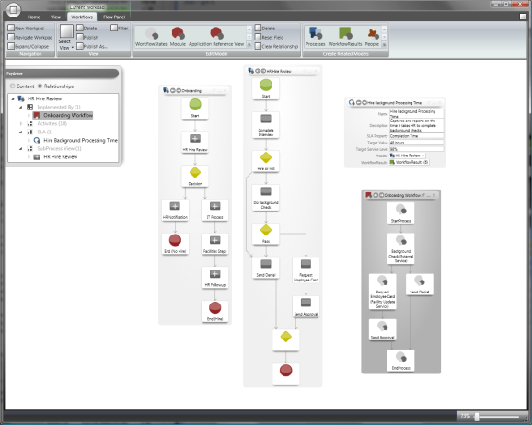
The "Oslo" Visual Editor Examining the Onboarding workflow
Workflows can be created and modified by assembling activities from the repository
Activities in this workflow

Slide 23
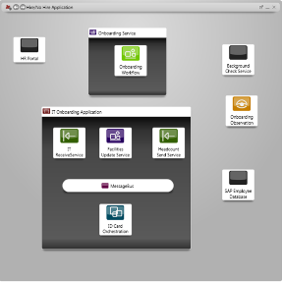
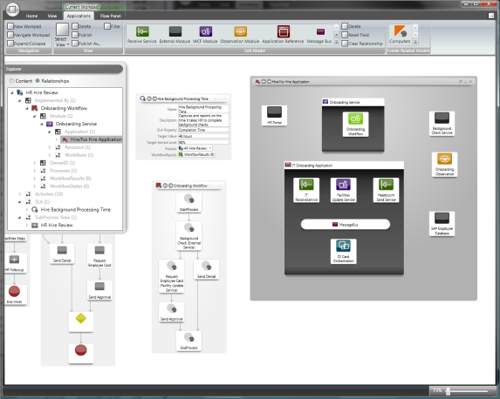
The "Oslo" Visual Editor Examining the application this workflow is part of
Onboarding service
Onboarding workflow
Application name: Hire/NoHire
Service provided by SAP
BizTalk application
Notes:
There will probably be lines among the various pieces of the app in the final product.

Slide 24


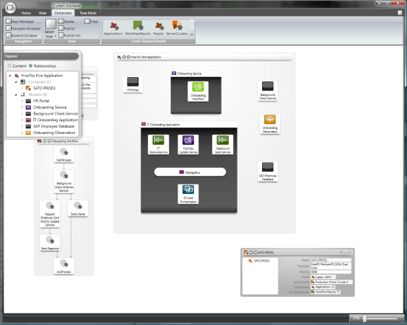
The "Oslo" Visual Editor Examining the computer this workflow runs on
Application name: Hire/NoHire
Computer name: SAT-PROD1
Administrator’s name

Slide 25
Extending The Visual Editor Customizing your world
What the visual editor displays is determined entirely by the schemas in the repository
A schema can have a view experience defined for it
Microsoft will ship a set of schemas with pre-defined views
Customers and ISVs are free to add their own

Slide 26
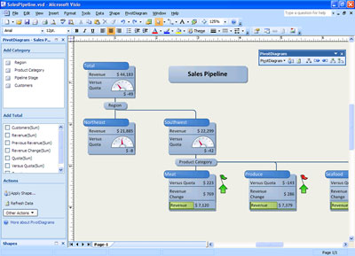

Using Other Tools Working with the repository
Other tools can also be used to work with information in the repository
Potential examples: Visio, Visual Studio, System Center tools, tools created by third parties
Visio
“Oslo” Visual Editor
1) Create business process description
2) Store business process description
3) Use business process description
Repository
Notes:
Third parties are also free to create tools that work with the repository. For example, an ISV that’s really good at making BA tools could build one (or extend an existing product) to work with the “Oslo” repository.

Slide 27
Windows Workflow Foundation In "Oslo"

Slide 28
Illustrating WF The basics
Workflow
Visual Studio
Activities
WF Workflow Designer
Base Activity Library (BAL)
Runtime Engine
Host Process
Other Activities

Slide 29
A Symbiosis WF and Windows Communication Foundation (WCF)
Workflows often use WCF to expose and/or consume services
Hence the term WF/WCF application
Service
Interactions between activities use parameters and are more tightly coupled
Workflow
Workflow
Interactions between a service and its client use messages and are more loosely coupled

Slide 30
WF: The Next Generation
Many more activities will be provided
Examples
Accessing data
Interacting with SharePoint
Invoking PowerShell cmdlets
WCF messaging
A primary goal is to make it possible to create useful applications by assembling existing activities into workflows
A workflow’s logic will be defined solely in the XML-based XAML language
Not using a mixture of XAML and code, as it is today
Notes:
The WF designer will have a rules editor that lets people use a simple VB-like syntax to specify rules in workflows

Slide 31
Creating WF/WCF Applications Using the WF workflow designer
The “Oslo” release of WF will include a new version of the WF workflow designer
It’s aimed at developers
The designer runs inside Visual Studio
The WF workflow designer allows
Creating workflows:
By graphically assembling activities
By working directly in XAML
Creating new activities
In C# or Visual Basic
More

Slide 32
Creating WF/WCF Applications Using the "Oslo" visual editor
The “Oslo” visual editor can be used to create workflows
It might be used by a more technical business analyst, for example
The visual editor allows defining workflows by graphically assembling activities from the repository
It doesn’t allow creating new activities in code
Goals
Improve application development productivity
Help more people create WF/WCF applications
Notes:
The Quadrant PUM (dennis) was the dev manager for VB 1.0. His roots are in the transformational space of changing how people write applications. It raises the level of abstraction and enables new classes of people to participate in creating applications. “It’s a VB-like mission for me”, he says.

Slide 33
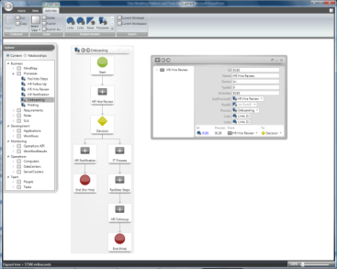
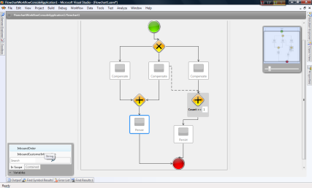
Working Together Different tools for different roles
Business analysts and developers can work together to build WF/WCF applications
Repository
“Oslo” Visual Editor
Visual Studio
Workflow definition as repository instance
Workflow definition as XAML
Business Analyst
Developer
Notes:
This is analogous to how VS and Expression Blend work together via XAML.
A developer is more likely to use Visual Studio—it’s more familiar, the dev is probably doing things that aren’t possible in the visual editor or supported in the repository. Over time, this may change.

Slide 34
The "Oslo" Process Server

Slide 35
Executing Applications
WF doesn’t mandate a particular host
WF/WCF apps can run in nearly any process
The “Oslo” wave includes a new process server
It provides a standard host for running WF/WCF apps
Although using it isn’t required; WF/WCF apps can still run in any process
It also supports other hosts

Slide 36
The "Oslo" Process Server Describing its parts
Lifecycle Manager
Loads applications into a host
Monitors applications running in a host
The first host: WF/WCF Host
Runs WF/WCF applications
Designed for long-running services
Provides services for
Application load balancing across multiple machines
With centralized persistence
Compensation for long-running transactions
XML messaging and transformation
More…

Slide 37
The "Oslo" Process Server With the WF/WCF host
Lifecycle Manager
WF/WCF Host
Other Hosts
WF/WCF Applications
Application Load Balancing
Compensation
Workflow Services
XML Messaging and Transformation
. . .

Slide 38
The "Oslo" Process Server Creating and running WF/WCF applications
“Oslo” Visual Editor
Visual Studio
WF/WCF Host
1) Create workflow
1) Create workflow
2) Load and run workflow
2) Load and run workflow
Repository
Filestore

Slide 39
BizTalk Server A roadmap
BizTalk Server 2006 R2
Shipping today
BizTalk Server 2006 R3
Scheduled to ship in the first half of 2009
Designed for Windows Server 2008, Visual Studio 2008, and SQL Server 2008
Adds UDDI support, improved B2B, etc.
BizTalk Server: The next generation
Becomes a host in the “Oslo” process server
Can run applications from the repository

Slide 40
BizTalk Server Illustrating a future release
Lifecycle Manager
WF/WCF Host
BizTalk Host
Other Hosts
WF/WCF Applications
BizTalk Applications
“Oslo” Process Server

Slide 41
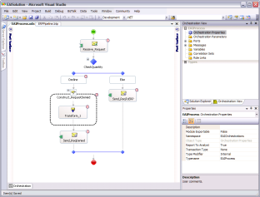
BizTalk Server Creating applications in a future release
Lifecycle Manager
Visual Studio with Orchestration Designer
“Oslo” Visual Editor
BizTalk Host
. . .
. . .
“Oslo” Process Server
Repository
Filestore

Slide 42
Planned "Oslo" Releases Breaking the waves
Oslo Wave 1
Oslo Wave 2
Oslo Wave 3
Next version of WF
(will ship with the
.NET Framework “4” and Visual Studio “10”)
Repository
Visual editor
Process server
- WF/WCF host only
Process server
- Lifecycle Manager
- BizTalk host

Slide 43
Summary
This talk has focused on three things in the "Oslo" wave:
A new repository with a visual editor
Giving people in diverse roles a way to work with a broad range of information
A new version of Windows Workflow Foundation
Making it easier to create WF/WCF applications
A new process server
Providing a standard host for WF/WCF applications, BizTalk applications, and more
These changes will affect all of us
Business analysts, architects, developers, and IT pros

Slide 44

About the Speaker
David Chappell is Principal of Chappell & Associates (www.davidchappell.com) in San Francisco, California. Through his speaking, writing, and consulting, he helps IT professionals understand, use, and make better decisions about enterprise software. David has been the keynote speaker for many conferences and events on five continents, and his popular seminars have been attended by tens of thousands of developers, architects, and decision makers in forty countries.
David’s books have been translated into ten languages and used regularly in courses at MIT, ETH Zurich, and many other universities. He is Series Editor for Addison-Wesley’s award-winning Independent Technology Guides, and he has been a regular columnist for several publications. In his consulting practice, David has helped clients such as Apple, Hewlett-Packard, IBM, Microsoft, Stanford University, and Target adopt new technologies, market new products, train their sales staffs, and create business plans.
David’s comments have appeared in The New York Times, CNN.com, and various other publications. Earlier in his career, he wrote software for supercomputers, chaired a U.S. national standardization working group, and played keyboards with the Peabody-award-winning Children’s Radio Theater. David holds a B.S. in Economics and an M.S. in Computer Science, both from the University of Wisconsin-Madison.

Slide 47

© 2008 Microsoft Corporation. All rights reserved. Microsoft, Windows, Windows Vista and other product names are or may be registered trademarks and/or trademarks in the U.S. and/or other countries.
The information herein is for informational purposes only and represents the current view of Microsoft Corporation as of the date of this presentation. Because Microsoft must respond to changing market conditions, it should not be interpreted to be a commitment on the part of Microsoft, and Microsoft cannot guarantee the accuracy of any information provided after the date of this presentation. MICROSOFT MAKES NO WARRANTIES, EXPRESS, IMPLIED OR STATUTORY, AS TO THE INFORMATION IN THIS PRESENTATION.

