Slide 1

OAK or SFO?
Eunkwang Joo, Ryan Jung, Julia Kosheleva-Coats, Divya Menghani
Notes:
There is an urban myth among Bay Area business travelers that it is better to fly out of OAK instead of SFO if you are trying to avoid delays. So we decided to use airport flight data to investigate this question and build a model to predict the delays at each airport.

Slide 2

Problem Statement
Given a specific date and a destination, should I fly from SFO or OAK to avoid delays?
Notes:
So, our main question is: on a specific day of the year, given my destination, is it better to fly out of SFO or OAK to avoid departure delay?

Slide 3
Our Approach
Data
Flight arrivals/departures for major U.S. airports (source: American Statistical Association)
Data from 2001 through 2008
Assumptions
Travelers are not price- and time-sensitive
Travelers search for direct flights
Models
Naïve Bayes classifier
Logistic regression
Notes:
Data:
Data available 1987 through 2008 → used most recent data due to variable availability. Avoids El Nino/La Nina years.
Very large dataset - each year dataset contains approximately 7MM flight records, 30 variables.
Data contains variables such as Date, Day of the Week, Flight Number, Origin and Destination, Departure and Arrival Delays, Carrier, Tail Number.
Since we have posed an classification problem, we chose Naïve Bayes as the baseline model.
Many variables that reflect the cause of a delay. We wanted to explore whether the probability of a flight delay at the origin airport is a linear function of a set of the predictor variables. And, to see whether logistic regression could be effective to predict the binary result of delay/no delay.

Slide 4
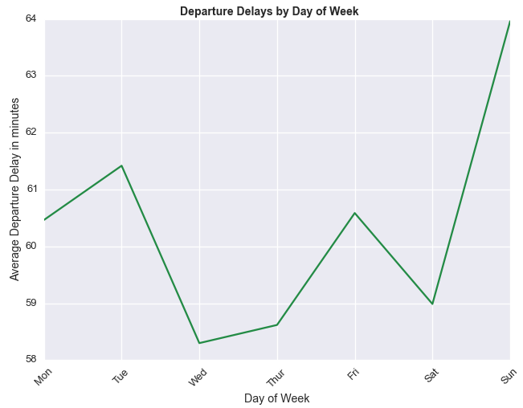
Naïve Bayes Classifier Model
Input variables:
Year
Month
Day of month
Day of week
Departure time
Airline carrier
Tail number
Origin
Destination
8-fold cross-validation: train on 7 years, test on 1 year
Balanced sampling: 33% train and 50% test
Notes:
Removed all canceled flights
Trained and test on all of the data, not SFO and OAK only to ensure that we are not overfitting and that the model is flexible to be used for any airport.

Slide 5
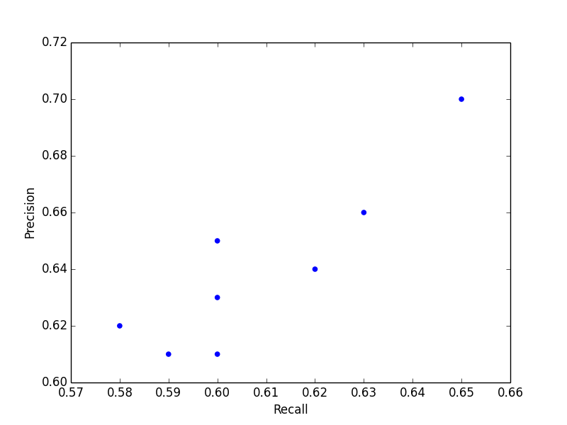
Naïve Bayes Classifier Results
Recall vs. Precision
Test Year | Precision | Recall | Accuracy | F-score
2001 | 0.58 | 0.62 | 0.61 | 0.60
2002 | 0.60 | 0.65 | 0.65 | 0.63
2003 | 0.65 | 0.70 | 0.70 | 0.67
2004 | 0.63 | 0.66 | 0.66 | 0.64
2005 | 0.62 | 0.64 | 0.64 | 0.63
2006 | 0.60 | 0.63 | 0.62 | 0.61
2007 | 0.60 | 0.61 | 0.60 | 0.61
Average:
0.61 0.64 0.64 0.63

Slide 6
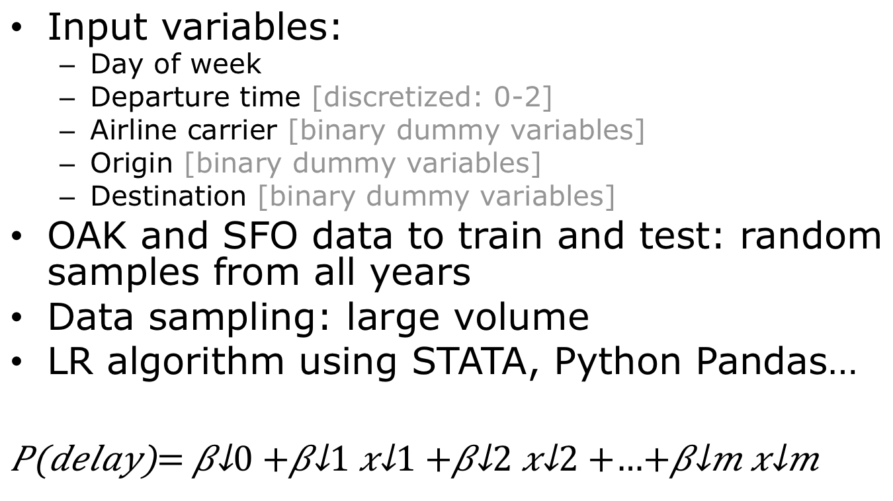
Logistic Regression Model
Input variables:
Day of week
Departure time [discretized: 0-2]
Airline carrier [binary dummy variables]
Origin [binary dummy variables]
Destination [binary dummy variables]
OAK and SFO data to train and test: random samples from all years
Data sampling: large volume
LR algorithm using STATA, Python Pandas…

Slide 7
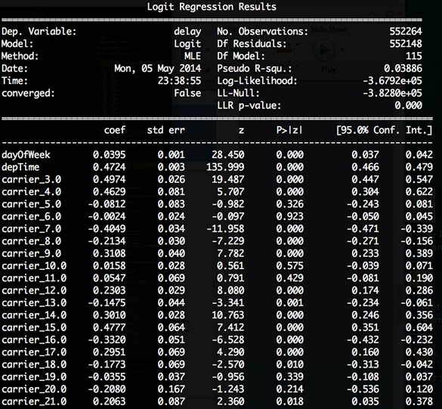
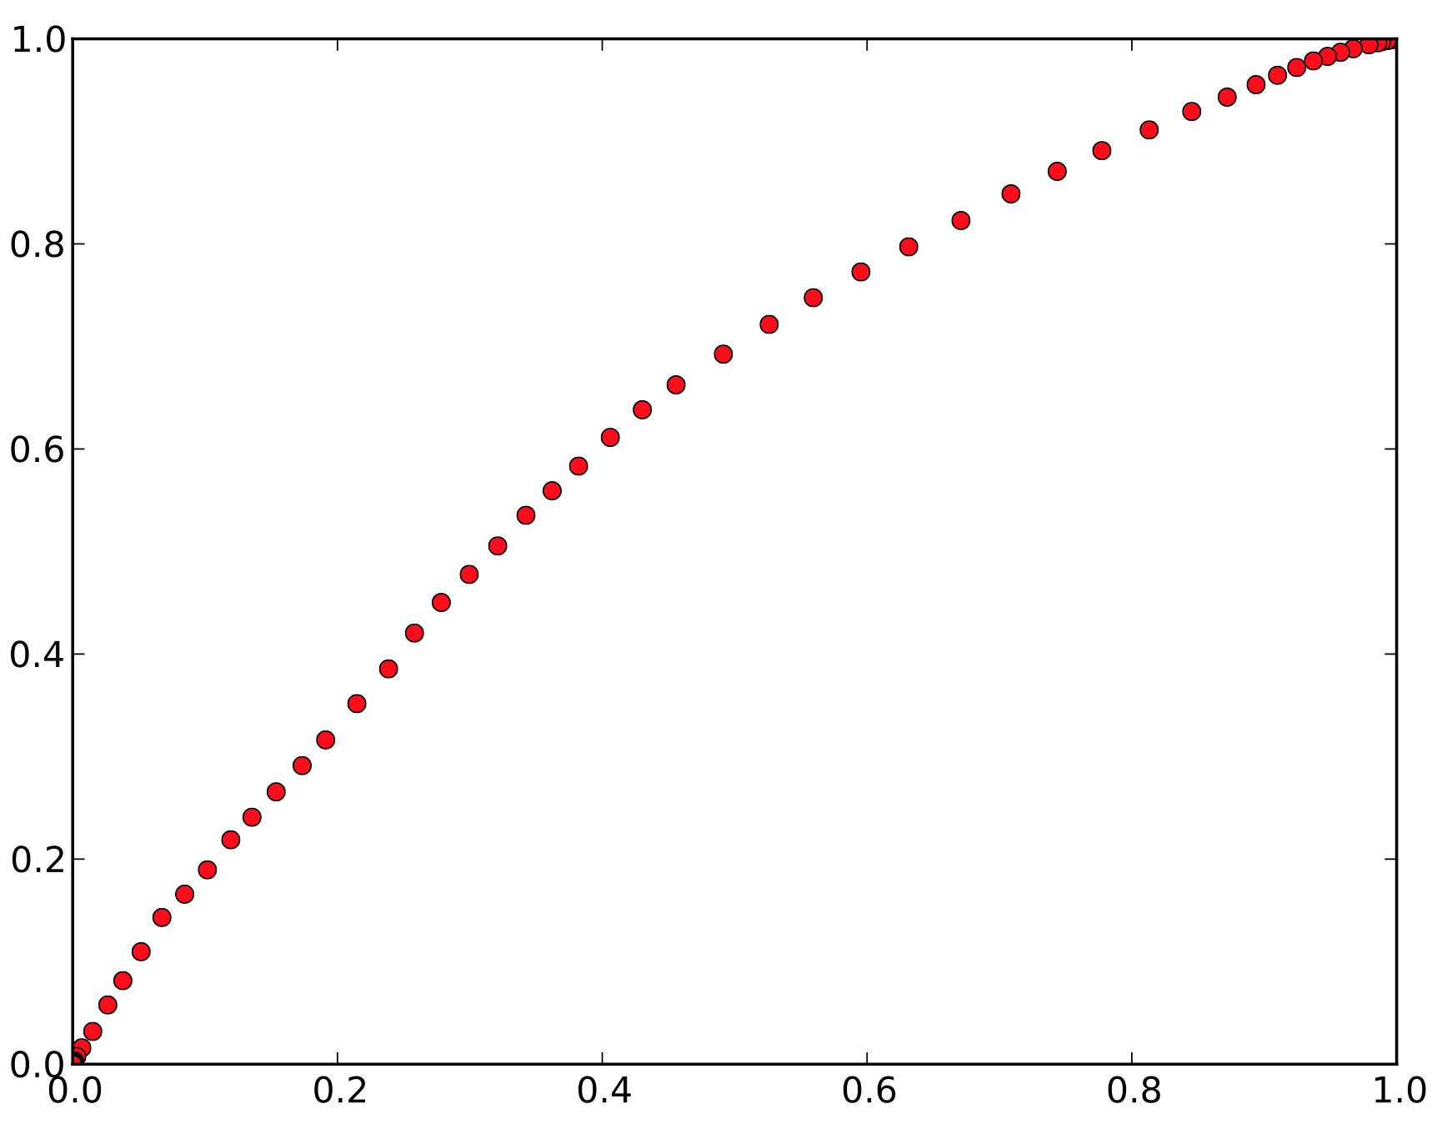
Logistic Regression Results
Precision | 0.61
Recall | 0.59
Accuracy | 0.61
F-score | 0.60
ROC Curve
TP rate
FP rate
Notes:
Show Precision, Recall, Accuracy, F1
Avg F1 at the bottom

Slide 8
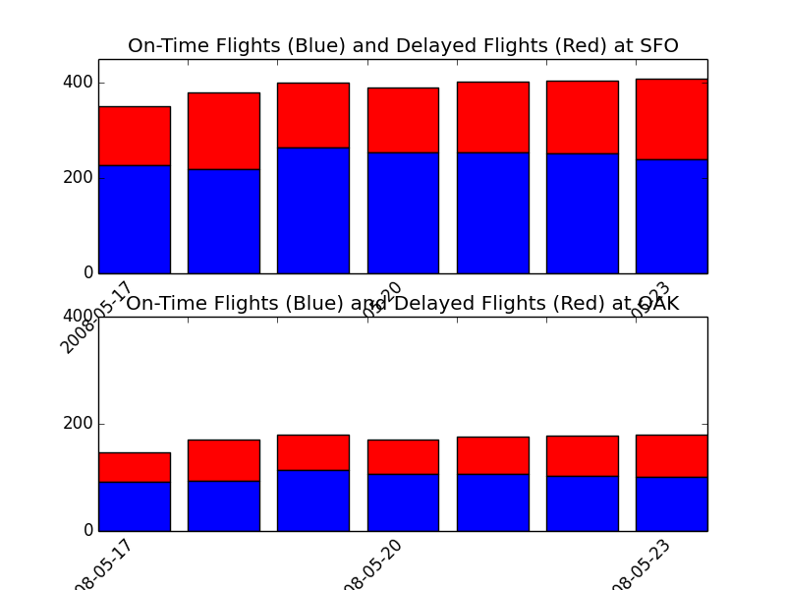

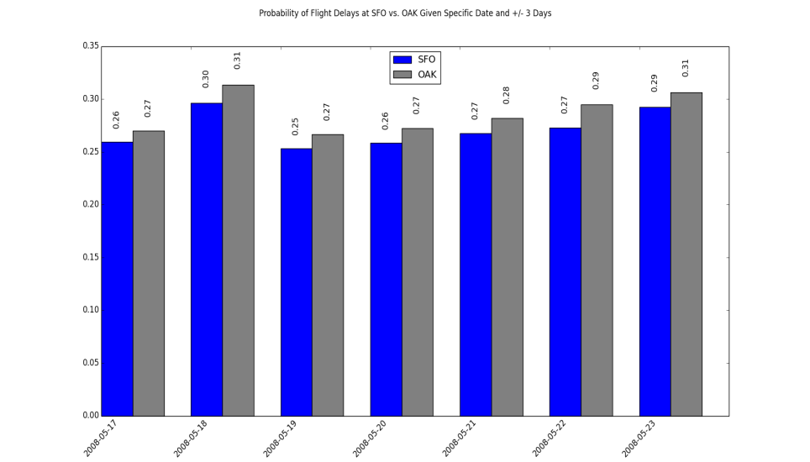
Imagine you have to take a trip around May 20th…
Which airport would you prefer?
Our algorithm shows that SFO has lower probability of delays for the 3 days before and after 5/20
What day would you leave?
5/19 or 5/20 are the best days to leave, given you have departure day flexibility
On-time (blue) and delayed (red) flights at SFO
On-time (blue) and delayed (red) flights at OAK
Delay
On Time
Probability of flight delays – SFO vs. OAK
Notes:
Show 1 week for a specific destination.
Look at the entire year for various destinations to see if there is a pattern.

