Slide 1
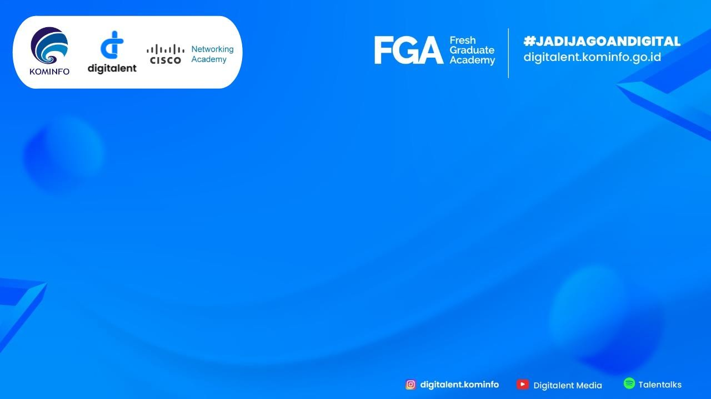
FGA 2023: Big Data using Python
Final Project
Digit Handwriting Recognation with CNN
Author:
Ainur Inas Annisa
Universitas Trunojoyo Madura

