Slide 1
FRIGO LOCO
Cloud ERP Platform
From spreadsheets to a scalable cloud system
for smart fridge operations
40+
200
540
Fridges today
Target fridges
Products
June 2026 · Dev Briefing · Confidential · v5

Slide 2
THE CHALLENGE
Why we're moving beyond Excel
Concrete pain points — and what we need the new system to do better.
Row limits exceeded
Stronger forecasting models
Excel cannot handle 20–30M rows of RFID event data needed for accurate forecasting.
Ability to use AI and current data to deliver more automated and better forecasting.
Manual data pipelines
Centralize alerts & automation
Financial reporting requires copy-pasting between two separate workbooks every week.
Negative stock, expiring products, low stock — all in the same system, not just emails.

Slide 3
THE SOLUTION
A cloud-native ERP built for smart fridges
React (TypeScript)
FastAPI (Python)
PostgreSQL
Railway.com
Azure Blob
Frontend
Backend API
Database
Hosting
File storage
8 core modules
Forecast
Menu & products
Purchase orders
Stock
Dispatch
Finance & returns
Alerts
Clients & fridges

Slide 4
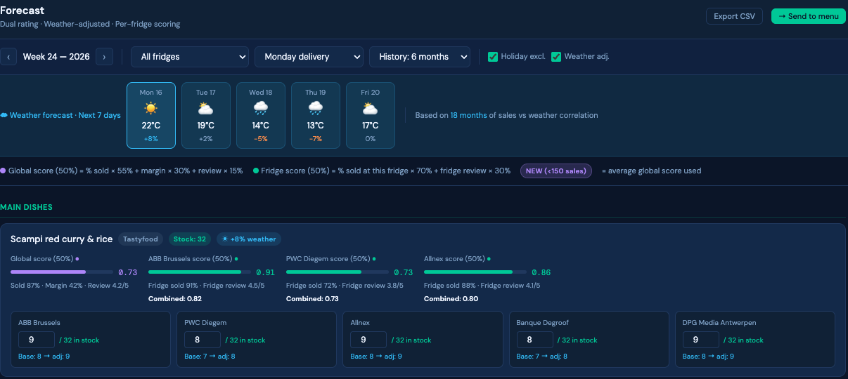
MODULE 1
1
Pull last 6–12 months of RFID sales per fridge per category per day-of-week
Forecast
1
2
Average per delivery day (Mondays vs Tuesdays treated separately)
3
Sell-through % (sold/added) → colour codes: ≥90% yellow, <70% red
4
Exclude holidays (near-zero days) automatically
Forecast UI — live mockup
5
Apply dual product rating: 50% global score + 50% per-fridge score
6
Weather adjustment: +/− % based on 18 months of weather/sales correlation

Slide 5
FORECAST — KEY FEATURE
1
Residual fridge stock logic
RFID gives live stock per fridge. Shelf life determines what stays vs what gets pulled.
How it works for DPG Media (Mon + Thu deliveries):
Forecast run on Wed afternoon for Thursday delivery
Coverage window = Thu → Sun (4 days until next Monday delivery)
1
2
API Husky: pull live stock in fridge + DLC remaining per product
DLC ≥ 4 days → product stays → deduct from forecast (green panel)
3
4
DLC < 4 days → driver pulls the product → withdrawal list on dispatch sheet
Net to deliver = Max(0, forecast − deductible residual stock)
5
6

Slide 6
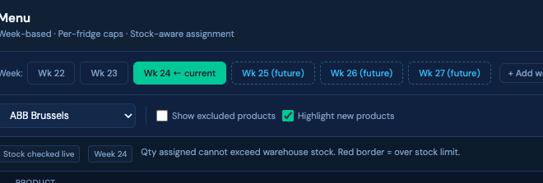
MODULE — WEEKLY MENU
1
Weekly menu — plan ahead
One menu per week defines which products CAN be in the fridges. Plannable weeks in advance.
Create menus ahead of time
1
Week tabs (S22, S23…) allow planning future menus before the week starts. Copy previous week in one click.
Menu UI — live mockup
Products selected via dropdown
2
Search across 540 products by name or brand. Grouped by category. Replaces checkboxes — much faster at scale.
Menu applies to all fridges as base
3
The weekly menu defines the permitted product list. Per-fridge quantities are then set in the dispatch matrix.
Forecast → dispatch matrix
4
Once the menu is validated, the global view (frigos × products) is pre-filled by the forecast. Manual adjustment always possible.

Slide 7
MODULE — ADD-ON SERVICES
1
Add-on services — coffee, fruits & business lunch
Beyond the fridge: a dedicated page for additional client services, auto-dispatched.
1
Dedicated page per service type
2
Auto-dispatch for recurring items
Separate page for Coffee, Fruits, and Business Lunch services. Each client can have a different service level.
Fruits are added automatically to the dispatch sheet based on schedule (e.g. 5 kg every Monday and Wednesday), excluding holidays.
3
Business lunch — order management
4
Any other product / ad-hoc
Business lunch added via dropdown with date, PO reference, and client. Automatically appears on the dispatch sheet for that date.
Any non-fridge product can be added manually. Linked to the client profile and tracked in dispatch history.

Slide 8
1
MODULE — MENU FEATURES
Menu — per-product & per-fridge rules
Granular control: caps, stock awareness, exclusions, targets.
1
Max per product per fridge
2
Stock-aware assignment
Set a hard cap on any product for any fridge. E.g. max 15 cookies at ABB. Cannot be exceeded when assigning quantities.
When assigning quantities, the system checks warehouse stock. You cannot assign more than what is available. Red border if exceeded.
3
New product baseline (≤ 250 sales)
4
Exclude a product from a specific fridge
Products with fewer than 250 sales receive the average global score as a placeholder until real data accumulates.
Tick/untick a product to exclude it from a fridge's weekly menu. E.g. sandwiches not distributed at a specific location.
Product targets & fridge groups
5
Set targets per product per fridge. Create fridge groups — e.g. replace Coke with Fanta across a group while keeping targets. Managed via a dedicated Targets tab.

Slide 9
1
MODULE — PURCHASE ORDERS
Supplier orders — beyond just PO numbers
Warehouse-first design: view by date, scan delivery notes, clear stock visibility.
1
View orders by date
2
Proper stock page
Not just by PO number. Filter by delivery date to see what's arriving today, this week. Essential for warehouse planning.
Dedicated stock view: current stock, on-order quantities, and the difference clearly visible side by side.
3
In-stock vs ordered distinction
4
Warehouse manager dedicated view
Clearly differentiate between stock physically in warehouse vs quantities on open purchase orders. No more confusion.
Dedicated entry point and breadcrumbs for warehouse staff. Workflow optimised for daily receiving: scan, confirm, done.
Scan & attach delivery note
2
5
6
Later: link to invoicing
Driver or warehouse staff can photograph the supplier delivery note and attach it to the PO as proof of receipt.
Future phase: automatic link between purchase order → delivery receipt → Peppol invoice for 3-way reconciliation.

Slide 10
MODULE — DISPATCH
1
2 dispatch per day possible
Dispatch
Delivery sheets auto-generated — categories in correct order — withdrawal list included.
Auto-deduct stock
Category order enforced
Saving a dispatch immediately deducts from warehouse stock
Hot → Frozen → Salads → Wraps → Granolas → Soups → Desserts → Drinks → Snacks
Withdrawal list on sheet
Add products manually
Products with DLC too short are flagged for driver to pull — mark as loss or return to WH
Ability to add products not in the standard weekly menu directly in dispatch
Past-date safeguard
Clone dispatch day
Saving a dispatch for a past date requires explicit user confirmation
Copy any delivery day to another date in one click
Reminders on sheet
'N'oubliez pas votre uniforme' and other important reminders printed on every sheet

Slide 11
2
MODULE — LOGISTICS & ROUTING
Create & assign delivery routes
From dispatch sheet to driver app — optimised routes, pick lists, SMS alerts.
Inputs
Outputs
→
Clients to be delivered this day
✓
Optimised number of routes generated
→
✓
Routes assigned to drivers
→
Number of delivery staff available
✓
Driver app: dedicated page with route, pick list, estimated time & KM
→
SMS reminder sent to driver automatically
✓
Pick list per route — what to load from warehouse

Slide 12
MODULES 4 & 7
Stock & Alerts
1
Negative stock is impossible. Issues surface before they become problems.
Stock rules
Alert types
Ability to adjust stock manually (with required explanation box)
Expiry alert
Products expiring within 2 days (configurable)
Every PO receipt automatically adds to stock
Low stock
Per-product configurable minimum threshold
Every dispatch save automatically deducts from stock
Negative Alert
Full audit trail: user + timestamp on every movement
Operation blocked before stock would go negative
RFID offline
Fridge hasn't reported sales in >N hours

Slide 13
1
MODULE — CLIENT MANAGEMENT
Dedicated client page
One page per client — everything about their fridge, services, interventions and fees in one place.
1
Client info
2
Machine intervention log
Location, number of workers, type of workers (white collar / blue collar). Used to calibrate forecast targets and product mix.
Track any intervention on the fridge: technical issue, cleaning, hardware replacement. Timestamped and linked to the client.
3
Preferences & special services
4
Fee management
Record client preferences (e.g. no fish products) and any special services required (coffee machine, fruit basket, catering).
Track monthly fees per service type: fridge rental, coffee machine, fruit delivery, catering. Used in financial reporting.

Slide 14
ACCESS & ROLES
The right access for every team member
Ops manager
Full access — all modules, settings, historical edits
Warehouse staff
Stock, dispatch, order receipt — read-only on forecasts and finance
Driver / delivery
Read-only dispatch sheets for their assigned route — mobile view
Finance / reporting
Read-only access to returns, P&L reports, and consumption reports
Admin
User management, settings, import/export of master data

Slide 15
DELIVERY PLAN
5-phase migration — operations never stop
1
2
3
4
5
Foundation
Supply chain
Dispatch
Reporting
Automation
DB, auth, products,
clients, fridges
Orders, stock,
PO receipt, alerts
Dispatch, forecast,
menu, PDF export
Returns, P&L,
consumption reports
Auto-forecast,
email alerts, mobile
Each phase delivers a working product. Excel stays live until each module is validated.

Slide 16
NEXT STEPS
Let's build it.
1
Agency to review technical spec and confirm stack
2
Kick off Phase 1: data model + auth in sprint 1
3
Parallel: migrate Excel data (540 products, 40 fridges, 30 weeks of financial history)
4
Operations team reviews Phase 2 before Excel is retired for stock/orders
React · FastAPI · PostgreSQL · Railway · Azure Blob

Slide 17
Product & module design
Detailed decisions from design sessions — Slides 18 to 24

Slide 18
PRODUCT RATING — SCORING MODEL
Dual scoring: global × per-fridge
Each product gets a global score AND a fridge-specific score. Combined 50/50.
Global score 50%
Fridge score 50%
% Sold (global)
55%
% Sold at this fridge
70%
Profit margin
30%
Fridge review score
30%
Customer review
15%
Note: margin excluded from fridge score — same product, margin doesn't vary per fridge.
New products (≤ 250 sales): use average global score as placeholder until real data accumulates

Slide 19
MODULE — MENU
Menu creation flow
One menu per week defines which products CAN be in the fridges. Quantities adjusted per fridge.
Select week
1
Week tabs (S22–S27+). Future menus plannable in advance.
Choose products per category
2
Dropdown list with search + brand filter. 540 products from Husky producttype API.
Menu applies to all fridges
3
This is the permitted product list. Quantities are set per-fridge in the next step.
Vue globale — dispatch matrix
4
Frigos × products table. Forecast pre-fills quantities. Manual override always possible.

Slide 20
VUE GLOBALE — DISPATCH MATRIX
Frigos × products — the Excel view rebuilt
Clients in rows, products in columns grouped by category. Pre-filled by forecast, manually adjustable.
Frozen first column
Forecast pre-fill
Client names sticky on scroll — essential with 540 products
Clicking 'Apply forecast' fills all cells using the scoring + residual stock logic
fc / man indicator
Column totals
Each cell shows whether the value comes from forecast or was manually overridden
Total units per product across all fridges vs warehouse stock — turns red if exceeded
Row totals
Weekly scope
Per-fridge: units, food cost, potential sale revenue
Each week tab stores its own dispatch state independently

Slide 21
DATA — HUSKY PRODUCT CATALOGUE
540 real products from Husky API
Source: GET /api/v1/{merchant}/producttype · Exported 01 Jun 2026
1. Cold Dishes
65
2. Wraps & Sandwiches
67
3. Warm Dishes Jar
50
4. Warm Dishes
132
5. Desserts
71
6. Snacks
58
7. Drinks
58
8. Breakfast
13
9. Soup
9
10. Frozen Warm Dishes
17
3 data issues to resolve at migration:
① 218 products missing expiry duration (DLC) — mainly Snacks & Frozen ② Per-fridge pricing (if-XXXXXX) needs mapping to internal fridge IDs ③ 20 Box n° test lines → exclude

Slide 22
API INTEGRATION — HUSKY
Key API endpoints
All forecast inputs come from Husky RFID API. No manual data entry needed.
GET
/api/v1/{merchant}/producttype
Feeds product master data + scoring inputs
Product catalogue: name, code, category, brand, price, DLC
GET
/api/v1/{merchant}/purchases
Feeds forecast calculation (avg consumption per delivery day)
Sales history per fridge, per product, per date
GET
/api/v1/{merchant}/restock
Feeds residual fridge stock + withdrawal list logic
ADDED/REMOVED events per fridge — live stock
GET
/api/v1/{merchant}/productreview
Feeds review component of product scoring
Customer ratings per product (rating: 1 or -1)

Slide 23
DATA MIGRATION — KNOWN ISSUES TO FIX
Issues carried over from Excel — must not be replicated
Negative stock possible
→ Database-level CHECK constraint (stock ≥ 0). Block + alert at application layer before any operation that would breach it.
Past-date dispatch saves silently
→ Require explicit user confirmation when saving a dispatch for a date in the past.
Order cancellation removes stock incorrectly
→ Cancellation flow must reverse the stock deduction. Add an explicit cancel-with-reversal operation.
No timestamp on saves
→ Timestamp and user ID recorded on every dispatch save, stock change, and data entry. Non-negotiable for audit.
218 products missing DLC
→ Block dispatch for products without expiry duration. Force entry in product master before activating.
Import loses product order
→ Preserve left-to-right order from source file on all imports. Never sort alphabetically.

Slide 24
UPDATED SCOPE
Action items for the dev team
Data model
Schema: fridge_product_prices, DLC mandatory, stock audit log, weekly_menu state, product targets, client service fees
Husky API
Connect 4 endpoints: producttype, purchases, restock, productreview. Map if-XXXXXX fridge IDs to internal keys
Migration
Import 540 products, 40 fridges, 30 weeks financial history. Flag 218 products missing DLC for manual entry
DB constraint
Add CHECK (stock >= 0) constraint before any other feature. Non-negotiable, not a UI validation
Menu → dispatch
Menu (week + product selection) feeds global dispatch matrix with forecast pre-fill. Targets tab for fridge groups. Add-on services page.
React · FastAPI · PostgreSQL · Railway · Azure Blob · Husky RFID API

