Slide 1
MOVIE TICKET BOOKING
BY
Haripriya A

Slide 2
AGENDA
Introduction
Business and functional requirements
Advantages
How the project is working
ER diagram
Output

Slide 3
Introduction
Ticket booking is an app where users can book the
tickets in this platform
It is online database and search engine that allows users
to book the available seats.

Slide 4
Business and functional requirements
Business requirements
In this system ticket booking and see the availability seats
And cost of the ticket, choose the movie language and time.
Functional requirements
1.show the seats
2. select the movie by the user
3.user should choose the time and seat
4. buy a ticket

Slide 5
5.Enter the details for booking ticket conformation.
6.Statistics
7.Show the booked tickets user info.
Tools used contd..
1.python
2.Git
3. Aws

Slide 6
Advantages
Ease of ticket booking the users don’t need to come before the
cinemas to book their tickets.
Location the closest theatre users no longer have to move and
travel to fareway theaters as the it displays all the movie name and
languages.

Slide 7
How the project is working
In this project it shows the available seats in the theater
Then choose the movie by using these buttons we can
Specify the things. If you choose show the seats we can
able to see the available seats then if you choose he movie
It will display the available movies and then the in which
Language the movie is available.
you can choose the showtime and you can also choose the
Seating rows and Columns after these all you have to enter your
Personal details for the confirmation booking ticket.In show booked
Tickets we can identify the how many seats are avaliable.

Slide 8
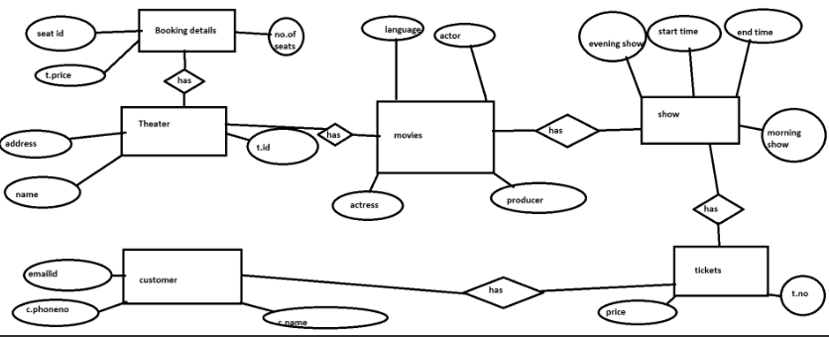
ER diagram

Slide 9
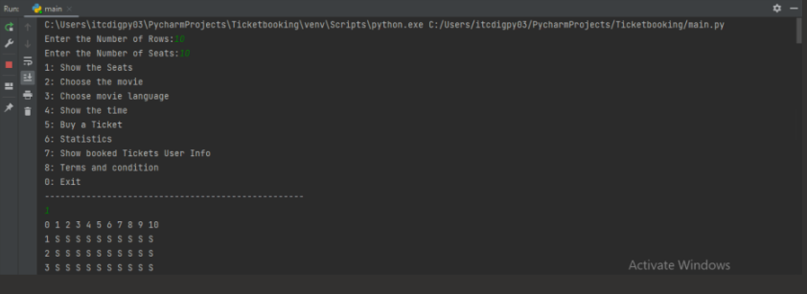
Output

Slide 10
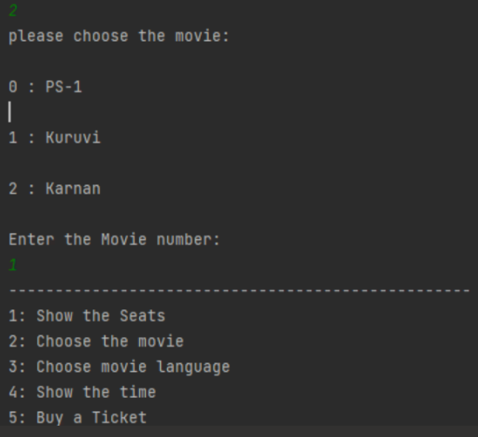

Slide 11
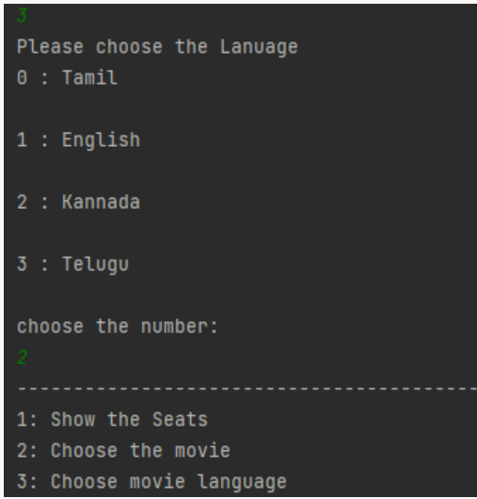

Slide 12
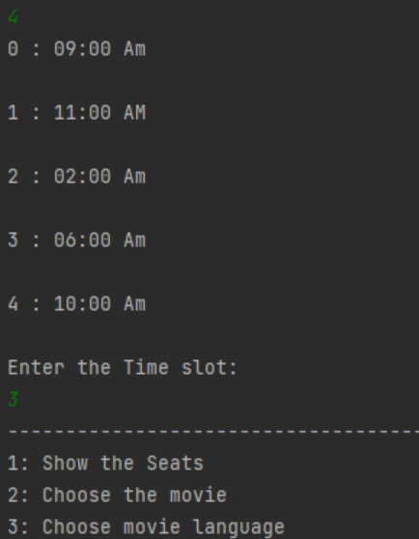
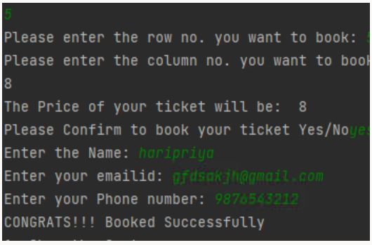

Slide 13
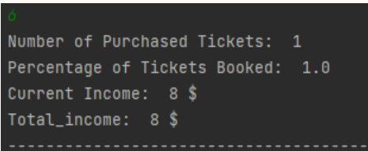
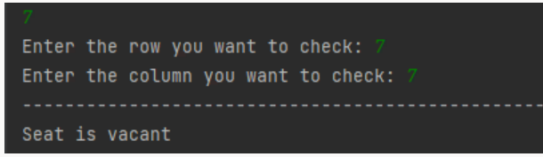
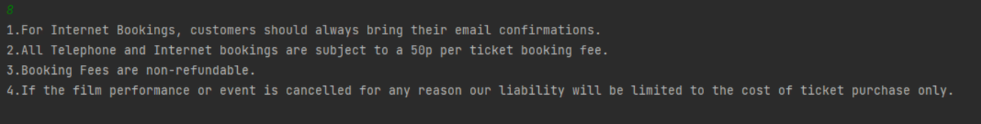

Slide 14
THANK YOU
Question and anwser??

