Slide 1
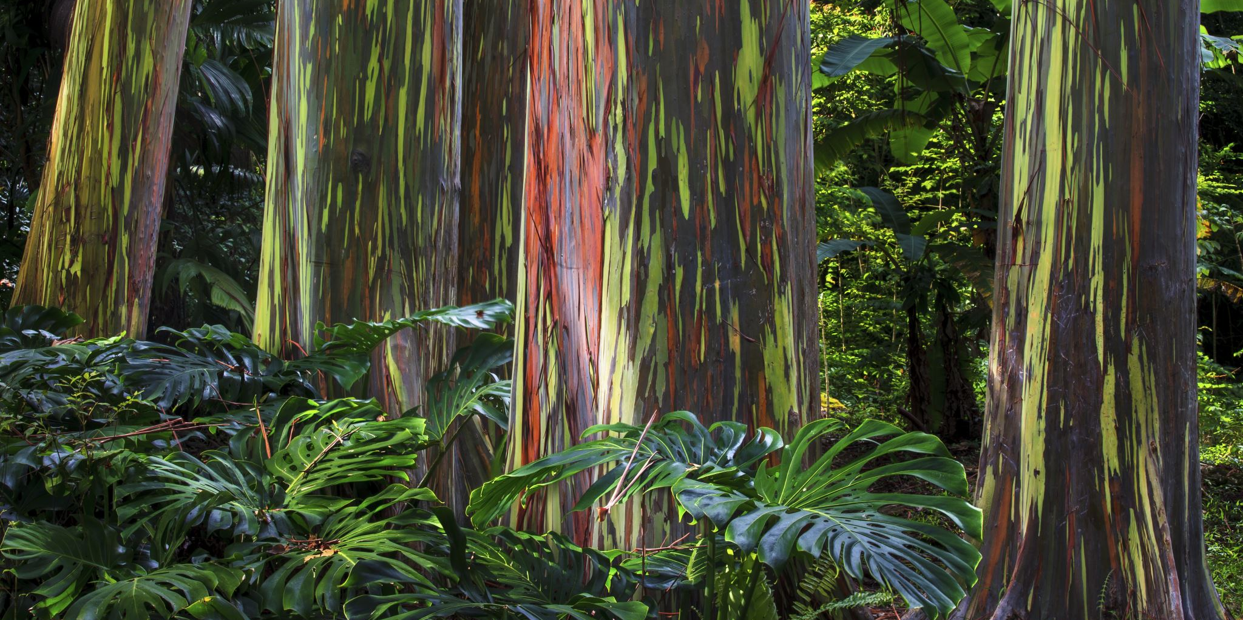
Gair Wood Environmental Monitoring Project
MSc Advanced Computer Science (Data Analytics)
Hiral Mahida
University of Leeds
July 2025

Slide 2

Project Overview
Aim: Analyze temperature and soil data from Gair Wood for environmental insights
Focus Areas:
- Soil type and location mapping
- Time-based temperature trends
- Probe comparison
- Weather effects
- Prediction and visualization in Power BI

Slide 3
Dataset Summary
Master Excel file: Probe ID, location, soil type
23 CSV files: Temperature logs per probe
Data Range: Various timestamps in 2024
Total Records: [To be updated after merging]

Slide 4
Data Cleaning and Preparation
Removed duplicate and missing records
Merged all probe files using Probe ID
Unified timestamp formats
Mapped metadata (e.g., soil type, location) from master sheet

Slide 5

Exploratory Data Analysis
Temperature variation by:
- Probe
- Soil Type
- Time (Hourly, Daily, Weekly)
Outlier detection and normalization
Visual trends in heat maps and line graphs

Slide 6

Soil & Habitat Analysis
Soil types: e.g., Sandy, Clay, Loamy
Habitat classification based on location
Relationship between soil type and temperature retention
Summary of patterns observed

Slide 7
Time & Weather Impact
Diurnal and seasonal variation
Weather temperature comparison
Prediction of temperature using linear regression

Slide 8
Probe Comparison
Details about Probe
Probe performance by location and soil
Similarity analysis: e.g., K-means

Slide 9
Power BI Dashboard
Interactive graphs (temperature trends, soil type filters)
Drill-through by probe
Predictive modeling & visual storytelling
Integrated map visuals

Slide 10
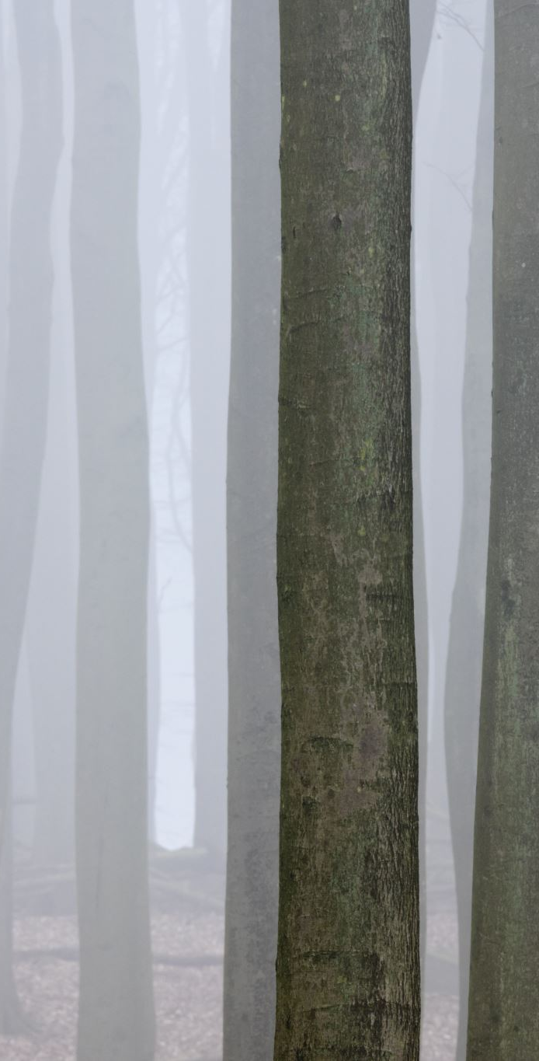
Conclusion & Future Work
Gair Wood shows varied thermal behavior based on soil and time
Cleaned and integrated dataset allows scalable monitoring
Future:
- Integrate weather API for real-time prediction
- Add soil moisture sensors
- Build automated alert systems

Slide 11

Thank YOu

