Slide 1
Publishing Linked Data from RDB (RDB2RDF)
Oscar Corcho, Freddy Priyatna,
Raúl García-Castro
Escuela Técnica Superior de Ingenieros Informáticos,
Universidad Politécnica de Madrid
Campus de Montegancedo sn, 28660 Boadilla del Monte, Madrid
http://www.oeg-upm.net/
{ocorcho,fpriyatna,rgarcia}@fi.upm.es
Acknowledgements: Some slides are taken from Juan Sequeda’s RDB2RDF tutorial at ISWC2013

Slide 2
Table of Contents
Introduction
Direct Mapping
R2RML
R2RML examples
Assignment

Slide 3

Linked Data generation process
Define resource naming strategy
Resource naming strategy
Select data source
Develop ontology
Ontology
Data source
Ontology
Obtain access to data source
Access, data
Analyse data source
Transform data source
Schema, data
RDF data
Analyse licensing of the data source
Link with other datasets
Linked dataset
License
Deliverable D4.1: Requirements and guidelines for energy data generation. Filip Radulovic, Raúl García-Castro, María Poveda-Villalón, Matthias Weise, Thanasis Tryferidis. READY4SmartCities technical report. May 2014

Slide 4
What is RDB2RDF?
Alice
25
Alice
Person
foaf:name
foaf:age
foaf:name
ID | NAME | AGE | CID
1 | Alice | 25 | 100
2 | Bob | NULL | 100
<Person/1>
<Person/2>
City
foaf:based_near
CID | NAME
100 | Austin
200 | Madrid
<City/100>
foaf:name
Austin
<City/200>
foaf:name
Madrid

Slide 5
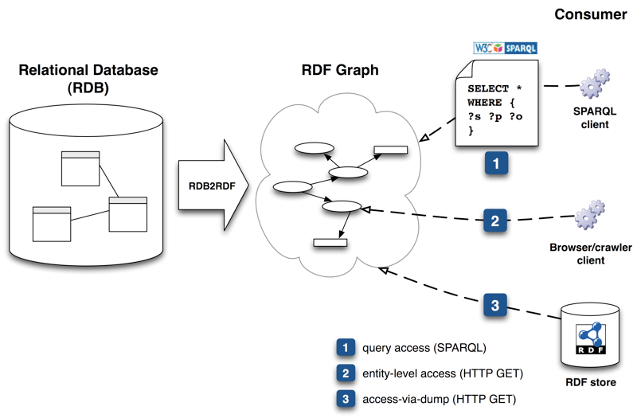
Why RDB2RDF?
A majority of dynamic Web content is backed by relational databases (RDB), and so are many enterprise systems

Slide 6
RDB2RDF Requirements
Core
Direct + transformative mappings
Generation of Globally Unique Identifiers (i.e., URIs)
Materialize RDF (ETL) + virtual RDF views (query translation)
Datatypes (inc. vendor specific)
Rename SQL column names
Apply functions before mapping
Exposing many-to-many join tables as simple triples
Creating classes based on attribute values
Optional
Named graphs, namespace declaration, static metadata (e.g., licensing, provenance )

Slide 7
RDB2RDF Scenarios
Scenario 1. Direct mapping
Quick solution to export RDF
Potentially good for large database schemas
Scenario 2. R2RML
Existing ontologies that allow interoperability with other sources
Mostly a manual effort

Slide 8

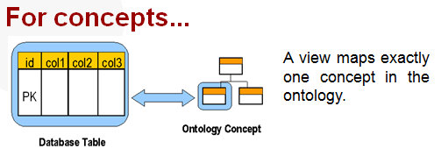
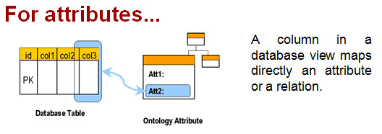
Scenario 1: Direct Mapping
Existing table and column names are encoded into URIs
Data is translated into RDF and loaded into an existing, Internet accessible triplestore
SPARQL
Relational
Database
Direct
Mapping
Engine
Triplestore
Extract
Transform
Load

Slide 9
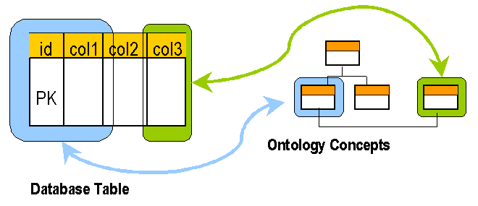
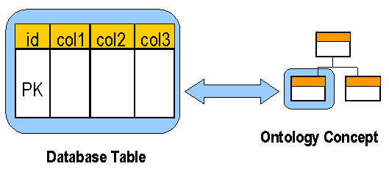
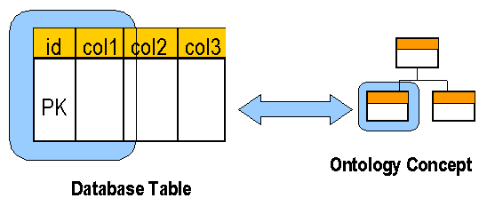
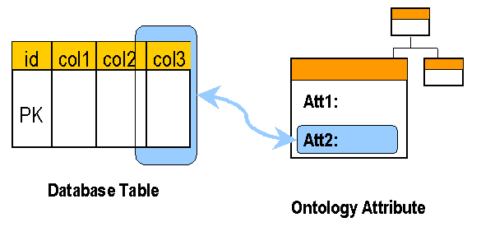
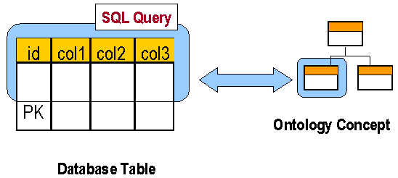
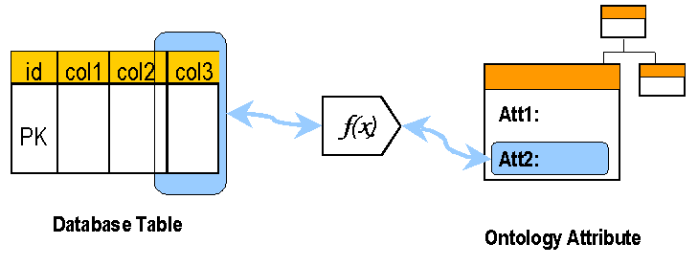
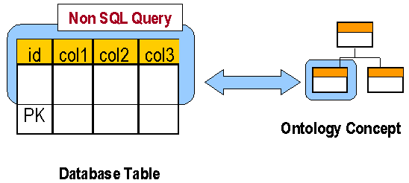
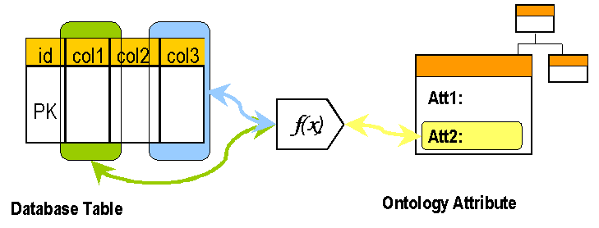
However, different mapping alternatives exist
For concepts...
One or more concepts can be extracted from a single data field (not in 1NF).
A view maps exactly one concept in the ontology.
For attributes...
A subset of the columns in the view maps a concept in the ontology.
A column in a database view maps directly an attribute or a relation.
A subset (selection) of the records of a database view maps a concept in the ontology.
A column in a database view maps an attribute or a relation after some transformation.
A subset of the records of a database view maps a concept in the ontology, but the selection cannot be made using SQL.
A set of columns in a database view map an attribute or a relation.

Slide 10


Scenario 2: R2RML
Domain Ontologies
(e.g. FOAF, etc.)
SPARQL
Relational
Database
R2RML
File
R2RML
Mapping
Engine
Triplestore
Extract
Transform
Load
www.rdb2rdf.org - ISWC2013

Slide 11
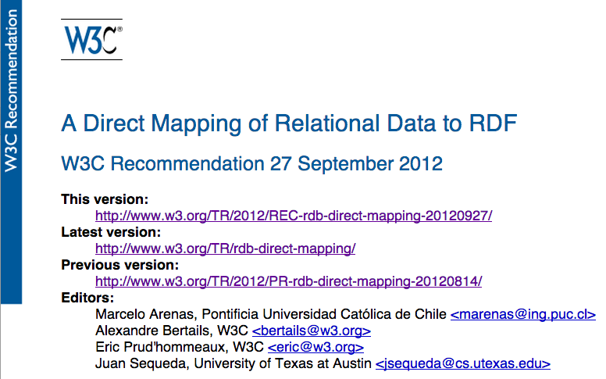
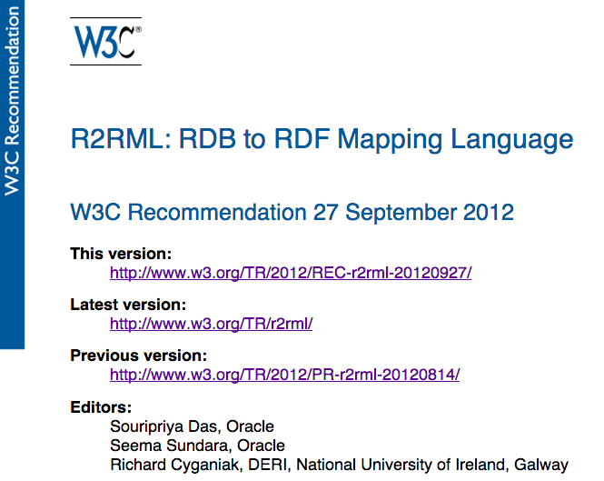
W3C RDB2RDF Standards
A Direct Mapping of Relational Data to RDF
Default automatic mapping of relational data to RDF
W3C Recommendation 27 September 2012
R2RML: RDB to RDF Mapping Language
Customizable language to map relational data to RDF
W3C Recommendation 27 September 2012
11

Slide 12
Table of Contents
Introduction
Direct Mapping
R2RML examples
R2RML examples
Assignment

Slide 13
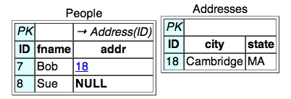
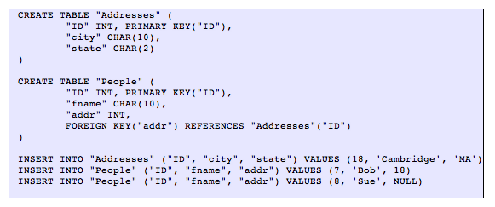
Direct Mapping
The direct mapping defines an RDF Graph representation of the data in an RDB
It takes as input an RDB (data and schema), and generates an RDF graph (called the direct graph)

Slide 14
Direct Mapping - example
For each row in every table:
<TABLENAME/PKCOLUMNNAME=CELLVALUE> rdf:type <TABLENAME>
<People/ID=7> rdf:type <People> .
<People/ID=7> <People#ID> 7 .
<People/ID=7> <People#fname> "Bob" .
<People/ID=7> <People#addr> 18 .
<People/ID=7> <People#ref-addr> <Addresses/ID=18> .
<People/ID=8> rdf:type <People> .
<People/ID=8> <People#ID> 8 .
<People/ID=8> <People#fname> "Sue" .
<Addresses/ID=18> rdf:type <Addresses> .
<Addresses/ID=18> <Addresses#ID> 18 .
<Addresses/ID=18> <Addresses#city> "Cambridge" .
<Addresses/ID=18> <Addresses#state> "MA" .
https://www.w3.org/TR/rdb-direct-mapping/

Slide 15
Direct Mapping - example
For every cell
<TABLENAME/COLUMNNAME=CELLVALUE> <TABLENAME#COLUMNNAME> <CELLVALUE>
<People/ID=7> rdf:type <People> .
<People/ID=7> <People#ID> 7 .
<People/ID=7> <People#fname> "Bob" .
<People/ID=7> <People#addr> 18 .
<People/ID=7> <People#ref-addr> <Addresses/ID=18> .
<People/ID=8> rdf:type <People> .
<People/ID=8> <People#ID> 8 .
<People/ID=8> <People#fname> "Sue" .
<Addresses/ID=18> rdf:type <Addresses> .
<Addresses/ID=18> <Addresses#ID> 18 .
<Addresses/ID=18> <Addresses#city> "Cambridge" .
<Addresses/ID=18> <Addresses#state> "MA" .

Slide 16
Direct Mapping - example
For every cell in the foreign key column
<TABLENAME/PKCOLUMNNAME=CELLVALUE> <TABLENAME#ref-COLUMNNAME> <REFTABLENAME/REFPKCOLUMNAME=CELLVALUE>
<People/ID=7> rdf:type <People> .
<People/ID=7> <People#ID> 7 .
<People/ID=7> <People#fname> "Bob" .
<People/ID=7> <People#addr> 18 .
<People/ID=7> <People#ref-addr> <Addresses/ID=18> .
<People/ID=8> rdf:type <People> .
<People/ID=8> <People#ID> 8 .
<People/ID=8> <People#fname> "Sue" .
<Addresses/ID=18> rdf:type <Addresses> .
<Addresses/ID=18> <Addresses#ID> 18 .
<Addresses/ID=18> <Addresses#city> "Cambridge" .
<Addresses/ID=18> <Addresses#state> "MA" .

Slide 17
Summary: Direct Mapping
Default and automatic mapping
URIs are automatically generated
<table>
<table#attribute>
<table#ref-attribute>
<Table#pkAttr=pkValue>
RDF represents the same relational schema

Slide 18
Table of Contents
Introduction
Direct Mapping
R2RML
R2RML examples
Assignment

Slide 19
W3C R2RML
Input
Database (schema and data)
Target ontologies
Mappings between the database and target ontologies in R2RML
Output
RDF graph
Domain Ontologies
(e.g. FOAF, etc.)
SPARQL
Relational
Database
R2RML
File
R2RML
Mapping
Engine
Triplestore
Extract
Transform
Load

Slide 20
Example Input & Desired Output
Example Input Database
EMP
DEPT
EMPNO | ENAME | JOB | DEPTNO
7369 | SMITH | CLERK | 10
DEPTNO | DNAME | LOC
10 | APPSERVER | NEW YORK
Desired RDF Output
<http://data.example.com/employee/7369> rdf:type ex:Employee.
<http://data.example.com/employee/7369> ex:name "SMITH".
<http://data.example.com/employee/7369> ex:department <http://data.example.com/department/10>.
<http://data.example.com/department/10> rdf:type ex:Department.
<http://data.example.com/department/10> ex:name "APPSERVER".
<http://data.example.com/department/10> ex:location "NEW YORK".

Slide 21
Triples Map
R2RML Mapping Document = a finite set of Triples Maps (rr:TriplesMap)
Specifies transformation rules from a logical table rows to RDF triples
MUST have exactly one rr:logicalTable property
Generates the same subject
MUST have exactly one rr:subjectMap property
MAY have zero or more rr:predicateObjectMap properties

Slide 22
Triples Map Example
@prefix rr: <http://www.w3.org/ns/r2rml#>.
@prefix ex: <http://example.com/ns#>.
<#TriplesMap1>
rr:logicalTable [ … ];
rr:subjectMap [ … ];
rr:predicateObjectMap [ … ];
rr:predicateObjectMap [ … ];
…
.
<#TriplesMap2>
rr:logicalTable [ … ];
rr:subjectMap [ … ];
rr:predicateObjectMap [ … ];
rr:predicateObjectMap [ … ];
…
.
EMP
EMPNO | ENAME | JOB | DEPTNO
7369 | SMITH | CLERK | 10
<http://data.example.com/employee/7369> rdf:type ex:Employee.
<http://data.example.com/employee/7369> ex:name "SMITH".
<http://data.example.com/employee/7369> ex:department
<http://data.example.com/department/10>.
DEPT
DEPTNO | DNAME | LOC
10 | APPSERVER | NEW YORK
<http://data.example.com/department/10> rdf:type ex:Department.
<http://data.example.com/department/10> ex:name "APPSERVER".
<http://data.example.com/department/10> ex:location "NEW YORK".

Slide 23
Logical Table
Triples Map
MUST have exactly one rr:logicalTable property
Logical table: tabular SQL query result that is to be mapped to RDF triples.
Either
Base Table or View (rr:table)
R2RML view (rr:query)

Slide 24
Logical Table: Example
EMP
<#TriplesMap1>
rr:logicalTable [ rr:tableName "EMP" ];
rr:subjectMap [ … ];
rr:predicateObjectMap [ … ];
rr:predicateObjectMap [ … ];
…
.
<#TriplesMap2>
rr:logicalTable [ rr:tableName "DEPT" ];
rr:subjectMap [ … ];
rr:predicateObjectMap [ … ];
rr:predicateObjectMap [ … ];
…
.
EMPNO | ENAME | JOB | DEPTNO
7369 | SMITH | CLERK | 10
<http://data.example.com/employee/7369> rdf:type ex:Employee.
<http://data.example.com/employee/7369> ex:name "SMITH".
<http://data.example.com/employee/7369> ex:department
<http://data.example.com/department/10>.
DEPT
DEPTNO | DNAME | LOC
10 | APPSERVER | NEW YORK
<http://data.example.com/department/10> rdf:type ex:Department.
<http://data.example.com/department/10> ex:name "APPSERVER".
<http://data.example.com/department/10> ex:location "NEW YORK“.

Slide 25
Subject Map and Predicate Map
Triples Map
MUST have exactly one rr:subjectMap property
MAY have zero or more rr:predicateObjectMap properties
Subject Map (rr:SubjectMap)
MAY have one or more rr:class properties
PredicateObjectMap (rr:PredicateObjectMap)
Predicate Map (rr:PredicateMap)
Object Map (rr:ObjectMap)

Slide 26
rr:class: Example
EMP
<#TriplesMap1>
rr:logicalTable [ rr:tableName "EMP" ];
rr:subjectMap [ …
rr:class ex:Employee;
];
rr:predicateObjectMap [
rr:predicateMap [ … ]
rr:objectMap [ … ]
];
…
.
<#TriplesMap2>
rr:logicalTable [ rr:tableName "DEPT" ];
rr:subjectMap [ …
rr:class ex:Department;
];
rr:predicateObjectMap [
rr:predicateMap [ … ]
rr:objectMap [ … ]
];
…
.
EMPNO | ENAME | JOB | DEPTNO
7369 | SMITH | CLERK | 10
<http://data.example.com/employee/7369> rdf:type ex:Employee.
<http://data.example.com/employee/7369> ex:name "SMITH".
<http://data.example.com/employee/7369> ex:department
<http://data.example.com/department/10>.
DEPT
DEPTNO | DNAME | LOC
10 | APPSERVER | NEW YORK
<http://data.example.com/department/10> rdf:type ex:Department.
<http://data.example.com/department/10> ex:name "APPSERVER".
<http://data.example.com/department/10> ex:location "NEW YORK".

Slide 27
Term Map
RDF Term
IRI
Literal
Blank Node
Term Map (rr:TermMap): a function that generates an RDF term from a logical table row.
Where to use?
Subject Map
Predicate Map
Object Map
How to generate?
Constant
Column
Template
What type?
IRI
Literal
Blank Node

Slide 28
Subject Map: Example
EMP
<#TriplesMap1>
rr:logicalTable [ rr:tableName "EMP" ];
rr:subjectMap [
rr:template “http://data.example.com/employee/{EMPNO}”;
rr:termType rr:IRI; rr:class ex:Employee
];
rr:predicateObjectMap [
rr:predicateMap [ … ] rr:objectMap [ … ]
];
…
.
EMPNO | ENAME | JOB | DEPTNO
7369 | SMITH | CLERK | 10
<http://data.example.com/employee/7369> rdf:type ex:Employee.
<http://data.example.com/employee/7369> ex:name "SMITH".
<http://data.example.com/employee/7369> ex:department <http://data.example.com/department/10>.
<#TriplesMap2>
rr:logicalTable [ rr:tableName "DEPT" ];
rr:subjectMap [
rr:template “http://data.example.com/department/{DEPTNO}”;
rr:termType rr:IRI; rr:class ex:Department
];
rr:predicateObjectMap [
rr:predicateMap [ … ] rr:objectMap [ … ]
];
…
.
DEPT
DEPTNO | DNAME | LOC
10 | APPSERVER | NEW YORK
<http://data.example.com/department/10> rdf:type ex:Department.
<http://data.example.com/department/10> ex:name "APPSERVER".
<http://data.example.com/department/10> ex:location "NEW YORK".

Slide 29
Predicate Object Map: Example(1)
<#TriplesMap1>
rr:logicalTable [ rr:tableName "EMP" ];
rr:subjectMap [
rr:template “http://data.example.com/employee/{EMPNO}”;
rr:termType rr:IRI; rr:class ex:Employee;
];
rr:predicateObjectMap [
rr:predicateMap [ rr:constant ex:name; rr:termType rr:IRI ]
rr:objectMap [ rr:column “ENAME”; rr:termType rr:Literal ]
];
…
.
EMP
EMPNO | ENAME | JOB | DEPTNO
7369 | SMITH | CLERK | 10
<http://data.example.com/employee/7369> rdf:type ex:Employee.
<http://data.example.com/employee/7369> ex:name "SMITH".
<http://data.example.com/employee/7369> ex:department <http://data.example.com/department/10>.

Slide 30
Predicate Object Map: Example (2)
<#TriplesMap2>
rr:logicalTable [ rr:tableName "DEPT" ];
rr:subjectMap [
rr:template “http://data.example.com/employee/{DEPTNO}”;
rr:termType rr:IRI; rr:class ex:Department;
];
rr:predicateObjectMap [
rr:predicateMap [ rr:constant ex:name; rr:termType rr:IRI ]
rr:objectMap [ rr:column “DNAME”; rr:termType rr:Literal ]
];
rr:predicateObjectMap [
rr:predicateMap [ rr:constant ex:location; rr:termType rr:IRI ]
rr:objectMap [ rr:column “LOC”; rr:termType rr:Literal ]
];
.
DEPT
DEPTNO | DNAME | LOC
10 | APPSERVER | NEW YORK
<http://data.example.com/department/10> rdf:type ex:Department.
<http://data.example.com/department/10> ex:name "APPSERVER".
<http://data.example.com/department/10> ex:location "NEW YORK".

Slide 31
Almost There
Example Input Database
EMP
DEPT
EMPNO | ENAME | JOB | DEPTNO
7369 | SMITH | CLERK | 10
DEPTNO | DNAME | LOC
10 | APPSERVER | NEW YORK
Desired RDF Output
<http://data.example.com/employee/7369> rdf:type ex:Employee.
<http://data.example.com/employee/7369> ex:name "SMITH".
<http://data.example.com/employee/7369> ex:department <http://data.example.com/department/10>.
<http://data.example.com/department/10> rdf:type ex:Department.
<http://data.example.com/department/10> ex:name "APPSERVER".
<http://data.example.com/department/10> ex:location "NEW YORK".

Slide 32
RefObjectMap
Using subjects of another triples map as the value for objects
join between logical tables
rr:RefObjectMap
has exactly one rr:parentTriplesMap property
MAY have one or more rr:joinCondition properties
rr:child
rr:parent

Slide 33
RefObjectMap: Example
<#TriplesMap1>
rr:logicalTable [ rr:tableName "EMP" ];
rr:subjectMap [
rr:template “http://data.example.com/employee/{EMPNO}”;
rr:termType rr:IRI; rr:class ex:Employee
];
rr:predicateObjectMap [
rr:predicateMap [
rr:constant ex:department; rr:termType rr:IRI
]
rr:objectMap [
rr:parentTriplesMap <#TriplesMap2>;
rr:joinCondition [
rr:child "DEPTID"; rr:parent "DEPTNO";
];
]
];
…
.
EMP
EMPNO | ENAME | JOB | DEPTID
7369 | SMITH | CLERK | 10
<http://data.example.com/employee/7369> rdf:type ex:Employee.
<http://data.example.com/employee/7369> ex:name "SMITH".
<http://data.example.com/employee/7369> ex:department
<http://data.example.com/department/10>.
DEPT
<#TriplesMap2>
rr:logicalTable [ rr:tableName "DEPT" ];
rr:subjectMap [
rr:template “http://data.example.com/department/{DEPTNO}”;
rr:termType rr:IRI; rr:class ex:Department
];
rr:predicateObjectMap [
rr:predicateMap [ … ] rr:objectMap [ … ]
];
…
.
DEPTNO | DNAME | LOC
10 | APPSERVER | NEW YORK
<http://data.example.com/department/10> rdf:type ex:Department.
<http://data.example.com/department/10> ex:name "APPSERVER".
<http://data.example.com/department/10> ex:location "NEW YORK“.

Slide 34
Complete Mappings
EMP
<#TriplesMap1>
rr:logicalTable [ rr:tableName "EMP" ];
rr:subjectMap [
rr:template “http://data.example.com/employee/{EMPNO}”;
rr:termType rr:IRI; rr:class ex:Employee; ];
rr:predicateObjectMap [
rr:predicateMap [ rr:constant ex:name; rr:termType rr:IRI ]
rr:objectMap [ rr:column “ENAME”; rr:termType rr:Literal ] ];
rr:predicateObjectMap [
rr:predicateMap [ rr:constant ex:department; rr:termType rr:IRI ]
rr:objectMap [
rr:parentTriplesMap <#TriplesMap2>;
rr:joinCondition [ rr:child "DEPTID"; rr:parent "DEPTNO"; ];
]
];.
EMPNO | ENAME | JOB | DEPTID
7369 | SMITH | CLERK | 10
<http://data.example.com/employee/7369> rdf:type
ex:Employee.
<http://data.example.com/employee/7369> ex:name "SMITH".
<http://data.example.com/employee/7369> ex:department
<http://data.example.com/department/10>.
DEPT
DEPTNO | DNAME | LOC
10 | APPSERVER | NEW YORK
<#TriplesMap2>
rr:logicalTable [ rr:tableName "DEPT" ];
rr:subjectMap [
rr:template “http://data.example.com/employee/{DEPTNO}”;
rr:termType rr:IRI; rr:class ex:Department; ];
rr:predicateObjectMap [
rr:predicateMap [ rr:constant ex:name; rr:termType rr:IRI ]
rr:objectMap [ rr:column “DNAME”; rr:termType rr:Literal ] ];
rr:predicateObjectMap [
rr:predicateMap [ rr:constant ex:location; rr:termType rr:IRI ]
rr:objectMap [ rr:column “LOC”; rr:termType rr:Literal ]
]; .
<http://data.example.com/department/10> rdf:type
ex:Department.
<http://data.example.com/department/10> ex:name
"APPSERVER".
<http://data.example.com/department/10> ex:location
"NEW YORK".

Slide 35
Table of Contents
Introduction
Direct Mapping
R2RML
R2RML examples
Assignment

Slide 36
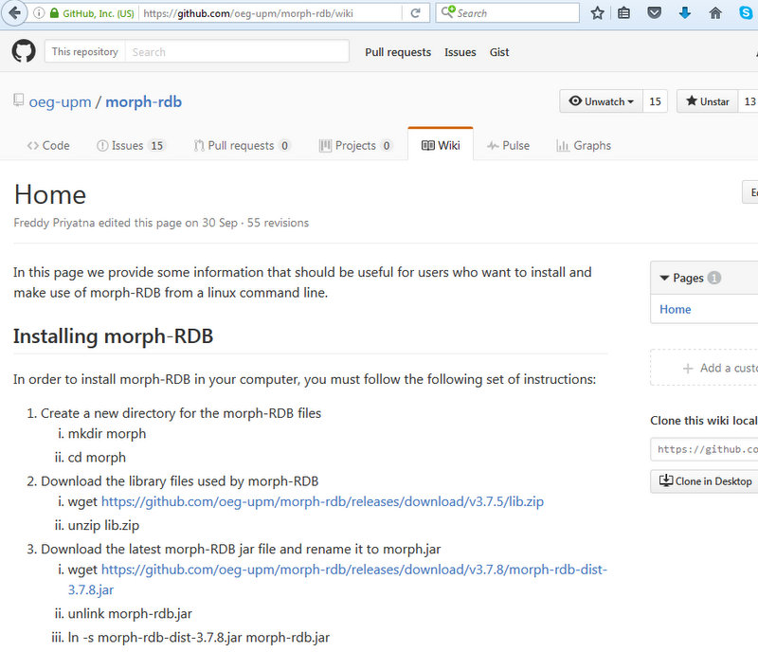
Installing morph-RDB
https://github.com/oeg-upm/morph-rdb/wiki

Slide 37
Running examples with CSV/RDB

Slide 38
Table of Contents
Introduction
Direct Mapping
R2RML
R2RML examples
Assignment

Slide 39
Assignment
https://goo.gl/forms/ewFN0EVkNCF8p6k42

Slide 40

Questions?

