Slide 1
Deep Learning in Microsoft with CNTK
S6843
Alexey Kamenev
Microsoft Research

Slide 2







Deep Learning in the company
Bing
Cortana
Ads
Relevance
Multimedia
…
Skype
HoloLens
Research
Speech, image, text

Slide 3
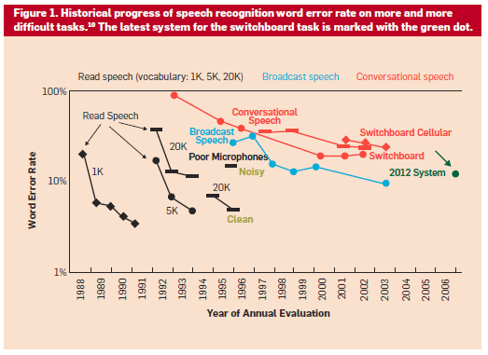
2015 System
Human Error Rate 4%

Slide 4
ImageNet: Microsoft 2015 ResNet
Microsoft had all 5 entries being the 1-st places this year: ImageNet classification, ImageNet localization, ImageNet detection, COCO detection, and COCO segmentation

Slide 5
CNTK Overview
A deep learning tool that balances
Efficiency: Can train production systems as fast as possible
Performance: Can achieve state-of-the-art performance on benchmark tasks and production systems
Flexibility: Can support various tasks such as speech, image, and text, and can try out new ideas quickly
Inspiration: Legos
Each brick is very simple and performs a specific function
Create arbitrary objects by combining many bricks
CNTK enables the creation of existing and novel models by combining simple functions in arbitrary ways.
Historical facts:
Created by Microsoft Speech researchers (Dong Yu et al.) 4 years ago
Was quickly extended to handle other workloads (image/text)
Open-sourced (CodePlex) in early 2015
Moved to GitHub in Jan 2016

Slide 6
Functionality
Supports
CPU and GPU with a focus on GPU Cluster
GPU (CUDA): uses NVIDIA libraries, including cuDNN v5.
Windows and Linux
automatic numerical differentiation
efficient static and recurrent network training through batching
data parallelization within and across machines with 1-bit quantized SGD
memory sharing during execution planning
Modularized: separation of
computational networks
execution engine
learning algorithms
model description
data readers
Models can be described and modified with
Network definition language (NDL) and model editing language (MEL)
Python, C++ and C# (in progress)

Slide 7
CNTK Architecture
CPU/GPU
IExecutionEngine
CN Description
Builder Lambda
CN
Use
Build
Evaluate
Compute Gradient
Features & Labels
IDataReader
ILearner
Load
Get data
Task-specific reader
SGD, AdaGrad, etc.

Slide 8
Main Operations
Train a model with the train command
Evaluate a model with the eval command
Edit models (e.g., add nodes, remove nodes, change the flag of a node) with the edit command
Write outputs of one or more nodes in the model to files with the write command
Finer operation can be controlled through script languages (beta)

Slide 9
At the Heart: Computational Networks
A generalization of machine learning models that can be described as a series of computational steps.
E.g., DNN, CNN, RNN, LSTM, DSSM, Log-linear model
Representation:
A list of computational nodes denoted as
n = {node name : operation name}
The parent-children relationship describing the operands
{n : c₁, · · · , c_{Kn} }
Kn is the number of children of node n. For leaf nodes Kn = 0.
Order of the children matters: e.g., XY is different from YX
Given the inputs (operands) the value of the node can be computed.
Can flexibly describe deep learning models.
Adopted by many other popular tools as well

Slide 10
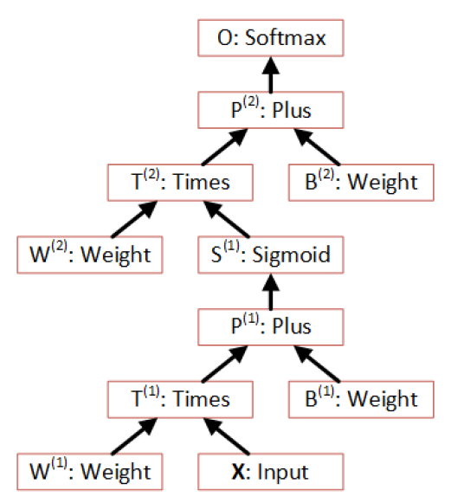
Example: One Hidden Layer NN
O
Output
Layer
Softmax
P⁽²⁾
W⁽²⁾, b⁽²⁾
S⁽¹⁾
Hidden
Layer
Sigmoid
P⁽¹⁾
W⁽¹⁾, b⁽¹⁾
X

Slide 11
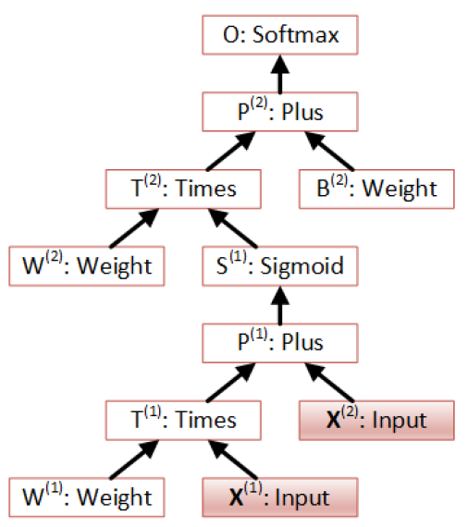
Example: CN with Multiple Inputs

Slide 12
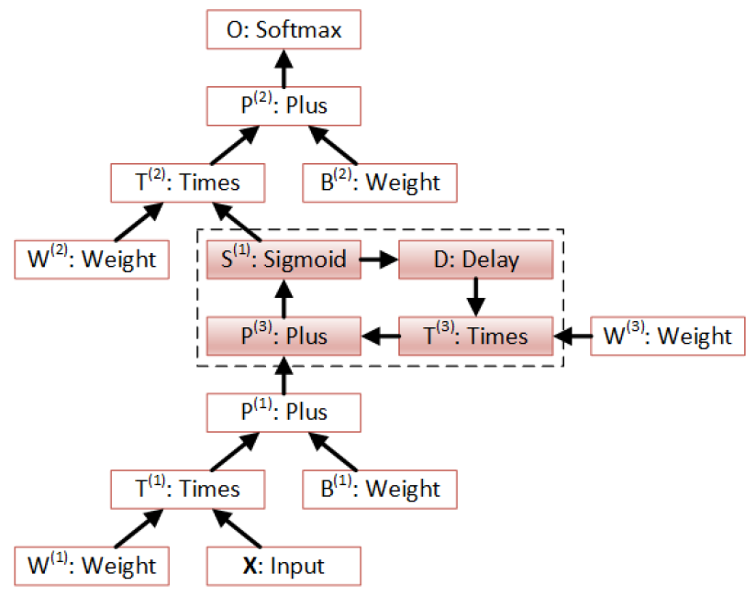
Example: CN with Recurrence

Slide 13
Usage Example (with Config File)
cntk configFile=yourConfigFile DeviceNumber=1
command=Train:Test
Train=[
action = "train"
deviceId=$DeviceNumber$
modelPath=“$your_model_path$
NDLNetworkBuilder=[…]
SGD=[…]
reader=[…]
]
String Replacement
CPU: CPU
GPU: >=0 or auto
You can also use C++, Python and C# (work in progress) to directly instantiate related objects.

Slide 14
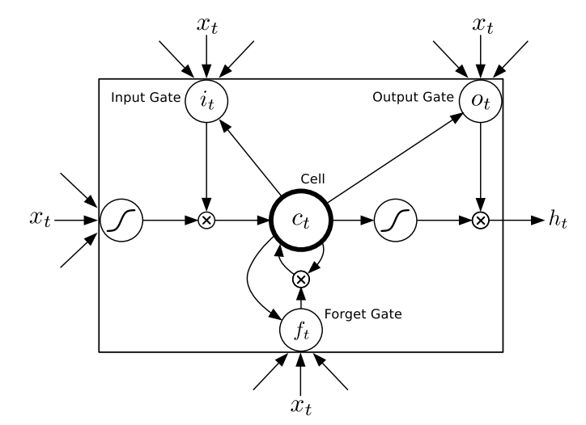
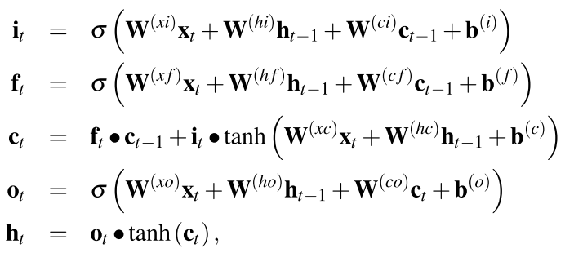
Network Definition with NDL (LSTM)

Slide 15
Network Definition with NDL
LSTMComponent(inputDim, outputDim, inputVal) = [
Wxo = Parameter(outputDim, inputDim)
Wxi = Parameter(outputDim, inputDim)
Wxf = Parameter(outputDim, inputDim)
Wxc = Parameter(outputDim, inputDim)
bo = Parameter(outputDim, 1, init=fixedvalue, value=-1.0)
bc = Parameter(outputDim, 1, init=fixedvalue, value=0.0)
bi = Parameter(outputDim, 1, init=fixedvalue, value=-1.0)
bf = Parameter(outputDim, 1, init=fixedvalue, value=-1.0)
Whi = Parameter(outputDim, outputDim)
Wci = Parameter(outputDim , 1)
Whf = Parameter(outputDim, outputDim)
Wcf = Parameter(outputDim , 1)
Who = Parameter(outputDim, outputDim)
Wco = Parameter(outputDim , 1)
Whc = Parameter(outputDim, outputDim)
Wrapped as a macro and can be reused
parameters

Slide 16
Network Definition with NDL
delayH = PastValue(outputDim, output, timeStep=1)
delayC = PastValue(outputDim, ct, timeStep=1)
WxiInput = Times(Wxi, inputVal)
WhidelayHI = Times(Whi, delayH)
WcidelayCI = DiagTimes(Wci, delayC)
it = Sigmoid (Plus ( Plus (Plus (WxiInput, bi), WhidelayHI),
WcidelayCI))
WhfdelayHF = Times(Whf, delayH)
WcfdelayCF = DiagTimes(Wcf, delayC)
Wxfinput = Times(Wxf, inputVal)
ft = Sigmoid( Plus (Plus (Plus(Wxfinput, bf), WhfdelayHF),
WcfdelayCF))
recurrent nodes
(use FutureValue to build BLSTM)

Slide 17
Network Definition with NDL
Convolutions (2D and ND)
Simple Syntax for 2D convolutions:
ConvReLULayer(inp, outMap, inWCount, kW, kH, hStride, vStride, wScale, bValue)
[
W = LearnableParameter(outMap, inWCount, init = Gaussian, initValueScale = wScale)
b = ImageParameter(1, 1, outMap, init = fixedValue, value = bValue)
c = Convolution(W, inp, kW, kH, outMap, hStride, vStride, zeroPadding = true)
p = Plus(c, b)
y = RectifiedLinear(p)
]
# conv2
kW2 = 5
kH2 = 5
map2 = 32
hStride2 = 1
vStride2 = 1
conv2 = ConvReLULayer(pool1, map2, 800, kW2, kH2, hStride2, vStride2, conv2WScale, conv2BValue)
Reusable macro
Macro usage

Slide 18
Network Definition with NDL
Powerful syntax for ND convolutions:
Convolution(w, input,
{kernel dimensions},
mapCount = {map dimensions},
stride = {stride dimensions},
sharing = {sharing},
autoPadding = {padding (boolean)},
lowerPad = {lower padding (int)},
upperPad = {upper padding (int)})
ConvLocalReLULayer(inp, outMap, outWCount, inMap, inWCount, kW, kH, hStride, vStride, wScale, bValue)
[
W = LearnableParameter(outWCount, inWCount, init = Gaussian, initValueScale = wScale)
b = ImageParameter(1, 1, outMap, init = fixedValue, value = bValue)
c = Convolution(W, inp,
{kW, kH, inMap},
mapCount = outMap,
stride = {hStride, vStride, inMap},
sharing = {false, false, false})
p = Plus(c, b)
y = RectifiedLinear(p)
]
Sharing is disabled – enables locally connected convolutions

Slide 19
Network Definition with NDL
Same engine and syntax for pooling:
Pooling(input, poolKind
{kernel dimensions},
stride = {stride dimensions},
autoPadding = {padding (boolean)},
lowerPad = {lower padding (int)},
upperPad = {upper padding (int)})
MaxoutLayer(inp, kW, kH, kC, hStride, vStride, cStride)
[
c = Pooling(inp, “max”,
{kW, kH, kC},
stride = {hStride, vStride, cStride})
]
Pool and stride in any way you like

Slide 20
Model Editing with MEL
Insert a new layer (e.g., for discriminative pretraining)
CE.S=Softmax(CE.P)
CE.P=Plus(CE.T,bO)
CE.T=Times(WO*L2.S)
MODIFY
MEL
L2.S=Sigmoid(L2.P)
L2.P=Plus(L2.T,bO)
L2.T=Times(W2,L1.S)
CREATE
CE.S=Softmax(CE.P)
CE.P=Plus(CE.T,bO)
CE.T=Times(WO,L1.S)
L1.S=Sigmoid(CE.P)
L1.P=Plus(L1.T,b1)
L1.T=Times(W1,X)
L1.S=Sigmoid(CE.P)
L1.P=Plus(L1.T,b1)
L1.T=Times(W1,X)
X
X

Slide 21
Computation: Without Loops
Given the root node, the computation order can be determined by a depth-first traverse of the directed acyclic graph (DAG).
Only need to run it once and cache the order
Can easily parallelize on the whole minibatch to speed up computation

Slide 22

With Loops (Recurrent Connections)
Very important in many interesting models
Implemented with Delay (PastValue or FutureValue) node
Naive solution:
Unroll whole graph over time
Compute sample by sample

Slide 23
With Loops (Recurrent Connections)
We developed a smart algorithm to analyze the computational network so that we can
Find loops in arbitrary computational networks
Do whole minibatch computation on everything except nodes inside loops
Group multiple sequences with variable lengths (better convergence property than tools that only support batching of same length sequences)
Users just describe computation steps. Speed up is automatic

Slide 24
Data Parallelization: 1-Bit Quantized SGD
Bottleneck for distributed learning: Communication cost
Solution: reduce the amount of data need to be communicated by quantizing gradients to just 1 bit
It’s a lot safer to quantize gradients than model parameters and outputs (gradients are small and noisy anyway)
Carry quantization residue to next minibatch (important)
Further hide communication with double-buffering: send one while processing the other
Use an O(1) communication scheduler to sync gradients
Increase minibatch size to fully utilize each GPU as early as possible
1-Bit Stochastic Gradient Descent and its Application to Data-Parallel Distributed Training of Speech DNNs, InterSpeech 2014, F. Seide, H. Fu, J. Droppo, G. Li, D. Yu

Slide 25
O(1) Aggregation
1
1
1
2
2
2
3
3
3
1+3
1
1
2
1+2
2
3
3
2+3
1+2+3
1
1
2
1+2+3
2
3
3
3+2+1

Slide 26
CNTK = Cinderella NTK?
CNTK Computational Performance

Slide 27
Memory Sharing
Use same memory across minibatches: don’t destroy and reallocate memory at each minibatch.
Share memory across computation nodes when possible
Analyze the execution plan and release the memory to a pool to be reused by other nodes or computation if possible
E.g., when a node finished computing all its children’s gradients, the matrices owned by that node can all be released.
Can reduce memory by 1/3 to 1/2 for training in most cases
Can reduce memory even more if gradients are not needed.

Slide 28
CNTK 2.0
CNTK as a library
C++, Python and .NET bindings
Allows creation of new nodes as well as new network types
Sequence-to-Sequence with attention models
Blockwise Model Update Filtering (BMUF) (1)
Reinforcement Learning
Performance improvements
(1) Kai Chen and Qiang Huo, “Scalable training of deep learning machines by incremental block training with intra-block parallel optimization and blockwise model-update filtering”,
in Internal Conference on Acoustics, Speech and Signal Processing , March 2016, Shanghai, China.

Slide 29
Summary
CNTK is a powerful tool that supports CPU/GPU and runs under Windows/Linux
CNTK is extensible with the low-coupling modular design: adding new readers and new computation nodes is easy with a new reader design
Network definition language, macros, and model editing language (as well as Python and C++ bindings in the future) makes network design and modification easy
Compared to other tools CNTK has a great balance between efficiency, performance, and flexibility

Slide 30
Azure GPU Lab (Project Philly) - Coming
High performance deep learning platform on Azure
Scalable to hundreds of NVIDIA GPUs
Rapid, no-hassle, deep learning experimentation
Larger models and training data sets
Multitenant
Fault tolerant
Open source friendly
CNTK optimized
3rd party accessible (coming)
The project has been running internally for 6+ months with great success

Slide 31

Project Philly Architecture
Job submit job monitor
Node0 GPU0,1,2,3
Node1 GPU0,1,2,3
Node2 GPU1
Node2 GPU2
…
Web
Portal
CNTK
CNTK
CNTK
CNTK
Data Ingress / Egress
JobA User0
JobA User0
JobB User1
JobC User2
REST API
Docker (Ubuntu Distribution)
Samba
YARN (Job/Container Scheduling, Resource Management)
FUSE
HDFS (Distributed Storage)
CoreOS

Slide 32
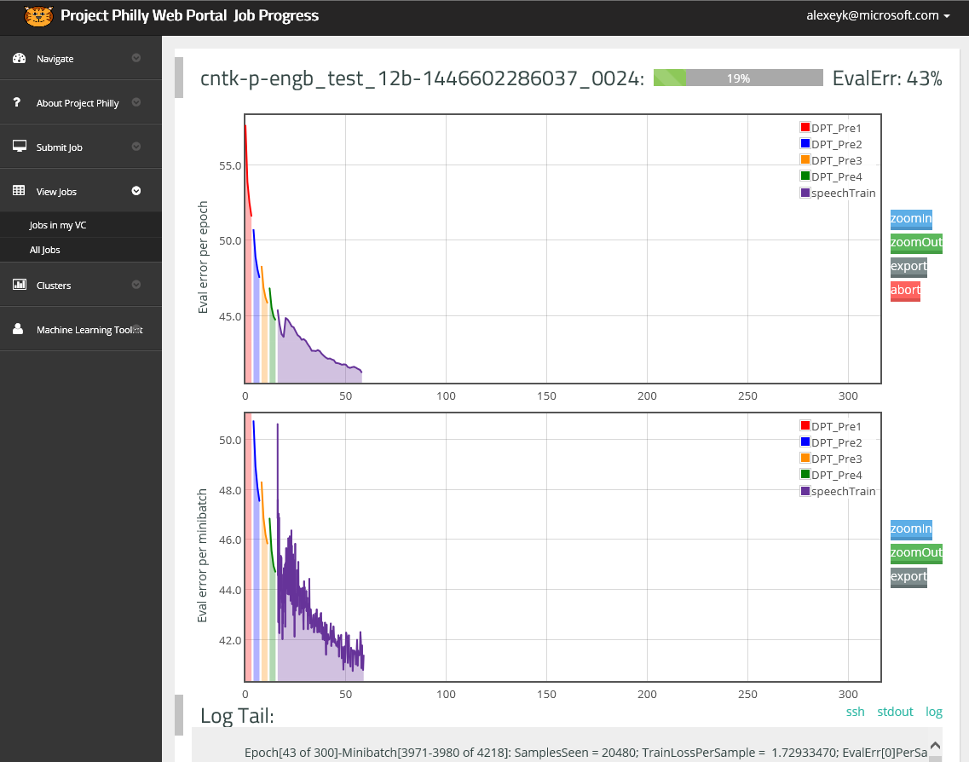
Project Philly Job Monitoring

Slide 33
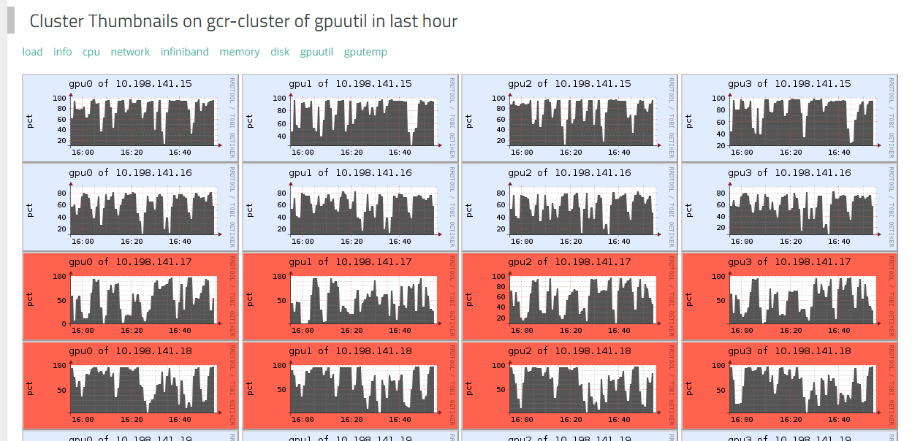
Project Philly Cluster Monitoring

Slide 34

Additional Resources
CNTK:
https://github.com/Microsoft/CNTK
Contains all the source code and example setups
You may understand better how CNTK works by reading the source code
New features are added constantly
How to contact:
CNTK team: ask a question on CNTK GitHub!
Alexey:
Email: alexey.kamenev@microsoft.com
: https://www.linkedin.com/in/alexeykamenev

