Slide 1
Machine Learning
Project Name: Grocery Demand Forecasting
Supervisor: Mr. Vu Quang Huy
Students:
Vuong Van Hau – 15110044
Nguyen Duc Thinh - 15110132

Slide 2
Forecasting
Forecasting is the process of predicting the future
The forecast is the basis for business decisions involving
. Financial . Production . Inventory . Personnel . Facilities
Sales will be $200 million!

Slide 3
How do you decide what to produce when you don’t know what your customers will buy?
Marshall L. Fisher, The Wharton School, University of Pennsylvania

Slide 4

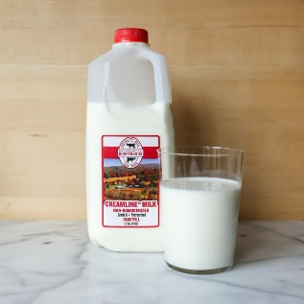
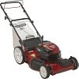
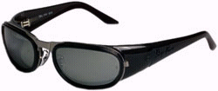





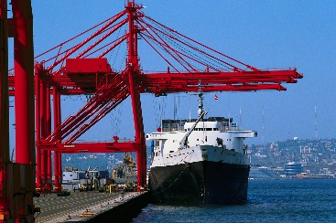


Products differ
Supply Chains and Strategies differ
Raw Materials
Component Suppliers
Manufacturer
Retailers
Consumers
Factories in ASIA
DC in US
Marshall L. Fisher, The Wharton School, University of Pennsylvania

Slide 5
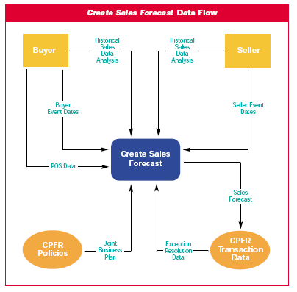
Forecasting is a collaborative effort
Gale Weisenfeld, VP, Planning / MIO, Federated Department Stores

Slide 6
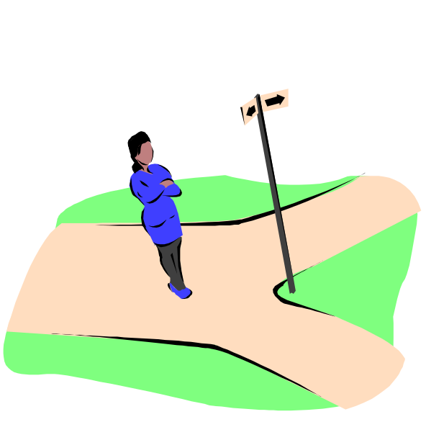
Forecasting Facts
There a several facts that are true about forecasting.
. Those businesses that adopt a forecasting discipline do better than those who do not . Of those that forecast, those who do it “better” are typically more successful . Forecasting provides direction for an organization detailed functional activities
There is an old saying “if you do not know where you are going then any road you take will get you there”. Forecasting provides a road for each functional area of the organization to follow.

Slide 7
Functional Areas and Forecasting
Organization
Finance
Operations
Marketing
Determines the revenue to be generated and the operating costs associated with the schedules to produce a financial P/(L) forecast for stock holders, bankers, and executive management
Warehousing can plan staffing for stocking/shipping
Production looks at demand and on-hand inventory to develop a schedule and determine capacity requirements to meet demand and maintain safety stock
Purchasing can use the schedule to notify suppliers of dates raw materials are needed
Initiates the forecast in $ or units (typically)
Manages the forecasting process

Slide 8
Features Common to Forecasts
. Unattended computer forecasts are usually not as good as computer forecasts that incorporate qualitative insights
. Forecasts are rarely (if ever) correct … one of the objectives of forecasting is to be the “least” wrong
. Forecasts are more accurate if developed at the group rather than the item level (Consider a Hanes underwear style with 4 sizes and 6 colors … the style can be forecasted more accurately than the 24 individual items that make up the style)
. Forecast accuracy is greatest for periods closer to the time the forecast is developed

Slide 9
Elements of a Good Forecast
. A discipline (each time period)
. Timely
. Accurate . Based on a reliable methodology which is simple to understand and relatively easy to use . Published so that all functional areas affected by the forecast can utilize the information (Can you think of an area of an organization that would never have the need for a forecast?) . Meaningful sot that it can be utilized efficiently and effectively
Timely
Reliable
Accurate
Meaningful
Written
Easy to use

Slide 10

Steps in the Forecasting Process
. Determine the purpose of the forecast (long range planning, new product introduction, day to day operations) . Establish a time horizon which the forecast will cover (remember that forecast accuracy diminishes over time)
. Gather historical demand data and select a methodology (usually a combination of statistical/mathematical, computer and qualitative insight) . Prepare the forecast . Monitor the forecast
“Forecast”
Step 6 Monitor the forecast
Step 5 Prepare the forecast
Step 4 Gather and analyze data
Step 3 Select a forecasting technique
Step 2 Establish a time horizon
Step 1 Determine purpose of forecast

Slide 11
A Flowchart of the Forecasting Process
Identify the purpose of the forecast
Collect historical demand data
Plot data and identify patterns
Select a forecast methodology
Develop forecast for period of historical data
Check forecast accuracy
Make adjustments to model … chose new one if necessary
Is accuracy of forecast acceptable?
Monitor results and measure forecast accuracy
Develop forecast for the planning horizon
Adjust the forecast based on qualitative insights

Slide 12
Forecasting Methodologies
. Qualitative (subjective insights, management, sales and marketing staff etc)
. Quantitative (Mathematical/Statistical Methods) .. Averaging/Smoothing Techniques
.. Time Series Techniques .. Associative Techniques
The methodology selected depends . on the purpose of the forecast (the quantitative sophistication required usually decreases as the horizon increases) . on the amount of data (number of products to be forecasted)

Slide 13
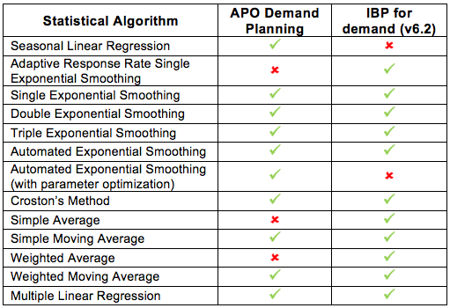
Forecasting Methodologies

Slide 14
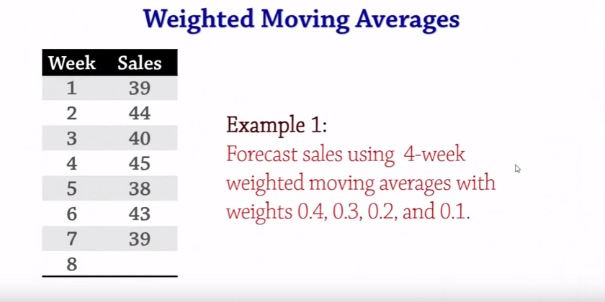
Forecasting Methodologies

Slide 15
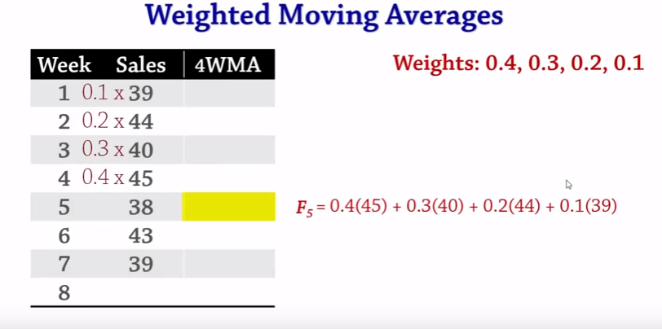
Forecasting Methodologies

Slide 16
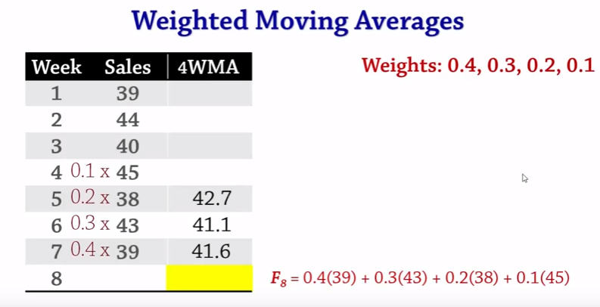
Forecasting Methodologies

Slide 17
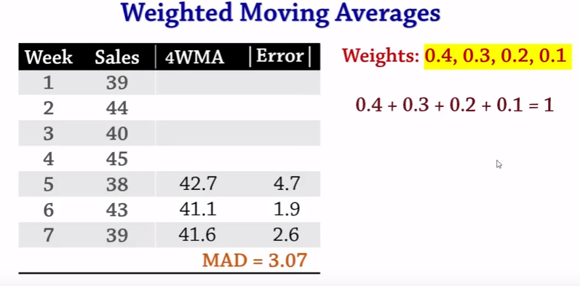
Forecasting Methodologies

Slide 18
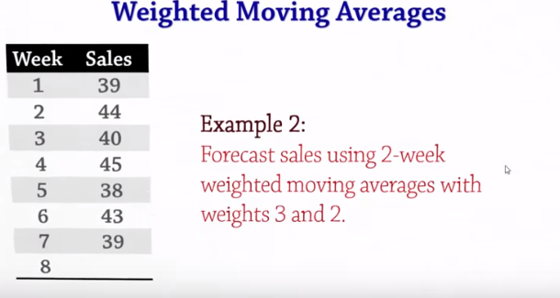
Forecasting Methodologies

Slide 19
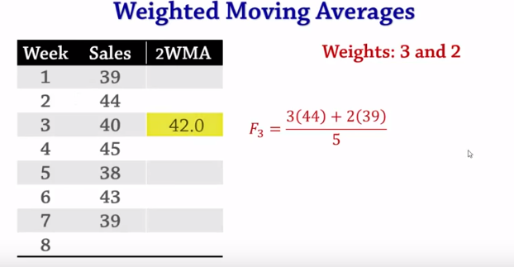
Forecasting Methodologies

Slide 20
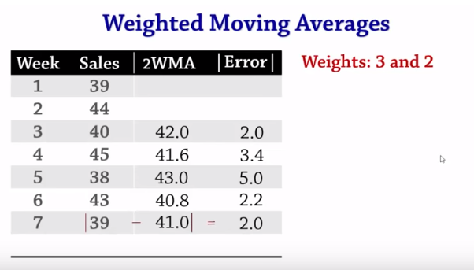
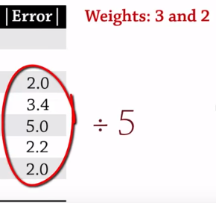

Forecasting Methodologies

Slide 21
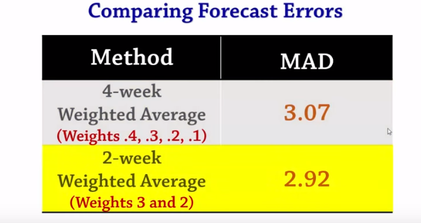
Forecasting Methodologies

Slide 22
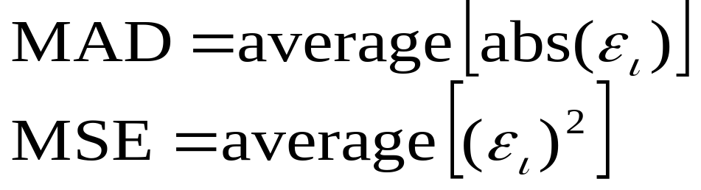
Monitoring the Forecast
There are two measures used to monitor the accuracy of a forecast. The Mean Absolute Deviation (MAD) and the Mean Squared Error (MSE).
The MAD is the average of the absolute value of the forecast errors. The MSE is the average of the squared forecast errors.
Note: The formula for the MSE shown above may vary slightly. Some people divide the sum of the squared errors by n-1 rather than n.
05 - <number>

Slide 23
History … An Indicator Of The Future ???
Forecasting deals with making a statement about the future … Can history be used to tell us something about the future?
Actual Historical Demand
Future Demand
Time
05 - <number>

