Slide 1

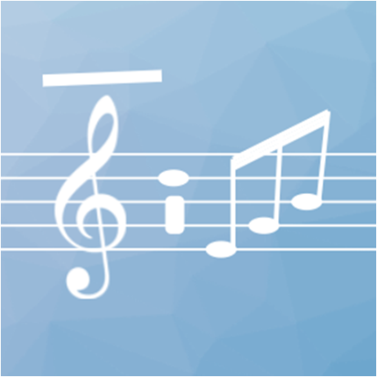
DSP & Audio Programming in .NET
.NET Standard 2.0

Slide 2
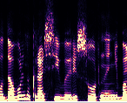
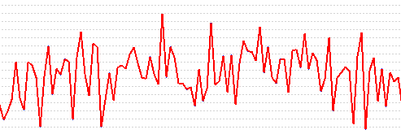
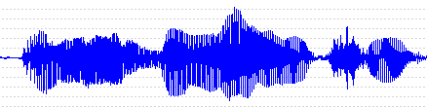

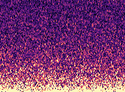

1D signals / Audio
Speech
Music
Noise

Slide 3
DSP & Audio Tasks
Signal Interpretation
Signal Modification
Signal Generation

Slide 4
Transforms
Complex Fast Fourier Transform
Real Fast Fourier Transform
Short-Time Fourier Transform
Fast Wavelet Transform
Discrete Cosine Transform (type I-IV)
Cepstral Transform
Hartley Transform
Mellin Transform
Hilbert Transform
Goertzel algorithm

Slide 5
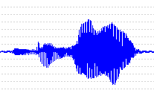
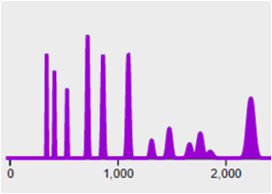
Transforms
Direct
Transformer
Object
Inverse

Slide 6
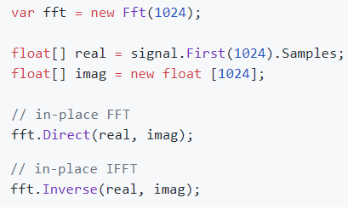
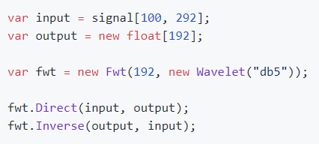
Code Examples
Complex FFT
Fast Wavelet Transform
(Daubechies 5)

Slide 7
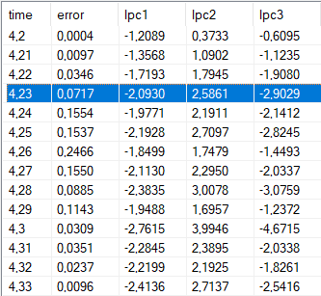
Feature Extractors
ComputeFrom
Feature
Extractor
ProcessFrame

Slide 8
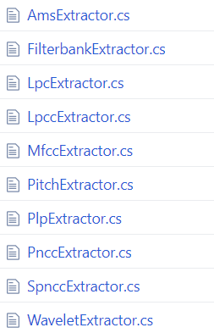
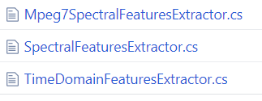
Feature Extractors

Slide 9

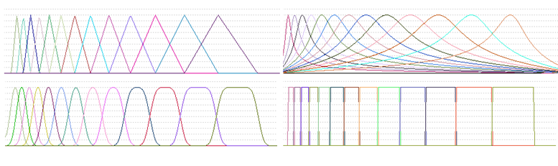
Filter Banks

Slide 10
Spectral and TD Descriptors
MIR
Music
Information
Retrieval
Spectral Centroid
Spectral Spread
Spectral Flatness
Spectral Noiseness
Spectral Rolloff
Spectral Crest
Spectral Entropy
Spectral Decrease
Spectral Contrast
Harmonic Centroid
Harmonic Spread
Inharmonicity
Odd-to-Even Ratio
Tristimulus
Energy
RMS
ZCR
Entropy
MPEG-7
Standard

Slide 11
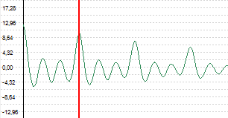
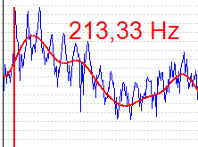
Pitch Estimation
Time domain
Frequency domain
Autocorrelation
Harmonic Product Spectrum
YIN
Harmonic Sum Spectrum
Zero-crossings
(Schmitt trigger)
First Spectral Peak

Slide 12
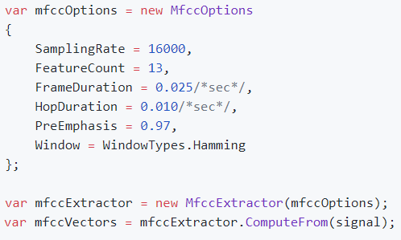
Configuring Extractors

Slide 13
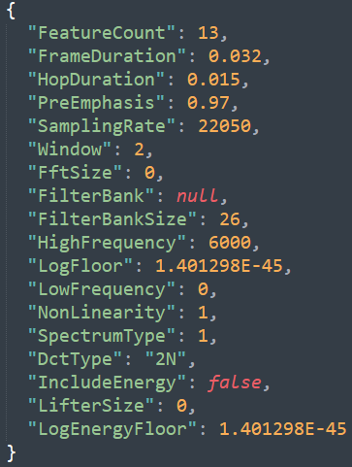
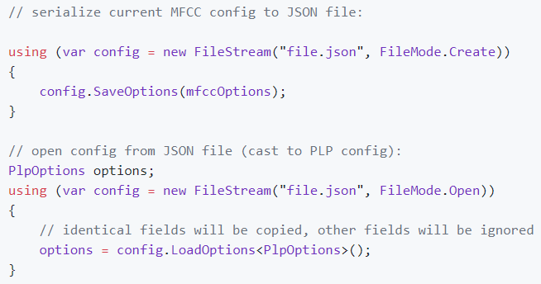
Configuring Extractors

Slide 14
Signal Modification
Resampling
Spectral
Subtraction
Filtering
Audio Effects
Time Stretching

Slide 15
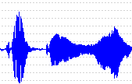
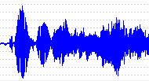
Digital Filters
Process (online)
IOnlineFilter
IFilter
ApplyTo (offline)

Slide 16

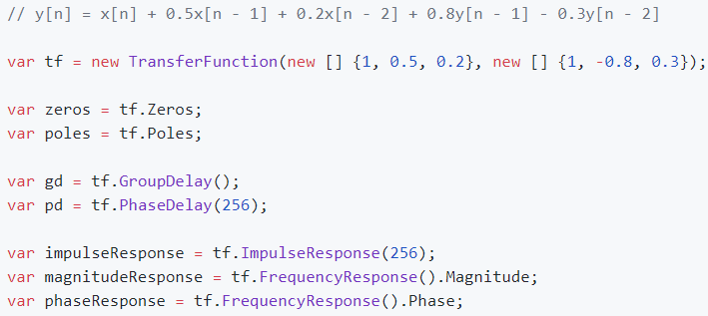
Transfer Function

Slide 17
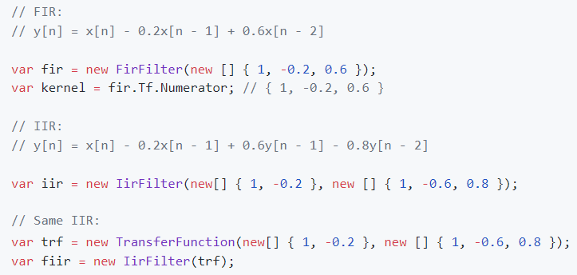
Transfer Function

Slide 18
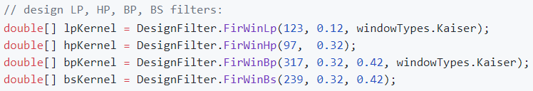
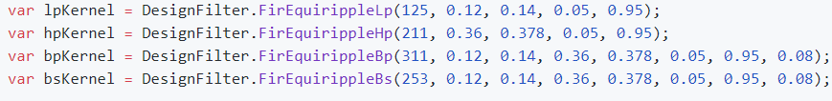
FIR Filter Design
Frequency sampling
Window method (sinc)
Remez / Parks-McClellan (equiripple)

Slide 19
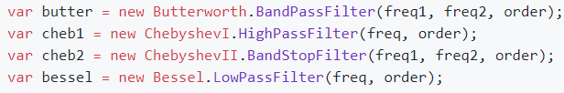
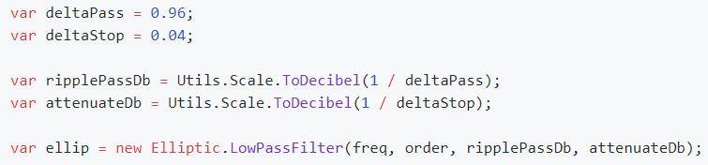
IIR Filter Design
Butterworth
Chebyshev-I
Chebyshev-II
Elliptic
Bessel

Slide 20
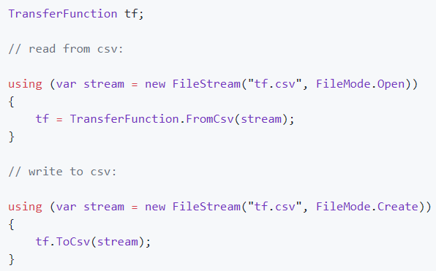
Integration With MATLAB / sciPy

Slide 21

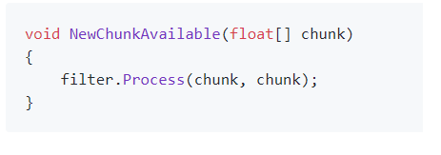
Online Filtering
Just process data periodically sample after sample:
Or chunk after chunk:

Slide 22
Offline Filtering
call Process(sample) in a loop
directly (difference equation)
overlap-add block convolution (OLA)
overlap-save block convolution (OLS)

Slide 23
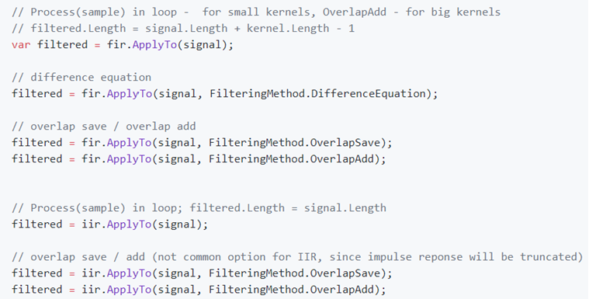
Offline Filtering

Slide 24
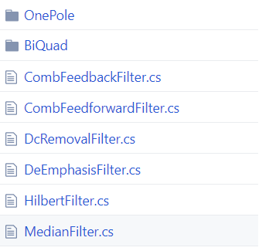
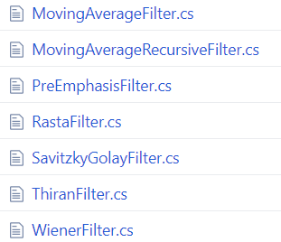
NWaves Filters

Slide 25
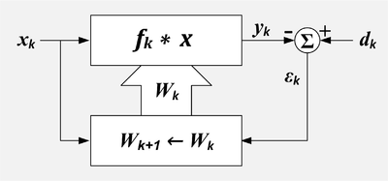
Adaptive Filters
LmsFilter
NlmsFilter
SignLmsFilter
VariableStepLmsFilter
LmfFilter
NlmfFilter
RlsFilter

Slide 26
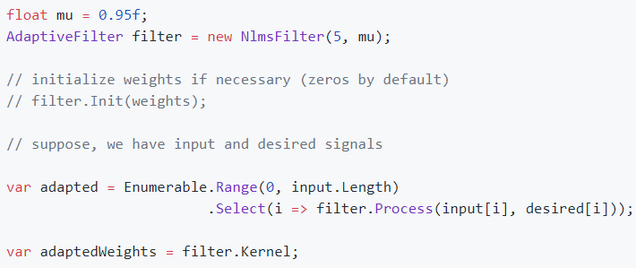
Adaptive Filters

Slide 27
Operations
Convolution
Cross-correlation
Block convolution
Resampling
Time-stretching
Rectification
Audio Effects
Envelope detection
Spectral subtraction
Signal reconstruction from spectrogram
Harmonic-percussive source separation
Modulation
Deconvolution

Slide 28
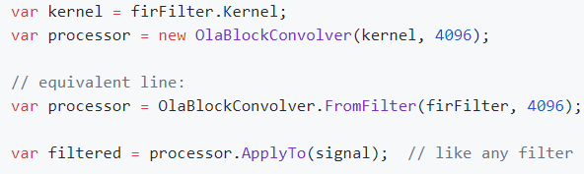
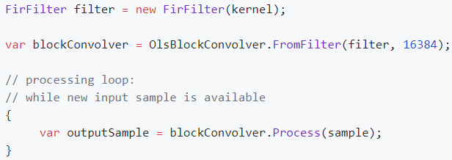
Block Convolvers (OLA / OLS)
Overlap-Add
Overlap-Save

Slide 29
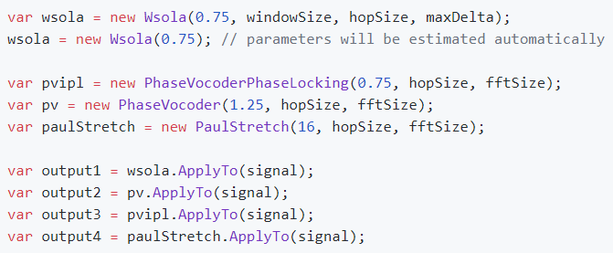
TSM (Time-Scale Modification)

Slide 30
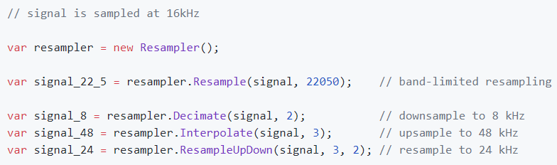
Resampling

Slide 31
Audio Effects
WahWah
AutoWah
Phaser
Tremolo
Vibrato
Flanger
Chorus
Delay
Echo
Overdrive
Distortion
Tube distortion
Pitch shift
Robotize
Whisperize
Morph sounds

Slide 32
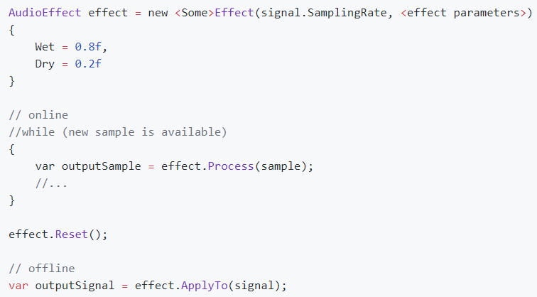
Audio Effects

Slide 33
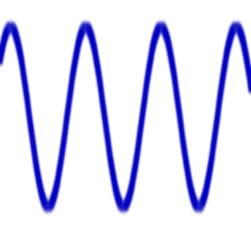
Signal Builders
NextSample (online)
Signal
Builder
Build (offline)

Slide 34
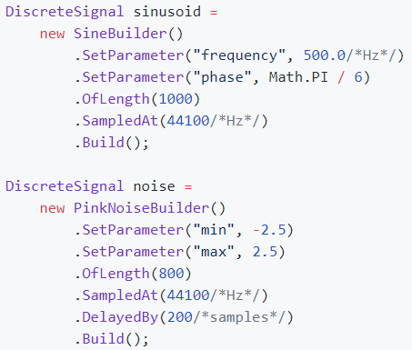
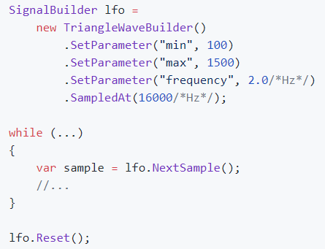
Signal Builders

Slide 35
Enjoy!
https://github.com/ar1st0crat/NWaves
PM> Install-Package NWaves

