Slide 1
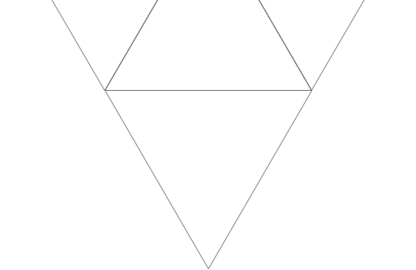

Limitation of First-Order Logic
Team members:
WENQIAN JIA, LINKAI GAO, ZIQI WANG

Slide 2
Part 1: Inability to Handle Uncertainty
Speaker: ZIQI WANG

Slide 3


Scenario 1
First-order logic do not have built-in mechanisms to handle probability, uncertainty.
Example:
P(x)：“X cough”
Q(x)：“X has a cold”
Obstacle : In first-order logic :
Solution：Probabilistic logic :
This expression can better reflect uncertainty and help doctors make more reasonable judgments when facing multiple possibilities.

Slide 4
Scenario 2
First order logic can only handle propositions with clear truth and falsehood
Example :
P(x)：“X is a good student.”
Q(x)：“X always submits homework on time.”
Obstacle: in first order logic:
Solution :in fuzzy logic:
Fuzzy Logic allow the truth value of a proposition to take values between 0 and 1, not just 0 or 1.

Slide 5
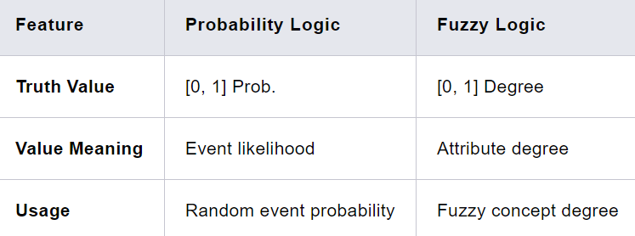
Difference in Tools

Slide 6
Part 2: Non-monotonic Logic & HOL
Speaker: Wenqian Jia

Slide 7
Domain: Incomplete Information
First-order logic: complete, precise, consistent
The real world: incomplete, inexact, inconsistent
"All birds can fly"
"Birds usually fly"
"Except for penguins, ostriches... All birds can fly "

Slide 8
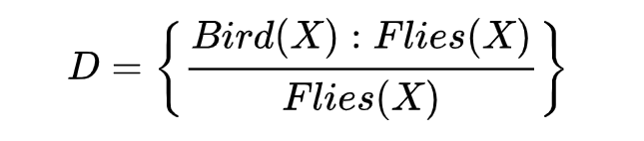
Solution: Non-monotonic Logic
The truth of a proposition may change when new information is added to or old information is deleted from the system.
A default theory is a pair (D, A) where D is a set of defaults, and A is a set of axioms.
"Birds usually fly"

Slide 9
Domain: Expressing Higher-order Logic
Leibniz law:
For any individual x and y, if x and y are equal, then for any property P,
P(x) if and only if P(y).
First-order logic can only quantify individuals,
and properties are sets containing individuals.

Slide 10

Solution: Higher-order Logic (HOL)
Leibniz law:
For any individual x and y, if x and y are equal, then for any property P,
P(x) if and only if P(y).

Slide 11
Part 3: Temporal Logic
Speaker: Linkai Gao

Slide 12

The Time Limitation of FOL
For past, present, and future events：
For complex temporal relationships：
FOL lacks systematic time-dependent expressions!

Slide 13
Solution: Temporal Logic
Symbols | Expression Symbolized | Rough Analogy
G | It will always be the case that… | ∀ + will
F | It will sometimes be the case that… | ∃ + will
H | It has always been the case that… | ∀ + past
P | It has at some time operators the case that… | ∃ + past
S(a, b) | a=True since b=True | /
U(a, b) | a=True until b=True | /

Slide 14


Examples

Slide 15
Advantages and Disadvantages
√ Modeling: Temporal logic enables modeling of complex temporal behaviors in systems, useful in AI applications like robotics and control systems.
√ Completeness: It offers a comprehensive framework for time-related reasoning, ideal for applications involving temporal logic.
× Complexity: The formal syntax and semantics can be challenging, requiring significant mathematical expertise.

Slide 16
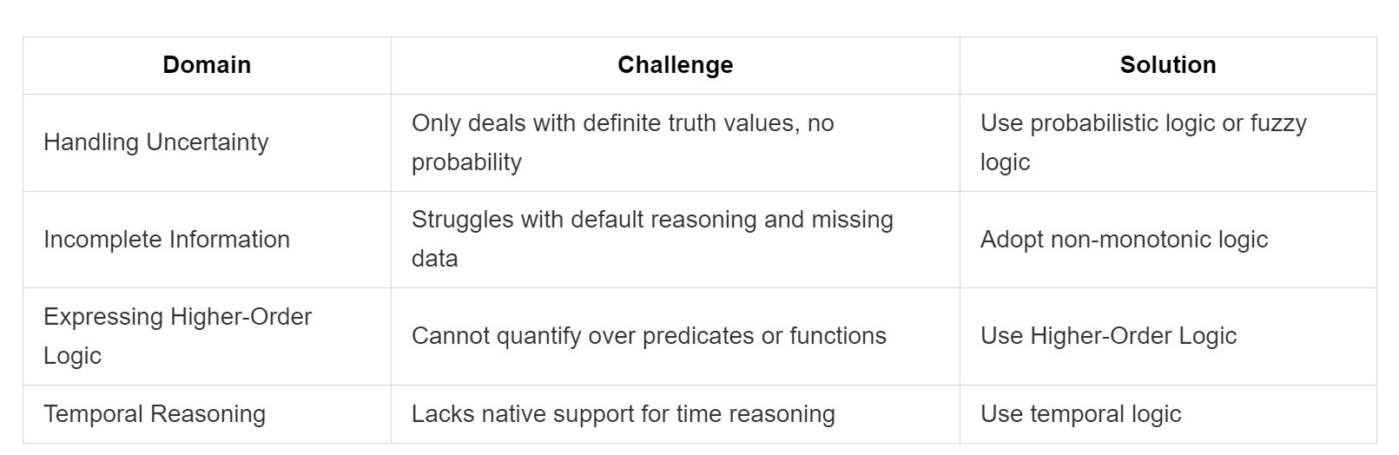
Conclusion

Slide 17
Thanks!

