Slide 1
DVTk Steering Committee meeting February 2006

Slide 2
Agenda
Welcome
Status
and Progress
DVTk Roadmap
DVTk and other
initiatives
Governance
structure
Development
questions
Agenda
Welcome
Status and Progress of DVTk project
DVTk roadmap
Relation of DVTk to other initiatives/organisations
Governance structure DVTK
Development questions

Slide 3
Status and Progress of DVTk project
Welcome
Status
and Progress
DVTk Roadmap
DVTk and other
initiatives
Governance
structure
Development
questions
DVTk Community | Development activities | Problem Reports
DVTk community
  Downloads
  Feedback / Questions
  Meeting structure
Development activities
  Completed activities
  Activities “In Progress”
  Problem Reports

Slide 4
DVTk community
Welcome
Status
and Progress
DVTk Roadmap
DVTk and other
initiatives
Governance
structure
Development
questions
DVTk Community | Development activities | Problem Reports
Total Visits
8748
14/02/2006
Average Visits per day
37
Average Visits per week
256
Average Visits per month
1098
Busiest Month Visits
1270
Busiest Month
01/2006
Forum Board Statistic Total Topics 49 | Total Posts 132 | Total Views 6703

Slide 5
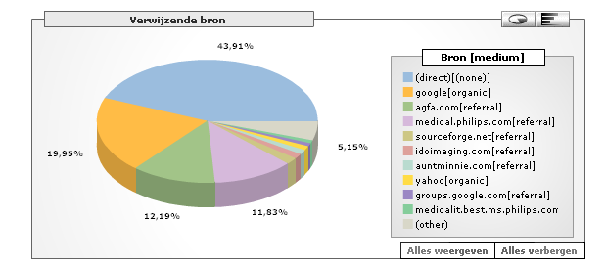
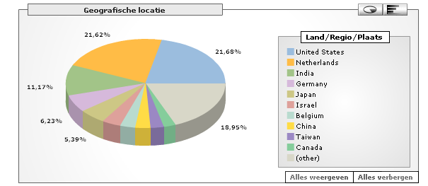
DVTk community
Welcome
Status
and Progress
DVTk Roadmap
DVTk and other
initiatives
Governance
structure
Development
questions
DVTk Community | Development activities | Problem Reports

Slide 6
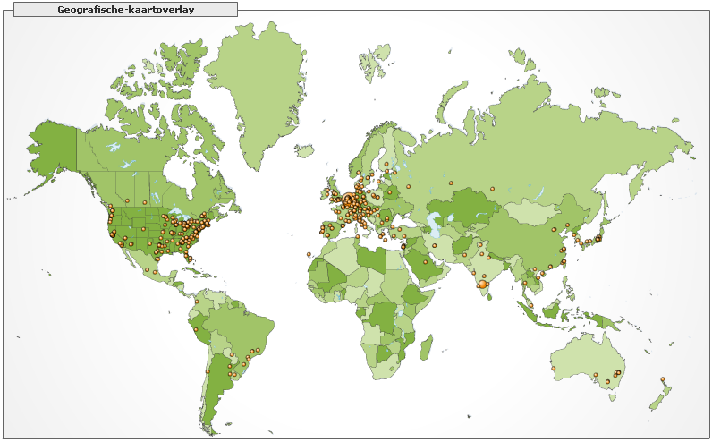
DVTk community
Welcome
Status
and Progress
DVTk Roadmap
DVTk and other
initiatives
Governance
structure
Development
questions
DVTk Community | Development activities | Problem Reports

Slide 7
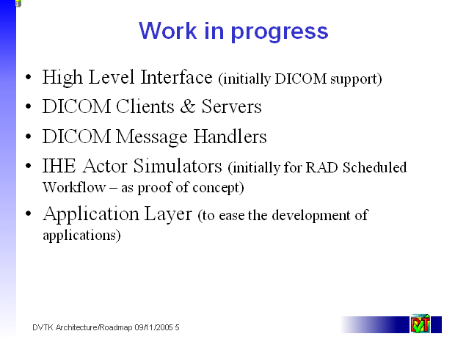
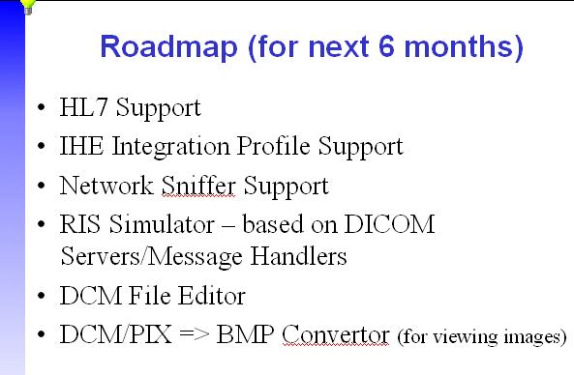
Development activities (planned activities)
Welcome
Status
and Progress
DVTk Roadmap
DVTk and other
initiatives
Governance
structure
Development
questions
DVTk Community | Development activities | Problem Reports

Slide 8
Development activities
Welcome
Status
and Progress
DVTk Roadmap
DVTk and other
initiatives
Governance
structure
Development
questions
DVTk Community | Development activities | Problem Reports
Planned Activities | Status
High Level Interface (initially DICOM support) | Done
DICOM Clients & Servers / DICOM Message Handlers | Done
IHE Integration Profile Support | In Progress
IHE Actor Simulators (initially for RAD Scheduled Workflow – as proof of concept) | Done
Application Layer (to ease the development of applications) | Done
Common message/data format | In Progress
HL7 Support | Not started!
Network Sniffer Support | In Progress
RIS Simulator – based on DICOM Servers/Message Handlers | Done
DCM File Editor | Done

Slide 9
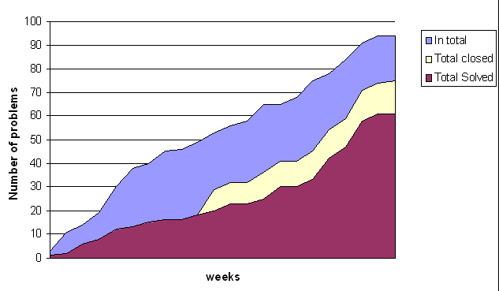
Development activities
Welcome
Status
and Progress
DVTk Roadmap
DVTk and other
initiatives
Governance
structure
Development
questions
DVTk Community | Development activities | Problem Reports

Slide 10
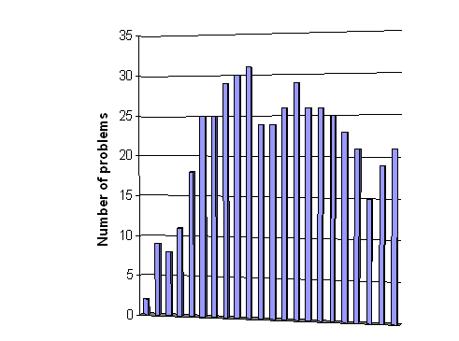
Development activities
Welcome
Status
and Progress
DVTk Roadmap
DVTk and other
initiatives
Governance
structure
Development
questions
DVTk Community | Development activities | Problem Reports

Slide 11
DVTk roadmap
Welcome
Status
and Progress
DVTk Roadmap
DVTk and other
initiatives
Governance
structure
Development
questions
Validation | IHE | Emulators | DICOM-file | Service | Development
Become the leading tool (de-facto standard) in DICOM validation and DICOM service tools:
  Wider acceptance of DVTk in the whole DICOM world.

Slide 12
How can we get wider acceptance of DVTk
Welcome
Status
and Progress
DVTk Roadmap
DVTk and other
initiatives
Governance
structure
Development
questions
Validation | IHE | Emulators | DICOM-file | Service | Development
Innovation and Product differentiation within DVTk products:
  DICOM Validation Framework
  IHE framework ^{new}
  Emulators ^{new}
  DICOM-file Tools
  Service Tools ^{new}
  DVTk Developers Tools

Slide 13
DICOM Validation Framework
Welcome
Status
and Progress
DVTk Roadmap
DVTk and other
initiatives
Governance
structure
Development
questions
Validation | IHE | Emulators | DICOM-file | Service | Development
The DICOM Validation Framework is a software utility that will assist in testing DICOM conformance. DVTk is used to provide an independent measurement of the accuracy of a Product’s DICOM Interface, according to both the DICOM Standard and the Product’s Conformance Statement.
The DICOM Validation Framework is the successor of DVT (also known in the past as A-DVT and VTS) and provides the core code for all products within the DICOM Validation Toolkit (DVTk).

Slide 14
Innovation in the DICOM Validation Framework
Welcome
Status
and Progress
DVTk Roadmap
DVTk and other
initiatives
Governance
structure
Development
questions
Validation | IHE | Emulators | DICOM-file | Service | Development
Reporting functionality in DVTk DICOM Validation Framework:
  Overview of problems over different scripts/sessions:
      How to keep an overview of so many results?
      How to handle duplicates of Errors and Warnings?
  Managing Problems
      How to ‘hide’ non-relevant Errors and Warnings in logging?
      How to add a problem to a result file?
      How to relate Errors and Warnings to a Problem Reports?
  How to put result and interpretation easily in a report?

Slide 15
IHE Framework ^{new}
Welcome
Status
and Progress
DVTk Roadmap
DVTk and other
initiatives
Governance
structure
Development
questions
Validation | IHE | Emulators | DICOM-file | Service | Development
The IHE Framework is a software utility that will assist in testing IHE conformance. The IHE framework will make it possible to simulate different IHE actors and test different IHE scenario’s.

Slide 16
IHE Validation Framework
Welcome
Status
and Progress
DVTk Roadmap
DVTk and other
initiatives
Governance
structure
Development
questions
Validation | IHE | Emulators | DICOM-file | Service | Development
HL7 support
IHE Framework User Interface

Slide 17
HL7 Support still under discussion
Welcome
Status
and Progress
DVTk Roadmap
DVTk and other
initiatives
Governance
structure
Development
questions
Validation | IHE | Emulators | DICOM-file | Service | Development
HL7 message transport.
  HAPI
  MWB?
HL7 message creation (possible cooperation with NIST)
HL7 message validation using XML schema/definition.
  Validating bar2xml
  HAPI
  MWB
Support for HL7 V2.x and V3.x?

Slide 18
Emulators ^{new}
Welcome
Status
and Progress
DVTk Roadmap
DVTk and other
initiatives
Governance
structure
Development
questions
Validation | IHE | Emulators | DICOM-file | Service | Development
The Emulators based on DVTk are stand-alone easy to use applications that will emulate the basic functionality of a system with all validation possibilities provided by DVTk.

Slide 19
Innovation in the Emulators
Welcome
Status
and Progress
DVTk Roadmap
DVTk and other
initiatives
Governance
structure
Development
questions
Validation | IHE | Emulators | DICOM-file | Service | Development
The goal is to create a set of Emulators that will emulate the basic functionality of a system but with all validation possibilities provided by DVTk:
  RIS Emulator (WLM – MPPS)
  Modality Emulator (WLM – MPPS – Storage – Storage commit)
  Workstation Emulator (Storage – Query/Retrieve)
  PACS Emulator (Storage – Query/Retrieve – Storage commit)
  Printer Emulator (Printing)

Slide 20
Innovation in the Emulators
Welcome
Status
and Progress
DVTk Roadmap
DVTk and other
initiatives
Governance
structure
Development
questions
Validation | IHE | Emulators | DICOM-file | Service | Development
The main requirements of these system Emulators are:
  Easy To use
  Flexible
  Make us of all DVTk Validation functionality
We plan to release one system emulator each month!

Slide 21
DICOM-File Tools
Welcome
Status
and Progress
DVTk Roadmap
DVTk and other
initiatives
Governance
structure
Development
questions
Validation | IHE | Emulators | DICOM-file | Service | Development
Within the DVTk products there is a set of easy to use products which are focussed on creation, validation and manipulation of DCM files.

Slide 22
Innovation DICOM-File Tools
Welcome
Status
and Progress
DVTk Roadmap
DVTk and other
initiatives
Governance
structure
Development
questions
Validation | IHE | Emulators | DICOM-file | Service | Development
Create and enhance a set of DICOM-File Tools:
  DCM Editor
  Media Validator
  DCM Compare Tool
  DICOM File Anonymizer
  DCM file stripper
  DCM Attribute Validator and Viewer

Slide 23
Service Tools ^{new}
Welcome
Status
and Progress
DVTk Roadmap
DVTk and other
initiatives
Governance
structure
Development
questions
Validation | IHE | Emulators | DICOM-file | Service | Development
DVTk provides a lot of functionality to make the servicing of DICOM interfaces much easier. The DICOM Service tools are stand-alone applications that are designed to fulfil the needs of a service engineer.

Slide 24
Innovation in DVTk Service Tools
Welcome
Status
and Progress
DVTk Roadmap
DVTk and other
initiatives
Governance
structure
Development
questions
Validation | IHE | Emulators | DICOM-file | Service | Development
Integration of diverse medical imaging devices and information systems requires a detailed analysis of DICOM capabilities to permit description of the interoperability that will be achieved within the integrated whole. Identifying the cause(s) of unexpected interoperability problems, especially during the course of such an integration installation, during installation in other conventional multi-vendor environments, or in system test labs is critical.
We want to introduce Sniffing functionality in DVT that enables its user to "sniff" the network communication, analyze DICOM network communication, and to conveniently display and validate the DICOM information for further analysis.

Slide 25
DVTk Developers Tools
Welcome
Status
and Progress
DVTk Roadmap
DVTk and other
initiatives
Governance
structure
Development
questions
Validation | IHE | Emulators | DICOM-file | Service | Development
With the release of DVTk 2.1 a set of software components / libraries where introduced. These components and libraries provide access to all functionality of DVTk.
A set of development tools is available to make programming of DICOM test applications of Visual Basic scripts easier.

Slide 26
Innovation in the DVTk Developers Tools
Welcome
Status
and Progress
DVTk Roadmap
DVTk and other
initiatives
Governance
structure
Development
questions
Validation | IHE | Emulators | DICOM-file | Service | Development
Create and enhance a set Software Interfaces
  DVTk and DVTk data, these interfaces provides access to the core code of DVTk.
  High Level Interface
  Client/Server Interfaces
  IHE Layer
  Application Layer
  Comparison Layer
  Common Data Format Layer

Slide 27
Innovation in the DVTk Developers Tools
Welcome
Status
and Progress
DVTk Roadmap
DVTk and other
initiatives
Governance
structure
Development
questions
Validation | IHE | Emulators | DICOM-file | Service | Development
Example Code and scripts:
  Visual Basic Scripts
  Test Applications
  DVTk based applications
Coding and Scripting support tools:
  Visual Basic Script parser
  Help documentation for the different Interface
  DVTk software interfaces Tutorial (when and how to use the different software interfaces of DVTk)

Slide 28
Relation of DVTk to other initiatives/organisations
Welcome
Status
and Progress
DVTk Roadmap
DVTk and other
initiatives
Governance
structure
Development
questions
IHE- Gazelle project | NIST and HL7
DVTk and IHE/ Gazelle project
Possible cooperation with NIST organization regarding HL7 validation

Slide 29
DVTK Architecture
Welcome
Status
and Progress
DVTk Roadmap
DVTk and other
initiatives
Governance
structure
Development
questions
IHE- Gazelle project | NIST and HL7
IHE Actor Simulators
Common Message/Data Format ?
Comparison component
Dicom Clients & Servers
Dicom Message Handlers
High Level Interface
Protocol
?
HL7
DVTK
DvtkData
DvtkManaged
CodeAdapter

Slide 30
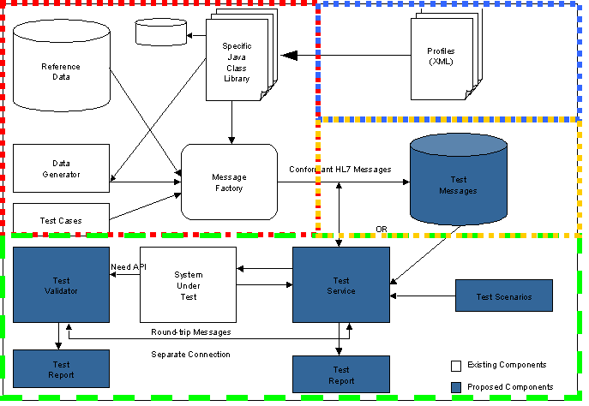
NIST Architecture
Welcome
Status
and Progress
DVTk Roadmap
DVTk and other
initiatives
Governance
structure
Development
questions
IHE- Gazelle project | NIST and HL7

Slide 31
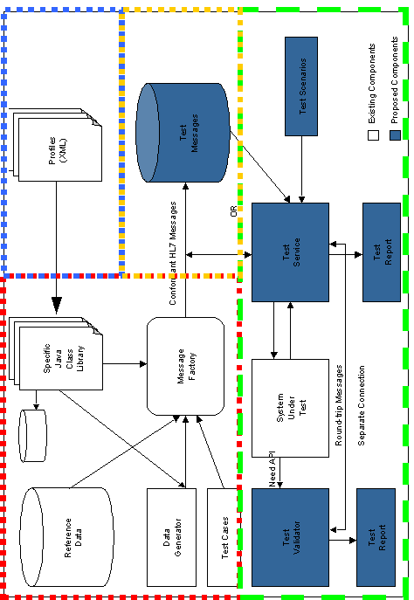
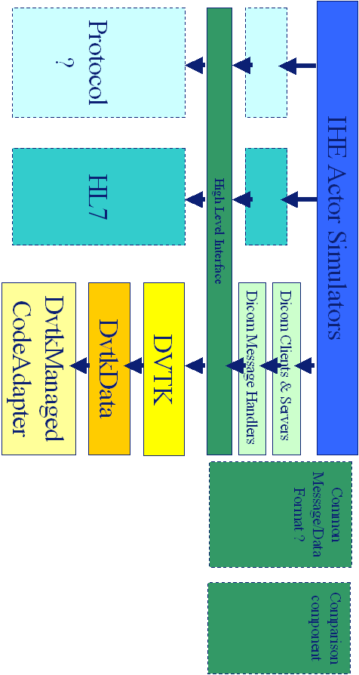
Overlap
Welcome
Status
and Progress
DVTk Roadmap
DVTk and other
initiatives
Governance
structure
Development
questions
IHE- Gazelle project | NIST and HL7
=

Slide 32
Overlap
Welcome
Status
and Progress
DVTk Roadmap
DVTk and other
initiatives
Governance
structure
Development
questions
IHE- Gazelle project | NIST and HL7
Possible cooperation with NIST organization regarding HL7 validation:
  Requirements
  Design issues
  Open Source
How to continue?

Slide 33
Governance structure DVTK
Welcome
Status
and Progress
DVTk Roadmap
DVTk and other
initiatives
Governance
structure
Development
questions
Organization structure of DVTk | Legal aspects of DVTk community
Discussion Organisation structure of DVTk
Discussion Legal aspects of the DVTk community

Slide 34
Development questions
Welcome
Status
and Progress
DVTk Roadmap
DVTk and other
initiatives
Governance
structure
Development
questions
Copyright statements | Visual Studio 2005
Strategy of Copyright statements
DICOM Validation Framework
  Do we continue to use one generic copyright statement:
    How to include new code contributors in Copyright statements?
    What if one code contributor resigns?
  How to handle code from 3rd parties (Dave Harvey)
Visual studio 2005
  When are we going to migrate to visual studio 2005
    Is there one company with the need to go to Visual studio 2005?

Slide 35


Slide 36
DVTK Architecture V2.1
Applications
DVT
GUI
DVT
CMD
DvtkManagedCodeAdapter
Contains C++ libraries:
Definition File Management
Validation
Scripting - .ds/.dss
Sessions – script/emulator/media
Emulators
Utilities
DVTK
DvtkData
DvtkManaged
CodeAdapter

Slide 37
Comments
DICOM Clients & Servers + DICOM Message Handlers implement DICOM SCU/SCP Emulators. (Once these are complete the existing emulators will be removed from DvtkManagedCodeAdapter.)
Common Message/Data Format might support a common message/data representation to allow easy comparison of values from differing protocols. (Initial ideas are for common name, id, date, time, uid formats)

Slide 38
Heading
Introduction
Heading page 1 | Heading page 2 | Heading page 3
Text

