Slide 1
Requirement Reporting Functionality in DVTk
Overview of new reporting functionality in DVTk

Slide 2
New Reporting functionality in DVTk
Introduction
GUI Changes
Details
Overview of Problems| Managing Results| Reporting
Overview of problems over different scripts/sessions:
    How to keep an overview of so many results?
    How to handle duplicates of Errors and Warnings?
Managing Problems
    How to ‘hide’ non-relevant Errors and Warnings in logging?
    How to add a problem to a result file?
    How to relate Errors and Warnings to a Problem Reports?
How to put result and interpretation easily in a report?

Slide 3
Overview of problems over different scripts/sessions
Introduction
GUI Changes
Details
Overview of Problems| Managing Results| Reporting
    How to keep an overview of so many results?
    How to handle duplicates of Errors and Warnings?
Search for all errors and warnings in all results files related to a Project.
Sort all “Errors and Warnings” based on error message.

Slide 4
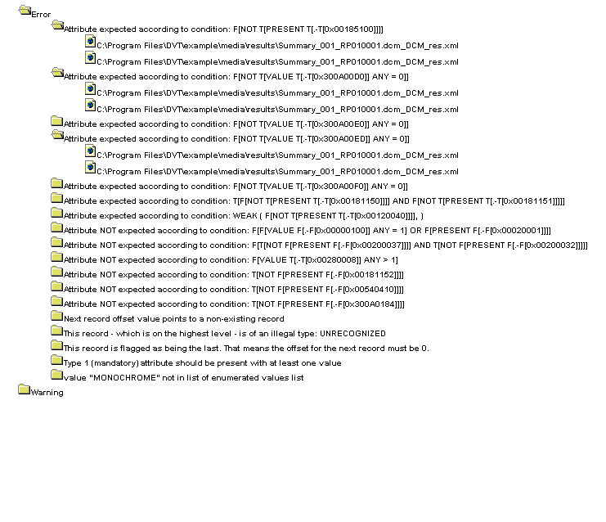
Based on Results Manager (SourceForge.net)
Introduction
GUI Changes
Details
Overview of Problems| Managing Results| Reporting

Slide 5
Managing Problems
‘Hide’ non-relevant Errors and Warnings in logging?
Introduction
GUI Changes
Details
Overview of Problems| Managing Results| Reporting
In some situation DVTk reports an Error or a Warning.
This Error or Warning could be incorrect. (e.g. problem in definition file, intended system behavior, etc.)
We need to have mechanisms to hide these issues within DVTk

Slide 6
Managing Problems
Add a problem to a result file?
Introduction
GUI Changes
Details
Overview of Problems| Managing Results| Reporting
In some situations DVTk gives no Error or warning but the test case fails. (e.g. Viewing of a Image fails)
This error need to be added to the results.
We need to have mechanisms to add problems to specific testcases within DVTk

Slide 7
Managing Problems
Basic principle of ‘adding’ and ‘hiding’ problems
Introduction
GUI Changes
Details
Overview of Problems| Managing Results| Reporting
Do not change results files created by DVTk.
All ‘hided’ and ‘added’ problems are logged in separate project XML file (e.g. for project file STORAGE.pdvt, STORAGE.pdvt.xml is used).
XML file can be reused in new DVTk project.
The DVTk style sheet will take care of hiding and adding of problems in the results representation .

Slide 8
Managing Problems project XML file (XML Schema)
Introduction
GUI Changes
Details
Overview of Problems| Managing Results| Reporting
<?xml version="1.0" encoding="UTF-8"?>
<xs:schema xmlns:xs="http://www.w3.org/2001/XMLSchema" elementFormDefault="qualified">
<xs:element name="Nodes">
<xs:complexType>
<xs:sequence>
<xs:element ref="skipped"/>
<xs:element ref="Problem"/>
<xs:element ref=“added"/>
</xs:sequence>
</xs:complexType>
</xs:element>
<xs:element name="Problem">
<xs:complexType>
<xs:sequence>
<xs:element ref="Message" maxOccurs="unbounded"/>
</xs:sequence>
</xs:complexType>
</xs:element>
<xs:element name="skipped">
<xs:complexType>
<xs:sequence>
<xs:element ref="Message" maxOccurs="unbounded"/>
</xs:sequence>
</xs:complexType>
</xs:element>
<xs:element name=“added">
<xs:complexType>
<xs:sequence>
<xs:element ref="Message" maxOccurs="unbounded"/>
</xs:sequence>
</xs:complexType>
</xs:element>
<xs:element name="Message">
<xs:complexType>
<xs:sequence>
<xs:element ref="Name"/>
<xs:element ref="Comment"/>
<xs:element ref="PRnr"/>
</xs:sequence>
</xs:complexType>
</xs:element>
<xs:element name="PRnr" type="xs:string"/>
<xs:element name="Comment" type="xs:string"/>
<xs:element name="Name" type="xs:string"/>
</xs:schema>

Slide 9
Create Report
Introduction
GUI Changes
Details
Overview of Problems| Managing Results| Reporting
Based on all scripts and results files related to a project.
Include ‘Hide’ and ‘Added’ rules defined.
Provide overview of all test cases:
  Indicates in test case is executed
  Indicates Passes/Failed based on ‘Hide’ and ‘Add rules’
  Indicates PR information
Generated report via XSLT stylesheet

Slide 10
User Interface Changes
Introduction
GUI Changes
Details
Overview of Problems| Managing Results ’Hide’| Managing Results ’Add’| Reporting
Overview of problems over different scripts/sessions.
‘Hiding’ problems
‘Adding’ problems
Generated report via XSLT stylesheet

Slide 11
Overview of problems
Introduction
GUI Changes
Details
Overview of Problems| Managing Results ’Hide’| Managing Results ’Add’| Reporting
In Session TreeView, a Project node is present, under which all Session nodes are available.
When this new Project node is selected, two Tabs are available:
- Activity Logging
- Results Manager (see next pages)
(Tab control in screenshots not correct)

Slide 12
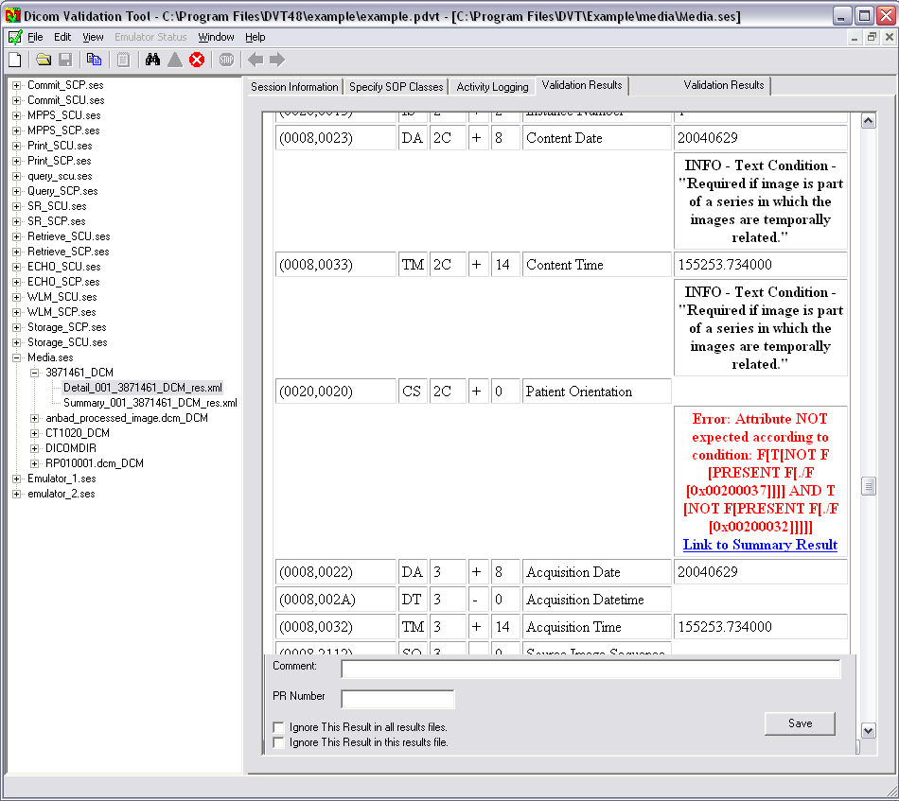
Overview of problems
Introduction
GUI Changes
Details
Overview of Problems| Managing Results ’Hide’| Managing Results ’Add’| Reporting
Applicable
Hyperlink to Resultsfile
Detail
(Link)
Hyperlink to a message
(message ID + Result file)
(Link)
(Link)
(Link)
(Link)
(Link)
Hyperlink to a message
(message ID + Result file of first occurrence)
Refreshed when message is selected
Issues Details

Slide 13
Managing Results ’Hide’
Introduction
GUI Changes
Details
Overview of Problems| Managing Results ’Hide’| Managing Results ’Add’| Reporting
Detail
Hyperlink to a message
(message ID + Result file of first occurrence)
Refreshed when message is selected
Implement this by:
  Open Results file (in hyperlink)
  Goto XML node with correct message ID
  Retrieve messages text
  Check ‘hide’ status in project XML file
  Update Ignore Issue screen (this is the only thing visible for the user)
Issues Details

Slide 14
Managing Results ’Hide’
Introduction
GUI Changes
Details
Overview of Problems| Managing Results ’Hide’| Managing Results ’Add’| Reporting
Detail
Hyperlink to a message
(message ID + Result file)
Refreshed when message is selected
Implement this by:
  Open Results file (in hyperlink)
  Goto XML node with correct message ID
  Retrieve messages text
  Check ‘hide’ status in project XML file
  Update Ignore Issue screen (this is the only thing visible for the user)
Add issue
Issues Details

Slide 15
Managing Results ’Hide’
Detail
Introduction
GUI Changes
Details
Detail
Overview of Problems| Managing Results ’Hide’| Managing Results ’Add’| Reporting
Saves changes in project XML file
Implement this by:
  Open project XML file
  Remove XML node related to the message (if exists)
  Add XML node to the <Nodes> in the project XML file
    If ‘Ignore This Result in all results files.’ is turned on:
    <skipped>
    <Message>
    <Name>Message Text - Location</Name>
    <Comment>Comment</Comment>
    <PRnr>PR number</PRnr>
    </Message>
    </skipped>
    If ‘Ignore This Result in this results files.’ is turned on:
    <skipped>
    <Message>
    <Name>Result file - Message Text - Location </Name>
    <Comment>Comment</Comment>
    <PRnr>PR number</PRnr>
    </Message>
    </skipped>
    If none ‘Ignore’ option is turned on:
    <Problem>
    <Message>
    <Name>Message Text - Location</Name>
    <Comment>Comment</Comment>
    <PRnr>PR number</PRnr>
    </Message>
    </Problem>
Issues Details
Add issue
Ignore Issues
Add issue

Slide 16
Managing Results ’Add’
Introduction
GUI Changes
Details
Overview of Problems| Managing Results ’Hide’| Managing Results ’Add’| Reporting
Detail
Only visible in validation Results
Add issue
Ignore Issues
Add

Slide 17
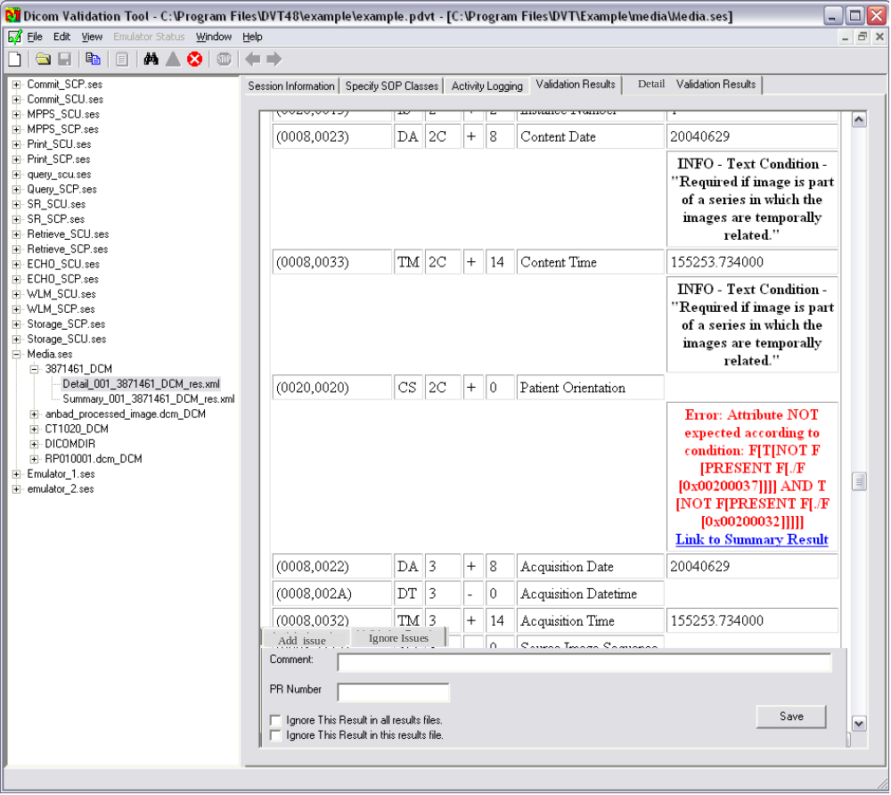
Managing Results ’Add’
Introduction
GUI Changes
Details
Overview of Problems| Managing Results ’Hide’| Managing Results ’Add’| Reporting
Saves changes in project XML file
Implement this by:
  Open project XML file
  Add XML node to the <Nodes> in the project XML file
    <added>
    <Message>
    <Name> Result file - Message Text </Name>
    <Comment>Comment</Comment>
    <PRnr>PR number</PRnr>
    </Message>
    </added>
Add

Slide 18
Removing ‘Added’ Problem
Introduction
GUI Changes
Details
Overview of Problems| Managing Results ’Hide’| Managing Results ’Add’| Reporting
To remove a ‘added’ problem:
Select hyperlink in results file
Select one of the ignore options
Implement this by: :
  Open project XML file
  Remove XML node related to the message (if exists)
  Check if the problem is a added one. If so do nothing!

Slide 19
Possible to switch between original and derived results
Introduction
GUI Changes
Details
Overview of Problems| Managing Results ’Hide’| Managing Results ’Add’| Reporting
Within DVTk there should be two stylesheets:
  Display original results files. So not making use of the project XML file .
  Display results making use of the project XML file :
    Seeing additional errors
    Hiding Errors/Warings
It must be possible to toggle between stylesheets.
  Indicator which indicates which mode DVTk is currently in
  Additional Toolbar button which toggles this option

Slide 20
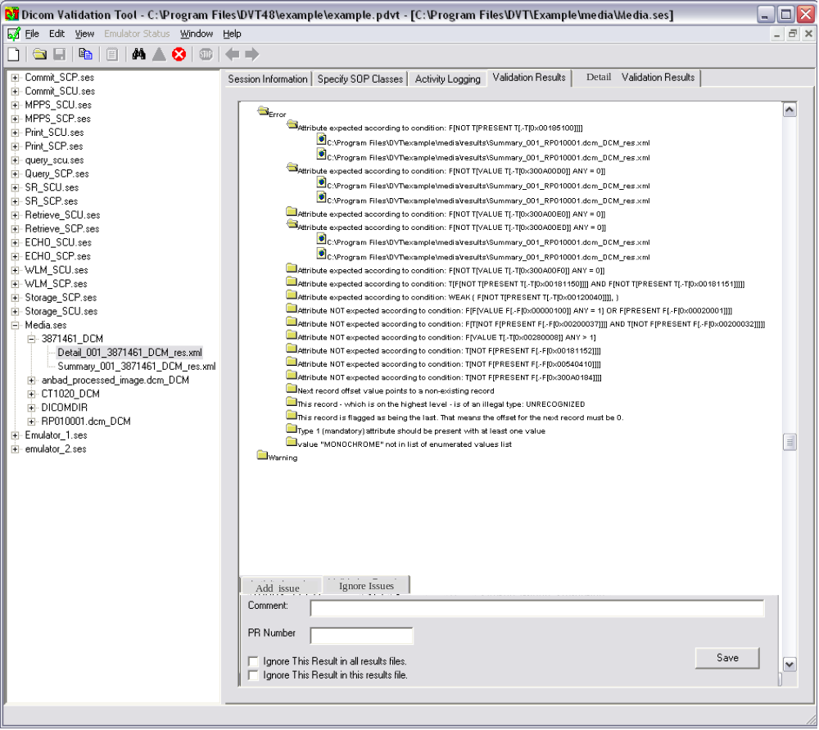
Generating Report
Introduction
GUI Changes
Details
Overview of Problems| Managing Results ’Hide’| Managing Results ’Add’| Reporting
Additional option in File Menu to generate Report
  ‘Save As’ Dialog opened
  XSLt Stylesheet called to create report.

Slide 21
Results manager tab
Introduction
GUI Changes
Details
Results manager tab | Other
This details section overrules the screenshots shown before! (use the name “Results manager” for the new tab)
When clicking on a Message hyperlink, the BeforeNavigate2 method must recognize that this is not a “normal” hyperlink and refresh the information on the bottom of the tab. Set e.cancel to true.
The back and forward buttons in the toolbar should also work in combination with this tab.

Slide 22
Results manager tab
Introduction
GUI Changes
Details
Results manager tab | Other
All added problems must also be visible in the tab (the style sheet will take care of this) (in the screenshots only the errors and warnings are shown).
For now, when adding a problem, ignoring an error or warning, etc. in this tab, don’t refresh the displayed HTML immediately (this will take to much time with large projects). Instead make a text available in the bottom of this tab stating that the HTML content is not up-to-date.

Slide 23
Results manager tab
Introduction
GUI Changes
Details
Results manager tab | Other
When the User wants to refresh the content of this tab (after e.g. ignoring several errors and warnings), he may use the Refresh key (F5) or Refresh menu item to do this. This may take up to 10 seconds with large projects.

Slide 24
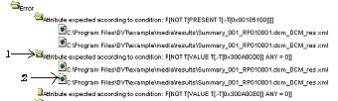
Results manager tab
Introduction
GUI Changes
Details
Results manager tab | Other
When selecting a Message with a folder icon (see above pointed by 1.), the checkbox “Ignore this results in this results file” must be disabled and not checked.
When selecting a Message representing a results file (see above pointed by 2.), the checkbox “Ignore this results in all results files” must be disabled and not checked.

Slide 25
Results manager tab
Introduction
GUI Changes
Details
Results manager tab | Other
When the User selects a Message in the “Validation results” Tab, both checkbox (“Ignore this results in this results file” and “Ignore this results in all results files”) are enabled. When checking one of these checkboxes, check if the other checkbox is also checked. If this is the case, uncheck the other checkbox.

Slide 26


