Slide 1

Chapter 3
Transport Layer
Computer Networking: A Top Down Approach
6th edition
Jim Kurose, Keith Ross
Addison-Wesley
March 2012
Transport Layer
3-<number>

Slide 2
Chapter 3: Transport Layer
our goals:
understand principles behind transport layer services:
  multiplexing, demultiplexing
  reliable data transfer
  flow control
  congestion control
learn about Internet transport layer protocols:
  UDP: connectionless transport
  TCP: connection-oriented reliable transport
  TCP congestion control
Transport Layer
3-<number>

Slide 3
Chapter 3 outline
3.1 transport-layer services
3.2 multiplexing and demultiplexing
3.3 connectionless transport: UDP
3.4 principles of reliable data transfer
3.5 connection-oriented transport: TCP
  segment structure
  reliable data transfer
  flow control
  connection management
3.6 principles of congestion control
3.7 TCP congestion control
Transport Layer
3-<number>

Slide 4

















Transport services and protocols
provide logical communication between app processes running on different hosts
transport protocols run in end systems
  send side: breaks app messages into segments, passes to network layer
  rcv side: reassembles segments into messages, passes to app layer
more than one transport protocol available to apps
  Internet: TCP and UDP
application
transport
network
data link
physical
logical end-end transport
application
transport
network
data link
physical
Transport Layer
3-<number>

Slide 5
Transport vs. network layer
network layer: logical communication between hosts
transport layer: logical communication between processes
  relies on, enhances, network layer services
household analogy:
12 kids in Ann’s house sending letters to 12 kids in Bill’s house:
hosts = houses
processes = kids
app messages = letters in envelopes
transport protocol = Ann and Bill who demux to in-house siblings
network-layer protocol = postal service
Transport Layer
3-<number>

Slide 6
Internet transport-layer protocols
IP service model
  Best effort service
  Unreliable
TCP and UDP
  Extend host-to-host delivery to process-to-process
  Called transport multiplexing and demultiplexing
application
transport
network
data link
physical
network
data link
physical
network
data link
physical
network
data link
physical
logical end-end transport
network
data link
physical
network
data link
physical
network
data link
physical
network
data link
physical
application
transport
network
data link
physical
Transport Layer
3-<number>

Slide 7
Internet transport-layer protocols
reliable, in-order delivery (TCP)
  congestion control
  flow control
  connection setup
  loss recovery
unreliable, unordered delivery: UDP
  no-frills extension of “best-effort” IP
services not available:
  delay guarantees
  bandwidth guarantees
Transport Layer
3-<number>

Slide 8
Chapter 3 outline
3.1 transport-layer services
3.2 multiplexing and demultiplexing
3.3 connectionless transport: UDP
3.4 principles of reliable data transfer
3.5 connection-oriented transport: TCP
  segment structure
  reliable data transfer
  flow control
  connection management
3.6 principles of congestion control
3.7 TCP congestion control
Transport Layer
3-<number>

Slide 9

Multiplexing/demultiplexing
multiplexing at sender:
demultiplexing at receiver:
handle data from multiple
sockets, add transport header (later used for demultiplexing)
use header info to deliver
received segments to
correct socket
application
application
P1
P2
application
socket
P3
transport
P4
process
transport
network
transport
network
link
network
link
physical
link
physical
physical
Transport Layer
3-<number>

Slide 10
How demultiplexing works
host receives IP datagrams
  each datagram has source IP address, destination IP address
  each datagram carries one transport-layer segment
  each segment has source, destination port number
host uses IP addresses & port numbers to direct segment to appropriate socket
32 bits
source port #
dest port #
other header fields
application
data
(payload)
TCP/UDP segment format
Transport Layer
3-<number>

Slide 11
Connectionless demultiplexing
recall: when creating datagram to send into UDP socket, must specify
  destination IP address
  destination port #
recall: created socket has host-local port #:
DatagramSocket mySocket1 = new DatagramSocket(12534);
when host receives UDP segment:
  checks destination port # in segment
  directs UDP segment to socket with that port #
IP datagrams with same dest. port #, but different source IP addresses and/or source port numbers will be directed to same socket at dest
Transport Layer
3-<number>

Slide 12
Connectionless demux: example
DatagramSocket serverSocket = new DatagramSocket
(6428);
DatagramSocket mySocket2 = new DatagramSocket
(9157);
DatagramSocket mySocket1 = new DatagramSocket (5775);
application
application
P1
application
P3
P4
transport
transport
network
transport
network
link
network
link
physical
link
physical
physical
source port: 6428
dest port: 9157
source port: ?
dest port: ?
source port: 9157
dest port: 6428
source port: ?
dest port: ?
Transport Layer
3-<number>

Slide 13
Connection-oriented demux
Reconsider TCP c/s program
  Server: welcome socket on port 12000
  Client: create a socket and send connection establish request (src IP+port)
  Server: create a new socket identified with src IP, src port, dst IP, and dst port
Transport Layer
3-<number>

Slide 14
Connection-oriented demux
TCP socket identified by 4-tuple:
  source IP address
  source port number
  dest IP address
  dest port number
demux: receiver uses all four values to direct segment to appropriate socket
server host may support many simultaneous TCP sockets:
  each socket identified by its own 4-tuple
web servers have different sockets for each connecting client
  non-persistent HTTP will have different socket for each request
Transport Layer
3-<number>

Slide 15
Connection-oriented demux: example
application
application
P4
P5
P6
application
P3
P2
P3
transport
transport
network
transport
network
link
network
link
physical
link
physical
server: IP address B
physical
host: IP address A
source IP,port: B,80
dest IP,port: A,9157
host: IP address C
source IP,port: C,5775
dest IP,port: B,80
source IP,port: A,9157
dest IP, port: B,80
source IP,port: C,9157
dest IP,port: B,80
three segments, all destined to IP address: B,
dest port: 80 are demultiplexed to different sockets
Transport Layer
3-<number>

Slide 16
Connection-oriented demux: example
threaded server
application
application
application
P4
P3
P3
P2
transport
transport
network
transport
network
link
network
link
physical
link
physical
server: IP address B
physical
host: IP address A
source IP,port: B,80
dest IP,port: A,9157
host: IP address C
source IP,port: C,5775
dest IP,port: B,80
source IP,port: A,9157
dest IP, port: B,80
source IP,port: C,9157
dest IP,port: B,80
high-performing Web servers often use only one process, and create a new thread with a new connection socket for each new client connection.
Transport Layer
3-<number>

Slide 17
Chapter 3 outline
3.1 transport-layer services
3.2 multiplexing and demultiplexing
3.3 connectionless transport: UDP
3.4 principles of reliable data transfer
3.5 connection-oriented transport: TCP
  segment structure
  reliable data transfer
  flow control
  connection management
3.6 principles of congestion control
3.7 TCP congestion control
Transport Layer
3-<number>

Slide 18
UDP: User Datagram Protocol [RFC 768]
“no frills,” “bare bones” Internet transport protocol
“best effort” service, UDP segments may be:
  lost
  delivered out-of-order to app
connectionless:
  no handshaking between UDP sender, receiver
  each UDP segment handled independently of others
UDP use:
  streaming multimedia apps (loss tolerant, rate sensitive)
  DNS
  SNMP
reliable transfer over UDP:
  add reliability at application layer
  application-specific error recovery!
Transport Layer
3-<number>

Slide 19
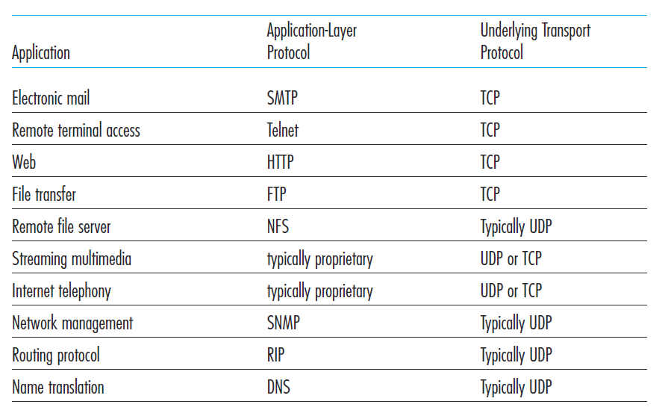

Transport Layer
3-<number>

Slide 20
UDP: segment header
length, in bytes of UDP segment, including header
32 bits
source port #
dest port #
length
checksum
why is there a UDP?
no connection establishment (which can add delay)
simple: no connection state at sender, receiver
small header size
no congestion control: UDP can blast away as fast as desired
application
data
(payload)
UDP segment format
Transport Layer
3-<number>

Slide 21
UDP checksum
Goal: detect “errors” (e.g., flipped bits) in transmitted segment
sender:
treat segment contents, including header fields, as sequence of 16-bit integers
checksum: addition (one’s complement sum) of segment contents
sender puts checksum value into UDP checksum field
receiver:
all four 16-bit words are added, including the checksum.
If no errors, then clearly the sum at the receiver will be 1111111111111111.
  no error detected. But maybe errors nonetheless? More later ….
Transport Layer
3-<number>

Slide 22
Internet checksum: example
example: add two 16-bit integers
1 1 1 1 0 0 1 1 0 0 1 1 0 0 1 1 0
1 1 1 0 1 0 1 0 1 0 1 0 1 0 1 0 1
1 1 0 1 1 1 0 1 1 1 0 1 1 1 0 1 1
1 1 0 1 1 1 0 1 1 1 0 1 1 1 1 0 0
1 0 1 0 0 0 1 0 0 0 1 0 0 0 0 1 1
wraparound
sum
checksum
Note: when adding numbers, a carryout from the most significant bit needs to be added to the result
Transport Layer
3-<number>
Notes:
Kurose and Ross forgot to say anything about wrapping the carry and adding it to low order bit

Slide 23
UDP checksum
Many link-layer protocol provide error-checking, then why checksum in UDP?
  no guarantee that all the links between source and destination provide error checking;
  error may happen when segment stored in a router’s memory
End-end principle in system design
Transport Layer
3-<number>

Slide 24
Chapter 3 outline
3.1 transport-layer services
3.2 multiplexing and demultiplexing
3.3 connectionless transport: UDP
3.4 principles of reliable data transfer
3.5 connection-oriented transport: TCP
  segment structure
  reliable data transfer
  flow control
  connection management
3.6 principles of congestion control
3.7 TCP congestion control
Transport Layer
3-<number>

Slide 25

Principles of reliable data transfer
important in application, transport, link layers
  top-10 list of important networking topics!
characteristics of unreliable channel will determine complexity of reliable data transfer protocol (rdt)
Transport Layer
3-<number>

Slide 26
Principles of reliable data transfer
important in application, transport, link layers
  top-10 list of important networking topics!
characteristics of unreliable channel will determine complexity of reliable data transfer protocol (rdt)
Transport Layer
3-<number>

Slide 27
Principles of reliable data transfer
important in application, transport, link layers
  top-10 list of important networking topics!
characteristics of unreliable channel will determine complexity of reliable data transfer protocol (rdt)
Transport Layer
3-<number>

Slide 28

Reliable data transfer: getting started
rdt_send(): called from above, (e.g., by app.). Passed data to
deliver to receiver upper layer
deliver_data(): called by rdt to deliver data to upper
send
side
receive
side
udt_send(): called by rdt,
to transfer packet over
unreliable channel to receiver
rdt_rcv(): called when packet arrives on rcv-side of channel
Transport Layer
3-<number>

Slide 29
Reliable data transfer: getting started
we’ll:
incrementally develop sender, receiver sides of reliable data transfer protocol (rdt)
consider only unidirectional data transfer
  but control info will flow on both directions!
use finite state machines (FSM) to specify sender, receiver
event causing state transition
actions taken on state transition
state: when in this “state” next state uniquely determined by next event
state
1
state
2
event
actions
Use Λ to denote the lack of event/action
Transport Layer
3-<number>

Slide 30
rdt1.0: reliable transfer over a reliable channel
underlying channel perfectly reliable
  no bit errors
  no loss of packets
separate FSMs for sender, receiver:
  sender sends data into underlying channel
  receiver reads data from underlying channel
Wait for call from above
rdt_send(data)
Wait for call from below
rdt_rcv(packet)
extract (packet,data)
deliver_data(data)
packet = make_pkt(data)
udt_send(packet)
sender
receiver
Dashed line indicates the start state
Transport Layer
3-<number>

Slide 31
rdt2.0: channel with bit errors
underlying channel may flip bits in packet
  checksum to detect bit errors
  but still assume no packet loss
How do humans recover from “errors”
during conversation?
Transport Layer
3-<number>

Slide 32
rdt2.0: channel with bit errors
underlying channel may flip bits in packet
  checksum to detect bit errors
the question: how to recover from errors:
  acknowledgements (ACKs): receiver explicitly tells sender that pkt received OK
  negative acknowledgements (NAKs): receiver explicitly tells sender that pkt had errors
  sender retransmits pkt on receipt of NAK
  reliable data transfer protocols based on such retransmission are known as ARQ (Automatic Repeat reQuest) protocols.
Transport Layer
3-<number>

Slide 33
rdt2.0: channel with bit errors
new mechanisms in rdt2.0 (beyond rdt1.0):
  error detection: checksum field in the rdt2.0 packet
  feedback: control msgs (ACK,NAK) from receiver to sender
  retransmission:
Transport Layer
3-<number>

Slide 34
rdt2.0: FSM specification
rdt_send(data)
sndpkt = make_pkt(data, checksum)
udt_send(sndpkt)
receiver
rdt_rcv(rcvpkt) &&
isNAK(rcvpkt)
Wait for call from above
Wait for ACK or NAK
rdt_rcv(rcvpkt) &&
corrupt(rcvpkt)
udt_send(sndpkt)
udt_send(NAK)
rdt_rcv(rcvpkt) && isACK(rcvpkt)
Λ
Wait for call from below
sender
rdt_rcv(rcvpkt) &&
notcorrupt(rcvpkt)
extract(rcvpkt,data)
deliver_data(data)
udt_send(ACK)
Transport Layer
3-<number>

Slide 35
rdt2.0: operation with no errors
rdt_send(data)
snkpkt = make_pkt(data, checksum)
udt_send(sndpkt)
rdt_rcv(rcvpkt) &&
isNAK(rcvpkt)
Wait for call from above
Wait for ACK or NAK
rdt_rcv(rcvpkt) &&
corrupt(rcvpkt)
udt_send(sndpkt)
udt_send(NAK)
rdt_rcv(rcvpkt) && isACK(rcvpkt)
Wait for call from below
Λ
rdt_rcv(rcvpkt) &&
notcorrupt(rcvpkt)
extract(rcvpkt,data)
deliver_data(data)
udt_send(ACK)
Transport Layer
3-<number>

Slide 36
rdt2.0: error scenario
rdt_send(data)
snkpkt = make_pkt(data, checksum)
udt_send(sndpkt)
rdt_rcv(rcvpkt) &&
isNAK(rcvpkt)
Wait for call from above
Wait for ACK or NAK
rdt_rcv(rcvpkt) &&
corrupt(rcvpkt)
udt_send(sndpkt)
udt_send(NAK)
rdt_rcv(rcvpkt) && isACK(rcvpkt)
Wait for call from below
Λ
rdt_rcv(rcvpkt) &&
notcorrupt(rcvpkt)
extract(rcvpkt,data)
deliver_data(data)
udt_send(ACK)
Transport Layer
3-<number>

Slide 37
rdt2.0 has a fatal flaw!
what happens if ACK/NAK corrupted?
sender doesn’t know what happened at receiver!
can’t just retransmit: possible duplicate
handling duplicates:
sender retransmits current pkt if ACK/NAK corrupted
sender adds sequence number to each pkt
receiver discards (doesn’t deliver up) duplicate pkt
stop and wait
sender sends one packet,
then waits for receiver
response
Transport Layer
3-<number>

Slide 38
rdt2.1: sender, handles garbled ACK/NAKs
a 1-bit sequence number will suffice, the receiver only needs to know whether the sender is resending
  the previously transmitted packet
  a new packet
ACK and NAK packets do not need to indicate the sequence number of the packet they are acknowledging
  The sender knows that a received ACK or NAK packet (whether garbled or not) was generated in response to its most recently transmitted data packet.
Transport Layer
3-<number>

Slide 39
rdt2.1: sender, handles garbled ACK/NAKs
rdt_send(data)
sndpkt = make_pkt(0, data, checksum)
udt_send(sndpkt)
rdt_rcv(rcvpkt) &&
( corrupt(rcvpkt) ||
isNAK(rcvpkt) )
Wait for call 0 from above
Wait for ACK or NAK 0
udt_send(sndpkt)
rdt_rcv(rcvpkt)
&& notcorrupt(rcvpkt)
&& isACK(rcvpkt)
rdt_rcv(rcvpkt)
&& notcorrupt(rcvpkt)
&& isACK(rcvpkt)
Λ
Λ
Wait for ACK or NAK 1
Wait for
call 1 from above
rdt_rcv(rcvpkt) &&
( corrupt(rcvpkt) ||
isNAK(rcvpkt) )
rdt_send(data)
udt_send(sndpkt)
sndpkt = make_pkt(1, data, checksum)
udt_send(sndpkt)
Transport Layer
3-<number>

Slide 40
rdt2.1: receiver, handles garbled ACK/NAKs
rdt_rcv(rcvpkt) && notcorrupt(rcvpkt)
&& has_seq0(rcvpkt)
extract(rcvpkt,data)
deliver_data(data)
sndpkt = make_pkt(ACK, chksum)
udt_send(sndpkt)
rdt_rcv(rcvpkt) && (corrupt(rcvpkt)
rdt_rcv(rcvpkt) && (corrupt(rcvpkt)
sndpkt = make_pkt(NAK, chksum)
udt_send(sndpkt)
sndpkt = make_pkt(NAK, chksum)
udt_send(sndpkt)
Wait for
0 from below
Wait for
1 from below
rdt_rcv(rcvpkt) &&
notcorrupt(rcvpkt) &&
has_seq1(rcvpkt)
rdt_rcv(rcvpkt) &&
not corrupt(rcvpkt) &&
has_seq0(rcvpkt)
sndpkt = make_pkt(ACK, chksum)
udt_send(sndpkt)
sndpkt = make_pkt(ACK, chksum)
udt_send(sndpkt)
rdt_rcv(rcvpkt) && notcorrupt(rcvpkt)
&& has_seq1(rcvpkt)
extract(rcvpkt,data)
deliver_data(data)
sndpkt = make_pkt(ACK, chksum)
udt_send(sndpkt)
Transport Layer
3-<number>

Slide 41
rdt2.1: discussion
sender:
seq # added to pkt
two seq. #’s (0,1) will suffice. Why?
must check if received ACK/NAK corrupted
twice as many states
  state must “remember” whether “expected” pkt should have seq # of 0 or 1
receiver:
must check if received packet is duplicate
  state indicates whether 0 or 1 is expected pkt seq #
note: receiver can not know if its last ACK/NAK received OK at sender
Transport Layer
3-<number>

Slide 42
rdt2.1: discussion
Receiver:
  When an out-of-order packet is received, the receiver sends a positive acknowledgment.
  When a corrupted packet is received, the receiver sends a negative acknowledgment.
Transport Layer
3-<number>

Slide 43
rdt2.2: a NAK-free protocol
same functionality as rdt2.1, using ACKs only
instead of NAK, receiver sends ACK for last pkt received OK
  receiver must explicitly include seq # of pkt being ACKed
duplicate ACK at sender results in same action as NAK: retransmit current pkt
Transport Layer
3-<number>

Slide 44
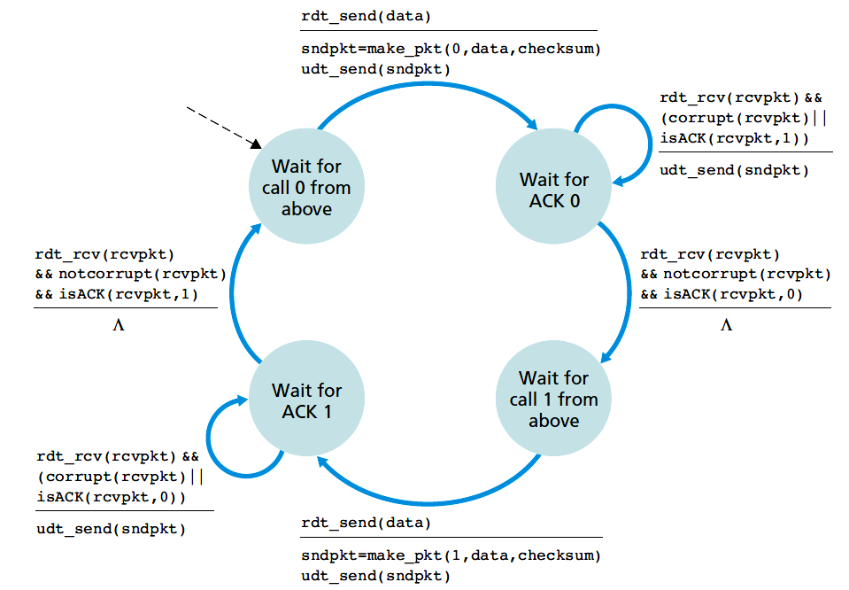
rdt2.2: sender
Transport Layer
3-<number>

Slide 45
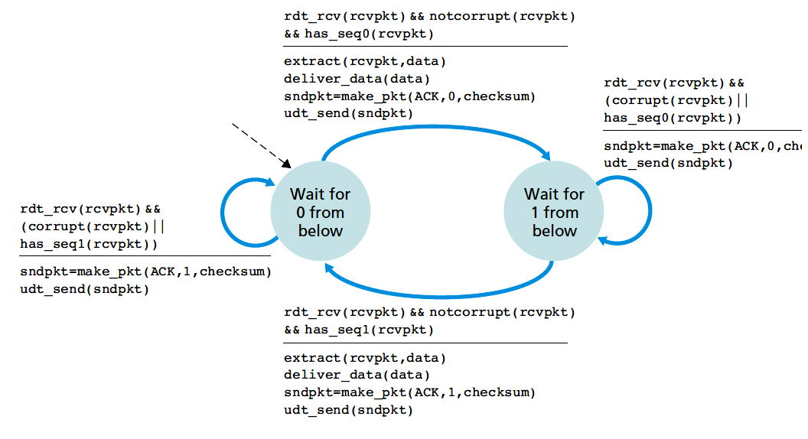
rdt2.2: receiver
Transport Layer
3-<number>

Slide 46
rdt3.0: channels with errors and loss
new assumption: underlying channel can also lose packets (data, ACKs)
  checksum, seq. #, ACKs, retransmissions will be of help … but not enough
approach: sender waits “reasonable” amount of time for ACK
retransmits if no ACK received in this time
if pkt (or ACK) just delayed (not lost):
  retransmission will be duplicate, but seq. #’s already handles this
  receiver must specify seq # of pkt being ACKed
Transport Layer
3-<number>

Slide 47
rdt3.0: channels with errors and loss
Sender doesn't know
  Data packet is lost, or
  Ack is lost, or
  Both
Countdown timer
  Start a timer each time a data packet is transmitted (retransmitted)
  Respond to a timer interrupt
  Stop the timer
Transport Layer
3-<number>

Slide 48
rdt3.0 sender
rdt_send(data)
rdt_rcv(rcvpkt) &&
( corrupt(rcvpkt) ||
isACK(rcvpkt,1) )
sndpkt = make_pkt(0, data, checksum)
udt_send(sndpkt)
start_timer
rdt_rcv(rcvpkt)
Λ
Λ
Wait for
call 0from above
Wait for ACK0
timeout
udt_send(sndpkt)
start_timer
rdt_rcv(rcvpkt)
&& notcorrupt(rcvpkt)
&& isACK(rcvpkt,1)
rdt_rcv(rcvpkt)
&& notcorrupt(rcvpkt)
&& isACK(rcvpkt,0)
stop_timer
stop_timer
Wait for ACK1
Wait for
call 1 from above
timeout
udt_send(sndpkt)
start_timer
rdt_rcv(rcvpkt)
rdt_send(data)
Λ
rdt_rcv(rcvpkt) &&
( corrupt(rcvpkt) ||
isACK(rcvpkt,0) )
sndpkt = make_pkt(1, data, checksum)
udt_send(sndpkt)
start_timer
Λ
Transport Layer
3-<number>

Slide 49

rdt3.0 in action
sender
receiver
sender
receiver
send pkt0
pkt0
send pkt0
pkt0
rcv pkt0
rcv pkt0
ack0
send ack0
ack0
send ack0
rcv ack0
rcv ack0
send pkt1
pkt1
send pkt1
pkt1
rcv pkt1
X
ack1
send ack1
loss
rcv ack1
send pkt0
pkt0
rcv pkt0
timeout
resend pkt1
ack0
send ack0
pkt1
rcv pkt1
ack1
send ack1
rcv ack1
send pkt0
pkt0
(a) no loss
rcv pkt0
ack0
send ack0
(b) packet loss
Transport Layer
3-<number>

Slide 50
rdt3.0 in action
sender
receiver
sender
receiver
send pkt0
pkt0
send pkt0
pkt0
rcv pkt0
rcv pkt0
ack0
send ack0
send ack0
rcv ack0
ack0
send pkt1
pkt1
rcv ack0
rcv pkt1
send pkt1
pkt1
send ack1
rcv pkt1
ack1
send ack1
ack1
X
loss
timeout
resend pkt1
pkt1
rcv pkt1
timeout
resend pkt1
rcv ack1
pkt1
rcv pkt1
pkt0
(detect duplicate)
send pkt0
send ack1
ack1
(detect duplicate)
ack1
rcv pkt0
rcv ack1
send ack1
rcv ack1
ack0
send ack0
pkt0
do nothing
send pkt0
rcv pkt0
ack0
send ack0
(c) ACK loss
(d) premature timeout/ delayed ACK
Transport Layer
3-<number>

Slide 51

Performance of rdt3.0
rdt3.0 is correct, but performance stinks
e.g.: 1 Gbps link, 15 ms prop. delay, 8000 bit packet:
L
8000 bits
D_{trans} =
=
=
8 microsecs
R
10⁹ bits/sec
  U _{sender}: utilization – fraction of time sender busy sending
  if RTT=30 msec, 1KB pkt every 30 msec: 33kB/sec thruput over 1 Gbps link
network protocol limits use of physical resources!
Transport Layer
3-<number>

Slide 52
rdt3.0: stop-and-wait operation
sender
receiver
first packet bit transmitted, t = 0
last packet bit transmitted, t = L / R
first packet bit arrives
RTT
last packet bit arrives, send ACK
ACK arrives, send next
packet, t = RTT + L / R
Transport Layer
3-<number>

Slide 53


Pipelined protocols
pipelining: sender allows multiple, “in-flight”, yet-to-be-acknowledged pkts
  range of sequence numbers must be increased
  buffering at sender and/or receiver
two generic forms of pipelined protocols: go-Back-N, selective repeat
Transport Layer
3-<number>

Slide 54

Pipelining: increased utilization
sender
receiver
first packet bit transmitted, t = 0
last bit transmitted, t = L / R
first packet bit arrives
RTT
last packet bit arrives, send ACK
last bit of 2nd packet arrives, send ACK
last bit of 3rd packet arrives, send ACK
ACK arrives, send next
packet, t = RTT + L / R
3-packet pipelining increases
utilization by a factor of 3!
Transport Layer
3-<number>

Slide 55
Pipelined protocols: overview
Go-back-N:
sender can have up to N unacked packets in pipeline
receiver only sends cumulative ack
  doesn’t ack packet if there’s a gap
sender has timer for oldest unacked packet
  when timer expires, retransmit all unacked packets
Selective Repeat:
sender can have up to N unack’ed packets in pipeline
rcvr sends individual ack for each packet
sender maintains timer for each unacked packet
  when timer expires, retransmit only that unacked packet
Transport Layer
3-<number>

Slide 56

Go-Back-N: sender
k-bit seq # in pkt header
“window” of up to N, consecutive unack’ed pkts allowed
[0, send_base-1]: packets transmitted and acked
[send_base, nextseqnum-1]: packets transmitted but not acked, in-flight packets
[nextseqnum, send_base+N-1]: packets can be sent
[send_base+N, ]: packets can not be sent
N: window size
GBN is called a sliding-window protocol
Transport Layer
3-<number>

Slide 57
Go-Back-N: sender
ACK(n): ACKs all pkts up to, including seq # n - “cumulative ACK”
  may receive duplicate ACKs (see receiver)
timer for oldest in-flight pkt
timeout(n): retransmit packet n and all higher seq # pkts in window
Transport Layer
3-<number>

Slide 58
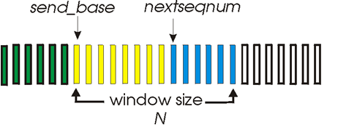
GBN: sender extended FSM
rdt_send(data)
if (nextseqnum < base+N) {
sndpkt[nextseqnum] = make_pkt(nextseqnum,data,chksum)
udt_send(sndpkt[nextseqnum])
if (base == nextseqnum)
start_timer
nextseqnum++
}
else
refuse_data(data)
Λ
base=1
nextseqnum=1
timeout
Wait
start_timer
udt_send(sndpkt[base])
udt_send(sndpkt[base+1])
…
udt_send(sndpkt[nextseqnum-1])
rdt_rcv(rcvpkt)
&& corrupt(rcvpkt)
rdt_rcv(rcvpkt) &&
notcorrupt(rcvpkt)
base = getacknum(rcvpkt)+1
If (base == nextseqnum)
stop_timer
else
start_timer
Transport Layer
3-<number>

Slide 59
GBN: sender extended FSM
When rdt_send() is called from above, check if the window is full
  Not full: send packet, update variables
  Full: return data to the uppper layer
Receive ACK with seq. n:
  All the packets up to n (including n) is acked, stop timer
  Restart timer if some packets are acked.
Timeout:
  Resend all the packets in [base, nextseqnum-1]
Transport Layer
3-<number>

Slide 60
GBN: receiver extended FSM
default
udt_send(sndpkt)
rdt_rcv(rcvpkt)
&& notcurrupt(rcvpkt)
&& hasseqnum(rcvpkt,expectedseqnum)
Λ
Wait
extract(rcvpkt,data)
deliver_data(data)
sndpkt = make_pkt(expectedseqnum,ACK,chksum)
udt_send(sndpkt)
expectedseqnum++
expectedseqnum=1
sndpkt =
make_pkt(expectedseqnum,ACK,chksum)
ACK-only: always send ACK for correctly-received pkt with highest in-order seq #
  may generate duplicate ACKs
  need only remember expectedseqnum
out-of-order pkt:
  discard (don’t buffer): no receiver buffering!
  re-ACK pkt with highest in-order seq #
Transport Layer
3-<number>

Slide 61
GBN in action
sender window (N=4)
sender
receiver
0 1 2 3 4 5 6 7 8
send pkt0
send pkt1
send pkt2
send pkt3
(wait)
0 1 2 3 4 5 6 7 8
receive pkt0, send ack0
receive pkt1, send ack1
receive pkt3, discard,
(re)send ack1
0 1 2 3 4 5 6 7 8
X
0 1 2 3 4 5 6 7 8
loss
0 1 2 3 4 5 6 7 8
rcv ack0, send pkt4
rcv ack1, send pkt5
0 1 2 3 4 5 6 7 8
receive pkt4, discard,
(re)send ack1
ignore duplicate ACK
receive pkt5, discard,
(re)send ack1
pkt 2 timeout
0 1 2 3 4 5 6 7 8
send pkt2
send pkt3
send pkt4
send pkt5
0 1 2 3 4 5 6 7 8
0 1 2 3 4 5 6 7 8
rcv pkt2, deliver, send ack2
rcv pkt3, deliver, send ack3
rcv pkt4, deliver, send ack4
rcv pkt5, deliver, send ack5
0 1 2 3 4 5 6 7 8
Transport Layer
3-<number>

Slide 62
Selective repeat
receiver individually acknowledges all correctly received pkts
  buffers pkts, as needed, for eventual in-order delivery to upper layer
sender only resends pkts for which ACK not received
  sender timer for each unACKed pkt
sender window
  N consecutive seq #’s
  limits seq #s of sent, unACKed pkts
Transport Layer
3-<number>

Slide 63

Selective repeat: sender, receiver windows
Sender and receiver not have identical view
Transport Layer
3-<number>

Slide 64
Selective repeat
sender
receiver
data from above:
if next available seq # in window, send pkt
timeout(n):
resend pkt n, restart timer
ACK(n) in [send_base,sendbase+N]:
mark pkt n as received
if n is the smallest unACKed pkt, advance window base to next unACKed seq #
pkt n in [rcvbase, rcvbase+N-1]
send ACK(n)
out-of-order: buffer
in-order: deliver (also deliver buffered, in-order pkts), advance window to next not-yet-received pkt
pkt n in [rcvbase-N,rcvbase-1]
ACK(n)
otherwise:
ignore
Transport Layer
3-<number>

Slide 65
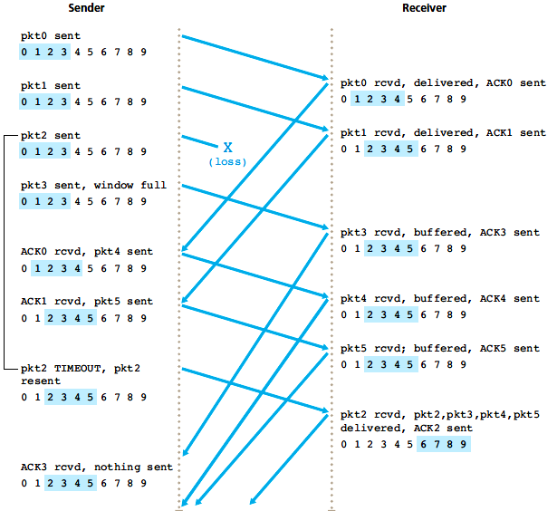
Selective repeat in action
Q: what happens when ack2 arrives?
Transport Layer
3-<number>

Slide 66

Selective repeat: dilemma
sender window
(after receipt)
receiver window
(after receipt)
0 1 2 3 0 1 2
pkt0
0 1 2 3 0 1 2
pkt1
0 1 2 3 0 1 2
example:
seq #’s: 0, 1, 2, 3
window size=3
0 1 2 3 0 1 2
pkt2
0 1 2 3 0 1 2
0 1 2 3 0 1 2
0 1 2 3 0 1 2
pkt3
X
0 1 2 3 0 1 2
pkt0
will accept packet
with seq number 0
receiver sees no difference in two scenarios!
duplicate data accepted as new in (b)
Q: what relationship between seq # size and window size to avoid problem in (b)?
(a) no problem
receiver can’t see sender side.
receiver behavior identical in both cases!
something’s (very) wrong!
0 1 2 3 0 1 2
pkt0
0 1 2 3 0 1 2
pkt1
0 1 2 3 0 1 2
0 1 2 3 0 1 2
pkt2
0 1 2 3 0 1 2
X
0 1 2 3 0 1 2
X
window size must be less than or equal to half the size of the sequence number space
timeout
retransmit pkt0
X
0 1 2 3 0 1 2
pkt0
will accept packet
with seq number 0
(b) oops!
Transport Layer
3-<number>

Slide 67
Comparing GBN and SR
GBN
Pros
  Sender maintains one timer
  Receiver does not need to buffer out-of-order packets
  Easy to implement
Cons
  Waste bandwidth, causing congestions
SR
Pros
  Do not waste bandwith
Cons
  Sender maintains timer for each unacked packet
  Reciever buffers out-of-order packets
  Complex
Transport Layer
3-<number>

Slide 68
Chapter 3 outline
3.1 transport-layer services
3.2 multiplexing and demultiplexing
3.3 connectionless transport: UDP
3.4 principles of reliable data transfer
3.5 connection-oriented transport: TCP
  segment structure
  reliable data transfer
  flow control
  connection management
3.6 principles of congestion control
3.7 TCP congestion control
Transport Layer
3-<number>

Slide 69
TCP: Overview RFCs: 793,1122,1323, 2018, 2581
point-to-point:
  one sender, one receiver
  multicasting is not possible
reliable, in-order byte steam:
  no “message boundaries”
pipelined:
  TCP congestion and flow control set window size
full duplex data:
  bi-directional data flow in same connection
  MSS: maximum segment size
  First determine the maximum transmission unit (MTU) of the link layer, then set MSS by deducing the TCP/IP header length (typically 40 bytes)
  Ethernet/PPP have MSS of 1500 bytes.
Transport Layer
3-<number>

Slide 70
TCP: Overview
connection-oriented:
  handshaking (exchange of control msgs) inits sender, receiver state before data exchange
  Client sends a special segment, sender returns a special segment; and client responds with a third segment
  Three-way handshake
flow controlled:
  sender will not overwhelm receiver
Transport Layer
3-<number>

Slide 71
TCP segment structure
32 bits
URG: urgent data
(generally not used)
counting
by bytes
of data
(not segments!)
source port #
dest port #
sequence number
ACK: ACK #
valid
acknowledgement number
head
len
not
used
U
receive window
A
PSH: push data now
(generally not used)
P
R
S
F
# bytes
rcvr willing
to accept
checksum
Urg data pointer
RST, SYN, FIN:
connection estab
(setup, teardown
commands)
options (variable length)
application
data
(variable length)
Location of the last byte of the urgent data, if URG is set
Internet
checksum
(as in UDP)
Transport Layer
3-<number>

Slide 72
TCP seq. numbers, ACKs
outgoing segment from sender
sequence numbers:
  byte stream “number” of first byte in segment’s data
acknowledgements:
  seq # of next byte expected from other side
  cumulative ACK
Q: how receiver handles out-of-order segments
  A: TCP spec doesn’t say, - up to implementor
source port #
dest port #
sequence number
acknowledgement number
rwnd
checksum
urg pointer
window size
N
  sender sequence number space
sent
ACKed
sent, not-yet ACKed
(“in-flight”)
usable
but not
yet sent
not
usable
incoming segment to sender
source port #
dest port #
sequence number
acknowledgement number
A
rwnd
checksum
urg pointer
Transport Layer
3-<number>

Slide 73
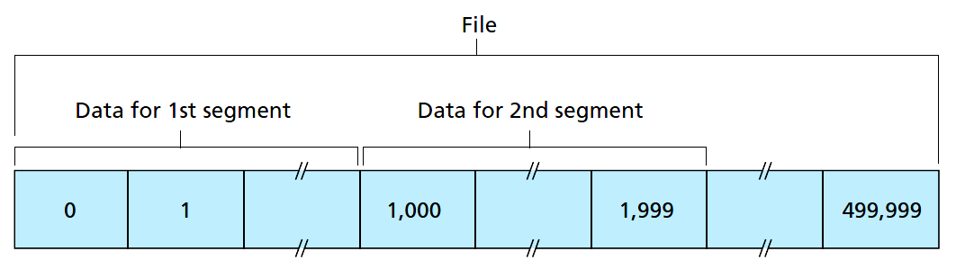
TCP seq. numbers, ACKs
Example 1: A file of 500,000 bytes, MSS=1000 bytes
  Segment 1, seq#=0
  Segment 2, seg#=1000
  Segment 3, seg#=2000
  …
Example 2: A receives a segment from B containing 0~535 bytes, and another segment containing 900~1000 bytes, but not the bytes 536~899.
  A’s segment to B ack#=536
  Accumulative acknowledgement
Transport Layer
3-<number>

Slide 74
TCP seq. numbers, ACKs
Host A
Host B
User
types
‘C’
Seq=42, ACK=79, data = ‘C’
host ACKs
receipt of
‘C’, echoes
back ‘C’
Seq=79, ACK=43, data = ‘C’
host ACKs
receipt
of echoed
‘C’
Seq=43, ACK=80
the acknowledgment for the first client-to-server data is said to be piggybacked on the server-to-client data segment.
simple telnet scenario
Transport Layer
3-<number>

Slide 75
TCP round trip time, timeout
Q: how to set TCP timeout value?
longer than RTT
  but RTT varies
too short: premature timeout, unnecessary retransmissions
too long: slow reaction to segment loss
Q: how to estimate RTT?
SampleRTT: measured time from segment transmission until ACK receipt
  ignore retransmissions
SampleRTT will vary, want estimated RTT “smoother”
  average several recent measurements, not just current SampleRTT
Transport Layer
3-<number>

Slide 76

TCP round trip time, timeout
EstimatedRTT = (1- α)*EstimatedRTT + α*SampleRTT
exponential weighted moving average (EWMA)
influence of past sample decreases exponentially fast
typical value: α = 0.125
指数加权移动平均
RTT: gaia.cs.umass.edu to fantasia.eurecom.fr
RTT (milliseconds)
sampleRTT
EstimatedRTT
time (seconds)
Transport Layer
3-<number>

Slide 77
TCP round trip time, timeout
Measure the variability of the RTT
EWMA of the difference between SampleRTT and EstimatedRTT
Recommed value for β is 0.25
Transport Layer
3-<number>

Slide 78

TCP round trip time, timeout
timeout interval: EstimatedRTT plus “safety margin”
  large variation in EstimatedRTT -> larger safety margin
Initial TimeoutInterval=1 sec.
TimeoutInterval = EstimatedRTT + 4*DevRTT
estimated RTT
“safety margin”
Transport Layer
3-<number>

Slide 79
Chapter 3 outline
3.1 transport-layer services
3.2 multiplexing and demultiplexing
3.3 connectionless transport: UDP
3.4 principles of reliable data transfer
3.5 connection-oriented transport: TCP
  segment structure
  reliable data transfer
  flow control
  connection management
3.6 principles of congestion control
3.7 TCP congestion control
Transport Layer
3-<number>

Slide 80
TCP reliable data transfer
TCP creates rdt service on top of IP’s unreliable service
  pipelined segments
  cumulative acks
  single retransmission timer
retransmissions triggered by:
  timeout events
  duplicate acks
let’s initially consider simplified TCP sender:
  ignore duplicate acks
  ignore flow control, congestion control
Transport Layer
3-<number>

Slide 81
TCP sender events:
data rcvd from app:
create segment with seq #
seq # is byte-stream number of first data byte in segment
start timer if not already running
  think of timer as for oldest unacked segment
  expiration interval: TimeOutInterval
timeout:
retransmit segment that caused timeout
restart timer
ack rcvd:
if ack acknowledges previously unacked segments
  update what is known to be ACKed
  start timer if there are still unacked segments
Transport Layer
3-<number>

Slide 82
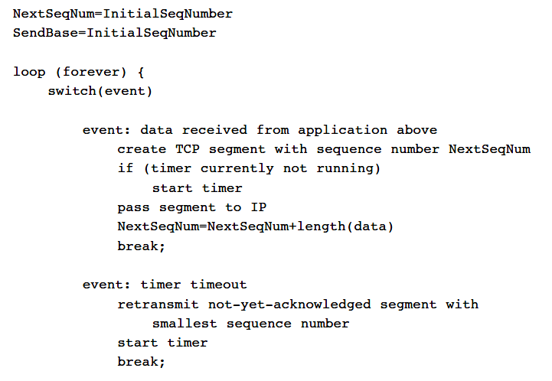
TCP sender events:
Transport Layer
3-<number>

Slide 83
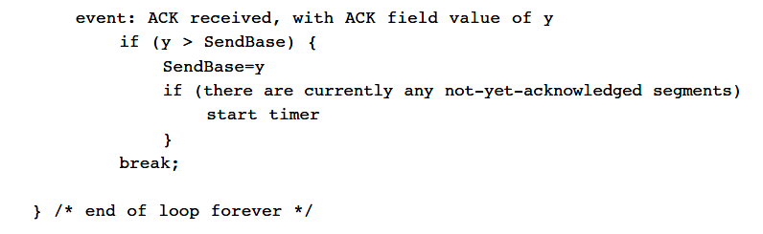
TCP sender events:
Transport Layer
3-<number>

Slide 84
TCP sender (simplified)
data received from application above
create segment, seq. #: NextSeqNum
pass segment to IP (i.e., “send”)
NextSeqNum = NextSeqNum + length(data)
if (timer currently not running)
start timer
Λ
NextSeqNum = InitialSeqNum
SendBase = InitialSeqNum
wait
for
event
timeout
retransmit not-yet-acked segment with smallest seq. #
start timer
ACK received, with ACK field value y
if (y > SendBase) {
SendBase = y
/* SendBase–1: last cumulatively ACKed byte */
if (there are currently not-yet-acked segments)
start timer
else stop timer
}
Transport Layer
3-<number>

Slide 85
TCP: retransmission scenarios
Host A
Host B
Host A
Host B
SendBase=92
Seq=92, 8 bytes of data
Seq=92, 8 bytes of data
timeout
timeout
Seq=100, 20 bytes of data
ACK=100
X
ACK=100
ACK=120
Seq=92, 8 bytes of data
Seq=92, 8
bytes of data
SendBase=100
SendBase=120
ACK=100
ACK=120
SendBase=120
lost ACK scenario
premature timeout
The second segment will not be retransmitted untill another timeout
Transport Layer
3-<number>

Slide 86
TCP: retransmission scenarios
Host A
Host B
Seq=92, 8 bytes of data
Seq=100, 20 bytes of data
timeout
ACK=100
X
ACK=120
Seq=120, 15 bytes of data
cumulative ACK
Transport Layer
3-<number>

Slide 87
Doubling timeout
whenever the timeout event occurs, TCP retransmits the not-yetacknowledged segment with the smallest sequence number, as described above.
  But each time TCP retransmits, it sets the next timeout interval to twice the previous value.
  A limited form of congestion control
whenever the timer is started after either of the two other events (that is, data received from application above, and ACK received), the TimeoutInterval is derived from the most recent values of EstimatedRTT and DevRTT.
Transport Layer
3-<number>

Slide 88
TCP ACK generation [RFC 1122, RFC 2581]
event at receiver
arrival of in-order segment with
expected seq #. All data up to
expected seq # already ACKed
arrival of in-order segment with
expected seq #. One other
segment waiting for ACK
transmission.
arrival of out-of-order segment
higher-than-expect seq. # .
Gap detected
arrival of segment that
partially or completely fills gap
TCP receiver action
delayed ACK. Wait up to 500ms
for next segment. If no next segment,
send ACK
immediately send single cumulative
ACK, ACKing both in-order segments
immediately send duplicate ACK,
indicating seq. # of next expected byte
immediate send ACK, given that
segment starts at lower end of gap
Transport Layer
3-<number>

Slide 89
TCP fast retransmit
time-out period often relatively long:
  long delay before resending lost packet
detect lost segments via duplicate ACKs.
  sender often sends many segments back-to-back
  if segment is lost, there will likely be many duplicate ACKs.
TCP fast retransmit
if sender receives 3 ACKs for same data
(“triple duplicate ACKs”), resend unacked segment with smallest seq #
  likely that unacked segment lost, so don’t wait for timeout
Transport Layer
3-<number>

Slide 90
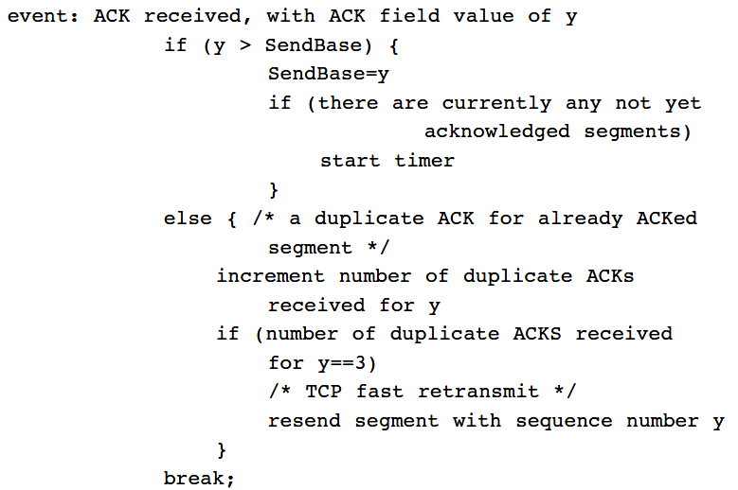
TCP fast retransmit
Transport Layer
3-<number>

Slide 91
TCP fast retransmit
Host A
Host B
Seq=92, 8 bytes of data
The first ACK is not dupliccated ACK
Seq=100, 20 bytes of data
X
ACK=100
timeout
ACK=100
ACK=100
ACK=100
Seq=100, 20 bytes of data
fast retransmit after sender
receipt of triple duplicate ACK
Transport Layer
3-<number>

Slide 92
Discussion
Maintains the smallest seq # of transmitted but not acked byte (SendBase) and the sequence of the next byte to send (NextSeqNum)
  GBN-like
Buffer out-of-order segments, accumulative acknowledgement, only need to retransmit lost data
  SR-like
Transport Layer
3-<number>

Slide 93
Chapter 3 outline
3.1 transport-layer services
3.2 multiplexing and demultiplexing
3.3 connectionless transport: UDP
3.4 principles of reliable data transfer
3.5 connection-oriented transport: TCP
  segment structure
  reliable data transfer
  flow control
  connection management
3.6 principles of congestion control
3.7 TCP congestion control
Transport Layer
3-<number>

Slide 94
TCP flow control
application
process
application may
remove data from
TCP socket buffers ….
application
TCP socket
receiver buffers
OS
… slower than TCP
receiver is delivering
(sender is sending)
TCP
code
flow control
IP
code
receiver controls sender, so sender won’t overflow receiver’s buffer by transmitting too much, too fast
from sender
receiver protocol stack
Transport Layer
3-<number>

Slide 95
TCP flow control
receiver “advertises” free buffer space by including rwnd value in TCP header of receiver-to-sender segments
  RcvBuffer size set via socket options (typical default is 4096 bytes)
  many operating systems autoadjust RcvBuffer
sender limits amount of unacked (“in-flight”) data to receiver’s rwnd value
guarantees receive buffer will not overflow
to application process
RcvBuffer
buffered data
rwnd
free buffer space
TCP segment payloads
receiver-side buffering
Transport Layer
3-<number>

Slide 96
TCP flow control
Receiver maintains
  LastByteRead: last byte read by the application process
  LastByteRcvd: last byte arrived in the receiver buffer
Sender maintains
  LastByteSent
  LastByteAcked
  Ensure than
rwnd = RcvBuffer - [LastByteRead - LastByteRcvd]
LastByteSent – LastByteAcked ≤ rwnd
Transport Layer
3-<number>

Slide 97
TCP flow control
One problem
  Receiver announce rwnd=0 to the sender
  Sender stops to send
  Receiver has no data to acknowledge, sender has no way to know the receiver's new rwnd
TCP specification requires sender to continue to send segments with one data byte when receiver's receive window is zero.
Transport Layer
3-<number>

Slide 98
Chapter 3 outline
3.1 transport-layer services
3.2 multiplexing and demultiplexing
3.3 connectionless transport: UDP
3.4 principles of reliable data transfer
3.5 connection-oriented transport: TCP
  segment structure
  reliable data transfer
  flow control
  connection management
3.6 principles of congestion control
3.7 TCP congestion control
Transport Layer
3-<number>

Slide 99
Connection Management
before exchanging data, sender/receiver “handshake”:
agree to establish connection (each knowing the other willing to establish connection)
agree on connection parameters
application
application
connection state: ESTAB
connection variables:
  seq # client-to-server
  server-to-client
  rcvBuffer size
  at server,client
connection state: ESTAB
connection Variables:
  seq # client-to-server
  server-to-client
  rcvBuffer size
  at server,client
network
network
Socket clientSocket =
newSocket("hostname","port number");
Socket connectionSocket = welcomeSocket.accept();
Transport Layer
3-<number>

Slide 100
TCP 3-way handshake
client state
server state
LISTEN
LISTEN
choose init seq num, x
send TCP SYN segment
SYNSENT
SYNbit=1, Seq=x
choose init seq num, y
send TCP SYNACK
segment, acking SYN
SYN RCVD
SYNbit=1, Seq=y
ACKbit=1; ACKnum=x+1
received SYNACK(x)
indicates server is live;
send ACK for SYNACK;
this segment may contain
client-to-server data
ESTAB
ACKbit=1, ACKnum=y+1
received ACK(y)
indicates client is live
ESTAB
Transport Layer
3-<number>

Slide 101
TCP 3-way handshake
Client: send initial TCP SYN segment
  SYNbit=1
  Choose an initial sequence number x
Server:
  Receive TCP SYN segment, allocate buffer and variables
  Send SYNACK segment (SYNbit=1, ACKbit=1), choose an initial sequence number y, acknowledge sequence number x+1
Client:
  Receive SYNACK segment
  Send ACK, acknowledge sequence number y+1
Transport Layer
3-<number>

Slide 102
TCP 3-way handshake: FSM
closed
Socket connectionSocket = welcomeSocket.accept();
Λ
Socket clientSocket =
newSocket("hostname","port number");
SYN(x)
SYNACK(seq=y,ACKnum=x+1)
create new socket for
communication back to client
listen
SYN(seq=x)
SYN
rcvd
SYN
sent
SYNACK(seq=y,ACKnum=x+1)
ACK(ACKnum=y+1)
ESTAB
ACK(ACKnum=y+1)
Λ
Transport Layer
3-<number>

Slide 103
TCP: closing a connection
client state
server state
ESTAB
ESTAB
clientSocket.close()
FIN_WAIT_1
can no longer
send but can
receive data
FINbit=1, seq=x
CLOSE_WAIT
ACKbit=1; ACKnum=x+1
can still
send data
FIN_WAIT_2
wait for server
close
LAST_ACK
FINbit=1, seq=y
TIMED_WAIT
can no longer
send data
ACKbit=1; ACKnum=y+1
timed wait
for 2*max
segment lifetime
CLOSED
CLOSED
Transport Layer
3-<number>

Slide 104
TCP: closing a connection
Client:
  Send segment with FINbit=1, enters into FIN_WAIT_1 state
  Wait and receive acknowledgement from server, enters into FIN_WAIT_2 state
  Wait and receive segment with FINbit=1, acknowledges the segment, enters into TIME_WAIT state
  Stay in the TIME_WAIT state for a while, retransmit acknowledgement if lost, then enters into CLOSED state
Server
  Receive segment with FINbit=1 from the client, acknowledges it, enters into CLOSE_WAIT state
  Send segment with FINbit=1, enters into LAST_ACK state
  Receive acknowledgement from the client, enters into CLOSED state.
Transport Layer
3-<number>

Slide 105
TCP: closing a connection
client, server each close their side of connection
  send TCP segment with FIN bit = 1
respond to received FIN with ACK
  on receiving FIN, ACK can be combined with own FIN
simultaneous FIN exchanges can be handled
Transport Layer
3-<number>

Slide 106
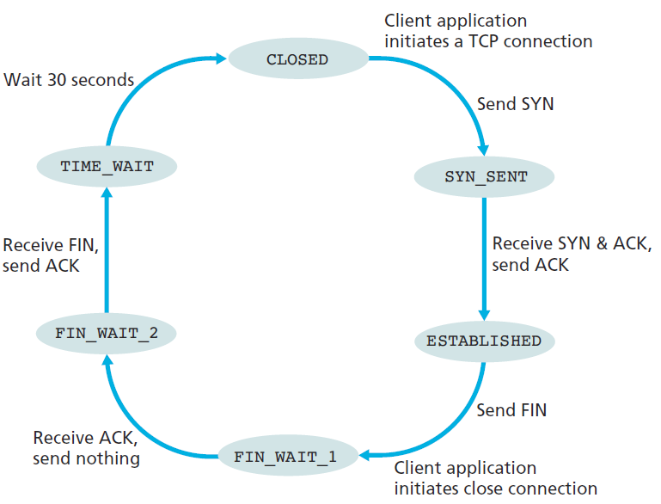
Client TCP FSM
Transport Layer
3-<number>

Slide 107
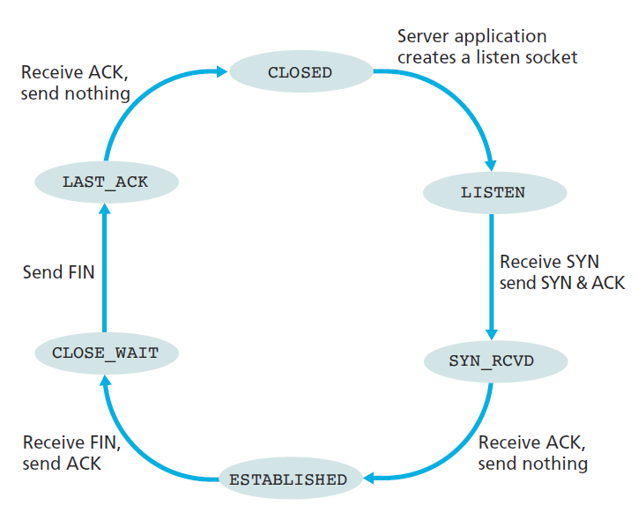
Server TCP FSM
Transport Layer
3-<number>

Slide 108
Reject connection
A server receives a TCP SYN packet with destination port, but the host is not accepting connections on that port.
Send a special reset segment to the source. This TCP segment has the RSTbit=1.
nmap: port scan tool
Transport Layer
3-<number>

Slide 109
Chapter 3 outline
3.1 transport-layer services
3.2 multiplexing and demultiplexing
3.3 connectionless transport: UDP
3.4 principles of reliable data transfer
3.5 connection-oriented transport: TCP
  segment structure
  reliable data transfer
  flow control
  connection management
3.6 principles of congestion control
3.7 TCP congestion control
Transport Layer
3-<number>

Slide 110
Principles of congestion control
congestion:
informally: “too many sources sending too much data too fast for network to handle”
different from flow control!
manifestations:
  lost packets (buffer overflow at routers)
  long delays (queueing in router buffers)
a top-10 problem!
Transport Layer
3-<number>

Slide 111

Causes/costs of congestion: scenario 1
original data: λ_{in}
throughput: λ_{out}
two senders, two receivers
one router, infinite buffers
output link capacity: R
no retransmission
Host A
unlimited shared output link buffers
Host B
R/2
λ_{out}
delay
λ_{in}
R/2
λ_{in}
R/2
maximum per-connection throughput: R/2
large delays as arrival rate, λ_{in}, approaches capacity
Transport Layer
3-<number>

Slide 112
Causes/costs of congestion: scenario 2
one router, finite buffers
sender retransmission of timed-out packet
  application-layer input = application-layer output: λ_{in} = λ_{out}
  transport-layer input includes retransmissions : λ_{in} λ_{in}
‘
λ‘_{in} is called offered load
λ_{in} : original data
λ'_{in}: original data, plus retransmitted data
λ_{out}
Host A
finite shared output link buffers
Host B
Transport Layer
3-<number>

Slide 113
Causes/costs of congestion: scenario 2
R/2
idealization: perfect knowledge
sender sends only when router buffers available
λ_{out}
λ_{in}
R/2
λ_{in} : original data
copy
λ'_{in}: original data, plus retransmitted data
λ_{out}
A
free buffer space!
finite shared output link buffers
Host B
Transport Layer
3-<number>

Slide 114

Causes/costs of congestion: scenario 2
Idealization: known loss packets can be lost, dropped at router due to full buffers
sender only resends if packet known to be lost
λ_{in} : original data
copy
λ'_{in}: original data, plus retransmitted data
λ_{out}
A
no buffer space!
Host B
Transport Layer
3-<number>

Slide 115
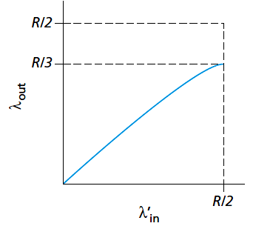
Causes/costs of congestion: scenario 2
Idealization: known loss packets can be lost, dropped at router due to full buffers
sender only resends if packet known to be lost
out of the 0.5R units of data transmitted, 0.333R bytes/sec (on average) are original data and 0.166R bytes/sec (on average) are retransmitted data.
λ_{in} : original data
λ'_{in}: original data, plus retransmitted data
λ_{out}
A
free buffer space!
Host B
Transport Layer
3-<number>

Slide 116
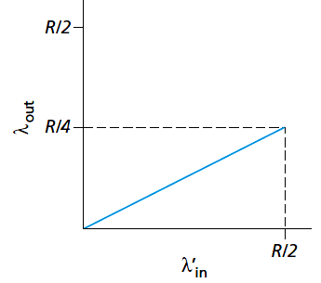


Causes/costs of congestion: scenario 2
Realistic: duplicates
packets can be lost, dropped at router due to full buffers
sender times out prematurely, sending two copies, both of which are delivered
the work done by the router in forwarding the retransmitted copy of the original packet was wasted.
λ_{in}
copy
λ'_{in}
λ_{out}
timeout
A
free buffer space!
Host B
Transport Layer
3-<number>

Slide 117
Causes/costs of congestion: scenario 2
Realistic: duplicates
packets can be lost, dropped at router due to full buffers
sender times out prematurely, sending two copies, both of which are delivered
“costs” of congestion:
delay
more work (retrans) for given “goodput”
unneeded retransmissions: link carries multiple copies of pkt
  decreasing goodput
Transport Layer
3-<number>

Slide 118
Causes/costs of congestion: scenario 3
Q: what happens as λ_{in} and λ_{in}’ increase ?
four senders
multihop paths
timeout/retransmit
A: as red λ_{in}’ increases, all arriving blue pkts at upper queue are dropped, blue throughput  0
Host A
λ_{in} : original data
λ_{out}
Host B
λ'_{in}: original data, plus retransmitted data
finite shared output link buffers
Host D
Host C
Transport Layer
3-<number>

Slide 119
Causes/costs of congestion: scenario 3
C/2
λ_{out}
λ_{in}’
C/2
Blue traffic arrives at router with rate of R (router-router capacity)
Red traffic arrives at router with extremely large rate λ_{in}’
another “cost” of congestion:
when packet dropped, any “upstream” transmission capacity used for that packet was wasted!
Transport Layer
3-<number>

Slide 120
Approaches towards congestion control
two broad approaches towards congestion control:
end-end congestion control:
no explicit feedback from network
congestion inferred from end-system observed loss, delay
approach taken by TCP
network-assisted congestion control:
routers provide feedback to end systems
  single bit indicating congestion (SNA, DECbit, TCP/IP ECN, ATM)
  explicit rate for sender to send at
Transport Layer
3-<number>

Slide 121
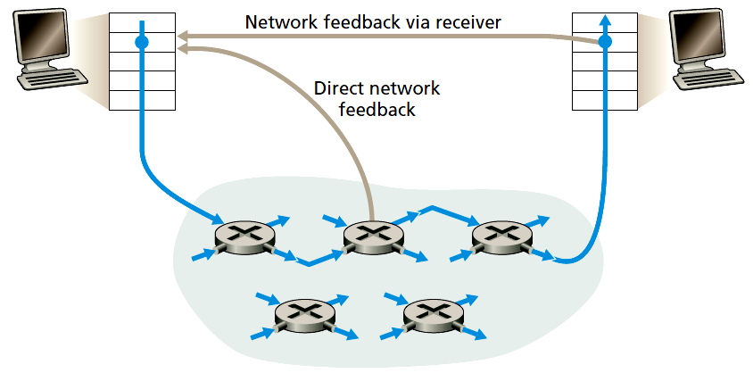
Approaches towards congestion control
Transport Layer
3-<number>

Slide 122
Case study: ATM ABR congestion control
ABR: available bit rate:
“elastic service”
if sender’s path “underloaded”:
  sender should use available bandwidth
if sender’s path congested:
  sender throttled to minimum guaranteed rate
RM (resource management) cells:
sent by sender, interspersed with data cells
bits in RM cell set by switches (“network-assisted”)
  NI bit: no increase in rate (mild congestion)
  CI bit: congestion indication (severe congestion)
RM cells returned to sender by receiver, with bits intact
Transport Layer
3-<number>

Slide 123
Case study: ATM ABR congestion control
RM cell
data cell
two-byte ER (explicit rate) field in RM cell
  congested switch may lower ER value in cell
  ER filed set as the minimum supportable rate on path
EFCI bit in data cells: set to 1 in congested switch
  if data cell preceding RM cell has EFCI set, receiver sets CI bit in returned RM cell
Transport Layer
3-<number>

Slide 124
Chapter 3 outline
3.1 transport-layer services
3.2 multiplexing and demultiplexing
3.3 connectionless transport: UDP
3.4 principles of reliable data transfer
3.5 connection-oriented transport: TCP
  segment structure
  reliable data transfer
  flow control
  connection management
3.6 principles of congestion control
3.7 TCP congestion control
Transport Layer
3-<number>

Slide 125
Congestion Window
TCP stack maintains variables
  LastByteSent
  LastByteAcked
  rwnd
Sender's congestion control mechanism tracks additional variable
  Congestion window, cwnd
  Ensure that
Sender's data rate: cwnd/RTT (bytes/sec)
Transport Layer
3-<number>

Slide 126
TCP congestion control: additive increase multiplicative decrease
approach: sender increases transmission rate (cwnd), probing for usable bandwidth, until loss occurs
  additive increase: increase cwnd by 1 MSS every RTT until loss detected
  multiplicative decrease: cut cwnd in half after loss
additively increase window size …
…. until loss occurs (then cut window in half)
AIMD saw tooth
behavior: probing
for bandwidth
cwnd: TCP sender
congestion window size
time
Transport Layer
3-<number>

Slide 127
TCP Congestion Control: details
sender sequence number space
TCP sending rate:
roughly: send cwnd bytes, wait RTT for ACKS, then send more bytes
cwnd
last byte
ACKed
last byte sent
sent, not-yet ACKed
(“in-flight”)
rate
cwnd
sender limits transmission:
cwnd is dynamic, function of perceived network congestion
~
bytes/sec
~
RTT
Transport Layer
3-<number>

Slide 128
TCP Slow Start
Host A
Host B
when connection begins, increase rate exponentially until first loss event:
  initially cwnd = 1 MSS
  double cwnd every RTT
  done by incrementing cwnd for every ACK received
summary: initial rate is slow but ramps up exponentially fast
one segment
RTT
two segments
four segments
time
Slow start is not slow!
Transport Layer
3-<number>

Slide 129
TCP Slow Start
When to end the exponential growth?
  if there is a loss event (i.e., congestion) indicated by a timeout,
    the TCP sender sets the value of cwnd to 1 and begins the slow start process anew; It also sets the value of a second state variable, ssthresh to cwnd/2 (Tahoe and Reno)
  The second way in which slow start may end cwnd equals ssthresh, enter into congestion avoidance state
  The final way in which slow start can end is if three duplicate ACKs are detected, in which case TCP performs a fast retransmit and enters the fast recovery state.
    Reno only
Transport Layer
3-<number>

Slide 130
TCP: detecting, reacting to loss
loss indicated by timeout (Tahoe and Reno):
  cwnd set to 1 MSS;
  window then grows exponentially (as in slow start) to threshold, then grows linearly
loss indicated by 3 duplicate ACKs: TCP RENO
  dup ACKs indicate network capable of delivering some segments
  Goes to the fast recovery state
TCP Tahoe always sets cwnd to 1 (timeout or 3 duplicate acks)
Transport Layer
3-<number>

Slide 131
Congestion Avoidance
Increases the value of cwnd by just a single MSS every RTT
  TCP sender increases cwnd by MSS bytes (MSS/cwnd) whenever a new ack arrives.
  When a cwnd of data is acked, cwnd increases by MSS
When to end?
  When a timeout occurs: The value of cwnd is set to 1 MSS, and the value of ssthresh is updated to half the value of cwnd when the loss event occurred.
  Triple duplicate ACK event: halves the value of cwnd (adding in 3 MSS to account for the triple duplicate ACKs received) and records the value of ssthresh to be half the value of cwnd when the triple duplicate ACKs were received. (Reno only)
Transport Layer
3-<number>

Slide 132
Fast Recovery
In fast recovery, the value of cwnd is increased by 1 MSS for every duplicate ACK received for the missing segment that caused TCP to enter the fast-recovery state.
Eventually, when an ACK arrives for the missing segment, TCP enters the congestion-avoidance state after deflating cwnd.
Transport Layer
3-<number>

Slide 133
Fast Recovery
If a timeout event occurs, fast recovery transitions to the slow-start state after performing the same actions as in slow start and congestion avoidance:
  The value of cwnd is set to 1 MSS,
  The value of ssthresh is set to half the value of cwnd when the loss event occurred.
Reno has fast-recovery state, but Tahoe doesn't
Tahoe always set cwnd = 1MSS and halves ssthresh when timeout or 3 every duplicate ACKs
Transport Layer
3-<number>

Slide 134

Summary: TCP Congestion Control
New
ACK!
New
ACK!
duplicate ACK
new ACK
dupACKcount++
new ACK
cwnd = cwnd + MSS · (MSS/cwnd)
dupACKcount = 0
transmit new segment(s), as allowed
cwnd = cwnd+MSS
dupACKcount = 0
transmit new segment(s), as allowed
Λ
cwnd = 1 MSS
ssthresh = 64 KB
dupACKcount = 0
cwnd > ssthresh
slow
start
Λ
congestion
avoidance
timeout
ssthresh = cwnd/2
cwnd = 1 MSS
dupACKcount = 0
retransmit missing segment
duplicate ACK
timeout
dupACKcount++
ssthresh = cwnd/2
cwnd = 1 MSS
dupACKcount = 0
retransmit missing segment
timeout
New
ACK!
ssthresh = cwnd/2
cwnd = 1
dupACKcount = 0
retransmit missing segment
New ACK
dupACKcount == 3
cwnd = ssthresh
dupACKcount = 0
dupACKcount == 3
ssthresh= cwnd/2
cwnd = ssthresh + 3
retransmit missing segment
ssthresh= cwnd/2
cwnd = ssthresh + 3
retransmit missing segment
fast
recovery
duplicate ACK
cwnd = cwnd + MSS
transmit new segment(s), as allowed
Transport Layer
3-<number>

Slide 135
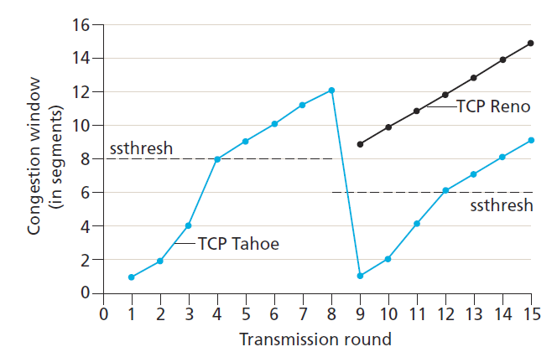
Initially, ssthresh=8 MSS
First 4 rounds, same for Tahoe and Reno
Lost detected at round 8 (3 dup Ack)
  Set ssthresh=6 MSS (both Tahoe and Reno)
  Tahoe: cwnd drop to 1 MSS
  Reno: cwnd drop to 6 +3=9 MSS
Transport Layer
3-<number>

Slide 136
TCP throughput
avg. TCP thruput as function of window size, RTT?
  ignore slow start, assume always data to send
W: window size (measured in bytes) where loss occurs
  avg. window size (# in-flight bytes) is ¾ W
  avg. thruput is 3/4W per RTT
W
W/2
avg TCP thruput =
3
W
4
RTT
bytes/sec
Transport Layer
3-<number>

Slide 137
TCP Futures: TCP over “long, fat pipes”
example: 1500 byte segments, 100ms RTT, want 10 Gbps throughput
To achieve 10Gbps throughtpuy, requires W = 83,333 in-flight segments
throughput in terms of segment loss probability, L [Mathis 1997]:
  ➜ to achieve 10 Gbps throughput, need a loss rate of L = 2·10⁻¹⁰ – a very small loss rate!
Lead to research of new versions of TCP for high-speed
1.22
.
MSS
TCP throughput =
RTT
L
Transport Layer
3-<number>

Slide 138
TCP Fairness
fairness goal: if K TCP sessions share same bottleneck link of bandwidth R, each should have average rate of R/K
TCP connection 1
bottleneck
router
capacity R
TCP connection 2
Transport Layer
3-<number>

Slide 139
Why is TCP fair?
two competing sessions:
additive increase gives slope of 1, as throughout increases
multiplicative decrease decreases throughput proportionally
R
equal bandwidth share
loss: decrease window by factor of 2
congestion avoidance: additive increase
Connection 2 throughput
loss: decrease window by factor of 2
congestion avoidance: additive increase
Connection 1 throughput
R
Transport Layer
3-<number>

Slide 140
Fairness (more)
Fairness and UDP
multimedia apps often do not use TCP
  do not want rate throttled by congestion control
instead use UDP:
  send audio/video at constant rate, tolerate packet loss
Fairness, parallel TCP connections
application can open multiple parallel connections between two hosts
web browsers do this
e.g., link of rate R with 9 existing connections:
  new app asks for 1 TCP, gets rate R/10
  new app asks for 11 TCPs, gets R/2
Transport Layer
3-<number>

Slide 141
Chapter 3: summary
principles behind transport layer services:
  multiplexing, demultiplexing
  reliable data transfer
  flow control
  congestion control
instantiation, implementation in the Internet
  UDP
  TCP
next:
leaving the network “edge” (application, transport layers)
into the network “core”
Transport Layer
3-<number>

