Slide 1


Chapter 6
Wireless and Mobile Networks
Computer Networking: A Top Down Approach
6th edition
Jim Kurose, Keith Ross
Addison-Wesley
March 2012
Wireless, Mobile Networks
6-<number>

Slide 2
Ch. 6: Wireless and Mobile Networks
Background:
# wireless (mobile) phone subscribers now exceeds # wired phone subscribers (5-to-1)!
# wireless Internet-connected devices equals # wireline Internet-connected devices
  laptops, Internet-enabled phones promise anytime untethered Internet access
two important (but different) challenges
  wireless: communication over wireless link
  mobility: handling the mobile user who changes point of attachment to network
Wireless, Mobile Networks
6-<number>

Slide 3
Chapter 6 outline
6.1 Introduction
Wireless
6.2 Wireless links, characteristics
  CDMA
6.3 IEEE 802.11 wireless LANs (“Wi-Fi”)
6.4 Cellular Internet Access
  architecture
  standards (e.g., GSM)
Mobility
6.5 Principles: addressing and routing to mobile users
6.6 Mobile IP
6.7 Handling mobility in cellular networks
6.8 Mobility and higher-layer protocols
6.9 Summary
Wireless, Mobile Networks
6-<number>

Slide 4



















Elements of a wireless network
network
infrastructure
Wireless, Mobile Networks
6-<number>

Slide 5



Elements of a wireless network
wireless hosts
laptop, smartphone
run applications
may be stationary (non-mobile) or mobile
  wireless does not always mean mobility
network
infrastructure
Wireless, Mobile Networks
6-<number>

Slide 6

Elements of a wireless network
base station
typically connected to wired network
relay - responsible for sending packets between wired network and wireless host(s) in its “area”
  e.g., cell towers, 802.11 access points
network
infrastructure
Wireless, Mobile Networks
6-<number>

Slide 7
Elements of a wireless network
wireless link
typically used to connect mobile(s) to base station
also used as backbone link
multiple access protocol coordinates link access
various data rates, transmission distance
network
infrastructure
Wireless, Mobile Networks
6-<number>

Slide 8
Characteristics of selected wireless links
200
802.11n
54
802.11a,g
802.11a,g point-to-point
5-11
802.11b
4G: LTWE WIMAX
4
3G: UMTS/WCDMA-HSPDA, CDMA2000-1xEVDO
Data rate (Mbps)
1
802.15
.384
2.5G: UMTS/WCDMA, CDMA2000
.056
2G: IS-95, CDMA, GSM
Indoor
10-30m
Outdoor
50-200m
Mid-range
outdoor
200m – 4 Km
Long-range
outdoor
5Km – 20 Km
Wireless, Mobile Networks
6-<number>

Slide 9
Elements of a wireless network
infrastructure mode
base station connects mobiles into wired network
handoff: mobile changes base station providing connection into wired network
network
infrastructure
Wireless, Mobile Networks
6-<number>

Slide 10


Elements of a wireless network
ad hoc mode
no base stations
nodes can only transmit to other nodes within link coverage
nodes organize themselves into a network: route among themselves
Wireless, Mobile Networks
6-<number>

Slide 11
Wireless network taxonomy
single hop
multiple hops
host connects to
base station (WiFi,
WiMAX, cellular)
which connects to
larger Internet
host may have to
relay through several
wireless nodes to
connect to larger
Internet: mesh net
infrastructure
(e.g., APs)
no base station, no
connection to larger
Internet. May have to
relay to reach other
a given wireless node
MANET, VANET
no
infrastructure
no base station, no
connection to larger
Internet (Bluetooth,
ad hoc nets)
Wireless, Mobile Networks
6-<number>

Slide 12
Chapter 6 outline
6.1 Introduction
Wireless
6.2 Wireless links, characteristics
  CDMA
6.3 IEEE 802.11 wireless LANs (“Wi-Fi”)
6.4 Cellular Internet Access
  architecture
  standards (e.g., GSM)
Mobility
6.5 Principles: addressing and routing to mobile users
6.6 Mobile IP
6.7 Handling mobility in cellular networks
6.8 Mobility and higher-layer protocols
6.9 Summary
Wireless, Mobile Networks
6-<number>

Slide 13
Wireless Link Characteristics (1)
important differences from wired link ….
  decreased signal strength: radio signal attenuates as it propagates through matter (path loss)
  interference from other sources: standardized wireless network frequencies (e.g., 2.4 GHz) shared by other devices (e.g., phone); devices (motors) interfere as well
  multipath propagation: radio signal reflects off objects ground, arriving ad destination at slightly different times
…. make communication across (even a point to point) wireless link much more “difficult”
Wireless, Mobile Networks
6-<number>

Slide 14
Wireless Link Characteristics (2)
SNR: signal-to-noise ratio
  larger SNR – easier to extract signal from noise (a “good thing”)
SNR versus BER (bit error rate) tradeoffs
  given physical layer: increase power -> increase SNR->decrease BER
  given SNR: choose modulation technique that meets BER requirement, giving highest thruput
    SNR may change with mobility: dynamically adapt modulation technique to channel conditions
10⁻¹
10⁻²
10⁻³
BER
10⁻⁴
10⁻⁵
10⁻⁶
10⁻⁷
10
20
30
40
SNR(dB)
QAM256 (8 Mbps)
QAM16 (4 Mbps)
BPSK (1 Mbps)
Wireless, Mobile Networks
6-<number>

Slide 15

Wireless network characteristics
Multiple wireless senders and receivers create additional problems (beyond multiple access):
A
B
C
C
A’s signal
strength
C’s signal
strength
B
A
Hidden terminal problem
B, A hear each other
B, C hear each other
A, C can not hear each other means A, C unaware of their interference at B
space
Signal attenuation:
B, A hear each other
B, C hear each other
A, C can not hear each other interfering at B
Wireless, Mobile Networks
6-<number>

Slide 16
Code Division Multiple Access (CDMA)
unique “code” assigned to each user; i.e., code set partitioning
  all users share same frequency, but each user has own “chipping” sequence (i.e., code) to encode data
  allows multiple users to “coexist” and transmit simultaneously with minimal interference (if codes are “orthogonal”)
encoded signal = (original data) X (chipping sequence)
decoding: inner-product of encoded signal and chipping sequence
Wireless, Mobile Networks
6-<number>

Slide 17
CDMA encode/decode
channel output Z_{i,m}
Z_{i,m}= d_{i}.c_{m}
data
bits
d₀ = 1
1
1
1
1
1
d₁ = -1
1
1
1
-
-
-
-
1
-
-
-
1
-
1
1
1
1
1
sender
1
1
slot 1
channel
output
slot 0
channel
output
1
1
1
1
1
code
1
1
-
-
-
1
-
1
1
1
-
-
-
1
-
1
1
1
slot 1
slot 0
M
D_{i} = Σ Z_{i,m}.c_{m}
m=1
M
received
input
1
1
1
1
1
1
1
1
d₀ = 1
-
-
-
-
1
-
-
-
1
-
1
1
1
1
1
1
d₁ = -1
1
slot 1
channel
output
slot 0
channel
output
1
1
1
1
1
code
1
1
-
-
-
1
-
1
1
1
-
-
-
1
-
1
1
1
receiver
slot 1
slot 0
Wireless, Mobile Networks
6-<number>

Slide 18



CDMA encode/decode
Formally, sender’s CDMA code consists of a sequence of M values
  (1,1,1,-1,1,-1,-1,-1)
Encode
  1,1,1,-1,1,-1,-1,-1,-1,-1,-1,1,-1,1,1,1
Decode
  (1,1,1,-1,1,-1,-1,-1)(1,1,1,-1,1,-1,-1,-1)/8=1
  (-1,-1,-1,1,-1,1,1,1) (1,1,1,-1,1,-1,-1,-1)/8=-1
Wireless, Mobile Networks
6-<number>

Slide 19

CDMA: two-sender interference
channel sums together transmissions by sender 1 and 2
Sender 1
Sender 2
using same code as sender 1, receiver recovers sender 1’s original data from summed channel data!
Wireless, Mobile Networks
6-<number>

Slide 20
CDMA: two-sender interference
Sender 1:
  CDMA code: (1,1,1,-1,1,-1,-1,-1)
  Encode (1,-1) as (1,1,1,-1,1,-1,-1,-1,-1,-1,-1,1,-1,1,1,1)
Sender 2:
  CDMA code: (1,-1,1,1,1,-1,1,1)
  Encode (1,1) as (1,-1,1,1,1,-1,1,1,1,-1,1,1,1,-1,1,1)
Sum up
  (2,0,2,0,2,-2,0,0,0,-2,0,2,0,0,2,2)
Receiver 1:
  (2,0,2,0,2,-2,0,0)(1,1,1,-1,1,-1,-1,-1)/8=1
  (0,-2,0,2,0,0,2,2)(1,1,1,-1,1,-1,-1,-1)/8=-1
Receiver 2:
  (2,0,2,0,2,-2,0,0)(1,-1,1,1,1,-1,1,1)/8=1
  (0,-2,0,2,0,0,2,2)(1,-1,1,1,1,-1,1,1)/8=1
Wireless, Mobile Networks
6-<number>

Slide 21
Chapter 6 outline
6.1 Introduction
Wireless
6.2 Wireless links, characteristics
  CDMA
6.3 IEEE 802.11 wireless LANs (“Wi-Fi”)
6.4 Cellular Internet Access
  architecture
  standards (e.g., GSM)
Mobility
6.5 Principles: addressing and routing to mobile users
6.6 Mobile IP
6.7 Handling mobility in cellular networks
6.8 Mobility and higher-layer protocols
6.9 Summary
Wireless, Mobile Networks
6-<number>

Slide 22
IEEE 802.11 Wireless LAN
802.11b
2.4-5 GHz unlicensed spectrum
up to 11 Mbps
direct sequence spread spectrum (DSSS) in physical layer
  all hosts use same chipping code
802.11a
  5-6 GHz range
  up to 54 Mbps
802.11g
  2.4-5 GHz range
  up to 54 Mbps
802.11n: multiple antennae (MIMO)
  2.4-5 GHz range
  up to 200 Mbps
all use CSMA/CA for multiple access
all have base-station and ad-hoc network versions
Wireless, Mobile Networks
6-<number>

Slide 23




802.11 LAN architecture
wireless host communicates with base station
  base station = access point (AP)
Basic Service Set (BSS) (aka “cell”) in infrastructure mode contains:
  wireless hosts
  access point (AP): base station
  ad hoc mode: hosts only
Internet
hub, switch
or router
BSS 1
BSS 2
Host and AP’s wireless interface has MAC address
Wireless, Mobile Networks
6-<number>

Slide 24
802.11: Channels, association
802.11b: 2.4GHz-2.485GHz spectrum divided into 11 channels at different frequencies
  Any two channels are non-overlapping if and only separated by four or more channels.
    E.g., 1, 6, 11
  AP admin chooses frequency for AP
  interference is possible: channel can be same as that chosen by neighboring AP!
host: must associate with an AP
  scans channels, listening for beacon frames containing AP’s name (SSID) and MAC address
  selects AP to associate with
  may perform authentication
  will typically run DHCP to get IP address in AP’s subnet
Wireless, Mobile Networks
6-<number>

Slide 25
802.11: passive/active scanning
BBS 1
BBS 2
BBS 1
BBS 2
AP 1
1
1
AP 2
1
AP 2
2
AP 1
2
2
3
3
4
H1
H1
passive scanning:
beacon frames sent from APs
association Request frame sent: H1 to selected AP
association Response frame sent from selected AP to H1
active scanning:
Probe Request frame broadcast from H1
Probe Response frames sent from APs
Association Request frame sent: H1 to selected AP
Association Response frame sent from selected AP to H1
beacon frames contains SSID and AP’s MAC
Wireless, Mobile Networks
6-<number>

Slide 26
802.11: authentication
Two ways:
  Based on station’s MAC address
  Username and password
AP communicate with authentication server
  Using RADIUS or DIAMETER protocol
  Many AP communicates to one authentication server, providing centralized authentication
Wireless, Mobile Networks
6-<number>

Slide 27




IEEE 802.11: multiple access
avoid collisions: 2⁺ nodes transmitting at same time
802.11: CSMA - sense before transmitting
  don’t collide with ongoing transmission by other node
802.11: no collision detection!
  difficult to receive (sense collisions) when transmitting due to weak received signals (fading)
  can’t sense all collisions in any case: hidden terminal, fading
  goal: avoid collisions: CSMA/C(ollision)A(voidance)
A
B
C
C
B
A’s signal
strength
C’s signal
strength
A
space
Wireless, Mobile Networks
6-<number>

Slide 28
IEEE 802.11 MAC Protocol: CSMA/CA
802.11 sender
1 if sense channel idle for DIFS then
  transmit entire frame (no CD)
2 if sense channel busy then
  start random backoff time using binary exponential backoff
  timer counts down while channel idle
3 transmit when timer expires
4 if no ACK, increase random backoff interval, repeat 2
802.11 receiver
- if frame received OK
return ACK after SIFS (ACK needed due to hidden terminal problem)
sender
receiver
DIFS
data
SIFS
ACK
Wireless, Mobile Networks
6-<number>

Slide 29
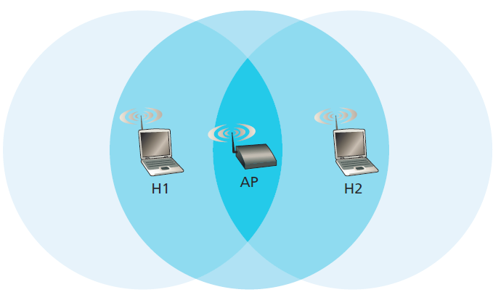
IEEE 802.11 MAC Protocol: CSMA/CA
Why link-layer ACK?
  Hard to detect collision. The station can not abort.
  The receiver acknowledges the frame in case of no collision.
Can link-layer ACK avoids collision? NO
  Two stations are hidden station to each other
  Two stations choose random backoff values that are close to each other
Wireless, Mobile Networks
6-<number>

Slide 30
Avoiding collisions (more)
idea: allow sender to “reserve” channel rather than random access of data frames: avoid collisions of long data frames
sender first transmits small request-to-send (RTS) packets to BS using CSMA
  Indicate total time required
  RTSs may still collide with each other (but they’re short)
BS broadcasts clear-to-send CTS in response to RTS
CTS heard by all nodes
  sender transmits data frame
  other stations defer transmissions
Wireless, Mobile Networks
6-<number>

Slide 31

Collision Avoidance: RTS-CTS exchange
A
B
AP
RTS(B)
RTS(A)
reservation collision
RTS(A)
CTS(A)
CTS(A)
DATA (A)
defer
time
ACK(A)
ACK(A)
Wireless, Mobile Networks
6-<number>

Slide 32
Collision Avoidance: RTS-CTS
Avoid data frame collisions completely
  The hidden station problem is mitigated, since a long DATA frame is transmitted only after the channel has been reserved.
  A collision involving an RTS or CTS frame will last only for the duration of the short RTS or CTS frame. Once the RTS and CTS frames are correctly transmitted, the following DATA and ACK frames should be transmitted without collisions.
RTS/CTS is only used when transmitting long DATA frame
Wireless, Mobile Networks
6-<number>

Slide 33
802.11 frame: addressing
2
2
6
6
6
2
6
0 - 2312
4
frame
control
duration
address
1
address
2
address
3
seq
control
address
4
payload
CRC
Address 4: used only in ad hoc mode
Address 1: MAC address
of wireless host or AP
to receive this frame
Address 3: MAC address
of router interface to which AP is attached
Address 2: MAC address
of wireless host or AP
transmitting this frame
Wireless, Mobile Networks
6-<number>

Slide 34
802.11 frame: addressing
Internet
H1
R1
router
R1 MAC addr H1 MAC addr
dest. address
source address
802.3 frame
AP MAC addr H1 MAC addr R1 MAC addr
address 1
address 2
address 3
802.11 frame
Wireless, Mobile Networks
6-<number>

Slide 35
802.11 frame: addressing
R1 knows IP address of H1, use ARP to determine H1’s MAC address, encapsulate 802.3 frame with H1 as dst_addr, R1 as src_addr.
Frame reaches to AP, AP converts it to 802.11 frame, with H1 as address 1, AP as address 2, R1 as address 3.
H1 responds, encapsulate 802.11 frame with AP and H1 as address 1 and address 2, R1 as address 3.
Frame reaches to AP, AP converts it to 802.3 frame, with H1 as src_addr, R1 as dst_addr.
Wireless, Mobile Networks
6-<number>

Slide 36
802.11 frame: more
frame seq #
(for RDT)
duration of reserved
transmission time (RTS/CTS)
2
2
6
6
6
2
6
0 - 2312
4
frame
control
duration
address
1
address
2
address
3
seq
control
address
4
payload
CRC
2
2
4
1
1
1
1
1
1
1
1
Protocol
version
Type
Subtype
To
AP
From
AP
More
frag
Retry
Power
mgt
More
data
WEP
Rsvd
frame type
(RTS, CTS, ACK, data)
Whether encryption
is used or not
Wireless, Mobile Networks
6-<number>

Slide 37

802.11: mobility within same subnet
H1 remains in same IP subnet: IP address can remain same
switch: which AP is associated with H1?
  self-learning: switch will see frame from H1 and “remember” which switch port can be used to reach H1
BBS 1
H1
BBS 2
H1 may keep its IP address and all of its ongoing TCP connections.
Wireless, Mobile Networks
6-<number>

Slide 38
802.11: advanced capabilities
Rate adaptation
base station, mobile dynamically change transmission rate (physical layer modulation technique) as mobile moves, SNR varies
  Two frames without ack, fall back to next lower rate
  10 frames acked, or timeout since last fallback, promote to next higher level
10⁻¹
10⁻²
QAM256 (8 Mbps)
QAM16 (4 Mbps)
10⁻³
BPSK (1 Mbps)
BER
10⁻⁴
operating point
10⁻⁵
10⁻⁶
10⁻⁷
10
20
30
40
SNR(dB)
1. SNR decreases, BER increase as node moves away from base station
2. When BER becomes too high, switch to lower transmission rate but with lower BER
Wireless, Mobile Networks
6-<number>

Slide 39
802.11: advanced capabilities
power management
node-to-AP: “I am going to sleep until next beacon frame”
  AP knows not to transmit frames to this node
  node wakes up before next beacon frame (by using a timer)
beacon frame: contains list of mobiles with AP-to-mobile frames waiting to be sent
  node will stay awake if AP-to-mobile frames to be sent; otherwise sleep again until next beacon frame
Wireless, Mobile Networks
6-<number>

Slide 40
802.15: personal area network – Bluetooth
less than 10 m diameter
replacement for cables (mouse, keyboard, headphones)
ad hoc: no infrastructure
Up to eight devices forms a piconet
master/slaves:
  slaves request permission to send (to master)
  master grants requests
802.15: evolved from Bluetooth specification
  2.4-2.5 GHz radio band
  up to 721 kbps
S
P
P
radius of
coverage
M
S
S
P
P
M
Master device
Slave device
Parked device (inactive)
S
P
Wireless, Mobile Networks
6-<number>

Slide 41
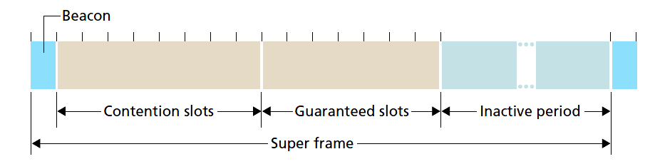
802.15: personal area network – Zigbee
Low-powered, low-data-rate, low-duty-cycle devices
Reduced-function devices work as salve
A full-function device works as master
Time-slotted manner of media access
Wireless, Mobile Networks
6-<number>

Slide 42
Chapter 6 outline
6.1 Introduction
Wireless
6.2 Wireless links, characteristics
  CDMA
6.3 IEEE 802.11 wireless LANs (“Wi-Fi”)
6.4 Cellular Internet access
  architecture
  standards (e.g., GSM)
Mobility
6.5 Principles: addressing and routing to mobile users
6.6 Mobile IP
6.7 Handling mobility in cellular networks
6.8 Mobility and higher-layer protocols
6.9 Summary
Wireless, Mobile Networks
6-<number>

Slide 43
Cellular network generations
1G: FDMA, voice-only
2G: digital systems,
  Standard: GSM
  2.5G: includes data
3G: voice and data
  CDMA in radio interface
  Up to 3.8 Mbps
4G: higher data rate
  OFDM in radio interface
  All-IP EPC to support voice and data
  Up to 100 Mbps
Wireless, Mobile Networks
6-<number>

Slide 44


Components of cellular network architecture
MSC
connects cells to wired tel. net.
manages call setup (more later!)
handles mobility (more later!)
cell
covers geographical region
base transceiver station (BTS) analogous to 802.11 AP
mobile users attach to network through BS
air-interface: physical and link layer protocol between mobile and BS
Mobile
Switching
Center
Public telephone
network
Mobile
Switching
Center
wired network
Wireless, Mobile Networks
6-<number>

Slide 45
Cellular networks: the first hop
Two techniques for sharing mobile-to-BS radio spectrum
combined FDMA/TDMA: divide spectrum in frequency channels, divide each channel into time slots
CDMA: code division multiple access
time slots
frequency
bands
Wireless, Mobile Networks
6-<number>

Slide 46
2G (voice) network architecture
Base station system (BSS)
MSC
BTS
BSC
G
Public
telephone
network
Gateway
MSC
Legend
Base transceiver station (BTS)
Base station controller (BSC)
BSC:
Allocate BTS ratio channels
Perform paging (find the cell in
which a mobile user resides)
Perform handoff
Mobile Switching Center (MSC)
Mobile subscribers
Wireless, Mobile Networks
6-<number>

Slide 47
3G (voice+data) network architecture
MSC
G
Public
telephone
network
radio
network
controller
Gateway
MSC
G
Public
Internet
SGSN
Key insight: new cellular data
network operates in parallel
(except at edge) with existing
cellular voice network
voice network unchanged in core
data network operates in parallel
GGSN
Serving GPRS Support Node (SGSN)
Gateway GPRS Support Node (GGSN)
Wireless, Mobile Networks
6-<number>

Slide 48
3G (voice+data) network architecture
Two important nodes
  SGSN: Deliver datagram from/to mobile nodes; authentication; handoff
  GGSN: Connect multiple SGSN to Internet; hide the mobility within the GGSN’s network
Radio network controller (RNC)
  Connects both MSC (circuit-switching) and SGSN (packet-switching)
CDMA replaces TDMA/FDMA in radio interface
Wireless, Mobile Networks
6-<number>

Slide 49
3G (voice+data) network architecture
MSC
G
Public
telephone
network
radio
network
controller
Gateway
MSC
G
Public
Internet
SGSN
GGSN
radio interface
(WCDMA, HSPA)
radio access network
Universal Terrestrial Radio
Access Network (UTRAN)
core network
General Packet Radio Service
(GPRS) Core Network
public
Internet
Wireless, Mobile Networks
6-<number>

Slide 50
Chapter 6 outline
6.1 Introduction
Wireless
6.2 Wireless links, characteristics
  CDMA
6.3 IEEE 802.11 wireless LANs (“Wi-Fi”)
6.4 Cellular Internet Access
  architecture
  standards (e.g., GSM)
Mobility
6.5 Principles: addressing and routing to mobile users
6.6 Mobile IP
6.7 Handling mobility in cellular networks
6.8 Mobility and higher-layer protocols
6.9 Summary
Wireless, Mobile Networks
6-<number>

Slide 51
What is mobility?
spectrum of mobility, from the network perspective:
The mobile node’s address may or may not remain same
no mobility
high mobility
mobile wireless user,
using same access
point
mobile user, connecting/ disconnecting from network using DHCP.
mobile user, passing through multiple access point while maintaining ongoing connections (like cell phone)
Wireless, Mobile Networks
6-<number>

Slide 52



Mobility: vocabulary
home network: permanent “home” of mobile
(e.g., 128.119.40/24)
home agent: entity that will perform mobility functions on behalf of mobile, when mobile is remote
wide area network
permanent address: address in home network, can always be used to reach mobile
e.g., 128.119.40.186
Wireless, Mobile Networks
6-<number>

Slide 53
Mobility: more vocabulary
permanent address: remains constant (e.g., 128.119.40.186)
visited network: network in which mobile currently resides (e.g., 79.129.13/24)
care-of-address (COA): address in visited network.
(e.g., 79,129.13.2)
wide area network
foreign agent: entity in visited network that performs mobility functions on behalf of mobile.
correspondent: wants to communicate with mobile
Wireless, Mobile Networks
6-<number>

Slide 54



How do you contact a mobile friend:
Consider friend frequently changing addresses, how do you find her?
I wonder where Alice moved to?
search all phone books?
call her parents?
expect her to let you know where he/she is?
Wireless, Mobile Networks
6-<number>

Slide 55
Mobility: approaches
let routing handle it: routers advertise permanent address of mobile-nodes-in-residence via usual routing table exchange.
  routing tables indicate where each mobile located
  no changes to end-systems
let end-systems handle it:
  indirect routing: communication from correspondent to mobile goes through home agent, then forwarded to remote
  direct routing: correspondent gets foreign address of mobile, sends directly to mobile
Wireless, Mobile Networks
6-<number>

Slide 56
Mobility: approaches
let routing handle it: routers advertise permanent address of mobile-nodes-in-residence via usual routing table exchange.
  routing tables indicate where each mobile located
  no changes to end-systems
let end-systems handle it:
  indirect routing: communication from correspondent to mobile goes through home agent, then forwarded to remote
  direct routing: correspondent gets foreign address of mobile, sends directly to mobile
not
scalable
to millions of
mobiles
Wireless, Mobile Networks
6-<number>

Slide 57
Mobility: registration
visited network
home network
1
2
wide area network
mobile contacts foreign agent on entering visited network
foreign agent contacts home agent home: “this mobile is resident in my network”
end result:
foreign agent knows about mobile
home agent knows location of mobile
Wireless, Mobile Networks
6-<number>

Slide 58
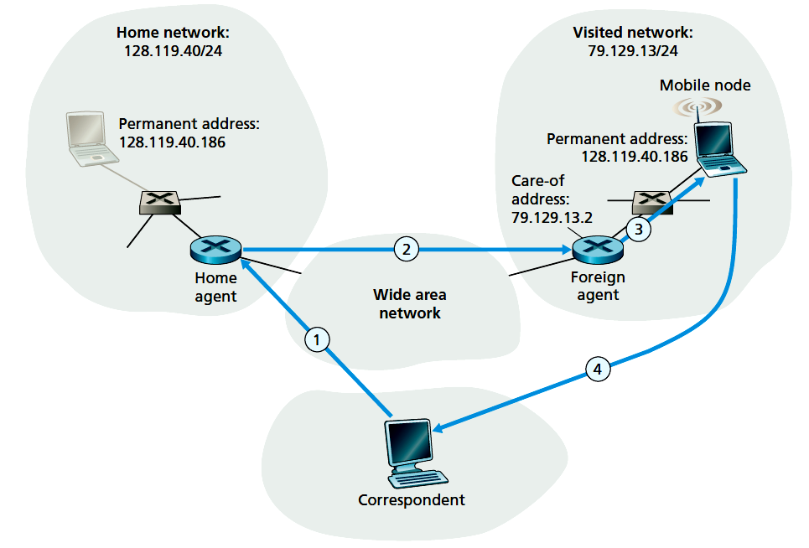
Mobility via indirect routing
foreign agent receives packets, forwards to mobile
home agent intercepts packets, forwards to foreign agent
correspondent addresses packets using home address of mobile
mobile replies directly to correspondent
Wireless, Mobile Networks
6-<number>

Slide 59
Datagram forwarding
Home agent encapsulate the correspondent’s original complete datagram within a new (larger) datagram, delivered to the mobile node’s COA
  Route the datagram to foreign network
  Keep the correspondent’s datagram intact
Foreign agent receives and decapsulates the datagram and forward the original datagram to the mobile node.
Wireless, Mobile Networks
6-<number>

Slide 60
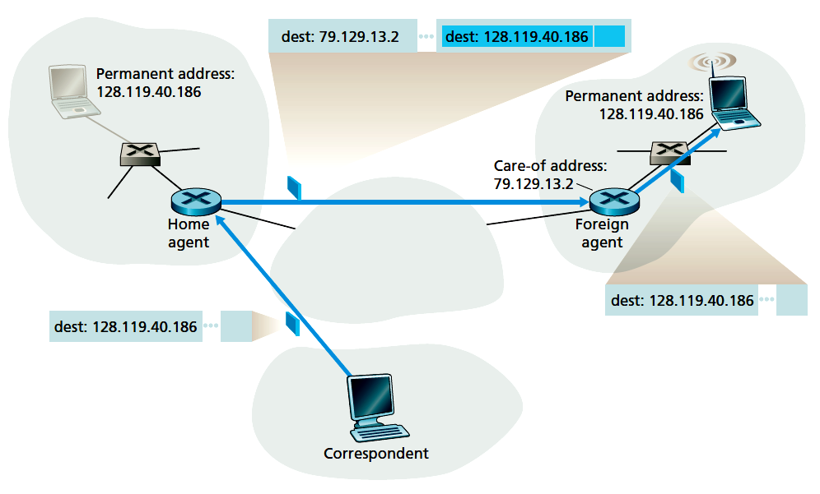

Datagram forwarding
Wireless, Mobile Networks
6-<number>

Slide 61



Indirect Routing: comments
mobile uses two addresses:
  permanent address: used by correspondent (hence mobile location is transparent to correspondent)
  care-of-address (COA): used by home agent to forward datagrams to mobile (through foreign agent)
foreign agent functions may be done by mobile itself
triangle routing: correspondent-home-network-mobile
  inefficient when the path
  between correspondent
  and mobile is more efficient
Wireless, Mobile Networks
6-<number>

Slide 62
Indirect Routing: comments
A mobile-node-to-foreign-agent protocol
  Mobile node registers/deregisters to foreign agent
A foreign-agent-to-home-agent registration protocol
  Foreign agent registers/deregisters COAs to home agent
A home-agent datagram encapsulation protocol
A foreign-agent decapsulation protocol
Wireless, Mobile Networks
6-<number>

Slide 63
Indirect routing: moving between networks
suppose mobile user moves to another network
  registers with new foreign agent
  new foreign agent registers with home agent
  home agent update care-of-address for mobile
  packets continue to be forwarded to mobile (but with new care-of-address)
mobility, changing foreign networks transparent: on going connections can be maintained!
Wireless, Mobile Networks
6-<number>

Slide 64


Mobility via direct routing
foreign agent receives packets, forwards to mobile
correspondent forwards to foreign agent
visited
network
home
network
3
1
2
4
correspondent requests, receives foreign address of mobile
mobile replies directly to correspondent
Wireless, Mobile Networks
6-<number>

Slide 65
Mobility via direct routing: comments
overcome triangle routing problem
non-transparent to correspondent: correspondent must get care-of-address from home agent
  what if mobile changes visited network during the communication?
  Update home agent is not enough.
Wireless, Mobile Networks
6-<number>

Slide 66
Accommodating mobility with direct routing
Identify the foreign agent in that foreign network where the mobile node was first found as the anchor foreign agent.
When the mobile node moves to a new foreign network, the mobile node registers with the new foreign agent, and the new foreign agent provides the anchor foreign agent with the mobile node’s new COA.
When the anchor foreign agent receives an encapsulated datagram for a departed mobile node, it can then re-encapsulate the datagram and forward it to the mobile node using the new COA.
Wireless, Mobile Networks
6-<number>

Slide 67
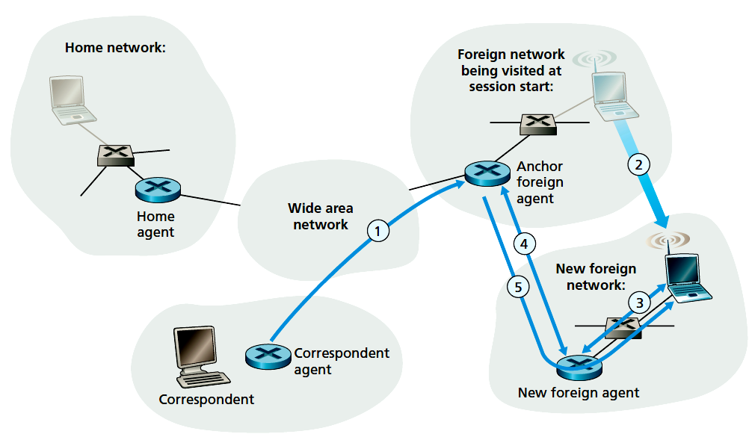
Accommodating mobility with direct routing
Wireless, Mobile Networks
6-<number>

Slide 68
Chapter 6 outline
6.1 Introduction
Wireless
6.2 Wireless links, characteristics
  CDMA
6.3 IEEE 802.11 wireless LANs (“Wi-Fi”)
6.4 Cellular Internet Access
  architecture
  standards (e.g., GSM)
Mobility
6.5 Principles: addressing and routing to mobile users
6.6 Mobile IP
6.7 Handling mobility in cellular networks
6.8 Mobility and higher-layer protocols
6.9 Summary
Wireless, Mobile Networks
6-<number>

Slide 69
Mobile IP
RFC 3344
has many features we’ve seen:
  home agents, foreign agents, foreign-agent registration, care-of-addresses, encapsulation (packet-within-a-packet)
three components to standard:
  indirect routing of datagrams
  agent discovery: home or foreign agents broadcast its service
  registration with home agent: register/degregister COAs
Wireless, Mobile Networks
6-<number>

Slide 70

Mobile IP: indirect routing
foreign-agent-to-mobile packet
packet sent by home agent to foreign agent: a packet within a packet
dest: 128.119.40.186
dest: 79.129.13.2
dest: 128.119.40.186
Permanent address: 128.119.40.186
Care-of address: 79.129.13.2
dest: 128.119.40.186
packet sent by correspondent
Wireless, Mobile Networks
6-<number>

Slide 71

Mobile IP: agent discovery
agent advertisement: foreign/home agents advertise service by broadcasting ICMP messages (typefield = 9)
H, F bits: home and/or foreign agent
M, G bits: whether a form of encapsulation is used
R bit: registration required (mobile node can not assume foreign functionality by itself)
Wireless, Mobile Networks
6-<number>

Slide 72
Mobile IP: agent discovery
Agent solicitation
  A mobile node wanting to learn about agents without waiting to receive an agent advertisement can broadcast an agent solicitation message, which is simply an ICMP message with type value 10.
  An agent receiving the solicitation will unicast an agent advertisement directly to the mobile node, which can then proceed as if it had received an unsolicited advertisement.
Wireless, Mobile Networks
6-<number>

Slide 73
Mobile IP: registration example
visited network: 79.129.13/24
home agent
HA: 128.119.40.7
foreign agent
COA: 79.129.13.2
mobile node
MA: 128.119.40.186
ICMP agent adv.
COA: 79.129.13.2
….
registration req.
Registration req.
Registration messages are in UPD, sent to port 434
COA: 79.129.13.2
HA: 128.119.40.7
MA: 128.119.40.186
Lifetime: 9999
identification:714
….
COA: 79.129.13.2
HA: 128.119.40.7
MA: 128.119.40.186
Lifetime: 9999
identification: 714
encapsulation format
….
registration reply
HA: 128.119.40.7
MA: 128.119.40.186
Lifetime: 4999
Identification: 714
encapsulation format
….
registration reply
HA: 128.119.40.7
MA: 128.119.40.186
Lifetime: 4999
Identification: 714
….
time
Wireless, Mobile Networks
6-<number>

Slide 74

Components of cellular network architecture
recall:
correspondent
wired public telephone
network
MSC
MSC
MSC
MSC
MSC
different cellular networks,
operated by different providers
Wireless, Mobile Networks
6-<number>

Slide 75
Handling mobility in cellular networks
home network: network of cellular provider you subscribe to (e.g., Sprint PCS, Verizon)
  home location register (HLR): database in home network containing permanent cell phone #, profile information (services, preferences, billing), information about current location (could be in another network)
  Home MSC: a switch that is connected by a correspondent when a call is placed to a mobile user
visited network: network in which mobile currently resides
  visitor location register (VLR): database with entry for each user currently in network
  could be home network
Wireless, Mobile Networks
6-<number>

Slide 76
GSM: indirect routing to mobile
HLR
home
network
2
correspondent
home
Mobile
Switching
Center
home MSC consults HLR,
gets roaming number of
mobile in visited network
1
call routed
to home network,
1st leg of the call
3
Public switched
telephone
network
VLR
Mobile
Switching
Center
4
home MSC sets up 2nd leg of call
to MSC in visited network
mobile
user
MSC in visited network completes
call through base station to mobile
visited
network
Wireless, Mobile Networks
6-<number>

Slide 77
GSM: indirect routing to mobile
registration
Mobile user registers with a visited network when it is covered by a new VLR
Visited VLR sends location update request message to mobile’s VLR
  Informs either roaming number or address of VLR
Call routing
Correspondent dials mobile user’s number, the call is routed to home MSC, first leg of the call
Home MSC queries HLR
  HLR returns the mobile’s roaming number, or
  HLR returns the VLR in the visited network, MSC queries VLR
Home MSC sets up second leg of the call to the MSC in the visited network
Wireless, Mobile Networks
6-<number>

Slide 78
GSM: handoff with common MSC
handoff goal: route call via new base station (without interruption)
reasons for handoff:
  stronger signal to/from new BSS (continuing connectivity, less battery drain)
  load balance: free up channel in current BSS
  GSM doesnt mandate why to perform handoff (policy), only how (mechanism)
handoff initiated by old BSS
VLR
Mobile
Switching
Center
old
routing
new
routing
old BSS
new BSS
Wireless, Mobile Networks
6-<number>

Slide 79
GSM: handoff with common MSC
1. old BSS informs MSC of impending handoff, provides list of 1⁺ new BSSs
2. MSC sets up path (allocates resources) to new BSS
3. new BSS allocates radio channel for use by mobile
4. new BSS signals MSC, old BSS: ready
5. old BSS tells mobile: perform handoff to new BSS
6. mobile, new BSS signal to activate new channel
7. mobile signals via new BSS to MSC: handoff complete. MSC reroutes call
8 MSC-old-BSS resources released
VLR
Mobile
Switching
Center
4
2
1
8
7
3
old BSS
5
6
new BSS
Wireless, Mobile Networks
6-<number>

Slide 80
GSM: handoff between MSCs
anchor MSC: first MSC visited during call
  call remains routed through anchor MSC
new MSCs add on to end of MSC chain as mobile moves to new MSC
optional path minimization step to shorten multi-MSC chain
home network
correspondent
Home MSC
anchor MSC
PSTN
MSC
MSC
MSC
(a) before handoff
Wireless, Mobile Networks
6-<number>

Slide 81
Chapter 6 summary
Wireless
wireless links:
  capacity, distance
  channel impairments
  CDMA
IEEE 802.11 (“Wi-Fi”)
  CSMA/CA reflects wireless channel characteristics
cellular access
  architecture
  standards (e.g., GSM, 3G, 4G LTE)
Mobility
principles: addressing, routing to mobile users
  home, visited networks
  direct, indirect routing
  care-of-addresses
case studies
  mobile IP
  mobility in GSM
impact on higher-layer protocols
Wireless, Mobile Networks
6-<number>

