Slide 1

Chapter 8
Security
Computer Networking: A Top Down Approach
6th edition
Jim Kurose, Keith Ross
Addison-Wesley
March 2012

Slide 2
Chapter 8: Network Security
Chapter goals:
understand principles of network security:
  cryptography and its many uses beyond “confidentiality”（保密）
  Authentication（真实）
  message integrity（完整）
security in practice:
  firewalls and intrusion detection systems
  security in application, transport, network, link layers
Network Security

Slide 3
Chapter 8 roadmap
8.1 What is network security?
8.2 Principles of cryptography
8.3 Message integrity and digital signature,
8.4 Authentication
8.5 Securing e-mail
8.6 Securing TCP connections: SSL
8.7 Network layer security: IPsec
8.8 Securing wireless LANs
8.9 Operational security: firewalls and IDS
Network Security

Slide 4
What is network security?
confidentiality: only sender, intended receiver should “understand” message contents
  sender encrypts message
  receiver decrypts message
authentication: sender, receiver want to confirm identity of each other
message integrity: sender, receiver want to ensure message not altered (in transit, or afterwards) without detection
operational security: services must be accessible and available to users
Network Security

Slide 5



Friends and enemies: Alice, Bob, Trudy
well-known in network security world
Bob, Alice (lovers!) want to communicate “securely”
Trudy (intruder) may intercept, delete, add messages
Alice
Bob
channel
data, control messages
secure
sender
s
data
secure
receiver
data
Trudy
Network Security

Slide 6
Who might Bob, Alice be?
… well, real-life Bobs and Alices!
Web browser/server for electronic transactions (e.g., on-line purchases)
on-line banking client/server
DNS servers
routers exchanging routing table updates
other examples?
Network Security

Slide 7
There are bad guys (and girls) out there!
Q: What can a “bad guy” do?
A: A lot! See section 1.6
  eavesdrop: intercept messages
  actively insert messages into connection
  impersonation: can fake (spoof) source address in packet (or any field in packet)
  hijacking: “take over” ongoing connection by removing sender or receiver, inserting himself in place
  denial of service: prevent service from being used by others (e.g., by overloading resources)
Network Security

Slide 8
Chapter 8 roadmap
8.1 What is network security?
8.2 Principles of cryptography
8.3 Message integrity, authentication
8.4 Authentication
8.5 Securing e-mail
8.6 Securing TCP connections: SSL
8.7 Network layer security: IPsec
8.8 Securing wireless LANs
8.9 Operational security: firewalls and IDS
Network Security

Slide 9

The language of cryptography
Alice’s
encryption
key
Bob’s
decryption
key
K
K
A
B
plaintext
encryption
algorithm
ciphertext
decryption
algorithm
plaintext
m plaintext message
K_{A}(m) ciphertext, encrypted with key K_{A}
m = K_{B}(K_{A}(m))
Network Security

Slide 10
Breaking an encryption scheme
cipher-text only attack: Trudy has ciphertext she can analyze
two approaches:
  brute force: search through all keys
  statistical analysis
known-plaintext attack: Trudy has plaintext corresponding to ciphertext
  e.g., in monoalphabetic cipher, Trudy determines pairings for a,l,i,c,e,b,o,
chosen-plaintext attack: Trudy can get ciphertext for chosen plaintext
Network Security

Slide 11
Symmetric key cryptography
K
K
S
S
plaintext
message, m
encryption
algorithm
ciphertext
decryption
algorithm
plaintext
K (m)
m = K_{S}(K_{S}(m))
S
symmetric key crypto: Bob and Alice share same (symmetric) key: K
e.g., key is knowing substitution pattern in mono alphabetic substitution cipher
Q: how do Bob and Alice agree on key value?
S
Caesar cipher: Taking each letter in the plaintext message and substituting the letter that is k letters later
Network Security

Slide 12
Monoalphabetic cipher
substitution cipher: substituting one thing for another
  monoalphabetic cipher: substitute one letter for another
plaintext: abcdefghijklmnopqrstuvwxyz
ciphertext: mnbvcxzasdfghjklpoiuytrewq
e.g.:
Plaintext: bob. i love you. alice
ciphertext: nkn. s gktc wky. mgsbc
Encryption key: mapping from set of 26 letters to set of 26 letters
Network Security

Slide 13
Polyalphabetic encryption
n substitution ciphers, M₁,M₂,…,M_{n}
cycling pattern:
  e.g., n=4: M₁,M₃,M₄,M₃,M₂; M₁,M₃,M₄,M₃,M₂; ..
for each new plaintext symbol, use subsequent subsitution pattern in cyclic pattern
  dog: d from M₁, o from M₃, g from M₄
  Encryption key: n substitution ciphers, and cyclic pattern
Network Security

Slide 14
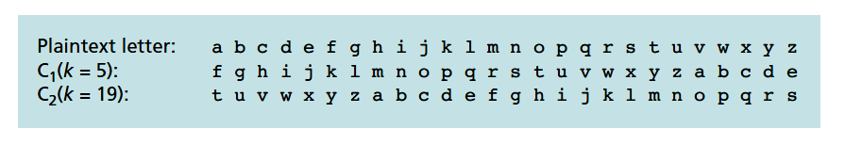
Polyalphabetic encryption
Using two Caesar ciphers
Repeating pattern: C₁, C₂, C₂, C₁, C₂
Network Security

Slide 15
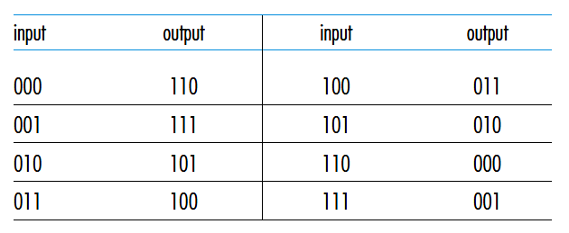
Block cipher
Message is encrypted in blocks of k bits.
Large k values against brute-force attack
  2^{k} possible mapping
  E.g, k=1024
Problem: maintaining a table of 2^{k} input values
  Hard to maintain and update
Network Security

Slide 16
Block cipher
Example: K=64
Break a 64-bit block into 8 chunks, each 8-bit chunk is processed by an 8-bit to 8-bit table
The 8 output chunks are reassembled into a 64-bit block.
The positions of the 64 bits in the block are then scrambled (permuted) to produce a 64-bit output.
This output is fed back to the 64-bit input, where another cycle begins.
After n cycles, the function provides a 64-bit block of ciphertext.
The key for this block cipher algorithm would be the eight permutation tables
  scramble function is publicly known
Network Security

Slide 17
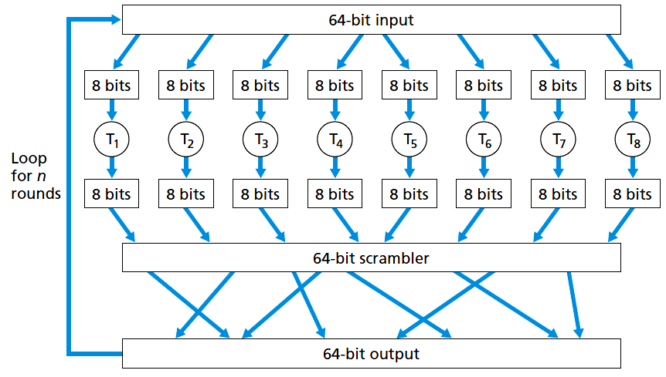
Block cipher
Network Security

Slide 18
Block cipher
Standards
  Use functions rather than tables
  Use a string of bits as key
DES uses 64-bit blocks with a 56-bit key.
AES uses 128-bit blocks and can operate with keys that are 128, 192, and 256 bits long.
Network Security

Slide 19
Cipher-block chaining
Problem of block cipher: two or more of the cleartext blocks can be identical.
  E.g., 200 OK
The sender creates a random k-bit number r(i) for the ith block and calculates
c(i) = K_{S}(m(i)⊕r(i)). (⊕ means exclusive or)
  A new k-bit random number is chosen for each block.
Receiver receives c(i) and r(i), it can recover each block of the plaintext by computing m(i)=K_{S}(c(i))⊕r(i).
Example:
  k=3, plain text 010 010 010
  r(1)=001 r(2)=111 r(3)=100
  Produce different ciphertext for same plaintext
Network Security

Slide 20
Cipher-block chaining
Problem: need to transmit r(i) from sender to receiver
  Transmit twice as many bits as before
Cipher-block chaining (CBC)
  Sender generates a k-bit string, Initialization Vector (IV), denoted as c(0)
  Runs block cipher algorithm c(1)=K_{s}(m(1)⊕c(0)), send c(1) to receiver.
  c(i)=K_{s}(m(i)⊕c(i-1))
  Receiver: knows c(i-1), obtain s(i)=K_{s}(c(i))⊕c(i-1)
Network Security

Slide 21

Public Key Cryptography
symmetric key crypto
requires sender, receiver know shared secret key
Q: how to agree on key in first place (particularly if never “met”)?
public key crypto
radically different approach from symmetric key crypto [Diffie-Hellman76, RSA78]
sender, receiver do not share secret key
public encryption key known to all
private decryption key known only to receiver
Network Security

Slide 22
Public key cryptography
+
Bob’s public
key
K
B
-
Bob’s private
key
K
B
plaintext
message, m
encryption
algorithm
ciphertext
decryption
algorithm
plaintext
message
+
K (m)
-
+
B
m = K (K (m))
B
B
Network Security

Slide 23
Public key encryption algorithms
requirements:
.
.
+
-
1
need K ( ) and K ( ) such that
B
B
-
+
K (K (m)) = m
B
B
2
+
given public key K , it should be impossible to compute private key K
B
-
B
RSA: Rivest, Shamir, Adelson algorithm
Network Security

Slide 24
Prerequisite: modular arithmetic
x mod n = remainder of x when divide by n
facts:
  [(a mod n) + (b mod n)] mod n = (a+b) mod n
  [(a mod n) - (b mod n)] mod n = (a-b) mod n
  [(a mod n) * (b mod n)] mod n = (a*b) mod n
thus
(a mod n)^{d} mod n = a^{d} mod n
example: x=14, n=10, d=2:
(x mod n)^{d} mod n = 4² mod 10 = 6
x^{d} = 14² = 196 x^{d} mod 10 = 6
Network Security

Slide 25
RSA: getting ready
message: just a bit pattern
bit pattern can be uniquely represented by an integer number
thus, encrypting a message is equivalent to encrypting a number.
example:
m= 10010001. This message is uniquely represented by the decimal number 145.
to encrypt m, we encrypt the corresponding number, which gives a new number (the ciphertext).
Network Security

Slide 26
RSA: Creating public/private key pair
1. choose two large prime numbers p, q.
(e.g., 1024 bits each)
2. compute n = pq, z = (p-1)(q-1)
3. choose e (with e<n) that has no common factors
with z (e, z are “relatively prime”).
4. choose d such that ed-1 is exactly divisible by z.
(in other words: ed mod z = 1 ).
5. public key is (n,e). private key is (n,d).
+
-
K
K
B
B
Network Security

Slide 27
RSA: encryption, decryption
0. given (n,e) and (n,d) as computed above
1. to encrypt message m (<n), compute
e
c = m mod n
2. to decrypt received bit pattern, c, compute
d
m = c mod n
magic
happens!
e
d
m = (m mod n)
mod n
c
Network Security

Slide 28
RSA example:
Bob chooses p=5, q=7. Then n=35, z=24.
e=5 (so e, z relatively prime).
d=29 (so ed-1 exactly divisible by z).
encrypting 8-bit messages.
m
e
e
bit pattern
m
c = m mod n
encrypt:
00001100
12
24832
17
d
d
c
c
m = c mod n
decrypt:
17
481968572106750915091411825223071697
12
Network Security

Slide 29
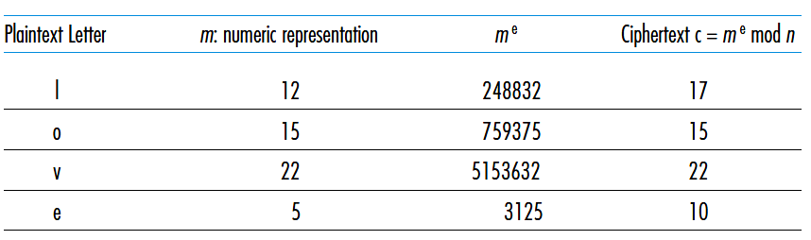
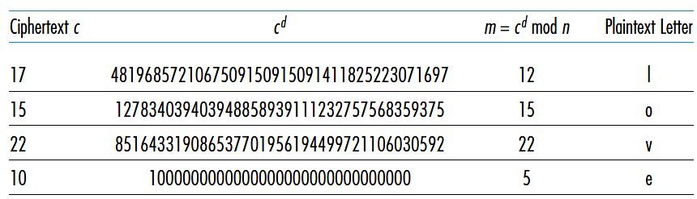
RSA example:
Network Security

Slide 30
Why does RSA work?
must show that c^{d} mod n = m
where c = m^{e} mod n
fact: for any x and y: x^{y} mod n = x^{(y mod z)} mod n
  where n= pq and z = (p-1)(q-1)
thus,
c^{d} mod n = (m^{e} mod n)^{d} mod n
= m^{ed} mod n
= m^{(ed mod z)} mod n
= m¹ mod n
= m
Network Security

Slide 31
RSA: another important property
The following property will be very useful later:
-
+
+
-
K (K (m)) = m
=
K (K (m))
B
B
B
B
use public key first, followed by private key
use private key first, followed by public key
result is the same!
Network Security

Slide 32
Why
-
+
+
-
K (K (m)) = m
?
=
K (K (m))
B
B
B
B
follows directly from modular arithmetic:
(m^{e} mod n)^{d} mod n = m^{ed} mod n
= m^{de} mod n
= (m^{d} mod n)^{e} mod n
Network Security

Slide 33
Why is RSA secure?
suppose you know Bob’s public key (n,e). How hard is it to determine d?
essentially need to find factors of n without knowing the two factors p and q
  fact: factoring a big number is hard
Network Security

Slide 34
RSA in practice: session keys
exponentiation in RSA is computationally intensive
DES is at least 100 times faster than RSA
use public key cryto to establish secure connection, then establish second key – symmetric session key – for encrypting data
session key, K_{S}
Bob and Alice use RSA to exchange a symmetric key K_{S}
  Sender computes c=(K_{S})^{e} mod n, receiver obtain K_{s}
once both have K_{S}, they use symmetric key cryptography
Network Security

Slide 35
Chapter 8 roadmap
8.1 What is network security?
8.2 Principles of cryptography
8.3 Message integrity and digital signature,
8.4 Authentication
8.5 Securing e-mail
8.6 Securing TCP connections: SSL
8.7 Network layer security: IPsec
8.8 Securing wireless LANs
8.9 Operational security: firewalls and IDS
Network Security

Slide 36
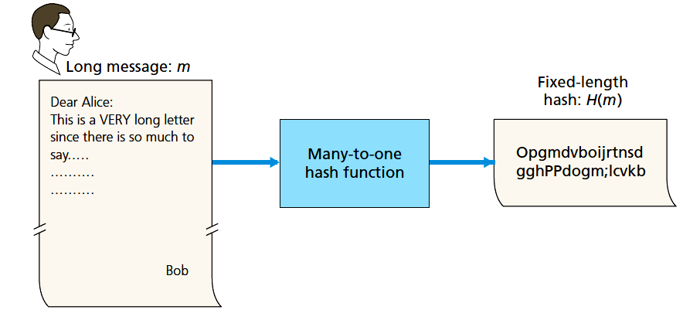
Cryptographic hash function
Takes an input, m, and computes a fixed size string H(m) known as a hash
  It is computationally infeasible to find any two different messages x and y such that H(x) = H(y).
Send (m, H(m))
Difficult to find y
that has a same
hash value
Network Security

Slide 37
Cryptographic hash function
A bad example: use checksum by adding 4-byte chunks
message
ASCII format
message
ASCII format
I O U 1
0 0 . 9
9 B O B
49 4F 55 31
30 30 2E 39
39 42 D2 42
I O U 9
0 0 . 1
9 B O B
49 4F 55 39
30 30 2E 31
39 42 D2 42
B2 C1 D2 AC
different messages
but identical checksums!
B2 C1 D2 AC
Network Security

Slide 38
Hash function algorithms
MD5 hash function widely used (RFC 1321)
  computes 128-bit message digest in 4-step process.
  arbitrary 128-bit string x, appears difficult to construct msg m whose MD5 hash is equal to x
SHA-1 is also used
  US standard [NIST, FIPS PUB 180-1]
  160-bit message digest
Network Security

Slide 39
Message authentication code
A flawed approach
  Alice creates message m and calculates the hash H(m) (for example with SHA-1).
  Alice then appends H(m) to the message m, creating an extended message (m, H(m)), and sends the extended message to Bob.
  Bob receives an extended message (m, h) and calculates H(m). If H(m) = h,
  Bob concludes that everything is fine.
Trudy can create a bogus message m′ in which she says she is Alice, calculate H(m′), and send Bob (m′, H(m′)).
Network Security

Slide 40
Message authentication code
Alice and Bob will need a shared secret s, called the authentication key.
Alice concatenates s with m to create m + s, and calculates the hash H(m + s) (for example with SHA-1).
  H(m + s) is called the message authentication code (MAC).
Alice then appends the MAC to the message m, creating an extended message (m, H(m + s)), and sends to Bob.
Bob receives an extended message (m, h) and knowing s, calculates the MAC H(m + s).
  If H(m + s) = h, Bob concludes that everything is fine.
Network Security

Slide 41
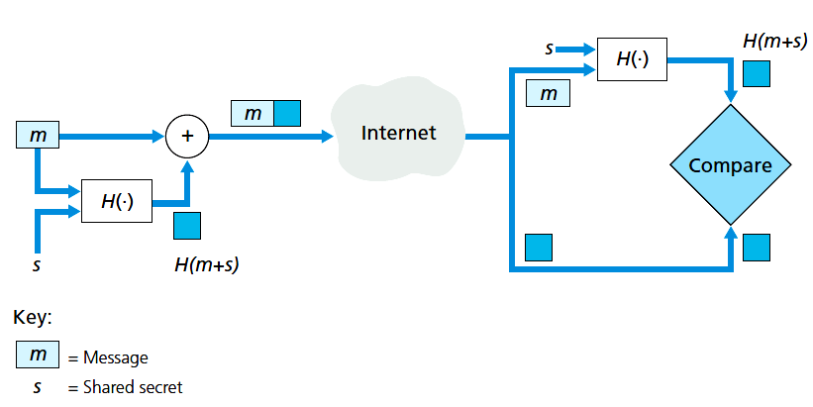
Message authentication code
Question: how to distributed authentication key?
  Manual config
  Public key
Network Security

Slide 42
Digital signatures
cryptographic technique analogous to hand-written signatures:
sender (Bob) digitally signs document, establishing he is document owner/creator.
verifiable, nonforgeable: recipient (Alice) can prove to someone that Bob, and no one else (including Alice), must have signed document
Network Security

Slide 43
Digital signatures
simple digital signature for message m:
Bob signs m by encrypting with his private key K_{B}, creating “signed” message, K_{B}(m)
-
-
Bob’s message, m
-
Bob’s private
key
-
K
m,K
(m)
B
B
Dear Alice
Oh, how I have missed you. I think of you all the time! …(blah blah blah)
Bob
Bob’s message, m, signed (encrypted) with his private key
Public key
encryption
algorithm
Network Security

Slide 44
Digital signatures
-
suppose Alice receives message m, with signature: m, K_{B}(m)
Alice verifies m signed by Bob by applying Bob’s public key K_{B} to K_{B}(m) then checks K_{B}(K_{B}(m) ) = m.
If K_{B}(K_{B}(m) ) = m, whoever signed m must have used Bob’s private key.
+
-
+
-
+
-
Alice thus verifies that:
  Bob signed m
  no one else signed m
  Bob signed m and not m’
non-repudiation:
  Alice can take m, and signature K_{B}(m) to court and prove that Bob signed m
-
Network Security

Slide 45
Message digests
large
message
m
H: Hash
Function
computationally expensive to public-key-encrypt long messages
goal: fixed-length, easy- to-compute digital “fingerprint”
apply hash function H to m, get fixed size message digest, H(m).
H(m)
Hash function properties:
many-to-1
produces fixed-size msg digest (fingerprint)
given message digest x, computationally infeasible to find m such that x = H(m)
Network Security

Slide 46
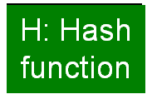

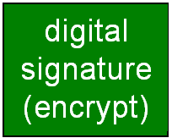
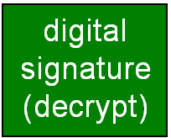
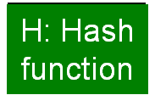
Digital signature = signed message digest
Bob sends digitally signed message:
Alice verifies signature, integrity of digitally signed message:
large
message
m
H(m)
encrypted
msg digest
-
K_{B}(H(m))
Bob’s
private
key
large
message
m
-
Bob’s
public
key
K
B
+
K
encrypted
msg digest
B
+
-
K_{B}(H(m))
H(m)
H(m)
equal
?
Network Security

Slide 47
Public-key certification
motivation: Trudy plays pizza prank on Bob
  Trudy creates e-mail order:
  Dear Pizza Store, Please deliver to me four pepperoni pizzas. Thank you, Bob
  Trudy signs order with her private key
  Trudy sends order to Pizza Store
  Trudy sends to Pizza Store her public key, but says it’s Bob’s public key
  Pizza Store verifies signature; then delivers four pepperoni pizzas to Bob
  Bob doesn’t even like pepperoni
Network Security

Slide 48
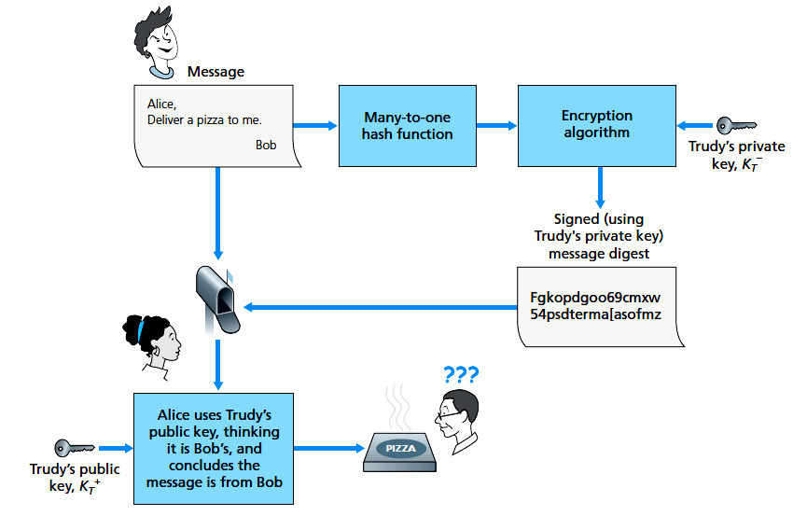

Network Security

Slide 49
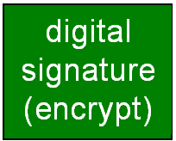


Certification authorities
certification authority (CA): binds public key to particular entity, E.
E (person, router) registers its public key with CA.
  E provides “proof of identity” to CA.
  CA creates certificate binding E to its public key.
  certificate containing E’s public key digitally signed by CA – CA says “this is E’s public key”
Bob’s
public
key
+
K
+
B
K
B
CA
private
key
certificate for Bob’s public key, signed by CA
-
Bob’s
identifying information
K
CA
Network Security

Slide 50
Certification authorities
when Alice wants Bob’s public key:
  gets Bob’s certificate (Bob or elsewhere).
  apply CA’s public key to Bob’s certificate, get Bob’s public key
+
Bob’s
public
key
K
B
+
K
B
CA
public
key
+
K
CA
Network Security

Slide 51
RSA in Linux
Create RSA key pair
Upload the public key on a server
or
root@server1:~# ssh-keygen -t rsa
Generating public/private rsa key pair.
Enter file in which to save the key (/root/.ssh/id_rsa):
Enter passphrase (empty for no passphrase):
Enter same passphrase again:
Your identification has been saved in /root/.ssh/id_rsa.
ssh-copy-id user@192.168.0.100
cat ~/.ssh/id_rsa.pub | ssh user@192.168.0.100 "cat >> ~/.ssh/authorized_keys"
Network Security

Slide 52
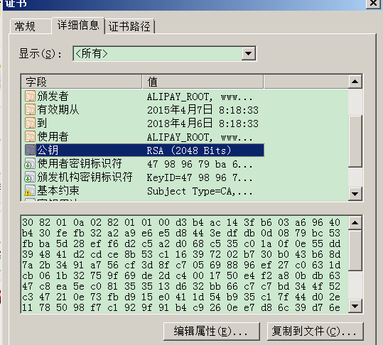
CA in practice
Network Security

Slide 53
Chapter 8 roadmap
8.1 What is network security?
8.2 Principles of cryptography
8.3 Message integrity and digital signature
8.4 Authentication
8.5 Securing e-mail
8.6 Securing TCP connections: SSL
8.7 Network layer security: IPsec
8.8 Securing wireless LANs
8.9 Operational security: firewalls and IDS
Network Security

Slide 54
Authentication
Need to verify
  The message indeed originated from Alice.
  The message was not tampered with on its way to Bob.
Network Security

Slide 55
Authentication
Goal: Bob wants Alice to “prove” her identity to him
Protocol ap1.0: Alice says “I am Alice”
“I am Alice”
Failure scenario??
Network Security

Slide 56
Authentication
Goal: Bob wants Alice to “prove” her identity to him
Protocol ap1.0: Alice says “I am Alice”
in a network,
Bob can not “see” Alice, so Trudy simply declares
herself to be Alice
“I am Alice”
Network Security

Slide 57
Authentication: another try
Protocol ap2.0: Alice says “I am Alice” in an IP packet
containing her source IP address
Alice’s
IP address
“I am Alice”
Failure scenario??
Network Security

Slide 58
Authentication: another try
Protocol ap2.0: Alice says “I am Alice” in an IP packet
containing her source IP address
Trudy can create
a packet “spoofing”
Alice’s address
Alice’s
IP address
“I am Alice”
Network Security

Slide 59
Authentication: another try
Protocol ap3.0: Alice says “I am Alice” and sends her
secret password to “prove” it.
Alice’s
IP addr
Alice’s
password
“I’m Alice”
Failure scenario??
Alice’s
IP addr
OK
Network Security

Slide 60

Authentication: another try
Protocol ap3.0: Alice says “I am Alice” and sends her
secret password to “prove” it.
Alice’s
IP addr
Alice’s
password
“I’m Alice”
playback attack: Trudy records Alice’s packet
and later
plays it back to Bob
Alice’s
IP addr
OK
Alice’s
IP addr
Alice’s
password
“I’m Alice”
Network Security

Slide 61
Authentication: yet another try
Protocol ap3.1: Alice says “I am Alice” and sends her
encrypted secret password to “prove” it.
Alice’s
IP addr
encrypted
password
“I’m Alice”
Failure scenario??
Alice’s
IP addr
OK
Network Security

Slide 62
Authentication: yet another try
Protocol ap3.1: Alice says “I am Alice” and sends her
encrypted secret password to “prove” it.
Alice’s
IP addr
encrypted
password
“I’m Alice”
record
and
playback
still works!
Alice’s
IP addr
OK
Alice’s
IP addr
encrypted
password
“I’m Alice”
Network Security

Slide 63
Authentication: yet another try
Goal: avoid playback attack
nonce: number (R) used only once-in-a-lifetime
(once used, never use again)
ap4.0: to prove Alice “live”, Bob sends Alice nonce, R. Alice
must return R, encrypted with shared secret key
“I am Alice”
R
K (R)
Alice is live, and only Alice knows key to encrypt nonce, so it must be Alice!
A-B
Failures, drawbacks?
Network Security

Slide 64
Authentication: ap5.0
ap4.0 requires shared symmetric key
can we authenticate using public key techniques?
ap5.0: use nonce, public key cryptography
“I am Alice”
Bob computes
R
+
-
-
K
(K (R)) = R
K (R)
A
A
A
and knows only Alice could have the private key, that encrypted R such that
“send me your public key”
+
K
A
+
-
K
(K (R)) = R
A
A
Network Security

Slide 65
ap5.0: security hole
man (or woman) in the middle attack: Trudy poses as Alice (to Bob) and as Bob (to Alice)
I am Alice
I am Alice
R
R
-
-
K (R)
K (R)
A
T
Send me your public key
Send me your public key
+
+
K
K
A
T
+
Trudy gets
+
K (m)
-
+
K (m)
A
m = K (K (m))
T
-
+
T
T
m = K (K (m))
sends m to Alice encrypted with Alice’s public key
A
A
Network Security

Slide 66
ap5.0: security hole
man (or woman) in the middle attack: Trudy poses as Alice (to Bob) and as Bob (to Alice)
difficult to detect:
Bob receives everything that Alice sends, and vice versa. (e.g., so Bob, Alice can meet one week later and recall conversation!)
problem is that Trudy receives all messages as well!
Network Security

Slide 67
Chapter 8 roadmap
8.1 What is network security?
8.2 Principles of cryptography
8.3 Message integrity and digital signature
8.4 Authentication
8.5 Securing e-mail
8.6 Securing TCP connections: SSL
8.7 Network layer security: IPsec
8.8 Securing wireless LANs
8.9 Operational security: firewalls and IDS
Network Security

Slide 68
Secure e-mail
Alice wants to send confidential e-mail, m, to Bob.
K_{S}
.
K_{S}(m )
K_{S}(m )
.
m
K_{S}( )
K_{S}( )
m
+
-
Internet
K_{S}
.
.
+
-
K_{S}
K_{B}( )
+
+
K_{B}( )
K_{B}(K_{S} )
K_{B}(K_{S} )
+
-
K_{B}
K_{B}
Alice:
generates random symmetric private key, K_{S}
encrypts message with K_{S} (for efficiency)
also encrypts K_{S} with Bob’s public key
sends both K_{S}(m) and K_{B}(K_{S}) to Bob
Network Security

Slide 69
Secure e-mail
Alice wants to send confidential e-mail, m, to Bob.
K_{S}
.
K_{S}(m )
K_{S}(m )
.
m
K_{S}( )
K_{S}( )
m
+
-
Internet
K_{S}
.
.
+
-
K_{S}
K_{B}( )
+
+
K_{B}( )
K_{B}(K_{S} )
K_{B}(K_{S} )
+
-
K_{B}
K_{B}
Bob:
uses his private key to decrypt and recover K_{S}
uses K_{S} to decrypt K_{S}(m) to recover m
No authentication, anyone can claim to be Alice
Network Security

Slide 70
Secure e-mail (continued)
Alice wants to provide sender authentication message integrity
-
+
K_{A}
K_{A}
.
.
-
-
.
-
K_{A}(H(m))
K_{A}(H(m))
+
H(m )
m
H( )
K_{A}( )
K_{A}( )
+
-
compare
Internet
.
m
H( )
H(m )
m
Alice digitally signs message
  Compute hash, and sign with private key
sends both message (in the clear) and digital signature
Network Security

Slide 71
Secure e-mail (continued)
Alice wants to provide secrecy, sender authentication,
message integrity.
-
K_{A}
.
.
-
-
K_{A}(H(m))
K_{S}
m
H( )
K_{A}( )
.
+
K_{S}( )
m
+
Internet
.
+
K_{S}
K_{B}( )
+
K_{B}(K_{S} )
+
K_{B}
Alice uses three keys: her private key, Bob’s public key, newly created symmetric key
Network Security

Slide 72
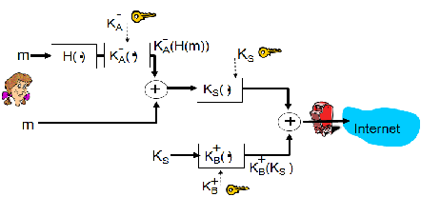
Secure e-mail (continued)
PGP (Pretty Good Privacy)
  De facto standard
  Essentially same as the previous slide
  Software generate public key pair, choose MD5 or SHA
  for hashing
Network Security

Slide 73
Chapter 8 roadmap
8.1 What is network security?
8.2 Principles of cryptography
8.3 Message integrity and digital signature
8.4 Authentication
8.5 Securing e-mail
8.6 Securing TCP connections: SSL
8.7 Network layer security: IPsec
8.8 Securing wireless LANs
8.9 Operational security: firewalls and IDS
Network Security

Slide 74
SSL: Secure Sockets Layer
widely deployed security protocol
  supported by almost all browsers, web servers
  https
  billions $/year over SSL
mechanisms: [Woo 1994], implementation: Netscape
variation -TLS: transport layer security, RFC 2246
provides
  confidentiality
  integrity
  authentication
original goals:
  Web e-commerce transactions
  encryption (especially credit-card numbers)
  Web-server authentication
  optional client authentication
  minimum hassle in doing business with new merchant
available to all TCP applications
  secure socket interface
Network Security

Slide 75
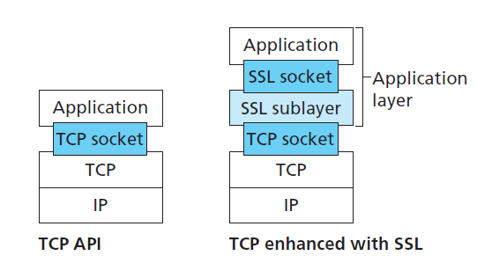
SSL and TCP/IP
SSL provides application programming interface (API) to applications
C and Java SSL libraries/classes readily available
Network Security

Slide 76
Could do something like PGP:
-
K_{A}
.
.
-
-
K_{A}(H(m))
K_{S}
m
H( )
K_{A}( )
.
+
K_{S}( )
m
+
Internet
.
+
K_{S}
K_{B}( )
+
K_{B}(K_{S} )
+
K_{B}
but want to send byte streams & interactive data
want set of secret keys for entire connection
want certificate exchange as part of protocol: handshake phase
Network Security

Slide 77
Toy SSL: a simple secure channel
handshake: Alice and Bob use their certificates, private keys to authenticate each other and exchange shared secret
key derivation: Alice and Bob use shared secret to derive set of keys
data transfer: data to be transferred is broken up into series of records
connection closure: special messages to securely close connection
Network Security

Slide 78
Toy: a simple handshake
SSL hello
public key certificate
K_{B}⁺(MS) = EMS
MS: master secret
EMS: encrypted master secret with Bob’s public key
Network Security

Slide 79
Toy: key derivation
considered bad to use same key for more than one cryptographic operation
  use different keys for message authentication code (MAC) and data encryption
four keys:
  E_{A} = encryption key for data sent from Alice to Bob
  M_{A} = MAC key for data sent from Alice to Bob
  E_{B} = encryption key for data sent from BoB to Alice
  M_{B} = MAC key for data sent from BoB to Alice
keys derived from key derivation function (KDF)
  takes master secret and (possibly) some additional random data and creates the keys
Network Security

Slide 80
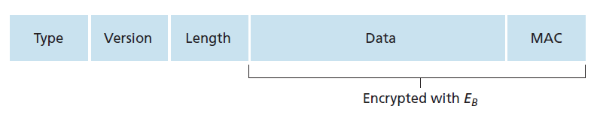
Toy: data records
why not encrypt data in constant stream as we write it to TCP?
  where would we put the MAC? If at end, no message integrity until all data processed.
  e.g., with instant messaging, how can we do integrity check over all bytes sent before displaying?
instead, break stream in series of records
  each record carries a MAC
  receiver can act on each record as it arrives
issue: in record, receiver needs to distinguish MAC from data
  want to use variable-length records
Network Security

Slide 81
Toy: sequence numbers
problem: attacker can capture and replay record or re-order records
solution: put sequence number into MAC:
  MAC = MAC(M_{B}, sequence||data)
  note: no sequence number field
problem: attacker could replay all records
solution: use nonce
M_{B}: MAC key
Network Security

Slide 82
Toy: control information
problem: truncation attack:
  attacker forges TCP connection close segment
  one or both sides thinks there is less data than there actually is.
solution: record types, with one type for closure
  type 0 for data; type 1 for closure
MAC = MAC(M_{B}, sequence||type||data)
Network Security

Slide 83
Toy SSL: summary
hello
certificate, nonce
K_{B}⁺(MS) = EMS
type 0, seq 1, data
bob.com
type 0, seq 2, data
type 0, seq 1, data
encrypted
type 0, seq 3, data
type 1, seq 4, close
type 1, seq 2, close
Network Security

Slide 84
Chapter 8 roadmap
8.1 What is network security?
8.2 Principles of cryptography
8.3 Message integrity and digital signature
8.4 Authentication
8.5 Securing e-mail
8.6 Securing TCP connections: SSL
8.7 Network layer security: IPsec
8.8 Securing wireless LANs
8.9 Operational security: firewalls and IDS
Network Security

Slide 85


Firewalls
firewall
isolates organization’s internal net from larger Internet, allowing some packets to pass, blocking others
administered
network
public
Internet
trusted “good guys”
untrusted “bad guys”
firewall
Network Security

Slide 86
Firewalls
Objectives:
All traffic from outside to inside, and vice versa, passes through the firewall.
Only authorized traffic, as defined by the local security policy, will be allowed to pass
The firewall itself is immune to penetration
three types of firewalls:
  stateless packet filters
  stateful packet filters
  application gateways
Network Security

Slide 87
Stateless packet filtering
Should arriving packet be allowed in? Departing packet let out?
internal network connected to Internet via router firewall
router filters packet-by-packet, decision to forward/drop packet based on:
  source IP address, destination IP address
  Protocol type
  TCP/UDP source and destination port numbers
  ICMP message type
  TCP flags, e.g., SYN and ACK bits
Network Security

Slide 88
Stateless packet filtering: example
example 1: block incoming and outgoing datagrams with IP protocol field = 17 and with either TCP source or dest port = 23
  result: all incoming, outgoing UDP flows and telnet connections are blocked
example 2: block inbound TCP segments with ACK=0.
  result: prevents external clients from making TCP connections with internal clients, but allows internal clients to connect to outside.
Network Security

Slide 89
Stateless packet filtering: more examples
Policy | Firewall Setting
No outside Web access. | Drop all outgoing packets to any IP address, port 80
No incoming TCP connections, except those for institution’s public Web server only. | Drop all incoming TCP SYN packets to any IP except 130.207.244.203, port 80
Prevent Web-radios from eating up the available bandwidth. | Drop all incoming UDP packets - except DNS and router broadcasts.
Prevent your network from being used for a smurf DoS attack. | Drop all ICMP packets going to a “broadcast” address (e.g. 130.207.255.255).
Prevent your network from being tracerouted | Drop all outgoing ICMP TTL expired traffic
Network Security

Slide 90
Access Control Lists
Policies implemented with ACL: table of rules, applied top to bottom to incoming packets: (action, condition) pairs
action | source address | dest address | protocol | source port | dest port | flag bit
allow | 222.22/16 | outside of 222.22/16 | TCP | > 1023 | 80 | any
allow | outside of 222.22/16 | 222.22/16 | TCP | 80 | > 1023 | ACK
allow | 222.22/16 | outside of 222.22/16 | UDP | > 1023 | 53 | ---
allow | outside of 222.22/16 | 222.22/16 | UDP | 53 | > 1023 | ----
deny | all | all | all | all | all | all
Network Security

Slide 91
Stateful packet filtering
stateless packet filter: heavy handed tool
  admits packets that “make no sense,” e.g., dest port = 80, ACK bit set, even though no TCP connection established:
action | source address | dest address | protocol | source port | dest port | flag bit
allow | outside of 222.22/16 | 222.22/16 | TCP | 80 | > 1023 | ACK
stateful packet filter: track status of every TCP connection
  track connection setup (SYN), teardown (FIN): determine whether incoming, outgoing packets “makes sense”
  timeout inactive connections at firewall: no longer admit packets
Network Security

Slide 92
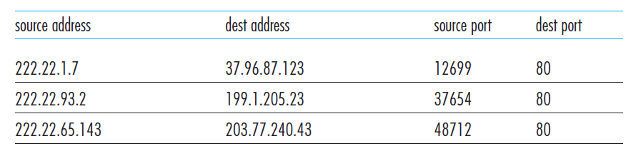
Stateful packet filtering
Maintain a connection table for all on-going connections
Network Security

Slide 93
Stateful packet filtering
ACL augmented to indicate need to check connection state table before admitting packet
action | source address | dest address | proto | source port | dest port | flag bit | check conxion
allow | 222.22/16 | outside of 222.22/16 | TCP | > 1023 | 80 | any
allow | outside of 222.22/16 | 222.22/16 | TCP | 80 | > 1023 | ACK | x
allow | 222.22/16 | outside of 222.22/16 | UDP | > 1023 | 53 | ---
allow | outside of 222.22/16 | 222.22/16 | UDP | 53 | > 1023 | ---- | x
deny | all | all | all | all | all | all
Network Security

Slide 94
Stateful packet filtering
Suppose an attacker send TCP segment to internal web server with
  Dst. Port = 80
  Src addr. = 150.23.23.155
  Src. Port = 12543
  ACK = 1
Not part of any ongoing TCP connection, reject the packet
Network Security

Slide 95

Application gateways
gateway-to-remote
host telnet session
host-to-gateway
telnet session
filters packets on application data as well as on IP/TCP/UDP fields.
example: allow select internal users to telnet outside.
application
gateway
router and filter
1. require all telnet users to telnet through gateway.
2. for authorized users, gateway sets up telnet connection to dest host. Gateway relays data between 2 connections
3. router filter blocks all telnet connections not originating from gateway.
Network Security

Slide 96
Application gateways
gateway-to-remote
host telnet session
host-to-gateway
telnet session
The router’s filter is configured to block all Telnet connections except those that originate from the IP address of the application gateway.
application
gateway
router and filter
The Telnet application gateway not only performs user authorization but also acts as a Telnet server and a Telnet client, relaying information between the user and the remote Telnet server
Network Security

Slide 97
Limitations of firewalls, gateways
IP spoofing: router can’t know if data “really” comes from claimed source
if multiple app’s. need special treatment, each has own app. gateway
client software must know how to contact gateway.
  e.g., must set IP address of proxy in Web browser
filters often use all or nothing policy for UDP
tradeoff: degree of communication with outside world, level of security
many highly protected sites still suffer from attacks
Network Security

Slide 98
Intrusion detection systems
packet filtering:
  operates on TCP/IP headers only
  no correlation check among sessions
IDS: intrusion detection system
  deep packet inspection: look at packet contents (e.g., check character strings in packet against database of known virus, attack strings)
  examine correlation among multiple packets
    port scanning
    network mapping
    DoS attack
Network Security

Slide 99
Intrusion detection systems
multiple IDSs: different types of checking at different locations
Demilitarized zone (DMZ)—protected only by the packet filter, but also monitored by IDS sensors.
  Servers need to communicate outside in DMZ
firewall
internal
network
Internet
IDS
sensors
Web
server
DNS
server
FTP
server
demilitarized
zone
Network Security

Slide 100
Intrusion detection systems
Signature-based IDS system
  Maintains database of attack signature
  Sniff every packet and compare with signature
  Limitation: 1) completely blind to new attacks; 2) matching a signature may not be attack
Anomaly-based IDS system
  Looks for packet streams that are statistically unusual
  Pro: don’t rely on previous knowledge
  Con: hard to distinguish between normal and abnormal
Sort: open source IDS
Network Security

Slide 101
Network Security (summary)
basic techniques…...
  cryptography (symmetric and public)
  message integrity
  end-point authentication
…. used in many different security scenarios
  secure email
  secure transport (SSL)
  IP sec
  802.11
operational security: firewalls and IDS
Network Security

