Slide 1



SRS-Activity Point System
Niyoosha Ziad - 53
Manudev B S - 73
Arjun P R - 75
Arun M - 76

Slide 2
Product Scope
Designed to streamline the tracking, verification, and management of students’ extracurricular and co-curricular activities.
It ensures that students earn activity points based on their participation and achievements.
Reduces the functions of faculties in certificate validation.
The system provides real-time analytics, and seamless communication between faculties, students, and administrators.
2

Slide 3
Functional Requirements
Student
Platform to secure documents
Sort and filtering of certificates
Duty-leave tracker
Event Calendar
Feedback on events
Performance analysis
Peer comparison
3

Slide 4
Functional Requirements
Club
Upload Club Events Details
Avoid Event Clash
Certificate issuing
4

Slide 5
Functional Requirements
Faculty
Platform to secure documents
Performance Analytics
Real-Time Alerts
Exportable Data
Group Notifications and guidance
Workflow management
5

Slide 6
Non-Functional Requirements
Performance- handle 5000 concurrent users
response time less than 3sec
Safety - Data must be backed up.
In case of failure, the system should restore within 1 hour.
Security - all communication should be encrypted
Role-Based Access Control should restrict access to sensitive
data
Usability & Accessibility - UI should be user friendly
6

Slide 7
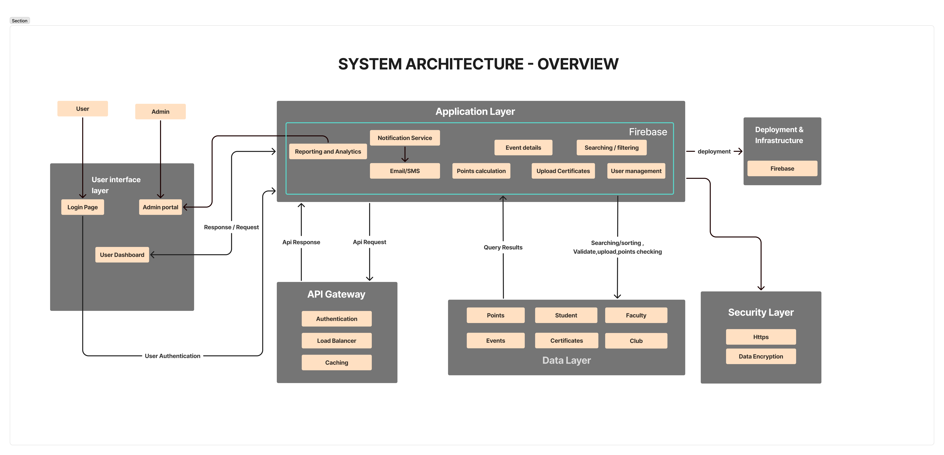
7

Slide 8
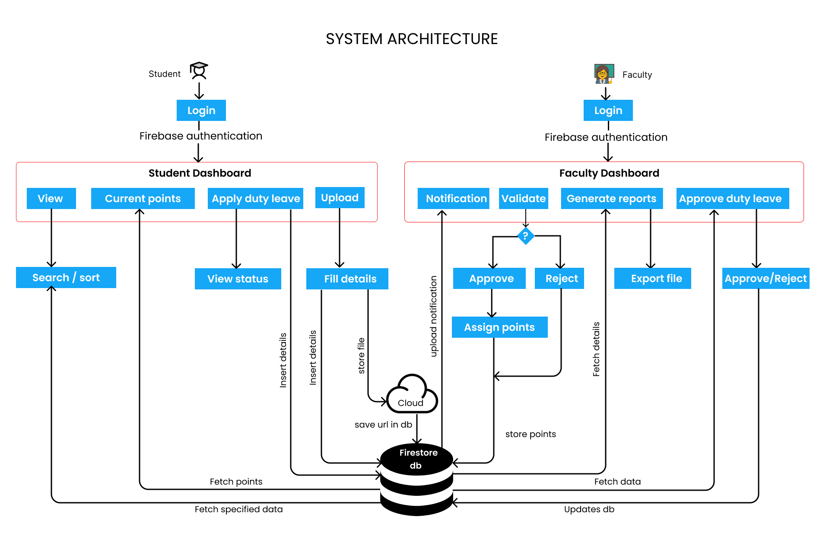

Slide 9
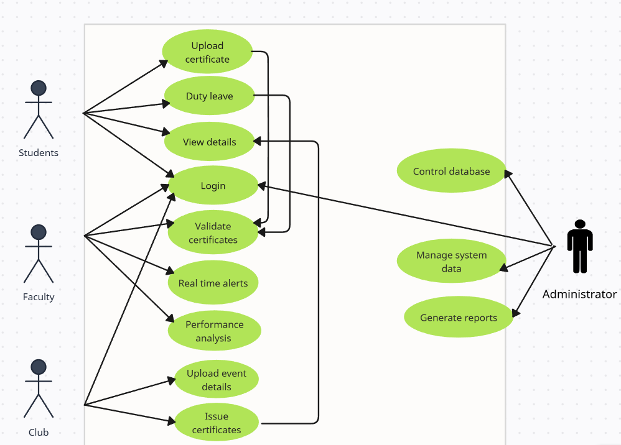
Use case diagram
8

Slide 10
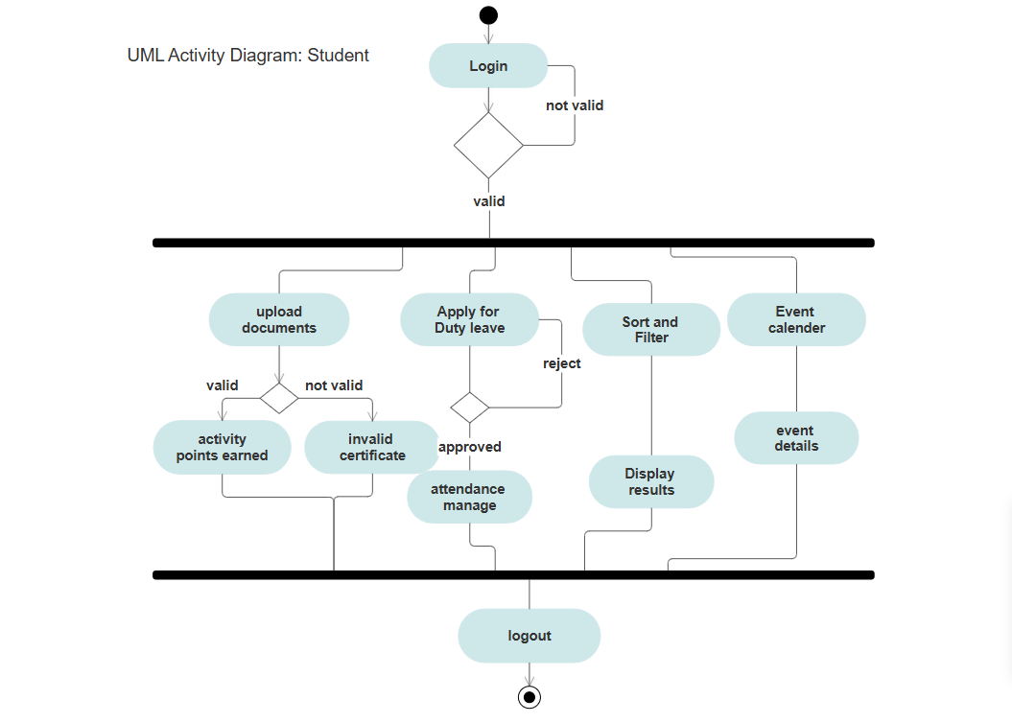
9

Slide 11
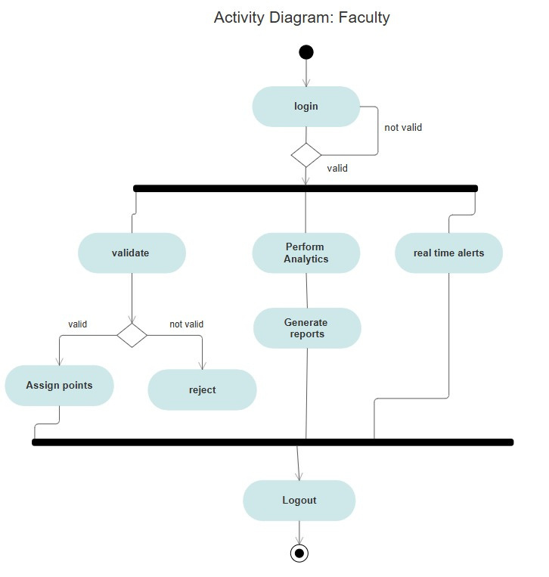
10

Slide 12
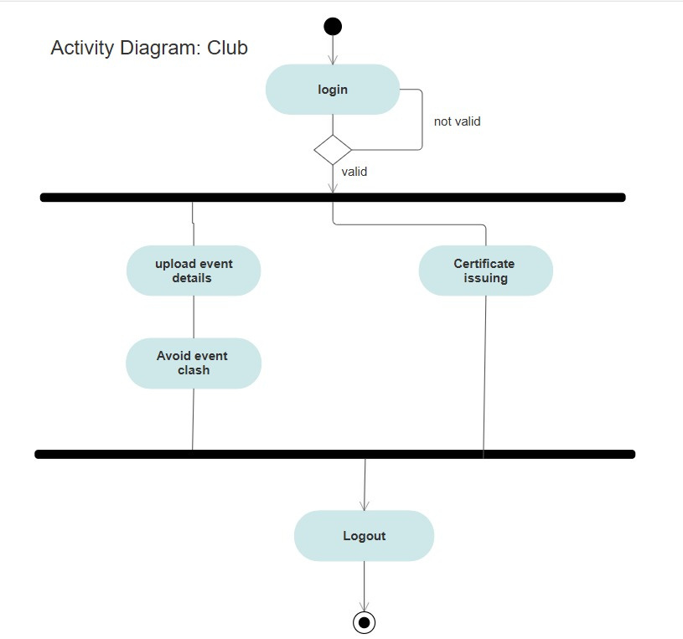
11

Slide 13
Timeline
Week 1
Setup and User Authentication
Week 2
Certificate Management System
Design the database schema in firestore for user roles
Implement user authentication and role-based access control
Build APIs for user login, signup, and role validation.
Design the UI for uploading and managing certificates
Build firestore database tables for storing certificate metadata
Implement APIs for certificate upload, retrieval, and filtering.
12

Slide 14
Timeline
Week 3
Student Performance Analysis
Week 4
Advanced Filtering and Sorting
Create a UI for Students to view and analyse their activity points
Build APIs and SQL queries to calculate and fetch student-specific performance data.
Display interactive charts for performance analysis.
Integrate duty leave tracking
Implement advanced filtering and sorting for certificates and events using optimized NoSQL queries.
Build APIs for search functionality across Students, Faculties, Clubs, and Admins.
Test the efficiency of database operations with large datasets.
13

Slide 15
Timeline
Week 5
Faculty Dashboard and Analytics
Week 6
Admin Control Panel
Create a dashboard UI for Faculties to verify certificates and monitor student performance.
Build firestore queries for fetching certificate verification statuses and student activity points.
Add notification system
Design the Admin control panel UI
Implement role-based access control (RBAC) to restrict operations based on user roles.
14

Slide 16
Timeline
Week 7
Notifications and Alerts
Week 8
Club Event Management
Implement a real-time notification system using Socket.io.
Build APIs for sending notifications based on database events (e.g., certificate upload, event reminders).
Design the UI for Clubs to upload event details and issue certificates.
Create firestore collection for managing club events and participant data.
Build APIs for creating, updating, and fetching club event details.
15

Slide 17
Thank
You

