Slide 1
Do schools kill creativity?
By ken robinson

Slide 2

Ken Robinson, a British author, speaker and educationalist.

Slide 3
The main questions
What is the world’s education system today?
Why is it important?
Are there any problems and how do schools and universities influence on people?

Slide 4
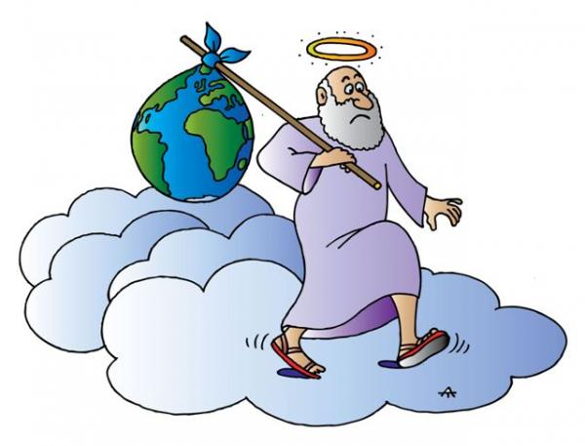

Slide 5
“... On coming to the house, they saw the child with his mother Mary, and they bowed down and worshiped him. Then they opened their treasures and presented him with gifts of gold, frankincense and myrrh ... “
Matthew 2:11
... the first boy said,
"I bring you gold.“ And the second boy said,
"I bring you myrrh.“ And the third boy said:
"Frank sent this."

Slide 6
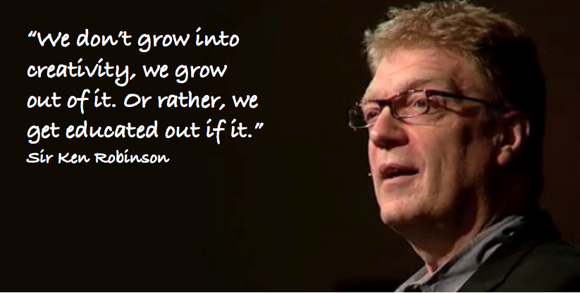
“There isn't an education
system on the planet, that teaches dance everyday to children the way we
each them mathematics. Why? Why not?”

Slide 7
The 2 ideas of hierarchy:
The most useful subjects for work are at the top – at school you are steered away from the things, that won’t help you to get a job
The whole system of public education around the world is a protracted process of university entrance

Slide 8
“...our only hope for the future is to rethink the fundamental principles on which we're educating our children. We have to be careful now that we use the gift of the human imagination wisely. “

Slide 9
Vocabulary
Vested interest – личная заинтересованность
Contention – утверждение, позиция
To squander - растрачивать
Literacy - грамотность
Frankincense - ладан
Myrrh - мирра
To stigmatize – клеймить, позорить
Benignly – милостиво, ласково
To be profoundly mistaken – быть глубоко ошибочным
Engulfed - поглощенный
Protracted - затянувшийся
Diverse - разнообразный
Compartment – часть, отдел
Distinct – особый, индивидуальный
To avert - предотвращать

