Slide 1
15-316: Software Foundations of Security and Privacy
Introduction
Fall 2022

Slide 3
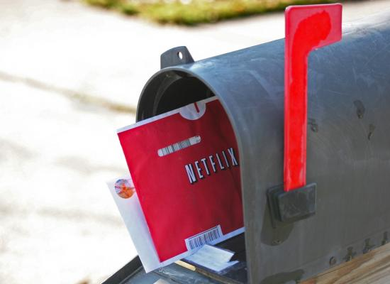
Failed Attempts at Security: Netflix Prize
$1million competition to improve Netflix’s recommendation system
100 million ratings from 500,000 users
“All customer identifying information has been removed; all that remains are ratings and dates … only a small sample was included, and that data was subject to perturbation”

Slide 4
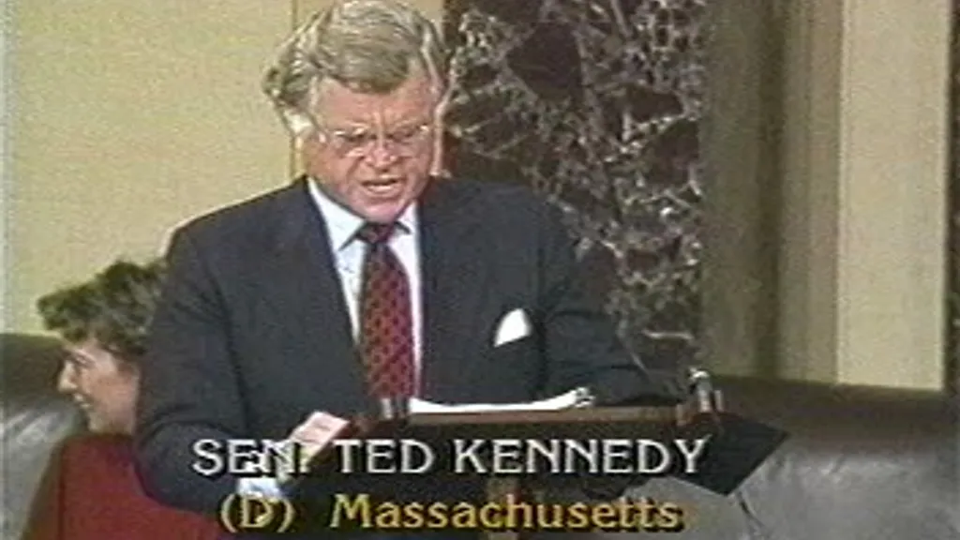
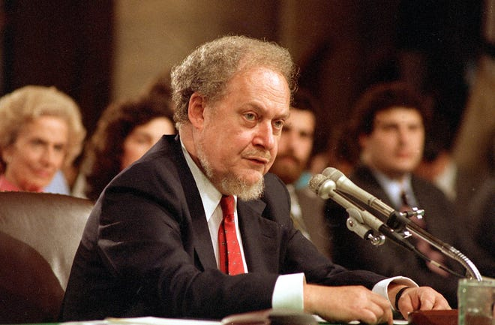
A brief digression
October 1987: US Senate rejects Robert Bork’s SCOTUS nomination 42-58
Ted Kennedy, 45 minutes after Bork’s nomination:
“Robert Bork's America is a land in which women would be forced into back-alley abortions, blacks would sit at segregated lunch counters, rogue police could break down citizens' doors in midnight raids, and schoolchildren could not be taught about evolution…”
During the debate, Bork’s video rental history was leaked to the press
Image source: Associated Press, 1987

Slide 5




Stunning revelations

Slide 6
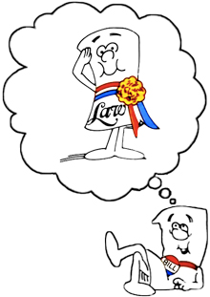
Video Privacy Protection Act of 1988
18 U.S. Code § 2710 –
Wrongful disclosure of video tape rental or sale records
(b)(1) A video tape service provider who knowingly discloses, to any person, personally identifiable information concerning any consumer of such provider shall be liable to the aggrieved person for the relief provided in subsection (c).
(c)(2) The court may award—actual damages but not less than liquidated damages in an amount of $2,500; punitive damages; reasonable attorneys’ fees; and such other preliminary and equitable relief as the court deems appropriate.

Slide 7
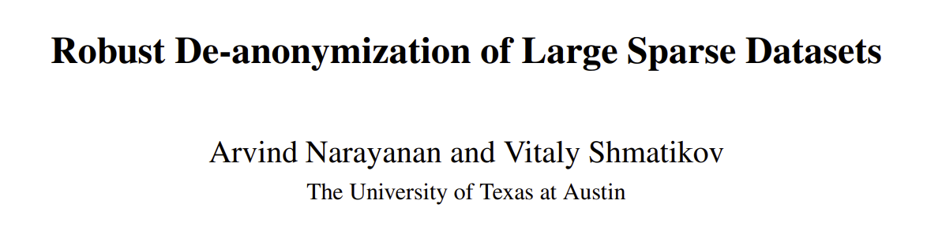
Recall: “All customer identifying information has been removed; all that remains are ratings and dates … only a small sample was included, and that data was subject to perturbation”
 | The Godfather | 12 Angry Men | Forrest Gump | … | Les Chiens | Bye Bye Monkey | Themroc | Sumo Do, Sumo Don’t | Spies
User1 | 5 | 4 | 3 | … |  |  |  | 5
User2 | 2 | 4 | 5 | … | 1
User3 | 5 | 5 | 5 | … |  |  |  |  | 3
Commonly Rated
More Obscure

Slide 8
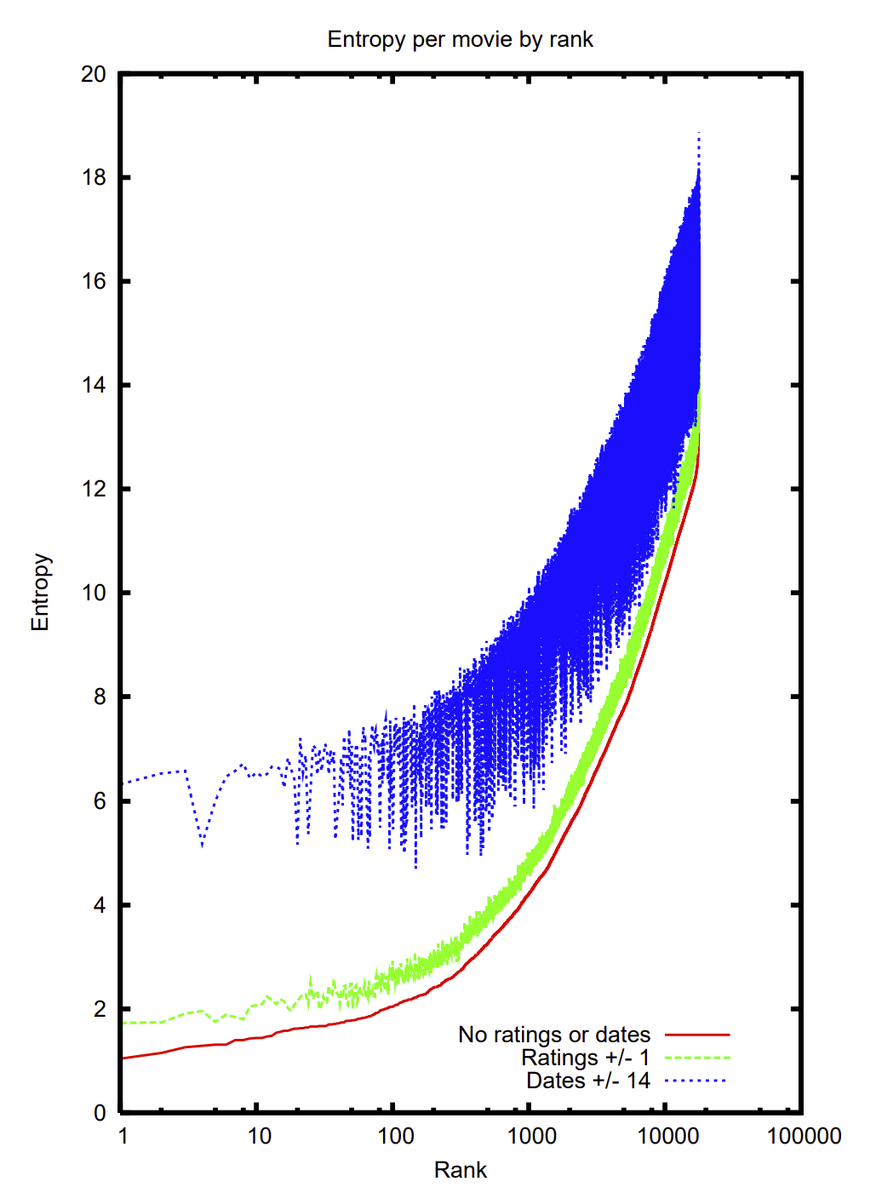
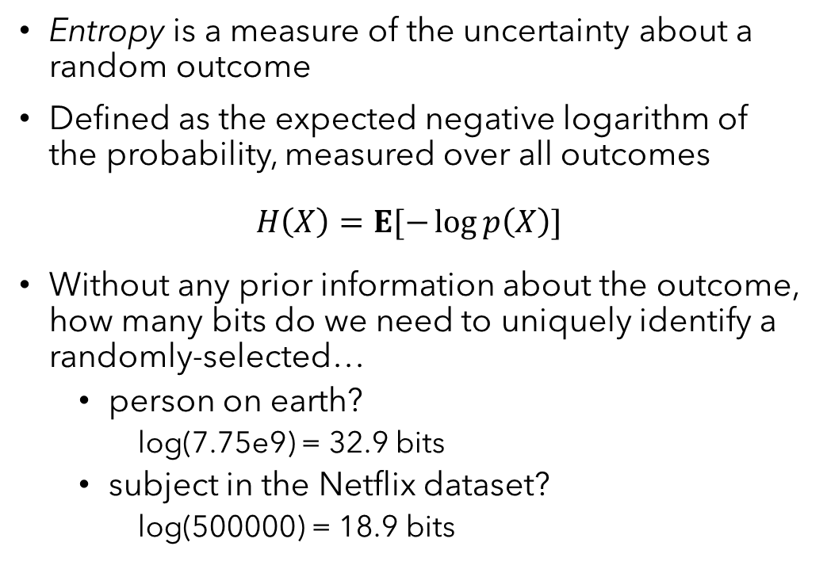
Entropy and identity
Entropy is a measure of the uncertainty about a random outcome
Defined as the expected negative logarithm of the probability, measured over all outcomes
$$H\left(X\right)=E[−\log{p\left(X\right)}]$$
Without any prior information about the outcome, how many bits do we need to uniquely identify a randomly-selected…
person on earth?
log(7.75e9) = 32.9 bits
subject in the Netflix dataset?
log(500000) = 18.9 bits

Slide 9
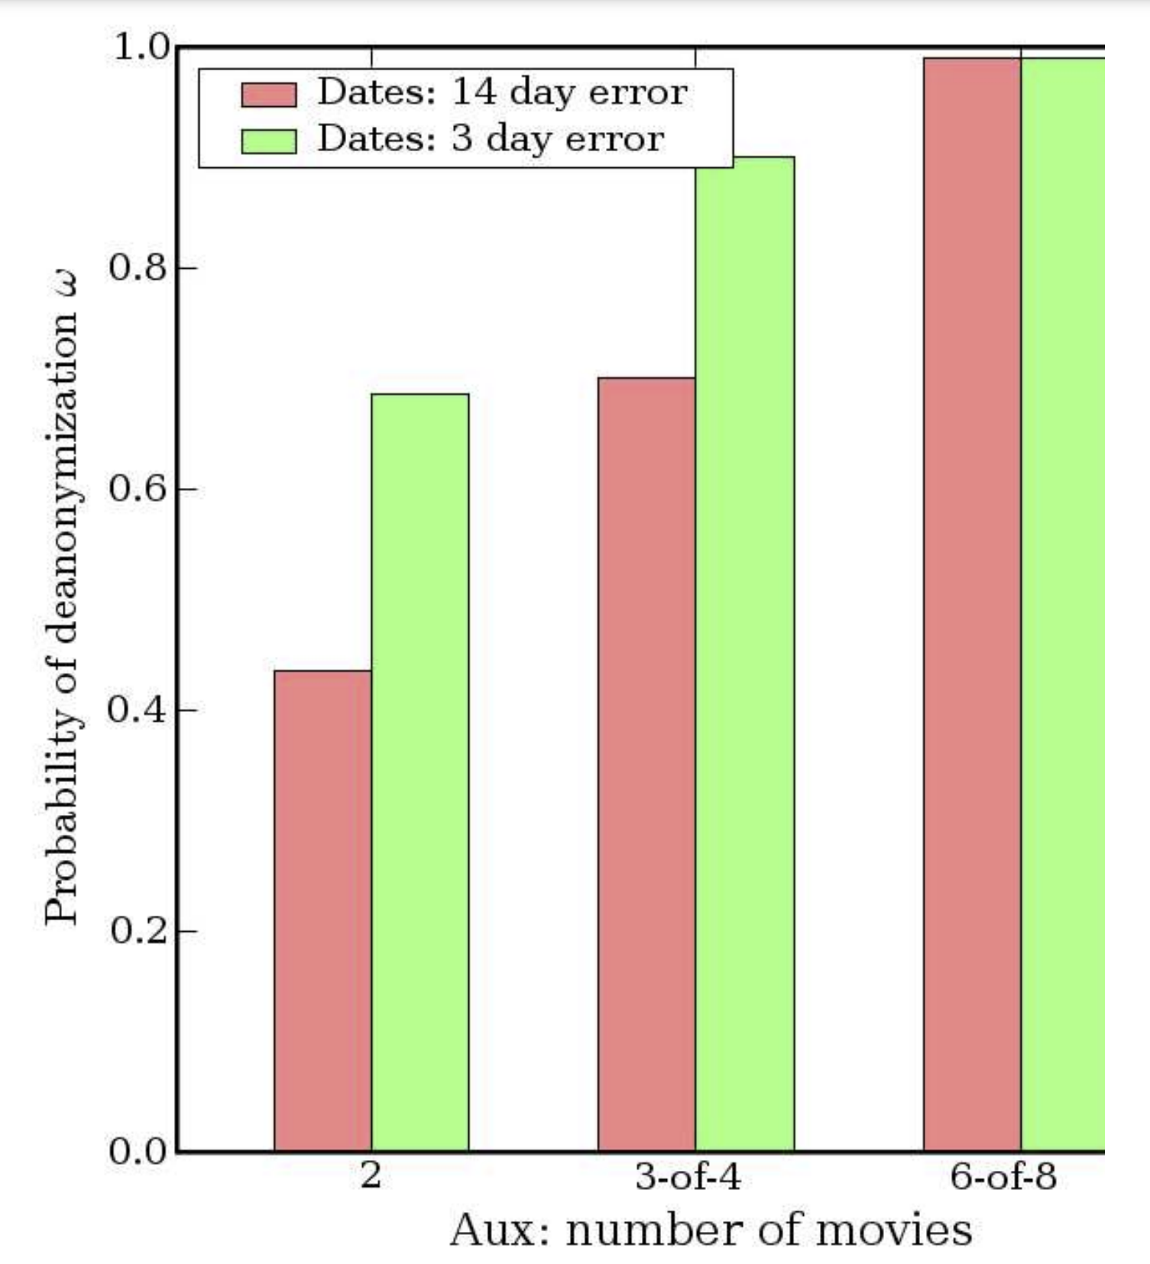
What is PII anyway?
Both Netflix and the law refer to personal identifying/identifiable information
Conventionally: name, government-issued identifiers, address, …
Results of this attack: “With 8 movie ratings (of which 2 may be completely wrong) and dates that may have a 14-day error, 99% of records be uniquely identified in the dataset. For 68%, two ratings and dates (with a 3-day error) are sufficient”
Netflix ended up settling a class-action lawsuit based on the Video Privacy Protection Act

Slide 10
Takeaways
Policy may seem straightforward, but is difficult to enforce
Need to be methodical and unambiguous about:
Defining security goals
Identifying a policy that is sufficient to achieve them
Developing a comprehensive method of enforcing the policy
Proving that the result matches the policy
Sneak peek: Differential Privacy
Goal: Person’s risk of privacy breach should not increase significantly due to their participation
Policy: Regardless of whether any single person is in the data, the output should remain about the same
Enforcement: Introduce carefully-designed randomness at key points in the computation
Result: Provable guarantee limiting what personal data can be learned via output

Slide 11
This course
Look at security from the coder’s perspective
We’ll cover a range of security concerns
Safety: The code will never do something we deem “bad”
Isolation: Untrusted code and data can’t affect important state
Information Flow: Confidential data remains that way
Privacy: Don’t jeopardize peoples’ control over their data and autonomy
Authorization: Only designated parties/code can obtain rights
Trust: Leverage a small base to establish trust in a complete system
Recurring themes
Ways of specifying computations that are secure, i.e. policies
Ways of ensuring that code meets policy, i.e. enforcement
Establishing rigorous connections between policy, enforcement, and code

Slide 12
Logic and languages
Why is this an L&L elective?
Precise ways to write down policies
Types, logical formulas, domain-specific languages
Often devised for correctness, perfect for security also
Rigorous means of enforcement
Static: verification, type checking
Dynamic: runtime monitors, code instrumentation
We will prove many of the approaches covered this semester

Slide 13
Learning objectives
After taking this course, you should:
Be able to identify, formalize, and implement a range of practical security & privacy policies
Understand the tradeoffs of different approaches to security & privacy, and how to use context-specific rationale to justify them
Understand how general principles like least privilege, roots of trust, and complete mediation play a role in formulating and vetting defenses
Be able to provide a formal security argument for several types of security mechanisms implemented in code

Slide 14
Logistics

Slide 15
Grading

Slide 16
Written homework (35%)

Slide 17
Labs (35%)

Slide 18
Quizzes (15%)

Slide 19
Final Exam (15%)

