Slide 1
Lecture 2: Safety & Proof

Slide 2
Today’s goals
Introduce safety as a distinct type of security policy
See examples of common safety problems
Understand limitations of heuristic defenses
Formulate a good mitigation

Slide 3
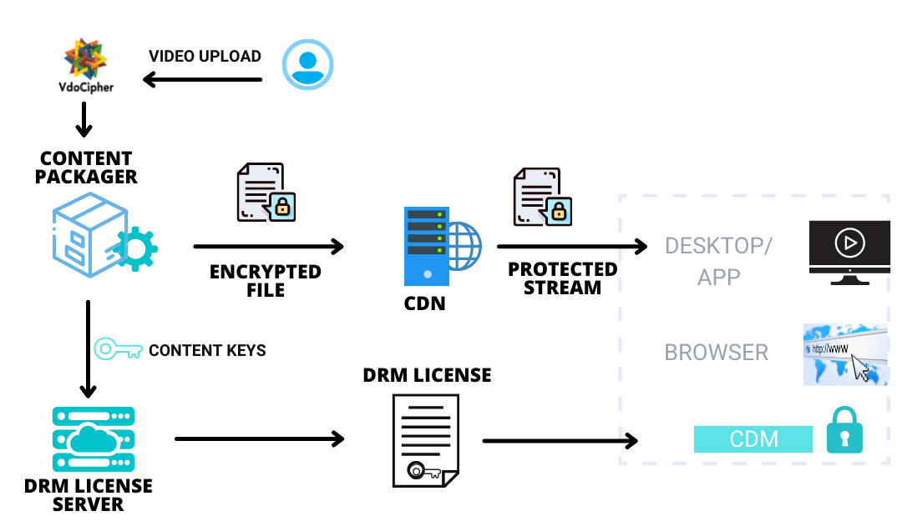
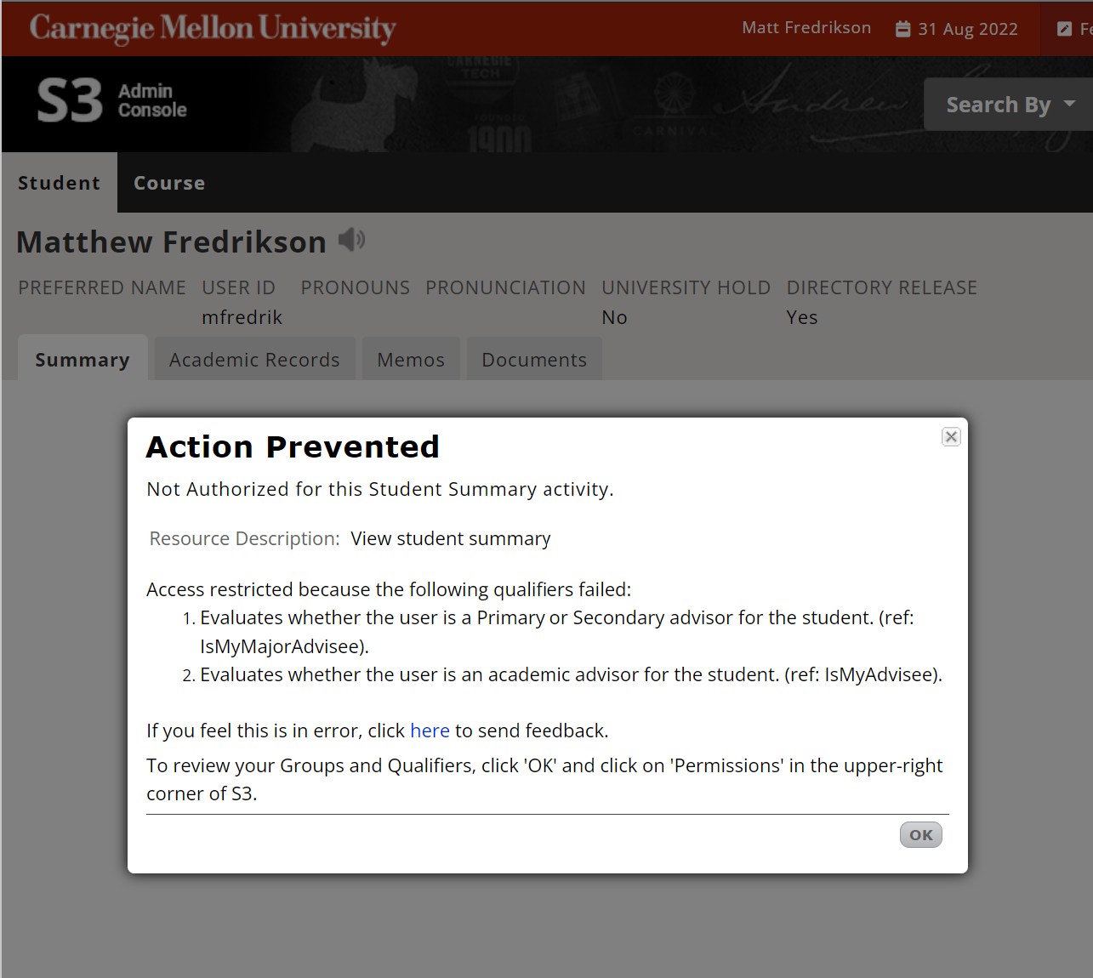


Policies are everywhere

Slide 4
How to enforce them?
Runtime monitor
Audit
Design the system accordingly
Build a good test suite
Use linters, static analysis tools
Verify the implementation (or a model of it)
…

Slide 5
Safety
A class of policies that can always be enforced at runtime
If the presented student ID is expired, deny payment
Only the student’s primary advisor may view their summary
Standard users may view content, but cannot copy it
Information labeled top secret may not influence the contents of secret documents
Safety policies do not always need to be enforced at runtime, though

Slide 6
Memory Safety

Slide 7
What is memory safety?
To an extent, depends on the platform
On modern systems, indicates the absence of:
Buffer overflow, over-read
Concurrent reads/writes to shared memory
Uninitialized read/dereference, null dereference
Invalid page fault
Use after free, invalid/double free
Stack/heap exhaustion
In many cases, violations result in corrupted state, unstable behavior
Sometimes they result in exploitable vulnerabilities

Slide 8
Recap: Buffer overflow
Occurs when data is written to a location outside of the space allocated for a buffer
A buffer may be allocated:
On the stack
Covered today
Easiest case to exploit
On the heap
Not covered
May still be exploitable, but more advanced

Slide 9
Basic Example
…
argv
argc
return addr
caller’s rbp
buf (64 bytes)
argc
argv
int main(int argc, char **argv) {
char buf[64];
gets(buf);
}
Dump of assembly code for function main:
4004fd: push %rbp
4004fe: mov %rsp,%rbp
400501: sub $0x50,%rsp
400505: mov %rdi,-0x48(%rbp)
400508: mov %rsi,-0x50(%rbp)
40050c: lea -0x40(%rbp),%rax
400510: mov %rax,%rdi
400518: callq 400400 <gets@plt>
40051d: leaveq
40051e: retq
%rbp
0x50 bytes
Reg | Value
rax | buf
rdi | buf
%rsp
Notes:
Talk about gcc command line arguments -- -z execstack and –fno-stack-protector. Buf and argv are pointers .. Hence the arrows ☺

Slide 10
“123456”
…
argv
argc
return addr
caller’s rbp
argc
argv
int main(int argc, char **argv) {
char buf[64];
gets(buf);
}
Dump of assembly code for function main:
4004fd: push %rbp
4004fe: mov %rsp,%rbp
400501: sub $0x50,%rsp
400505: mov %rdi,-0x48(%rbp)
400508: mov %rsi,-0x50(%rbp)
40050c: lea -0x40(%rbp),%rax
400510: mov %rax,%rdi
400518: callq 400400 <gets@plt>
40051d: leaveq
40051e: retq
%rbp
123456\0
0x50 bytes
Reg | Value
rax | buf
rdi | buf
%rsp

Slide 11
“A”x72 + “\xEF\xBE\xAD\xDE\x00\x00\x00\x00”
…
argv
0x0
0x0..0DEADBEEF
AAAAAAAA
argc
argv
int main(int argc, char **argv) {
char buf[64];
gets(buf);
}
Dump of assembly code for function main:
4004fd: push %rbp
4004fe: mov %rsp,%rbp
400501: sub $0x50,%rsp
400505: mov %rdi,-0x48(%rbp)
400508: mov %rsi,-0x50(%rbp)
40050c: lea -0x40(%rbp),%rax
400510: mov %rax,%rdi
400518: callq 400400 <gets@plt>
40051d: leaveq
40051e: retq
%rbp
AAAA…(64 total)
0x50 bytes
Reg | Value
rax | buf
rdi | buf
%rsp

Slide 12
Frame teardown, part 1
…
argv
0x0
AAAAAAAA
argc
argv
…
argv
0x0
AAAAAAAA
int main(int argc, char **argv) {
char buf[64];
gets(buf);
}
Dump of assembly code for function main:
4004fd: push %rbp
4004fe: mov %rsp,%rbp
400501: sub $0x50,%rsp
400505: mov %rdi,-0x48(%rbp)
400508: mov %rsi,-0x50(%rbp)
40050c: lea -0x40(%rbp),%rax
400510: mov %rax,%rdi
400518: callq 400400 <gets@plt>
40051d: leaveq
40051e: retq
corrupted
overwritten
0x0..0DEADBEEF
overwritten
%rbp
leave
mov %rbp,%rsp
pop %rbp
0x50 bytes
%rsp

Slide 13
Frame teardown, part 1
…
argv
0x0
AAAAAAAA
argc
argv
…
argv
0x0
AAAAAAAA
int main(int argc, char **argv) {
char buf[64];
gets(buf);
}
Dump of assembly code for function main:
4004fd: push %rbp
4004fe: mov %rsp,%rbp
400501: sub $0x50,%rsp
400505: mov %rdi,-0x48(%rbp)
400508: mov %rsi,-0x50(%rbp)
40050c: lea -0x40(%rbp),%rax
400510: mov %rax,%rdi
400518: callq 400400 <gets@plt>
40051d: leaveq
40051e: retq
corrupted
overwritten
0x0..0DEADBEEF
overwritten
%rbp
%rsp
leave
mov %rbp,%rsp
pop %rbp
0x50 bytes

Slide 14
Frame teardown, part 1
…
argv
0x0
AAAAAAAA
int main(int argc, char **argv) {
char buf[64];
gets(buf);
}
Dump of assembly code for function main:
4004fd: push %rbp
4004fe: mov %rsp,%rbp
400501: sub $0x50,%rsp
400505: mov %rdi,-0x48(%rbp)
400508: mov %rsi,-0x50(%rbp)
40050c: lea -0x40(%rbp),%rax
400510: mov %rax,%rdi
400518: callq 400400 <gets@plt>
40051d: leaveq
40051e: retq
corrupted
overwritten
0x0..0DEADBEEF
overwritten
%rbp
%rsp
leave
mov %rbp,%rsp
pop %rbp

Slide 15
Frame teardown, part 2
…
argv
0x0
int main(int argc, char **argv) {
char buf[64];
gets(buf);
}
Dump of assembly code for function main:
4004fd: push %rbp
4004fe: mov %rsp,%rbp
400501: sub $0x50,%rsp
400505: mov %rdi,-0x48(%rbp)
400508: mov %rsi,-0x50(%rbp)
40050c: lea -0x40(%rbp),%rax
400510: mov %rax,%rdi
400518: callq 400400 <gets@plt>
40051d: leaveq
40051e: retq
corrupted
overwritten
0x0..0DEADBEEF
%rsp
%rbp = AAAAAAAA
leave
mov %rbp,%rsp
pop %rbp

Slide 16
Frame teardown, part 3
…
argv
0x0
…
argv
0x0
int main(int argc, char **argv) {
char buf[64];
gets(buf);
}
Dump of assembly code for function main:
4004fd: push %rbp
4004fe: mov %rsp,%rbp
400501: sub $0x50,%rsp
400505: mov %rdi,-0x48(%rbp)
400508: mov %rsi,-0x50(%rbp)
40050c: lea -0x40(%rbp),%rax
400510: mov %rax,%rdi
400518: callq 400400 <gets@plt>
40051d: leaveq
40051e: retq
corrupted
overwritten
0x0..0DEADBEEF
%rsp

Slide 17
Frame teardown, part 3
…
argv
0x0
…
argv
0x0
int main(int argc, char **argv) {
char buf[64];
gets(buf);
}
Dump of assembly code for function main:
4004fd: push %rbp
4004fe: mov %rsp,%rbp
400501: sub $0x50,%rsp
400505: mov %rdi,-0x48(%rbp)
400508: mov %rsi,-0x50(%rbp)
40050c: lea -0x40(%rbp),%rax
400510: mov %rax,%rdi
400518: callq 400400 <gets@plt>
40051d: leaveq
40051e: retq
corrupted
%rsp
overwritten
0x0..0DEADBEEF

Slide 18
Frame teardown, part 3
…
argv
0x0
int main(int argc, char **argv) {
char buf[64];
gets(buf);
}
Dump of assembly code for function main:
4004fd: push %rbp
4004fe: mov %rsp,%rbp
400501: sub $0x50,%rsp
400505: mov %rdi,-0x48(%rbp)
400508: mov %rsi,-0x50(%rbp)
40050c: lea -0x40(%rbp),%rax
400510: mov %rax,%rdi
400518: callq 400400 <gets@plt>
40051d: leaveq
40051e: retq
corrupted
%rsp
overwritten
%rip = 0x00000000DEADBEEF
(probably crash)

Slide 19
Shellcode
…
0x080483fa <+22>: call 0x8048300 <gets@plt>
0x080483ff <+27>: leave
0x08048400 <+28>: ret
…
argv
argc
&buf
…
shellcode…
argc
argv
Traditionally, we inject assembly instructions for exec(“/bin/sh”) into buffer.
see “Smashing the stack for fun and profit” for exact string
or search online
%rbp
%rsp

Slide 20
Defenses

Slide 21
StackGuard [Cowen et al. 1998]
…
argv
argc
return addr
caller’s rbp
callee-save
CANARY
locals
Key idea: insert a unique identifier (“canary”) just below the saved return address
Function prologue inserts a random value below callee-save registers, above locals
Epilogue checks the value before returning
Terminate if the canary doesn’t match!
%rbp
%rsp

Slide 22
Data Pointer Subterfuge
int *ptr;
char buf[64];
memcpy(buf, user1);
*ptr = user2;
return addr
caller’s rbp
CANARY
ptr
buf (64 bytes)

Slide 23
Data Pointer Subterfuge
int *ptr;
char buf[64];
memcpy(buf, user1);
*ptr = user2;
return addr
caller’s rbp
CANARY
ptr
buf (64 bytes)
First overwrite ptr to point to saved return address

Slide 24
Data Pointer Subterfuge
int *ptr;
char buf[64];
memcpy(buf, user1);
*ptr = user2;
return addr
caller’s rbp
CANARY
ptr
buf (64 bytes)
First overwrite ptr to point to saved return address
Then modify return address via ptr

Slide 25
Memory protection
shellcode | padding | &buf
Either (or both):
Mark stack as non-executable
Make sure that each page is writeable or executable, exclusively

Slide 26
Memory protection
shellcode | padding | &buf
CRASH
Either (or both):
Mark stack as non-executable
Make sure that each page is writeable or executable, exclusively

Slide 27
Bypassing memory protection
Set return address to code that’s already marked executable!
Fertile ground: libc
More difficult with register-based calling conventions
Typically done via register-loading “gadgets”
Main point: no injected code
fake ret addr
&system()
caller’s rbp
buf (64 bytes)

Slide 28
Layout randomization (ASLR)
Recall: Our exploit needed a concrete address
True of both stack-based and return-to-libc:
Location of shell code
Library addresses, gadget offsets
Vulnerability (partially) due to fixed memory layout
Solution: Randomize the layout!

Slide 29
ASLR
Base address a
Base address b
Base address c
Program
Code
Uninitialized data
Initialized data
Mapped
Heap
Dynamic libraries
Thread stacks
Shared Memory
Stack
Main stack

Slide 30
ASLR
a + 16 bit rand r₁
b + 16 bit rand r₂
c + 24 bit rand r₃
Base address a
Base address b
Base address c
Program
Code
Uninitialized data
Initialized data
Mapped
Heap
Dynamic libraries
Thread stacks
Shared Memory
Stack
Main stack

Slide 31
How to attack ASLR
Attack
Brute Force
Non-randomized memory
Stack Juggling
GOT
Hijacking
ret2text
ret2ret
ret2got
Func ptr
ret2pop

Slide 32
Recap
Memory safety (esp. buffer overflow) issues cause vulnerability
There are a wide range of practical defenses
Canaries → pointer subterfuge
Memory protection → return-to-libc
ASLR → pick your favorite attack
Why not just enforce memory safety?

Slide 33
Basic Example, redux
char* fgets(char* s, int n, FILE *iop) {
register int c;
register char* cs;
cs = s;
while(--n > 0 && (c = getc(iop)) != EOF)
{
if((*cs++ = c) == '\n')
break;
}
*cs = '\0';
return (c == EOF && cs == s) ? NULL : s;
}
int main(int argc, char **argv) {
char buf[64];
fgets(buf, 64, stdin);
}
How do we know that this is actually safe?
How do we know that this is actually safe?
Notes:
Talk about gcc command line arguments -- -z execstack and –fno-stack-protector. Buf and argv are pointers .. Hence the arrows ☺

Slide 34
Basic Example, redux
char* fgets(char* s, int n, FILE *iop)
//@requires 0 <= n && 0 < s
{
register int c;
register char* cs;
cs = s;
while(--n > 0 && (c = getc(iop)) != EOF)
//@loop_invariant 0 < cs && cs – s <= n
{
if((*cs++ = c) == '\n')
break;
}
*cs = '\0';
return (c == EOF && cs == s) ? NULL : s;
}
Notes:
Talk about gcc command line arguments -- -z execstack and –fno-stack-protector. Buf and argv are pointers .. Hence the arrows ☺

