Slide 1
15-316: Software Foundations of Security and Privacy
Introduction
Spring 2026

Slide 2

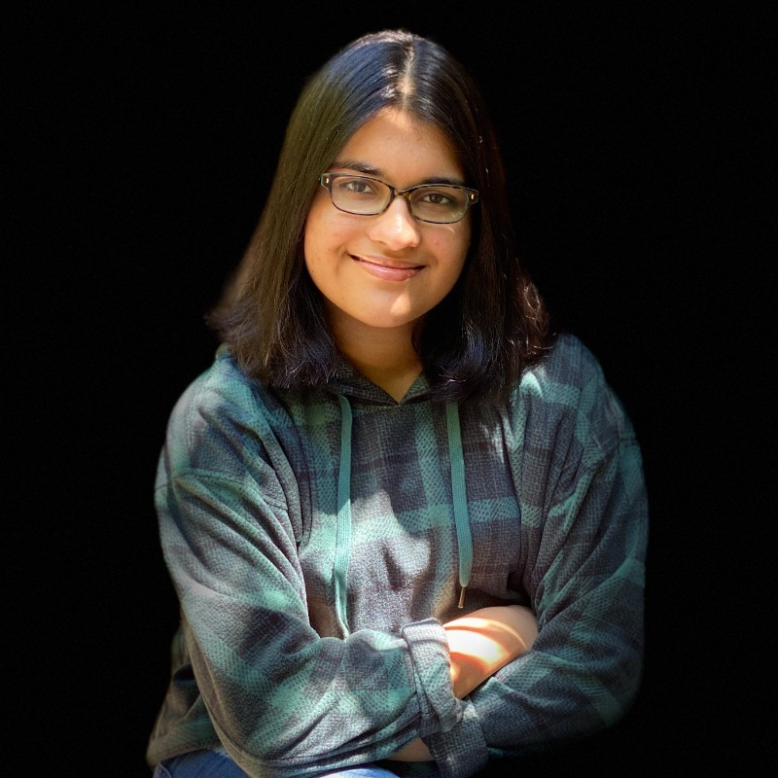
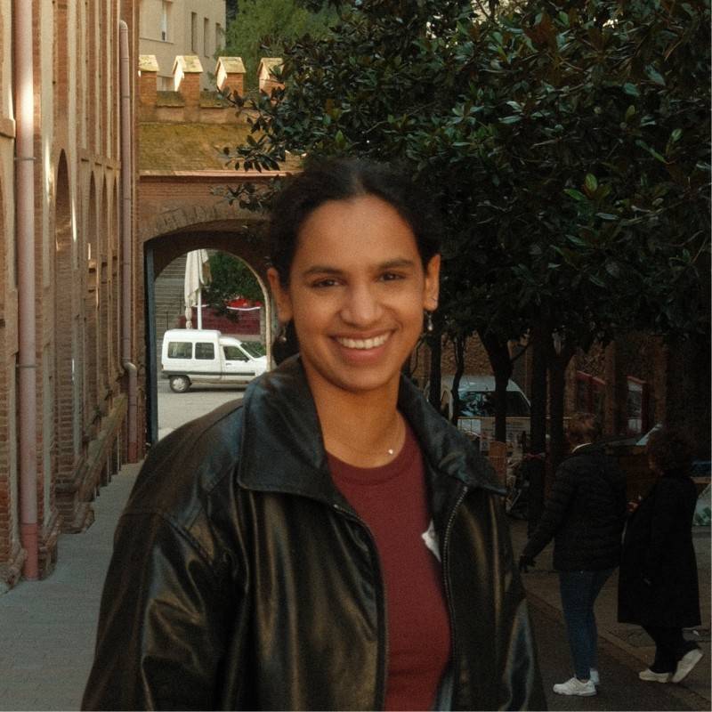
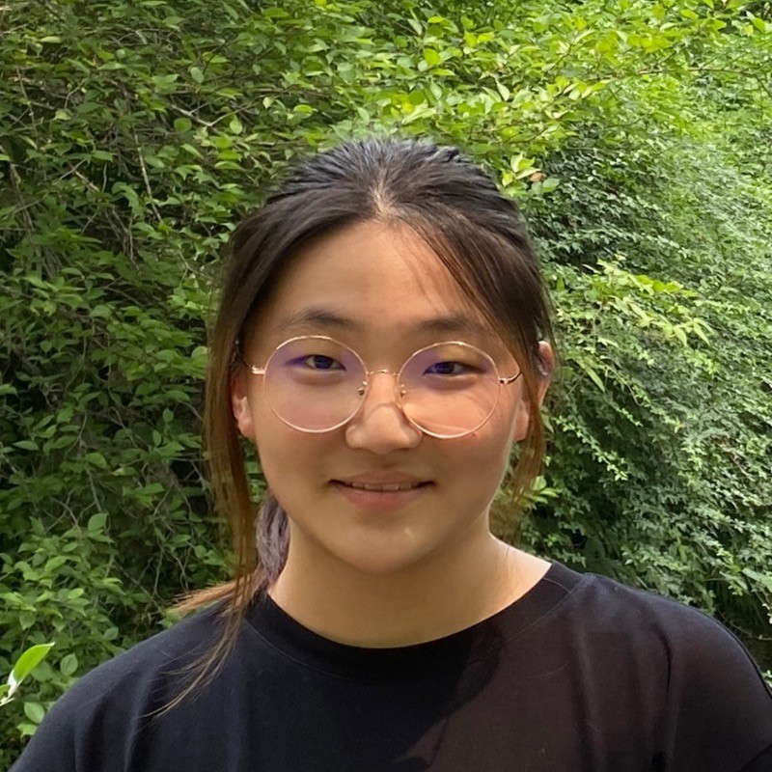


Course Staff
Justin Zou
Keya Mann
Sanjana Kuchibhotla
Yuchen Wang
Eleanor Li
Jackson Ma

Slide 3
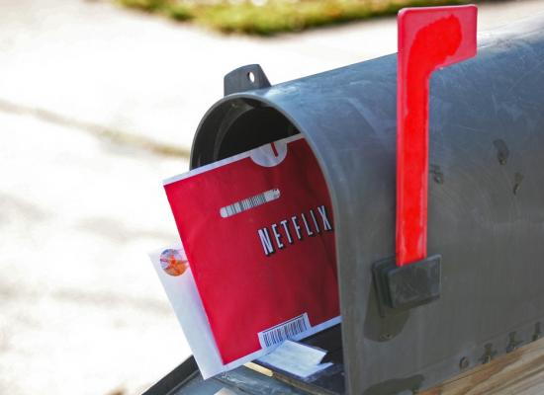
Failed Attempts at Security: Netflix Prize
$1million competition to improve Netflix’s recommendation system
100 million ratings from 500,000 users
“All customer identifying information has been removed; all that remains are ratings and dates … only a small sample was included, and that data was subject to perturbation”

Slide 4
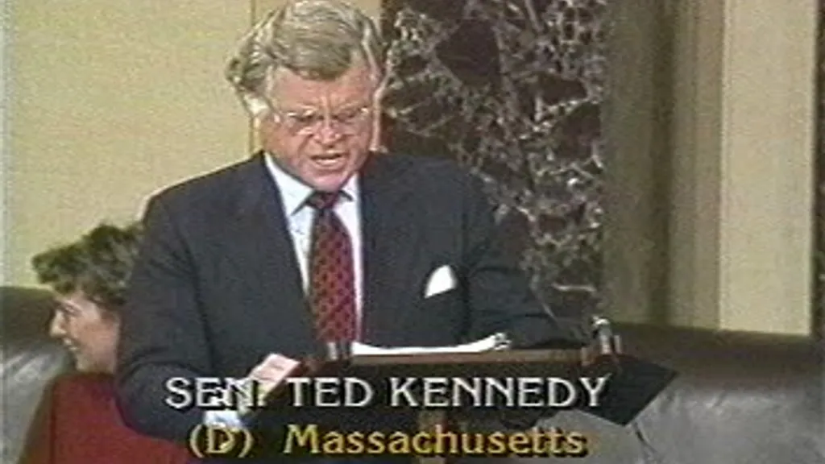
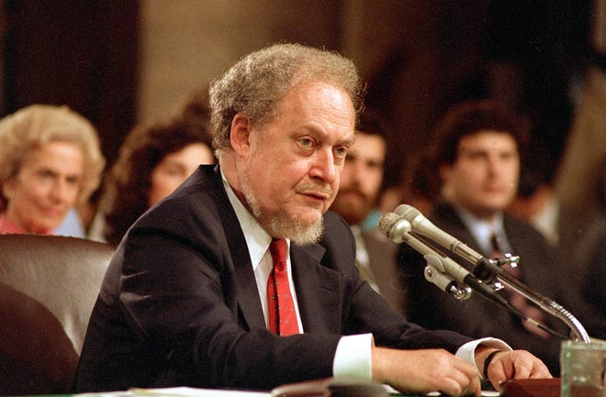
A brief digression
October 1987: US Senate rejects Robert Bork’s SCOTUS nomination 42-58
Ted Kennedy, 45 minutes after Bork’s nomination:
  “Robert Bork's America is a land in which women would be forced into back-alley abortions, blacks would sit at segregated lunch counters, rogue police could break down citizens' doors in midnight raids, and schoolchildren could not be taught about evolution…”
During the debate, Bork’s video rental history was leaked to the press
Image source: Associated Press, 1987

Slide 5




Damning revelations

Slide 6
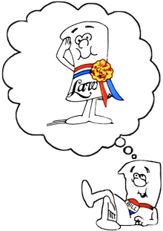
Video Privacy Protection Act of 1988
18 U.S. Code § 2710 –
Wrongful disclosure of video tape rental or sale records
(b)(1) A video tape service provider who knowingly discloses, to any person, personally identifiable information concerning any consumer of such provider shall be liable to the aggrieved person for the relief provided in subsection (c).
(c)(2) The court may award—actual damages but not less than liquidated damages in an amount of $2,500; punitive damages; reasonable attorneys’ fees; and such other preliminary and equitable relief as the court deems appropriate.

Slide 7
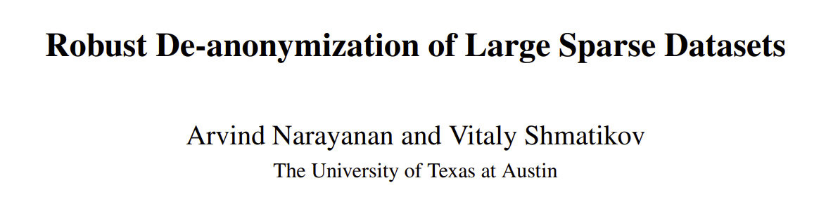
Recall: “All customer identifying information has been removed; all that remains are ratings and dates … only a small sample was included, and that data was subject to perturbation”
 | The Godfather | 12 Angry Men | Jurassic Park | … | Les Chiens | Bye Bye Monkey | Themroc | Sumo Do, Sumo Don’t | Spies
User1 | 5 | 4 | 3 | … |  |  |  | 5
User2 | 2 | 4 | 5 | … | 1
User3 | 5 | 5 | 5 | … |  |  |  |  | 3
Commonly Rated
More Obscure

Slide 8
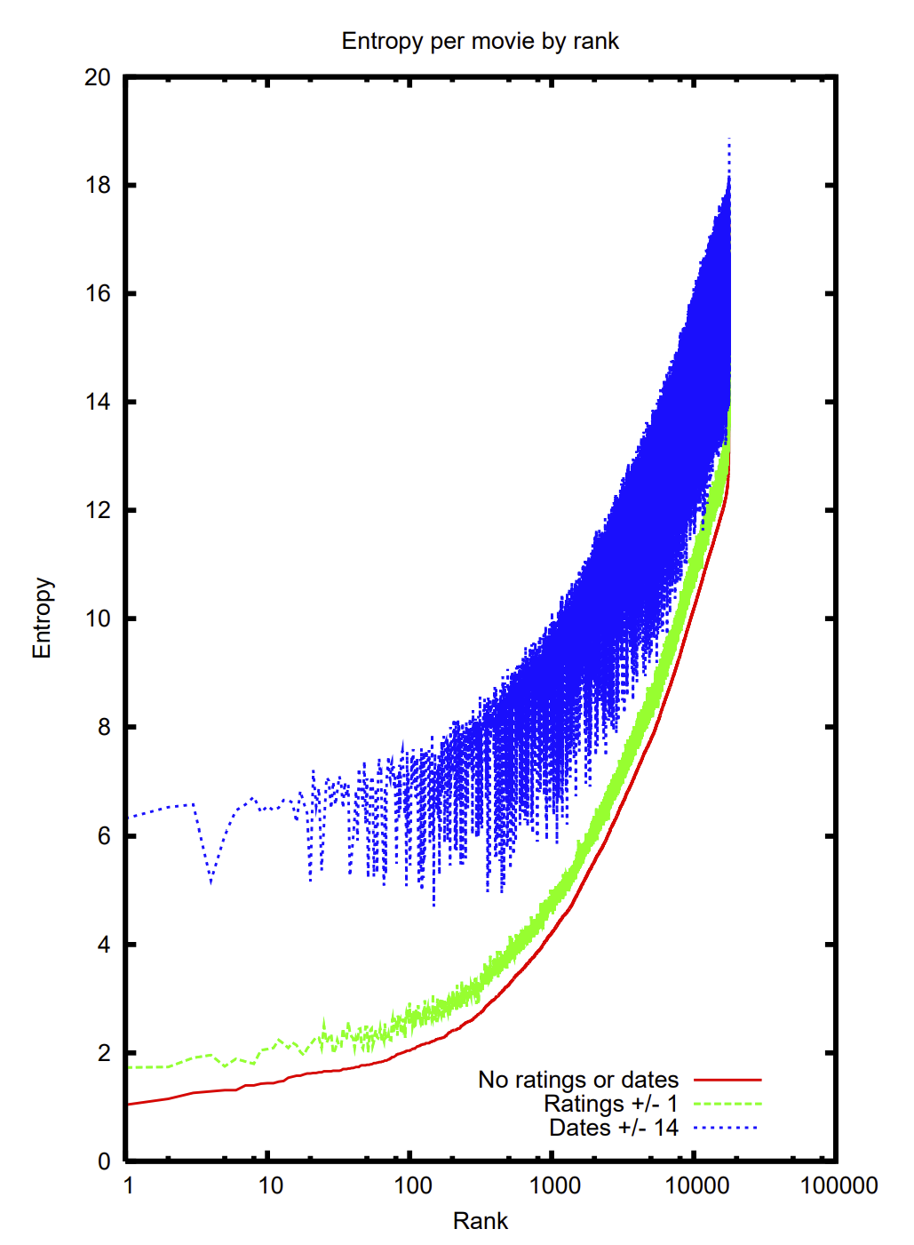
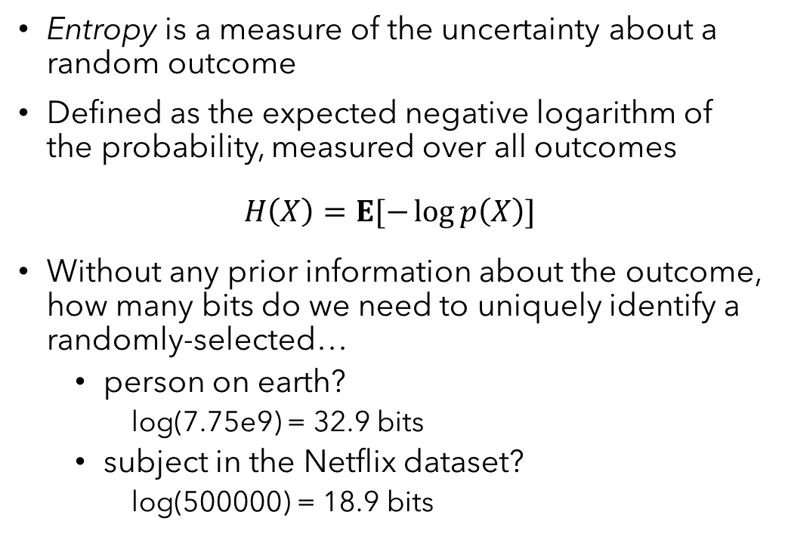
Entropy and identity
Entropy is a measure of the uncertainty about a random outcome
Defined as the expected negative logarithm of the probability, measured over all outcomes
$$H\left(X\right)=E[−\log{p\left(X\right)}]$$
Without any prior information about the outcome, how many bits do we need to uniquely identify a randomly-selected…
  person on earth?
    log(7.75e9) = 32.9 bits
  subject in the Netflix dataset?
    log(500000) = 18.9 bits

Slide 9
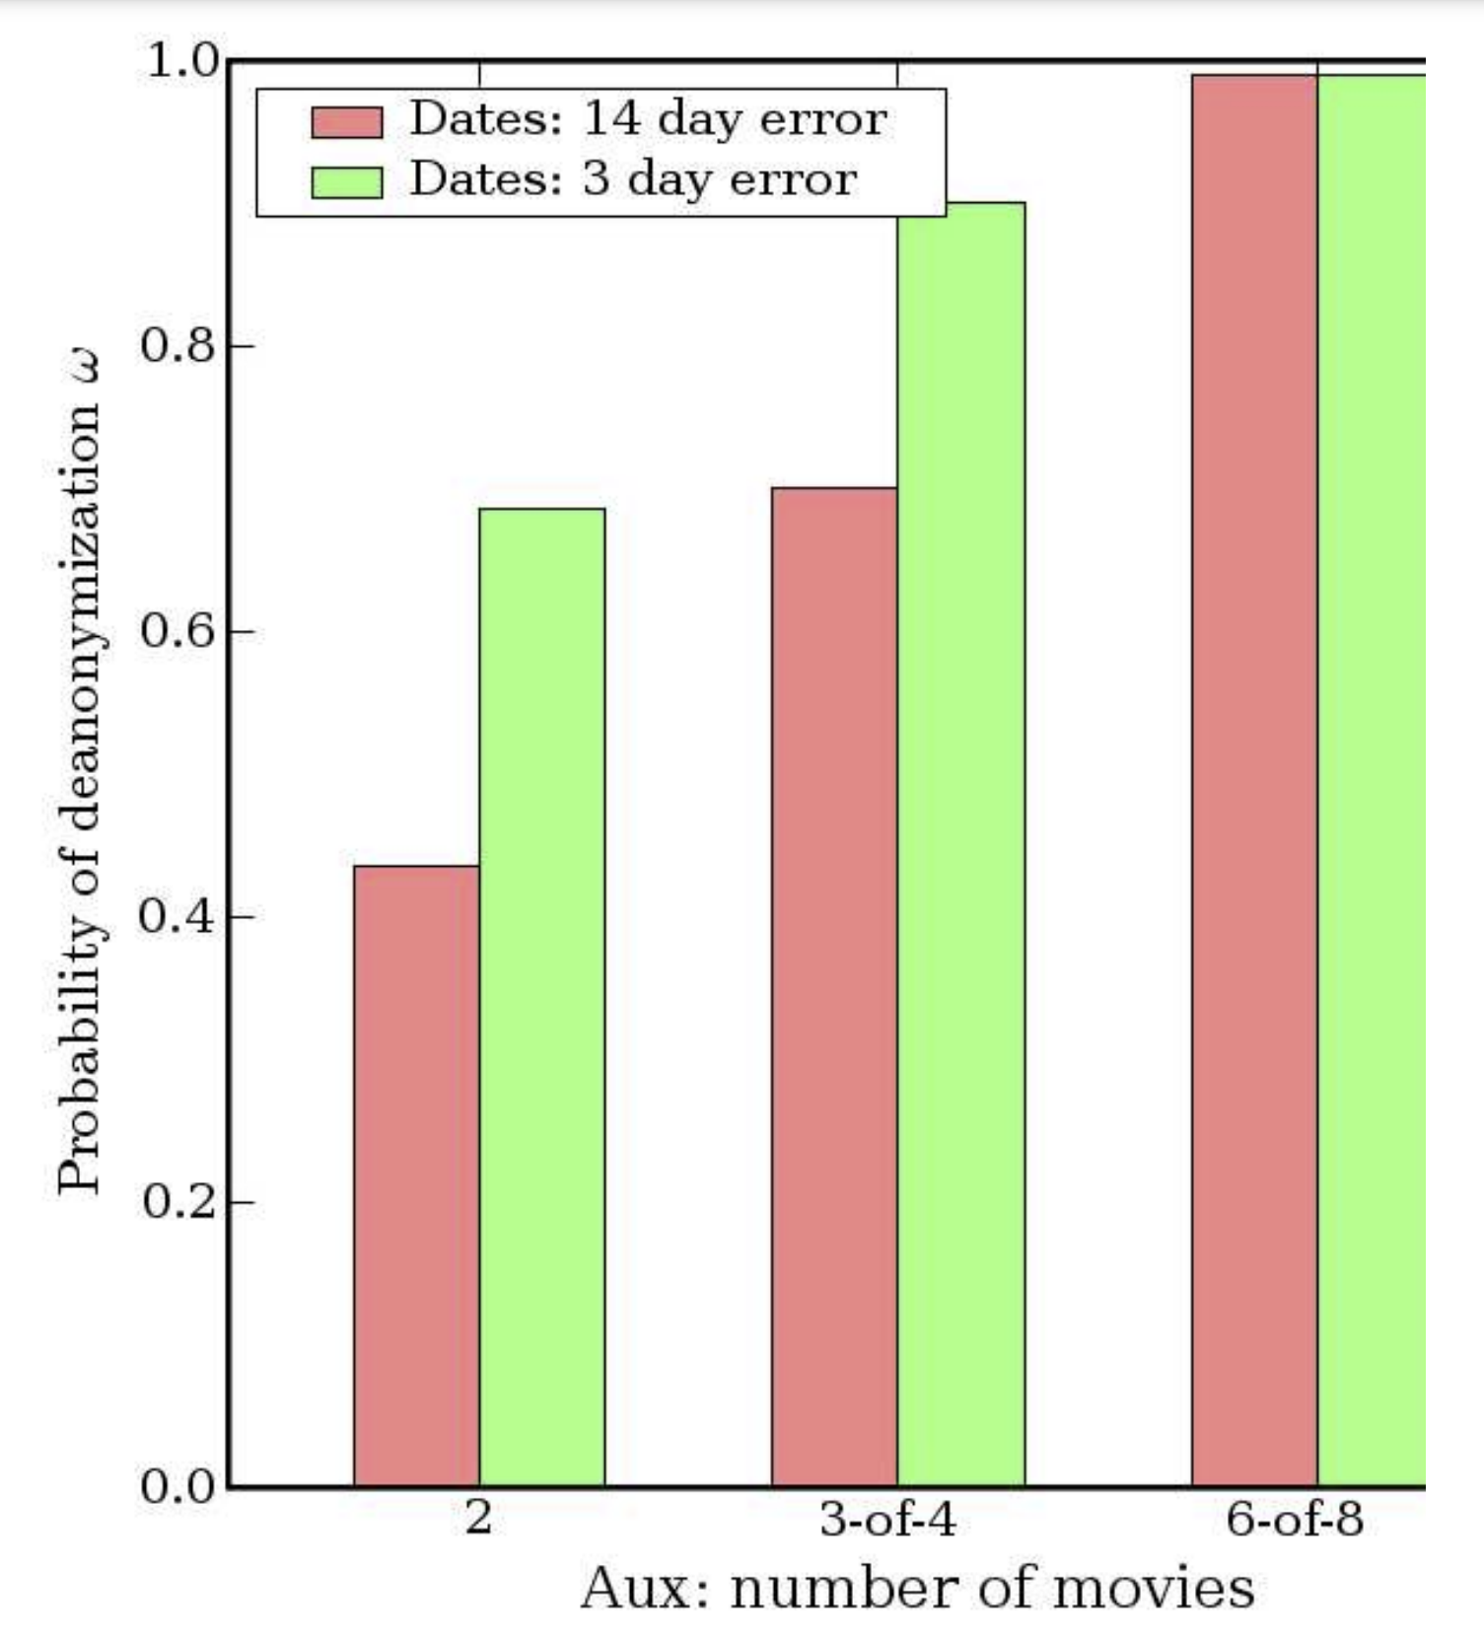
What is private information anyway?
Both Netflix and the law refer to personal identifying/identifiable information
Conventionally: name, unique identifiers, address, …
Results of this attack: “With 8 movie ratings (of which 2 may be completely wrong) and dates that may have a 14-day error, 99% of records are uniquely identified in the dataset. For 68%, two ratings and dates (with a 3-day error) are sufficient”
Netflix ended up settling a class-action lawsuit based on the Video Privacy Protection Act

Slide 10
Takeaways
Seemingly straightforward policy, surprisingly difficult to defend
Need to be methodical about:
  Defining security goals
  Identifying a policy
  Implementing enforcement
  Demonstrating results
Sneak peek: Differential Privacy
Goal: A person’s risk of privacy breach should not increase because they participate
Policy: Regardless of whether someone is in the data, the output should remain about the same
Enforcement: Introduce randomness at key points in computation
Result: Provable guarantee limiting what personal data can be learned via output

Slide 11
This course
Security from a programmer’s standpoint
We’ll cover a range of concerns
  Safety: The code will never do something we deem “bad”
  Isolation: Untrusted code and data can’t affect important state
  Information Flow: Confidential data remains that way
  Privacy: Control over peoples’ data and how it’s used
  Authorization: Only designated actors/code can obtain rights
  Trust: Leverage a small base to establish trust in a complete system
Recurring themes; ways of…
  specifying computations that are secure, i.e. policy
  ensuring that code meets policy, i.e. enforcement
  connecting the two rigorously, i.e. semantics

Slide 12
Logic and languages
Why is this a logic and languages elective?
Precise ways to write down policies
  Types, logical formulas, domain-specific languages
  Correctness and security go hand-in-hand
Enforcing them rigorously
  Static: verification, type checking
  Dynamic: runtime monitors, code instrumentation
  Either way, prove that the policy won’t be violated

Slide 13
Learning objectives
After taking this course, you should:
  Be able to identify, formalize, and implement a range of practical security & privacy policies
  Understand the tradeoffs of different approaches to security & privacy, and reason about which tradeoffs are justified
  Understand how general principles like least privilege, roots of trust, and complete mediation play a role in building defenses
  Be able to argue rigorously about software security mechanisms
  Understand the role of automated reasoning in analyzing security policies and mechanisms, and gain experience applying widely-used tools for this purpose

Slide 14
Logistics
Website: https://cs.cmu.edu/~15316
Contact: Piazza
Lecture: HOA 160, 2:00-3:20 Tuesday/Thursday
  Attendance expected, but not recorded
  Piazza is not a substitute for attending lecture
Submit everything to Gradescope
Office hours
  My office, Fridays from 1:00-2:30
  TAs in Gates Commons or CIC, details posted soon

Slide 15
Grading
Breakdown:
  40% written homework
  40% labs
  20% final exam
Final letter grades
  90/80/70/60 thresholds
  Round up
5 written homeworks
3 labs
Final exam during finals week
Five late days, no more than 2 used on any one assignment

Slide 16
Written homework
Focus on theory + fundamental skills
1 week to complete
Due dates for the semester are on the course website
Grades based on:
  Correctness (obviously)
  Rigor
  Clarity
Rigor and clarity in this course:
  Formally state what you intend to show
  List any assumptions
  Show your steps, with appropriate justification

Slide 17
Labs
Translate theory into something that works
  Design a set of policies and a way of enforcing them
  Formalize both
  Implement them for the setting described in the lab
  Learn to use new tools in the process
  May work with a partner
Grades are based on:
  Correct functionality (evaluated by autograder)
  Completeness, robustness of security mechanism
  Documentation, clarity of your solution
  In-person comprehension check (~15 minute quiz)
How to work with course staff when completing the labs
  We can help with: understanding the setting/concepts, critiquing your approach
  We won’t help with: debugging code, proposing an approach

Slide 18
Final Exam
Reason & apply main ideas from this course
  In-person, cumulative
  Questions resemble less time-intensive homework problems
  Representative practice exam released the last week of classes
Not a check on your recall of minute details
  Exam comes with an extensive formula sheet
  You may bring 1 page of handwritten notes

Slide 19
Use of AI tools
You may use AI to:
  Explain, answer questions about concepts covered in the course
  Check your understanding—but be careful, and check references!
  Generate practice exercises
  Help typeset work that you’ve already completed
You may not use AI to:
  Write any code for the labs
  Write test cases that you hand in for a grade
  Provide answers for written homework
  Generally: complete graded work for you

Slide 20
Before Thursday
Make sure that you are enrolled in Gradescope and Piazza sections
  Piazza signup: https://piazza.com/cmu/spring2026/15316
  Gradescope code: 2D2XJ5

