Slide 1
Android INTENTS

Slide 2
INTENT
An Intent is basically a message that is passed between components (such as Activities, Services, Broadcast Receivers, and Content Providers)

Slide 3
An Intent is a messaging object you can use to request an action from another app component. Although intents facilitate communication between components in several ways, there are three fundamental use cases:

Slide 4
Starting an activity
2. Delivering a broadcast
3. Starting a service

Slide 5
1. Starting an activity
An Activity represents a single screen in an app. You can start a new instance of an Activity by passing an Intent to startActivity(). The Intent describes the activity to start and carries any necessary data.

Slide 6
2. Starting a service
A Service is a component that performs operations in the background without a user interface. With Android 5.0 (API level 21) and later, you can start a service with JobScheduler.
For versions earlier than Android 5.0 (API level 21), you can start a service by using methods of theService class. You can start a service to perform a one-time operation (such as downloading a file) by passing an Intent to startService(). The Intent describes the service to start and carries any necessary data.

Slide 7
3. Delivering a broadcast
A broadcast is a message that any app can receive. The system delivers various broadcasts for system events, such as when the system boots up or the device starts charging. You can deliver a broadcast to other apps by passing an Intent to sendBroadcast() or sendOrderedBroadcast()

Slide 8

Types of Intents
Implicit Intents
Explicit intents

Slide 9
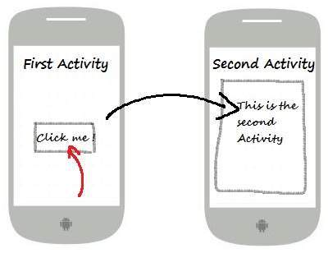
Explicit Intents
Explicit intent going to be connected internal world of application, suppose if you wants to connect one activity to another activity, we can do this quote by explicit intent, below image is connecting first activity to second activity by clicking button
These intents designate the target component by its name and they are typically used for application-internal messages - such as an activity starting a subordinate service or launching a sister activity.
// Explicit Intent by specifying its class name
Intent i = new Intent(FirstActivity.this, SecondActivity.class);
// Starts TargetActivity
startActivity(i);

Slide 10
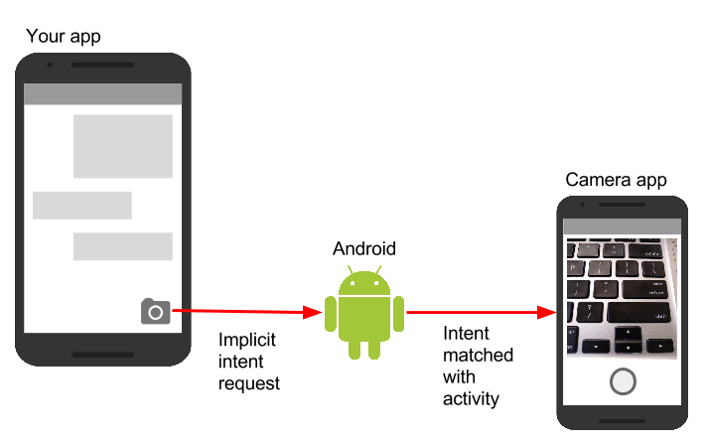
Implicit Intents
These intents do not name a target and the field for the component name is left blank. Implicit intents are often used to activate components in other applications
// Create the text message with a string Intent sendIntent = new Intent(); sendIntent.setAction(Intent.ACTION_SEND); sendIntent.putExtra(Intent.EXTRA_TEXT, textMessage); sendIntent.setType("text/plain"); // Verify that the intent will resolve to an activity if (sendIntent.resolveActivity(getPackageManager()) != null) { startActivity(sendIntent); }

Slide 11

Thanks!
Any questions?

