Slide 1
Lecture 11
Algorithm Analysis
Arne Kutzner
Hanyang University / Seoul Korea

Slide 2
Elementary Graph Algorithms

Slide 3
Graph Representation
Given graph G = (V, E).
May be either directed or undirected
When expressing the running time of an algorithm, it is often in terms of both |V| and |E|.
Two common ways to represent for algorithms:
  Adjacency lists
  Adjacency matrix

Slide 4
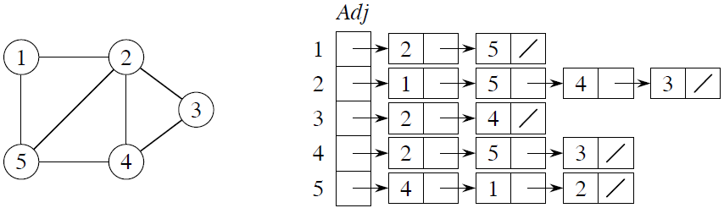
Graph Representation by Adjacency Lists
Array Adj of |V| lists, one per vertex
Vertex u’s list has all vertices v such that
(u, v) ∈ E. (Works for both directed and undirected graphs.)
Example: For an undirected graph:

Slide 5
Graph Representation by Adjacency Lists (2)
Space: (V + E).
Time: to list all vertices adjacent to u: Θ(degree(u)).
Time: to determine if (u, v) ∈ E: O(degree(u)).

Slide 6
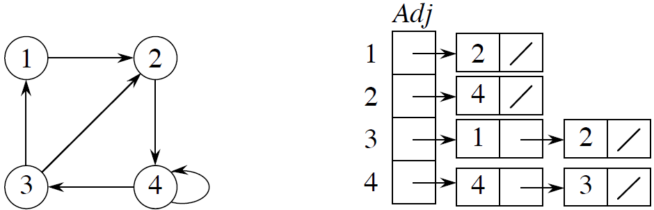
Graph Representation by Adjacency Lists (3)
Example for directed graph:

Slide 7
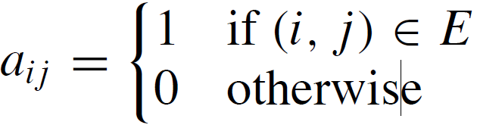
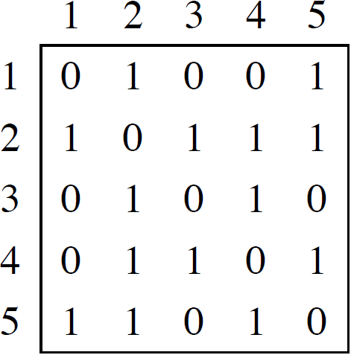
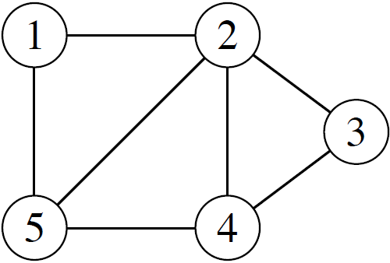
Graph Representation by Adjacency Matrix
|V| × |V| matrix A = (a_{ij} ), such that

Slide 8
Graph Representation by Adjacency Matrix
Space: Θ(V²)
Time: to list all vertices adjacent to u: Θ(V)
Time: to determine if (u, v) ∈ E: Θ(1)
(Can store weights instead of bits for weighted graph.)

Slide 9
Breadth-First Search

Slide 10
Breadth-First Search (BFS)
Input: Graph G = (V, E), either directed or undirected, and source vertex s ∈ V.
Output:
d[v] = distance (smallest # of edges) from s to v, for all v ∈ V
π[v] = u such that (u, v) is last edge on shortest path from s to v.
  u is v’s predecessor.
  set of edges {(π[v], v) : v ≠ s} forms a tree

Slide 11
BFS - Idea
Send a wave out from s.
  First hits all vertices 1 edge from s.
  From there, hits all vertices 2 edges from s.
  Etc.
Use FIFO queue Q to maintain wavefront.
v ∈ Q if and only if wave has hit v but has not come out of v yet.

Slide 12
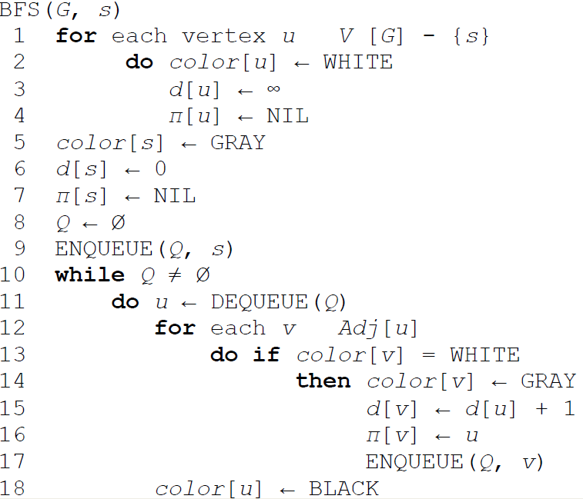
BFS - Pseudocode
∈
∈

Slide 13
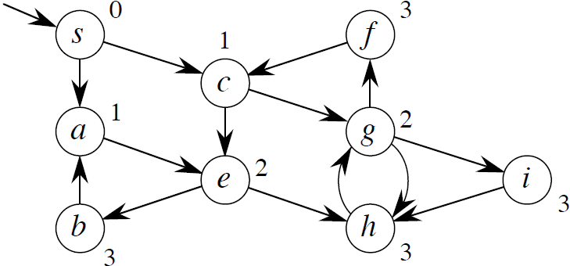
BFS - Example
Graph and its distances computed by BFS

Slide 14
BFS - Vertex Coloring
As BFS progresses, every vertex has a color:
  WHITE = undiscovered
  GRAY = discovered, in the Queue or under inspection, but not finished
  BLACK = finished, not in the Queue

Slide 15
BFS - Properties
Can show that queue Q consists of vertices with d values i, i, i, . . . i, i + 1, i + 1, . . . i + 1
  Only 1 or 2 values.
  If 2, differ by 1 and all smallest are first.
Since each vertex gets a finite d value at most once, values assigned to vertices are monotonically increasing over time.
BFS may not reach all vertices !

Slide 16
BFS - Complexity
Time = O(V + E).
  O(V) because every vertex enqueued at most once.
  O(E) because every vertex dequeued at most once and we examine (u, v) only when u is dequeued. Therefore, every edge examined at most once if directed, at most twice if undirected.

Slide 17
Depth-First Search

Slide 18
Depth-First Search
Input: G = (V, E), directed or undirected.
No source vertex given!
Output: 2 timestamps on each vertex:
  d[v] = discovery time
  f [v] = finishing time
Will be useful for other algorithms later on.
Properties:
  Will methodically explore every edge
  Start over from different vertices as necessary
  As soon as we discover a vertex, explore from it

Slide 19
Depth-First Search (cont.)
As DFS progresses, every vertex has a color:
  WHITE = undiscovered
  GRAY = discovered, but not finished
  (not done exploring from it)
  BLACK = finished
  (have found everything reachable from it)
Discovery and finish times:
  Unique integers from 1 to 2|V|
  For all v, d[v] < f [v]
  In other words, 1 ≤ d[v] < f [v] ≤ 2|V|

Slide 20
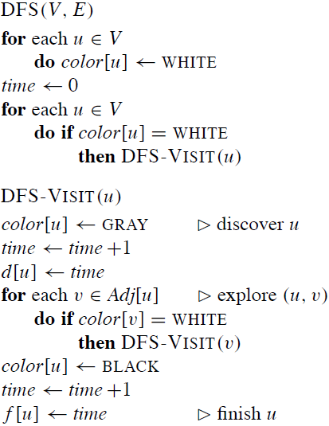
Depth-First Search –
Pseudocode

Slide 21
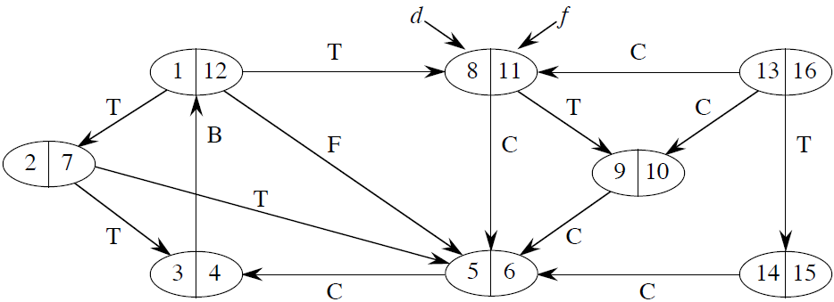
Depth-First Search Example

Slide 22
DFS - Complexity
Time = Θ(V + E).
Similar to BFS analysis.
Θ, not just O, since guaranteed to examine every vertex and edge.
DFS forms a depth-first forest comprised of > 1 depth-first trees.
Each tree is made of edges (u, v) such that u is gray and v is white when (u, v) is explored.

Slide 23
Parenthesis theorem
Theorem:
For all u, v, exactly one of the following holds:
d[u] < f [u] < d[v] < f [v] or d[v] < f [v] < d[u] < f [u] and neither of u and v is a descendant of the other.
d[u] < d[v] < f [v] < f [u] and v is a descendant of u.
d[v] < d[u] < f [u] < f [v] and u is a descendant of v.
Proof: in Textbook
Like parentheses: ( ) [ ] ( [ ] ) [ ( ) ]
So d[u] < d[v] < f [u] < f [v] cannot happen.
Corollary:
v is a proper descendant of u if and only if
d[u] < d[v] < f [v] < f [u].

Slide 24
White-Path Theorem
Theorem:
v is a descendant of u if and only if at time d[u], there is a path from u to v consisting of only white vertices. (Except for u, which was just colored gray.)
Proof: in Textbook

Slide 25
Classification of Edges
Tree edge: in the depth-first forest.
Found by exploring (u, v).
Back edge: (u, v), where u is a descendant of v.
Forward edge: (u, v), where v is a descendant of u, but not a tree edge.
Cross edge: any other edge. Can go between vertices in same depth-first tree or in different depth-first trees.
Theorem:
In DFS of an undirected graph, we get only tree and back edges. No forward or cross edges.

Slide 26
Classification of Edges (cont.)
DFS algorithm can be modified to classify edges as it encounters them.
When an edge (u,v) is reached it can be classified according to the color of v:
  WHITE: tree edge
  GRAY: back edge
  BLACK: forward or cross edge

Slide 27
Topological Sorting

Slide 28
Topological Sort
Directed acyclic graph (dag)
  A directed graph with no cycles.
Good for modeling processes and structures that have a partial order:
a > b and b > c ⇒a > c.
But may have a and b such that neither a > b nor b > c.
Can always make a total order (either a > b or b > a for all a ≠ b) from a partial order.
In fact, that’s what a topological sort will do.

Slide 29
Topological Sort (cont.)
Topological sort of a dag: a linear ordering of vertices such that if (u, v) ∈ E, then u appears somewhere before v. (Not like sorting numbers.)
Pseudocode:
TOPOLOGICAL-SORT(V, E)
1. call DFS(V, E) to compute finishing times f [v] for all v ∈ V
2. output vertices in order of decreasing finish times
Don’t need to sort by finish times.
  Can just output vertices as they are finished and understand that we want the reverse of this list.

Slide 30
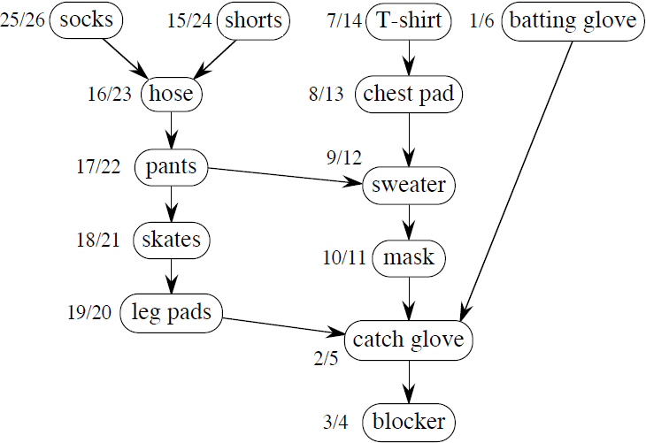
Topological Sort - Example

Slide 31
Deciding whether some Graph is acyclic
Lemma:
A directed graph G is acyclic if and only if a DFS of G yields no back edges.
Proof ⇒: Show that back edge ⇒ cycle.
Suppose there is a back edge (u, v). Then v is ancestor of u in depth-first forest. Therefore, there is a path from v to u, this implies the existence of some cycle.

Slide 32
DAG Lemma (cont.)
⇐: Show that cycle ⇒ back edge.
Suppose G contains cycle c. Let v be the first vertex discovered in c, and let (u, v) be the preceding edge in c. At time d[v], vertices of c form a white path from v to u (since v is the first vertex discovered in c). By white-path theorem, u is descendant of v in depth-first forest. Therefore, (u, v) is a back edge.

Slide 33
Strongly Connected Components

Slide 34
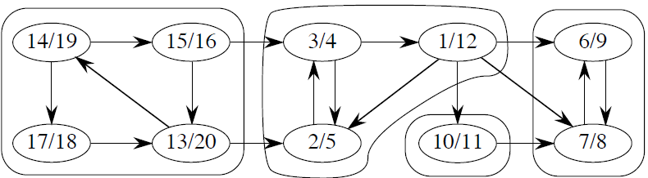
Strongly Connected Components
Given directed graph G = (V, E).
A strongly connected component (SCC) of G is a maximal set of vertices C ⊆ V such that for all u, v ∈ C, there is a path form u to v and a path form v to u.
Example:

Slide 35
Transposed Form of
Directed Graph
Algorithm uses G^{T} = transpose of G.
G^{T} = (V, E^{T}), E^{T} = {(u, v) : (v, u) ∈ E}.
  G^{T} is G with all edges reversed.
Can create G^{T} in Θ(V + E) time if using adjacency lists.
Observation: G and G^{T} have the same SCC’s.
(u and v are reachable from each other in G if and only if reachable from each other in G^{T}.)

Slide 36
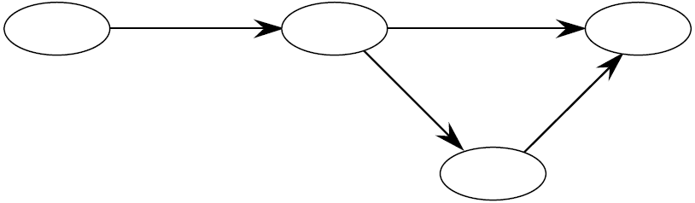
Component Graph
G^{SCC} = (V^{SCC}, E^{SCC}).
  V^{SCC} has one vertex for each SCC in G.
  E^{SCC} has an edge if there is an edge between the corresponding SCC’s in G.
SCC for example (2 slides before):

Slide 37
G^{SCC} is a dag
Lemma:
G^{SCC} is a dag. More formally, let C and C be distinct SCC’s in G, let u, v ∈ C, u’, v’∈ C’, and suppose there is a path from u to u’ in G. Then there cannot also be a path from v’ to v in G.
Proof: (informal)
Draw a diagram. If you insert a path form v’ to v, you will see a circle covering u, u’, v and v’.

Slide 38
Constructing G^{SCC} using DFS
SCC(G)
call DFS(G) to compute finishing times f [u] for all u
compute G^{T}
call DFS(G^{T}), but in the main loop, consider vertices in order of decreasing f [u]
(as computed in first DFS)
output the vertices in each tree of the depth-first forest formed in second DFS as a separate SCC

Slide 39
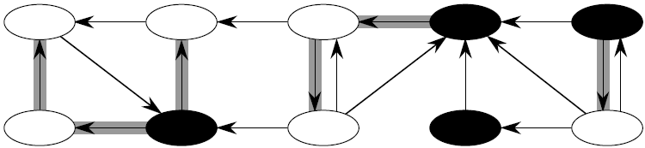
Constructing G^{SCC} for Example
Do DFS on G
Create G^{T}
DFS on G^{T} (roots blackened)

Slide 40
Correctness of SCC Construction
Idea: By considering vertices in second DFS in decreasing order of finishing times from first DFS, we are visiting vertices of the component graph in topological sort order.
To prove that it works, first deal with 2 notational issues:
  If we will be discussing d[u] and f [u]. These always refer to first DFS.
Extend notation for d and f to sets of vertices U ⊆ V:
  d(U) = min u∈U {d[u]} (earliest discovery time)
  f (U) = max u∈U {f [u]} (latest finishing time)

Slide 41
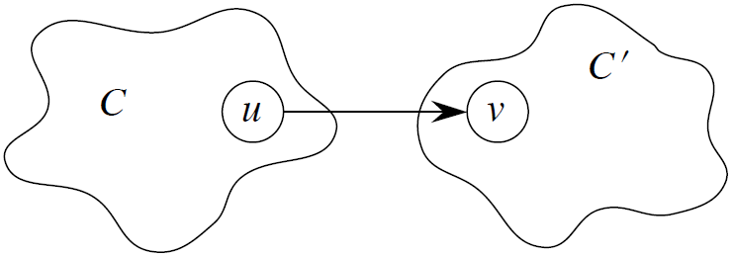
Important Observation
Lemma: Let C and C’ be distinct SCC’s in G = (V, E). Suppose there is an edge (u, v) ∈ E such that u ∈ C and v ∈ C’.
Then f(C) > f(C’)

Slide 42
2 Corollary
Corollary Let C and C’ be distinct SCC’s in
G = (V, E). Suppose there is an edge
(u, v) ∈ E^{T}, where u ∈ C and v ∈ C’.
Then f(C) < f(C’).
Proof (u, v) ∈ E^{T} ⇒ (v, u) ∈ E. Since SCC’s of G and G^{T} are the same, f(C) > f(C’).
Corollary Let C and C’ be distinct SCC’s in
G = (V, E), and suppose that f(C) > f(C’). Then there cannot be an edge from C to C’ in G^{T}.

Slide 43
Correctness of SCC Construction (cont.)
When we do the second DFS, on G^{T}, we start with SCC C such that f (C) is maximal.
The second DFS starts from some x ∈ C, and it visits all vertices in C. Corollary says that since f(C) > f(C’) for all other C’ ≠ C, there are no edges from C to any other C’ in G^{T}.
Therefore, DFS will visit only vertices in C. Which means that the depth-first tree rooted at x contains exactly the vertices of C.

