Slide 1
Lecture 2
Algorithm Analysis
Arne Kutzner
Hanyang University / Seoul Korea

Slide 2
Overview
2 algorithms for sorting of numbers are presented
Divide-and-Conquer strategy
Growth of functions / asymptotic notation

Slide 3
Sorting of Numbers
Input
A sequence of n numbers [a₁, a₂,..., a_{n}]
Output
A permutation (reordering)
[a‘₁, a‘₂,..., a‘_{n}] of the input sequence such that a‘₁≤ a‘₂ ≤... ≤ a‘_{n}

Slide 4
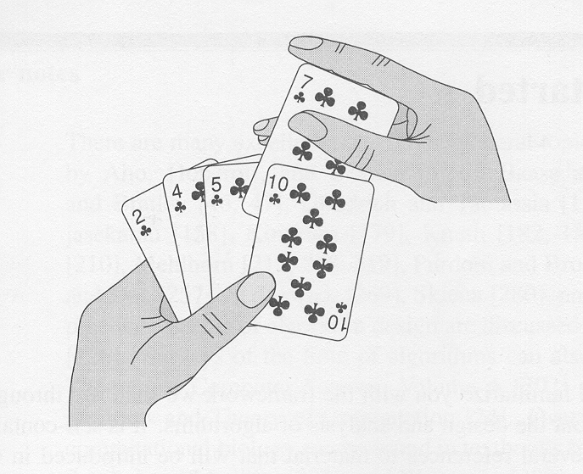
Sorting a hand of cards

Slide 5
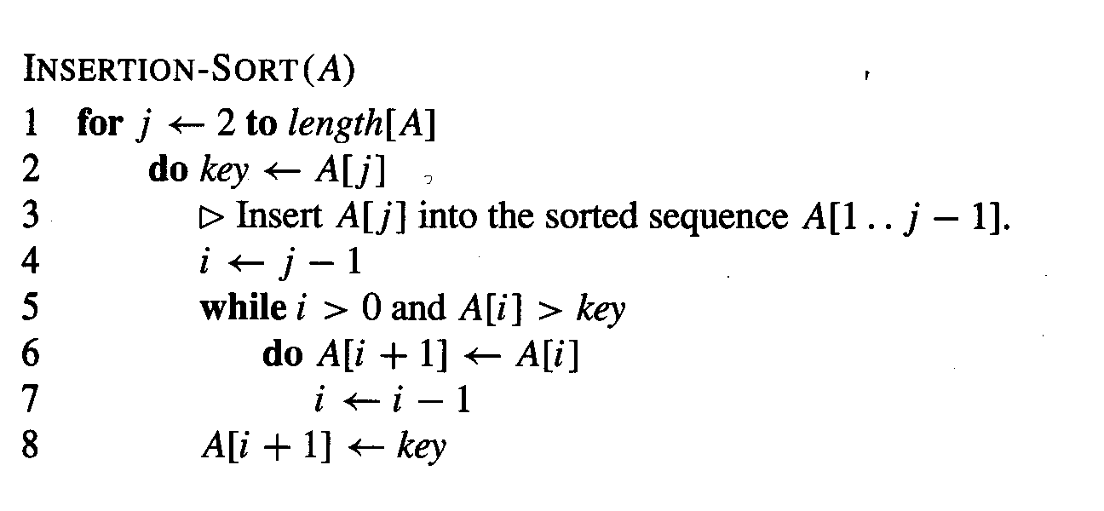
The insertion sort algorithm

Slide 6
Correctness of insertion sort
Loop invariants – for proving that some algorithm is correct
Three things must be showed about a loop invariant:
  Initialization: It is true prior to the first iteration of the loop
  Maintenance: If it is true before an iteration of the loop, it remains true before the next iteration
  Termination: When the loop terminates, the invariant gives us a useful property that helps show that the algorithm is correct

Slide 7
Loop invariant of insertion sort
At the start of each iteration of the for loop of lines 1-8, the subarray A[1..j-1] consists of the elements originally in A[1..j-1] but in sorted order

Slide 8
Analysing algorithms
Input size = number of items (numbers) to be sorted
We count the number of comparisons

Slide 9
Insertion sort / best-case
In the best-case (the input sequence is already sorted) insertion sort requires
n-1 comparisons

Slide 10
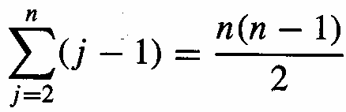
Insertion sort / worst-case
The input sequence is in reverse sorted order
We need
comparisons

Slide 11
Worst-case vs. average case
Worst-case running time of an algorithm is an upper bound on the running time for any input
For some algorithms, the worst case occurs fairly often.
The „average case“ is often roughly as bad as the worst case.

Slide 12
The divide-and-conquer approach
Divide the problem into a number of subproblems.
Conquer the subproblems by solving them recursively. If the subproblem sizes are small enough, however, just solve the subproblems in straightforward manner.
Combine the solutions to the subproblems into the solution for the original problem

Slide 13
Merge-sort algorithm
Divide: Divide the n-element sequence to be sorted into two subsequences of n/2 elements each.
Conquer: Sort the two subsequences recursively using merge sort.
Combine: Merge the two sorted subsequences to produce the sorted answer.

Slide 14
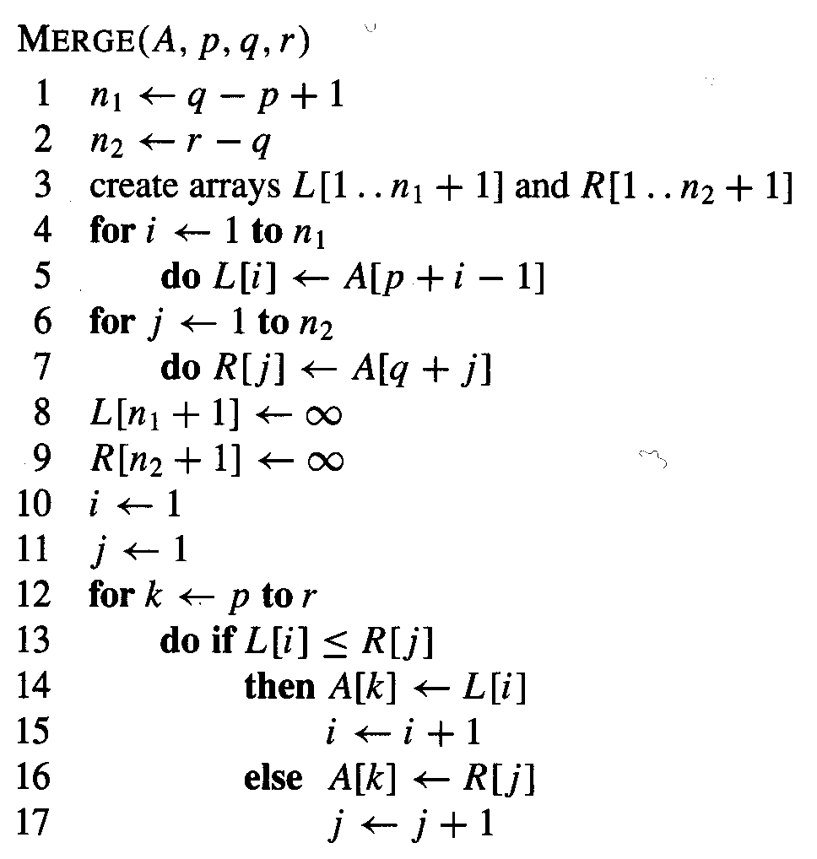
Merge procedure

Slide 15
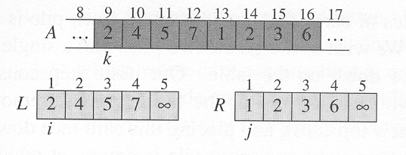
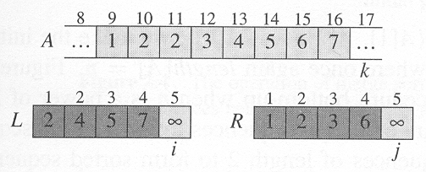
Example merge procedure

Slide 16
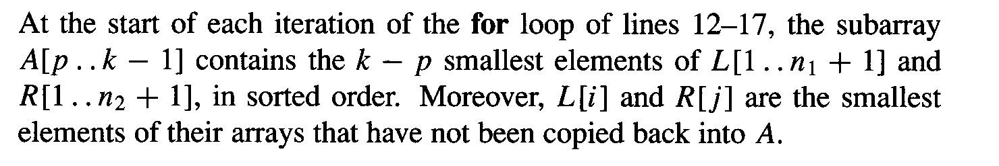
Correctness merge procedure
Loop invariant:

Slide 17
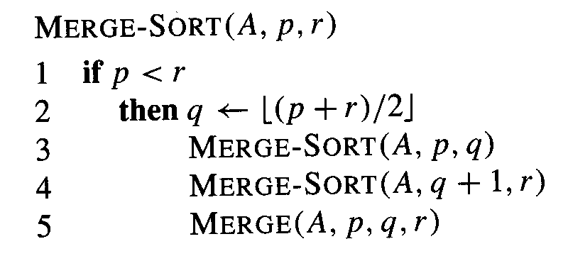
Merge-sort algorithm

Slide 18
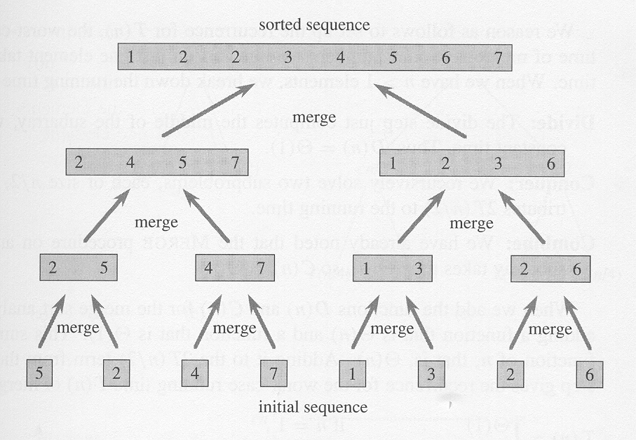
Example merge sort

Slide 19
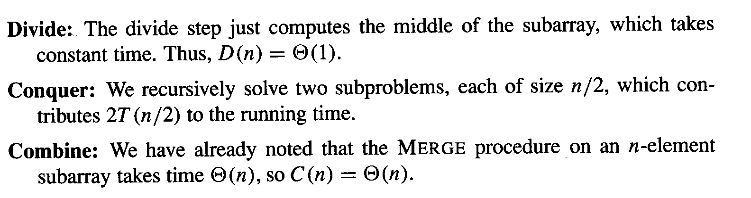
Analysis merge sort 1

Slide 20
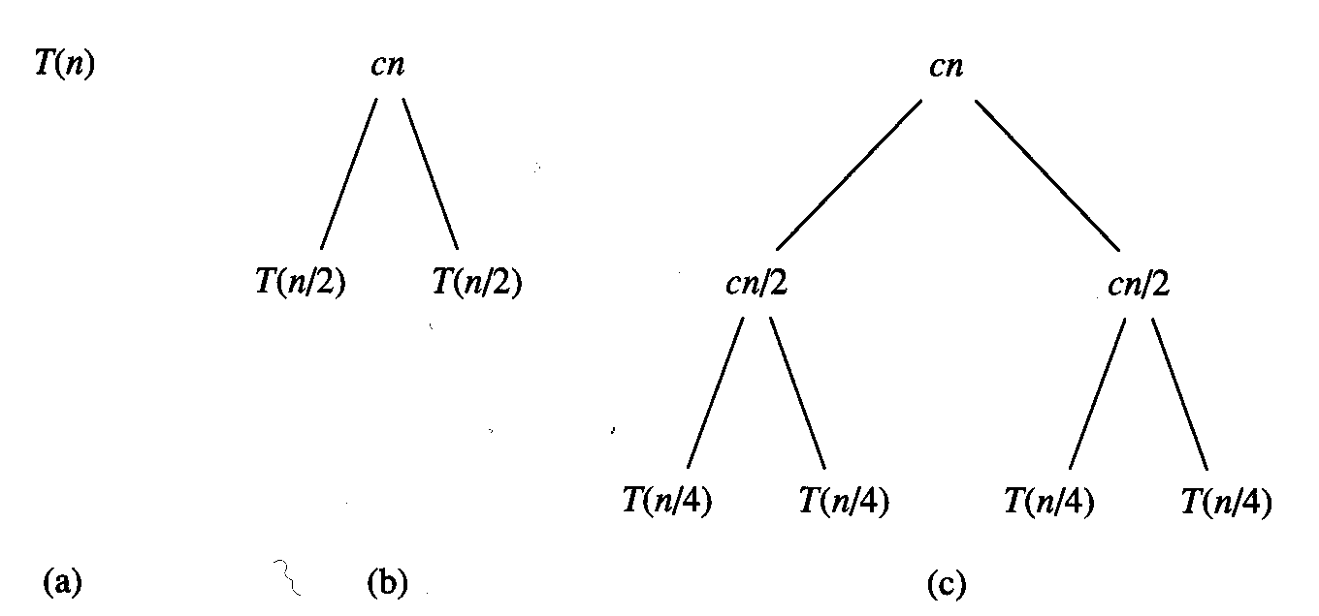
Analysis merge sort 2

Slide 21
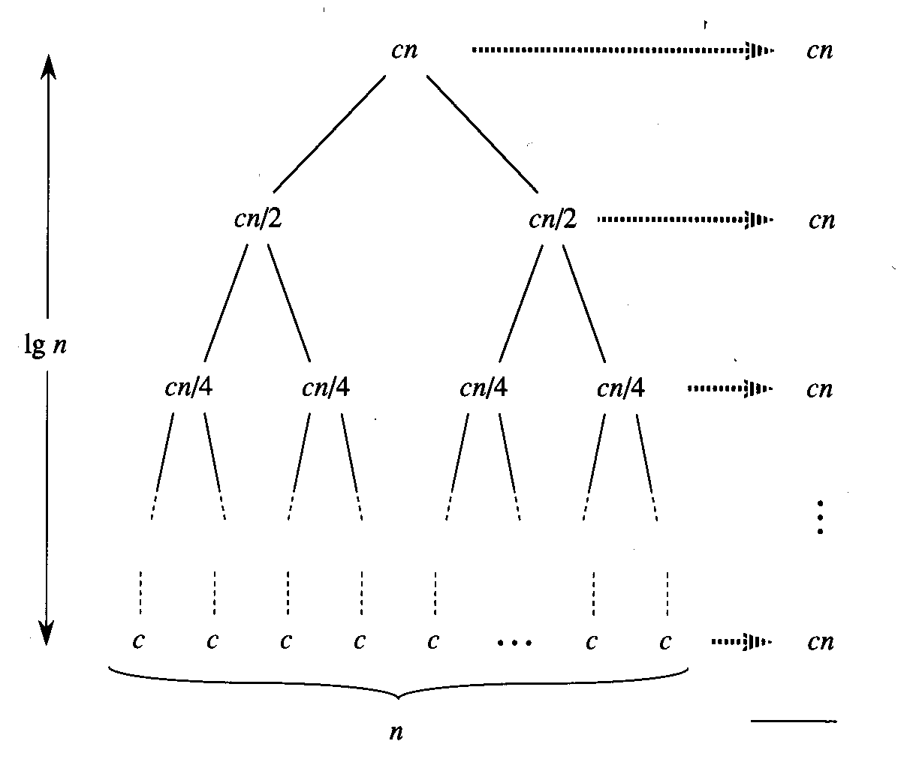
Analysis merge sort 3

Slide 22
Growth of functions
asymptotic notation

Slide 23
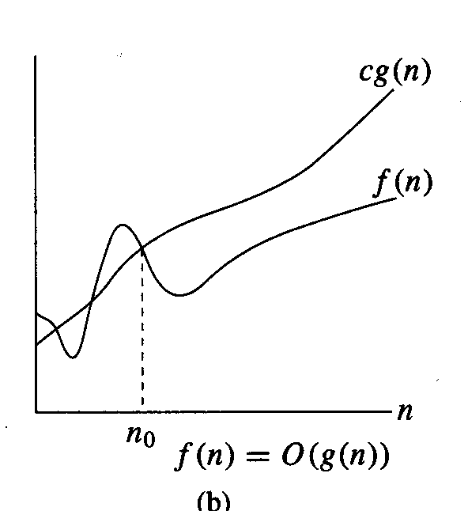
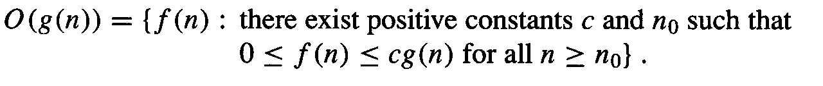
Asymptotic upper bound

Slide 24
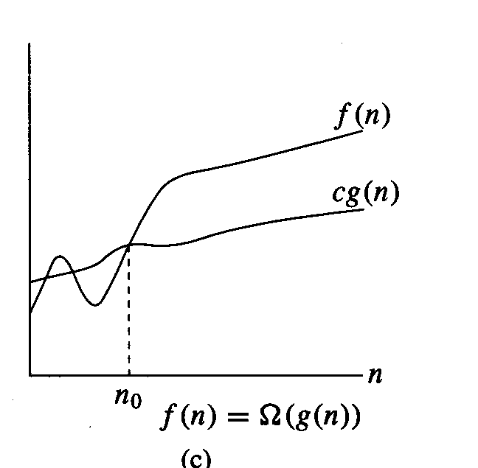
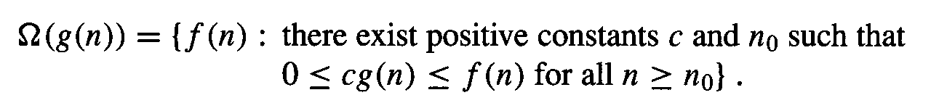
Asymptotic lower bound

Slide 25
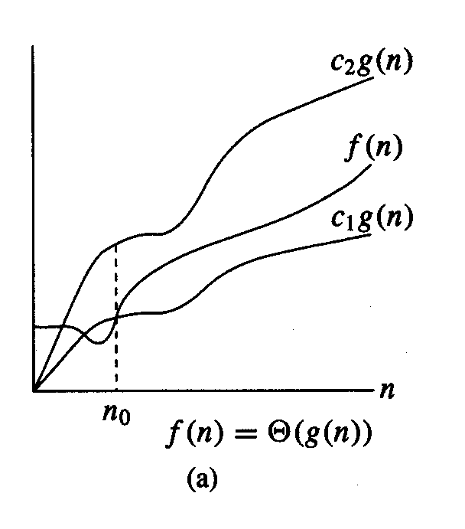
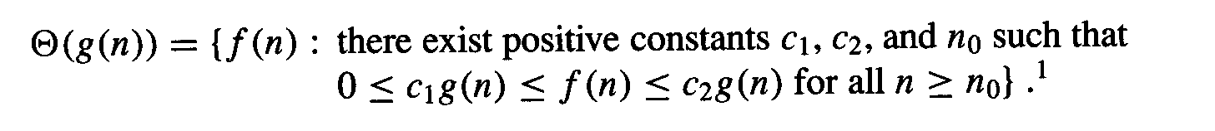
Asymptotically tight bound

Slide 26
Lower Bound for Sorting
Argumentation over decision tree
For an input of n elements we have to distinguish n! different leaves in the decision tree
According to mathematical machinery we get log n! ≈ n log n

Slide 27
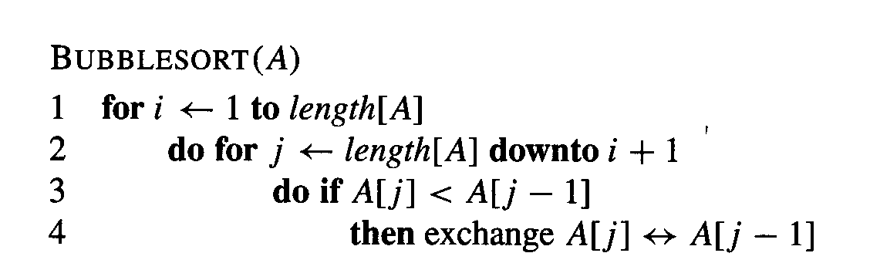
Bubblesort
Further popular sorting algorithm

