Slide 1
Lecture 9
Algorithm Analysis
Arne Kutzner
Hanyang University / Seoul Korea

Slide 2
Binary Search Trees

Slide 3
Definitions
We represent a binary tree by a linked data structure in which each node is an object.
root[T ] points to the root of tree T .
Each node contains the fields
  key (and possibly other satellite data).
  left: points to left child.
  right: points to right child.
  p: points to parent. p[root[T ]] = NIL.

Slide 4
Binary-Search-Tree Property
Stored keys must satisfy the binary-search-tree property.
  If y is in left subtree of x, then key[y] ≤ key[x].
  If y is in right subtree of x, then key[y] ≥ key[x].

Slide 5
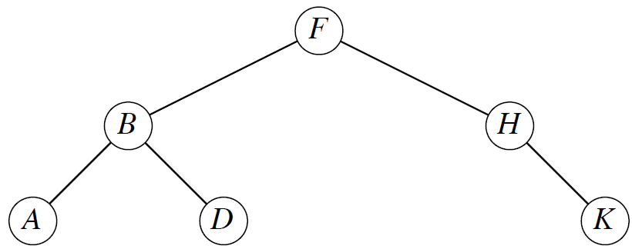
Example for Binary Search Tree

Slide 6
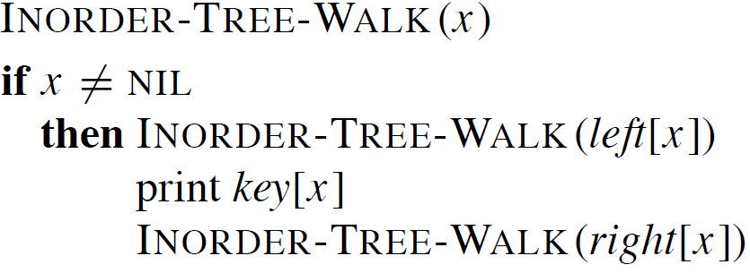
Inorder tree walk
The binary-search-tree property allows us to print keys in a binary search tree in order, recursively, using an algorithm called an inorder tree walk. Elements are printed in monotonically increasing order.

Slide 7
Inorder tree walk (cont.)
Correctness: Follows by induction directly from the binary-search-tree property.
Time: Intuitively, the walk takes Θ(n) time for a tree with n nodes, because we visit and print each node once.
  Formal proof using recurrence and substitution method

Slide 8
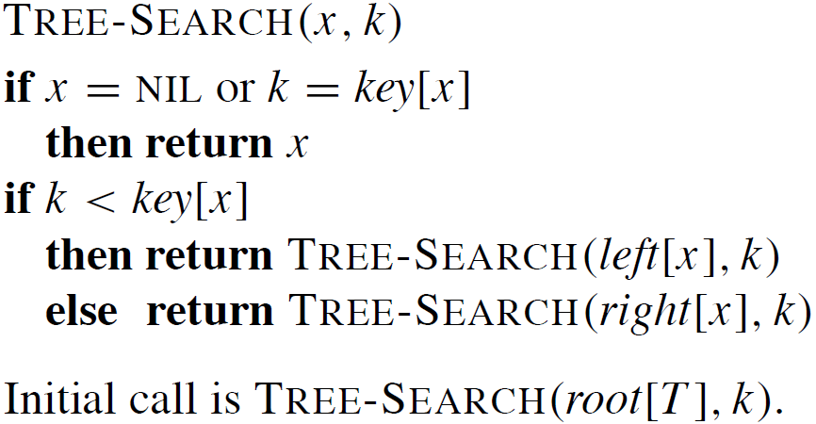
Searching
Time: The algorithm recurses, visiting nodes on a downward path from the root. Thus, running time is O(h), where h is the height of the tree.

Slide 9
Minimum and Maximum
The binary-search-tree property guarantees that the minimum key of a binary search tree is located at the leftmost node, and the maximum key of a binary search tree is located at the rightmost node.
Traverse the appropriate pointers (left or right) until NIL is reached.

Slide 10
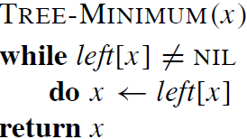
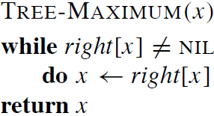
Maximum and Minimum(cont.)
Time: Both procedures visit nodes that form a downward path from the root to a leaf. Both procedures run in O(h) time, where h is the height of the tree.

Slide 11
Successor and Predecessor
Assuming that all keys are distinct, the successor of a node x is the node y such that key[y] is the smallest key > key[x].
  We can find x’s successor based entirely on the tree structure. No key comparisons are necessary.
If x has the largest key in the binary search tree, then we say that x’s successor is NIL.

Slide 12
Successor and Predecessor (cont.)
There are two cases:
If node x has a non-empty right subtree, then x’s successor is the minimum in x.s right subtree.
If node x has an empty right subtree, notice that: As long as we move to the left up the tree, we are visiting smaller keys. x’s successor y is the node that x is the predecessor of (x is the maximum in y’s left subtree).

Slide 13
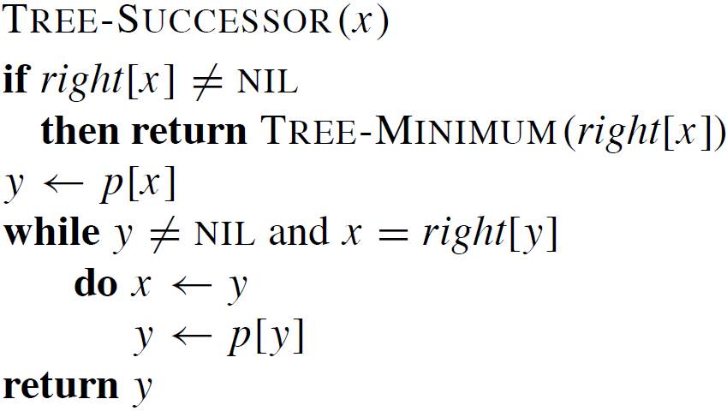
Successor and Predecessor
(Pseudocode)
moving upwards in the tree

Slide 14
Successor and Predecessor
TREE-PREDECESSOR is symmetric to TREE-SUCCESSOR.
Time: For both the TREE-PREDECESSOR and TREE-SUCCESSOR procedures, in both cases, we visit nodes on a path down the tree or up the tree. Thus, running time is O(h), where h is the height of the tree.

Slide 15
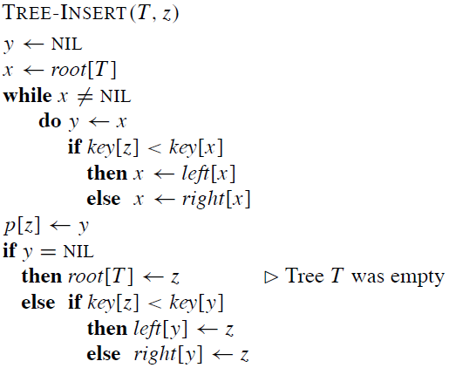
Insertion
node to be inserted
moving downwards the tree to the insertion position
placement of the new node

Slide 16
Insertion (remarks)
To insert value v into the binary search tree, the procedure is given node z, with key[z] = v, left[z] = NIL, and right[z] = NIL.
Beginning at root of the tree, trace a downward path, maintaining two pointers.
  Pointer x: traces the downward path.
  Pointer y: trailing pointer. to keep track of parent of x.
Traverse the tree downward by comparing the value of node at x with v, and move to the left or right child accordingly.
When x is NIL, it is at the correct position for node z.
Compare z’s value with y’s value, and insert z at either y’s left or right, appropriately

Slide 17
Insertion (Complexity)
Time: Same as TREE-SEARCH. On a tree of height h, procedure takes O(h) time.
TREE-INSERT can be used with INORDER-TREE-WALK to sort a given set of numbers.
(Exercise: What is the complexity of this approach?)

Slide 18
Deletion
We have to distinguish three cases:
Case 1: z has no children. Delete z by making the parent of z point to NIL, instead of to z.
Case 2: z has one child. Delete z by making the parent of z point to z’s child, instead of to z.
Case 3: z has two children. z’s successor y has either no children or one child.
(y is the minimum node - with no left child - in z’s right subtree.)
Delete y from the tree (via Case 1 or 2). Replace z’s key and satellite data with y’s.

Slide 19
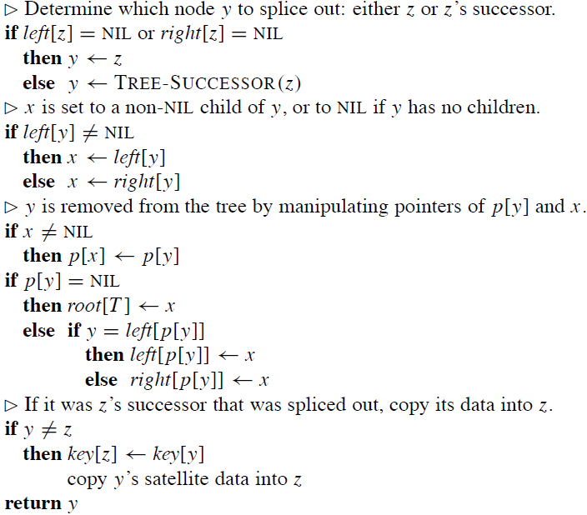
Pseudocode
Delete
y is the node to splice out

Slide 20
Delete (Complexity)
Time: O(h), on a tree of height h.

Slide 21
Minimizing running time
We’ve been analyzing running time in terms of h (the height of the binary search tree), instead of n (the number of nodes in the tree).
  Problem: Worst case for binary search tree is (n).no better than linked list.
  Solution: Guarantee small height (balanced tree).h = O(lg n).
In later chapters, by varying the properties of binary search trees, we will be able to analyze running time in terms of n.
  Method: Restructure the tree if necessary. Nothing special is required for querying, but there may be extra work when changing the structure of the tree (inserting or deleting).

