Slide 1

Multi-Agent System Evaluation and Metrics
An Overview of Methods and Challenges
Speaker: [Your Name] | Date: [Current Date]
Notes:
"Good morning/afternoon, everyone. Today, I'm going to talk about the evaluation and metrics of multi-agent systems, which is a crucial and evolving field in AI research. This presentation will give you an overview of the methods we use and the challenges we face."

Slide 2





Agenda
Agent vs. Traditional Testing
Agent Testing Methods
Understanding the fundamental differences between agent-based and conventional testing approaches.
Exploring Ground Truth validation, End-to-End (E2E) testing, and Capability Evaluation frameworks.
Key Evaluation Metrics
Challenges & Solutions
Defining critical metrics including Task Completion Rate and Plan Quality Assessment.
Addressing the issue of bug quantification and variability with structured rubric evaluation.
Notes:
Here's a quick overview of what we'll cover today. We'll start by comparing agent testing with traditional software testing, then dive into the specific methods we use, followed by the key metrics for evaluation, and finally discuss the challenges and potential solutions.

Slide 3
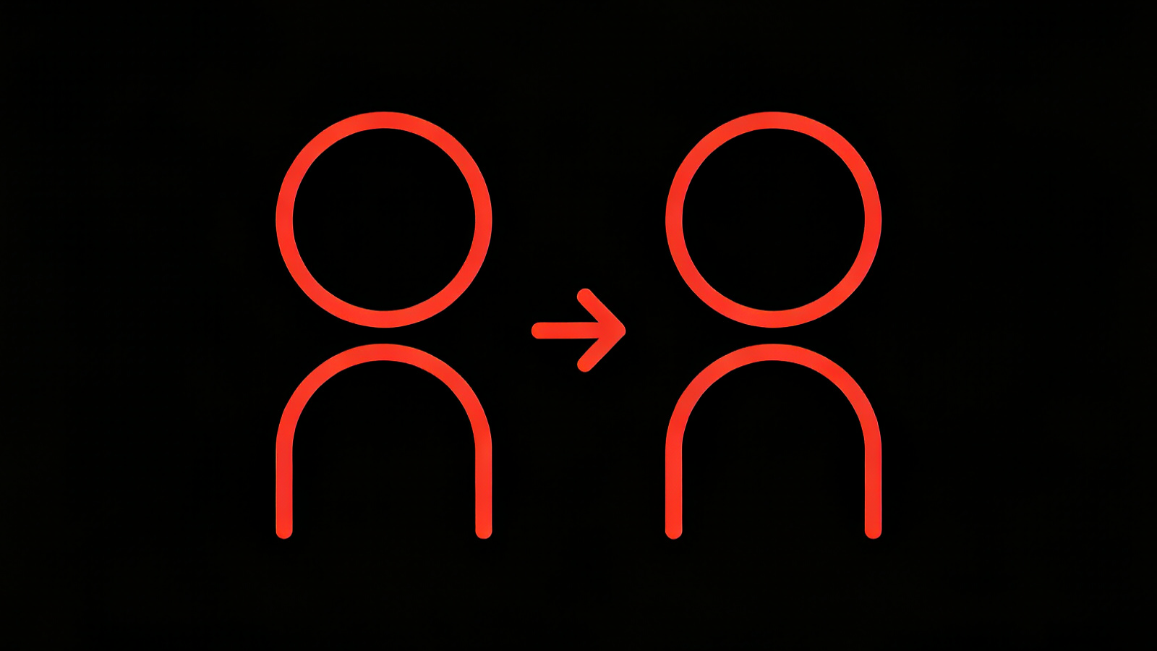
1. Agent vs Traditional Testing
COMPARISON ANALYSIS
Notes:
First, let's understand how testing multi-agent systems differs from testing traditional software.

Slide 4
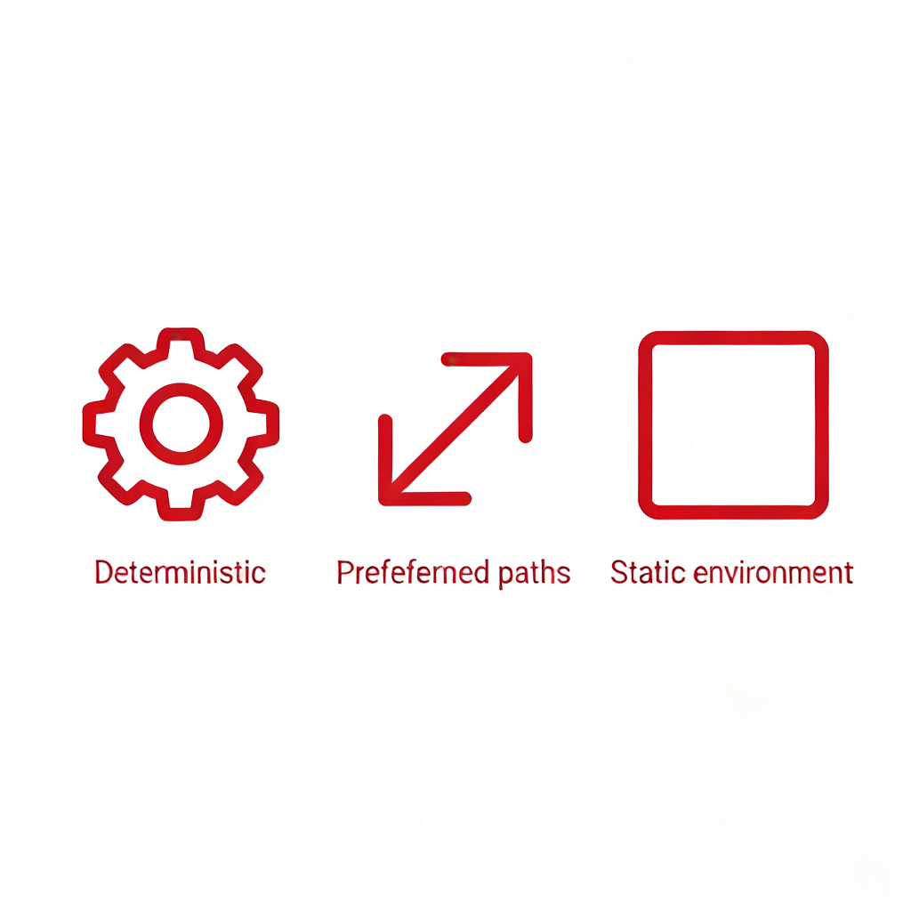







Key Differences
Traditional Software Testing
Multi-Agent System Testing
Deterministic:Behavior is predictable.
Non-Deterministic:Outcomes vary due to interactions.
Predefined Paths:Follows a fixed execution flow.
Emergent Behavior:Unpredictable from collaboration.
Static Environment:Operates in a controlled setting.
Dynamic Environment:Operates in a changing world.
Notes:
The core difference lies in determinism and environment. Traditional software is predictable and operates in a static world. Multi-agent systems, however, are non-deterministic, exhibit emergent behavior, and function in dynamic environments, making them much harder to test.

Slide 5
2. Project Agent Testing Pyramid
E2E (End-to-End Evaluation)
Agent Trajectory Evaluation
Component UT (Unit Testing)
Notes:
Now, let's look at the three-tiered pyramid model we use for agent testing in our project, which consists of E2E at the top, Agent Trajectory in the middle, and Component Unit Testing at the base.

Slide 6
2.1 Agent Trajectory Evaluation
Core Evaluation Content
Focuses on evaluating the agent's Reasoning, Action, and Execution layers.
Reasoning
↓
Action
↓
Execution
Key Metrics Source
References open-source frameworks such as Deepeval, Ragas, and Opik for defining metrics related to thought process quality, action correctness, and execution efficiency.
Notes:
The second layer is Agent Trajectory Evaluation. This layer dives deep into the agent's internal processes, specifically evaluating its reasoning, action selection, and execution. We draw on metrics from popular open-source frameworks like Deepeval, Ragas, and Opik to assess the quality of these layers.

Slide 7
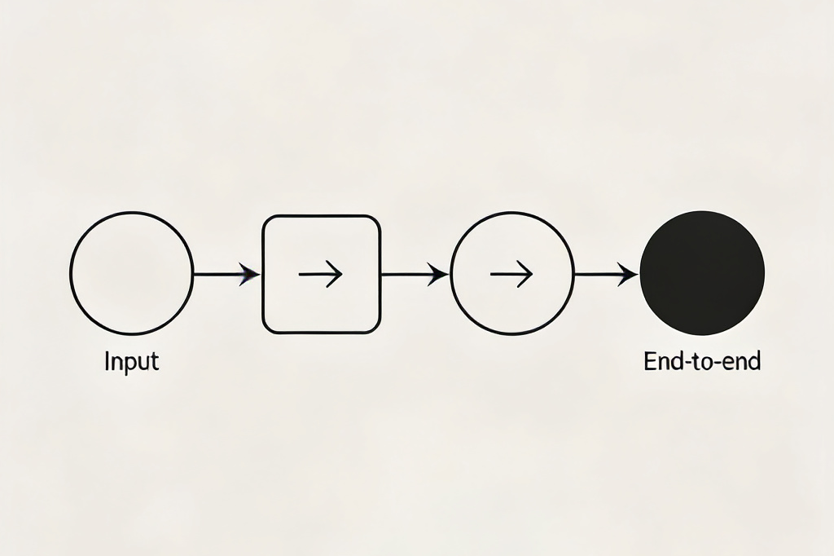
2.2 E2E Evaluation
E2E evaluation relies on ground truth for objective comparison and uses requirement & bug-driven rubric evaluation for a more nuanced, scenario-based assessment.
Figure: End-to-End Task Flow
Full Cycle Assessment
Notes:
At the top of our pyramid is E2E Evaluation. This method combines two approaches: comparing against a known ground truth for objective results, and using a rubric driven by specific requirements and bug scenarios to conduct a more comprehensive and practical assessment.

Slide 8
Notes:
The third method is Agent Capability Evaluation. Instead of looking at the whole task, we break it down to test specific skills like planning or reasoning. This helps us pinpoint exactly where an agent might be struggling, though it might not capture how these skills work together in a real task.

Slide 9

3. Key Evaluation Metrics
Quantify testing results with standardized measurements
Notes:
Once we have our testing methods, we need metrics to quantify the results. Let's look at some key metrics we use.

Slide 10


Task & Argument Metrics
Task Completion
Argument Correctness
Definition:The percentage of tasks successfully completed by the agent.
Definition:The logical soundness and factual accuracy of the agent's reasoning or explanations.
Measurement:Binary (success/failure) or graded based on how much of the task is completed.
Measurement:Often requires human evaluation or sophisticated NLP models to assess.
Key indicators for evaluating agent performance and trustworthiness.
Notes:
Two fundamental metrics are Task Completion and Argument Correctness. Task Completion tells us if the agent got the job done, while Argument Correctness assesses the quality of its reasoning, which is crucial for explainability and trust.

Slide 11
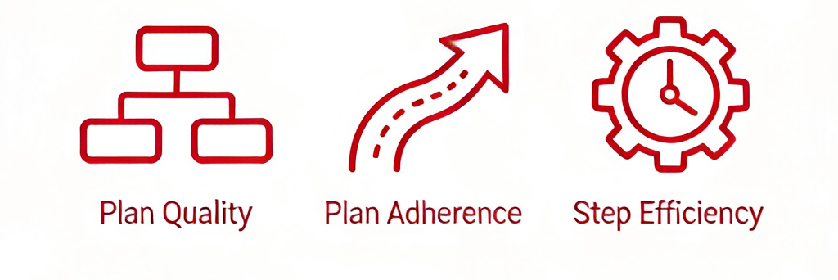



Plan & Step Metrics
Plan Quality
Plan Adherence
Step Efficiency
Definition:Agent's strategy/plan goodness for goal achievement.
Measurement:Based on optimality, feasibility, robustness.
Definition:Degree of following the plan during execution.
Measurement:Compare actions against outlined steps.
Definition:Steps/resources consumed to complete task.
Measurement:Lower steps/usage = higher efficiency.
Notes:
We also look at metrics related to the agent's planning and execution. Plan Quality measures how good the strategy is, Plan Adherence checks if the agent sticks to its plan, and Step Efficiency tells us how resourceful it is in completing the task.

Slide 12

4. Challenges & Solutions
EVALUATION OF MULTI-AGENT SYSTEMS
Notes:
"Despite these methods and metrics, we still face significant challenges in evaluating multi-agent systems. Let's discuss one major challenge and a potential solution."

Slide 13



Challenge: Bug Quantification
The Problem
Bugs in multi-agent systems are often non-deterministic and context-dependent, making them hard to reproduce and isolate.
Traditional Approach
Simple bug counting is insufficient, as not all bugs are equal in severity or impact on the overall system.
Our Need
A more nuanced way to quantify the impact of bugs on system performance and requirements satisfaction.
Elusive Bugs in Complex Systems
Notes:
A key challenge is bug quantification. In complex systems, bugs are often elusive and don't follow a simple pattern. Counting them doesn't tell us how severe they are or how much they affect the system's goals. We need a better way to measure this.

Slide 14

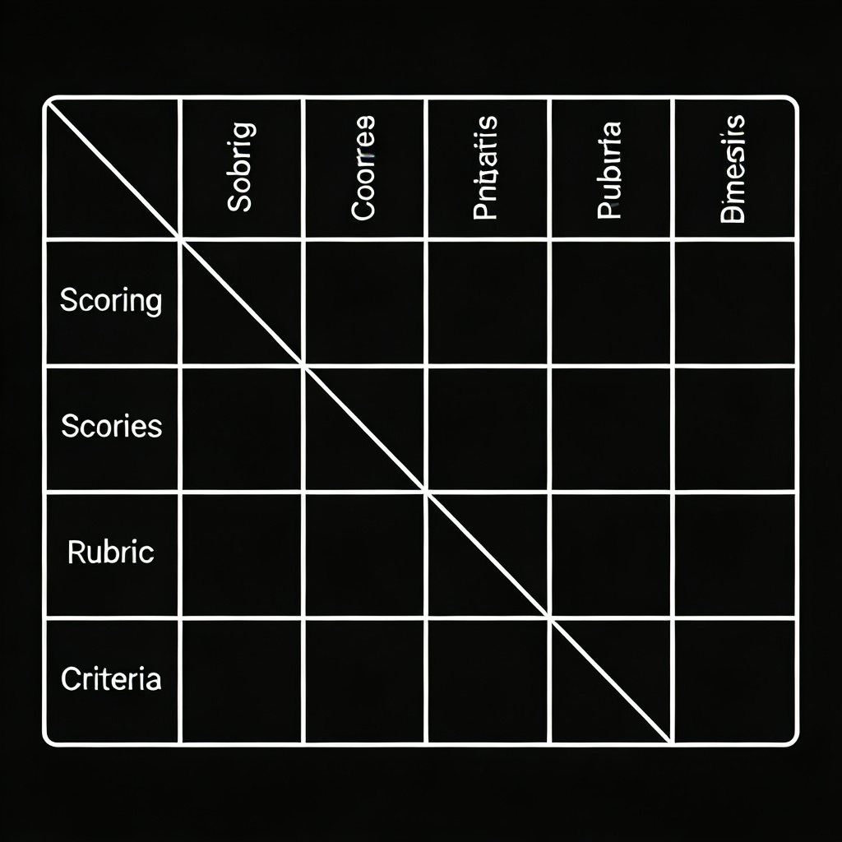

Solution: Bug/Requirement Rubric Evaluation
The Solution: Structured Scoring Guide
Define a detailed rubric (scoring guide) to evaluate bugs or requirement fulfillment across multiple predefined dimensions, ensuring objectivity.
Key Evaluation Dimensions
Assess based onSeverity(critical/major/minor),Impact(task/user/system),Frequencyof occurrence, andAlignmentwith requirements.
Operational Benefits
Provides aquantitative and consistentassessment method, facilitating effective prioritization of fixes and clear tracking of project progress.
Example: Rubric Scoring Matrix
Process Optimization Series | Quality Assurance
Notes:
Our proposed solution is Rubric-based Evaluation. By creating a detailed scoring guide, or rubric, we can evaluate each bug or requirement against multiple criteria like severity, impact, and frequency. This gives us a more precise and consistent way to quantify problems and prioritize fixes.

Slide 15



Summary & Q&A
Evaluation Methods
Key Metrics
Bug Quantification
Distinct approaches (Ground Truth, E2E, Capability) are required compared to traditional software testing.
Focus on Task Completion rate, Argument Correctness, and Plan-related measures for system performance.
Addressing the challenge through rubric-based evaluation to enable nuanced and detailed assessment.
Thank You for Listening!
Any questions or discussions are welcome.
Notes:
To summarize, evaluating multi-agent systems is a complex task that demands specialized methods and metrics. We've explored the key differences from traditional testing, the main evaluation approaches, and the critical metrics. We also highlighted the challenge of bug quantification and proposed rubric-based evaluation as a solution. Thank you for your attention, and I'll now take any questions you may have.

