Slide 1
Income, Welfare and Fertility

Slide 2
Research Question
What is the relationship between income and Fertility
How our welfare system affects our fertility

Slide 3
Why worthy tracking
Fertility is important
Population quality
Welfare system is designed to support it better
Not being exploited as an income tool

Slide 4
Dataset
SA2 Income Support from AURIN
A dataset including number of people that claims government support in all suburban around Greater Melbourne
Basic Community Profile from ABS
A dataset that contains information which collected in 2011 census
B24: Number of Children ever born

Slide 5
Processing Raw Data
Missing Value replacement
String Matching
Discretized -Define “High-Income” and “Multi-children”
Normalize
Python extracting data from excel

Slide 6
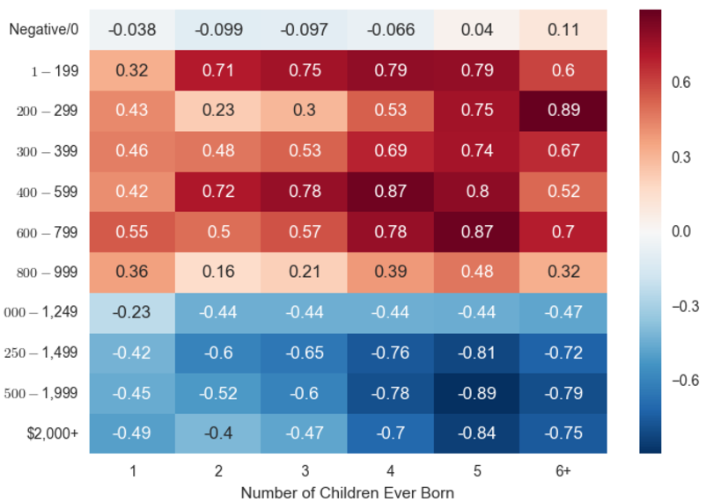

Slide 7
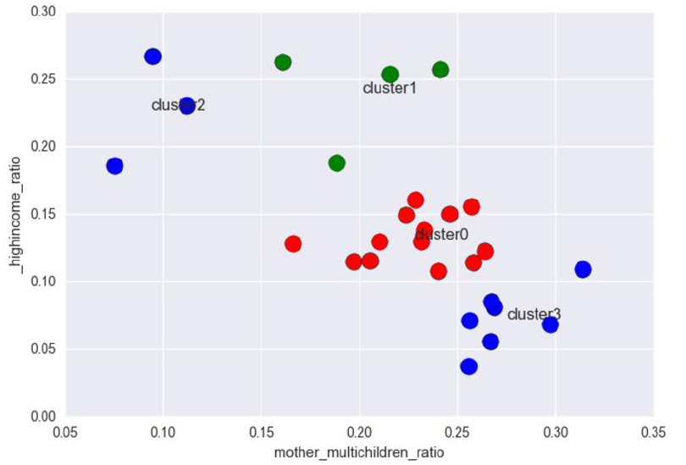
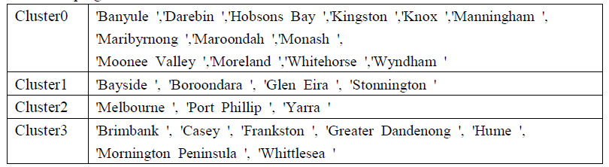
Result

Slide 8
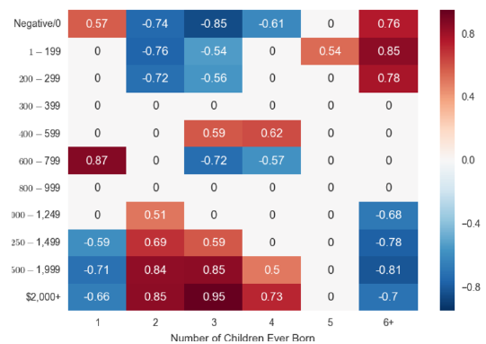
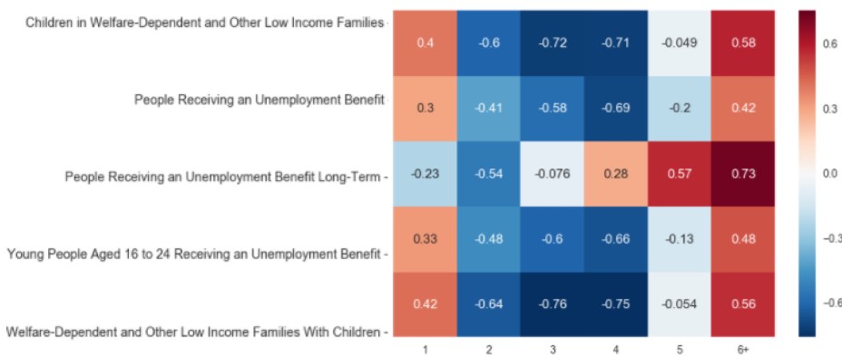
Result2

Slide 9
Challenge
Multi-Dimension Data
200+ suburban to LGA
String Matching
Similarity Measurement instead of Manually
Using Web Scraper : Phantomjs + Selenium

