Slide 1
Income, Welfare
And Fertility
PRESENTED BY Siyi Guo 737008

Slide 2
01 Research Question
CONTENTS
02 Dataset and Wrangling Methods
03 Result Presentation
04 Challenge and Discussion

Slide 3
Research Question:
What is the relationship between Income and Fertility?
Is Government welfare system being exploited?

Slide 4
Why Worth Tracking?
Fertility is important
Population quality

Slide 5
Dataset
SA2 Income Support from AURIN
At suburban level
A dataset including number of people that claims government support
Data include children support, unemployment support, etc
LGA Basic Community Profile from ABS
At Local Government area level
A dataset that contains information which collected in 2011 census
B24: Number of Children ever born
B17b: Income level by age.

Slide 6
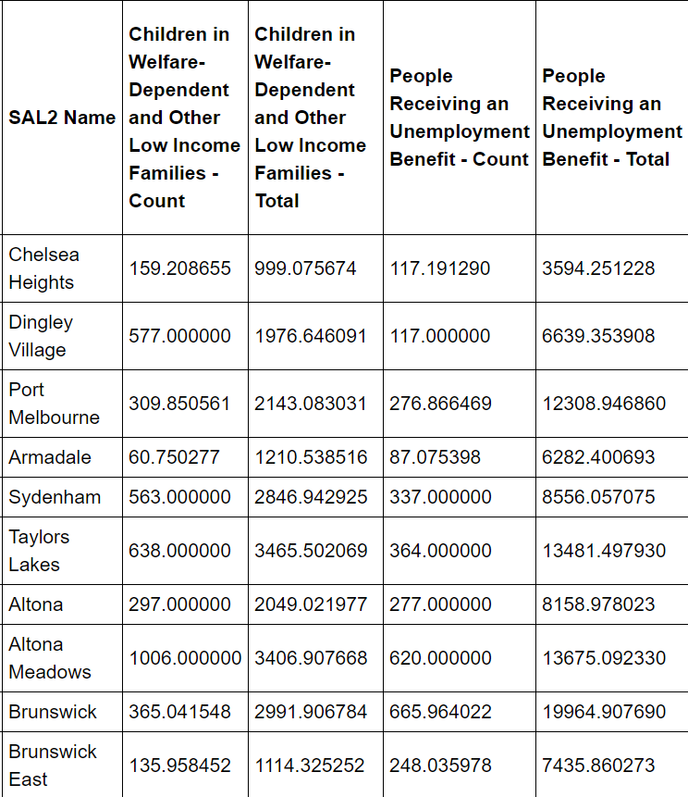
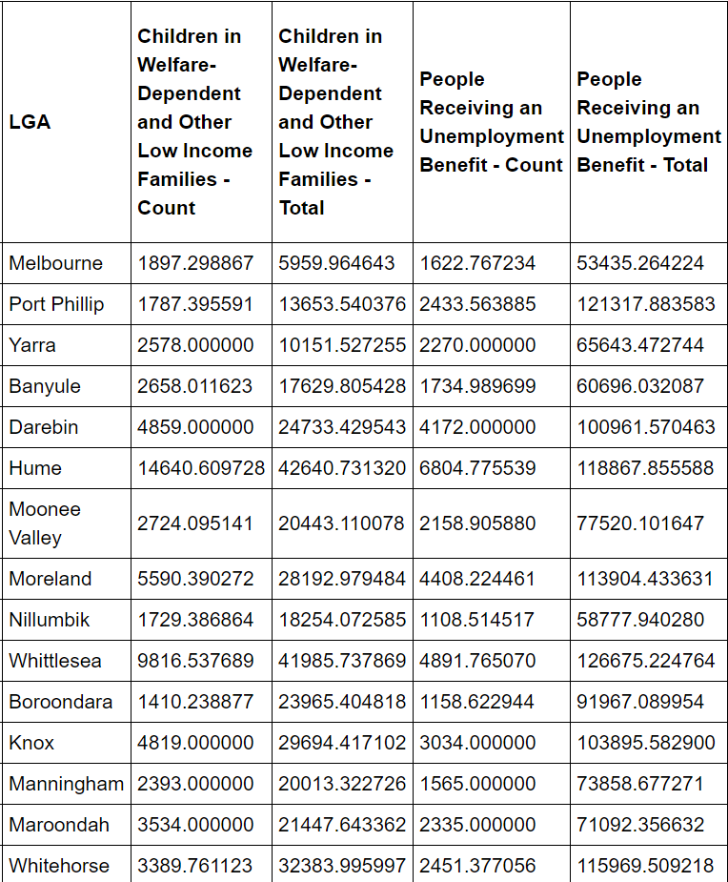
Data Wrangling
SA2 Income Support
Replace Missing Value
Integrate data from SA2 to LGA
Basic Community Profile
27 Data Set -> one Dataframe

Slide 7
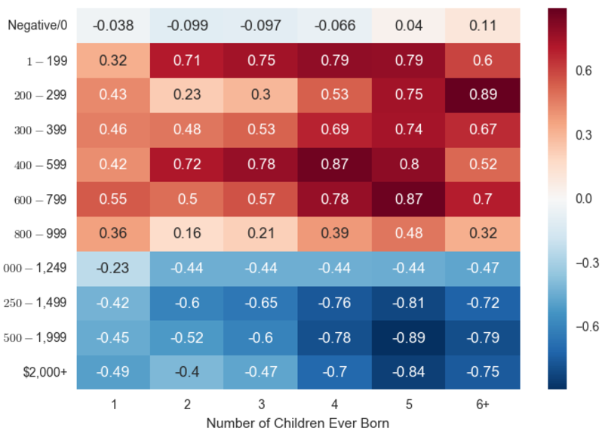
Result
Higher Income, Less Children
Normalization
Number of People at this income level / total people at this income level
Number of People born X children at this age / total people at this age
Pearson Coefficient
Pearson Coefficient between number of people at each factor
Across 27 LGA

Slide 8
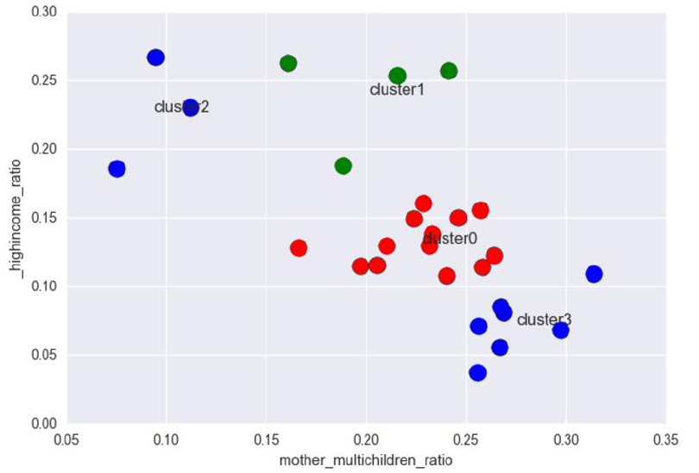
Result
Multi-Children Ratio:
number of children >=3
High Income:
Income Level > 1500/week
from ABS
K-means
Into 4 cluster
Different Characteristic LGA’s
Separate to reveal characteristic

Slide 9
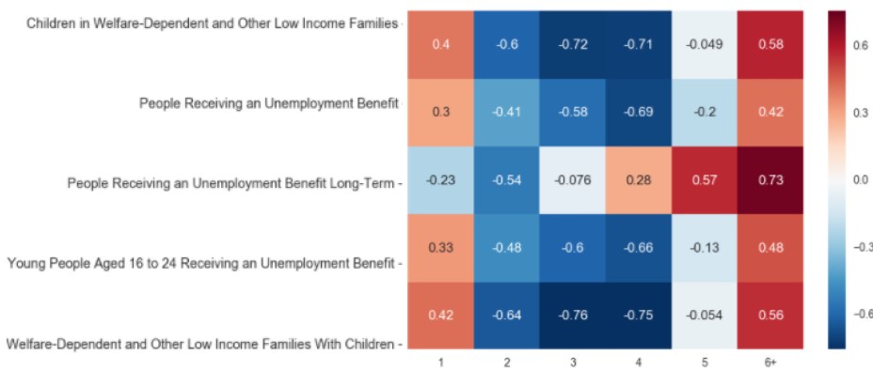
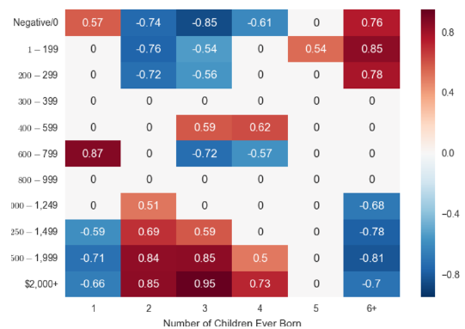
Result
Cluster3

Slide 10
Challenge and Improvement
Multi-Dimension Data
SA2 to LGA
String Matching
Similarity Measurement instead of Manually
Using Web Scraper : Phantomjs + Selenium

