Slide 1
Mobile Ads Click Prediction
Team: Observer
Team Observer:
Xiang Zhong, Jing Zhao, Yang Pei,
Hongbo Zhao, Zhe Sun, Qianwen Zhang

Slide 2

Outline
Problem Introduction
Attributes Selection
Model Selection
Evaluation

Slide 3


Problem Introduction
Given basic info of mobile ads:
Ads’ category,
App’s category, etc……
Predict whether a new ads will be clicked?
Mobile Ads

Slide 4
Data Sets & Attributes
Data | Size
Training Set | 6.31GB
Testing Set | 1.27GB
Ten days
One day
All attributes are Categories
Anonymous attributes
Number of value varies from 4 to 10 k.
id | click | C1 | C2 | site_category | C3 | C4 | app_category | ……
"1000009418151090000 | 0 | 1fbe01fe | f3845767 | 28905ebd | ecad2386 | 7801e8d9 | 07d7df22 | ……
"10000169349117800000 | 0 | 1fbe01fe | f3845767 | 28905ebd | ecad2386 | 7801e8d9 | 07d7df22 | ……
"10000371904215100000 | 1 | 1fbe01fe | f3845767 | 28905ebd | ecad2386 | 7801e8d9 | 07d7df22 | ……

Slide 5
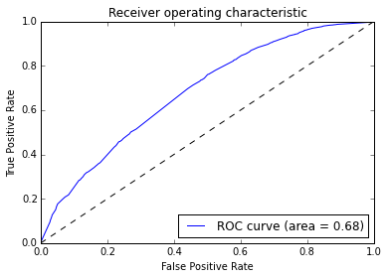
Evaluation Method
ROC and AUC
Higher AUC
Better Performance

Slide 6
Attribute Selection
Effective Attribute Pattern Mining
Try which kinds of Attribute combinations will produce high or low Click Rate
Example:
App category: Game app
Ads category: Game ads

Slide 7
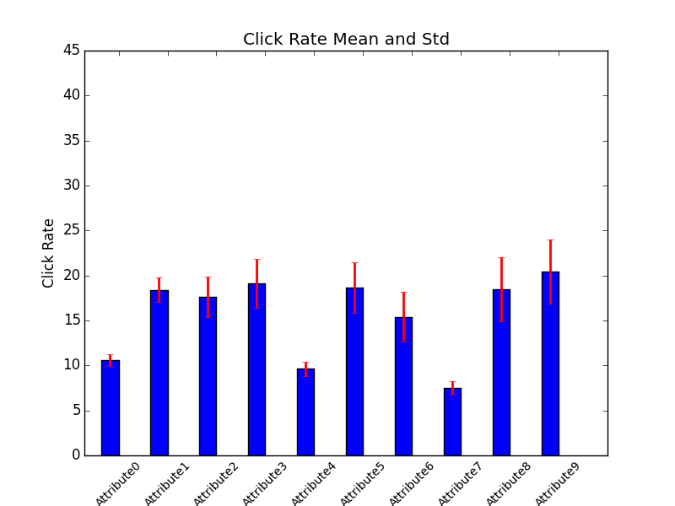
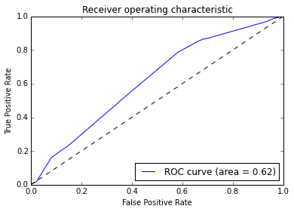
Attribute Selection(con’t)
Select the attributes that have greater variance
Greater variance means better Classification
Improvement Example:
Logistic Regression

Slide 8
Model Selection
Choice are limited due to Categorical data
Decision Tree
Random Forest
Naïve Bayesian
Logistic Regression
Hybrid Models

Slide 9
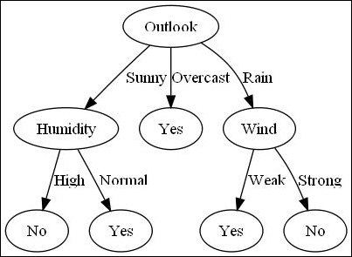
Decision Tree
Specified for categorical data.
All of our attributes are categorical.
Modified tree avoid
over fitting.
Split number

Slide 10
Random Forest
Constructing a multitude of decision trees
Choose the best tree from a subset of features
Prevent over fitting
Combine classifiers by averaging all the single trees.

Slide 11
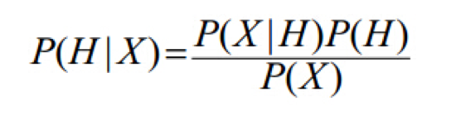
Naïve Bayesian
Fit for categorical data and classification
Few attributes have strong correlation.
Independent assumption

Slide 12
Naïve Bayesian
Find a way to “quantization” each attribute
The attractiveness of each value is estimated by the click rate
Use Gaussian Naïve Bayes to predict the overall click rate
During testing, use a process similar to EM algorithm

Slide 13
Logistic regression
Deal with numerical data only
Convert category to numerical data
Binary Extraction
App Category: Game Social
Features: 1 0
Dimension becomes too large >> 100
Drop infrequent values

Slide 14
Neural Network
Don’t need to preprocess data
Can throw data into the algorithm directly.
Black-box algorithm:
Cannot understand the inside mechanism
Limited Computation resource:
Cannot make the algorithm converge

Slide 15
Combination of Different models
Combine the output of Naïve Bayesian and Decision tree as input for logistic regression
Decision Tree
Data
Logistic Regression
Naïve Bayesian
output

Slide 16
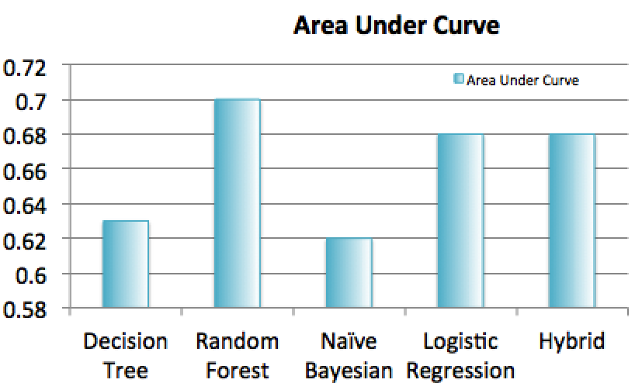
Evaluation
Random Forest has the best performance
Due to characteristics of dataset: Categorical Data

Slide 17
Con’t
Kaggle link: http://www.kaggle.com/c/avazu-ctr-prediction
Github link:
https://github.com/Kelvin-Zhong/Click-Through-Rate-Prediction
Reference:
"A two-stage ensemble of diverse models for advertisement ranking in KDD Cup 2012." KDDCup (2012).

Slide 18
Thank you
Q&A

