Slide 1
“Gang of Four”
Design Patterns

Slide 2
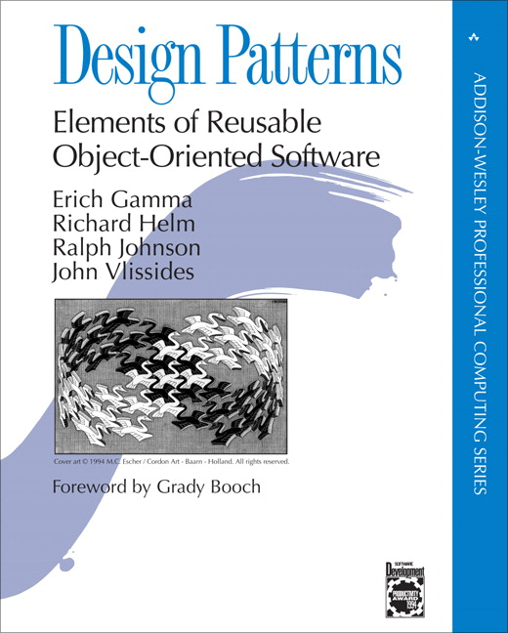
1995

Slide 3

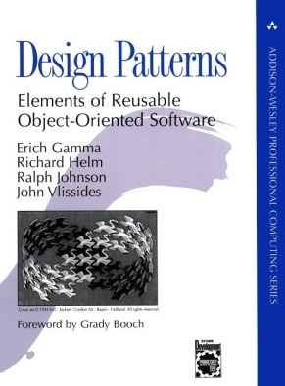
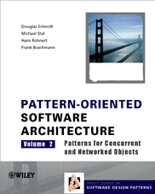

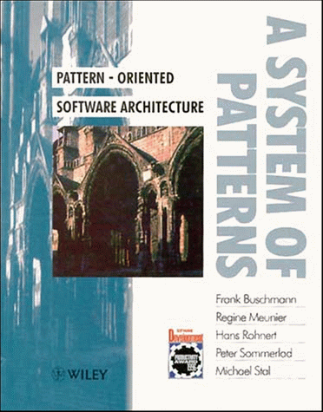
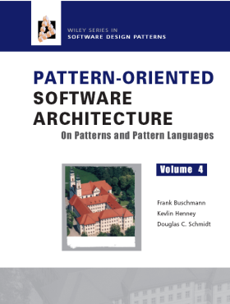
Overview of Patterns
Present solutions to common software problems arising within a certain context
Help resolve key software design forces
  Flexibility
  Extensibility
  Dependability
  Predictability
  Scalability
  Efficiency
Capture recurring structures & dynamics among software participants to facilitate reuse of successful designs
Generally codify expert knowledge of design strategies, constraints & “best practices”
AbstractService
service
Client
Proxy
Service
service
1
1
service
The Proxy Pattern

Slide 4
Design Patterns are NOT
Data structures that can be encoded in classes and reused as is (i.e., linked lists, hash tables)
Complex domain-specific designs
(for an entire application or subsystem)
If they are not familiar data structures or complex domain-specific subsystems, what are they?
They are: “ Descriptions of communicating objects and classes that are customized to solve a general design problem in a particular context.”

Slide 5
The “gang of four” (GoF)
  Design Patterns book catalogs 23 different patterns
  Solutions to different classes of problems, in C++ & Smalltalk
  Problems and solutions are broadly applicable, used by many people over many years
  Patterns suggest opportunities for reuse in analysis, design and programming
  GOF presents each pattern in a structured format

Slide 6
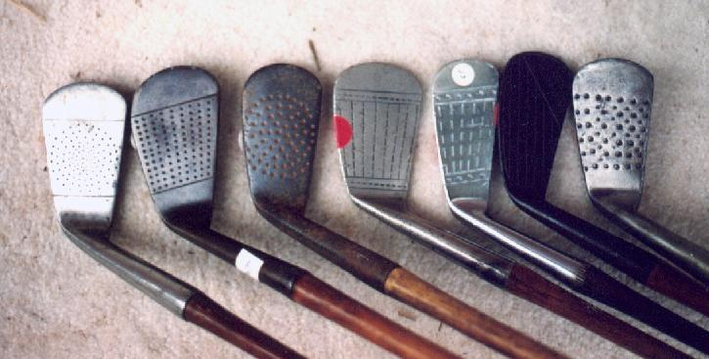
Elements of Design Patterns
Design patterns have 4 essential elements:
  Pattern name: increases vocabulary of designers
  Problem: intent, context, when to apply
  Solution: UML-like structure, abstract code
  Consequences: results and tradeoffs

Slide 7
Three Types of GoF Patterns
Creational patterns:
  Deal with initializing and configuring objects
Structural patterns:
  Composition of classes or objects
  Decouple interface and implementation of classes
Behavioral patterns:
  Deal with dynamic interactions among societies of objects
  How they distribute responsibility

Slide 8
GoF Patterns
Creational Structural Behavioral
Abstract Factory Adapter Chain of Responsibility
Builder Bridge Command
Factory Method Composite Interpreter
Prototype Decorator Iterator
Singleton Façade Mediator
Flyweight Memento
Proxy Observer
State
Strategy
Template Method
Visitor

Slide 9
Structural patterns
Assemble objects to realize new functionality
Example: Proxy
  Proxy acts as convenient surrogate or placeholder for another object.
  Examples?
    Remote Proxy: local representative for object in a different address space
    Virtual Proxy: represent large object that should be loaded on demand
    Protected Proxy: protect access to the original object

Slide 10
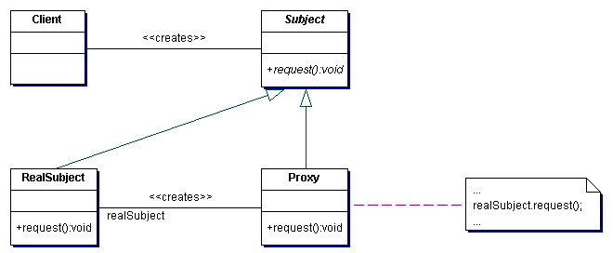
Proxy Pattern - Structure
Intent
  Provide a surrogate or placeholder for another object to control access to it.
Structure

Slide 11
Type: Structural Patterns
Adapter:
  Converts interface of a class into one that clients expect
Bridge:
  Links abstraction with many possible implementations
Composite:
  Represents part-whole hierarchies as tree structures
Decorator:
  Attach additional responsibilities to object dynamically
Facade:
  Simplifies the interface for a subsystem
Flyweight:
  Shares many fine-grained objects efficiently
Proxy:
  Provides a surrogate or placeholder for another object to control access to it

Slide 12

Adapter pattern
Problem: How to resolve incompatible interfaces or provide a stable interface to similar components with different interfaces?
Solution: Convert original interface component into another one through an intermediate adapter.

Slide 13
Illustration of Adapter Pattern
Old interface
Old package
Client
Old interface
New interface
New package
Client
Adapter

Slide 14
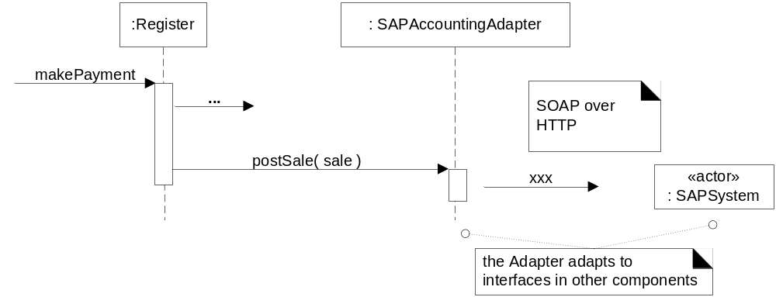
Using an Adapter: adapt postSale request to SOAP XML interface

Slide 15
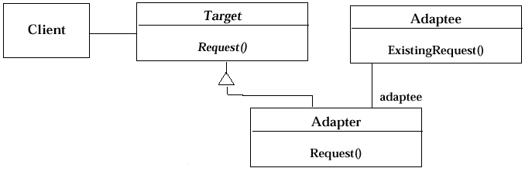
Adapter pattern
Adapter pattern uses inheritance

Slide 16
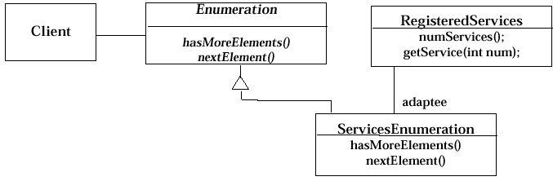
Object Adapter - example

Slide 17
Benefits of Adapter pattern
Reduces coupling to implementation specific details
Polymorphism and Indirection reveals essential behavior provided
Including name of design pattern in new class (e.g., TaxMasterAdapter) in class diagrams and code communicates to other developers in terms of known design patterns

Slide 18
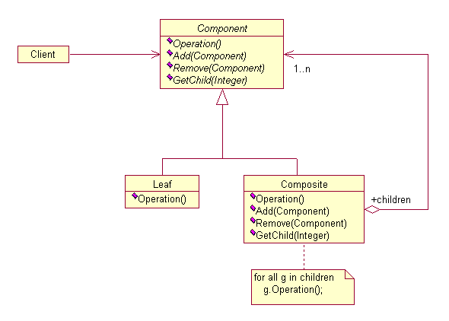
Composite Pattern
Composite lets clients treat individual objects and compositions of objects uniformly.

Slide 19
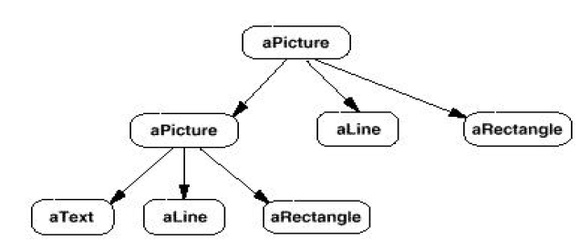
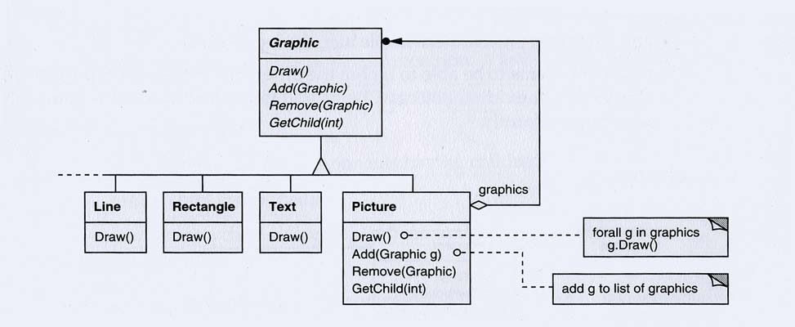
Composite
Pattern

Slide 20
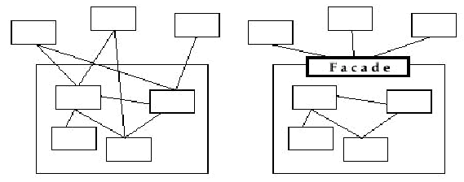
Facade Pattern
Facade Pattern
Provides a unified interface to a set of objects in a subsystem.
Facades allow us to provide a closed architecture

Slide 21
Structure of the Facade Pattern
Facade
Subsystem Classes
[Mancoridis picture]

Slide 22
Type: Creational Patterns
Singleton: Guarantee access to a singular (sole) instance
Simple Factory: Create specialized, complex objects
Abstract Factory: Create a family of specialized factories
Factory Method: Define an interface for creating an object, but let subclasses decide which class to instantiate
Builder: Construct a complex object step by step
Prototype: Clone new instances from a prototype
Lazy initialization: Delay costly creation until it is needed

Slide 23

Singleton pattern
A class with just instance and provide a global point of access
  Global Variables can be dangerous!
  (side effects, break information hiding)

Slide 24
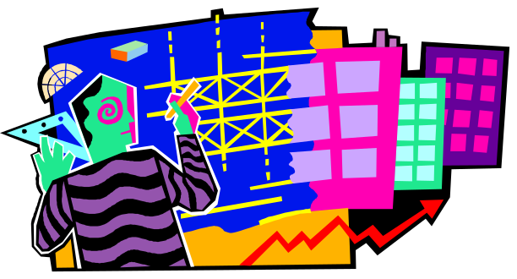
Simple Factory pattern
Context/Problem
  Who should be responsible for creating objects when there are special considerations, such as complex logic, a desire to separate the creation responsibilities for better cohesion, and so forth
Solution
  Create a Pure Fabrication to handle the creation

Slide 25

How does Simple Factory work
<abstract>
Product
<static>
ProductFactory
createProduct(in param) : Product
inherits
<Implementation Class>
ProductA
<Implementation Class>
ProductB
Produces different subclasses of Product according to parameters

Slide 26
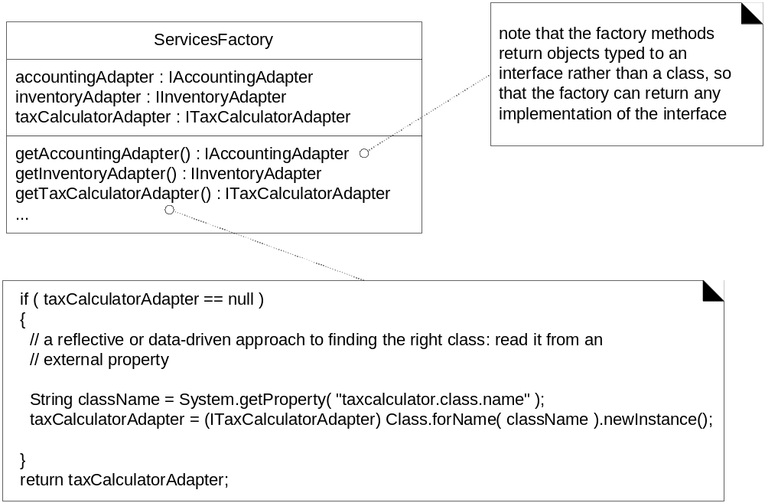
Factory can create different objects

Slide 27
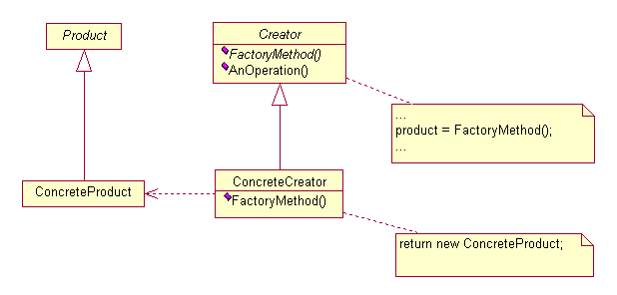
Factory Pattern
Intent:
  Define an interface for creating an object, but let subclasses decide which class to instantiate.

Slide 28
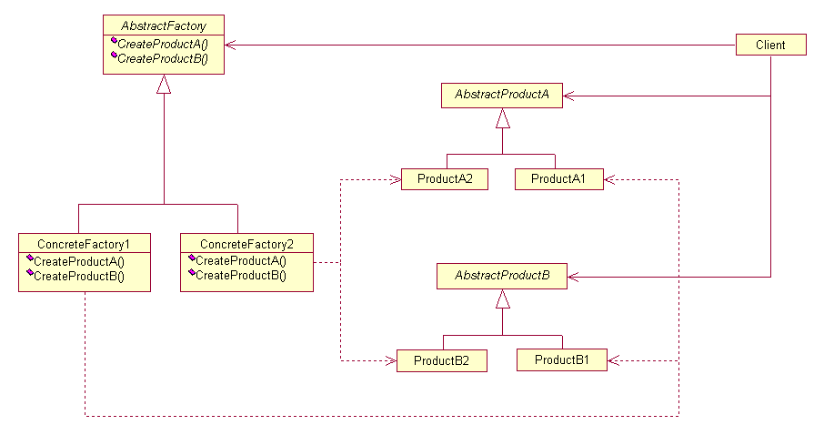
Abstract Factory Pattern

Slide 29
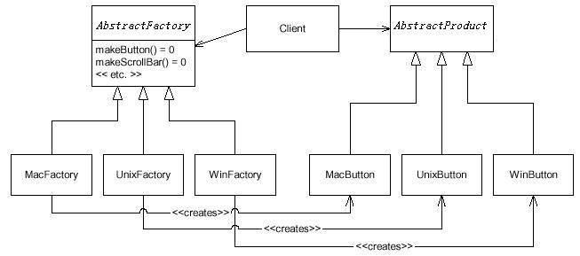
Abstract Factory Pattern - example
The Client remains blissfully unaware of the various concrete classes in this example.

Slide 30
Advantages of Factory pattern?
Separates responsibility of complex creation into cohesive helper classes
Hides complex creation logic, such as initialization from a file
Handles memory management strategies,
such or recycling or caching

Slide 31
Type: Behavioral Patterns
Chain of Responsibility:
  Request delegated to the responsible service provider
Command:
  Request or Action is first-class object, hence storable
Iterator:
  Aggregate and access elements sequentially
Interpreter:
  Language interpreter for a small grammar
Mediator:
  Coordinates interactions between its associates
Memento:
  Snapshot captures and restores object states privately

Slide 32
Type: Behavioral Patterns (cont.)
Observer:
  Observers update automatically when observed object changes
State:
  Object whose behavior depends on its state
Strategy:
  Abstraction for selecting one of many algorithms
Template Method:
  Algorithm with some steps supplied by derived class
Visitor:
  Operations applied to elements of a heterogeneous object structure

Slide 33

Observer pattern
Intent:
  Define a one-to-many dependency between objects
  so that when one object changes state, all its dependents are notified and updated automatically
Used in Model-View-Controller framework
  Model is problem domain
  View is windowing system
  Controller is mouse/keyboard control

Slide 34
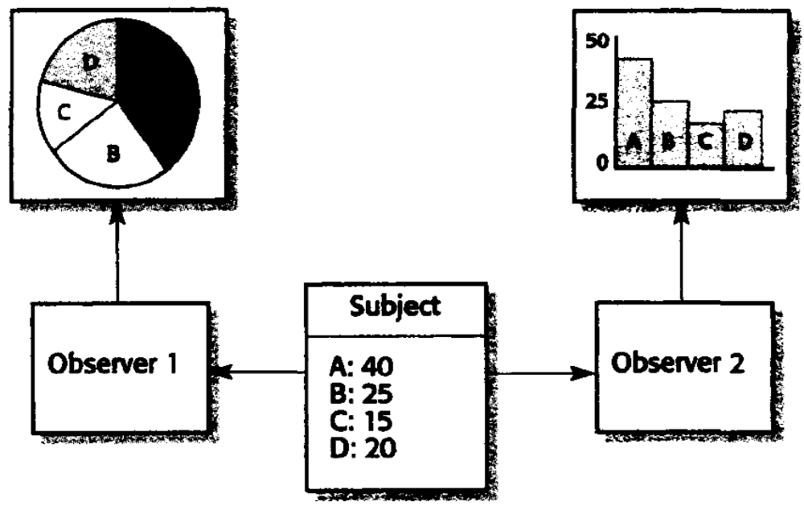
Observer pattern - motivation

Slide 35
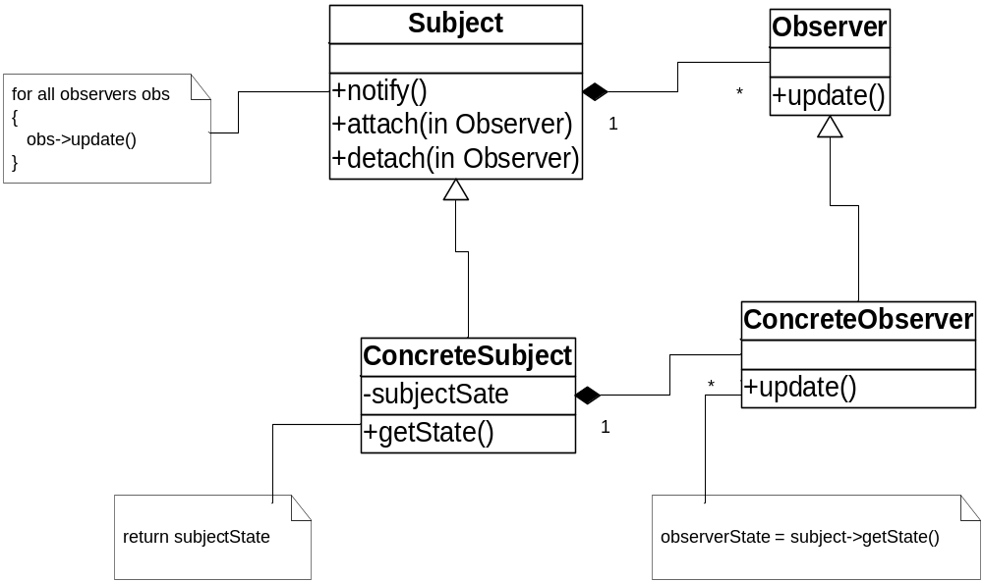
Structure of Observer Pattern

Slide 36

Command pattern
Synopsis or Intent:
  Encapsulate a request as an object,
  thereby letting you parameterize clients with different requests, queue or log requests, and support undoable operations
Solution:
  Interface of a Command object can be a simple execute() method
  Extra methods can support undo and redo
  Commands can be persistent and globally accessible, just like normal objects

Slide 37
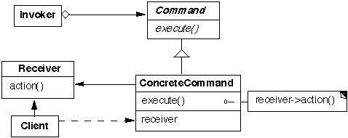
Command Pattern Structure:
Participants (the classes and/or objects participating in this pattern):
Command declares an interface for executing an operation
ConcreteCommand defines a binding between a Receiver object and an action implements Execute by invoking the corresponding operation(s) on Receiver
Invoker asks the command to carry out the request
Receiver knows how to perform operations associated with carrying out the request
Client creates a ConcreteCommand object and sets its receiver

Slide 38
Command pattern(continued)
Consequences:
  You can undo/redo any Command
    Each Command stores what it needs to restore state
  You can store Commands in a stack or queue
    Command processor pattern maintains a history
  It is easy to add new Commands, because you do not have to change existing classes
    Command is an abstract class, from which you derive new classes
    execute(), undo() and redo() are polymorphic functions

Slide 39
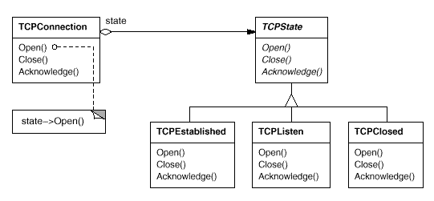
State Pattern – Motivation
Consider a class TCPConnection that represents a network connection.
  When a TCPConnection object receives requests from other objects, it responds differently depending on its current state.

Slide 40
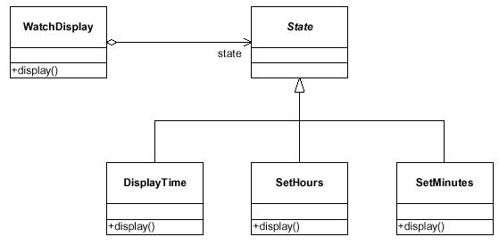
State Pattern – Example
Intent: Allow an object to alter its behavior when its internal state changes. The object will appear to change its class, from the point of view of the client.

Slide 41
Some Design Patterns

Slide 42
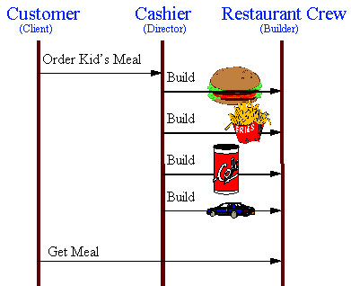
Builder - Example

Slide 43
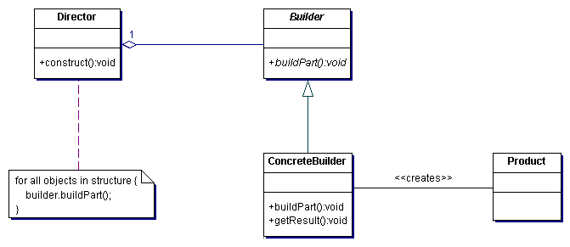
Builder Pattern
Intent:
Separate the construction of a complex object from its representation so that the same construction process can create different representations.
Structure

Slide 44
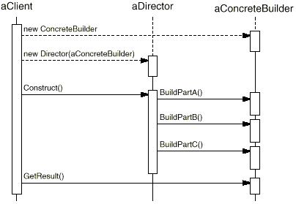
Builder Pattern
  The client creates the Director object and configures it with the desired Builder object.
  Director notifies the builder whenever a part of the product should be built.
  Builder handles requests from the director and adds parts to the product.
  The client retrieves the product from the builder.

Slide 45
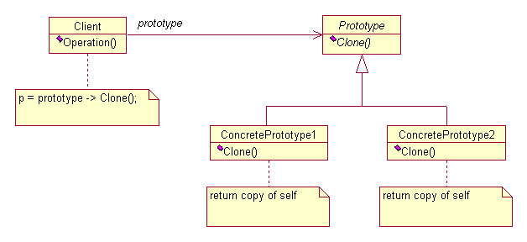
Prototype Pattern
Intent:
Specify the kinds of objects to create using a prototypical instance, and create new objects by copying this prototype.
Structure
A client asks a prototype to clone itself

Slide 46
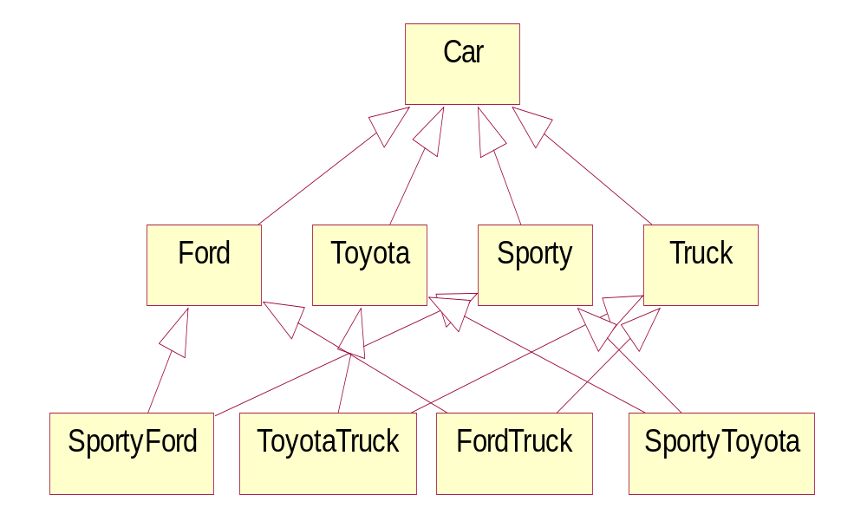
Bridge Pattern - motivation
How can we simplify this design?
Notes:
In the Best Practices module, we discussed some characteristics common to successful projects. OO facilitates the following best practices:
Develop Iteratively
Model Visually
Use Component Architecture
Defining basic OO terms and concepts allows everyone in the class to start on a level playing field.

Slide 47
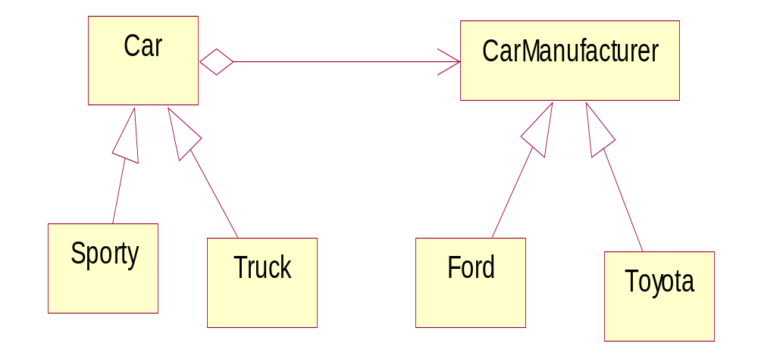
Bridge Pattern - example
Apply the Bridge Design Pattern
Intent: Decouple a class abstraction from its implementation.
- You might use Bridge when you might otherwise be tempted to use multiple inheritance...
Notes:
In the Best Practices module, we discussed some characteristics common to successful projects. OO facilitates the following best practices:
Develop Iteratively
Model Visually
Use Component Architecture
Defining basic OO terms and concepts allows everyone in the class to start on a level playing field.

Slide 48
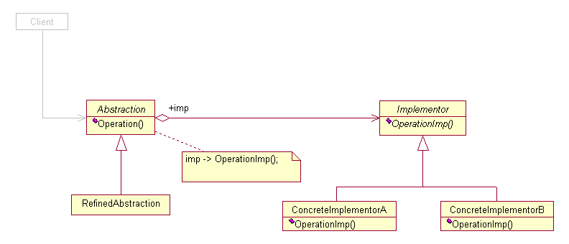
Bridge Pattern
Intent: Decouple an abstraction from its implementation so that the two can vary independently.

Slide 49
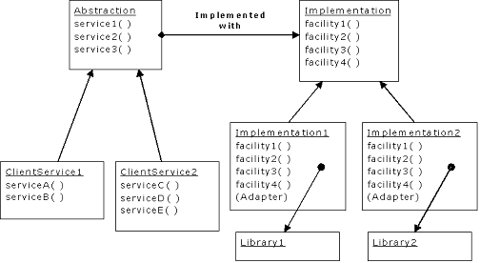
Bridge Pattern - example

Slide 50
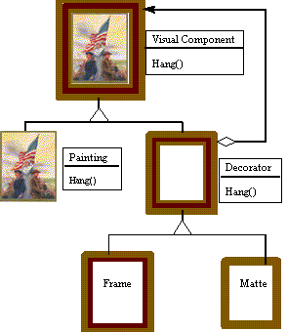
Decorator Pattern - motivation
Painting Example
  Although paintings can be hung on a wall with or without frames, frames are often added, and it is the frame which is actually hung on the wall.

Slide 51
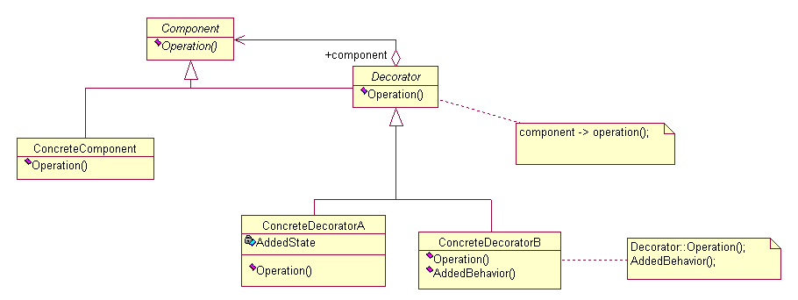
Decorator Pattern
Intent
  Attach additional responsibilities to an object dynamically.
  Decorators provide a flexible alternative to subclassing for extending functionality.

Slide 52
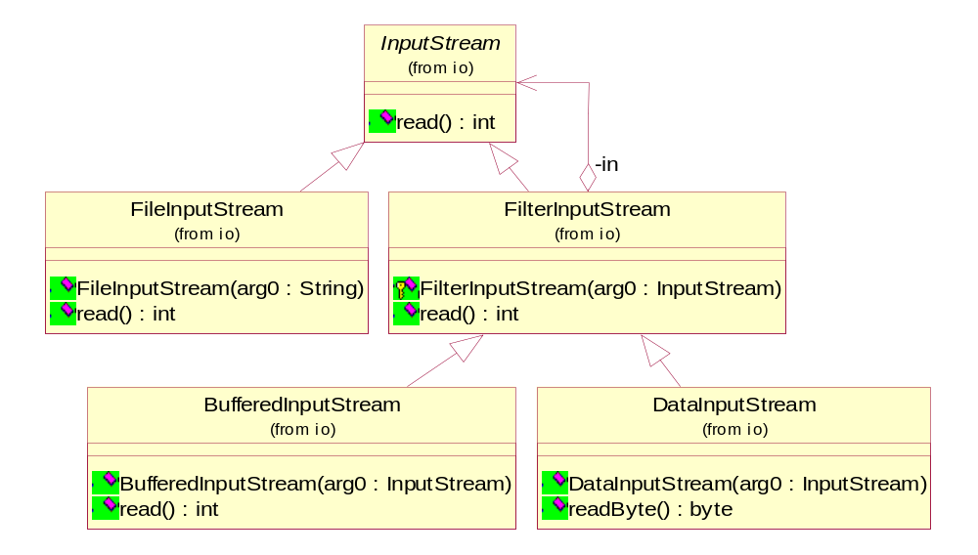
Decorator Pattern – example

Slide 53
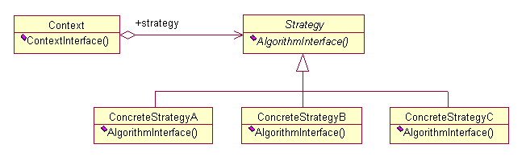
Strategy Pattern
Intent
  Define a family of algorithms, encapsulate each one, and make them interchangeable. Strategy lets the algorithm vary independently from the clients that use it.
Structure

Slide 54
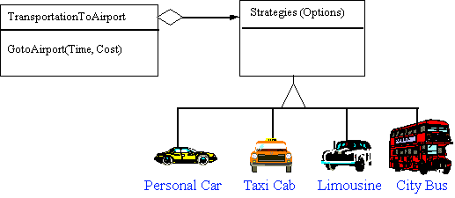
Strategy Pattern - example
A Strategy defines a set of algorithms that can be used interchangeably.
Modes of transportation to an airport is an example of a Strategy.

Slide 55
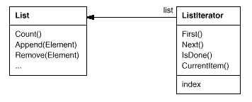
Iterator Pattern – motivation
An aggregate object such as a list should give you a way to access its elements without exposing its internal structure.
The key idea is to take the responsibility for access and traversal out of the list object and put it into an iterator object.

Slide 56
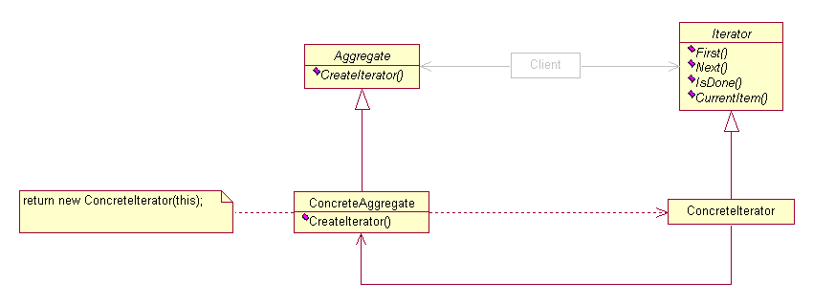
Iterator Pattern
Intent
  Provide a way to access the elements of an aggregate object sequentially without exposing its underlying representation.
Structure

Slide 57
Benefits of Design Patterns
Design patterns enable large-scale reuse of software architectures and also help document systems
Patterns explicitly capture expert knowledge and design tradeoffs and make it more widely available
Patterns help improve developer communication
Pattern names form a common vocabulary

Slide 58
Thank You

