Slide 1
Software Engineering
Software testing

Slide 2
Introduction
Two distinct goals of the software testing
  To demonstrate to the developer and the customer that the software meets requirements
  To discover faults or defects in the software where the behavior of the software is incorrect, undesirable or does not conform to its specification
Edsger Dijkstra:
  “Testing can only show the
  presence of errors, not their absence”

Slide 3
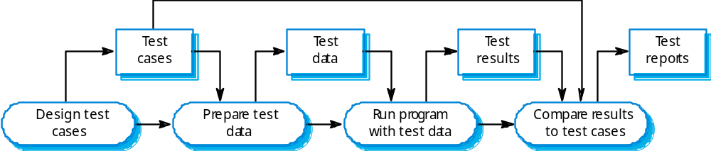
Introduction
A model of the software testing process

Slide 4
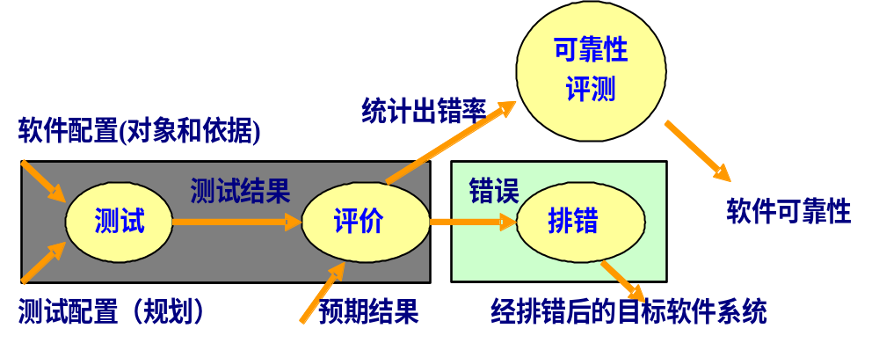
Software Testing Process
  数据处理 → 设计测试用例 → 判断结果

Slide 5
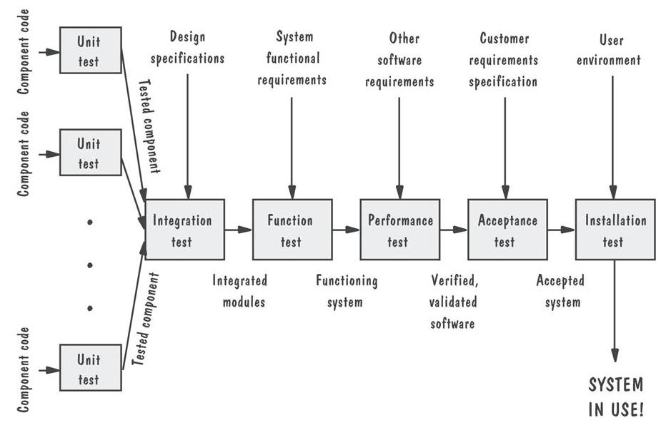
Testing Organization Illustrated

Slide 6

验收测试：如果软件是给一个客户开发的，需要进行一系列验收测试来保证满足客户所有的需求。验收测试主要由用户而不是开发者来进行的。
Alpha测试与Beta测试：如果一个软件是给很多客户使用的，可使用Alpha测试与Beta测试。
Alpha测试：是在一个受控的环境下，由用户在开发者的指导下进行测试，由开发者负责记录错误和使用中出现的问题。
Beta测试：由最终用户在自己的场所进行，开发发者通常不在场，也不能控制应用的环境。由用户记录错误和使用中出现的问题，并定期地交给开发者来解决。

Slide 7

Integration testing
  The process of system integration involves building a system from its components and testing the resultant system for problems that arise from component interactions
  A major problem that arises during integration testing is localizing errors
  To make it easier to locate errors, you should always use an incremental approach to system integration and testing
  A good rule of thumb is to integrate the component that implement the most frequently used functionality first. This means that the components that are most used receive the most testing

Slide 8
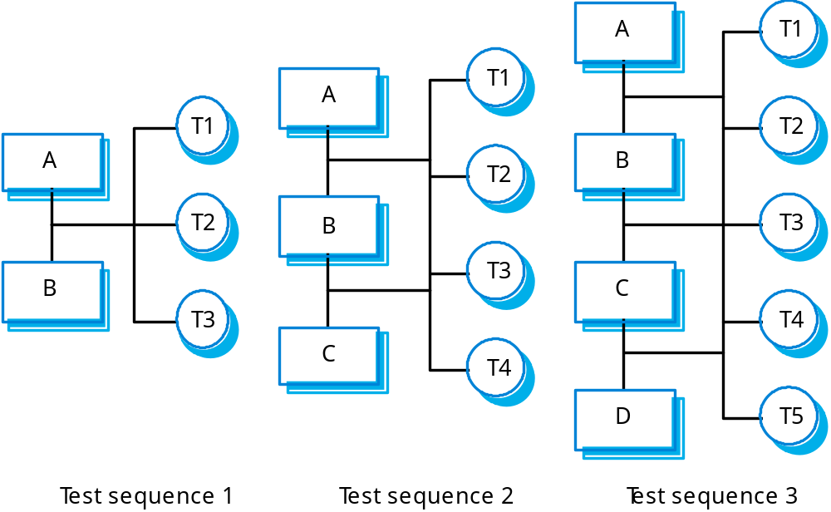
Incremental integration testing

Slide 9

Integration Testing Strategies
Options:
  • the “big bang” approach
  • an incremental construction strategy

Slide 10
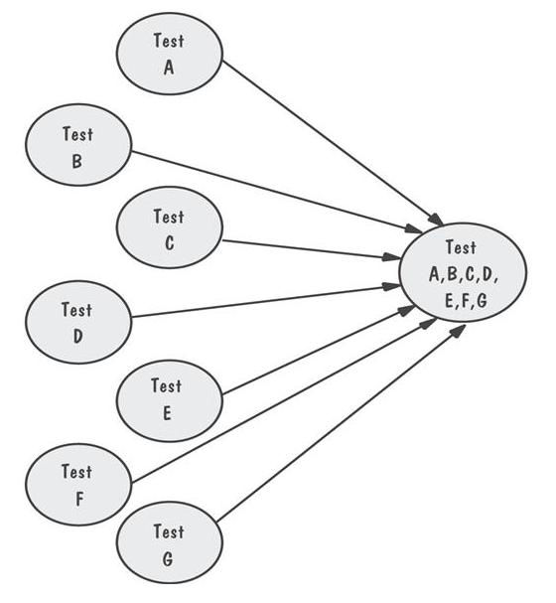
Big-Bang Integration Example
Requires both stubs and drivers to test the independent components

Slide 11
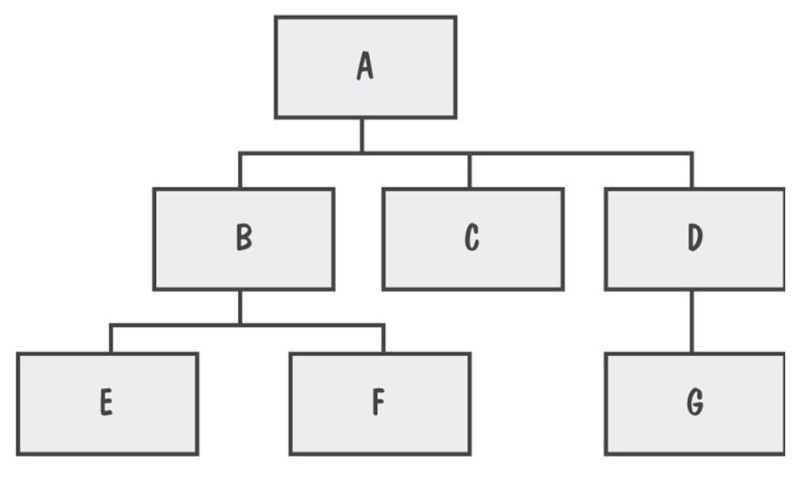
Integration Testing
System viewed as a hierarchy of components

Slide 12
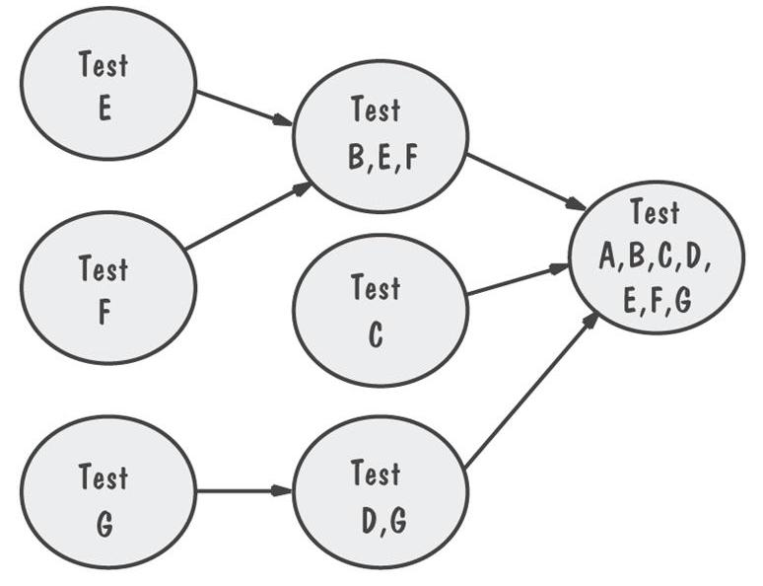
Bottom-Up Integration Example
The sequence of tests and their dependencies

Slide 13
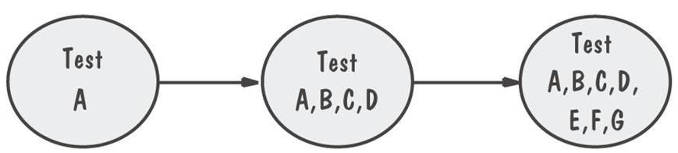
Top-Down Integration Example
Only A is tested by itself

Slide 14
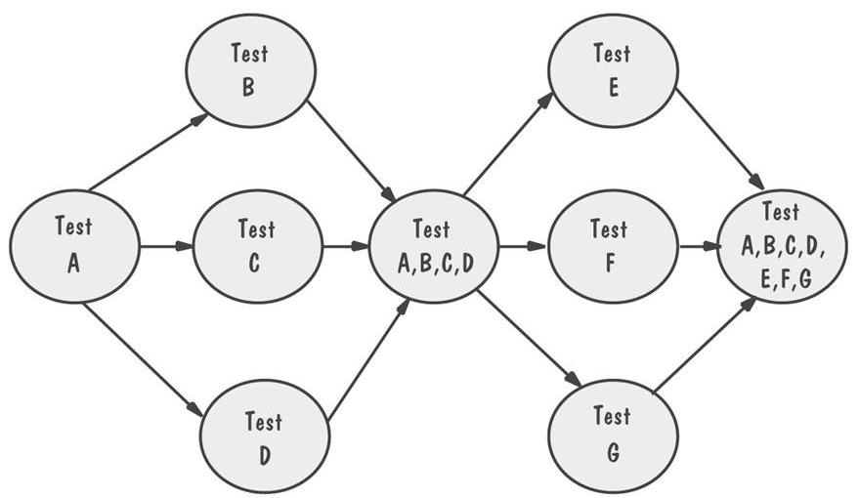
Modified Top-Down Integration Example
Each level’s components individually tested before the merger takes place

Slide 15
集成测试的策略：
自顶向下测试：从顶模块开始，沿被测程序的结构图逐渐向下测试。按照移动路线的差异，又可区分为两种不同的实施策略：
先广度后深度实施步骤。
组装顺序：M₁-M₂-M₃-M₄-M₅-M₆-M₇-M₈
M₁
M₂
M₃
M₄
先深度后广度实施步骤。
组装顺序：M₁-M₂-M₅-M₆-M₈-M₃-M₄-M₇
M₅
M₆
M₇
M₈
多模块程序

Slide 16

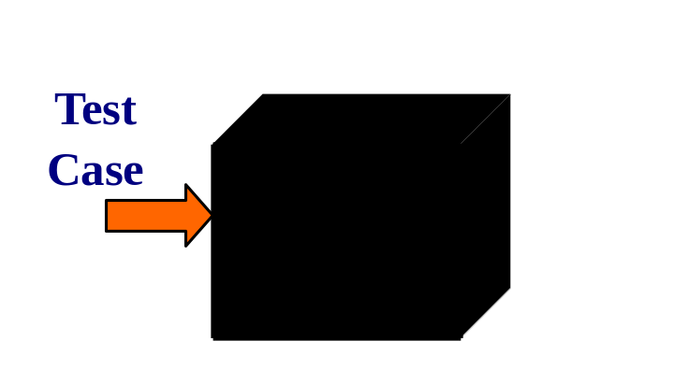
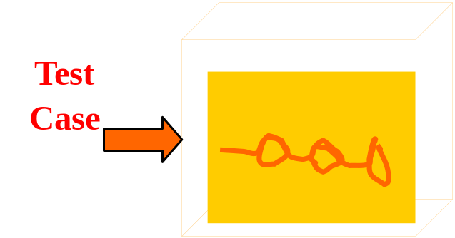
Black-box and White-box testing
Black-box testing
White-box testing

Slide 17
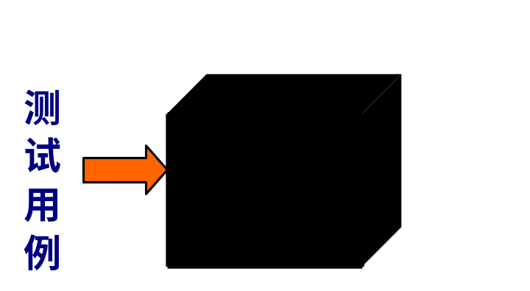
Release testing
Release testing is the process of testing a release of the system that will be distributed to customers
Release testing is usually a black-box testing process where the tests are derived from the system specification
Black-box testing
Another name for this is functional testing

Slide 18
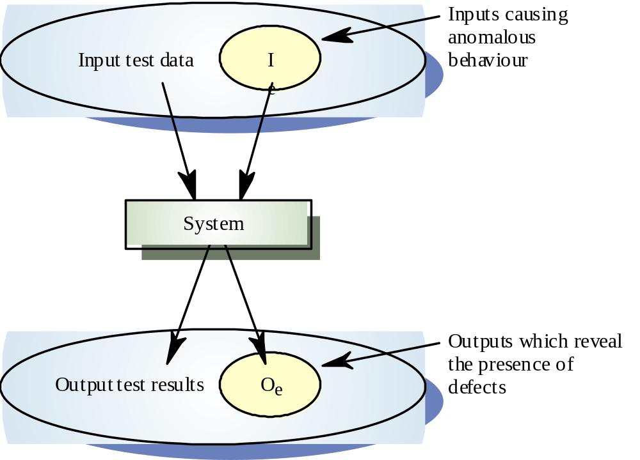
Black box testing

Slide 19

Release testing
Whittaker (2002) guidelines:
  Choose inputs that force the system to generate all error messages
  Design inputs that cause input buffers to overflow
  Repeat the same input or series of inputs numerous times
  Force invalid outputs to be generated
  Force computation results to be too large or too small

Slide 20

Release testing
LIBSYS Example:
  Test the login mechanism using correct and incorrect logins to check that valid users are accepted and invalid users are rejected
  Test the search facility using queries against known sources to check that the search mechanism is actually finding documents
  Test the system presentation facility to check that information about documents is displayed properly
  Test the mechanism to request permission for downloading
  Test the e-mail response indicating that the downloaded document is available

Slide 21

Performance testing
  An effective way to discover defects is to design tests around the limits of the system. In performance testing, this means stressing the system – hence the name stress testing
Two functions of stress testing
  It tests the failure behavior of the system
  It stresses the system and may cause defects to come to light that would not normally be discovered

Slide 22

Component testing
  Component testing (or unit testing) is the process of testing individual component in the system
Different types of component to be tested
  Individual functions or methods within an object
  Object classes that have several attributes and methods
  Composite components made up of several different objects or functions

Slide 23
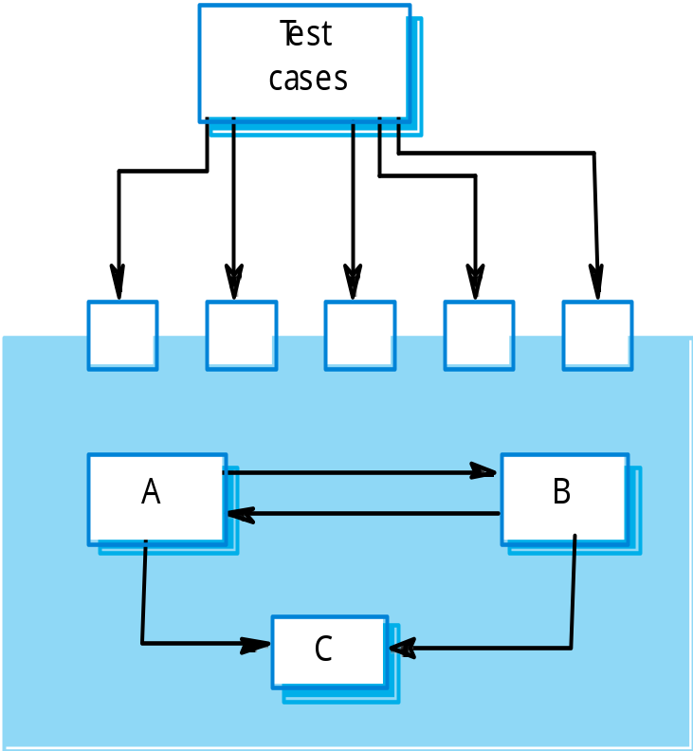
Interface testing
  Many components are made up of several interacting objects
  Testing these composite components then is primarily concerned with testing that the component interface behaves

Slide 24
Interface testing
Some general guidelines for interface testing
  Examine the code to be tested and explicitly list each call to an external component
  Where pointers are passed across an interface, always test the interface with null pointer parameters
  Where a component is called through a procedural interface, design tests that should cause the component to fail
  Use stress testing, as discussed in the previous section, in message-passing systems
  Where several components interact through shared memory, design tests that vary the order in which these components are activated

Slide 25

Test case design
  Design the test cases (inputs and predicted outputs) that test the system
Various approaches to test case design
  Requirements-based testing, where test cases are designed to test the system requirements
  Partition testing, identify input and output partitions and design tests so that the system executes inputs from all partitions and generates outputs in all partitions
  Structural testing, where you use knowledge of the program’s structure to design tests that exercise all parts of the program

Slide 26
Requirements-based testing
  Requirements-based testing is a systematic approach to test case design where you consider each requirement and derive a set of tests for it
LIBSYS requirements
  The user shall be able to search either all of the initial set of databases or select a subset from it
  The system shall provide appropriate viewers for the user to read documents in the document store
  Every order shall be allocated a unique identifier (ORDER_ID) that the user shall be able to copy to the accounts permanent storage area

Slide 27
Requirements-based testing
LIBSYS tests:
  Initiate user searches for items that are known to be present and known not to be present, where the set of database includes one database
  ….., includes two database
  ……, includes more than two databases
  Select one database from the set of databases and initiate user searches for items that are known to be present and known not to be present
  Select more than one database from the set of databases and ……

Slide 28

Partition testing
Input data and output results often fall into different classes where all members of a class are related.
Each of these classes is an equivalence partition or domain where the program behaves in an equivalent way for each class member.
Test cases should be chosen from each partition.

Slide 29
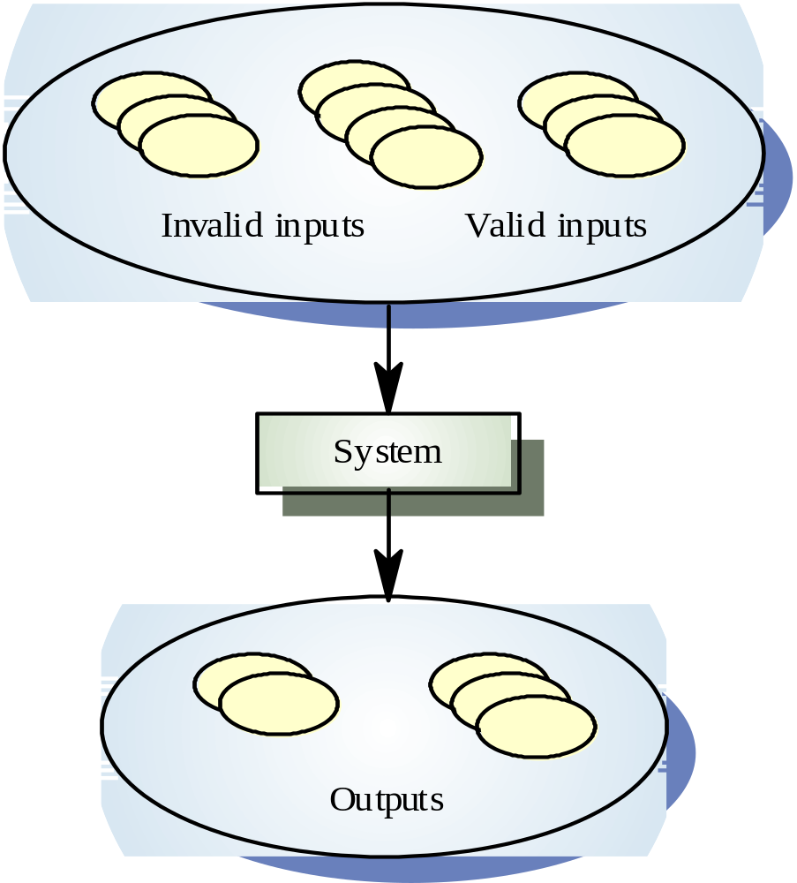
Equivalence partitioning

Slide 30
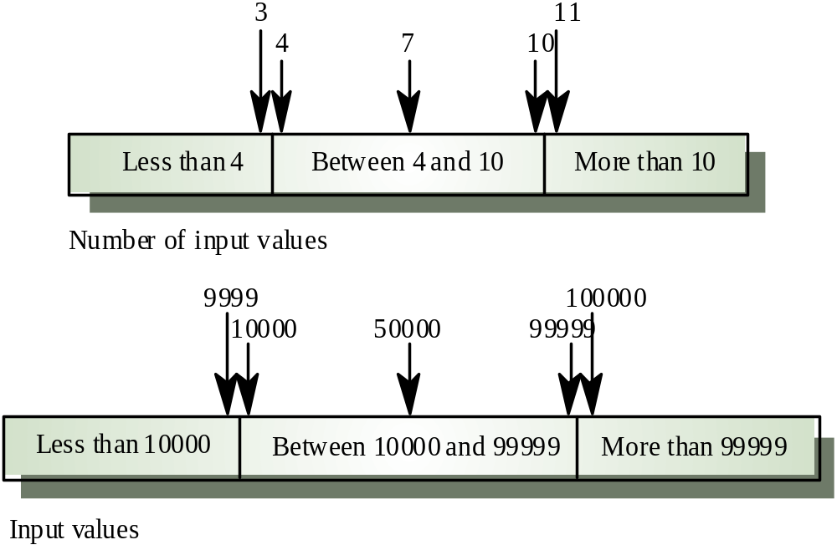
Equivalence partitions

Slide 31
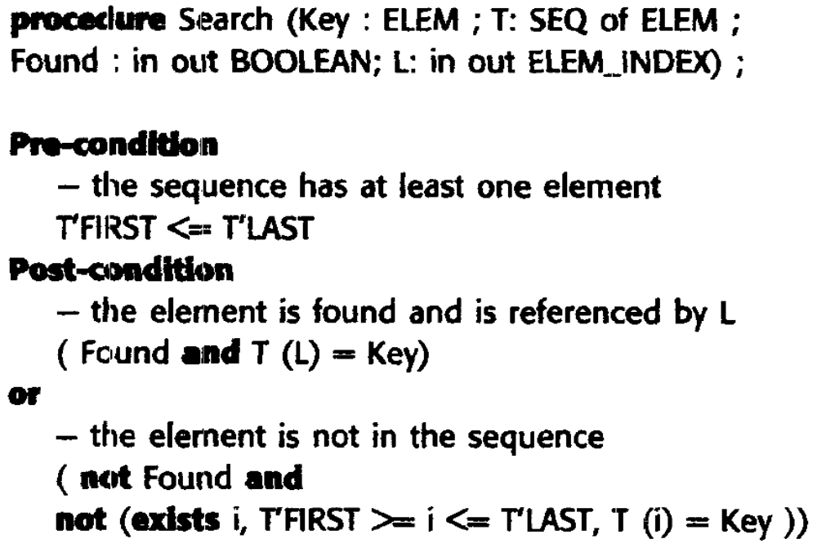
The specification of a search routine

Slide 32
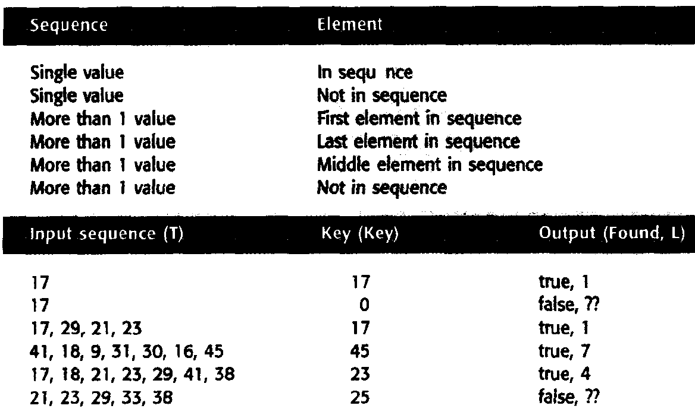
Equivalence partition for search routine

Slide 33
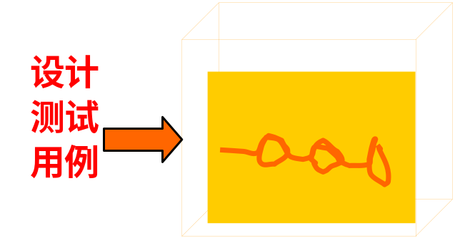
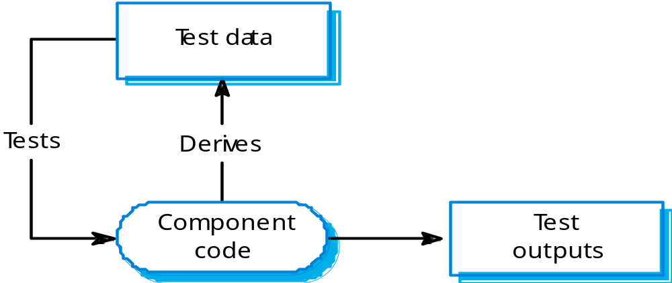
Structural testing
  Structural testing is an approach to test case design where the tests are derived from knowledge of the software’s structure and implementation
  Sometimes called ‘white-box’ testing

Slide 34
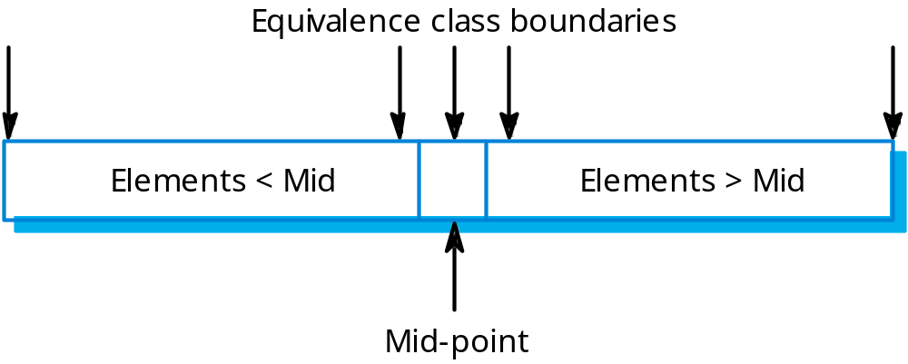
Binary search equiv. partitions

Slide 35
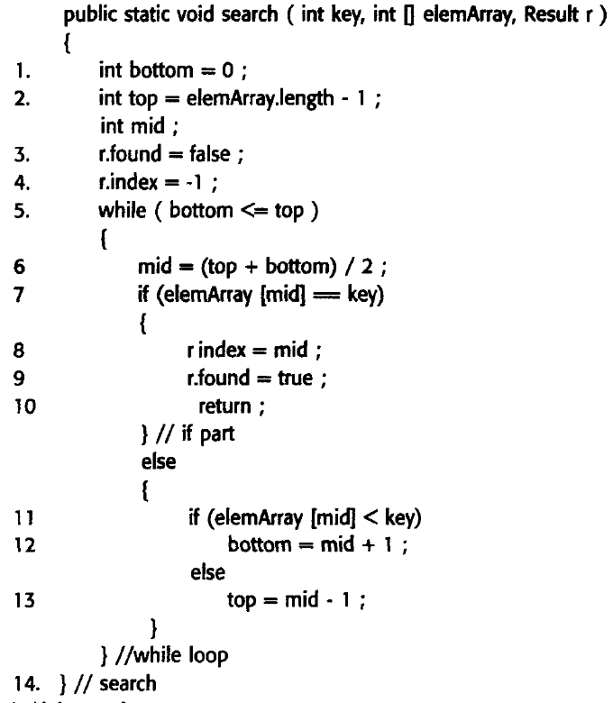

Slide 36
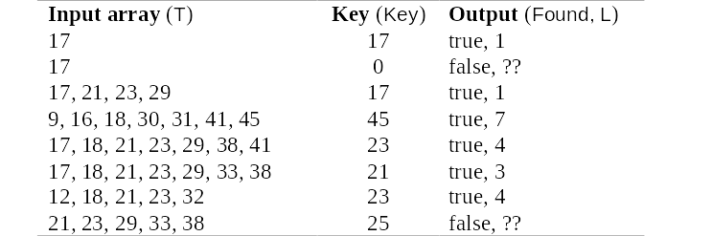
Binary search - test cases

Slide 37
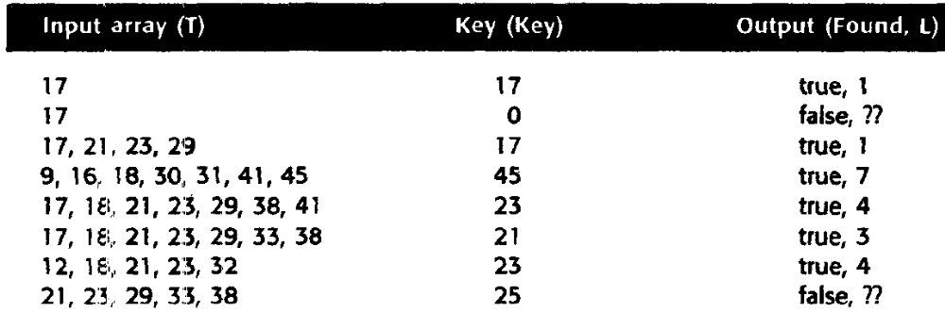
Structural testing
Test classes for search routine

Slide 38
Path testing
  Path testing is a structural testing strategy whose objective is to exercise every independent execution path through a component or program
  The number of paths through a program is usually proportional to its size
  Path testing does not test all possible combinations of all paths through the program
  The starting point for path testing is a program flow graph
  The objective of path testing is to ensure that each independent path through the program is executed at least once

Slide 39
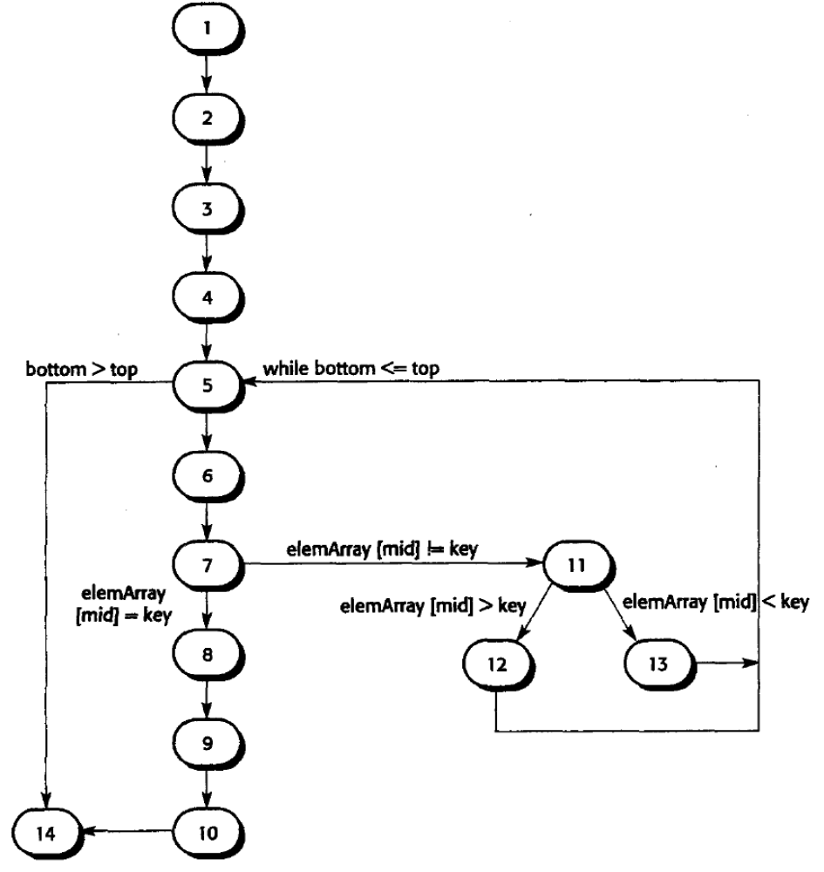
Flow graph for a binary search routine

Slide 40
When to Stop Testing More faulty?
Probability of finding faults during the development
Number of
Missed Bugs
Cost of
Testing
Quantity
Under
Testing
Testing
Equilibrium
Over
Testing
Amount of Testing

Slide 41
错误发现率模型
错误发现率：单位时间内发现的错误数。
错误发现率
极坏的工程
成功的工程
失败的工程
峰值时间
时间
错误发现率曲线
经验表明，失败工程的错误发现率曲线的斜率范围是-0.3～0，成功的工程为-1～-0.3

Slide 42


Fault seeding
Notes:
© SE, Testing, Hans van Vliet
Kinds of variations in program testing: seed faults founded by one group into the program tested by another group.

Slide 43
When to Stop Testing
Stopping Approaches
Coverage criteria
Fault seeding
    detected seeded Faults ₌ detected nonseeded faults
    total seeded faults total nonseeded faults
    N=Sn/s
    S:播种故障数，n找到非播种故障数，其中播种故障s个

Slide 44

When to Stop Testing
Stopping Approaches
两个独立的测试小组测试
  两个小组的有效性 E1=x/n, E2=y/n
  两个小组共同发现了q个故障
  小组1的有效性 E1=x/n=q/y 并且 E2 =y/n=q/x
  因此推导出 n= q/(E1*E2)，用q/y，q/x来模拟有效性
  n = x*y/q

Slide 45
When to Stop Testing
Identifying Fault-Prone Code
Track the number of faults found in each component during the development
Collect measurement (e.g., size, number of decisions) about each component
Classification trees: a statistical technique that sorts through large arrays of measurement information and creates a decision tree to show best predictors
  A tree helps in deciding the which components are likely to have a large number of errors

Slide 46
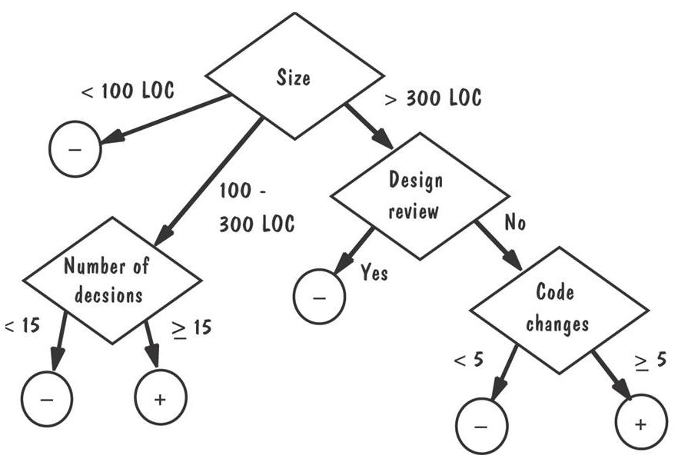
An Example of a Classification Tree

Slide 47
Test automation
  Testing is an expensive and laborious phase of the software process
Some of tools:
  Test manager
  Test data generator
  Oracle
  File comparator
  Report generator
  Dynamic analyzer
  Simulator

Slide 48
Thank You

