Slide 1

Software Engineering
Software processes

Slide 2

The Meaning of Process
A process: a series of steps involving activities, constrains, and resources that produce an intended ouput of some kind
A process involves a set of tools and techniques

Slide 3
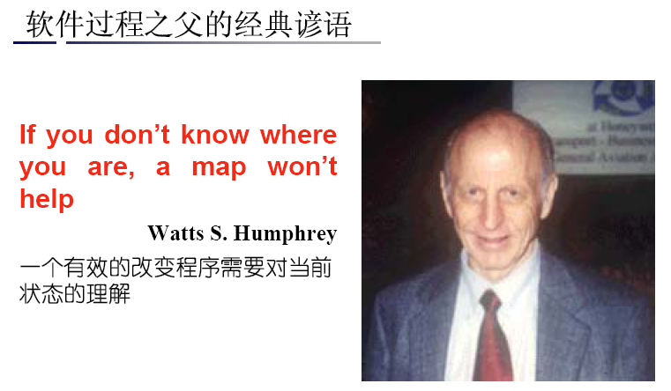
软件过程之父的经典谚语
清醒的头脑比聪明的头脑更重要！

Slide 4

Introduction
Software process
    No idea process, a flexible, agile process is likely to be more effective
    Fundamental activities to all software processes
      Software specification
      Software design and implementation
      Software validation
      Software maintenance

Slide 5
软件工程过程和软件生命期
软件生命期（Life cycle):
一个软件从定义、开发、使用和维护，直到最终被废弃，所经历的生存过程称为软件生存期或叫生命期。
生命期的划分：
制定计划
需求分析和定义
软件设计
程序编写
软件测试
运行/维护
定义阶段
开发阶段
运行维护阶段

Slide 6





钱太少
不干！
任务评价
要求维护
客户要求
变化授权人
任务评价
维护管理员
系统管理员

Slide 7
Software process models
Software process model
  Is an abstract representation of a software process
  Three process models
    The waterfall model
      Processes activities of specification, development, validation and evolution are taken as separate process phases
    Evolutionary development
      Interleave the activities of specification, development and validation
    Component-based software engineering
      Based on the existence of a number of reusable components
      Integrating these components

Slide 8

Software Process Models
Reasons for Modeling a Process
To form a common understanding
To find and evaluate appropriate activities for reaching process goals
To tailor a general process for a particular situation in which it will be used

Slide 9
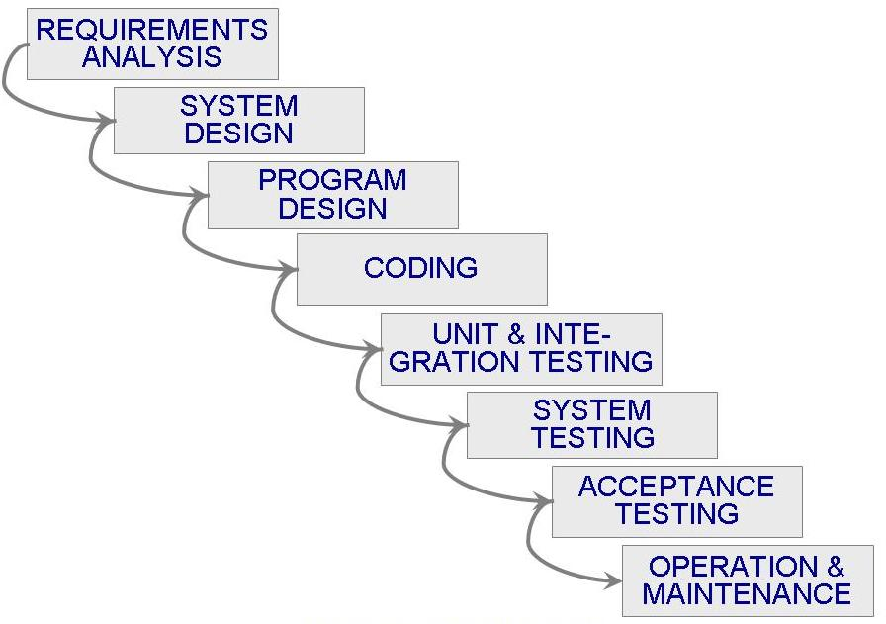
Waterfall Model
1970，W.Royce

Slide 10

瀑布模型
可行性研究
软件定义
需求分析
概要设计
详细设计
软件开发
实 现
集成测试
接收测试
软件使用与维护
使用与维护
退役

Slide 11
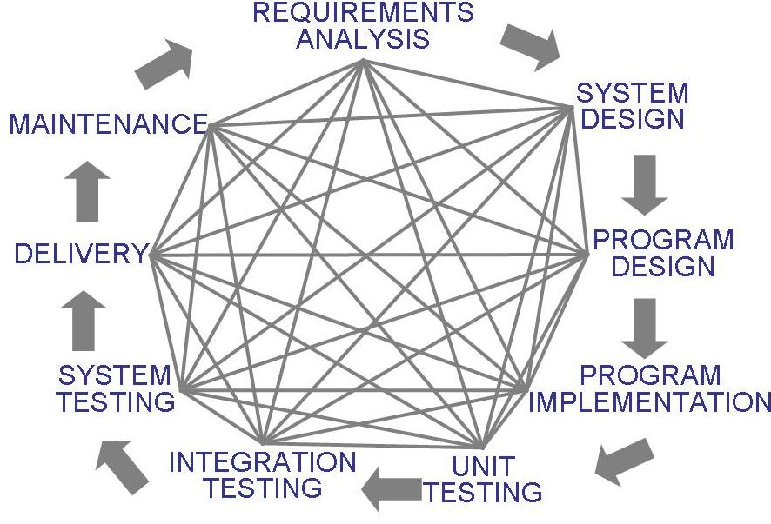
Waterfall Model (continued)
There is no iteration in waterfall model
Most software developments apply a great many iterations

Slide 12
Drawbacks of The Waterfall Model
Provides no guidance how to handle changes to products and activities during development (assumes requirements can be frozen)
Views software development as manufacturing process rather than as creative process
There is no iterative activities that lead to creating a final product
Long wait before a final product

Slide 13
Waterfall Model with Prototype
A prototype is a partially developed product
Prototyping helps
  developers assess alternative design strategies (design prototype)
  users understand what the system will be like (user interface prototype)
Prototyping is useful for verification and validation

Slide 14
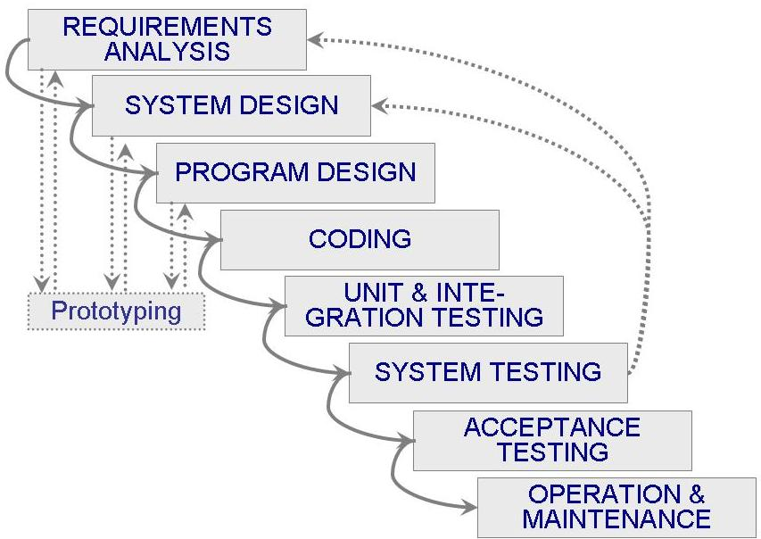
Waterfall model with prototyping

Slide 15
快速原型法
快速计划
交流
快速设计方式建模
部署交付和反馈
构建原型

Slide 16

V Model
A variation of the waterfall model
Uses unit testing to verify procedural design
Uses integration testing to verify architectural (system) design
Uses acceptance testing to validate the requirements
If problems are found during verification and validation, the left side of the V can be re-executed before testing on the right side is re-enacted

Slide 17
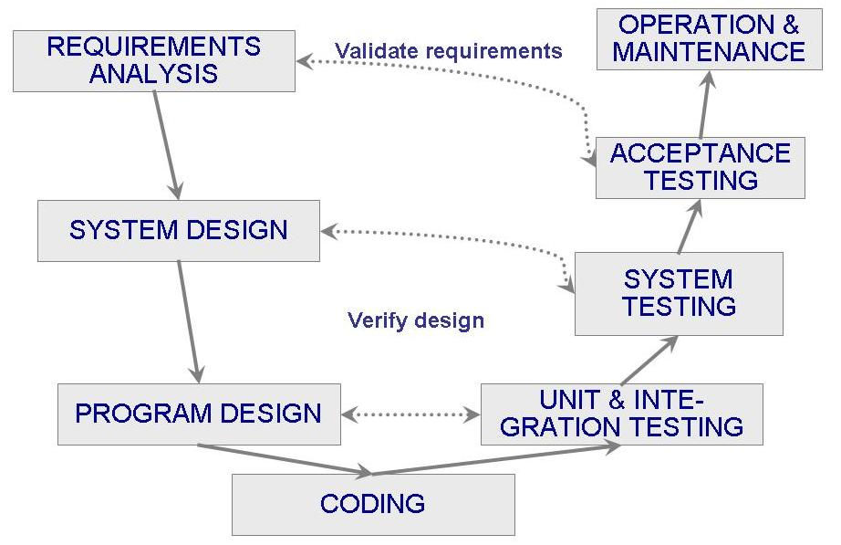
V Model (continued)

Slide 18
Evolutionary development
Evolutionary development
    Developing an initial implementation, exposing this to user comment and refine it through many versions until an adequate system has been developed
  Two fundamental types of prototyping
    Exploratory development
    Throwaway prototyping
  Advantages
    Specification can be developed incrementally
    Is a good approach to develop a small and medium-sized systems

Slide 19
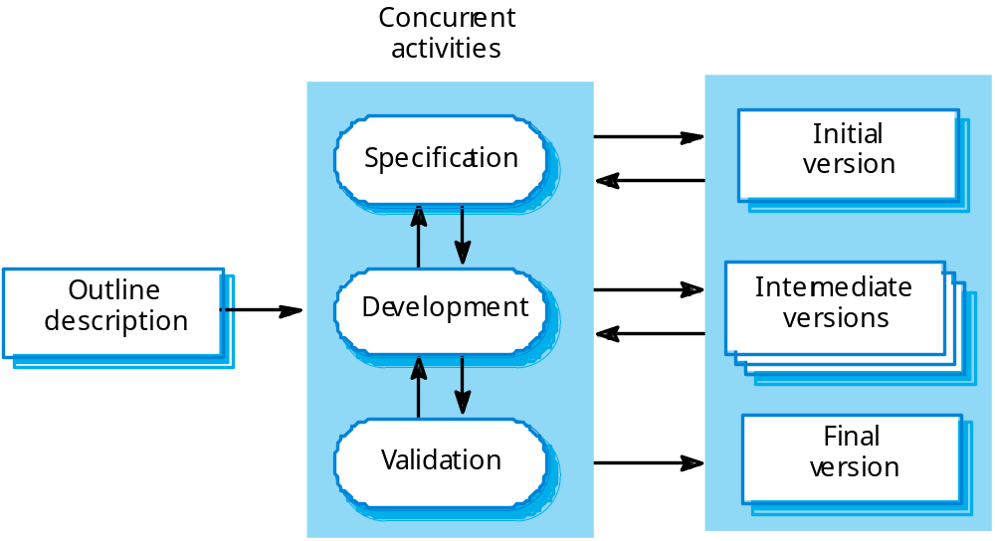
Evolutionary development

Slide 20
Incremental development
1
交流
2
计划
软件功能性和特征
3
建模（分析，设计）
增量n
4
构造（编码，测试）
1
2
5
部署（发布，反馈）
3
4
5
第n次增量发布
增量2
┇
增量1
1
2
3
4
1
5
第2次增量发布
2
3
4
5
第1次增量发布
项目日历时间

Slide 21
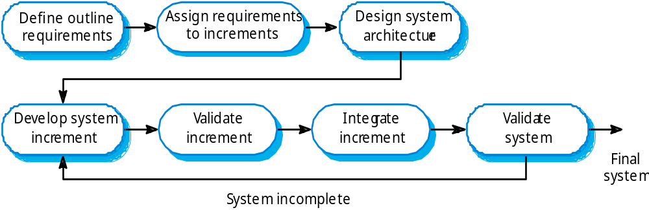
Incremental development

Slide 22

Incremental delivery
Advantages of Incremental delivery
  Customers do not have to wait until the entire system is delivered before they can gain value from it
  Customers can use the early increments as prototype and gain experience that informs their requirements for later system increments
  There is lower risk of overall project failure
  It is inevitable that most important system services receive the most testing

Slide 23
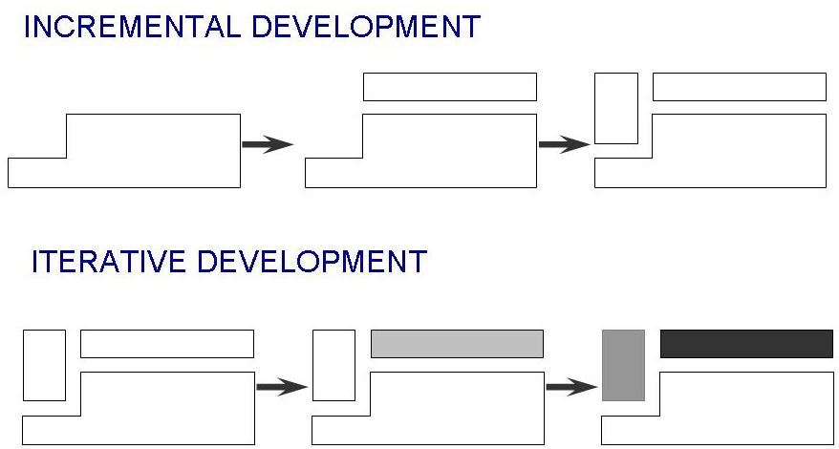
Incremental development: starts with small functional subsystem and adds functionality with each new release
Iterative development : starts with full system, then changes functionality of each subsystem with each new release

Slide 24
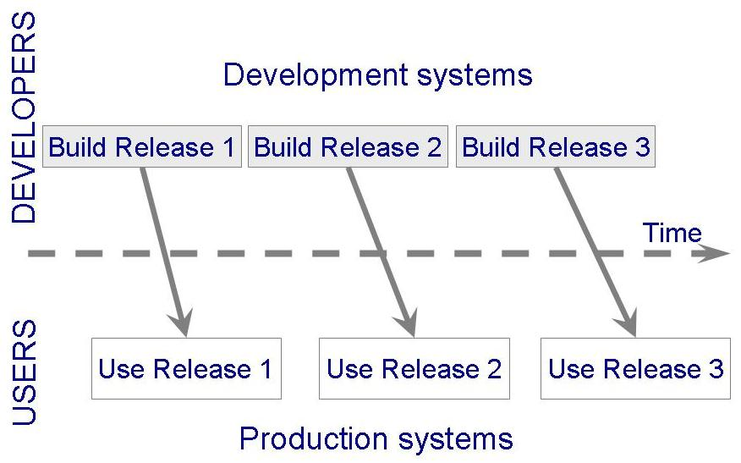
Phased Development: Increments and Iterations

Slide 25

Spiral development
Spiral model （B.Boehm，1988）
  The process is represented as a spiral
  Each loop in the spiral represents a phase of the software process
  Each loop in the spiral is split into four sectors
    Objective setting
    Risk assessment
    Development and validation
    Planning

Slide 26
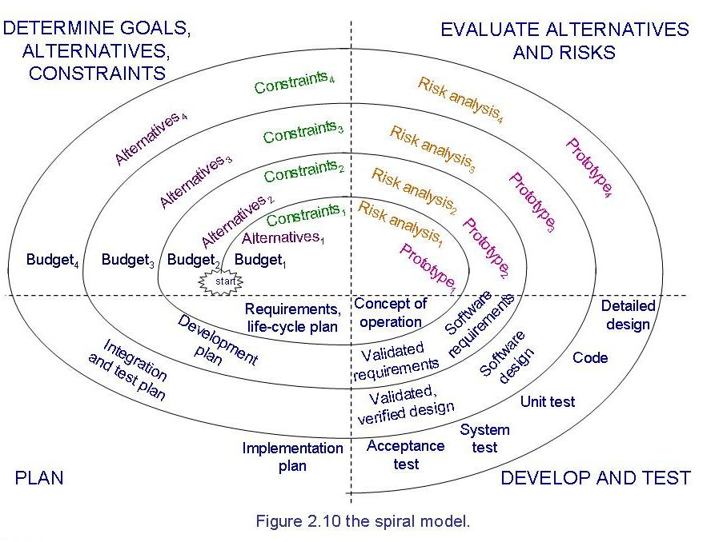

Slide 27
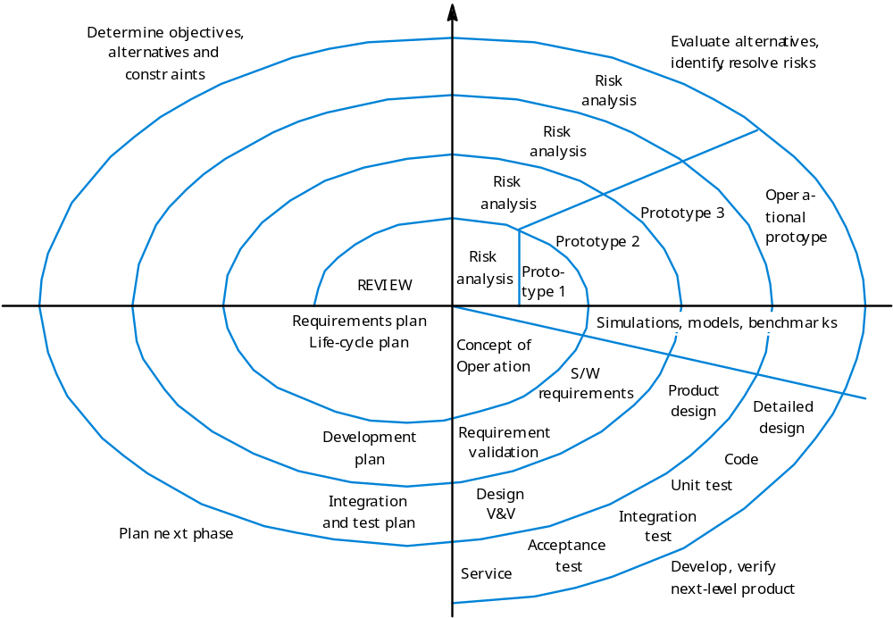

Slide 28
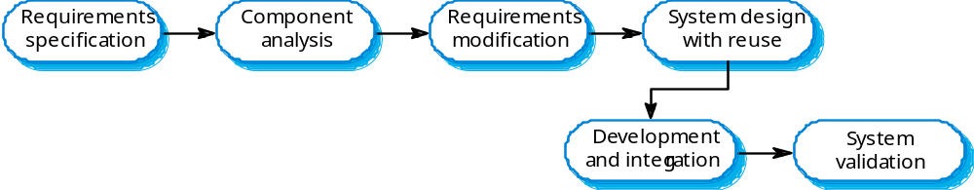
Component-based software engineering
Component-based software engineering(CBSE)
  Software reuse

Slide 29
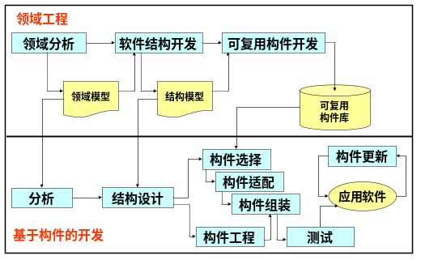

Slide 30

Other Process Models
Other Process Models
  Operational Specificiation Model
  Transformational Model
Relies on Formal Method (形式化方法)

Slide 31
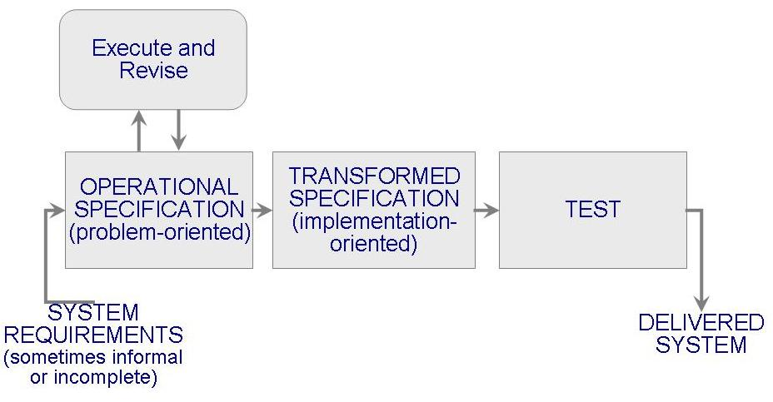
Operational Specificiation Model
Requirements are executed (examined) and their implication evaluated early in the development process

Slide 32

Transformational Model
Fewer major development steps
Applies a series of transformations to change a specification into a deliverable system
Relies on formalism
Requires formal specification (to allow transformations)

Slide 33
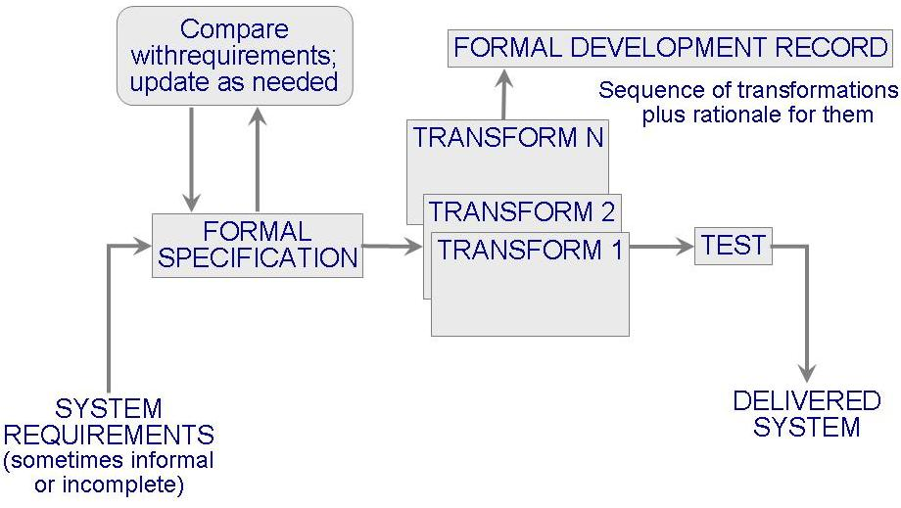
Transformational Model (continued)

Slide 34
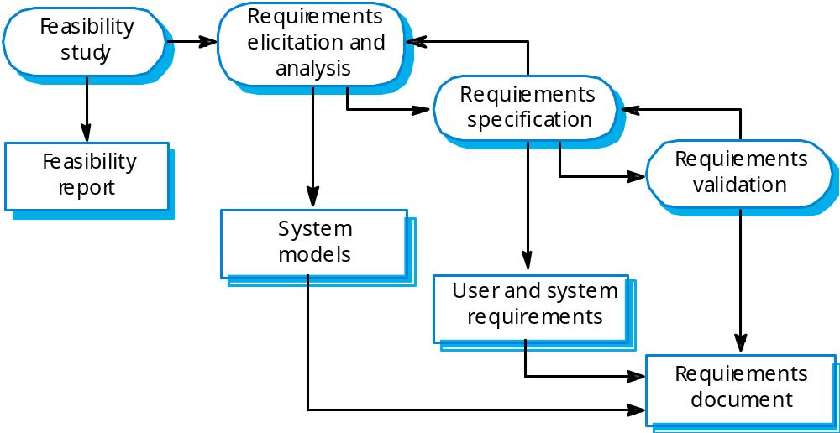
Process activities
Software specification

Slide 35

Software design and implementation
  A software design is a description of the structure of the software to be implemented, the data which is part of the system, the interfaces between system components and, sometimes, the algorithms used
  Design process

Slide 36
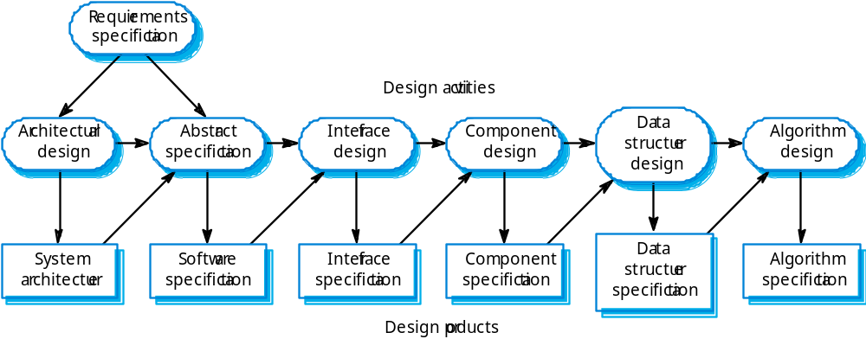
The software design process

Slide 37

Software implementation
Software development
  Follows naturally from the system design processed
  CASE tools may be used to generate a skeleton program from a design, includes code to define and implement interface
  Programming is a personal activity and there is no general process to follow

Slide 38
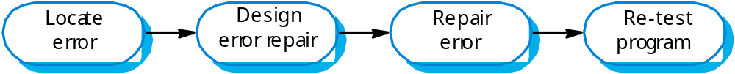

The debugging process

Slide 39
Software validation
Verification and validation (V & V) is intended to show that a system conforms to its specification and meets the requirements of the system customer.
Involves checking and review processes and system testing.
System testing involves executing the system with test cases that are derived from the specification of the real data to be processed by the system.

Slide 40
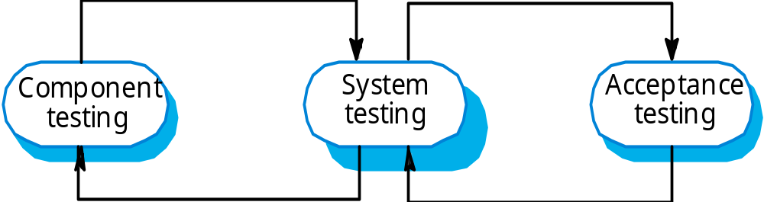
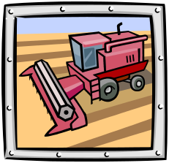
The testing process

Slide 41
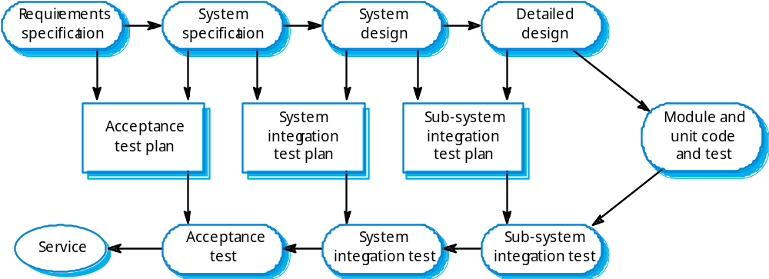
Software validation
System testing

Slide 42
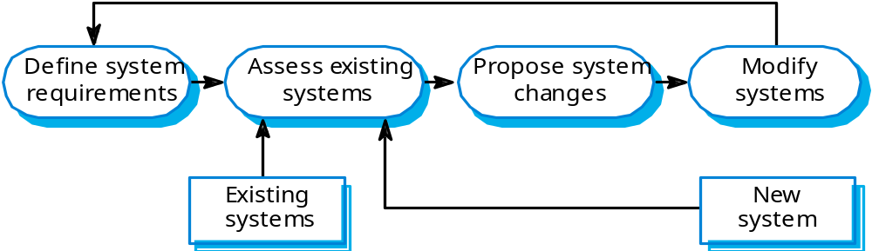
System evolution
Software evolution
  Software evolution (software maintenance) may cost much more than software development

Slide 43
Computer-Aided software engineering
Computer-Aided Software Engineering (CASE)
  Include design editors, data dictionaries, compilers, debuggers, system building tools and so on
  Examples of activities can be automated using CASE:
    The development of graphical system models
    Understanding a design using a data dictionary
    The generation of user interfaces from a graphical interface description created by the user
    Program debugging through the provision of information about an executing program
    Automated translation of program from an old version of a programming language to a more recent version

Slide 44
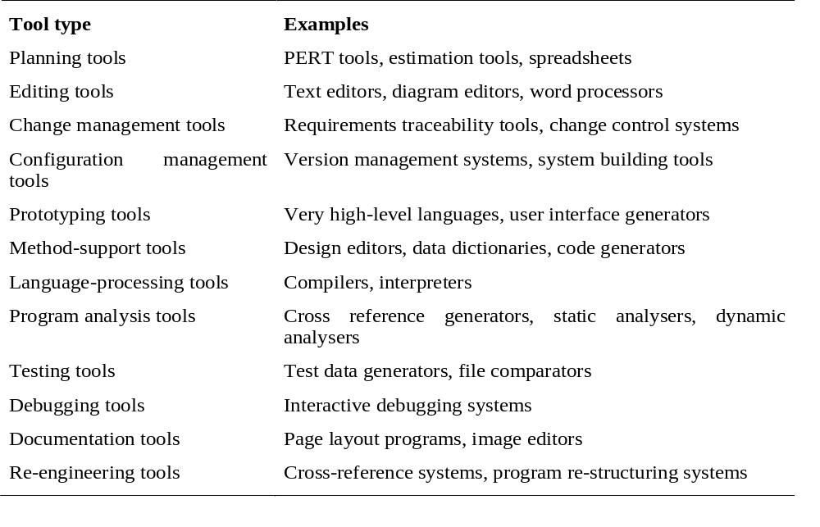
Functional tool classification

Slide 45
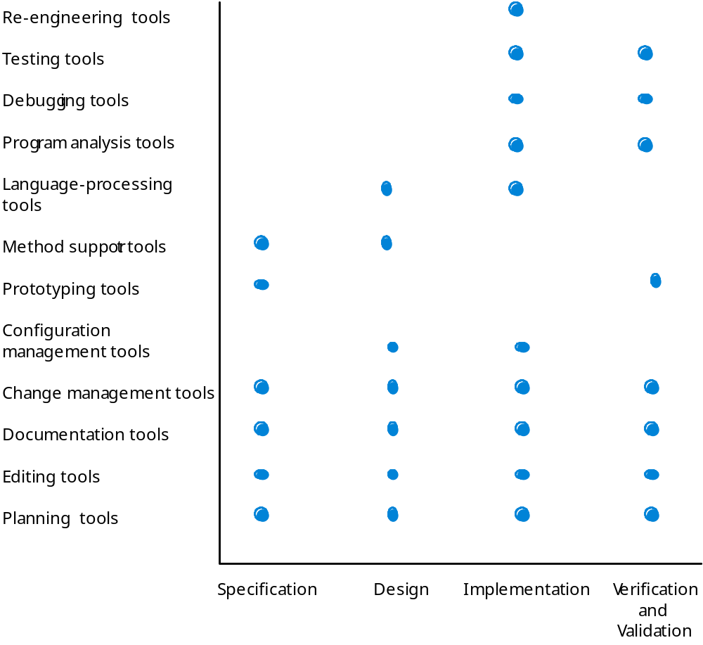

Slide 46
CASE integration
Tools
  Support individual process tasks such as design consistency checking, text editing, etc.
Workbenches
  Support a process phase such as specification or design, Normally include a number of integrated tools.
Environments
  Support all or a substantial part of an entire software process. Normally include several integrated workbenches.

Slide 47
