Slide 1
Process Models
Software Design (UML)

Slide 2
Process models
Process models show the overall process and the processes that are supported by the system-------(workflow model).
Data flow models may be used to show the processes and the flow of information from one process to another--------(dataflow model).

Slide 3
The Waterfall Process Model
Workflow model
Requirements
analysis and
definition
System and
SW design
Implementation
(Coding)
Testing and
Maintenance
Software Design (UML)

Slide 4
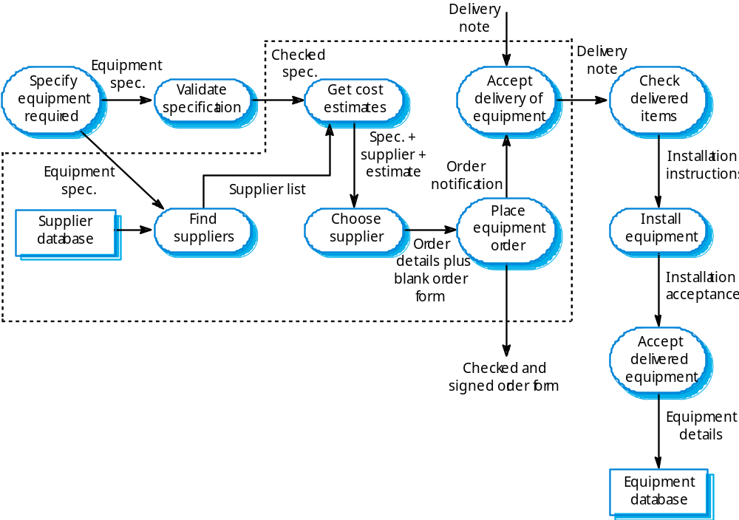
Equipment procurement process

Slide 5
Data flow diagrams
DFDs model the system from a functional perspective.
Tracking and documenting how the data associated with a process is helpful to develop an overall understanding of the system.
Data flow diagrams may also be used in showing the data exchange between a system and other systems in its environment.

Slide 6
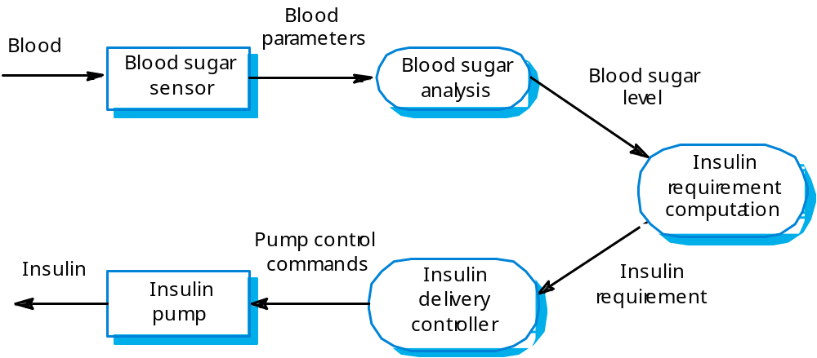
Insulin pump DFD

Slide 7
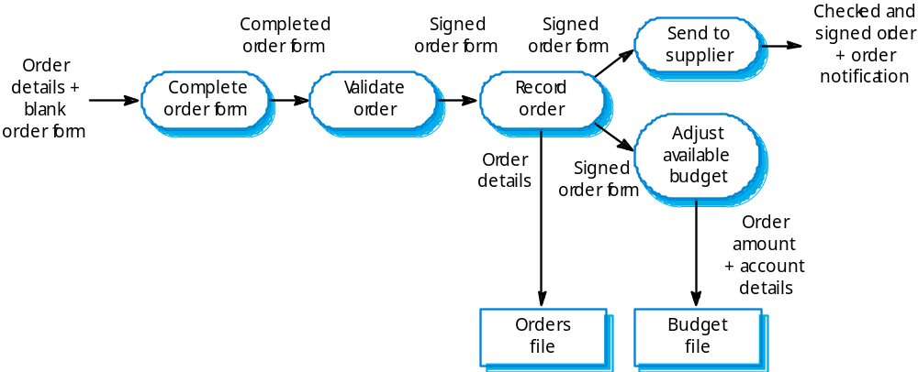
Order processing DFD

Slide 8
Software Design
Modeling using the Unified Modeling Language
(UML)
Software Design (UML)

Slide 9
UML Diagrams
  Dynamic modeling
Use Case Diagrams
    Use Case diagrams & descriptions
State Diagrams
    State diagrams ---- State Machine
Interaction Diagrams
    Sequence & collaboration diagrams
  Static modeling
Implementation Diagrams
    Package, Component & Deployment diagrams
Static Structure Diagrams
    Class & object diagrams

Slide 10
Use Case
“A use case specifies the behavior of a system or a part of a system, and is a description of a set of sequences of actions, including variants, that a system performs to yield an observable result of value to an actor.”
- The UML User Guide, [Booch,99]
“An actor is an idealization of an external person, process, or thing interacting with a system, subsystem, or class. An actor characterizes the interactions that outside users may have with the system.”
- The UML Reference Manual, [Rumbaugh,99]
Software Design (UML)

Slide 11
Use Cases (Cont’d)
Used to describe the main processes in a system and the interactions between the processes (use cases) and external systems or individuals called actors.
Once the overview is developed it can be expanded to include subprocesses.
The use case description is a generic scenario that is a series of sentences describing each step in the interaction between an actor and a use case.
System
Use Case
Use Case
Actor (People)
Actor (Systems)
Use Case

Slide 12
Use Case (Cont’d)
Register for Courses
A use case is rendered as an ellipse in a use case diagram. A use case is always labeled with its name.
Software Design (UML)

Slide 13
Use Case (Cont’d)
An actor is rendered as a stick figure in a use case diagram. Each actor participates in one or more use cases.
Student
Software Design (UML)

Slide 14
Use Case (Cont’d)
Actors can participate in a generalization relation with other actors.
Student
Person
Software Design (UML)

Slide 15
Use Case (Cont’d)
Actors may be connected to use cases
only by associations.
Register for Courses
Student
Software Design (UML)

Slide 16
Use Case (Cont’d)
Here we have a Student interacting with the Registrar and the
Billing System via a “Register for Courses” use case.
Billing System
Student
Register for Courses
Registrar
Software Design (UML)

Slide 17
State Machine
“The state machine view describes the dynamic behavior of objects over time by modeling the lifecycles of objects of each class. Each object is treated as an isolated entity that communicates with the rest of the world by detecting events and responding to them. Events represent the kinds of changes that objects can detect... Anything that can affect an object can be characterized as an event.”
- The UML Reference Manual, [Rumbaugh,99]
Software Design (UML)

Slide 18
State Machine
An object must be in some specific state at any given time during its lifecycle. An object transitions from one state to another as the result of some event that affects it. You may create a state diagram for any class, collaboration, operation, or use case in a UML model .
There can be only one start state in a state diagram, but there may be many intermediate and final states.
Software Design (UML)

Slide 19
State Diagrams
State is a set of values that describe an object at a certain instant.
State diagrams provide an exact view of what happens in one object when it receives successive messages.
Not every class needs to have its state diagram - only when they are very dynamic it is helpful for the understanding of all the possible states of an object and when a message would trigger each transition from one state to another.

Slide 20
State Machine
start state
final state
simple state
concurrent composite state
sequential composite state
Software Design (UML)

Slide 21
State Machine
download course offerings
downloading
unscheduled
make a course selection
selecting
make a different selection
verify selection
verifying
select another course
check schedule
sign schedule
checking schedule
scheduled
Software Design (UML)

Slide 22
State Diagram Example
enter PWD
CheckPWD
do: compare PWD
OK
Instantiate
:OwnerInfo
PWD unacceptable
(repeat 2 times)
PWD unacceptable
(3rd. wrong entry)
UnacceptablePWD
do: ask to repeat

Slide 23
Sequence Diagram
A sequence diagram is an interaction diagram that emphasizes the time ordering of messages. It shows a set of objects and the messages sent and received by those objects.
Graphically, a sequence diagram is a table that shows objects arranged along the X axis and messages, ordered in increasing time, along the Y axis.
- The UML User Guide, [Booch,99]
Software Design (UML)

Slide 24
Sequence Diagram
Graphical way to illustrate a scenario
They show the sequence in which objects pass messages to each other
Message : request to an object to perform a method (invoke a method)
They show when objects are created and destroyed

Slide 25
Sequence Diagram
an Order Line
An object in a sequence diagram is rendered
as a box with a dashed line descending from it.
The line is called the object lifeline, and it
represents the existence of an object over a
period of time.
Software Design (UML)

Slide 26
Sequence Diagram
an Order Line
a Stock Item
Messages are rendered as horizontal
arrows being passed from object to
object as time advances down the
object lifelines. Conditions ( such as
[check = “true”] ) indicate when a
message gets passed.
check()
[check = “true”]
remove()
Software Design (UML)

Slide 27
Sequence Diagram
an Order Line
a Stock Item
check()
[check = “true”]
remove()
This arrow indicates a return from a previous message, not a new message.
Software Design (UML)

Slide 28
Sequence Diagram
an Order
a Order Line
* prepare()
An iteration marker, such as * (as shown), or *[i = 1..n] , indicates that a message will be repeated as indicated.
Iteration
marker
Software Design (UML)

Slide 29
an Order Entry
window
an Order
an Order Line
a Stock Item
[Fowler,97]
prepare()
Condition
* prepare()
Object
check()
Message
[check = “true”]
remove()
needsToReorder()
Iteration
Return
Self-Delegation
[needsToReorder = “true”]
new
A Reorder
Item
[check = “true”]
new
A Delivery
Item
Creation
Software Design (UML)

Slide 30
Sequence diagram notation
(This is not an object)
object:
:Class
Class
object:
Event name
Event (number)
3 min.
Notes on what´s happening
Event
{constraints}
Event
Event
Event
Outside the system
Outside the system

Slide 31
Collaboration Diagram
A collaboration diagram emphasizes the relationship of the objects that participate in an interaction. Unlike a sequence diagram, you don’t have to show the lifeline of an object explicitly in a collaboration diagram. The sequence of events are indicated by sequence numbers preceding messages.
Object identifiers are of the form objectName : className, and either the objectName or the className can be omitted, and the placement of the colon indicates either an objectName: , or a :className.
Software Design (UML)

Slide 32
Collaboration Diagrams
Provides a second way of showing the sequence in which events occur
Objects are shown in rectangles connected by lines that indicate llinks between them.
Numbers indicate the order in which the operation is executed.
The numbers are written together with the message name and an arrow that indicates direction of flow.

Slide 33
Collaboration Diagram
: Order Entry Window
Object
Sequence Number
1: prepare()
Message
: Order
Self-Delegation
5: needToReorder()
2*: prepare()
3: check()
4: [check == true] remove()
: Order Line
: Stock Item
7: [check == true] new
6: new
:Delivery Item
:Reorder Item
[Fowler,97]
Software Design (UML)

Slide 34
Collaboration Diagram
1: Message name
: Class name
: Class name
2: Message name
(parameter list)
object name: Class name
attribute
attribute = value

Slide 35
Collaboration Diagram
Sequence Diagram
Both a collaboration diagram and a sequence diagram derive from the same information in the UML’s metamodel, so you can take a diagram in one form and convert it into the other. They are semantically equivalent.
Software Design (UML)

Slide 36
Activity Diagram
An activity diagram is essentially a flowchart, showing the flow of control from activity to activity.
Use activity diagrams to specify, construct, and document the dynamics of a society of objects, or to model the flow of control of an operation. Whereas interaction diagrams emphasize the flow of control from object to object, activity diagrams emphasize the flow of control from activity to activity. An activity is an ongoing non-atomic execution within a state machine.
- The UML User Guide, [Booch,99]
Software Design (UML)

Slide 37
Receive
[Fowler,97]
Order
Multiple Trigger
*
for each line
item on order
Cancel
Authorize
Check
Order
Payment
Line
[failed]
Item
[succeeded]
[in stock]
Assign to
Order
Synchronization Condition
[need to
reorder]
Reorder
[stock assigned to
Item
all line items and
payment authorized]
Dispatch
Order
Software Design (UML)

Slide 38
Software Design
Static Modeling using the
Unified Modeling Language (UML)
Material based on
[Booch99, Rambaugh99, Jacobson99, Fowler97, Brown99]
Software Design (UML)

Slide 39
Classes
A class is a description of a set of
objects that share the same attributes,
operations, relationships, and semantics.
Graphically, a class is rendered as a
rectangle, usually including its name,
attributes, and operations in separate,
designated compartments.
ClassName
attributes
operations
Software Design (UML)

Slide 40
Class Names
ClassName
The name of the class is the only required tag in the graphical representation of a class. It always appears in the top-most compartment.
attributes
operations
Software Design (UML)

Slide 41
Class Attributes
Person
name : String
address : Address
birthdate : Date
ssn : Id
An attribute is a named property of a
class that describes the object being modeled.
In the class diagram, attributes appear in
the second compartment just below the
name-compartment.
Software Design (UML)

Slide 42
Class Attributes (Cont’d)
Attributes are usually listed in the form:
attributeName : Type
A derived attribute is one that can be
computed from other attributes, but
doesn’t actually exist. For example,
a Person’s age can be computed from
his birth date. A derived attribute is
designated by a preceding ‘/’ as in:
/ age : Date
Person
name : String
address : Address
birthdate : Date
/ age : Date
ssn : Id
Software Design (UML)

Slide 43
Class Attributes (Cont’d)
Person
+ name : String
# address : Address
# birthdate : Date
/ age : Date
- ssn : Id
Attributes can be:
+ public
# protected
- private
/ derived
Software Design (UML)

Slide 44
Class Operations
Person
name : String
address : Address
birthdate : Date
ssn : Id
eat
sleep
work
play
Operations describe the class behavior
and appear in the third compartment.
Software Design (UML)

Slide 45
Class Operations (Cont’d)
PhoneBook
newEntry (n : Name, a : Address, p : PhoneNumber, d : Description)
getPhone ( n : Name, a : Address) : PhoneNumber
You can specify an operation by stating its signature: listing the name, type, and default value of all parameters, and, in the case of functions, a return type.
Software Design (UML)

Slide 46
Depicting Classes
When drawing a class, you needn’t show attributes and operation in every diagram.
Person
Person
Person
name : String
birthdate : Date
ssn : Id
Person
name
address
birthdate
eat()
sleep()
work()
play()
Person
eat
play
Software Design (UML)

Slide 47
Class Responsibilities
A class may also include its responsibilities in a class diagram.
A responsibility is a contract or obligation of a class to perform a particular service.
SmokeAlarm
Responsibilities
-- sound alert and notify guard station
when smoke is detected.
-- indicate battery state
Software Design (UML)

Slide 48
Relationships
In UML, object interconnections (logical or physical), are
modeled as relationships.
There are three kinds of relationships in UML:
  dependencies
  generalizations
  associations
Software Design (UML)

Slide 49
Dependency Relationships
A dependency indicates a semantic relationship between two or
more elements. The dependency from CourseSchedule to Course exists because Course is used in both the add and remove operations of CourseSchedule.
CourseSchedule
Course
add(c : Course)
remove(c : Course)
Software Design (UML)

Slide 50
Generalization Relationships
Person
A generalization connects a subclass
to its superclass. It denotes an
inheritance of attributes and behavior
from the superclass to the subclass and
indicates a specialization in the subclass
of the more general superclass.
Student
Software Design (UML)

Slide 51
Generalization Relationships (Cont’d)
UML permits a class to inherit from multiple superclasses, although some programming languages (e.g., Java) do not permit multiple inheritance.
Student
Employee
TeachingAssistant
Software Design (UML)

Slide 52
Association Relationships
If two classes in a model need to communicate with each other, there must be link between them.
An association denotes that link.
Student
Instructor
Software Design (UML)

Slide 53
Association Relationships (Cont’d)
We can indicate the multiplicity of an association by adding multiplicity adornments to the line denoting the association.
The example indicates that a Student has one or more Instructors:
Student
Instructor
1..*
Software Design (UML)

Slide 54
Association Relationships (Cont’d)
The example indicates that every Instructor has one or more Students:
Student
Instructor
1..*
Software Design (UML)

Slide 55
Association Relationships (Cont’d)
We can also indicate the behavior of an object in an association (i.e., the role of an object) using rolenames.
teaches
learns from
Student
Instructor
1..*
1..*
Software Design (UML)

Slide 56
Association Relationships (Cont’d)
We can also name the association.
membership
Student
Team
1..*
1..*
Software Design (UML)

Slide 57
Association Relationships (Cont’d)
We can specify dual associations.
member of
Student
Team
1..*
1..*
1
president of
1..*
Software Design (UML)

Slide 58
Association Relationships (Cont’d)
We can constrain the association relationship by defining the navigability of the association. Here, a Router object requests services from a DNS object by sending messages to (invoking the operations of) the server. The direction of the association indicates that the server has no knowledge of the Router.
Router
DomainNameServer
Software Design (UML)

Slide 59
Association Relationships (Cont’d)
Associations can also be objects themselves, called link classes or an association classes.
Registration
modelNumber
serialNumber
warrentyCode
Product
Warranty
Software Design (UML)

Slide 60
Association Relationships (Cont’d)
A class can have a self association.
next
LinkedListNode
previous
Software Design (UML)

Slide 61
Association Relationships (Cont’d)
We can model objects that contain other objects by way of special associations called aggregations and compositions.
An aggregation specifies a whole-part relationship between an aggregate (a whole) and a constituent part, where the part can exist independently from the aggregate. Aggregations are denoted by a hollow-diamond adornment on the association.
Car
Engine
Transmission
Software Design (UML)

Slide 62
Association Relationships (Cont’d)
A composition indicates a strong ownership and coincident lifetime of parts by the whole (i.e., they live and die as a whole). Compositions are denoted by a filled-diamond adornment on the association.
Window
Scrollbar
1
1
Titlebar
1
1
Menu
1
1 .. *
Software Design (UML)

Slide 63
Interfaces
An interface is a named set of operations that specifies the behavior of objects without showing their inner structure. It can be rendered in the model by a one- or two-compartment rectangle, with the stereotype <<interface>> above the interface name.
<<interface>>
ControlPanel
Software Design (UML)

Slide 64
Interface Services
<<interface>>
ControlPanel
Interfaces do not get instantiated. They have no attributes or state. Rather, they specify the services offered by a related class.
getChoices : Choice[]
makeChoice (c : Choice)
getSelection : Selection
Software Design (UML)

Slide 65
Interface Realization Relationship
<<interface>>
ControlPanel
A realization relationship connects a class with an interface that supplies its behavioral specification. It is rendered by a dashed line with a hollow triangle towards the specifier.
specifier
implementation
VendingMachine
Software Design (UML)

Slide 66
Enumeration
<<enumeration>>
Boolean
An enumeration is a user-defined data type that consists of a name and an ordered list of enumeration literals.
false
true
Software Design (UML)

Slide 67
Exceptions
<<exception>>
Exception
Exceptions can be modeled just like any other class.
Notice the <<exception>> stereotype in the name compartment.
getMessage()
printStackTrace()
<<exception>>
KeyException
<<exception>>
SQLException
Software Design (UML)

Slide 68
Package Diagrams
Packages are an organization of the defined classes into groups.
They represent logical software modules.
They use the same associations as Class-Diagrams (aggregation, association, generalization/specialization, dependency,…)
Package A
Package B
Package C

Slide 69
Packages
A package is a container-like element for organizing other elements into groups.
A package can contain classes and other packages and diagrams.
Packages can be used to provide controlled access between classes in different packages.
Compiler
Software Design (UML)

Slide 70
Packages (Cont’d)
Classes in the FrontEnd package and classes in the BackEnd package cannot access each other in this diagram.
Compiler
FrontEnd
BackEnd
Software Design (UML)

Slide 71
Packages (Cont’d)
Classes in the BackEnd package now have access to the classes in the FrontEnd package.
Compiler
FrontEnd
BackEnd
Software Design (UML)

Slide 72
Packages (Cont’d)
Compiler
We can model generalizations and dependencies between packages.
JavaCompiler
Java
Software Design (UML)

Slide 73
Component Diagram
Component diagrams are one of the two kinds of diagrams found in modeling the physical aspects of an object-oriented system. They show the organization and dependencies between a set of components.
Use component diagrams to model the static implementation view of a system. This involves modeling the physical things that reside on a node, such as executables, libraries, tables, files, and documents.
- The UML User Guide, Booch et. al., 1999
Software Design (UML)

Slide 74
Component Diagrams
Component is any form of software
Component diagrams show software components and their relationships (dotted arrows)
They show physical components from a high level view to show how code-modules are distributed.
They are more often used together with deploymend diagrams and not separate.
Component A
Component B

Slide 75
Component Diagram
path.dll
collision.dll
Here’s an example of a component model of an executable release.
[Booch,99]
driver.dll
version = 8.1.3.2
IDrive
ISelfTest
Software Design (UML)

Slide 76
Component Diagram
signal.h
signal.h
signal.h
version = 3.5
version = 4.0
version = 4.1
“parent”
“parent”
signal.cpp
interp.cpp
version = 4.1
Modeling source code.
[Booch, 99]
irq.h
device.cpp
Software Design (UML)

Slide 77
Deployment Diagram
Deployment diagrams are one of the two kinds of diagrams found in modeling the physical aspects of an object-oriented system. They show the configuration of run-time processing nodes and the components that live on them.
Use deployment diagrams to model the static deployment view of a system. This involves modeling the topology of the hardware on which the system executes.
- The UML User Guide, [Booch,99]
Software Design (UML)

Slide 78
Deployment Diagrams
Each node or processing element is represented by a 3D-box.
The communication/relationships are represented with solid lines
Printer
*
PC
1
Server
1
Fax
*
PC
1

Slide 79
Deployment Diagram
A component is a physical unit of implementation with well-defined interfaces that is intended to be used as a replaceable part of a system. Well designed components do not depend directly on other components, but rather on interfaces that components support.
- The UML Reference Manual, [Rumbaugh,99]
component
spell-check
Dictionary
interfaces
synonyms
Software Design (UML)

Slide 80
Deployment Diagram
stereotyped
<<database>>
component
Account
Transactions
Update
interface
usage dependency
component
ATM-GUI
realization dependency
[Rumbaugh,99]
Software Design (UML)

Slide 81
Deployment Diagram
server:HostMachine
<<database>>
meetingsDB
Deployment diagram of a client-server system.
[Rumbaugh,99]
:Scheduler
reservations
<<direct channel>>
clientMachine:PC
:Planner
Software Design (UML)

Slide 82
References
[Booch99] Booch, Grady, James Rumbaugh, Ivar Jacobson,
The Unified Modeling Language User Guide, Addison Wesley, 1999
[Rambaugh99] Rumbaugh, James, Ivar Jacobson, Grady Booch, The Unified
Modeling Language Reference Manual, Addison Wesley, 1999
[Jacobson99] Jacobson, Ivar, Grady Booch, James Rumbaugh, The Unified
Software Development Process, Addison Wesley, 1999
[Fowler, 1997] Fowler, Martin, Kendall Scott, UML Distilled
(Applying the Standard Object Modeling Language),
Addison Wesley, 1997.
[Brown99] First draft of these slides were created by James Brown.
Software Design (UML)

