Slide 1
An Introduction to
Petri Nets

Slide 2
Introduction
Petri Nets: Graphical and Mathematical modeling tools
  graphical tool
    visual communication aid
  mathematical tool
    state equations, algebraic equations, etc
concurrent, asynchronous, distributed, parallel, nondeterministic and/or stochastic systems

Slide 3
Informal Definition
The graphical presentation of a Petri net is a bipartite graph
There are two kinds of nodes
  Places: usually model resources or partial state of the system
  Transitions: model state transition and synchronization
Arcs are directed and always connect nodes of different types

Slide 4
Example
p2
t2
p1
t1
p4
t3
p3

Slide 5
State
The state of the system is modeled by marking the places with tokens
A place can be marked with a finite number (possibly zero) of tokens

Slide 6
Fire
A transition t is called enabled in a certain marking, if:
  For every arc from a place p to t, there exists a distinct token in the marking
An enabled transition can fire and result in a new marking
Firing of a transition t in a marking is an atomic operation

Slide 7
Fire (cont.)
Firing a transition results in two things:
  Subtracting one token from the marking of any place p for every arc connecting p to t
  Adding one token to the marking of any place p for every arc connecting t to p

Slide 8
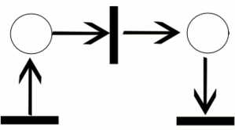
Fire (cont.)

Slide 9
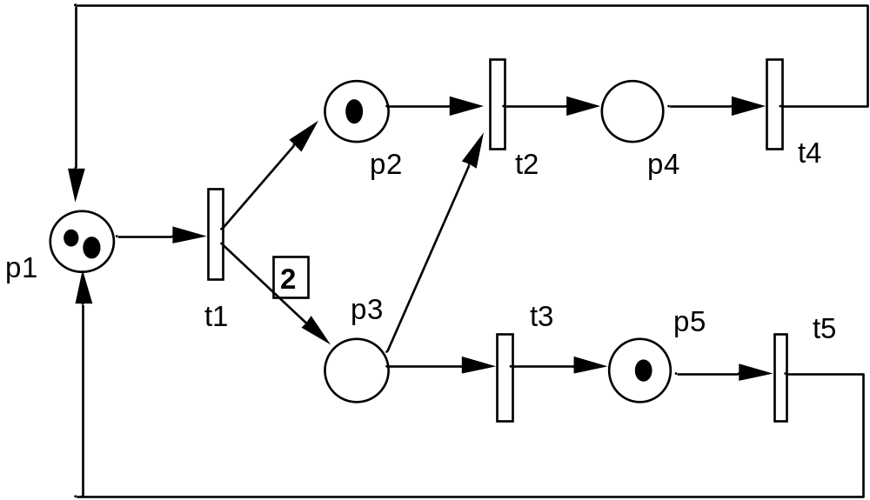
Graphic representation
Similar to that of ordinary PN but with default weight of 1 when not explicitly represented.

Slide 10
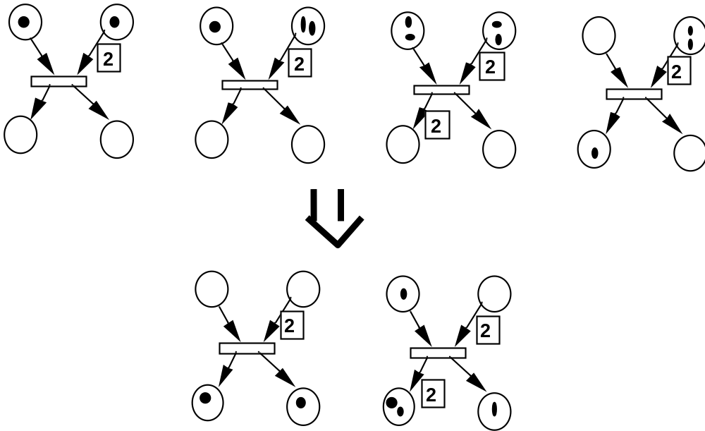
Transition firing

Slide 11

Nondeterminism
Execution of Petri nets is nondeterministic
  Multiple transitions can be enabled at the same time, any one of which can fire
  None are required to fire - they fire at will, between time 0 and infinity, or not at all

Slide 12
Concurrency
Independent inputs permit “concurrent” firing of transitions
They may
occur in either
order

© Oscar Nierstrasz
Petri Nets

Slide 13
Conflict
Overlapping inputs put transitions in conflict
a
Illustration of
conflicting
transitions.
Transitions a
and b conflict
since the
firing of one
will disable
the other
b
b
Only one of a or b may fire

© Oscar Nierstrasz
Petri Nets

Slide 14
Mutual Exclusion
The two subnets are forced to synchronize

© Oscar Nierstrasz
Petri Nets

Slide 15
Producers and Consumers
producer
consumer
© Oscar Nierstrasz
Petri Nets


Slide 16
Bounded Buffers
#occupied slots
#free slots

© Oscar Nierstrasz
Petri Nets

Slide 17
Liveness and Deadlock
Liveness:
A transition is deadlocked if it can never fire.
A transition is live if it can never deadlock.
b
a
Transition a is deadlocked.
Transitions b and c are live.
x
y
c
z
© Oscar Nierstrasz
Petri Nets

Slide 18
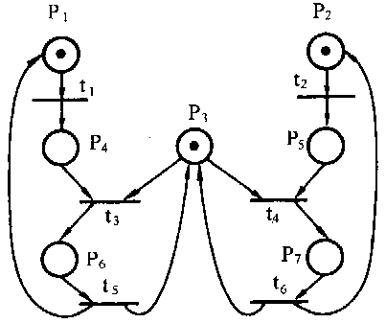
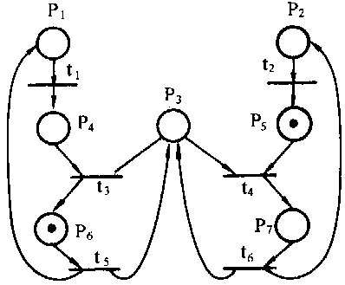
Conflict

Slide 19

Solution

Slide 20
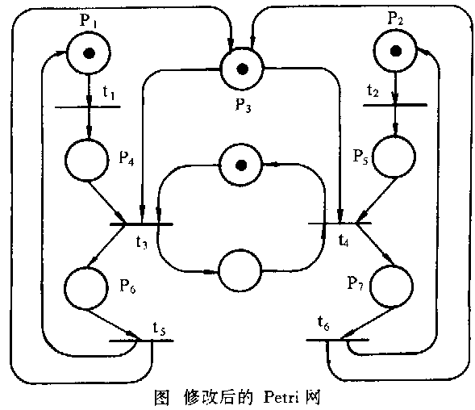
可能激发序列<t₁,t₃,t₅>无限循环，而 <t₂,t₄,t₆>被“饿死”
避免了t₃在t₄ 激发之前激发两次

Slide 21
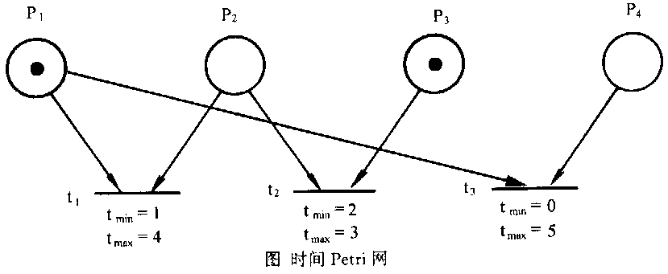
时间Petri网的思想：即使一个变迁处于使能状态，它也必须经过t_{min}之后才能被点燃，且必须在t_{max}之前。
t₁
t₂
t₃
0 1 2 3 4 5

Slide 22
Fork and Join

© Oscar Nierstrasz
Petri Nets

Slide 23
Iteration: 1 or more times

Slide 24
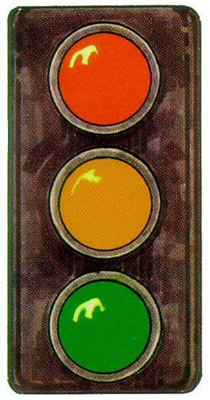
Exercise
Model a fair traffic light

Slide 25
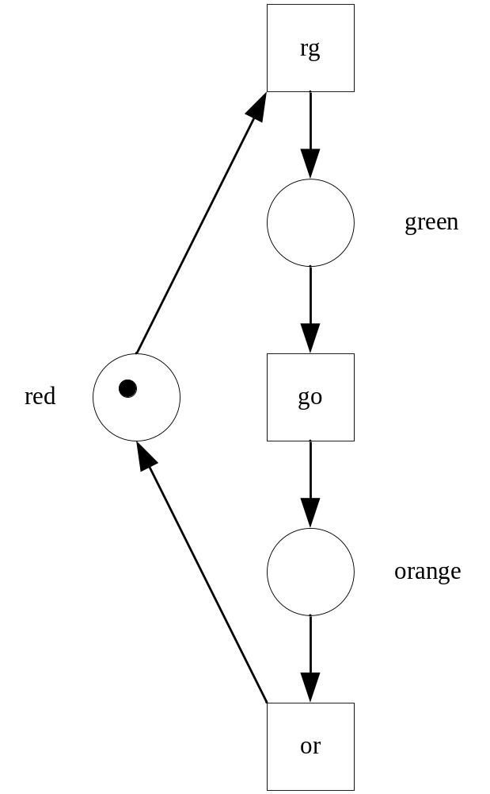

Example: Single traffic light

Slide 26

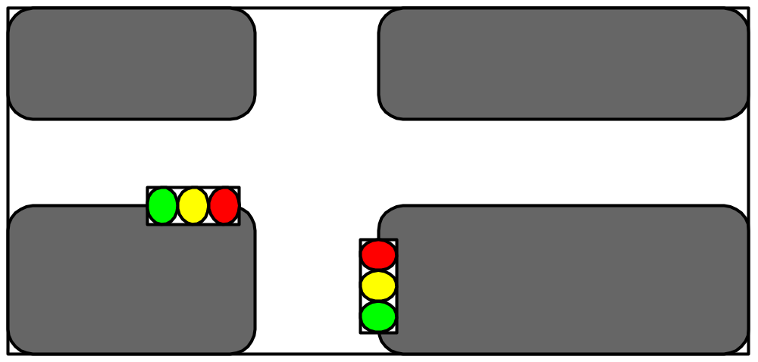
Problem

Slide 27
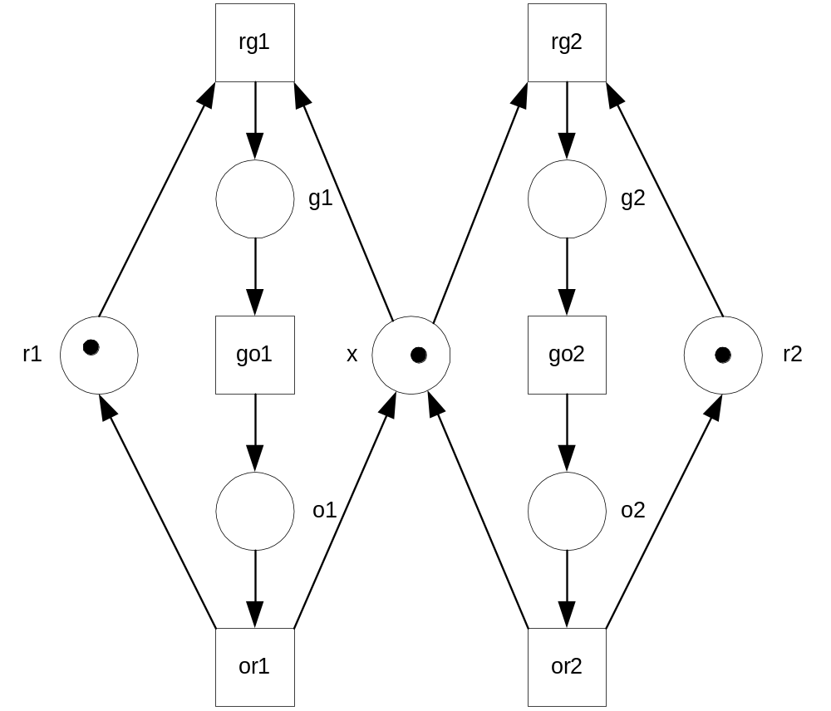
Solution

Slide 28
Example: In a Restaurant (A Petri Net)
Waiter
free
Customer 1
Customer 2
Take
order
Take
order
wait
Order
taken
wait
eating
eating
Tell
kitchen
Serve food
Serve food

Slide 29
Example: In a Restaurant
(Two Scenarios)
Scenario 1:
  Waiter takes order from customer 1; serves customer 1; takes order from customer 2; serves customer 2.
Scenario 2:
  Waiter takes order from customer 1; takes order from customer 2; serves customer 2; serves customer 1.

Slide 30
Example: In a Restaurant (Scenario 1)
Waiter
free
Customer 1
Customer 2
Take
order
Take
order
wait
Order
taken
wait
eating
eating
Tell
kitchen
Serve food
Serve food

Slide 31
Example: In a Restaurant (Scenario 2)
Waiter
free
Customer 1
Customer 2
Take
order
Take
order
wait
Order
taken
wait
eating
eating
Tell
kitchen
Serve food
Serve food

Slide 32
Formal Definition
A Petri net C = ⟨P,T,I,O⟩ consists of:
  A finite set P of places
  A finite set T of transitions
  An input function I: T → Nat^{P} (maps to bags of places)
  An output function O: T → Nat^{P}
A marking of C is a mapping m: P → Nat
Example:
  P = { x, y }
  T = { a, b }
  I(a) = { x }, I(b) = { x, x }
  O(a) = { x, y }, O(b) = { y }
  m(x) = 2 m(y) = 0
x
a
y
b
© Oscar Nierstrasz
Petri Nets

Slide 33
Related Models
Finite State Processes
b
a
d
c
© Oscar Nierstrasz
Petri Nets

Slide 34
Finite State Nets
Some Petri nets can be modelled by FSPs
a
v
{u,w}
u
a
b
c
{v,w}
{u,x}
x
c
w
b
b
a
{v,x}

© Oscar Nierstrasz
Petri Nets

Slide 35
Implementing Petri nets
We can implement Petri net structures in either centralized or decentralized fashion:
Centralized:
A single “net manager” monitors the current state of the net, and fires enabled transitions.
Decentralized:
Transitions are processes, places are shared resources, and transitions compete to obtain tokens.

Slide 36
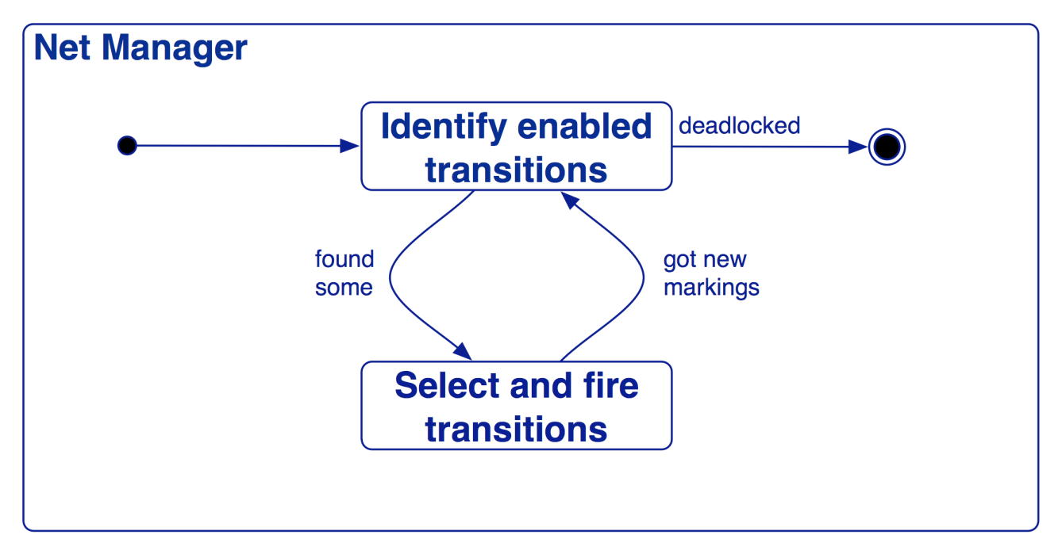
Centralized schemes
In one possible centralized scheme, the Manager selects and fires enabled transitions.
Concurrently enabled transitions can be fired in parallel.
Notes:
Problems: starvation (dining phils); deadlock (no detection) ...

Slide 37
Decentralized schemes
In decentralized schemes transitions are processes and tokens are resources held by places:
x
y
x
y
a
b
a
get()
b
Petri Nets

Slide 38
Role of a token
Tokens can play the following roles:
a physical object, for example a product, a part, a drug, a person;
an information object, for example a message, a signal, a report;
a collection of objects, for example a truck with products, a warehouse with parts, or an address file;
an indicator of a state, for example the indicator of the state in which a process is, or the state of an object;
an indicator of a condition: the presence of a token indicates whether a certain condition is fulfilled.

Slide 39
Role of a place
a type of communication medium, like a telephone line, a middleman, or a communication network;
a buffer: for example, a depot, a queue or a post bin;
a geographical location, like a place in a warehouse, office or hospital;
a possible state or state condition: for example, the floor where an elevator is, or the condition that a specialist is available.

Slide 40
Role of a transition
an event: for example, starting an operation, the death of a patient, a change seasons or the switching of a traffic light from red to green;
a transformation of an object, like adapting a product, updating a database, or updating a document;
a transport of an object: for example, transporting goods, or sending a file.

