Slide 1

Software Engineering
Software requirements

Slide 2

Introduction
Requirements engineering
  Requirements reflect the needs of customers for a system that helps solve some problem
  Requirements engineering: the process of finding out, analyzing, documenting and checking systems’ services and constraints

Slide 3
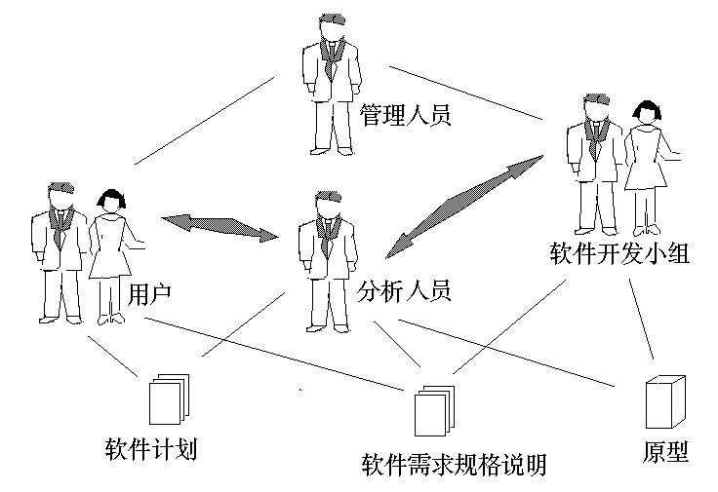
Requirement Engineering

Slide 4
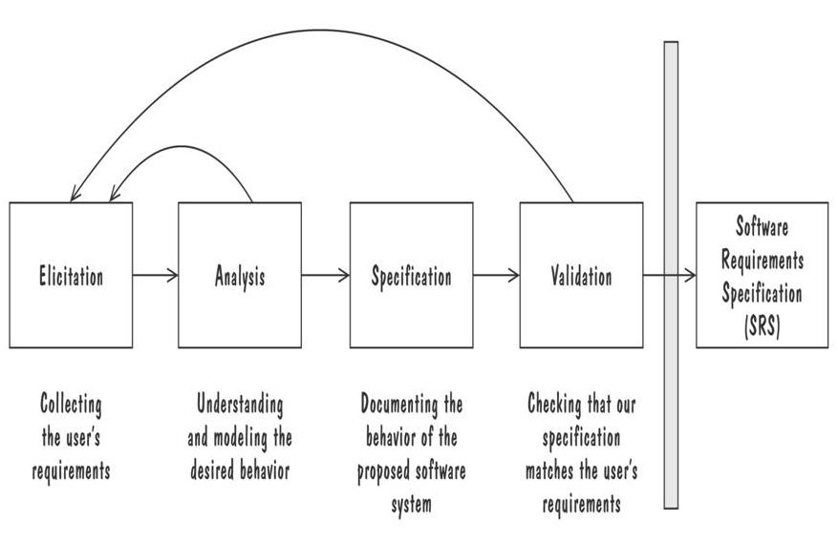
The Requirements Process

Slide 5
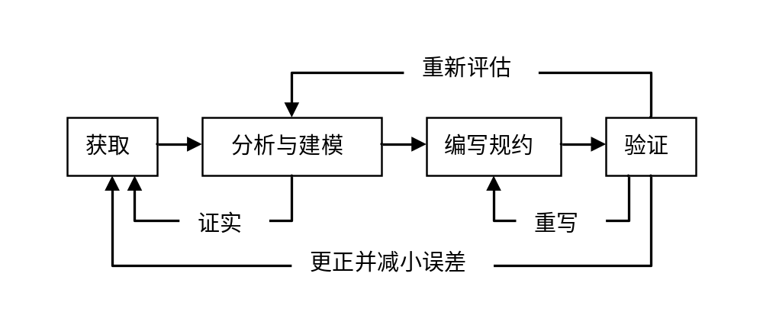
在实际的开发过程中，获取、分析、建模、编写规约和验证这些需求开发活动不会是线性地、顺序地完成。实际上，这些活动是交叉的、递增的和反复的。

Slide 6
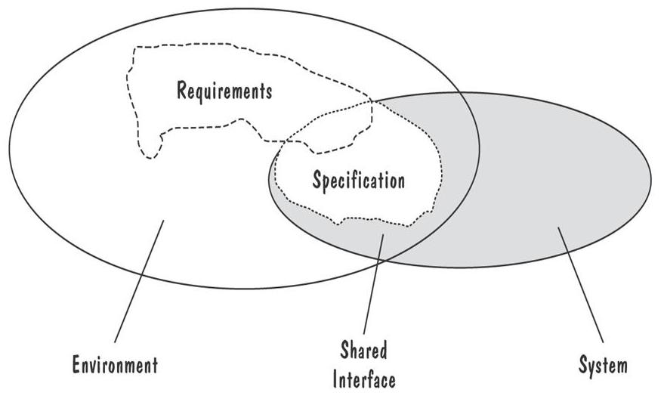
Types of Requirements
Requirements defined anywhwere within the environment's domain, including the system's interface
Specification restricted only to the intersection between environment and system domain

Slide 7

Introduction
Software requirements
  User requirements
    High-level abstract requirements
    Statements, in a natural language plus diagrams, of what services the system is expected to provide and the constraints under which it must operate
  System requirements
    Detail description of what the system should do
    Set out the system’s functions, services and operational constraints in detail
    Should be precise

Slide 8
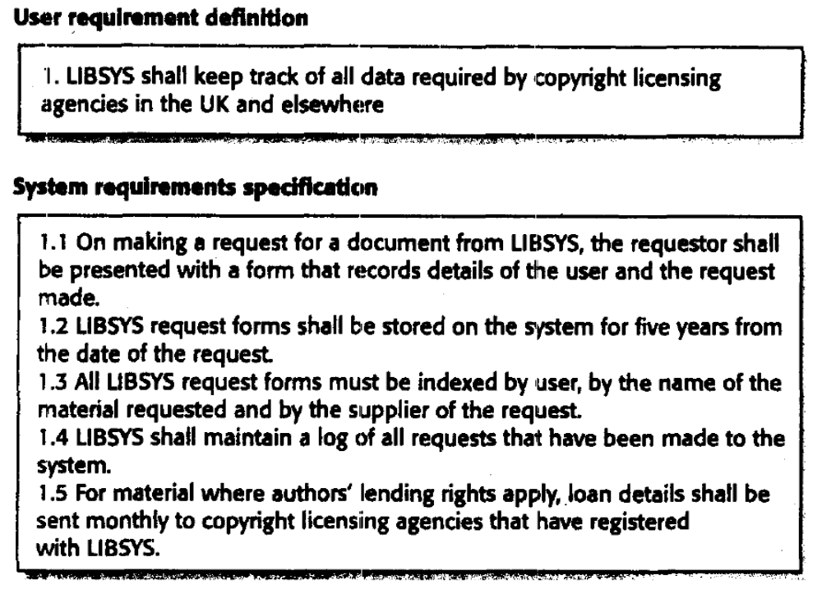

Slide 9
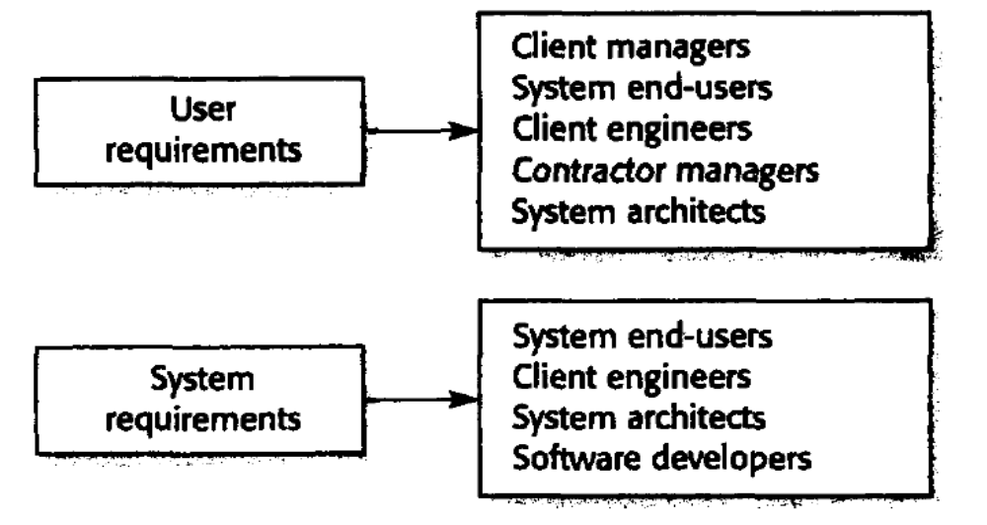
Different kinds of software requirements for different users

Slide 10
Requirement Type
  Functional requirements
    Statements of services the system should provide, how the system should react to particular inputs and how the system should behave in particular situations
  Non-functional requirements
    Constraints on the services or functions offered by the system, include timing constraints, constraints on the development process and standards
  Domain requirements
    Come from the application domain of the system and that reflect characteristics and constraints of that domain

Slide 11

Functional requirements
Functional requirements
  Describe what the system should do
  LIBSYS example
    The user shall be able to search either all of the initial set of databases or select a subset from it
  Completeness
    All services required by the user should be defined
  Consistency
    Requirements should not have contradictory definitions

Slide 12

Non-functional requirements
Non-functional requirements,
    Are requirements that are not directly concerned with the specific functions delivered by the system
    May related to emergent system properties such as reliability, response time and store occupancy
    Failing to meet a non-functional requirement can mean that the whole system is unusable(aircraft system : reliability)

Slide 13
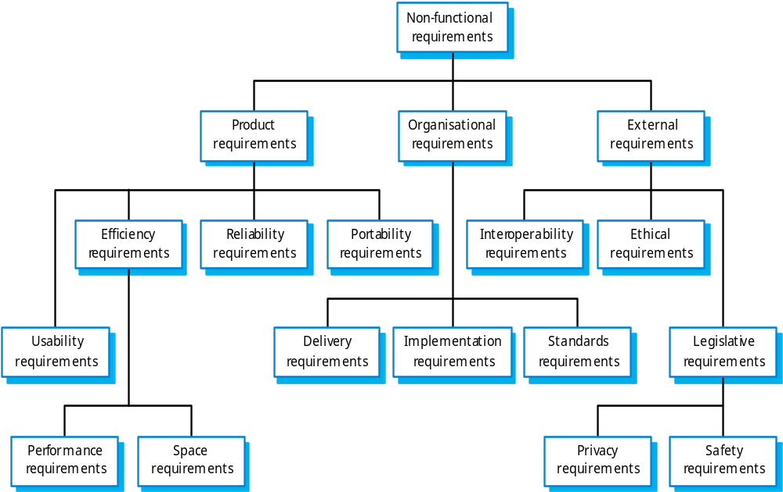

Slide 14

Non-functional requirements
  Whenever possible, you should write non-functional requirements quantitatively to translate their goals into quantitative requirements
    Speed: Processed transactions/second, User/Event response time
    Size: K bytes, Number of RAM chips
    Reliability: Mean time to failure
  It is helpful if you can differentiate functional and non-functional requirements in the requirements document. In practice, this is difficult to do

Slide 15
Specification
  Requirements are written in natural language sentences in a text document
    Lack of clarity, difficult to be precise and unambiguous
  Guidelines
    Invent a standard format
    Use language consistently
    Use text highlighting to pick out key parts of the requirement
    Avoid, as far as possible, the use of computer jargon

Slide 16

Specification
  Problems of Natural language
    Natural language is often used to write system requirements specifications, it can be confused and hard to understand
    Natural language understanding relies on the specification readers and writers using the same words for the same concept
    A natural language requirements specification is over flexible
    There is no easy way to modularize natural language requirements

Slide 17
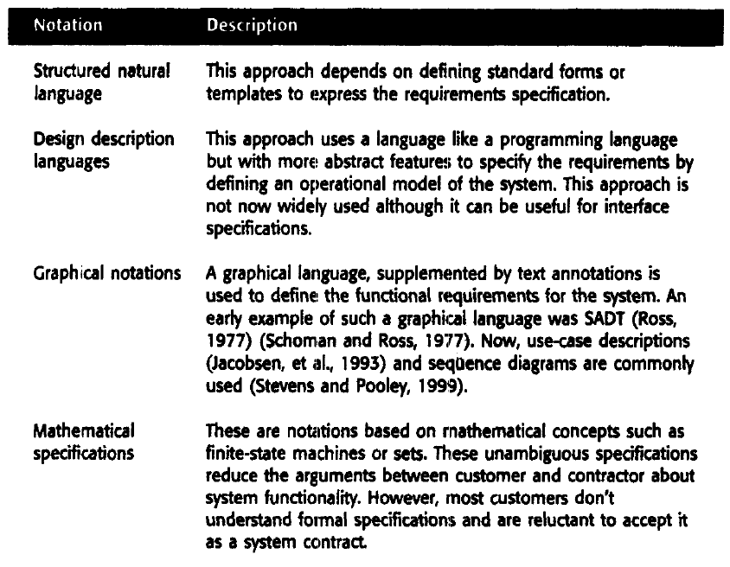
More specialized notations

Slide 18

Structured language specifications
  Advantage
    Maintains most of the expressiveness and understandability of natural language
    Ensures some degree of uniformity is imposed on the specification

Slide 19
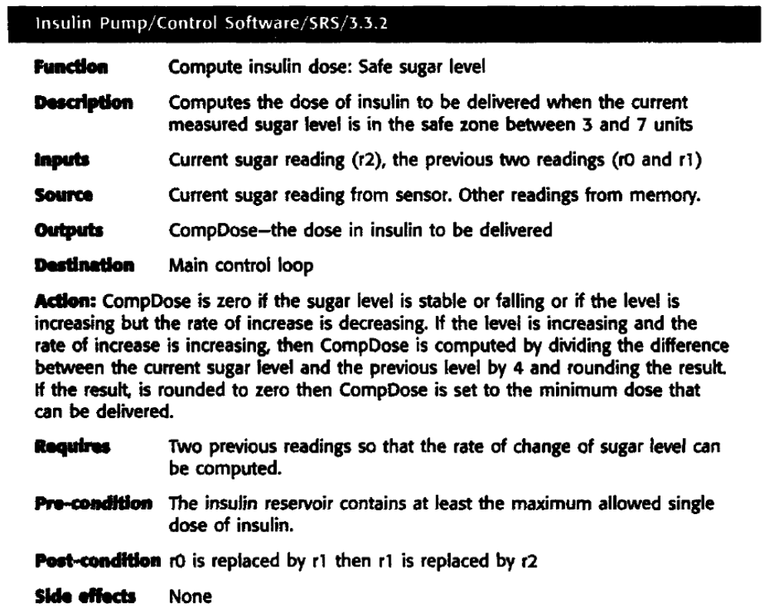

Slide 20
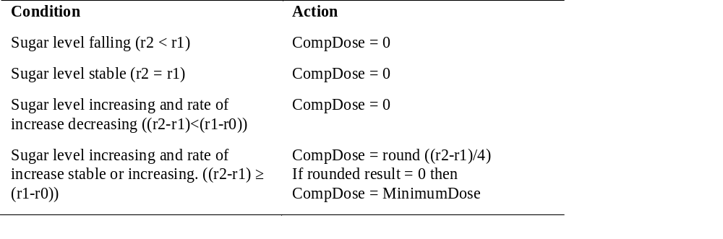
Tabular specification of computation

Slide 21
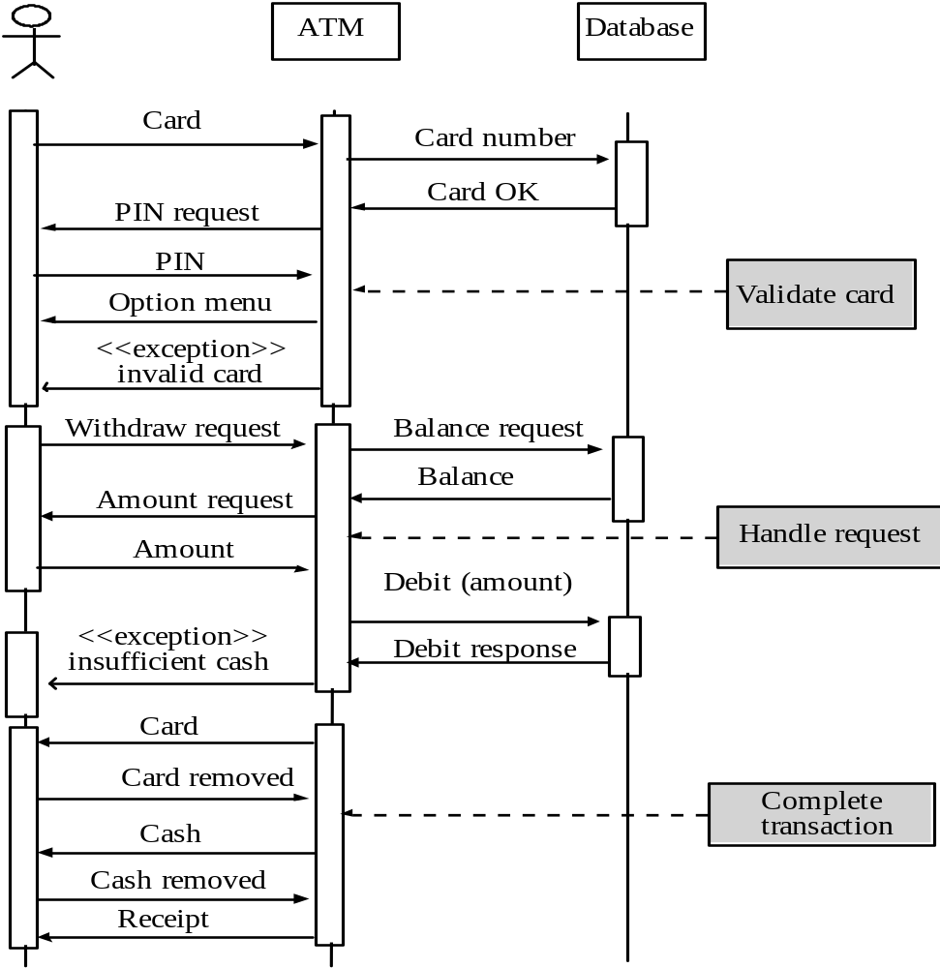

Slide 22
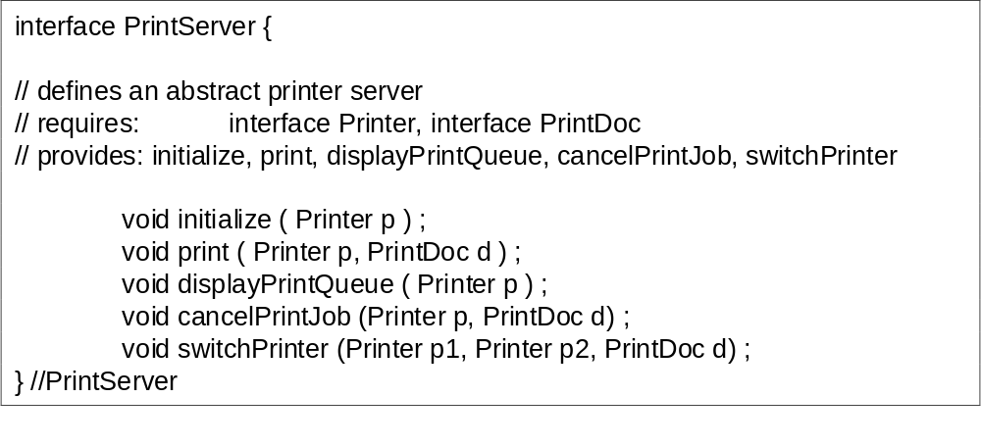
Interface specification
  Three types of interface
    Procedural interfaces( such as API);Data structures; Representations of data (such as the ordering of bits)

Slide 23
The software requirements document
Or called Software requirements specification (SRS)
  Readers of software requirements specification
    System customers
    Managers
    System engineers
    System test engineers
    System maintenance engineers

Slide 24

The software requirements document
The structure of a requirement document
  Preface
  Introduction
  User requirements definition
  System architecture
  System requirements specification
  System models
  System evolution
  Appendices
  Index

Slide 25
Software requirements specification
封面：
文档编号：
版 本 号：
文档名称：
项目名称：
项目负责人：
年 月 日
编写：
核对：
审核：
批准：
开发单位：

Slide 26
Requirement Specification
Ⅰ. 引言 | A.系统参考文献
 | B.整体描述
 | C.软件项目约束
Ⅱ. 信息描述 | A.信息内容表示
 | B.信息流表示： ⅰ数据流 ⅱ控制流
Ⅲ. 功能描述 | A.功能划分
 | B.功能描述： ⅰ处理说明 ⅱ限制∕局限 ⅲ 性能需求 ⅳ 设计约束 ⅴ 支撑图 C.控制描述 ⅰ控制规约 ⅱ 设计约束
Ⅳ. 行为描述 | A.系统状态
 | B.事件和响应
Ⅴ. 检验标准 | A.性能范围
 | B.测试种类
 | C.期望的软件响应
 | D.特殊的考虑
Ⅵ. 参考书目
Ⅶ. 附录

Slide 27
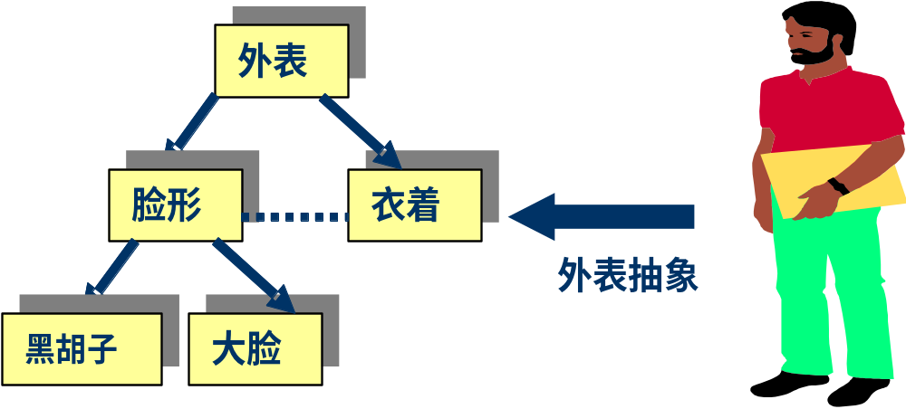
Modeling
Abstraction
  抽象有助于控制问题复杂度，抓住问题的本质,获取一般和特殊关系

Slide 28

Modeling Notations
It is important to have standard notations for modeling, documenting, and communicating decisions
Modeling helps us to understand requirements thoroughly

Slide 29
Entity-Relationship Diagrams
A popular graphical notational paradigm for representing conceptual models
  An entity: depicted as a rectangle, represents a collection of real-world objects that have common properties and behaviors
  A relationship: depicted as an edge between two entities, with diamond in the middle of the edge specifying the type of relationship
  An attribute: an annotation on an entity that describes data or properties associated with the entity

Slide 30
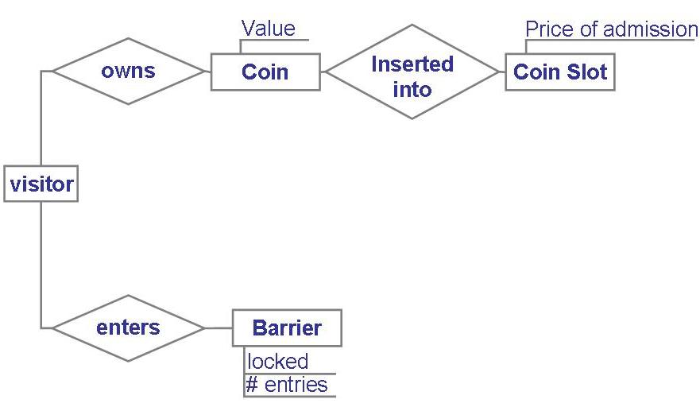
Entity-Relationship Diagrams (continued)
Entity diagram of turnstile problem

Slide 31

Event Traces
A graphical description of a sequence of events that are exchanged between real-world entities
  Vertical line: the timeline of distinct entity, whose name appear at the top of the line
  Horizontal line: an event or interaction between the two entities bounding the line
  Time progresses from top to bottom
Each graph depicts a single trace, representing one of several possible behaviors

Slide 32
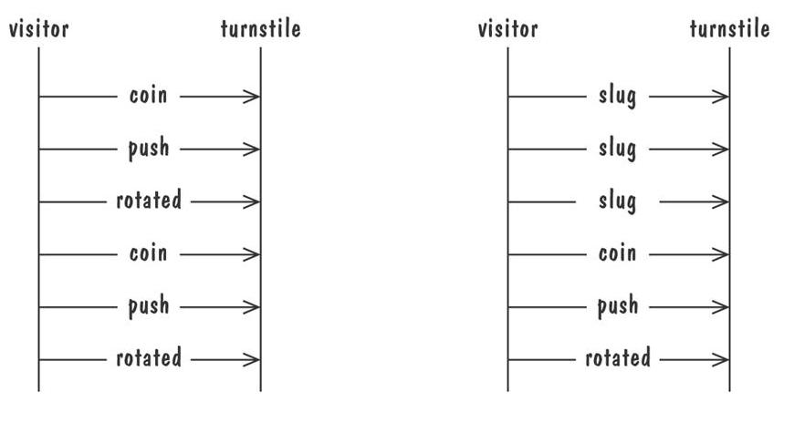
Graphical representation of two traces for the turnstile problem
  trace on the left represents typical behavior
  trace on the right shows exceptional behavior

Slide 33
Event Traces Example: Message Sequence Chart
An enhanced event-trace notation, with facilities for creating and destroying entities, specifying actions and timers, and composing traces
  Vertical line represents a participating entity
  A message is depicted as an arrow from the sending entity to the receiving entity
  Actions are specified as labeled rectangles positioned on an entity's execution line
  Conditions are important states in an entity's evolution, represented as labeled hexagon

Slide 34
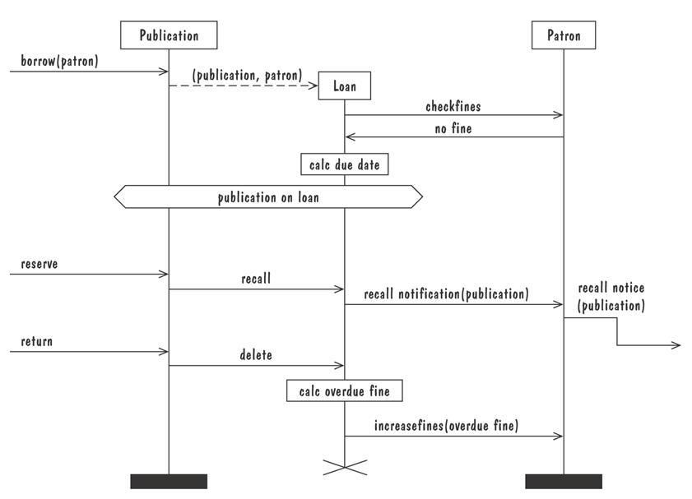
Message sequence chart for library loan transaction

Slide 35
Petri Nets
A form or state-transition notation that is used to model concurrent activities and their interaction
  Circles (places) represent activities or conditions
  Bars represents transitions
  Arcs connect a transition with its input places and its ouput places
  The places are populated with tokens, which act as enabling conditions for the transitions
  Each arc can be assigned a weight that specifies how many tokens are removed from arc's input place, when the transition fires

Slide 36
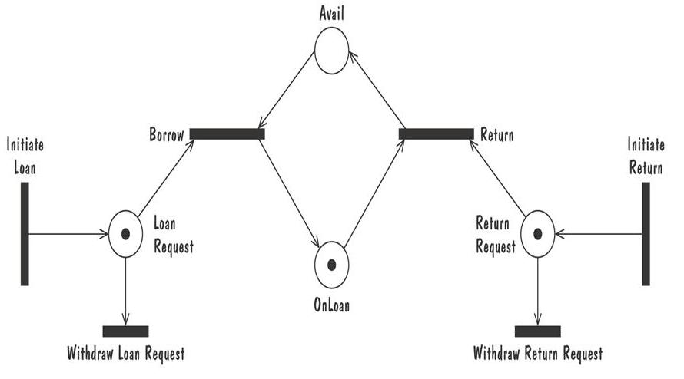
Petri Nets (continued)
Petri net of book loan

Slide 37
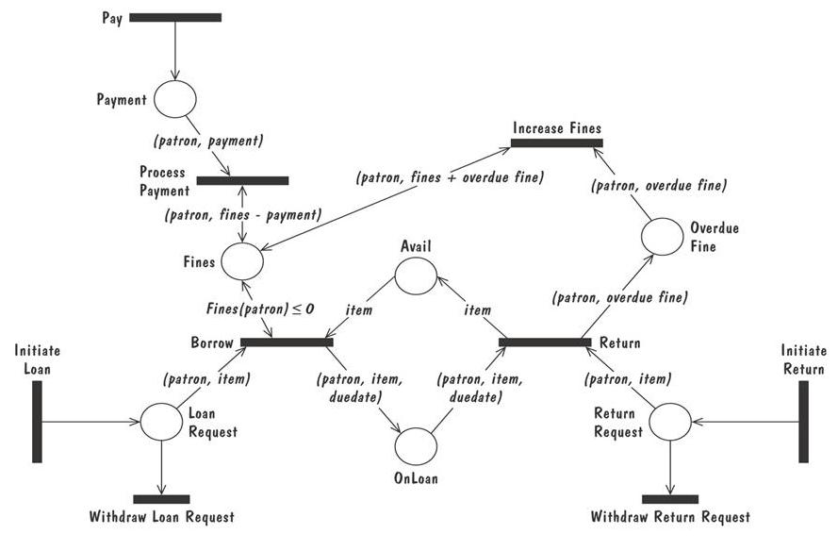
A high level Petri net specification for the library problem

Slide 38

Functions and Relations
Formal methods or approach: mathematically based specification and design techniques
Formal methods model requirements or software behavior as a collection of mathematical functions or relations
  Functions specify the state of the system's execution, and output
  A relation is used whenever an input value maps more than one ouput value

Slide 39
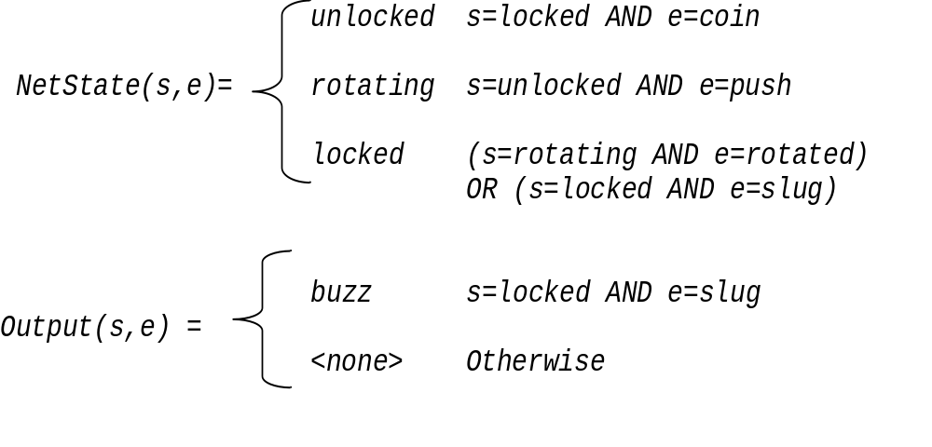
Example: representing turnstile problem using two functions
  One function to keep track of the state
  One function to specify the turnstile output

Slide 40

Functions and Relations Example: Decision Tables
It is a tabular representation of a functional specification that maps events and conditions to appropriate reponses or action
If there is n input conditions, there are 2^{n} possible combination of input conditions
Combinations map to the same set of result can be combined into a single column

Slide 41
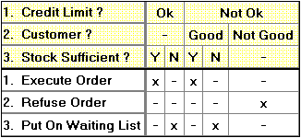
Decision Tables
condition stub (condition subjects)
condition entries (condition states)
action stub (action subjects)
action entries (action values)
Notes:
The tabular representation of the decision situation is characterized by the separation between conditions and actions, on one hand, and between subjects and conditional expressions (states), on the other hand.
Every table column (decision column) indicates which actions should (or should not) be executed for a specific combination of condition states.
In this definition, the decision table concept is deliberately restricted to the so called single-hit table, where columns are mutually exclusive. Only this type of table allows easy checking for consistency and completeness.

Slide 42
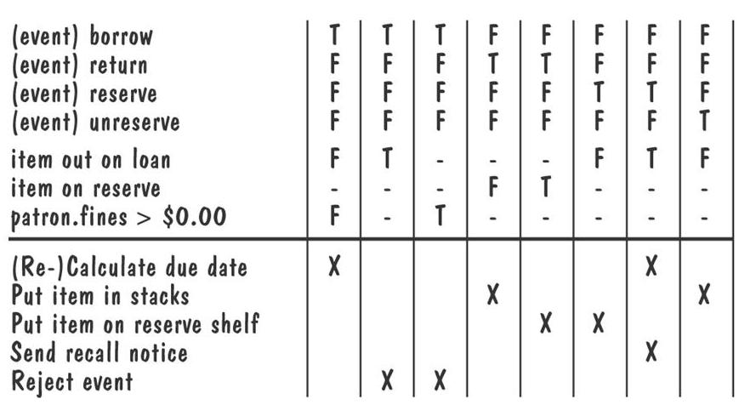
Decision table for library functions borrow, return, reserve, and unreserve

Slide 43
1
2
3
4
5
6
7
8
9
国内乘客
T
T
T
T
F
F
F
F
头等舱
T
F
T
F
T
F
T
F
残疾乘客
F
F
T
T
F
F
T
T
行李重量W≤30
T
F
F
F
F
F
F
F
F
免费
×
(W-30)×2
×
(W-30)×3
×
(W-30)×4
×
×
(W-30)×6
×
×
(W-30)×8
×
(W-30)×12
×

Slide 44
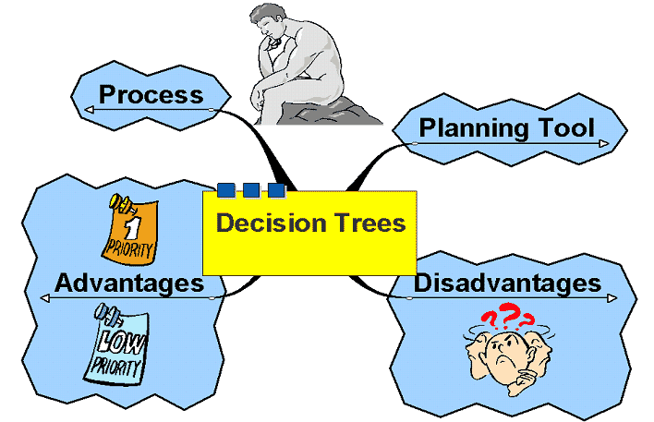
Decision Trees

Slide 45
Decision Trees
Three types of “nodes”
  Decision nodes - represented by squares (□)
  Chance nodes - represented by circles (Ο)
  Terminal nodes - represented by triangles (optional)
Solving the tree involves pruning all but the best decisions at decision nodes, and finding expected values of all possible states of nature at chance nodes
Create the tree from left to right
Solve the tree from right to left

Slide 46
Example Decision Tree
Chance
node
Event 1
Decision
node
Event 2
Decision 1
Event 3
Decision 2

Slide 47
Jenny Lind Decision Tree
Small Box Office
$200,000
Sign with Movie Co.
Medium Box Office
$1,000,000
Large Box Office
$3,000,000
Small Box Office
$900,000
Sign with TV Network
Medium Box Office
$900,000
Large Box Office
$900,000

Slide 48
Jenny Lind Decision Tree
Small Box Office
ER
?
.3
$200,000
Sign with Movie Co.
.6
Medium Box Office
$1,000,000
ER
?
.1
Large Box Office
$3,000,000
Small Box Office
ER
?
.3
$900,000
Sign with TV Network
.6
Medium Box Office
$900,000
.1
Large Box Office
$900,000

Slide 49
Jenny Lind Decision Tree - Solved
Small Box Office
ER
960,000
.3
$200,000
Sign with Movie Co.
.6
Medium Box Office
$1,000,000
ER
960,000
.1
Large Box Office
$3,000,000
Small Box Office
ER
900,000
.3
$900,000
Sign with TV Network
.6
Medium Box Office
$900,000
.1
Large Box Office
$900,000

Slide 50
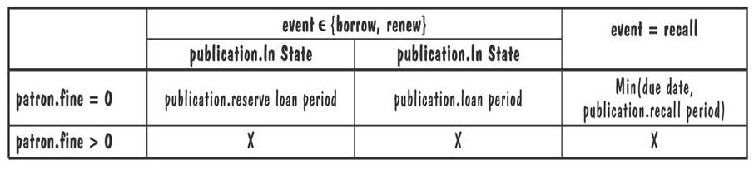

Functions and Relations Example: Parnas Tables
  The column and row headers are predicates used to specify cases
  An entry “X” either could be invalid under the specified conditions or the combindation of conditions is infeasible
Calc due date(patron, publication, event, Today) =

Slide 51
Logic
An operational notation is a notation used to describe a problem or a proposed software solution in terms of situational behavior
  Model of case-based behavior
  Examples: state machine, event traces, data-flow diagram, functional method
A descriptive notation is a notation that describes a problem or a proposed solution in terms of its properties or its variant
  Example: logic

Slide 52
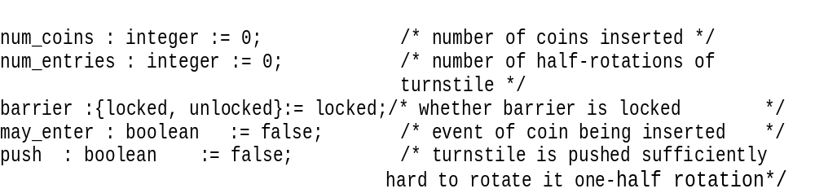

Consider the following variables of turnstile problem, with their initial value
The first-order logic expressions
(num_coins > num_entries ⬄ (barrier = unlocked)
(barrier = locked ) ⬄ ¬may_enter

Slide 53
Temporal logic 时态逻辑框架
Temporal logic introduces additional logical connectives for constraining how variables can change value over time
  □ 总归(always)
  ◇ 有时(sometime)
  ○ 下一次(next)
  U 直到(until)

Slide 54
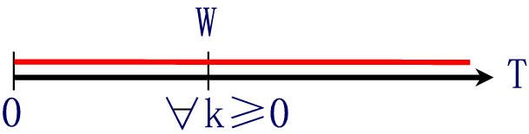
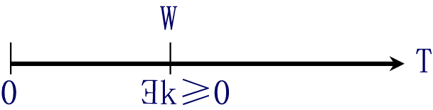
Temporal Logic (continued)
  □W Ξ W is true now and throughout the rest of execution
  ⋄W Ξ W is true now or at some point in the execution

Slide 55
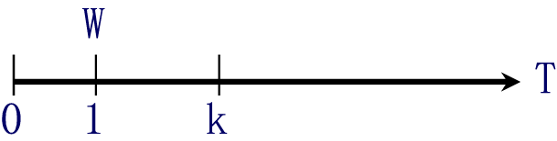
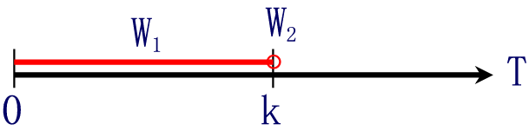
Temporal Logic (continued)
  ○W Ξ W is true in the next point in the execution
  W₁ U W₂ Ξ W₁ is true until a point where W₂ is true, but W₂ may never be true

Slide 56
Temporal Logic (continued)
Turnstile properties expressed in temporal logic
  □(insert_coin => ○ (may_enter U push))
  □(∀n(insert_coin ∧ num_coins=n) => ○(num_coins=n+1))

Slide 57
模型
如果w在模型M下为真，我们称M满足w或者称M是一个w的满足模型。我们把它记为
M |= w
如果存在w的一个满足模型M，则称一个公式w是可满足的（satisfiable）。
如果w在每个模型中为真，则称公式w是有效的（valid）(永真)。记为
|=w

Slide 58
关于时态逻辑的永真公式
对偶性(duality) (examples)
|= □~w ≡ ~◇w
w在一个序列的所有状态中为假当且仅当不存在使w在所有状态中为真。
|= ◇~w ≡ ~□w
存在一个w为假的状态当且仅当不存在使w为真的状态。

Slide 59
对偶性(duality)
|= ○~w ≡ ~○w
w在下一状态为假当且仅当不存在使
w在下一状态为真的情况。
这个语句限制每个状态有不多于一个
单个后继者。

Slide 60
蕴涵关系(examples)
|= w → ◇w
|= □w → w
|= ○w → ◇w
|= □w → ○w
|= □w → ◇w
|= □w → ○□w

Slide 61
交换次序的蕴涵（examples）
|= (□w1 ∨ □w2) → □(w1 ∨ w2)
|= ◇(w1 ∧ w2) → (◇w1 ∨ ◇w2)
|= ((w1 U w3) ∨ (w2 U w3))
→ ((w1 ∨ w2) U w3)

Slide 62
单调性(monotonicity)
|= □(w1 → w2) → (□w1 → □w2)
|= □(w1 → w2) → (◇w1 → ◇w2)
|= □(w1 → w2) → (○w1 → ○w2)

Slide 63
Thank You

