Slide 1

Software Engineering
Formal specification

Slide 2

Formal methods
Formal specification is part of a more general collection of techniques that are known as ‘formal methods’
These are all based on mathematical representation and analysis of software
Formal methods include
  Formal specification
  Specification analysis and proof
  Transformational development
  Program verification

Slide 3
Formal Specification
Goals of formal specification:
  Complete
  Consistent
  Concise
  Unambiguous
  Valid—state exactly what the user wants
Specifications based on formal semantic model
What is/are semantics?
What is a formal semantic model?

Slide 4
Formal Semantics
Semantics means “meaning”
Formal semantics:
  Meaning expressed in mathematics
Formal semantic model:
  Complete semantic definition of a language in mathematics
What mathematics?
  Discrete mathematics!
Formal semantics permit dependable communication between all parties

Slide 5
Types Of Languages
Procedural:
  Computation defined by desired sequence of actions computer is to perform
  Most high-level languages are procedural
Declarative:
  Computation defined by desired state that computer should be in
  Many specification languages are declarative
The big difference in languages is:
  Declarative: Says nothing about HOW, just WHAT
  Procedural: Says nothing about WHAT, just HOW

Slide 6

Types Of Languages—Examples
Procedural:
read (x);
y := x;
while y*2 > x loop
y := y – 1;
end loop;
print (y);
Declarative:
y*2 <= x AND (y+1)*2 > x

Slide 7
Library Example: Informal Statement
A book can either be in the stacks, on reserve, or loaned out
If a book is in the stacks or on reserve, then it can be requested
We want to
  formalize the concepts and the statements
  prove some theorems to gain confidence that the spec is correct

Slide 8

Library Example: Formalization (1/2)
First let’s formalize some concepts
  S: the book is in the stacks
  R: the book is on reserve
  L: the book is on loan
  Q: the book is requested

Slide 9
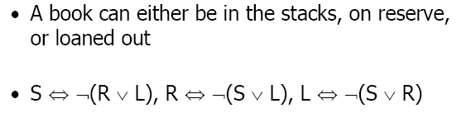

Library Example: Formalization (2/2)
If a book is requested, then it is on the shelf or
on reserve

Slide 10
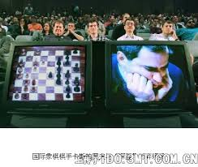
Prove and Infer by Machine?

Slide 11
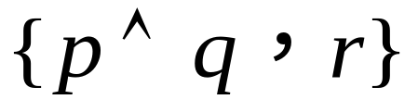
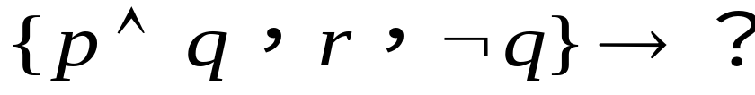
Resolution Refutation
Once the theorem prover shows that the negated goal is inconsistent with the given set of axioms, it follows that the original goal must be consistent .
This proves the theorem
Example
  Axioms:
  Goal: q
  Resolution:

Slide 12
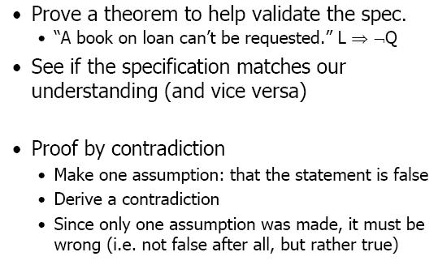
Library Example: Proof of a Theorem

Slide 13
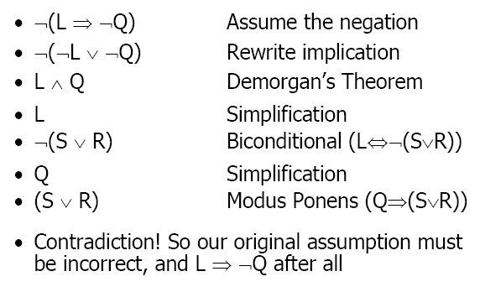
Library Example: Proof By Contradiction

Slide 14
Resolution Refutation（归结法）
The resolution principle, describes a way of finding contradictions in a data base of clauses with minimum substitution
Resolution Refutation proves a theorem by negating the statement to be proved and adding the negated goal to the set of axioms that are known or have been assumed to be true
It then uses the resolution rule of inference to show that this leads to a contradiction

Slide 15
Steps in Resolution Refutation Proofs
Put the premises or axioms into clause form
Add the negations of what is to be proved in clause form, to the set of axioms
Resolve these clauses together, producing new clauses that logically follow from them
Produce a contradiction by generating the empty clause
The substitutions used to produce the empty clause are those under which the opposite of the negated goal is true

Slide 16
The resolution principle
Example. Given a set S of clauses:
  (1) P∨Q
  (2) (P→Q) ∧ (Q→P)
  To Poof: P∧ Q
  Set to resolution: clause form
  (1) P∨Q
  (2) ∼P∨Q
  (3) P∨∼Q
  (4) ∼P∨∼Q

Slide 17
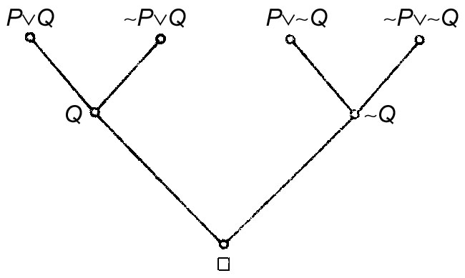
The resolution principle
Example (cont.)
  The deduction can be represented by a tree – deduction tree.

Slide 18
An Example
We wish to prove that
“Fido will die” from the statements that
“Fido is a dog” and
“all dogs are animals” and
“all animals will die”

Slide 19
Reasoning by Resolution
Convert these predicates to clause form
Predicate Form | Clause Form
x: [dog(x)→animal(x)] | ¬ dog(x) V animal(x)
Dog(fido) | Dog(fido)
y:[animal(y) →die(y)] | ¬ animal(y) V die(y)

Slide 20
Apply Resolution
Negate the conclusion that fido will die ¬die(fido)
¬dog(x) V animal(x) ¬animal(y) V die(y)
[Y/X]
dog(fido) ¬dog(y) V die(y)
[fido/Y]
die(fido) ¬die(fido)
Null clause → Hence fido will die

Slide 21
Example 2
Jack owns a dog.
Every dog owner is an animal lover.
No animal lover kills an animal.
Either Jack or Curiosity killed the cat, who is named Tuna.
Did Curiosity kill the cat?

Slide 22
Original Sentences
（
）
(Plus Background Knowledge)

Slide 23



Conjunctive Normal Form
  D is a placeholder for the dogs unknown name
p
p
Add negation of theorem to KB
Notes:
Add negation of theorem to KB: Kills (Curiosity, Tuna).
Proof by resolution on board

Slide 24
Proof by Resolution
¬kills(Curiosity,Tuna)
kills(Jack,Tuna) ∨ kills(Curiosity,Tuna)
kills(Jack,Tuna)
¬AnimalLover(w) ∨ ¬Animal(p) ∨ ¬kills(w,p)
{Jack/w, Tuna/p}
Animal(z) ∨ ¬Cat(z)
¬AnimalLover(Jack) ∨ ¬Animal(Tuna)
{Tuna/z}
¬AnimalLover(Jack) ∨ ¬Cat(Tuna)
Cat(Tuna)
¬AnimalLover(Jack)
¬Dog(y) ∨ ¬Owns(x,y) ∨ AnimalLover(x)
{Jack/x}
Dog(D)
¬Dog(y) ∨ ¬Owns(Jack,y)
Owns(Jack,D)
{D/y}
¬Owns(Jack,D)
NIL
Notes:
1. Not in CNF

Slide 25
Question: happy(ali)?
Anyone passing the SE Exam and winning the lottery is happy
X:[pass(x, SE) Λ win(x, lottery) →happy(x)]
Anyone who studies or is lucky can pass all their exams
X Y [studies(x) V lucky(x) →pass(x, y)]
Ali did not study but he is lucky
¬ study(ali) Λ lucky(ali)
Anyone who is lucky wins the lottery
X: [lucky(x) →win(x, lottery)]

Slide 26
Introduction
Formal methods
  Improve software quality, fewer errors
  Only a few software developed with formal methods
    Successful software engineering
    Market changes
    Limited scope of formal methods
    Limited scalability of formal methods
  Applied in some areas, such as critical system

Slide 27
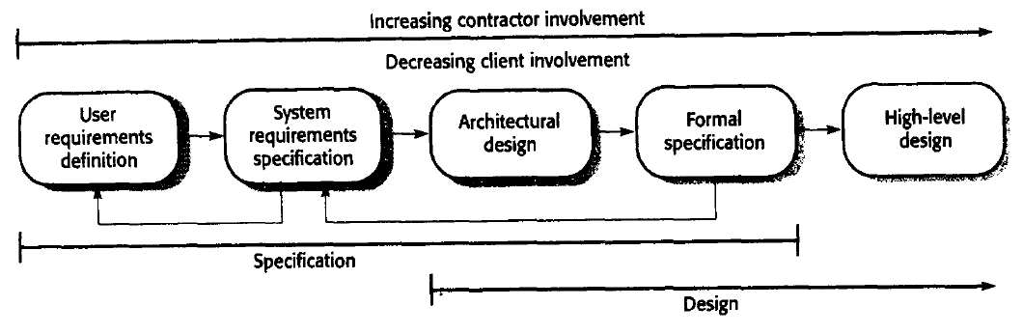
Formal specification in the software process
Formal specification
  Come after the system requirement
  tight feedback loop between detailed requirement specification and the formal specification

Slide 28
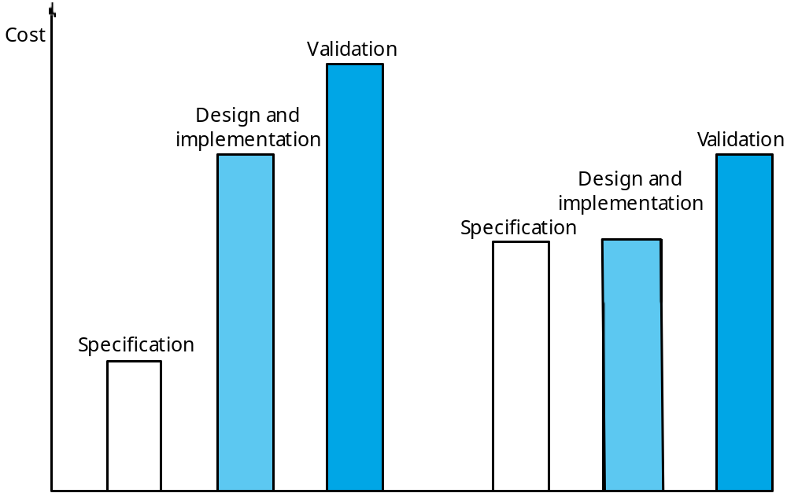
Software development costs with formal specification

Slide 29
Formal specification languages
  Algebraic approach
    System is described in terms of operations and their relationships
    Larch(Guttag et al., 1985,1993), OBJ(Futatsugi et al., 1985), Lotos(Bolognesi and Brinksma, 1987)
  Model-based approach
    A model of the system is built using mathematical constructs such as sets and sequences, and the system operations are defined by how they modify the system state
    Z(Spivey, 1992), VDM(Jones, 1980), B(Wordsworth, 1986), CSP(Hoare, 1985), Petri Nets(Peterson, 1981)

Slide 30
Interface specification
Large systems are decomposed into subsystems with well-defined interfaces between these subsystems
Specification of subsystem interfaces allows independent development of the different subsystems
Interfaces may be defined as abstract data types or object classes
The algebraic approach to formal specification is particularly well-suited to interface specification

Slide 31
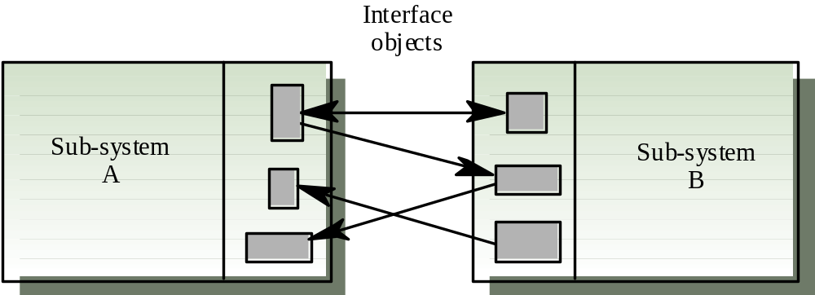
Sub-system interfaces

Slide 32
Sub-system interface specification
Algebraic approach
  Interface is similar to an object class
    An introduction, declares the sort (the type name ) being specified
    A description, where the operations are described informally
    The signature, defines the syntax of the interface to the object class or abstract data type
    The axioms, defines the semantics of the operations by defining a set of axioms that characterize the behavior of the abstract data type

Slide 33
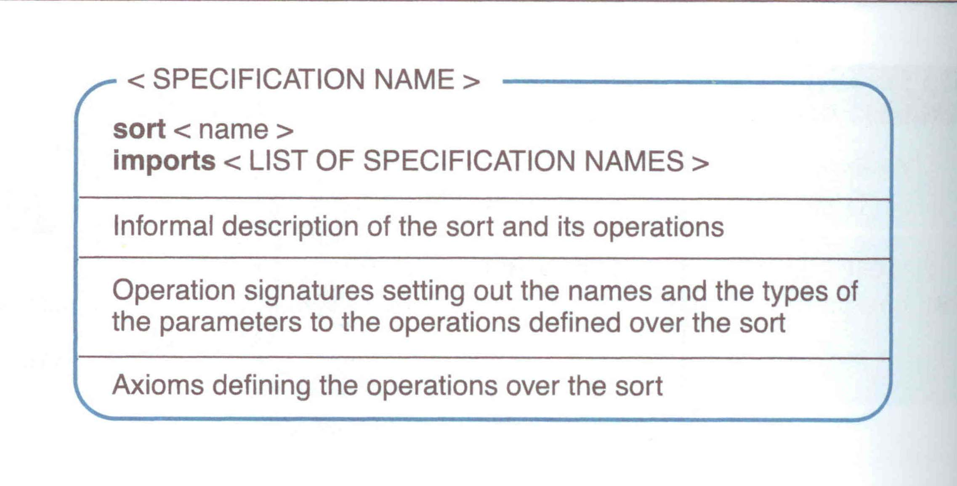
The structure of an algebraic specification

Slide 34
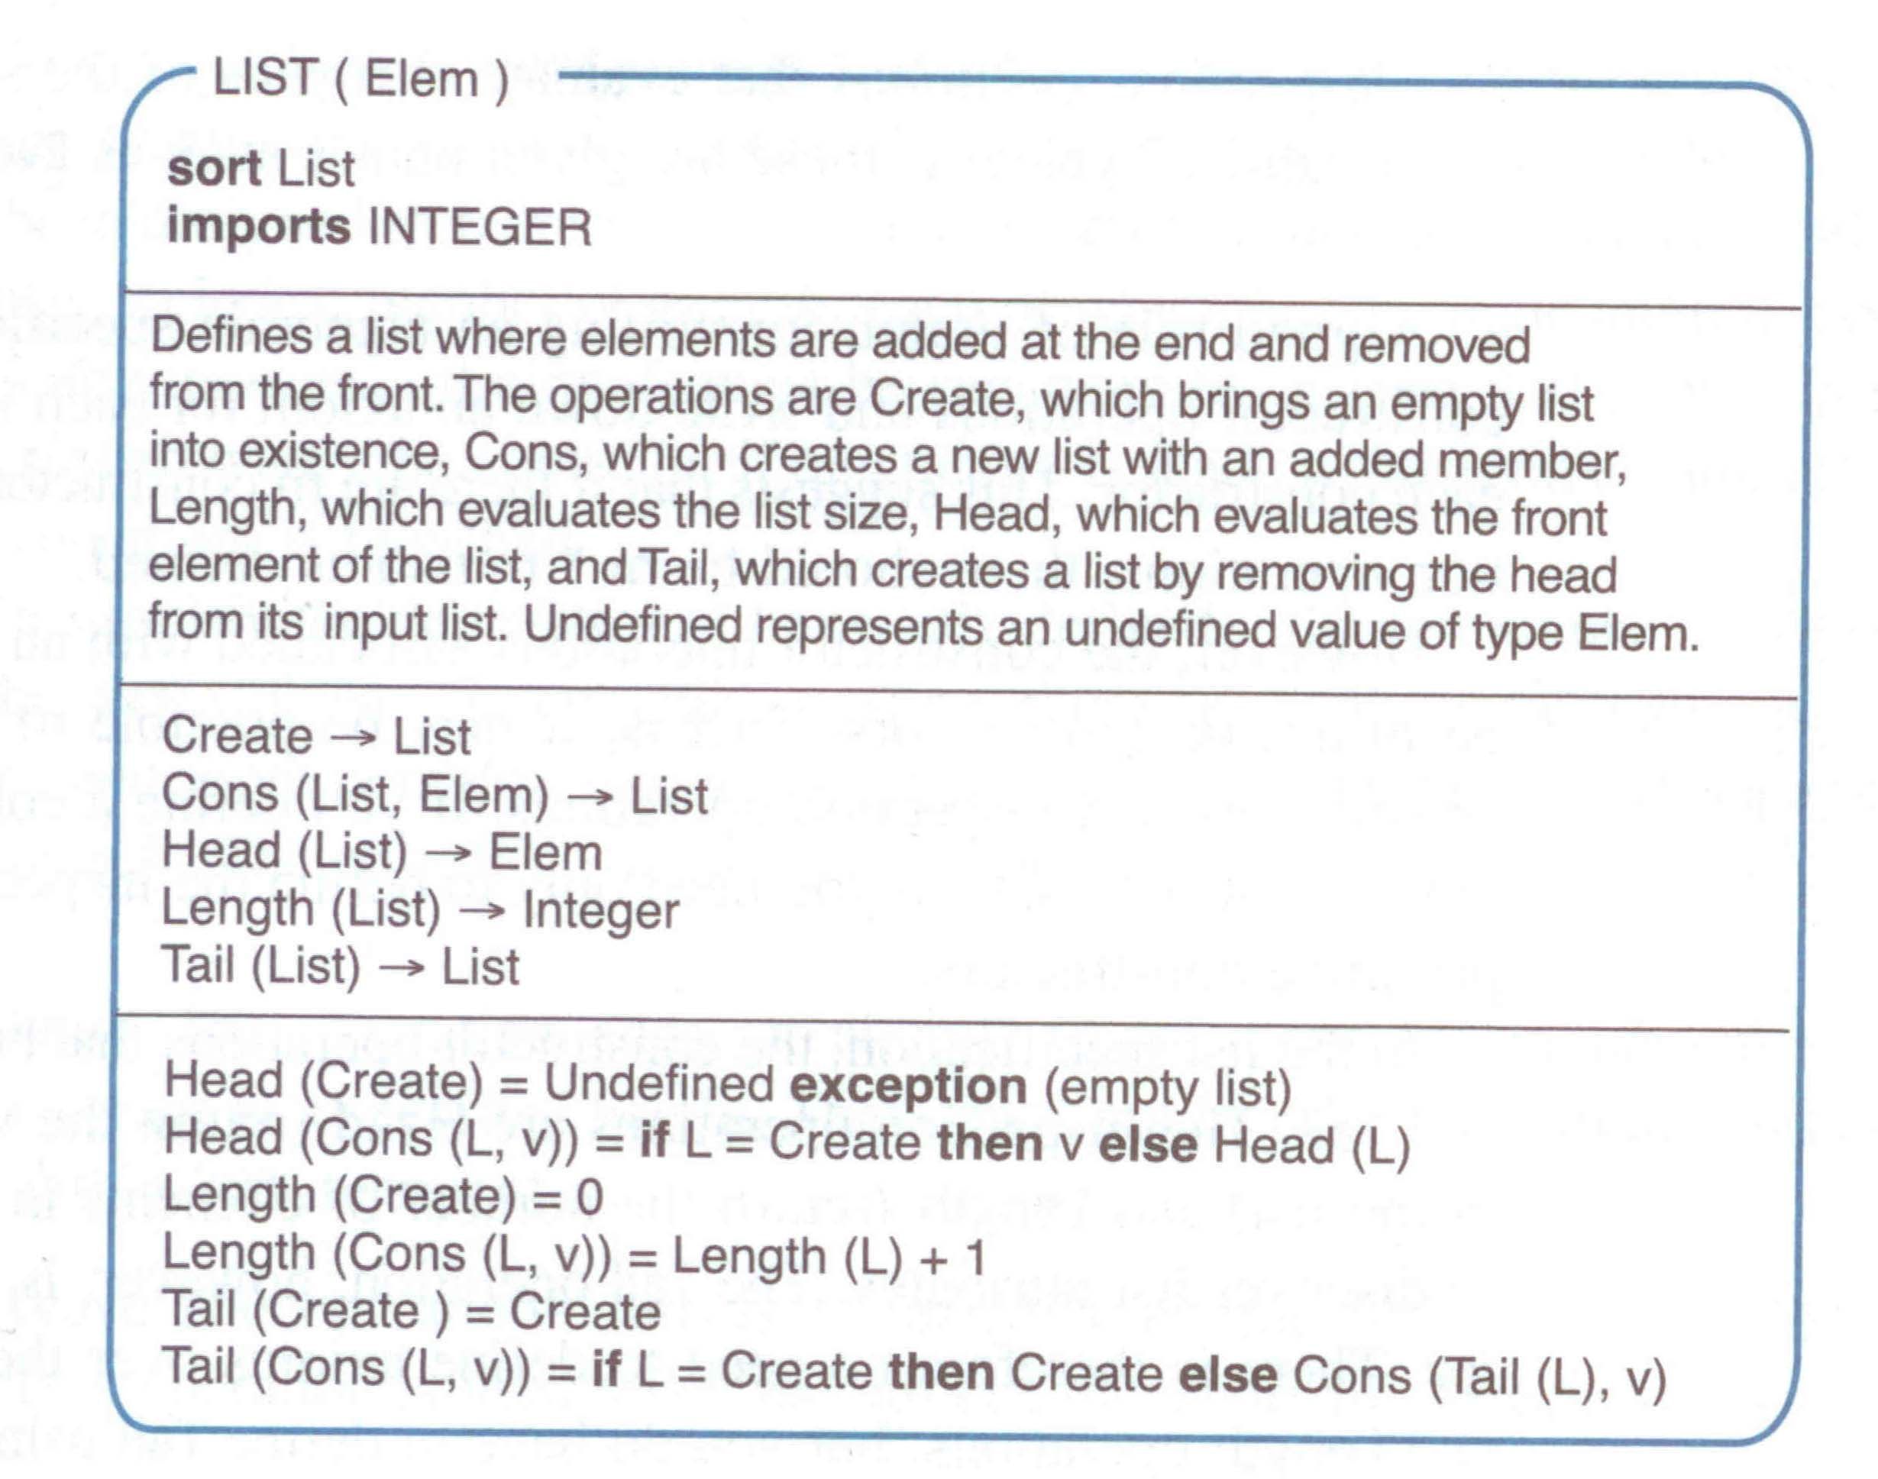

Slide 35
Recursion in specifications
Operations are often specified recursively.
Tail (Cons (L, v)) = if L = Create then Create
else Cons (Tail (L), v).
  Cons ([5, 7], 9) = [5, 7, 9]
  Tail ([5, 7, 9]) = Tail (Cons ( [5, 7], 9)) =
  Cons (Tail ([5, 7]), 9) = Cons (Tail (Cons ([5], 7)), 9) =
  Cons (Cons (Tail ([5]), 7), 9) =
  Cons (Cons (Tail (Cons ([], 5)), 7), 9) =
  Cons (Cons (Create, 7), 9) = Cons ([7], 9) = [7, 9]

Slide 36
Example: A sector object
Critical operations on an object representing a controlled sector are
  Enter. Add an aircraft to the controlled airspace;
  Leave. Remove an aircraft from the controlled airspace;
  Move. Move an aircraft from one height to another;
  Lookup. Given an aircraft identifier, return its current height;

Slide 37

Primitive operations
It is sometimes necessary to introduce additional operations to simplify the specification
The other operations can then be defined using these more primitive operations
Primitive operations
  Create. Bring an instance of a sector into existence
  Put. Add an aircraft without safety checks

Slide 38
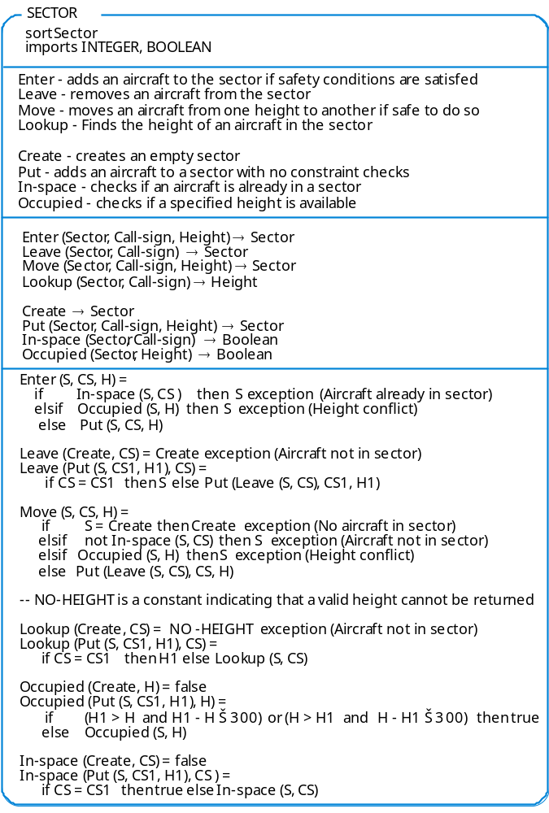

Slide 40

Behavioral specification
Model-based specification
  Abstract State Machine Language (AsmL)

Slide 41
Abstract State Machine Language (AsmL)
AsmL is an executable specification language for modelling the structure and behaviour of digital systems
Abstraction helps us reduce complex problems into manageable units and prevents us from getting lost in a sea of details
AsmL provides a variety of features that allow you to describe the relevant state of a system in a very economical, high-level way

Slide 42
State transitions
The behaviour of a machine (its run) can always be depicted as a sequence of states linked by state transitions
paint in green
A
B
paint in red
Moving from state A to state B is a state transition

Slide 43
Evolution of state variables
We can view any machine’s state as a dictionary of
(Name, Value)
pairs, called state variables
paint in green
A
B
paint in red
(Colour, Red) is a variable, where “Colour” is the name of variable, “Red” is the value

Slide 44
Example
Diagram shows the run of a machine that models how orders might be processed
Initialise
Process All Orders
S₁
Mode = “Initial”
Orders = 0
Balance = £0
S₂
Mode = “Active”
Orders = 2
Balance = £200
S₃
Mode = “Final”
Orders = 0
Balance = £500
Each transition operation:
can be seen as the result of invoking the machine’s control logic on the current state
calculates the subsequence state as output

Slide 45

Control Logic
The machine control logic is a black box that takes as input a state dictionary S₁ and gives as output a new dictionary S₂
input
mode | “Initial”
orders | 0
balance | £0
The Machine’s Control Logic
…
if mode = “Initial”
then mode := “Active”
output
Mode | “Active”
orders | 2
balance | £200
The two dictionaries S₁ and S₂ have the same set of keys, but the values associated with each variable name may differ between S₁ and S₂

Slide 46
Example.
Reading a file
var F as File? = undef
var Fcontents as String = “”
var Mode as String = “Initial”
Main()
step until fixpoint
if Mode = “Initial” then
F :=open(“mfile.txt”)
Mode :=“Reading”
if Mode = “Reading” and length(FContents) =0 then FContents :=fread (F,1)
if Mode = “Reading” and length(FContents) =1 then FContents := FContents + fread (F,1)
if Mode = “Reading” and length(FContents) >1 then
WriteLine (FContents)
Mode :=“Finished”

Slide 47
Example :Graph representation
Step 1
Step 2
S₁
F= undef
Fcontents =“”
Mode = Initial
S₂
F= <open file 1>
Fcontents =“”
Mode = Reading
S₃
F= <open file 1>
Fcontents =“a”
Mode = Reading
Step 3
S₄
F= <open file 1>
Fcontents =“ab”
Mode = Reading
S₅
F= <open file 1>
Fcontents =“ab”
Mode = Finished
Step5
Step 4

Slide 48
Behavioral specification
Model-based specification
  Z(Hayes, 1987;Spivey, 1992)
  Z Schema
    Schema signature
    Schema predicate

Slide 49
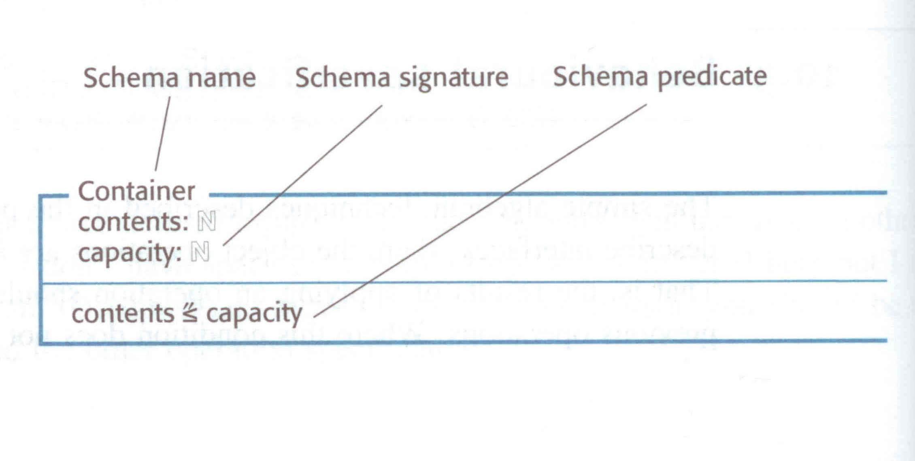

Slide 50
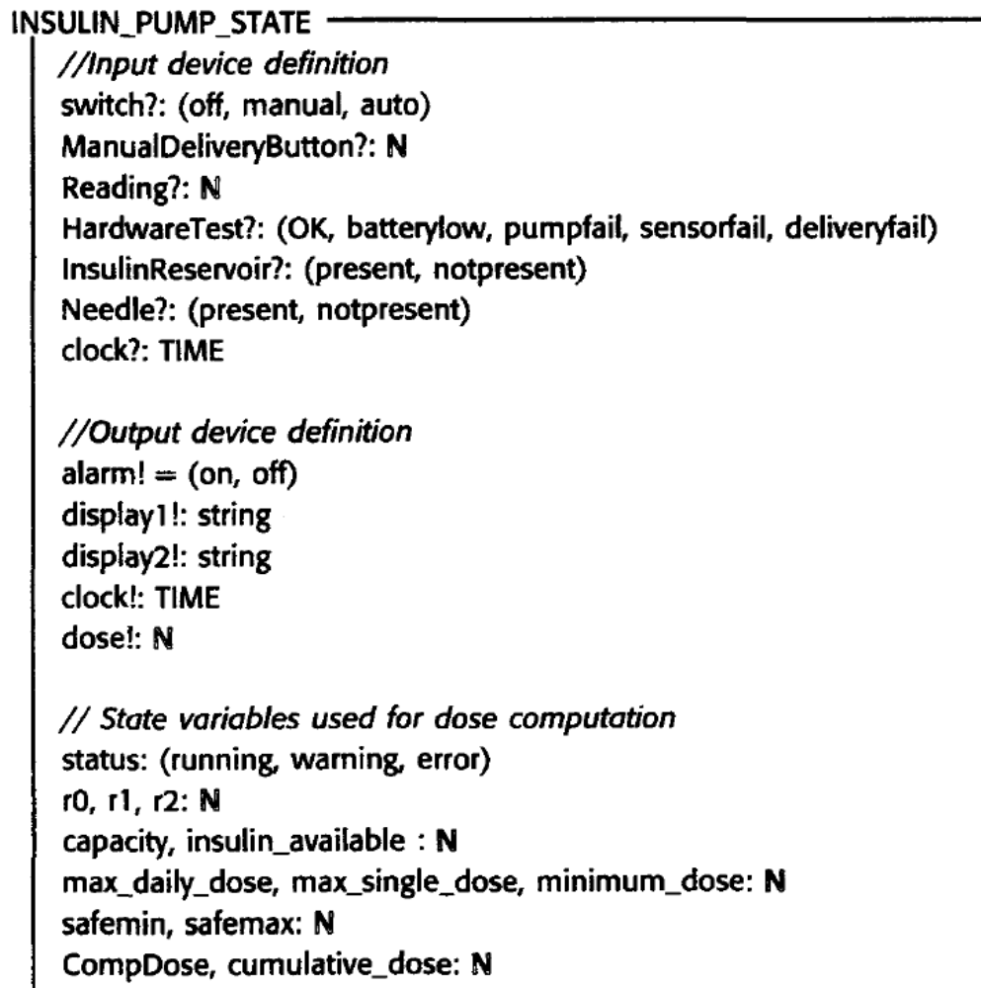
State Schema
for the insulin pump

Slide 51
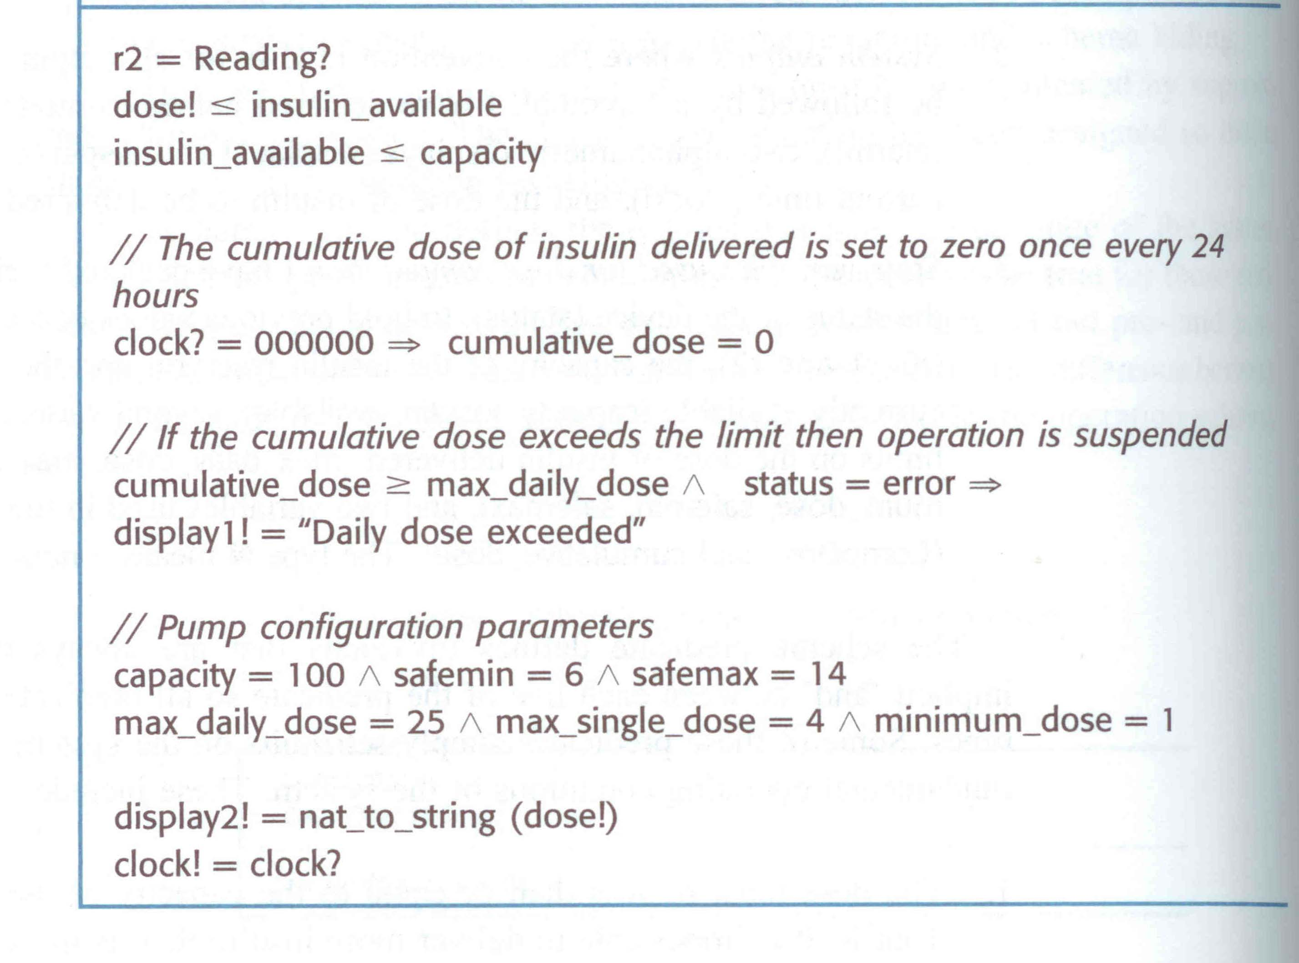

Slide 52
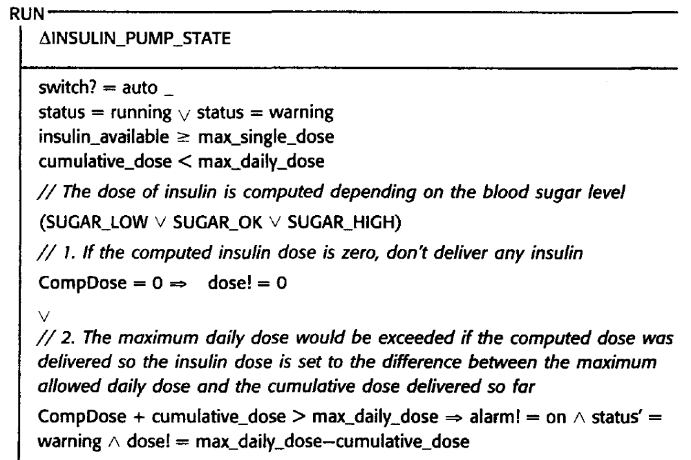

Slide 53
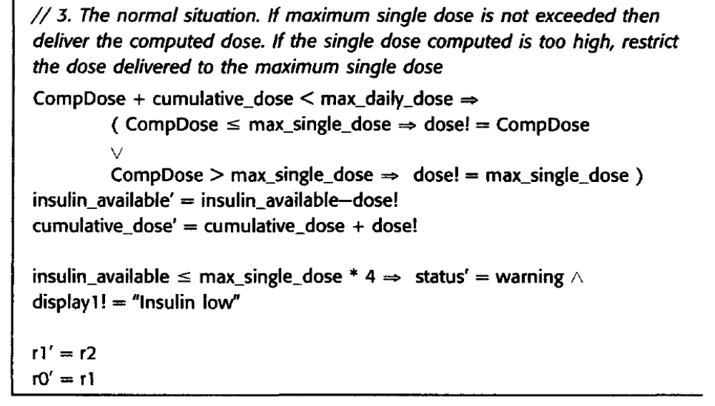

Slide 54
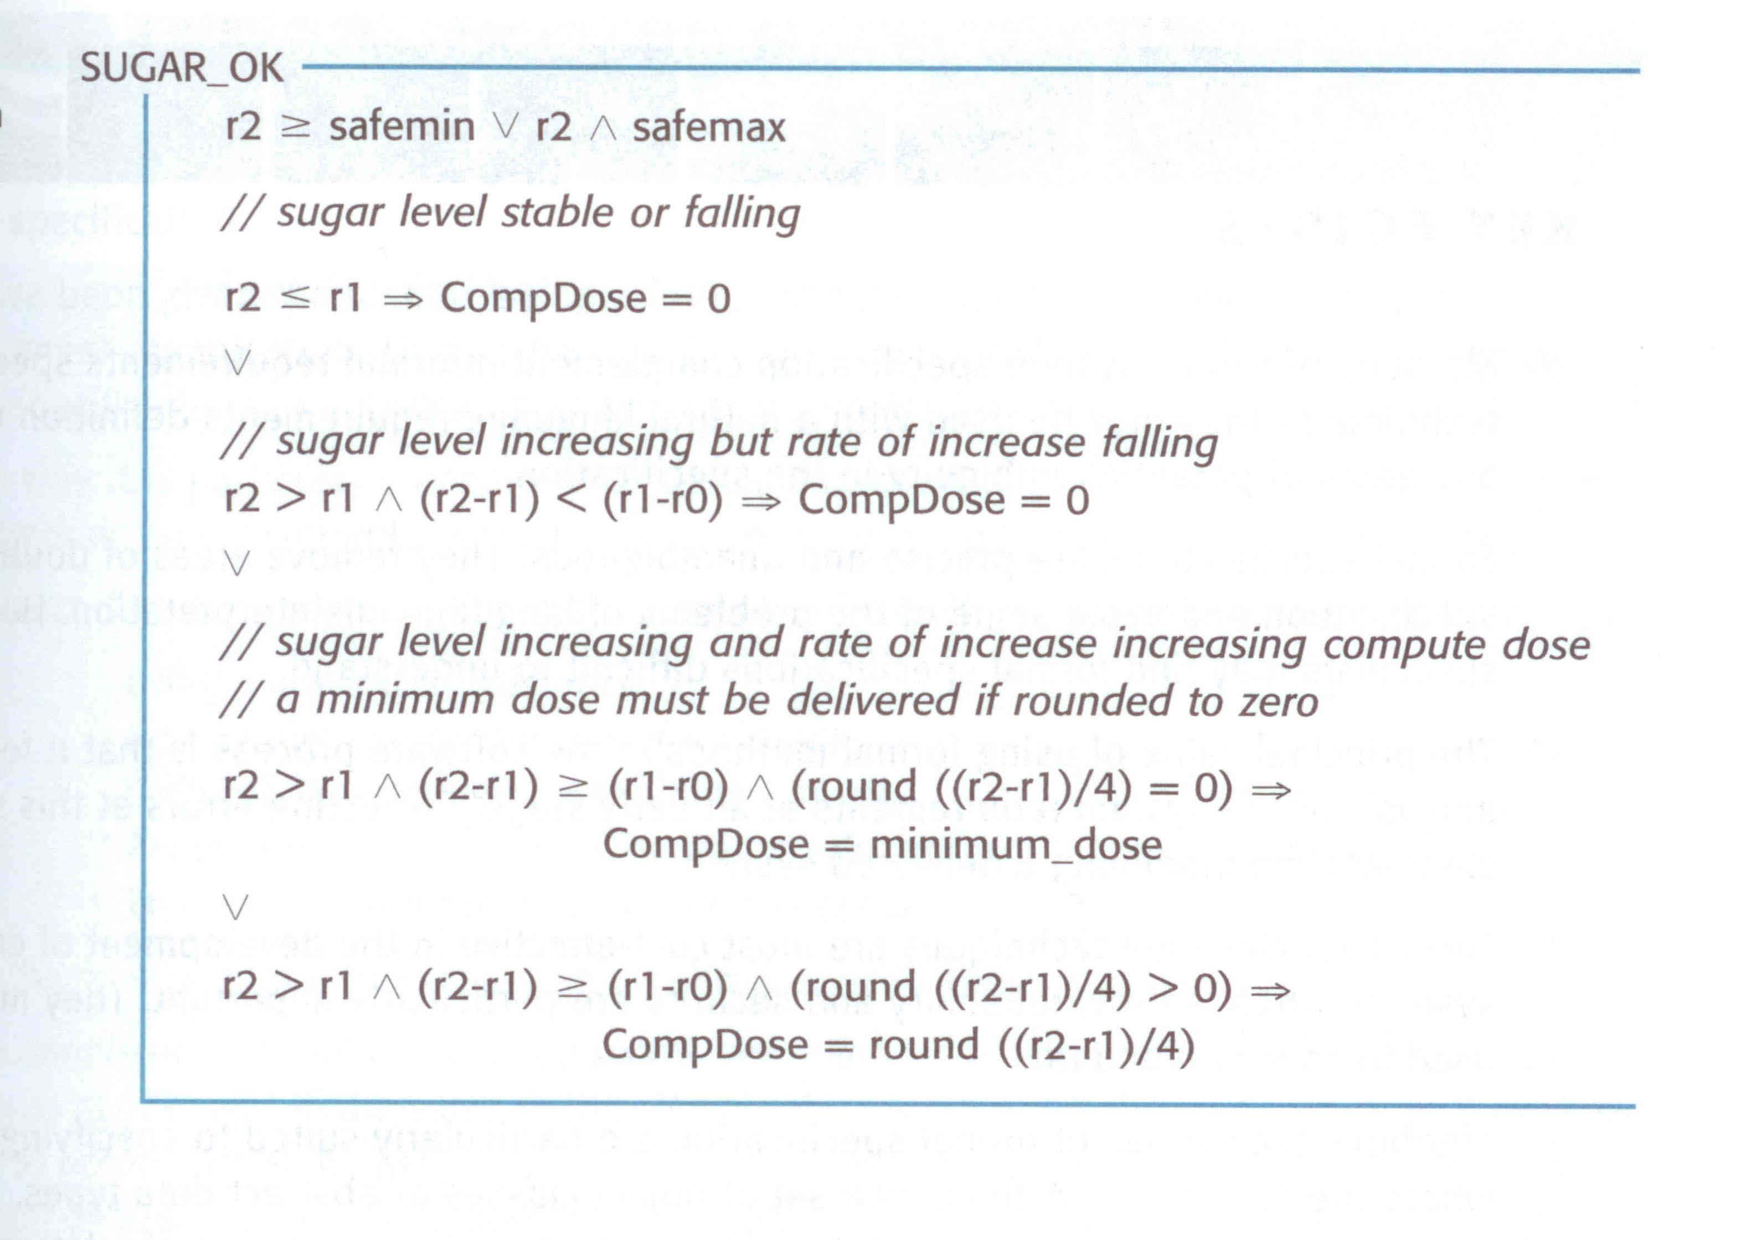

Slide 55
Thank You

