Slide 1
Software Engineering
Architectural design

Slide 2
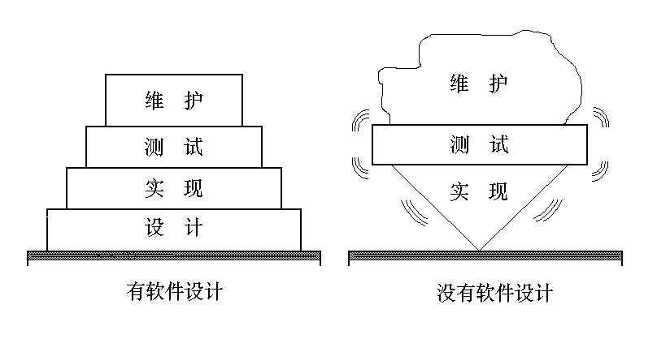
Software Design是后续开发步骤及软件维护工作的基础。如果没有设计，只能建立一个不稳定的系统结构

Slide 3

The Design Process
Design is the creative process of figuring out how to implement all of the customer’s requirements; the resulting plan is also called the design
Early design decisions address the system’s architecture
Later design decisions address how to implement the individual units

Slide 4
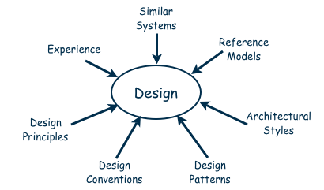
Design is a Creative Process
Many ways to leverage existing solutions
  Cloning: Borrow design/code in its entirely, with minor adjustments
  Reference models: Generic architecture that suggests how to decompose the system

Slide 5
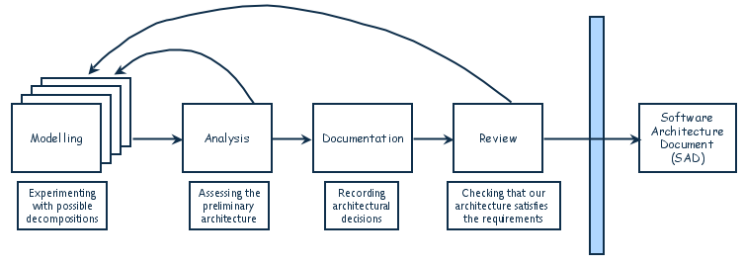
Design Process Model
Designing software system is an iterative process
The final outcome is the software architecture document

Slide 6
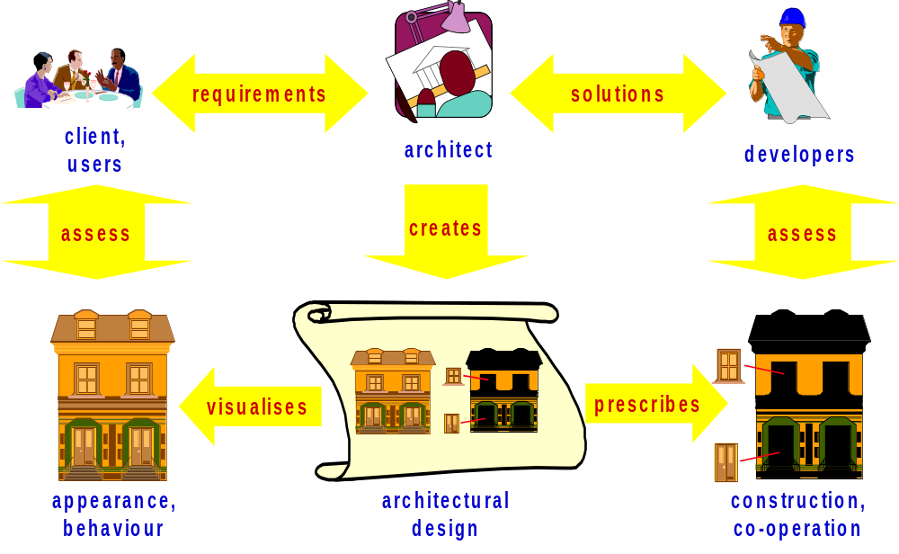
The Role of the Architect
Notes:
© SE, Architecture, Hans van Vliet
In a sense, the two elements on the lower left are new: the elements labeled appearance/behaviour, and the one labelled architectural design

Slide 7

Software Architecture (SA)
最早指出SA的重要性的是大师Edsger Dijkstra (1930-2002)
“..the larger the project, the more essential the structuring!”(1968)
Notes:
逝世于2002年8月6日

Slide 8
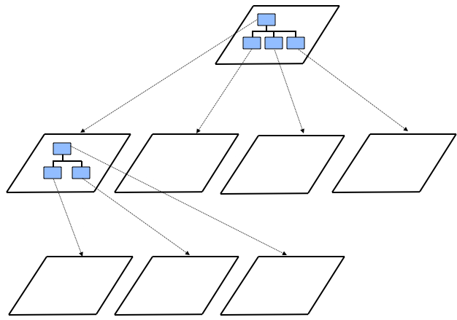
Decomposition and Views
High-level description of system’s key elements
Creating a hierarchy of information with increasing details
Top
level
First level of
decomposition
Second level of
decomposition

Slide 9
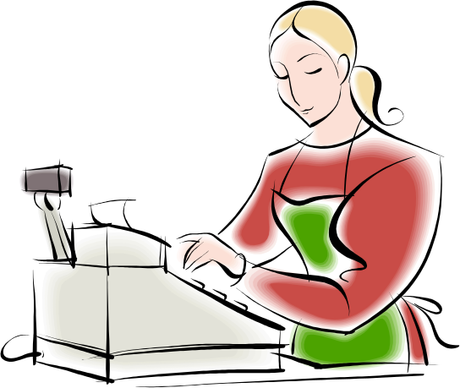
Popular Design Methods
Some design problems have no existing solutions
  Designers must decompose to isolate key problems
Some popular design methods:
  Functional decomposition
  Data-oriented decomposition
  Process-oriented decomposition
  Event-oriented decomposition
  Object-oriented design

Slide 10
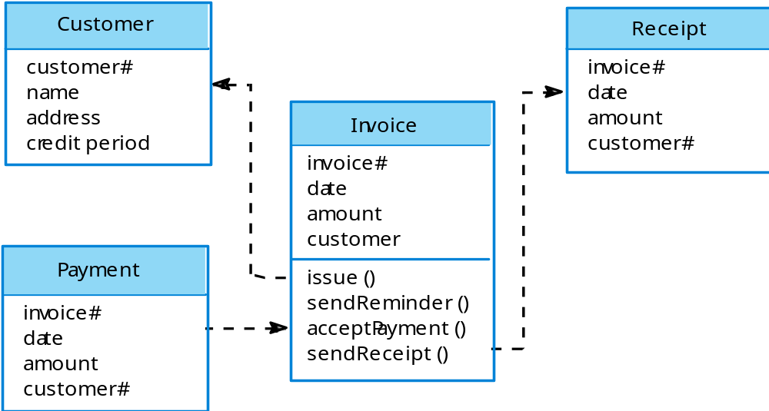
Invoice processing system

Slide 11
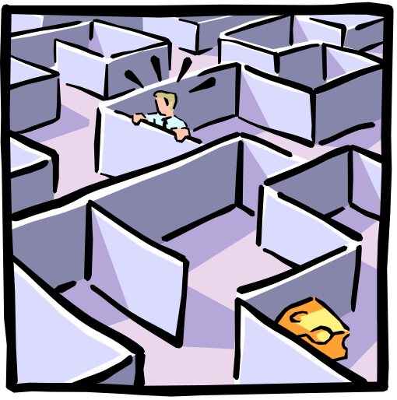
Introduction
Architectural design
  Identify sub-systems and establish a framework for sub-system control and communication
  Is the first stage in the design process

Slide 12
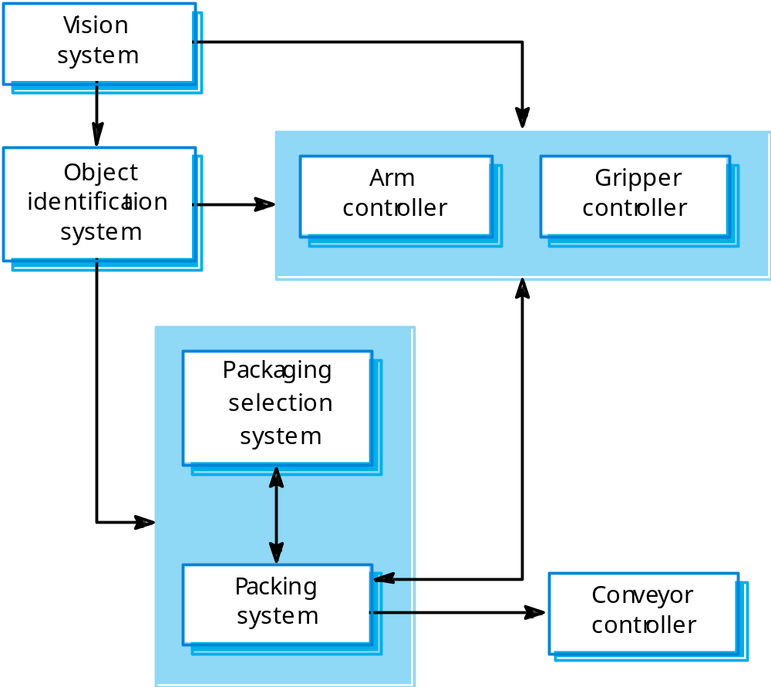
Packing robot control system

Slide 13
Architectural Styles and Strategies
Pipes-and-Filter
Client-Server
Peer-to-Peer
Publish-Subscribe
Repositories
Layering

Slide 14
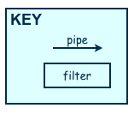
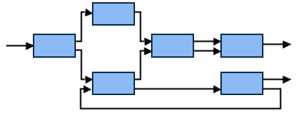
Architectural Styles：Pipes-and-Filter
The system has
  Streams of data (pipe) for input and output
  Transformation of the data (filter)
KEY
pipe

Slide 15
Architectural Styles：Pipes-and-Filter
Several important properties
  The designer can understand the entire system's effect on input and output as the composition of the filters
  The filters can be reused easily on other systems
  System evolution is simple
  Allow concurrent execution of filters
Drawbacks
  Not good for handling interactive application
Data-flow model

Slide 16
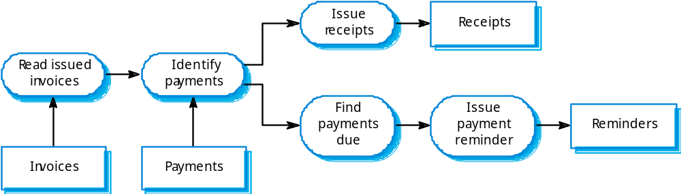
Architectural Styles：Pipes-and-Filter
A pipeline model of an invoice processing system

Slide 17
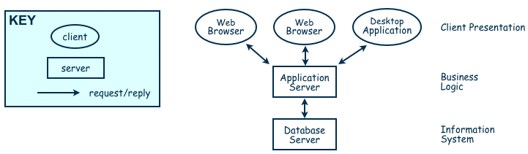
Architectural Styles：Client-Server
Two types of components:
  Server components offer services
  Clients access them using a request/reply protocol

Slide 18
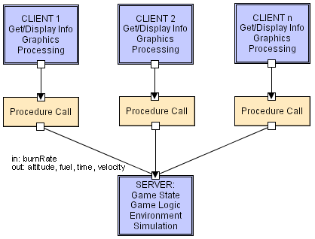
Client-Server
Software Architecture: Foundations, Theory, and Practice; Richard N. Taylor, Nenad Medvidovic, and Eric M. Dashofy; © 2008 John Wiley & Sons, Inc. Reprinted with permission.

Slide 19
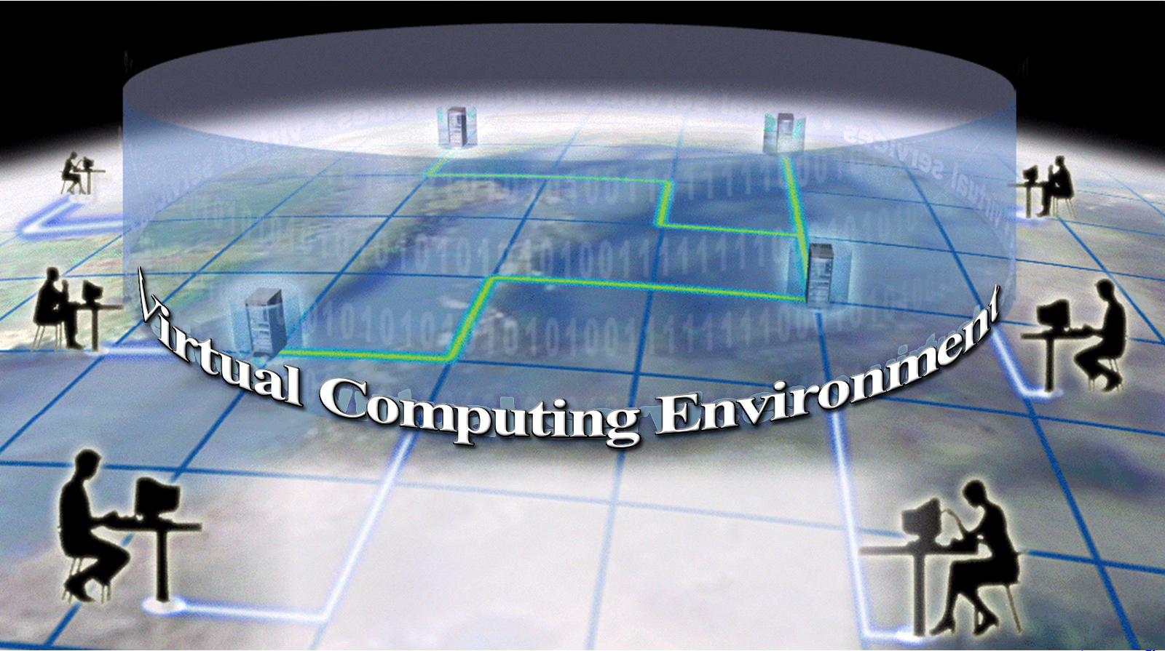
Architectural Styles：Client-Server
Major components of this model
  A set of servers
  A set of clients
  A network
Processing
Data
Applications

Slide 20
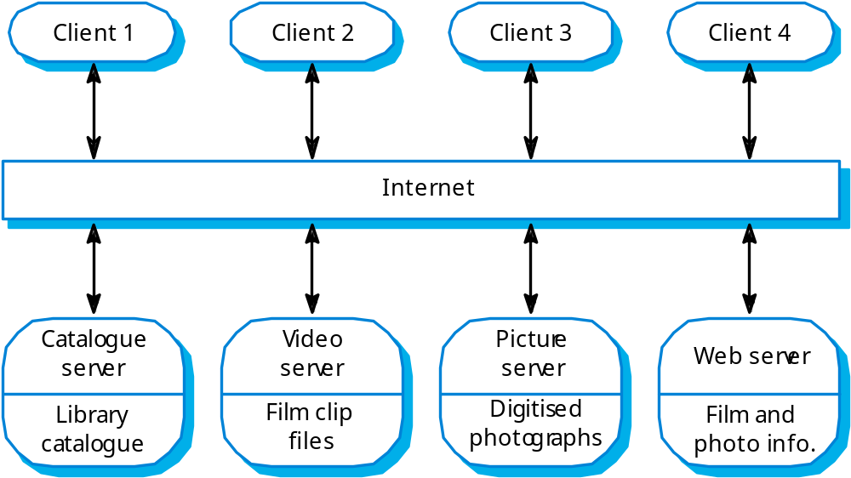
Film and picture library

Slide 21
Architectural Styles：Peer-to-Peer (P2P)
Each component acts as its own process and acts as both a client and a server to other peer components.
Any component can initiate a request to any other peer component.
Characteristics
  Scale up well
  Increased system capabilities
  Highly tolerant of failures

Slide 22
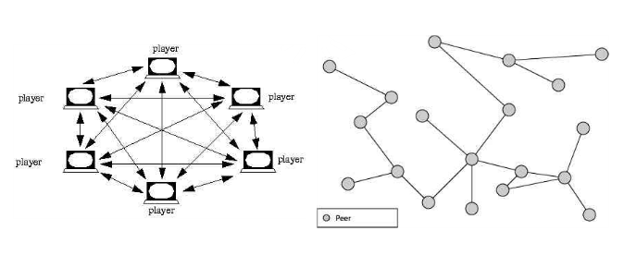
Peer-to-Peer

Slide 23

Architectural Styles：Publish-Subscribe
Components interact by broadcasting and reacting to events
  Component expresses interest in an event by subscribing to it
  When another component announces (publishes) that event has taken place, subscribing components are notified

Slide 24
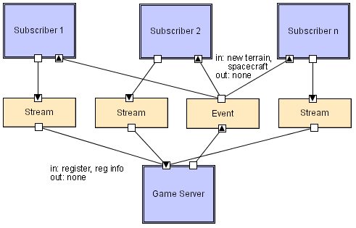
Pub-Sub

Slide 25
Architectural Styles：repository
Two components
  A central data store
  A collection of components that operate on it to store, retrieve, and update information
The challenge is deciding how the components will interact
  A traditional database: transactions trigger process execution
  A blackboard: the central store controls the triggering process

Slide 26
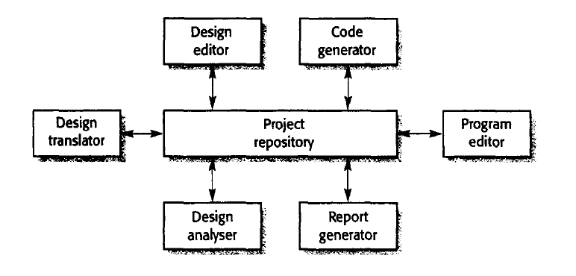
The repository model
The architecture of an integrated CASE toolset

Slide 27
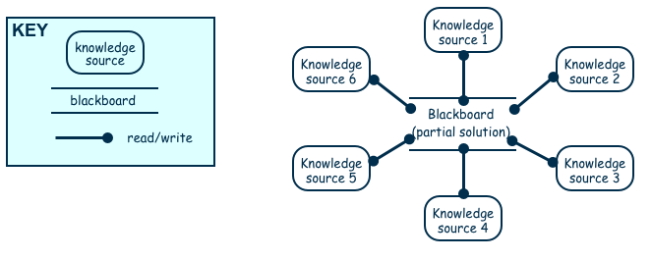
Architectural Styles：repository
Major advantage: openness
  Data representation is made available to various programmers (vendors) so they can build tools to access the repository
  But also a disadvantage: the data format must be acceptable to all components

Slide 28

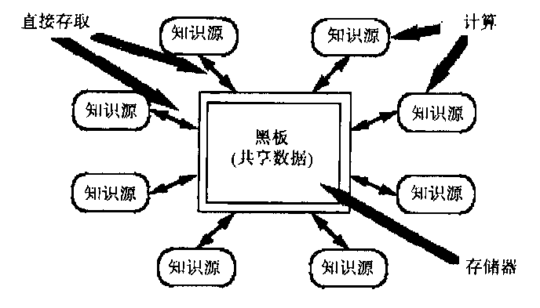
黑板系统
是独立、分离的与应用程序相关的知识。
它们之间的交互通过黑板完成。
按照与应用程序相关的层次来组织的解决问题的数据。知识源不断地改变黑板来解决问题。
黑板系统中没有部件的显式表示，控制完全由黑板的状态驱动。黑板状态的改变决定使用特定知识。

Slide 29
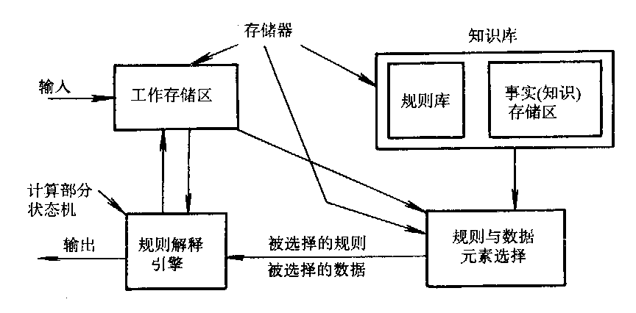
专家系统
工作存储区作为数据和程序状态区
要执行的伪码是知识库
解释引擎内部控制状态是由规则和数据元素选择器承担
解释引擎是规则解释器

Slide 30
Architectural Styles：Layering
Layers are hierarchical
  Each layer provides service to the one outside it and acts as a client to the layer inside it
Advantages
  High levels of abstraction
  Relatively easy to add and modify a layer
Disadvantages
  Not always easy to structure system layers
  System performance may suffer from the extra coordination among layers

Slide 31
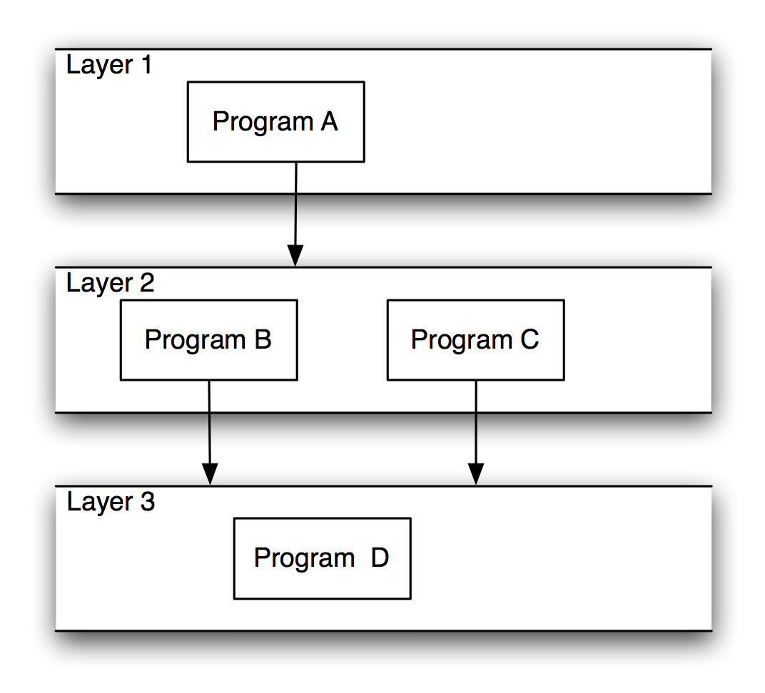
Layered Systems/Virtual Machines

Slide 32
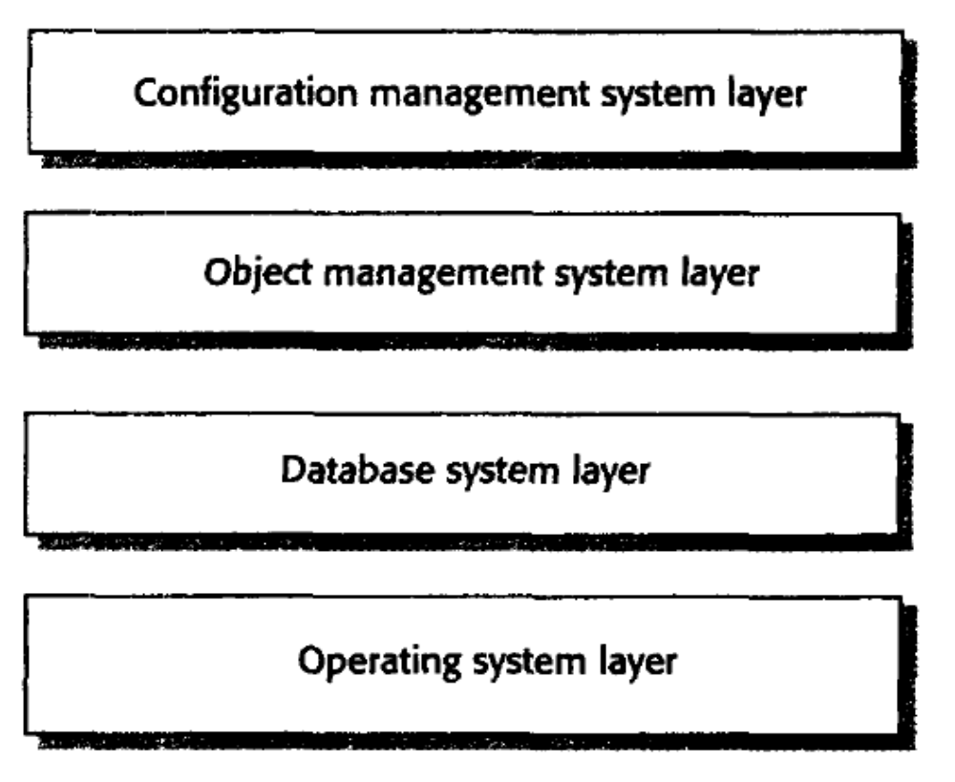
Architectural Styles：Layering
Sometimes called abstract machine model
Organizes a system into layers
Layered model of a version management system

Slide 33
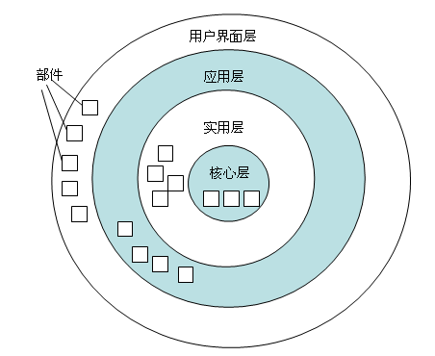
layered model

Slide 34
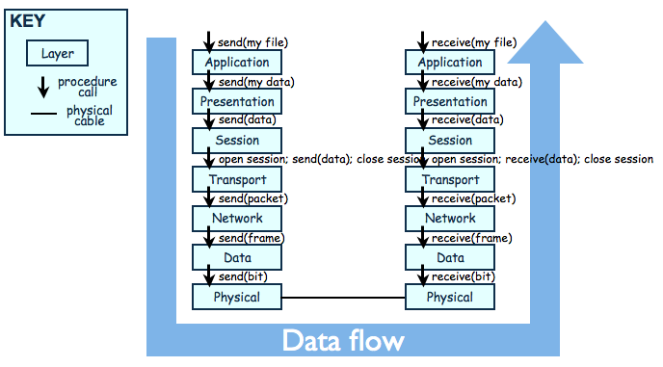
The OSI Model

Slide 35
Architectural Styles and Strategies
Combining Architectural Styles
Actual software architectures rarely based on purely one style
Architectural styles can be combined in several ways
  Use different styles at different layers
  Use mixture of styles to model different components or types of interaction
If architecture is expressed as collection of models, documentation must be created to show relation between models

Slide 36
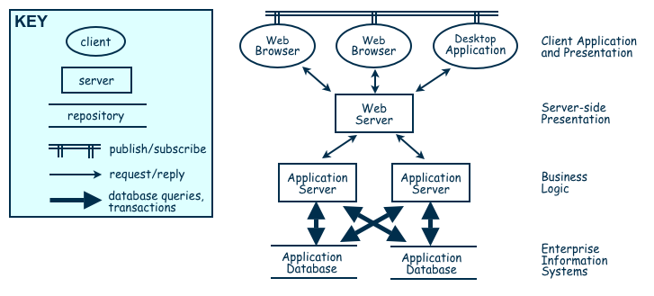
Combination of Publish-Subscribe, Client-Server, and Repository Architecture Styles

Slide 37

Control styles
Sub-system must be controlled
Two generic control styles
  Centralized control
    One sub-system has overall responsibility for control and starts and stops other sub-systems
  Event-based control
    Each sub-system can respond to externally generated events

Slide 38
Centralized control
Centralized control model
  One sub-system is designated as the system controller and has responsibility for managing the execution of other sub-systems
Whether the controlled sub-systems execute sequentially or in parallel
  The call-return model, (top-down subroutine model)
  The manager model, (one system component is designated as a system manager and controls the starting, stopping and coordination of other system processes)

Slide 39
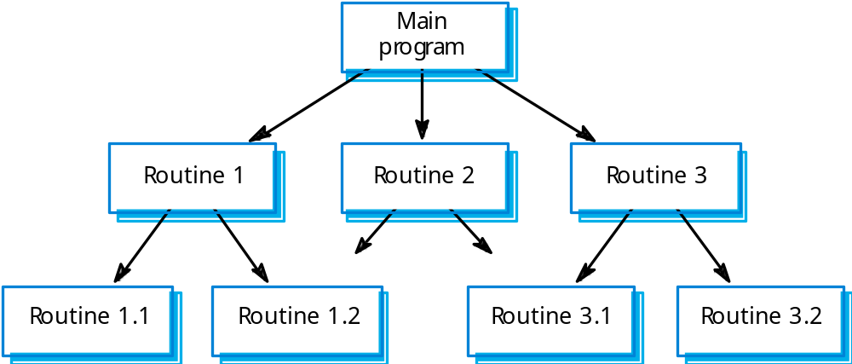
Call-return model

Slide 40
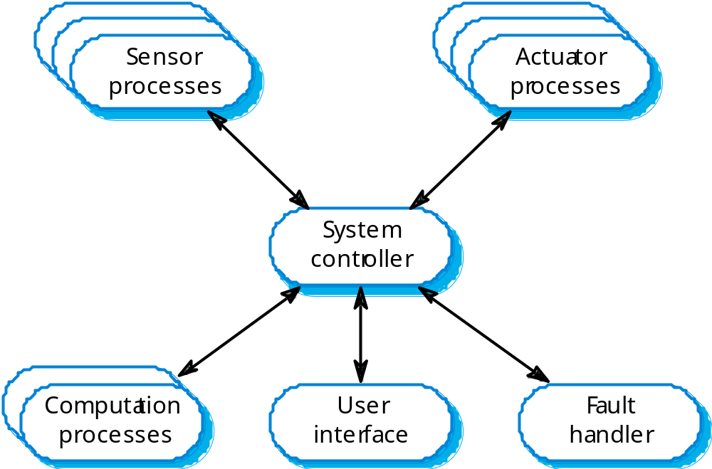
Real-time system control

Slide 41
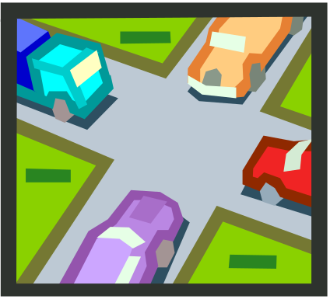
Event-driven systems
Event
  May be a signal that can take a range of values or a command input from a menu
Two event-driven control models
  Broadcast models
  Interrupt-driven models

Slide 42
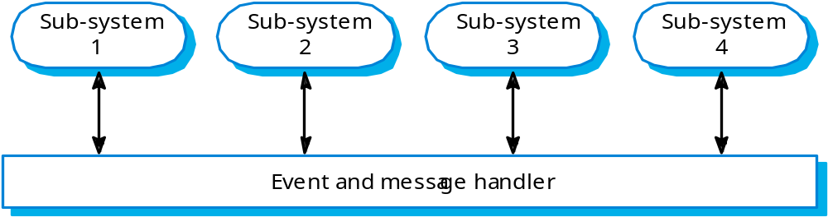
Event-driven systems
Broadcast model
  Sub-system register an interest in specific events
  All events could be broadcast to all sub-systems

Slide 43
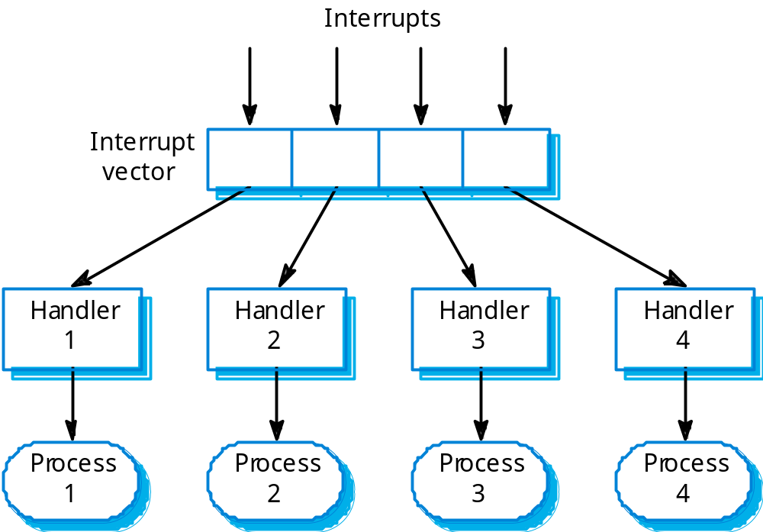
Interrupt-driven control

Slide 44
Achieving Quality Attributes
Reliability
A software system is reliable if it correctly performs its required functions under assumed conditions
  Is the software internally free of errors?
A fault is the result of human error, compared to a failure, which is an observable departure from required behaviour

Slide 45

Architecture Evaluation and Refinement
Safety Analysis
Several techniques during design to identify possible faults
Fault-tree analysis traces backwards through a design
  Trees then used to determine which faults to correct/avoid/tolerate

Slide 46
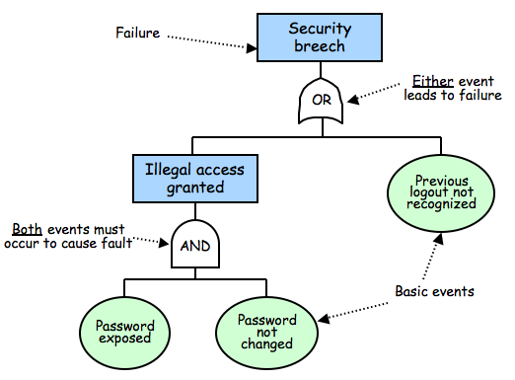
Architecture Evaluation and Refinement
Safety Analysis (continued)

Slide 47
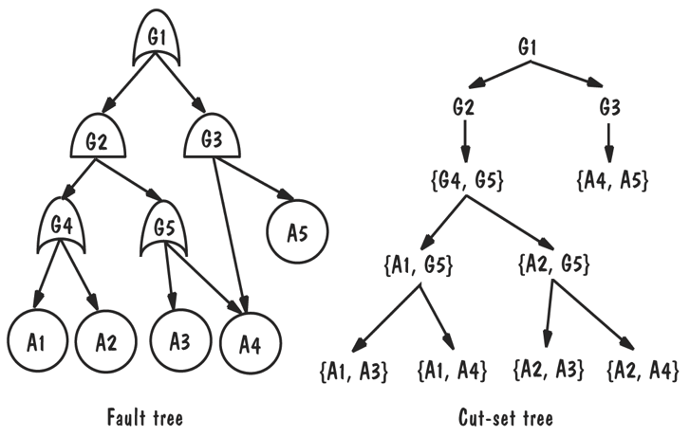
Architecture Evaluation and Refinement
Safety Analysis (continued)

Slide 48
Cut-set tree reveals event combinations can cause failure
  Rules for forming cut-set tree:
    Assign the top node of the cut-set tree to match the logic gate at the top of the fault tree.
    Working from the top down, expand the cut-set tree as follows:
      Expand an or-gate node to have two children, one for each or-gate child
      Expand an and-gate node to have a child composition node listing both of the and-gate children
      Expand a composition node by propagating the node to its children, but expanding one of the gates listed in the node
    Continue until all leaf nodes are basic events or composition nodes of basic events

Slide 49
Design Principles
Modularity
Modularity is the principle of keeping separate the various unrelated aspects of a system, so that each aspect can be studied in isolation
  each module will be easy to understand and develop
  easier to locate faults (because there are fewer suspect modules per fault)
  Easier to change the system (because a change to one module affects relatively few other modules
To determine how well a design separates concerns, we use two concepts that measure module independence: coupling and cohesion

Slide 50
Design Principles
Coupling
Two modules are tightly coupled when they depend a great deal on each other
Loosely coupled modules have some dependence, but their interconnections are weak
Uncoupled modules have no interconnections at all; they are completely unrelated
Uncoupled -
no dependencies
Loosely coupled -
some dependencies
Tightly coupled -
many dependencies

Slide 51
Design Principles
Cohesion
Cohesion refers to the dependence within and among a module’s internal elements (e.g., data, functions, internal modules)
Coincidental
Logical
Temporal
Procedural
Communicational
Functional
Informational
LOW COHESION
HIGH COHESION

Slide 52
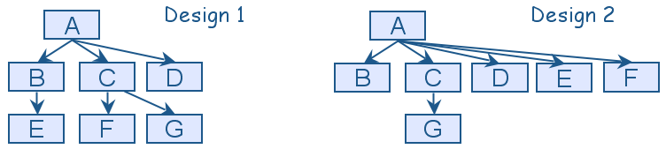
Design Principles
Uses graphs for two designs
  Fan-in refers to the number of units that use a particular software unit
  Fan-out refers to the number of units used by particular software unit

Slide 53
♠ 扇出 = 一个模块直接调用\控制的模块数。 3 ≤ fan-out ≤ 9
A
A的扇出
♠ 扇入 = 直接调用该模块的模块数
在不破坏独立性的前提下，fan-in 大的比较好。
A的扇入
A

Slide 54

选择适当的深度、宽度、扇出和扇入
♠ 深度 = 分层的层数。过大表示分工过细。
♠ 宽度 = 同一层上模块数的最大值。过大表示系统复杂度大。

Slide 55
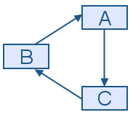
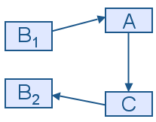
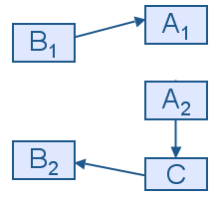
Design Principles
We can try to break a cycle in the uses graph using a technique called sandwiching
  One of the cycle’s units is decomposed into two units, such that one of the new units has no dependencies
  Sandwiching can be applied more than once, to break either mutual dependencies in tightly coupled units or long dependency chains

Slide 56
Thank You

