Slide 1
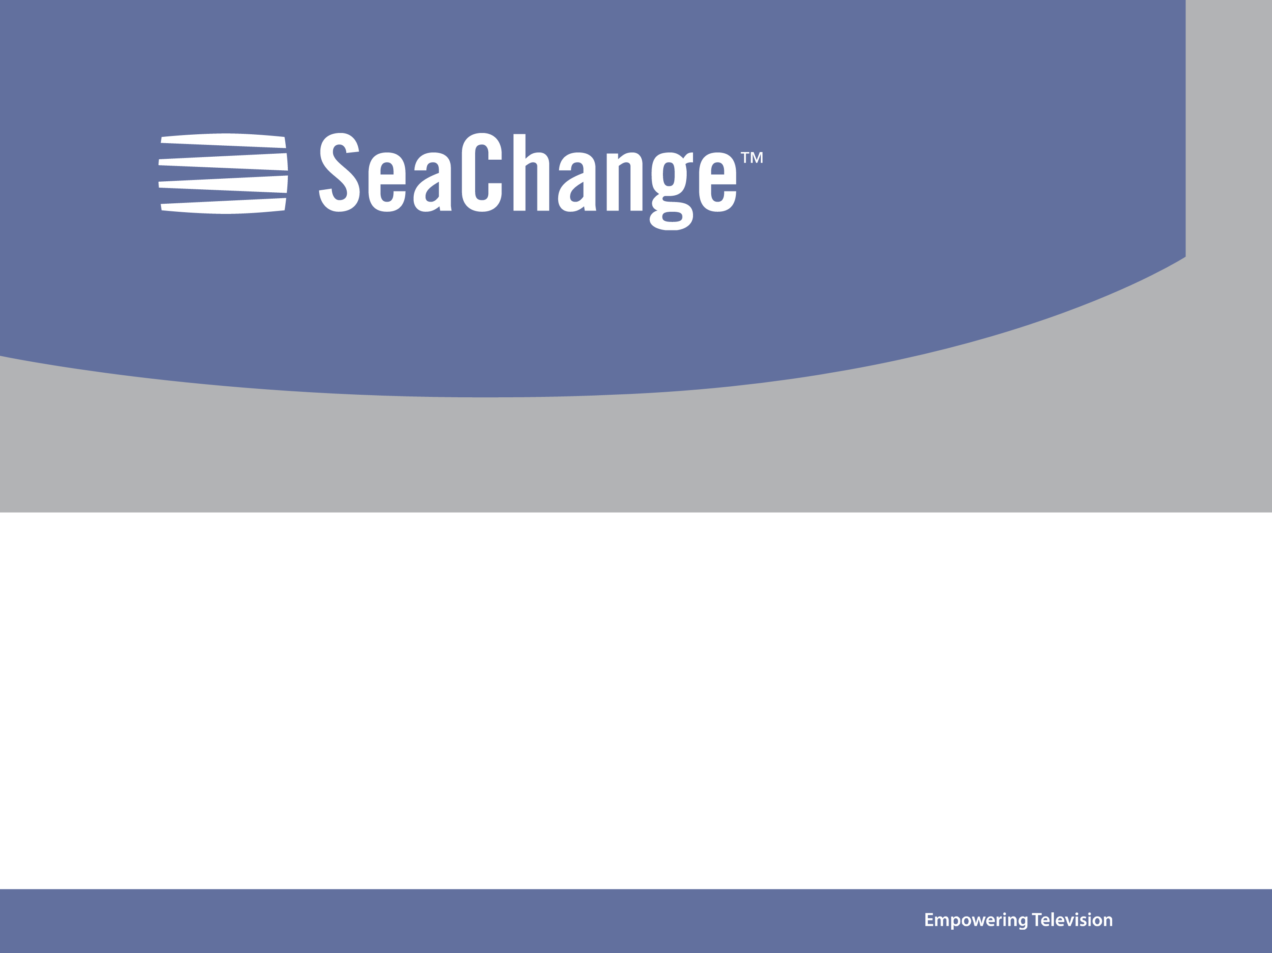
TianShan Arch Introduction
Hui Shao, 2006

Slide 2
Table of Contents
Axiom overview
Why isn’t Axiom “an open system”
Tianshan Arch
  Interfaces and components
Various deployment support

Slide 3
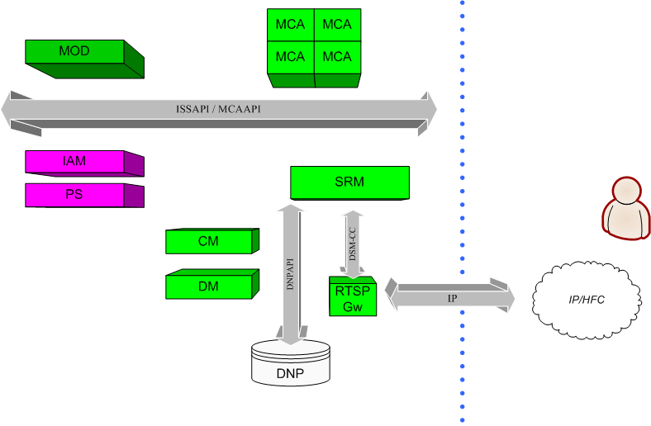
Axiom

Slide 4
Why isn’t SeaChange “an open system”
“Axiom was designed for its MOD application”
It is painful to host a new application or business logic other than MOD
  A client to drive VOD thru Axiom’s MOD or Zero application. Samples like autoplay.
  An application with ISSAPI, a misled story: STV_playback
  Long and complex work flow to add new bushiness logic
  Hardly to add user data, could be filter out at any step
  Valuable features go to naught: splicing, advertising and so on

Slide 5
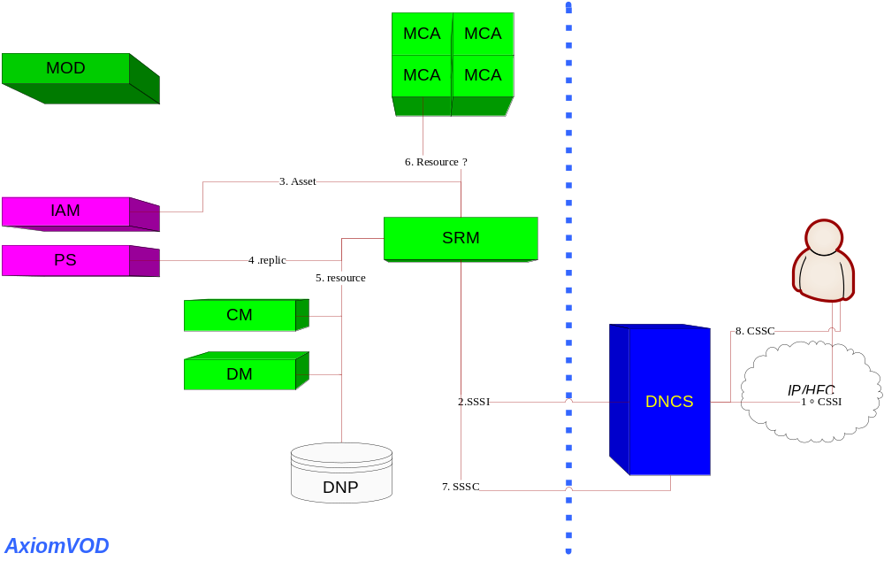
Why isn’t SeaChange “an open system”
Notes:
No application service is really involved during session setup
Who should translate the asset ordered: application service, not any others
Resource is pre-assigned before application is touched
Axiom SRM and DNCS is loosely connected

Slide 6
Why isn’t SeaChange “an open system”
Reason 1. Axiom was designed for MOD
  IAM, IPS, ICM, ISRM and more knew everything about the MOD application. Business logic has never been touched until session has been set up
    The first entry to MOD: SSAPI_OnNewStream() – too late
    The ordered asset is not explained by business logic but by ISRM and IAM
    Some reserved doors opened for SeaChange’s own MOD but not for any other 3rd party applications
Reason 2. Loose connection to headend
  DNP: a data duplicate of headend configuration – easy to be out of date
  Closed session setup procedure cycle
  Lack of interactions with 3rd party SRM
Notes:
Failures when DNP not match 3rd party. Session failures keep happening. Penaty??

Slide 7
The bad boys
ISRM
  Knew too much then has been too fat
  Learn nothing then “close”
ICM
  Is it a slave of ISRM because ISRM has been too fat?
IDM and DNP
  The duplicates of Headend settings but designed for SeaChange components, settings are static and easy to be out of date
  Weak remediation: penalty mechanism
IAM (IDS)
  Why tells others so much about its MOD knowledge and take place of the business logic
Notes:
Knew too much: asset, rtsp, dsmcc, mediacluster(query content with many mod-oriented data)
Learn nothing: hard to extend on work flow
ICM: multiple copy for service groups
Slave: has to work with ISRM

Slide 8
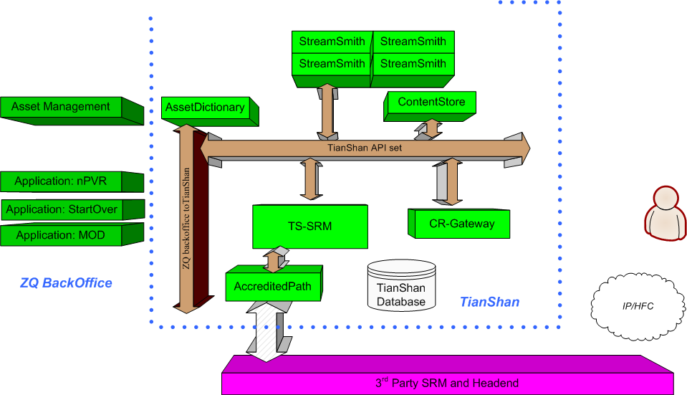

The Tianshan Architecture
glancing resource requirement collection
Resource narrowing
Notes:
Order a stream
Create session
Do application logic routing
Application service

Slide 9
Interfaces and Components
Object-oriented Interfaces: Tianshan API
  Session and Resource
  AccreditedPath ticketing and integration ticketing
  Streamer
  ContentStore
  Asset Dictionary
TS-SRM (Weiwoo)
  Business logic router: determine which application service should be invoked with a specific session setup context
  Session management: a database-powered entity management with lifecycle management
  Load balancing
  Resource Proxy, resource data schema and gateway to SRM
AccreditedPath
  An automation to find potential streaming network path with give parameters: 3 entities and 2 links
  A ticketing system and lifecycle management, portable narrowing algorithm
  Work as a SRM simulation when 3rd-party SRM is not available

Slide 10
Interface and Components (continued)
StreamSmith
  The implementation of Streamer
  Server-side playlist executor
  The consumer of AccreditedPath ticket
CR-Gateway
  A gateway to translate client request (RTSP, DSMCC and more) to Tianshan API
    Session setup
    Stream control
  Client connection management
  Scalable – system capability
ContentStore - a proxy of a content storage
  Implementation of ContentStore Interface
  Various content provision methods and management
  Agent of content propagation
  Commander of media process
Tianshan API to 3rd Party API gateway – a set of components for integration
  i.e. AssetDictionary

Slide 11
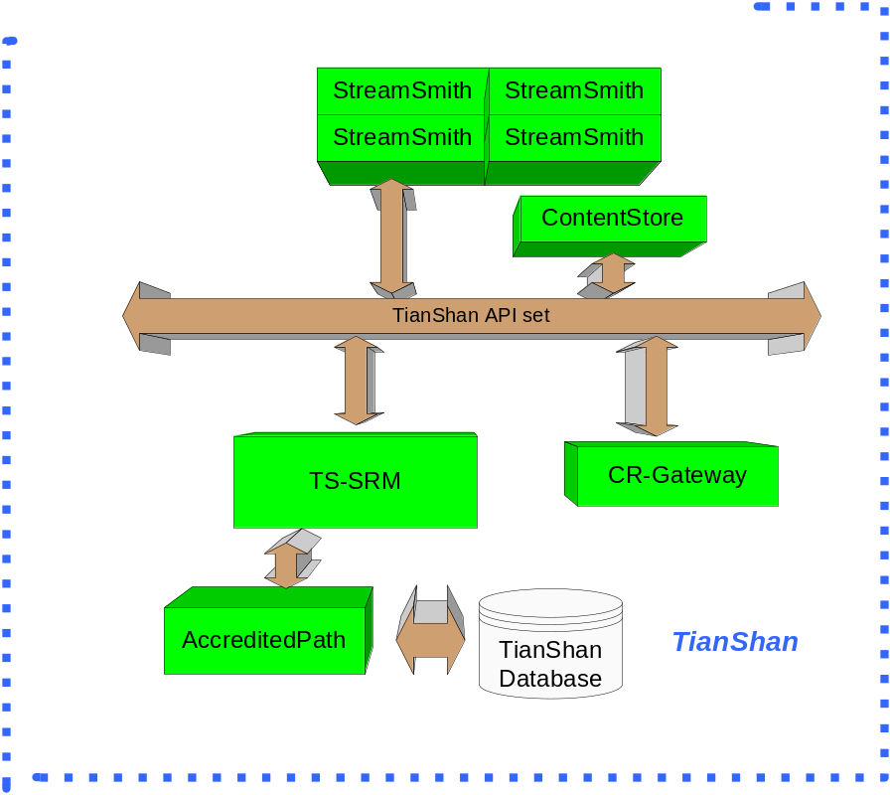
Derived Deployment (1- standalone)
No 3rd-party SRM then we create a local database definition to configure the resource
The application can be as simple as something embedded in side of StreamSmith plugin

Slide 12
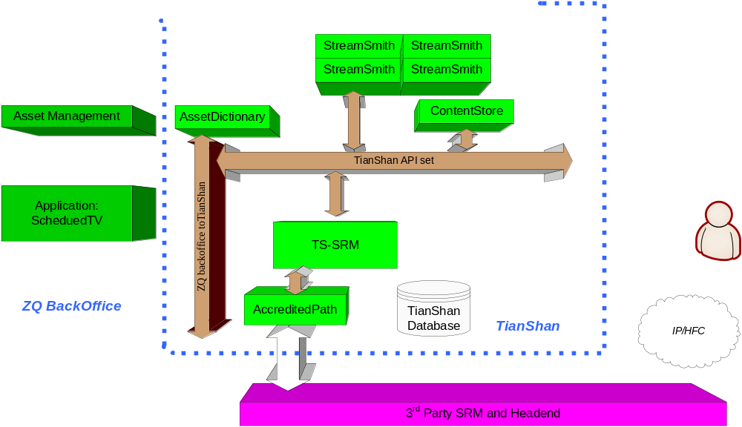
Derived Deployment (2 – server-driven application)
Notes:
ScheduledTV as an example, used must have a client-side to start a session
CR-gateway is unnecessary
Application server order stream directly thru TianShan API

Slide 13
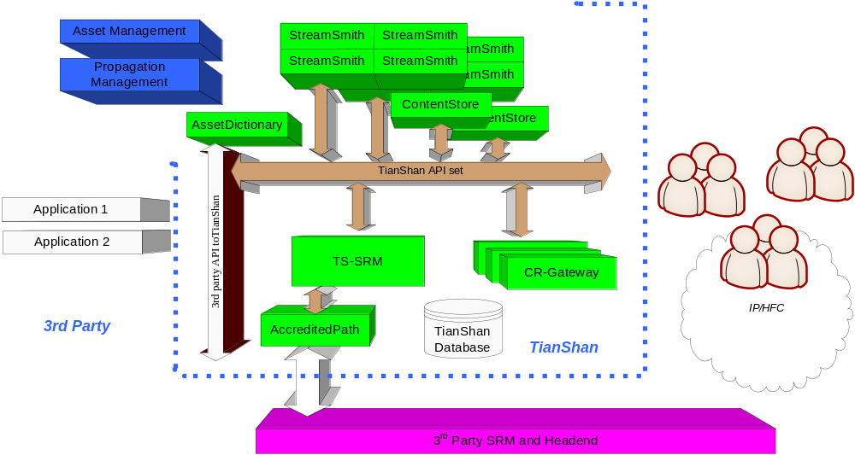
Derived Deployment (more: 3rdParty and high load)
Notes:
3rd party API to TianShan API gateway
Multiple CR-Gateway to handle requests from more clients
More contentStore and streamers to provide powerful streaming
Asset management is powered with propagation management

Slide 14
Summary
Business logic oriented
  Support various applications
  End-user friendly
Network oriented
  Integration opportunities
  Real time network condition
Scalability and Balancing

