Slide 1
Building parallelized apps with .NET and Visual Studio
SAC-808T
Stephen Toub
Principal Architect
Microsoft Corporation

Slide 2
Agenda
WHO WILL BENEFIT FROM THIS TALK
TOPICS
WHAT YOU’LL LEAVE WITH
.NET developers:
familiar with parallel programming support in Visual Studio 2010 and .NET 4
interested in parallelism, concurrency, and asynchrony
.NET 4 &Visual Studio 2010: Recap
.NET 4.5 & Visual Studio 11
Better performance
Async in C# / Visual Basic
More control
TPL Dataflow
New debugging windows
New profiler visualizations
Knowledge of improvements to existing parallelism libaries
Knowledge of new parallelism libraries and compiler support
Knowledge of new debugging and profiling support for parallel programming
Understanding of the past, present, and future of parallelism in .NET and Visual Studio

Slide 3
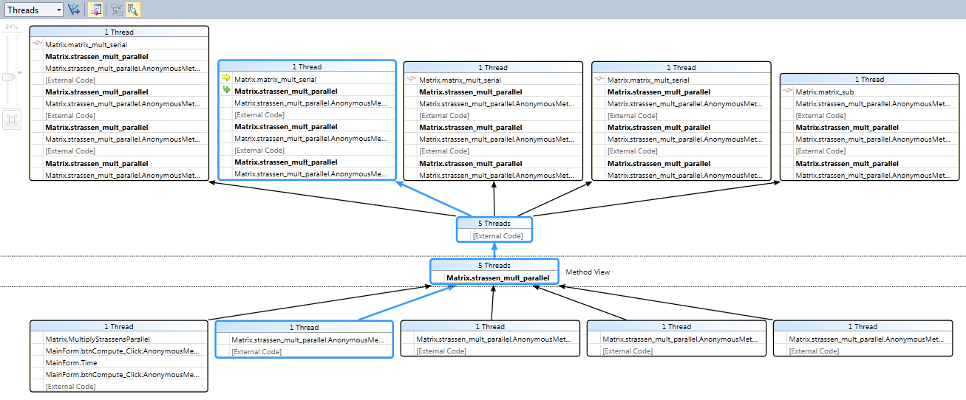
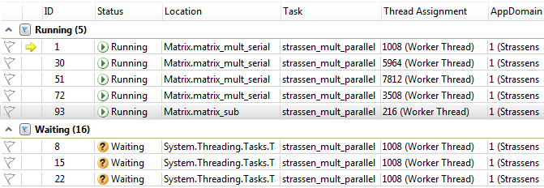

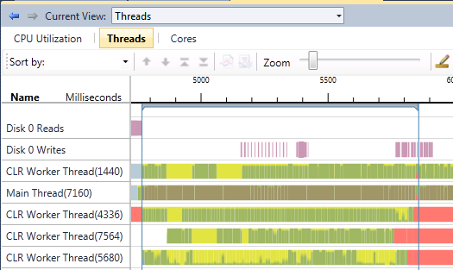
.NET 4 & Visual Studio 2010
Tools
let runAll() =
urlList
|> Seq.map fetchAsync
|> Async.Parallel
|> Async.StartAsTask
Programming Models
var results = from item in LoadData().AsParallel()
where IsValid(item)
orderby item ascending
select ComputeResult(item);
Parallel Debugger
Task.Factory.StartNew(() =>
{
Parallel.For(0, 1000, i =>
{
Compute(i);
});
}
Parallel LINQ
F#
Async
Agents Library
Parallel Pattern Library
Stacks
Task Parallel Library
private static ConcurrentDictionary<Uri, string> m_data =
new ConcurrentDictionary<Uri, string>();
private static string GetValue(Uri url)
{
return m_data.GetOrAdd(url, u => Download(u));
}
Tasks
Data Structures
Concurrency Visualizer
Data Structures
Runtime
CLR ThreadPool
ConcRT
CPU
Task Scheduler
Task Scheduler
Threads
Resource Manager
Resource Manager
Cores
Operating System
Windows
Key:
Tooling
Managed
Native

Slide 4
Performance
demo
Upgrade, and your code just get faster!

Slide 5
This is synchronous code with .NET 4…
public void CopyStreamToStream(Stream source, Stream destination) { byte[] buffer = new byte[0x1000]; int numRead; while ((numRead = source.Read(buffer, 0, buffer.Length)) != 0) { destination.Write(buffer, 0, numRead); } }

Slide 6

This is async (but blocking) code with .NET 4…
public void CopyStreamToStream(Stream source, Stream destination) { byte[] buffer = new byte[0x1000]; int numRead; while ((numRead = source.Read(buffer, 0, buffer.Length)) != 0) { destination.Write(buffer, 0, numRead); } }
public Task CopyStreamToStreamAsync(Stream source, Stream destination) {
return Task.Factory.StartNew(() =>
{ byte[] buffer = new byte[0x1000]; int numRead; while ((numRead = source.Read(buffer, 0, buffer.Length)) != 0) { destination.Write(buffer, 0, numRead); }
}); }

Slide 7
This is async code with .NET 4…
public void CopyStreamToStream(Stream source, Stream destination) { byte[] buffer = new byte[0x1000]; int numRead; while ((numRead = source.Read(buffer, 0, buffer.Length)) != 0) { destination.Write(buffer, 0, numRead); } }
public IAsyncResult BeginCopyStreamToStream(
Stream source, Stream destination, AsyncCallback callback, object state) { var tcs = new TaskCompletionSource<object>(state);
if (callback != null) tcs.Task.ContinueWith(_ => callback(tcs.Task)); var buffer = new byte[0x1000];
Action<IAsyncResult> readWriteLoop = null; readWriteLoop = iar => { try { for (bool isRead = iar == null; ; isRead = !isRead) { switch (isRead) { case true: iar = source.BeginRead(buffer, 0, buffer.Length,
readResult => { if (readResult.CompletedSynchronously) return; readWriteLoop(readResult); }, null); if (!iar.CompletedSynchronously) return; break; case false: int numRead = source.EndRead(iar); if (numRead == 0) { tcs.TrySetResult(null); return; } iar = destination.BeginWrite(buffer, 0, numRead,
writeResult => { if (writeResult.CompletedSynchronously) return; destination.EndWrite(writeResult); readWriteLoop(null); }, null); if (!iar.CompletedSynchronously) return; destination.EndWrite(iar); break; } } } catch (Exception e) {
tcs.TrySetException(e);
} }; readWriteLoop(null); return tcs.Task; }
public void EndCopyStreamToStream(IAsyncResult asyncResult) { ((Task)asyncResult).Wait(); }

Slide 8
This is async code with .NET 4.5…
public void CopyStreamToStream(Stream source, Stream destination) { byte[] buffer = new byte[0x1000]; int numRead; while ((numRead = source.Read(buffer, 0, buffer.Length)) != 0) { destination.Write(buffer, 0, numRead); } }
public async Task CopyStreamToStreamAsync(Stream source, Stream destination) { byte[] buffer = new byte[0x1000]; int numRead; while ((numRead = await source.ReadAsync(buffer, 0, buffer.Length)) != 0) { await destination.WriteAsync(buffer, 0, numRead); } }

Slide 9

This is async code with .NET 4.5…
public void CopyStreamToStream(Stream source, Stream destination) { byte[] buffer = new byte[0x1000]; int numRead; while ((numRead = source.Read(buffer, 0, buffer.Length)) != 0) { destination.Write(buffer, 0, numRead); } }
public async Task CopyStreamToStreamAsync(Stream source, Stream destination) { byte[] buffer = new byte[0x1000]; int numRead; while ((numRead = await source.ReadAsync(buffer, 0, buffer.Length)) != 0) { await destination.WriteAsync(buffer, 0, numRead); } }

Slide 10
New Task Methods Supporting Async
Task.Run
Quickly schedule new tasks
Task.Delay
Tasks that complete after a timeout
Task.WhenAll / WhenAny
Tasks that complete when any/all of a set complete
Task.FromResult
Tasks to wrap existing values
Task.Yield
Like DoEvents, but better!
Task.ConfigureAwait
Fine-grained control over your awaits
Task.ContinueWith
New overloads for “object state”

Slide 11
Async CTP vs .NET 4.5
demo

Slide 12
More Control
ConcurrentExclusiveSchedulerPair
Provides reader/writer scheduling support
CancellationTokenSource timer integration
new CancellationTokenSource(timeout).Token
ThreadLocal<T>.Values
Enables easier reductions
TaskCreationOptions
More control over integration with 3rd-party code, e.g. DenyChildAttach, HideScheduler
EnumerablePartitionerOptions
NoBuffering
…

Slide 13
More Control
demo

Slide 14
Parallel Programming Models
.NET 4 parallel programming models
“Here’s the data. Now set up the computation.”
Primitives for task and data parallelism
But what about the inverse?
“Set up the computation. Now here’s the data.”
Primitives for dataflow parallelism

Slide 15
TPL Dataflow Overview
System.Threading.Tasks.Dataflow.dll
Primitives for in-process message passing
“Blocks” that can buffer and process data
Used individually and/or linked together to create networks
Inspired by
Decades of computer science research/history
Related Microsoft technologies
Asynchronous Agents Library in Visual C++ 2010
Axum incubation project
CCR from Microsoft Robotics

Slide 16

TPL Dataflow Simple Producer/Consumer Example
ActionBlock<int>
var ab = new ActionBlock<int>(i =>
{
Process(i);
});
for(int i = 0; i < 5; i++)
{
ab.Post(i);
}
Message Queue
Process(4);
Process(0);
Process(1);
Process(2);
Process(3);
4
0
1
2
3

Slide 17
TPL Dataflow Dataflow Networks
“Dataflow Blocks” implement interfaces
IDataflowBlock, ITargetBlock<TInput>, ISourceBlock<TOutput>
Linkable to form a network
Data automatically propagated from sources to linked targets
Enables building powerful parallel and asynchronous pipelines, e.g.
ActionBlock, TransformBlock, JoinBlock, …
Integrates with Task, IObservable, …
data
TransformBlock<byte[],byte[]>
Compress
compressed
TransformBlock<byte[],byte[]>
Encrypt
and encrypted

Slide 18
System.Threading.Tasks.Dataflow.dll
demo

Slide 19
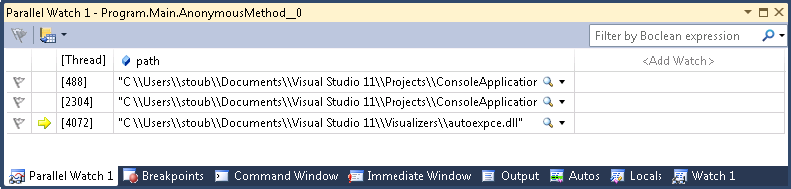
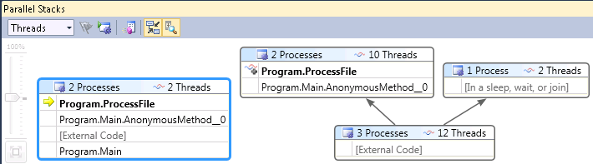

Parallel Debugging Additions
Parallel Watch
Multi-process
Pervasive Flagging

Slide 20
Parallel Debugging
demo

Slide 21
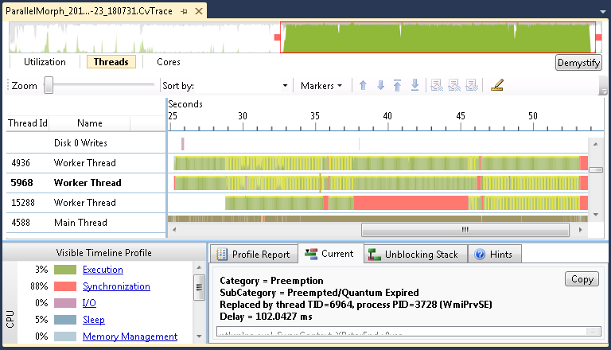
Concurrency Visualizer
Shift-Alt-F5
Faster processing, faster loading
Supports big traces
Supports EventSource and custom markers
Built-in support for TPL, PLINQ, Sync Data Structures, and Dataflow
Built-in support for your own EventSource types
Also provides Visual Studio markers API
New visualizations
e.g. defender view

Slide 22
Concurrency Visualizer
demo
Visualizing .NET 4.5 parallelism activity

Slide 23
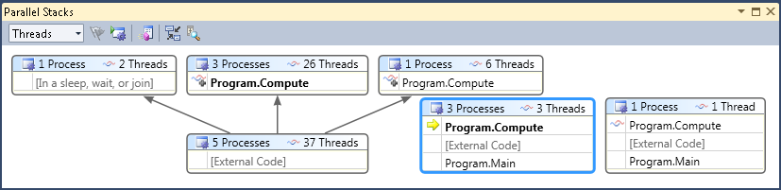
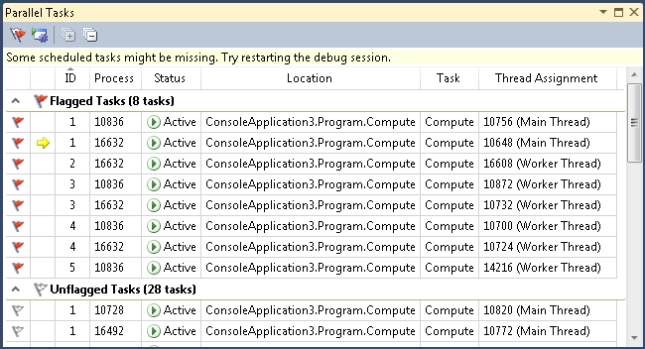
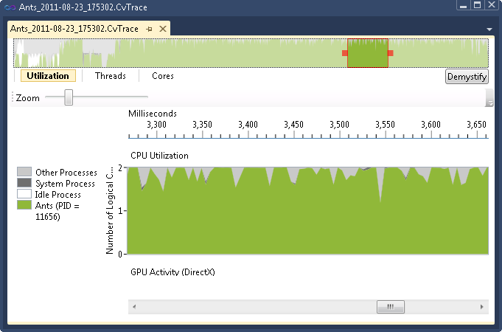
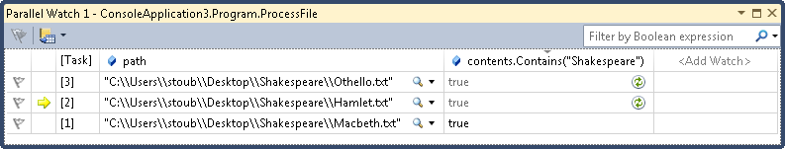
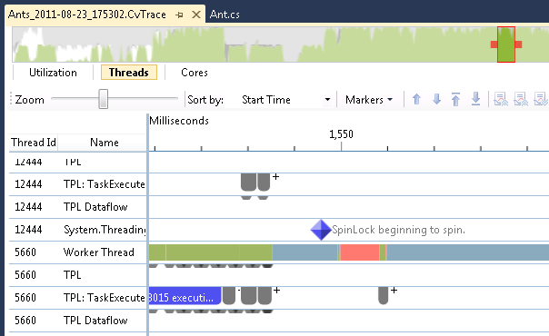
.NET 4.5 & Visual Studio 11
IEnumerable<T> TakeTop<T>(
this IEnumerable<T> source, int count)
{
return source
.AsParallel()
.OrderBy(k => k)
.Take(count);
}
async Task<string> ReplaceAsync(Stream input,
string oldText, string newText)
{
string contents = await new StreamReader(input).ReadToEndAsync();
return contents.Replace(oldText, newText);
}
var consumer = new ActionBlock<int>(
item => Process(item));
…
consumer.Post(42);
consumer.Post(43);
…
Tools
Programming Models
Parallel Debugger
PLINQ
C#/VB/F# Async
Dataflow
Async
Agents Library
Parallel Pattern Library
C++ AMP
Stacks
Task t = Task.WhenAny(
Task.Delay(10000)),
Task.Run(() => Parallel.ForEach(…)));
var tl = new ThreadLocal<int>(trackAllValues: true);
Parallel.For(0, 1000, i =>
{
tl.Value += Compute(i);
});
int result = tl.Values.Sum();
Task Parallel Library
Tasks
Watch
CPU
GPU
Data Structures
Data Structures
Runtime
Concurrency Visualizer
ConcRT
DirectX
CLR ThreadPool
Task Scheduler
Task Scheduler
CPU
GPU
Threads
Resource Manager
Resource Manager
Cores
Operating System
Windows
Key:
Tooling
Managed
Native
New
Updated

Slide 24
For more information
RELATED SESSIONS
ARTICLES, SAMPLES, VIDEOS, BLOGS
ID | Title | Speaker
TOOL-834T | What's new in .NET Framework 4.5 | Joshua Goodman
TOOL-816T | Future directions for C# and Visual Basic | Anders Hejlsberg
TOOL-810T | Async made simple in Windows 8, with C# and Visual Basic | Mads Torgersen; Alex Turner
SAC-804T | Building IIS and ASP.NET apps with the power of async | Damian Edwards
SAC-808T | Building parallelized apps with .NET and Visual Studio | Stephen Toub
TOOL-829T | The zen of async: Best practices for best performance | Stephen Toub
TOOL-802T | Taming GPU compute with C++ AMP | Daniel Moth
TOOL-835T | Writing modern C++ code: how C++ has evolved over the yearss | Herb Sutter
http://msdn.com/concurrency

Slide 25
thank you
Feedback and questions http://forums.dev.windows.com
Session feedback http://bldw.in/SessionFeedback

Slide 26

© 2011 Microsoft Corporation. All rights reserved. Microsoft, Windows, Windows Vista and other product names are or may be registered trademarks and/or trademarks in the U.S. and/or other countries.
The information herein is for informational purposes only and represents the current view of Microsoft Corporation as of the date of this presentation. Because Microsoft must respond to changing market conditions, it should not be interpreted to be a commitment on the part of Microsoft, and Microsoft cannot guarantee the accuracy of any information provided after the date of this presentation. MICROSOFT MAKES NO WARRANTIES, EXPRESS, IMPLIED OR STATUTORY, AS TO THE INFORMATION IN THIS PRESENTATION.

