Slide 1
NURBS分享1

Slide 2
1.曲线基础
2.幂基曲线 Power Basis Curve
3.多项式贝塞尔曲线 Polynomial Bezier Curve
4.有理贝塞尔曲线 Rational Bezier Curve
5.张量积曲面 Tensor Product Surface
6.非有理贝塞尔曲面 Nonrational Bezier Surface
7.有理贝塞尔曲面 Rational Bezier Surface

Slide 3
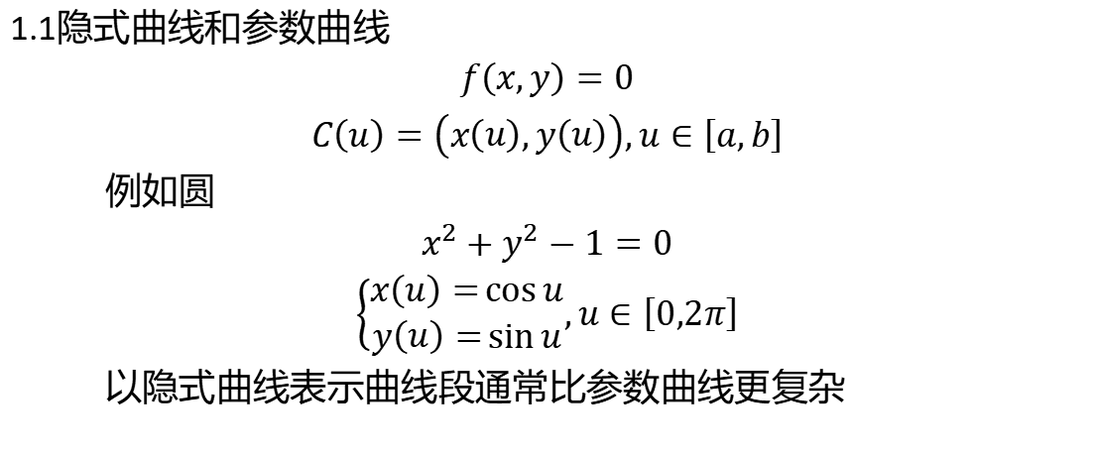
1.曲线基础
1.1隐式曲线和参数曲线
$f\left(x,y\right)=0$
$C\left(u\right)=\left(x\left(u\right),y\left(u\right)\right),u∈\left[a,b\right]$
例如圆
$x^{2}+y^{2}−1=0$
$\left\{\begin{aligned}x\left(u\right)=\cos{u} \\ y\left(u\right)=\sin{u}\end{aligned},u∈\left[0,2π\right]\right.$
以隐式曲线表示曲线段通常比参数曲线更复杂

Slide 4
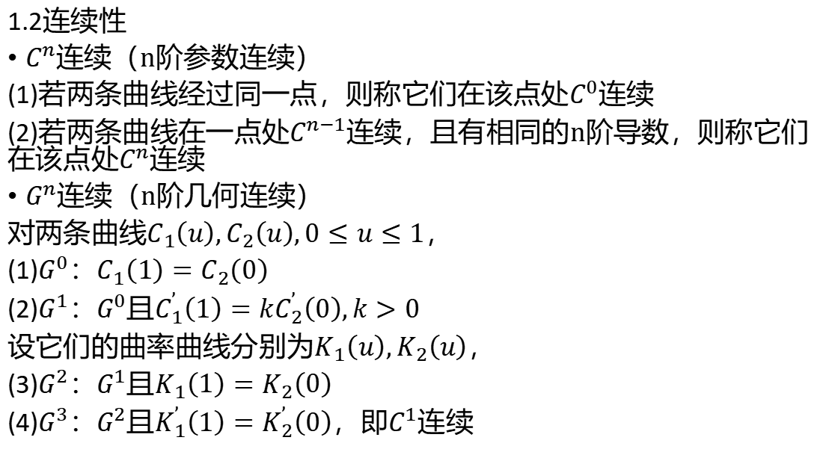
1.2连续性
$C^{n}$连续（n阶参数连续）
(1)若两条曲线经过同一点，则称它们在该点处$C^{0}$连续
(2)若两条曲线在一点处$C^{n−1}$连续，且有相同的n阶导数，则称它们在该点处$C^{n}$连续
$G^{n}$连续（n阶几何连续）
对两条曲线$C_{1}\left(u\right),C_{2}\left(u\right),0≤u≤1$，
(1)$G^{0}$：$C_{1}\left(1\right)=C_{2}\left(0\right)$
(2)$G^{1}$：$G^{0}$且$C_{1}^{’}\left(1\right)=kC_{2}^{’}\left(0\right),k>0$
设它们的曲率曲线分别为$K_{1}\left(u\right),K_{2}\left(u\right)$，
(3)$G^{2}$：$G^{1}$且$K_{1}\left(1\right)=K_{2}\left(0\right)$
(4)$G^{3}$：$G^{2}$且$K_{1}^{’}\left(1\right)=K_{2}^{’}\left(0\right)$，即$C^{1}$连续

Slide 5
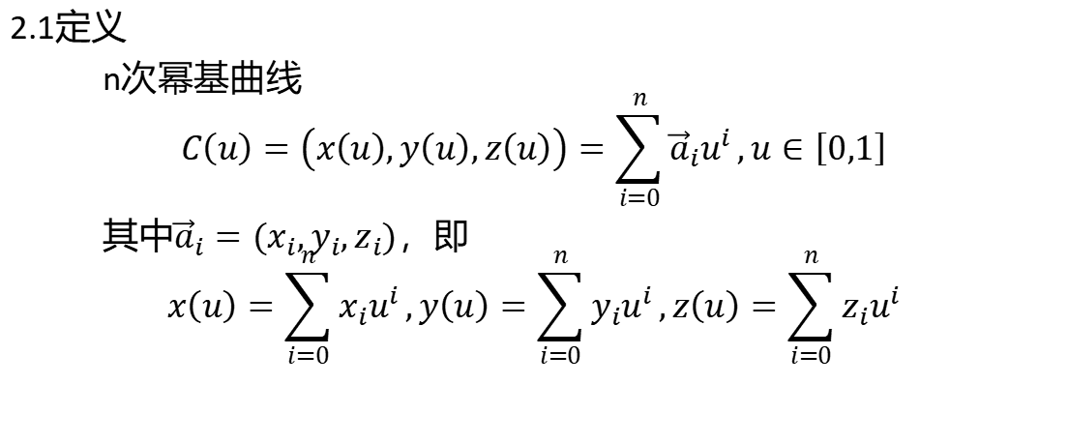
2.幂基曲线
2.1定义
n次幂基曲线
$$C\left(u\right)=\left(x\left(u\right),y\left(u\right),z\left(u\right)\right)=\sum_{i=0}^{n}{{\vec{a}}_{i}u^{i}},u∈\left[0,1\right]$$
其中${\vec{a}}_{i}=\left(x_{i},y_{i},z_{i}\right)$，即
$$x\left(u\right)=\sum_{i=0}^{n}{x_{i}u^{i}},y\left(u\right)=\sum_{i=0}^{n}{y_{i}u^{i}},z\left(u\right)=\sum_{i=0}^{n}{z_{i}u^{i}}$$

Slide 6
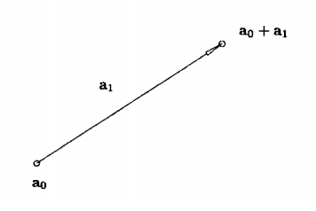
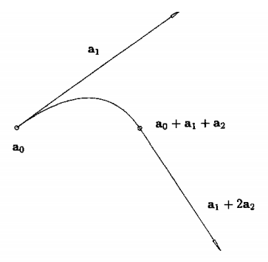
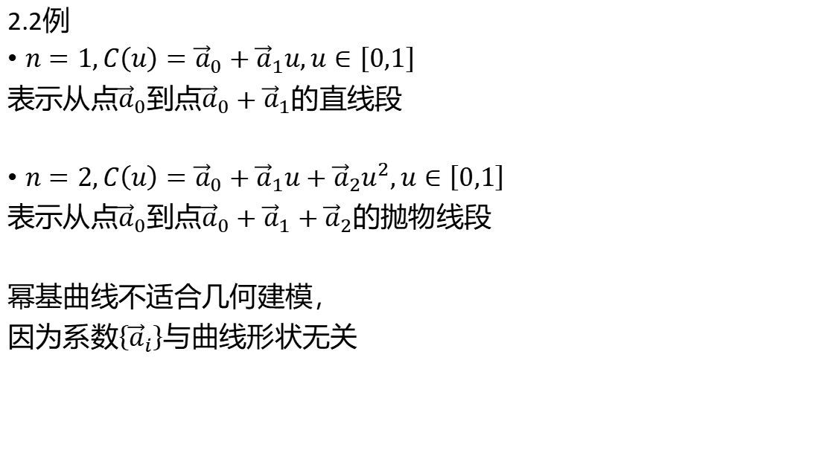
2.2例
$n=1,C\left(u\right)={\vec{a}}_{0}+{\vec{a}}_{1}u,u∈\left[0,1\right]$
表示从点${\vec{a}}_{0}$到点${{\vec{a}}_{0}+\vec{a}}_{1}$的直线段
$n=2,C\left(u\right)={\vec{a}}_{0}+{\vec{a}}_{1}u+{\vec{a}}_{2}u^{2},u∈\left[0,1\right]$
表示从点${\vec{a}}_{0}$到点${{\vec{a}}_{0}+\vec{a}}_{1}+{\vec{a}}_{2}$的抛物线段
幂基曲线不适合几何建模，
因为系数$\left\{{\vec{a}}_{i}\right\}$与曲线形状无关

Slide 7
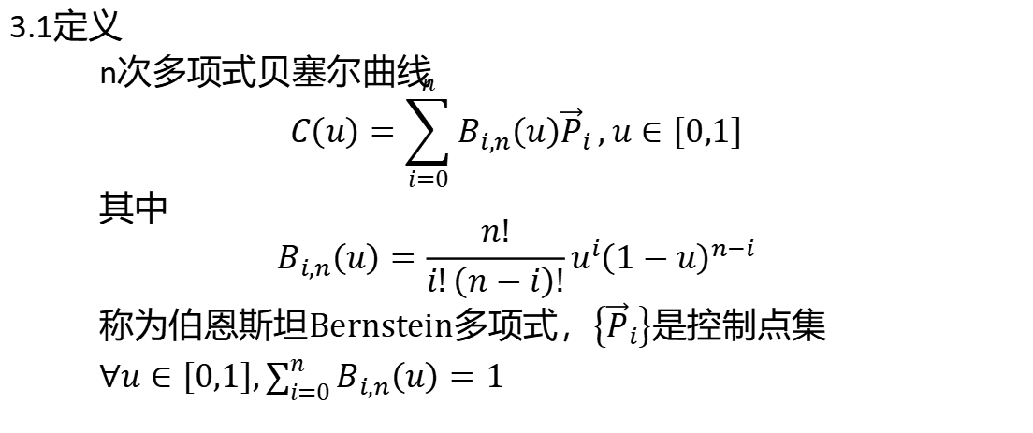
3.多项式贝塞尔曲线
3.1定义
n次多项式贝塞尔曲线
$$C\left(u\right)=\sum_{i=0}^{n}{B_{i,n}\left(u\right){\vec{P}}_{i}},u∈\left[0,1\right]$$
其中
$$B_{i,n}\left(u\right)=\frac{n!}{i!\left(n−i\right)!}u^{i}{\left(1−u\right)}^{n−i}$$
称为伯恩斯坦Bernstein多项式，$\left\{{\vec{P}}_{i}\right\}$是控制点集
$∀u∈\left[0,1\right],\sum_{i=0}^{n}{B_{i,n}\left(u\right)}=1$

Slide 8
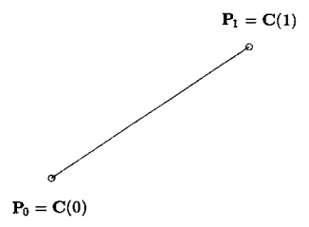
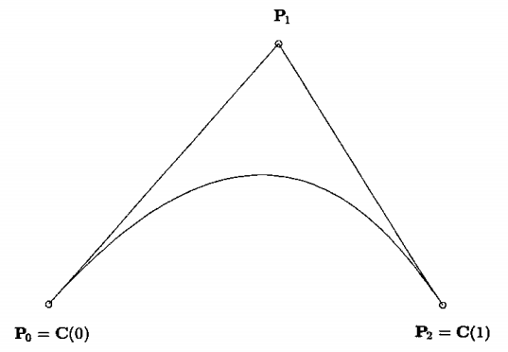
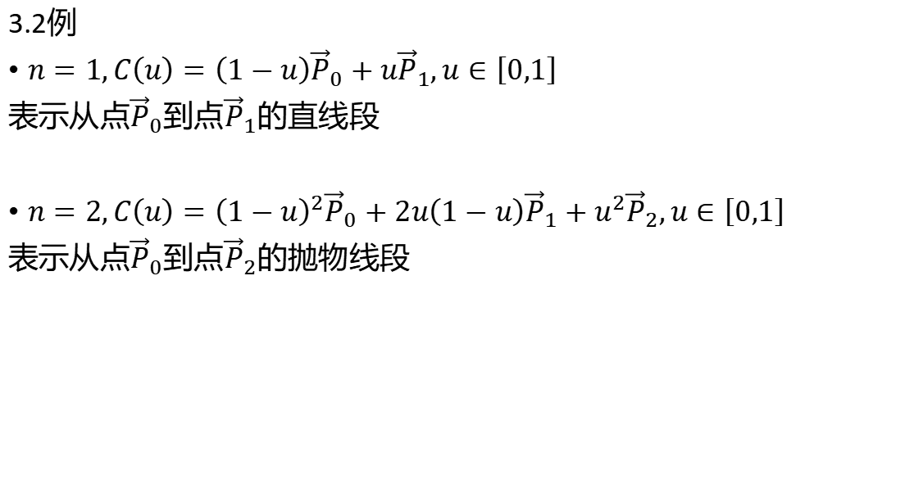
3.2例
$n=1,C\left(u\right)=\left(1−u\right){\vec{P}}_{0}+u{\vec{P}}_{1},u∈\left[0,1\right]$
表示从点${\vec{P}}_{0}$到点${\vec{P}}_{1}$的直线段
$n=2,C\left(u\right)={\left(1−u\right)}^{2}{\vec{P}}_{0}+2u\left(1−u\right){\vec{P}}_{1}+u^{2}{\vec{P}}_{2},u∈\left[0,1\right]$
表示从点${\vec{P}}_{0}$到点${\vec{P}}_{2}$的抛物线段

Slide 9
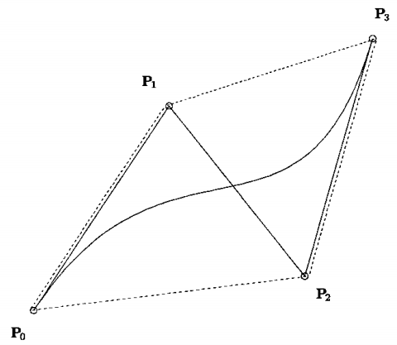
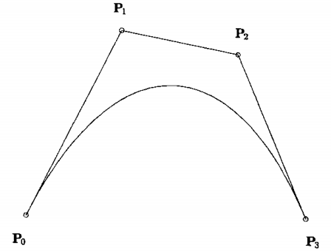
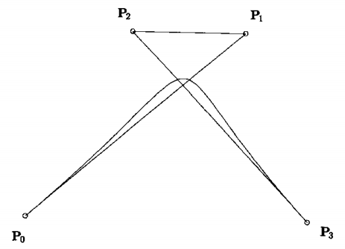

$n=3$

Slide 10
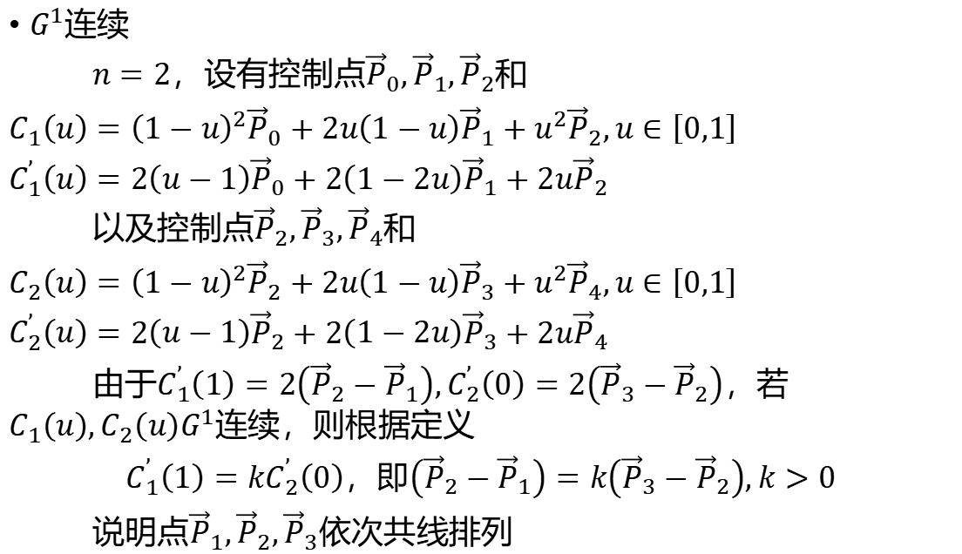
$G^{1}$连续
$n=2$，设有控制点${\vec{P}}_{0},{\vec{P}}_{1},{\vec{P}}_{2}$和
$C_{1}\left(u\right)={\left(1−u\right)}^{2}{\vec{P}}_{0}+2u\left(1−u\right){\vec{P}}_{1}+u^{2}{\vec{P}}_{2},u∈\left[0,1\right]$
$C_{1}^{’}\left(u\right)=2\left(u−1\right){\vec{P}}_{0}+2\left(1−2u\right){\vec{P}}_{1}+2u{\vec{P}}_{2}$
以及控制点${\vec{P}}_{2},{\vec{P}}_{3},{\vec{P}}_{4}$和
$C_{2}\left(u\right)={\left(1−u\right)}^{2}{\vec{P}}_{2}+2u\left(1−u\right){\vec{P}}_{3}+u^{2}{\vec{P}}_{4},u∈\left[0,1\right]$
$C_{2}^{’}\left(u\right)=2\left(u−1\right){\vec{P}}_{2}+2\left(1−2u\right){\vec{P}}_{3}+2u{\vec{P}}_{4}$
由于$C_{1}^{’}\left(1\right)=2\left({\vec{P}}_{2}−{\vec{P}}_{1}\right),C_{2}^{’}\left(0\right)=2\left({\vec{P}}_{3}−{\vec{P}}_{2}\right)$，若$C_{1}\left(u\right),C_{2}\left(u\right)G^{1}$连续，则根据定义
$C_{1}^{’}\left(1\right)=kC_{2}^{’}\left(0\right)$，即$\left({\vec{P}}_{2}−{\vec{P}}_{1}\right)=k\left({\vec{P}}_{3}−{\vec{P}}_{2}\right),k>0$
说明点${\vec{P}}_{1},{\vec{P}}_{2},{\vec{P}}_{3}$依次共线排列

Slide 11
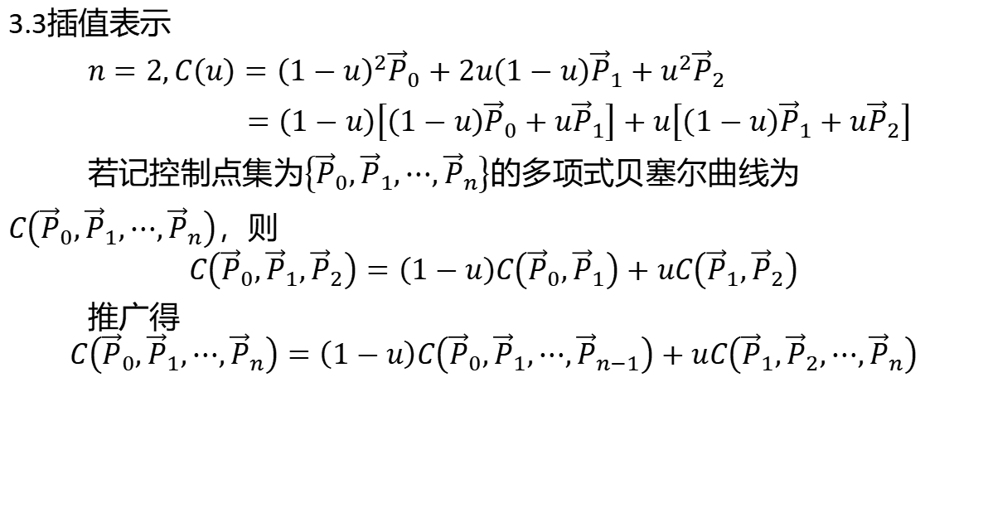
3.3插值表示
$n=2,C\left(u\right)={\left(1−u\right)}^{2}{\vec{P}}_{0}+2u\left(1−u\right){\vec{P}}_{1}+u^{2}{\vec{P}}_{2}$
$=\left(1−u\right)\left[\left(1−u\right){\vec{P}}_{0}+u{\vec{P}}_{1}\right]+u\left[\left(1−u\right){\vec{P}}_{1}+u{\vec{P}}_{2}\right]$
若记控制点集为$\left\{{\vec{P}}_{0},{\vec{P}}_{1},⋯,{\vec{P}}_{n}\right\}$的多项式贝塞尔曲线为
$C\left({\vec{P}}_{0},{\vec{P}}_{1},⋯,{\vec{P}}_{n}\right)$，则
$$C\left({\vec{P}}_{0},{\vec{P}}_{1},{\vec{P}}_{2}\right)=\left(1−u\right)C\left({\vec{P}}_{0},{\vec{P}}_{1}\right)+uC\left({\vec{P}}_{1},{\vec{P}}_{2}\right)$$
推广得
$$C\left({\vec{P}}_{0},{\vec{P}}_{1},⋯,{\vec{P}}_{n}\right)=\left(1−u\right)C\left({\vec{P}}_{0},{\vec{P}}_{1},⋯,{\vec{P}}_{n−1}\right)+uC\left({\vec{P}}_{1},{\vec{P}}_{2},⋯,{\vec{P}}_{n}\right)$$

Slide 12
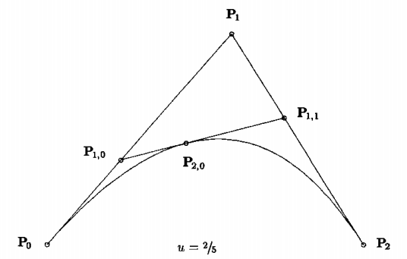
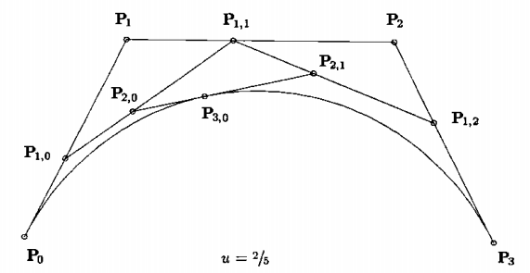

Slide 13
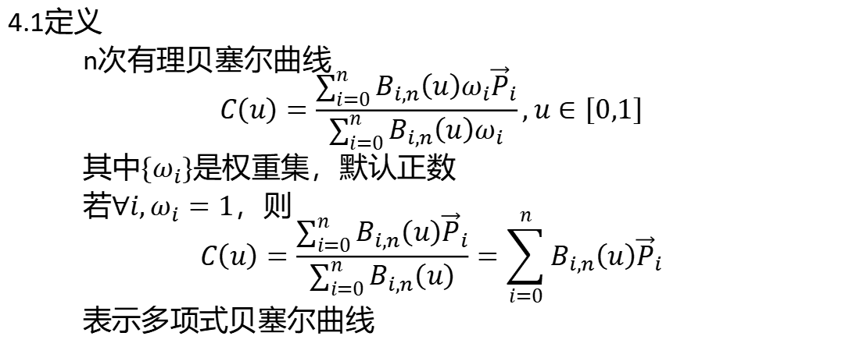
4.有理贝塞尔曲线
4.1定义
n次有理贝塞尔曲线
$$C\left(u\right)=\frac{\sum_{i=0}^{n}{B_{i,n}\left(u\right)ω_{i}{\vec{P}}_{i}}}{\sum_{i=0}^{n}{B_{i,n}\left(u\right)ω_{i}}},u∈\left[0,1\right]$$
其中$\left\{ω_{i}\right\}$是权重集，默认正数
若$∀i,ω_{i}=1$，则
$$C\left(u\right)=\frac{\sum_{i=0}^{n}{B_{i,n}\left(u\right){\vec{P}}_{i}}}{\sum_{i=0}^{n}{B_{i,n}\left(u\right)}}=\sum_{i=0}^{n}{B_{i,n}\left(u\right){\vec{P}}_{i}}$$
表示多项式贝塞尔曲线

Slide 14
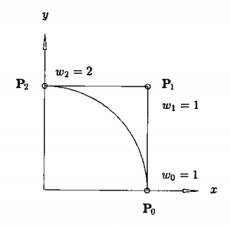
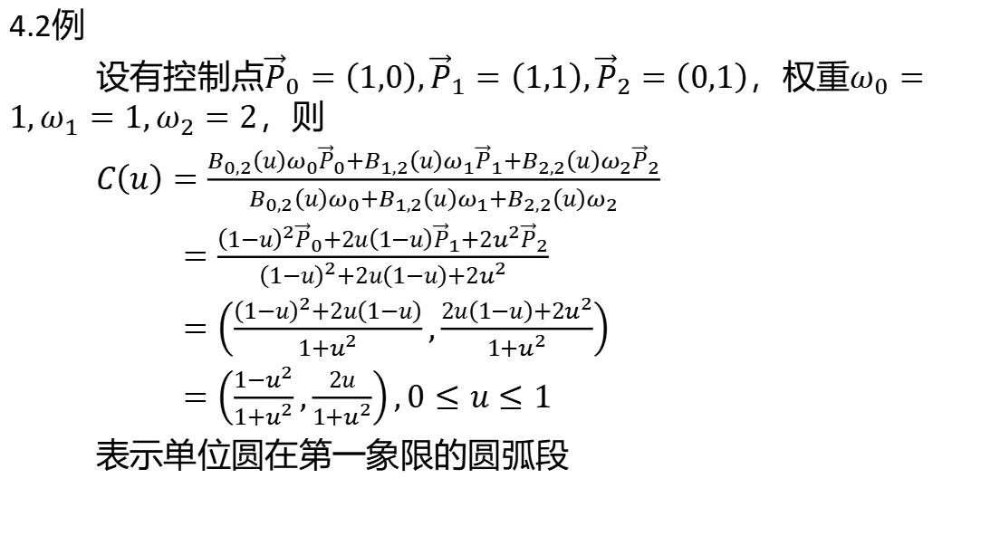
4.2例
设有控制点${\vec{P}}_{0}=\left(1,0\right),{\vec{P}}_{1}=\left(1,1\right),{\vec{P}}_{2}=\left(0,1\right)$，权重$ω_{0}=1,ω_{1}=1,ω_{2}=2$，则
$C\left(u\right)=\frac{B_{0,2}\left(u\right)ω_{0}{\vec{P}}_{0}+B_{1,2}\left(u\right)ω_{1}{\vec{P}}_{1}+B_{2,2}\left(u\right)ω_{2}{\vec{P}}_{2}}{B_{0,2}\left(u\right)ω_{0}+B_{1,2}\left(u\right)ω_{1}+B_{2,2}\left(u\right)ω_{2}}$
$=\frac{{\left(1−u\right)}^{2}{\vec{P}}_{0}+2u\left(1−u\right){\vec{P}}_{1}+2u^{2}{\vec{P}}_{2}}{{\left(1−u\right)}^{2}+2u\left(1−u\right)+2u^{2}}$
$=\left(\frac{{\left(1−u\right)}^{2}+2u\left(1−u\right)}{1+u^{2}},\frac{2u\left(1−u\right)+2u^{2}}{1+u^{2}}\right)$
$=\left(\frac{1−u^{2}}{1+u^{2}},\frac{2u}{1+u^{2}}\right),0≤u≤1$
表示单位圆在第一象限的圆弧段

Slide 15
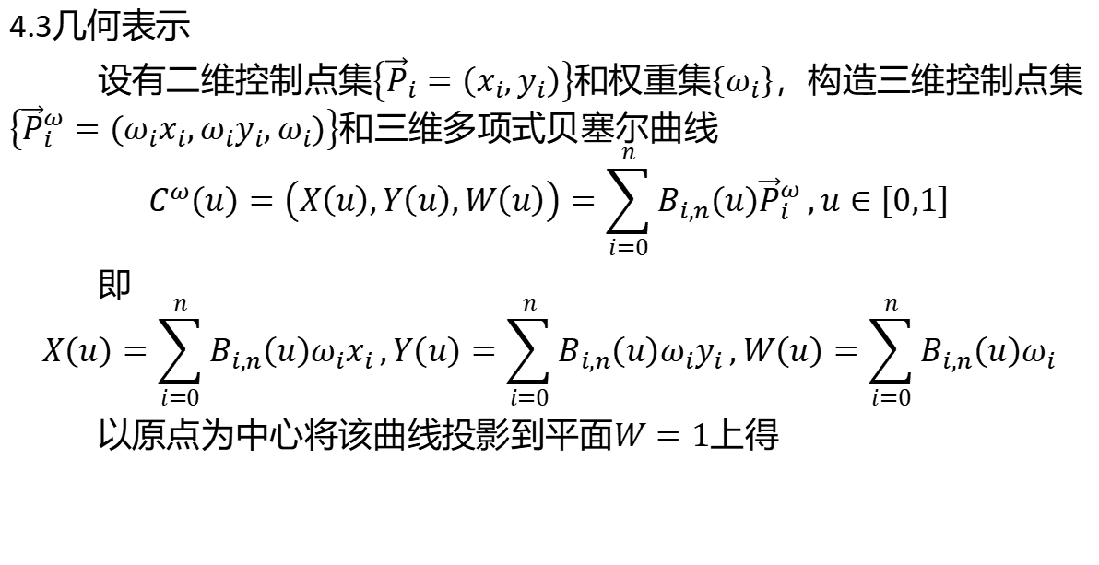
4.3几何表示
设有二维控制点集$\left\{{\vec{P}}_{i}=\left(x_{i},y_{i}\right)\right\}$和权重集$\left\{ω_{i}\right\}$，构造三维控制点集$\left\{{\vec{P}}_{i}^{ω}=\left(ω_{i}x_{i},ω_{i}y_{i},ω_{i}\right)\right\}$和三维多项式贝塞尔曲线
$$C^{ω}\left(u\right)=\left(X\left(u\right),Y\left(u\right),W\left(u\right)\right)=\sum_{i=0}^{n}{B_{i,n}\left(u\right){\vec{P}}_{i}^{ω}},u∈\left[0,1\right]$$
即
$$X\left(u\right)=\sum_{i=0}^{n}{B_{i,n}\left(u\right)ω_{i}x_{i}},Y\left(u\right)=\sum_{i=0}^{n}{B_{i,n}\left(u\right)ω_{i}y_{i}},W\left(u\right)=\sum_{i=0}^{n}{B_{i,n}\left(u\right)ω_{i}}$$
以原点为中心将该曲线投影到平面$W=1$上得

Slide 16
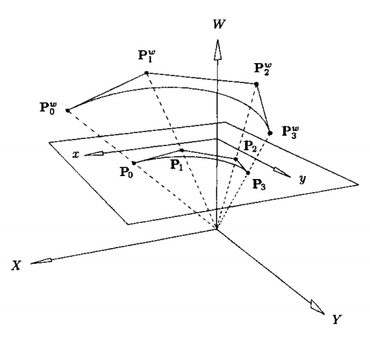
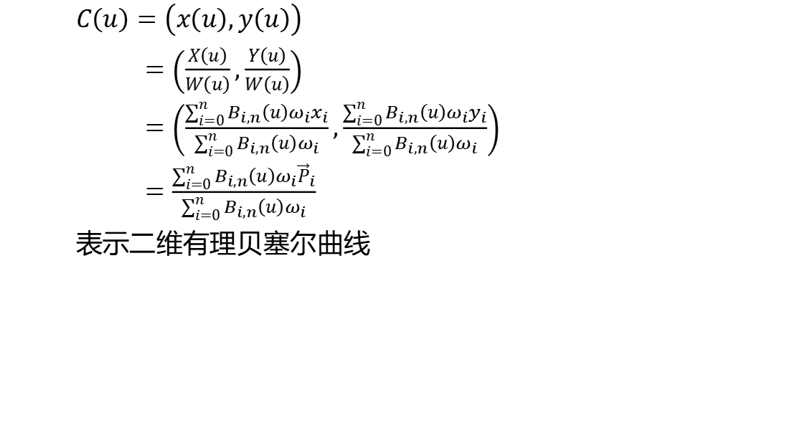
$C\left(u\right)=\left(x\left(u\right),y\left(u\right)\right)$
$=\left(\frac{X\left(u\right)}{W\left(u\right)},\frac{Y\left(u\right)}{W\left(u\right)}\right)$
$=\left(\frac{\sum_{i=0}^{n}{B_{i,n}\left(u\right)ω_{i}x_{i}}}{\sum_{i=0}^{n}{B_{i,n}\left(u\right)ω_{i}}},\frac{\sum_{i=0}^{n}{B_{i,n}\left(u\right)ω_{i}y_{i}}}{\sum_{i=0}^{n}{B_{i,n}\left(u\right)ω_{i}}}\right)$
$=\frac{\sum_{i=0}^{n}{B_{i,n}\left(u\right)ω_{i}{\vec{P}}_{i}}}{\sum_{i=0}^{n}{B_{i,n}\left(u\right)ω_{i}}}$
表示二维有理贝塞尔曲线

Slide 17
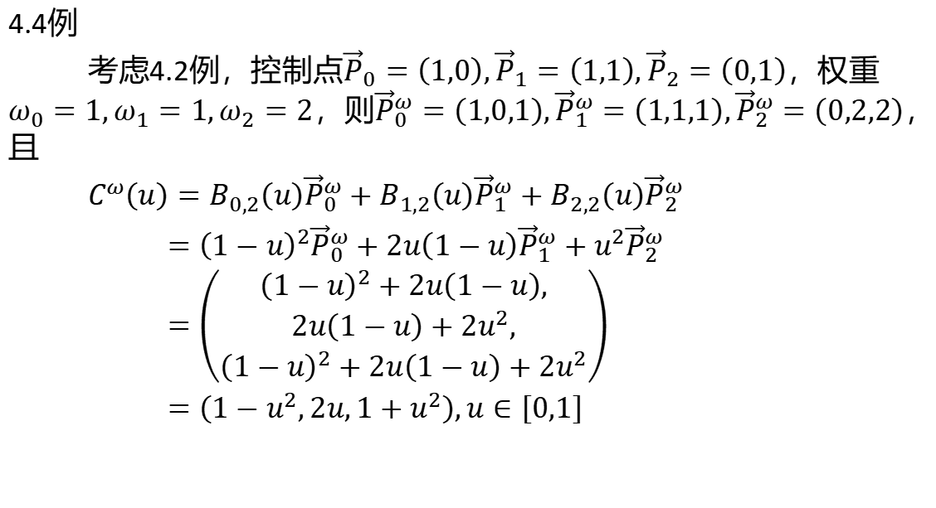
4.4例
考虑4.2例，控制点${\vec{P}}_{0}=\left(1,0\right),{\vec{P}}_{1}=\left(1,1\right),{\vec{P}}_{2}=\left(0,1\right)$，权重$ω_{0}=1,ω_{1}=1,ω_{2}=2$，则${\vec{P}}_{0}^{ω}=\left(1,0,1\right),{\vec{P}}_{1}^{ω}=\left(1,1,1\right),{\vec{P}}_{2}^{ω}=\left(0,2,2\right)$，且
$C^{ω}\left(u\right)=B_{0,2}\left(u\right){\vec{P}}_{0}^{ω}+B_{1,2}\left(u\right){\vec{P}}_{1}^{ω}+B_{2,2}\left(u\right){\vec{P}}_{2}^{ω}$
$={\left(1−u\right)}^{2}{\vec{P}}_{0}^{ω}+2u\left(1−u\right){\vec{P}}_{1}^{ω}+u^{2}{\vec{P}}_{2}^{ω}$
$=\left(\begin{aligned}{\left(1−u\right)}^{2}+2u\left(1−u\right), \\ 2u\left(1−u\right)+2u^{2}, \\ {\left(1−u\right)}^{2}+2u\left(1−u\right)+2u^{2}\end{aligned}\right)$
$=\left(1−u^{2},2u,1+u^{2}\right),u∈\left[0,1\right]$

Slide 18
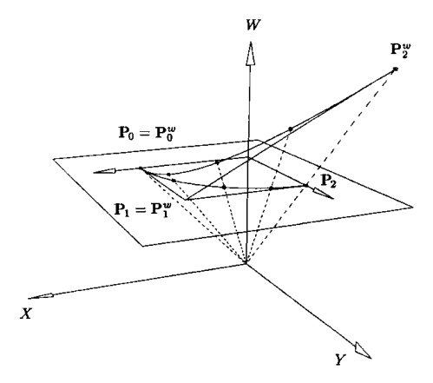

则
$C\left(u\right)=\left(\frac{1−u^{2}}{1+u^{2}},\frac{2u}{1+u^{2}}\right)$
与4.2例结果相同

Slide 19
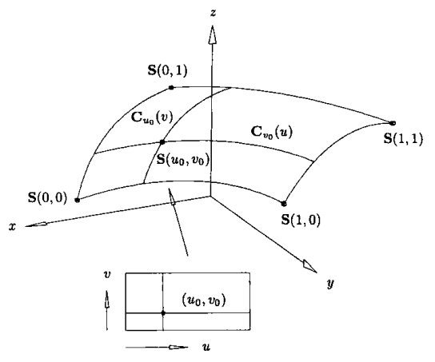
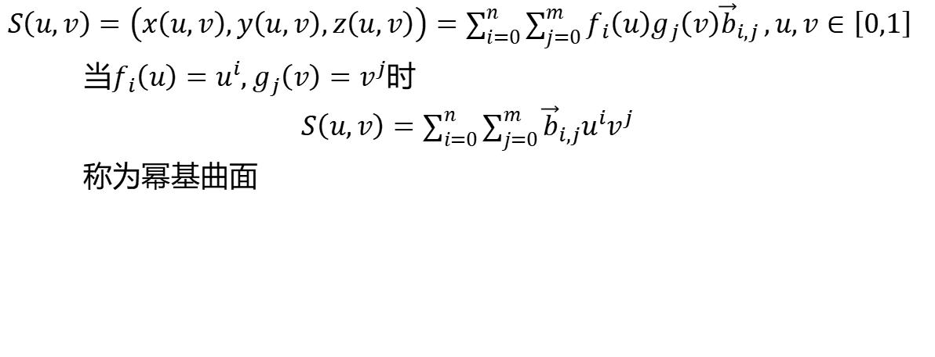
5.张量积曲面
$S\left(u,v\right)=\left(x\left(u,v\right),y\left(u,v\right),z\left(u,v\right)\right)=\sum_{i=0}^{n}{\sum_{j=0}^{m}{f_{i}\left(u\right)g_{j}\left(v\right){\vec{b}}_{i,j}}},u,v∈\left[0,1\right]$
当$f_{i}\left(u\right)=u^{i},g_{j}\left(v\right)=v^{j}$时
$S\left(u,v\right)=\sum_{i=0}^{n}{\sum_{j=0}^{m}{{\vec{b}}_{i,j}u^{i}v^{j}}}$
称为幂基曲面

Slide 20
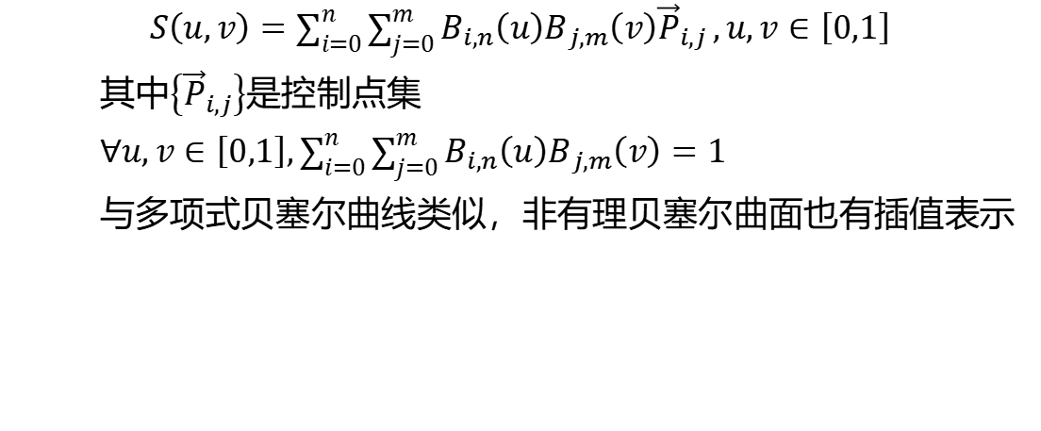
6.非有理贝塞尔曲面
$S\left(u,v\right)=\sum_{i=0}^{n}{\sum_{j=0}^{m}{B_{i,n}\left(u\right)B_{j,m}\left(v\right){\vec{P}}_{i,j}}},u,v∈\left[0,1\right]$
其中$\left\{{\vec{P}}_{i,j}\right\}$是控制点集
$∀u,v∈\left[0,1\right],\sum_{i=0}^{n}{\sum_{j=0}^{m}{B_{i,n}\left(u\right)B_{j,m}\left(v\right)}}=1$
与多项式贝塞尔曲线类似，非有理贝塞尔曲面也有插值表示

Slide 21
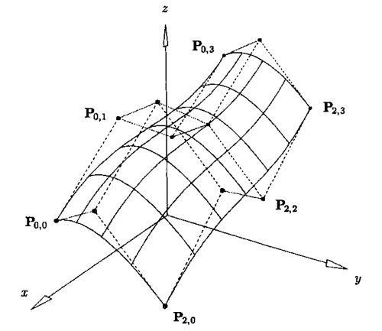

Slide 22
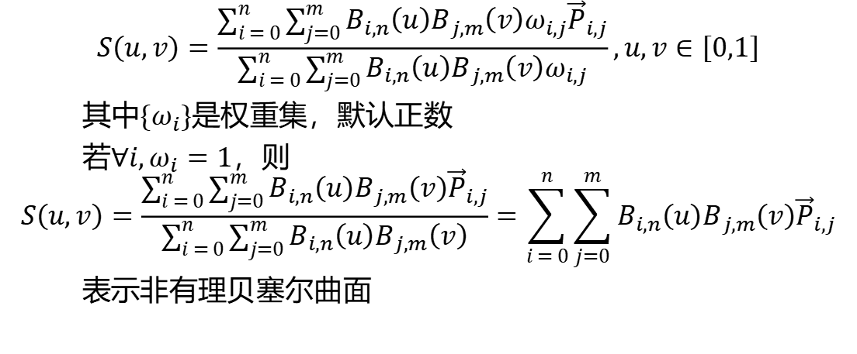
7.有理贝塞尔曲面
$$S\left(u,v\right)=\frac{\sum_{i = 0}^{n}{\sum_{j=0}^{m}{B_{i,n}\left(u\right)B_{j,m}\left(v\right)ω_{i,j}{\vec{P}}_{i,j}}}}{\sum_{i = 0}^{n}{\sum_{j=0}^{m}{B_{i,n}\left(u\right)B_{j,m}\left(v\right)ω_{i,j}}}},u,v∈\left[0,1\right]$$
其中$\left\{ω_{i}\right\}$是权重集，默认正数
若$∀i,ω_{i}=1$，则
$$S\left(u,v\right)=\frac{\sum_{i = 0}^{n}{\sum_{j=0}^{m}{B_{i,n}\left(u\right)B_{j,m}\left(v\right){\vec{P}}_{i,j}}}}{\sum_{i = 0}^{n}{\sum_{j=0}^{m}{B_{i,n}\left(u\right)B_{j,m}\left(v\right)}}}=\sum_{i = 0}^{n}{\sum_{j=0}^{m}{B_{i,n}\left(u\right)B_{j,m}\left(v\right){\vec{P}}_{i,j}}}$$
表示非有理贝塞尔曲面

