Slide 1
NURBS分享2

Slide 2
1.B样条基函数
2.B样条曲线
3.B样条曲面
4.NURBS曲线
5.NURBS曲面

Slide 3
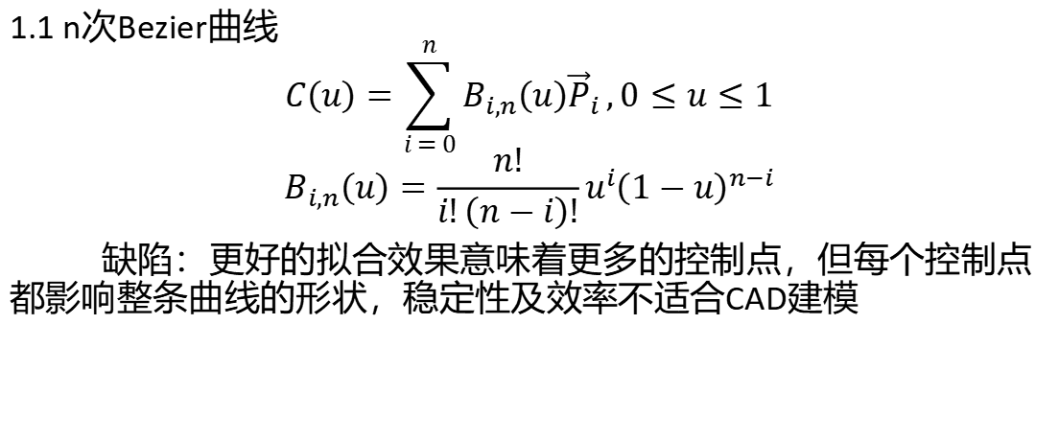
1.B样条基函数
1.1 n次Bezier曲线
$$C\left(u\right)=\sum_{i = 0}^{n}{B_{i,n}\left(u\right){\vec{P}}_{i}},0≤u≤1$$
$$B_{i,n}\left(u\right)=\frac{n!}{i!\left(n−i\right)!}u^{i}{\left(1−u\right)}^{n−i}$$
缺陷：更好的拟合效果意味着更多的控制点，但每个控制点都影响整条曲线的形状，稳定性及效率不适合CAD建模

Slide 4
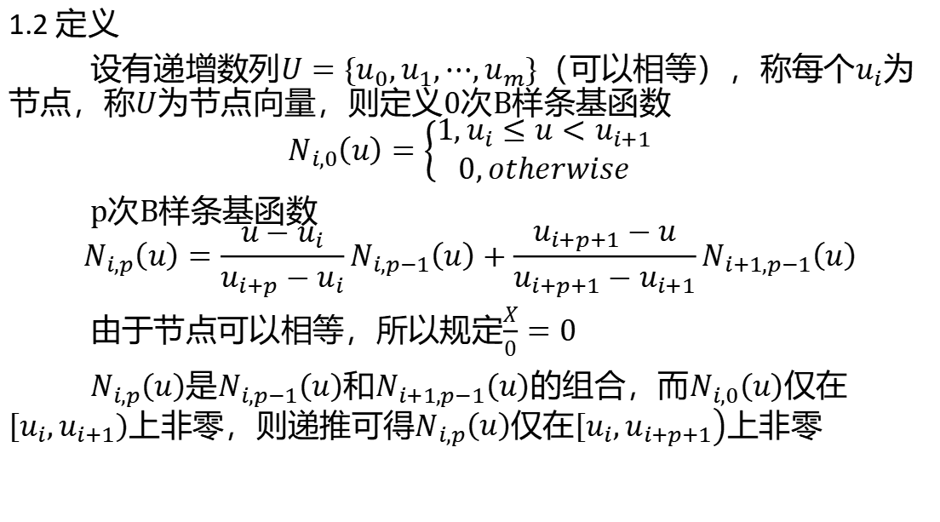
1.2 定义
设有递增数列$U=\left\{u_{0},u_{1},⋯,u_{m}\right\}$（可以相等），称每个$u_{i}$为节点，称$U$为节点向量，则定义0次B样条基函数
$$N_{i,0}\left(u\right)=\left\{\begin{aligned}1,u_{i}≤u<u_{i+1} \\ 0,otherwise\end{aligned}\right.$$
p次B样条基函数
$$N_{i,p}\left(u\right)=\frac{u−u_{i}}{u_{i+p}−u_{i}}N_{i,p−1}\left(u\right)+\frac{u_{i+p+1}−u}{u_{i+p+1}−u_{i+1}}N_{i+1,p−1}\left(u\right)$$
由于节点可以相等，所以规定$\frac{X}{0}=0$
$N_{i,p}\left(u\right)$是$N_{i,p−1}\left(u\right)$和$N_{i+1,p−1}\left(u\right)$的组合，而$N_{i,0}\left(u\right)$仅在$\left[u_{i}\right.,\left.u_{i+1}\right)$上非零，则递推可得$N_{i,p}\left(u\right)$仅在$\left[u_{i}\right.,\left.u_{i+p+1}\right)$上非零

Slide 5
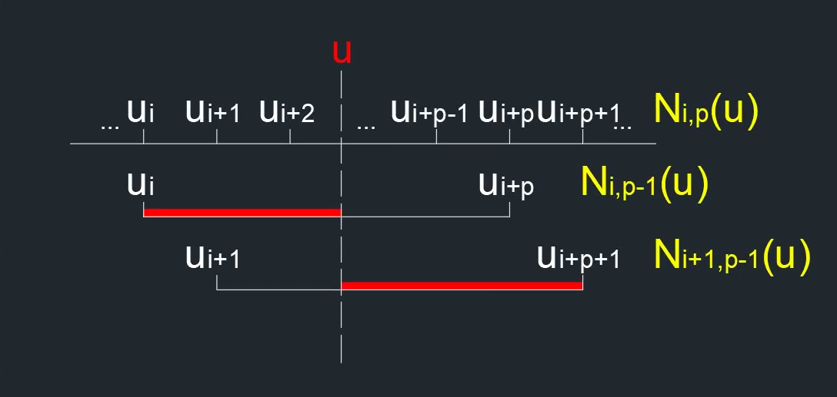

$$N_{i,p}\left(u\right)=\frac{u−u_{i}}{u_{i+p}−u_{i}}N_{i,p−1}\left(u\right)+\frac{u_{i+p+1}−u}{u_{i+p+1}−u_{i+1}}N_{i+1,p−1}\left(u\right)$$

Slide 6

1.3 节点向量
CAD建模中通常规定
$$U=\left\{\underset{p+1}{\underbrace{a,a,⋯,a}},u_{p+1},u_{p+2},⋯,u_{m−p−1},\underset{p+1}{\underbrace{b,b,⋯,b}}\right\}$$
若其中$\left\{u_{p+1},u_{p+2},⋯,u_{m−p−1}\right\}$等差，则称$U$均匀

Slide 7

1.4 导数
$$N_{i,p}^{\left(k\right)}\left(u\right)=p\left(\frac{N_{i,p−1}^{\left(k−1\right)}\left(u\right)}{u_{i+p}−u_{i}}−\frac{N_{i+1,p−1}^{\left(k−1\right)}\left(u\right)}{u_{i+p+1}−u_{i+1}}\right)$$
$$N_{i,p}^{\left(k\right)}\left(u\right)=\frac{p}{p−k}\left(\frac{u−u_{i}}{u_{i+p}−u_{i}}N_{i,p−1}^{\left(k\right)}\left(u\right)−\frac{u_{i+p+1}−u}{u_{i+p+1}−u_{i+1}}N_{i+1,p−1}^{\left(k\right)}\left(u\right)\right)$$

Slide 8
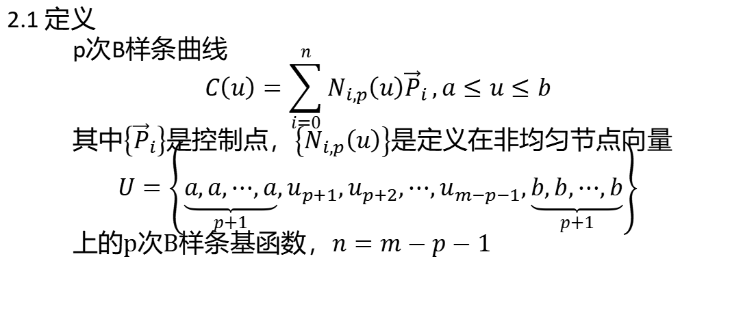
2.B样条曲线
2.1 定义
p次B样条曲线
$$C\left(u\right)=\sum_{i=0}^{n}{N_{i,p}\left(u\right){\vec{P}}_{i}},a≤u≤b$$
其中$\left\{{\vec{P}}_{i}\right\}$是控制点，$\left\{N_{i,p}\left(u\right)\right\}$是定义在非均匀节点向量
$$U=\left\{\underset{p+1}{\underbrace{a,a,⋯,a}},u_{p+1},u_{p+2},⋯,u_{m−p−1},\underset{p+1}{\underbrace{b,b,⋯,b}}\right\}$$
上的p次B样条基函数，$n=m−p−1$

Slide 9
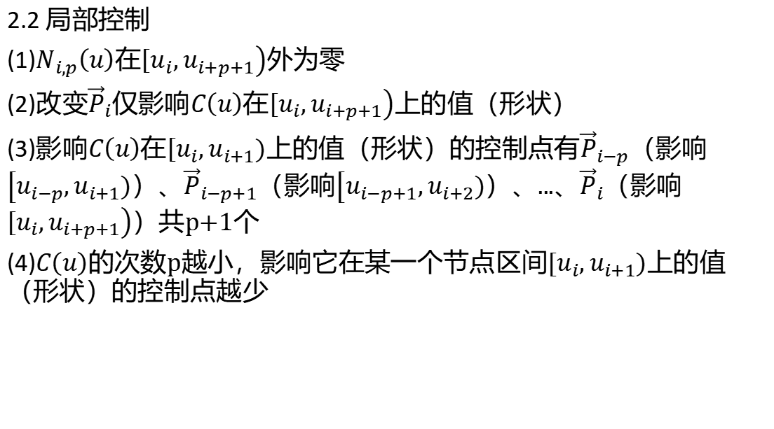
2.2 局部控制
(1)$N_{i,p}\left(u\right)$在$\left[u_{i}\right.,\left.u_{i+p+1}\right)$外为零
(2)改变${\vec{P}}_{i}$仅影响$C\left(u\right)$在$\left[u_{i}\right.,\left.u_{i+p+1}\right)$上的值（形状）
(3)影响$C\left(u\right)$在$\left[u_{i}\right.,\left.u_{i+1}\right)$上的值（形状）的控制点有${\vec{P}}_{i−p}$（影响$\left[u_{i−p}\right.,\left.u_{i+1}\right)$）、${\vec{P}}_{i−p+1}$（影响$\left[u_{i−p+1}\right.,\left.u_{i+2}\right)$）、...、${\vec{P}}_{i}$（影响$\left[u_{i}\right.,\left.u_{i+p+1}\right)$）共p+1个
(4)$C\left(u\right)$的次数p越小，影响它在某一个节点区间$\left[u_{i}\right.,\left.u_{i+1}\right)$上的值（形状）的控制点越少

Slide 10
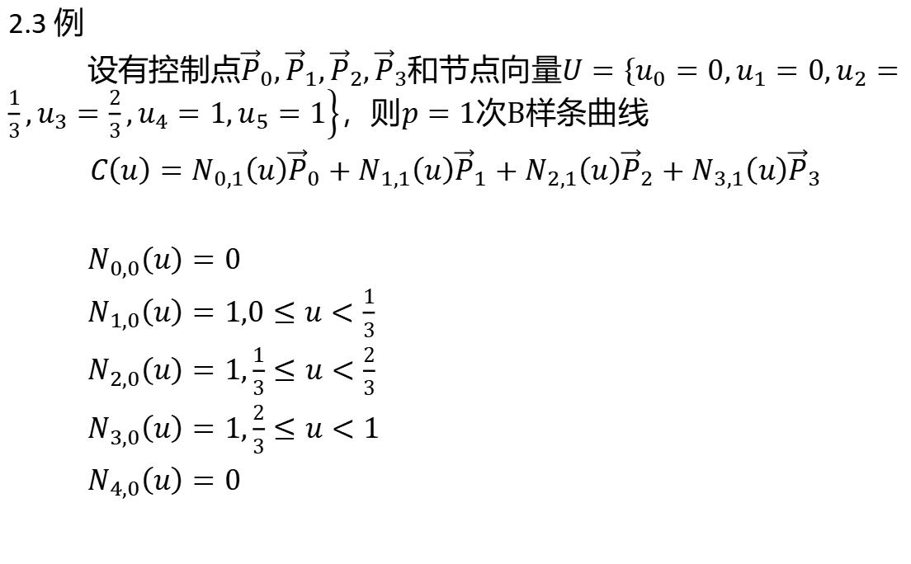
2.3 例
设有控制点${\vec{P}}_{0},{\vec{P}}_{1},{\vec{P}}_{2},{\vec{P}}_{3}$和节点向量$U=\left\{u_{0}=0,u_{1}=0,u_{2}=\frac{1}{3},u_{3}=\frac{2}{3},u_{4}=1,u_{5}=1\right\}$，则$p=1$次B样条曲线
$C\left(u\right)=N_{0,1}\left(u\right){\vec{P}}_{0}+N_{1,1}\left(u\right){\vec{P}}_{1}+N_{2,1}\left(u\right){\vec{P}}_{2}+N_{3,1}\left(u\right){\vec{P}}_{3}$
$N_{0,0}\left(u\right)=0$
$N_{1,0}\left(u\right)=1,0≤u<\frac{1}{3}$
$N_{2,0}\left(u\right)=1,\frac{1}{3}≤u<\frac{2}{3}$
$N_{3,0}\left(u\right)=1,\frac{2}{3}≤u<1$
$N_{4,0}\left(u\right)=0$

Slide 11
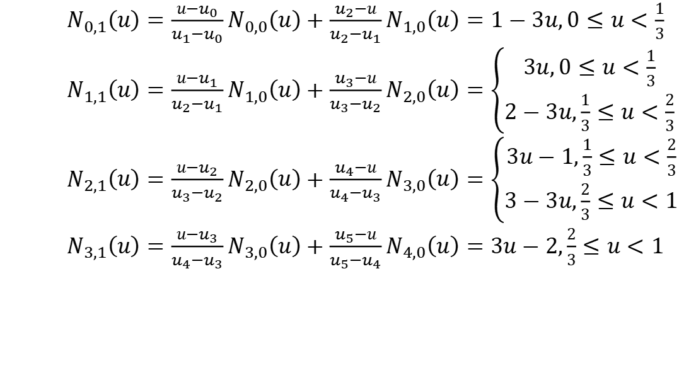
$N_{0,1}\left(u\right)=\frac{u−u_{0}}{u_{1}−u_{0}}N_{0,0}\left(u\right)+\frac{u_{2}−u}{u_{2}−u_{1}}N_{1,0}\left(u\right)=1−3u,0≤u<\frac{1}{3}$
$N_{1,1}\left(u\right)=\frac{u−u_{1}}{u_{2}−u_{1}}N_{1,0}\left(u\right)+\frac{u_{3}−u}{u_{3}−u_{2}}N_{2,0}\left(u\right)=\left\{\begin{aligned}3u,0≤u<\frac{1}{3} \\ 2−3u,\frac{1}{3}≤u<\frac{2}{3}\end{aligned}\right.$
$N_{2,1}\left(u\right)=\frac{u−u_{2}}{u_{3}−u_{2}}N_{2,0}\left(u\right)+\frac{u_{4}−u}{u_{4}−u_{3}}N_{3,0}\left(u\right)=\left\{\begin{aligned}3u−1,\frac{1}{3}≤u<\frac{2}{3} \\ 3−3u,\frac{2}{3}≤u<1\end{aligned}\right.$
$N_{3,1}\left(u\right)=\frac{u−u_{3}}{u_{4}−u_{3}}N_{3,0}\left(u\right)+\frac{u_{5}−u}{u_{5}−u_{4}}N_{4,0}\left(u\right)=3u−2,\frac{2}{3}≤u<1$

Slide 12
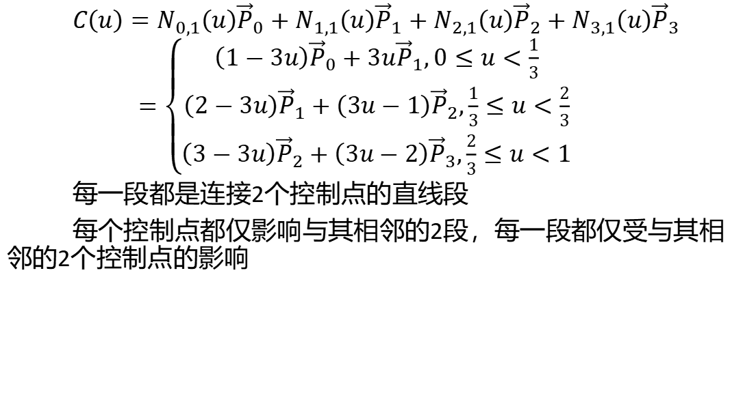
$C\left(u\right)=N_{0,1}\left(u\right){\vec{P}}_{0}+N_{1,1}\left(u\right){\vec{P}}_{1}+N_{2,1}\left(u\right){\vec{P}}_{2}+N_{3,1}\left(u\right){\vec{P}}_{3}$
$=\left\{\begin{aligned}\left(1−3u\right){\vec{P}}_{0}+3u{\vec{P}}_{1},0≤u<\frac{1}{3} \\ \left(2−3u\right){\vec{P}}_{1}+\left(3u−1\right){\vec{P}}_{2},\frac{1}{3}≤u<\frac{2}{3} \\ \left(3−3u\right){\vec{P}}_{2}+\left(3u−2\right){\vec{P}}_{3},\frac{2}{3}≤u<1\end{aligned}\right.$
每一段都是连接2个控制点的直线段
每个控制点都仅影响与其相邻的2段，每一段都仅受与其相邻的2个控制点的影响

Slide 13
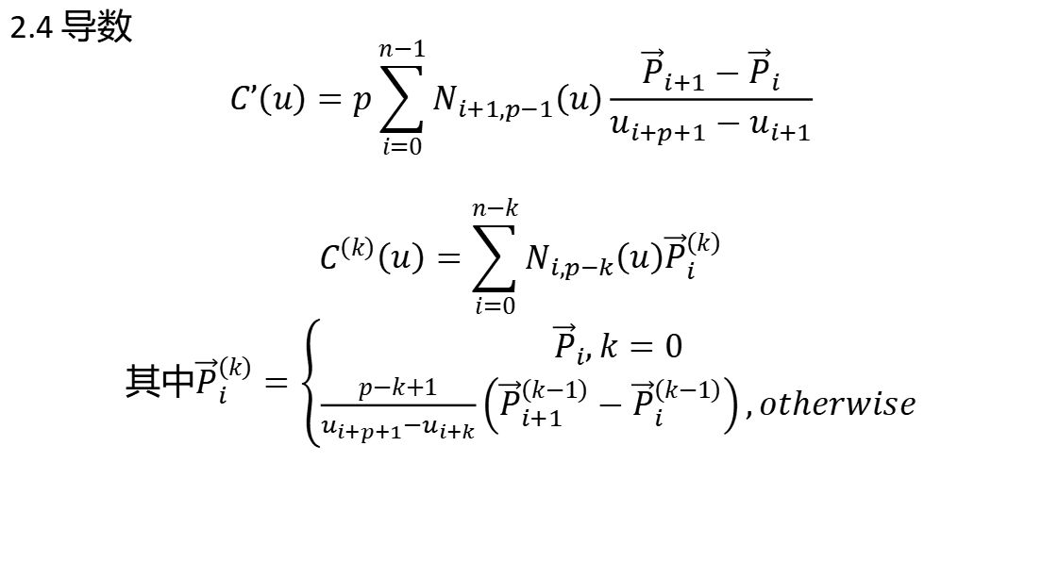
2.4 导数
$$C’\left(u\right)=p\sum_{i=0}^{n−1}{N_{i+1,p−1}\left(u\right)\frac{{\vec{P}}_{i+1}−{\vec{P}}_{i}}{u_{i+p+1}−u_{i+1}}}$$
$$C^{\left(k\right)}\left(u\right)=\sum_{i=0}^{n−k}{N_{i,p−k}\left(u\right){\vec{P}}_{i}^{\left(k\right)}}$$
其中${\vec{P}}_{i}^{\left(k\right)}=\left\{\begin{aligned}{\vec{P}}_{i},k=0 \\ \frac{p−k+1}{u_{i+p+1}−u_{i+k}}\left({\vec{P}}_{i+1}^{\left(k−1\right)}−{\vec{P}}_{i}^{\left(k−1\right)}\right),otherwise\end{aligned}\right.$

Slide 14
3.B样条曲面

Slide 15
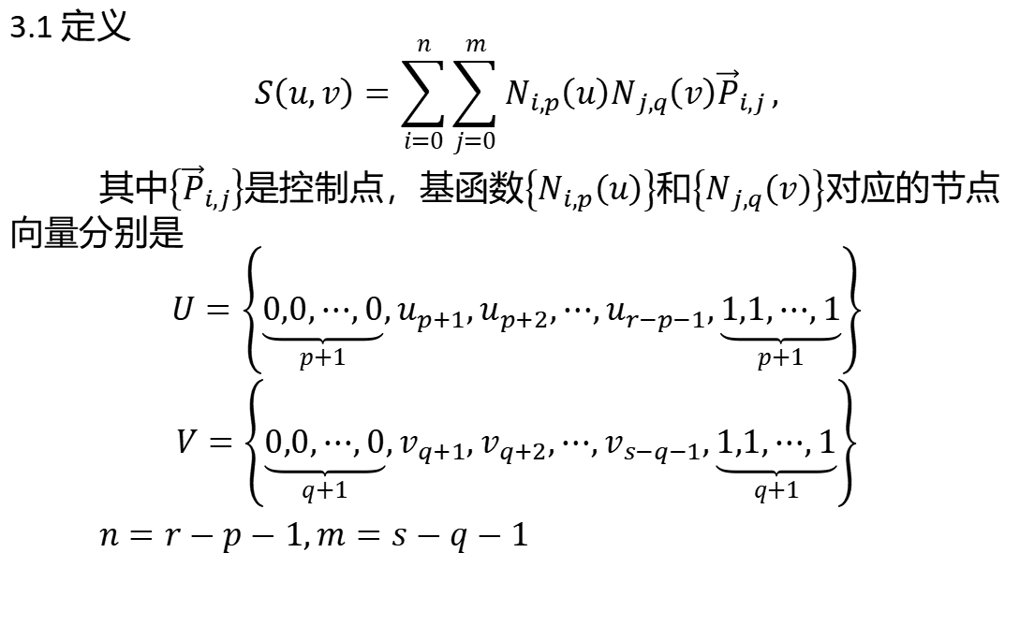
3.1 定义
$$S\left(u,v\right)=\sum_{i=0}^{n}{\sum_{j=0}^{m}{N_{i,p}\left(u\right)N_{j,q}\left(v\right){\vec{P}}_{i,j}}},$$
其中$\left\{{\vec{P}}_{i,j}\right\}$是控制点，基函数$\left\{N_{i,p}\left(u\right)\right\}$和$\left\{N_{j,q}\left(v\right)\right\}$对应的节点向量分别是
$$U=\left\{\underset{p+1}{\underbrace{0,0,⋯,0}},u_{p+1},u_{p+2},⋯,u_{r−p−1},\underset{p+1}{\underbrace{1,1,⋯,1}}\right\}$$
$V=\left\{\underset{q+1}{\underbrace{0,0,⋯,0}},v_{q+1},v_{q+2},⋯,v_{s−q−1},\underset{q+1}{\underbrace{1,1,⋯,1}}\right\}$
$n=r−p−1,m=s−q−1$

Slide 16
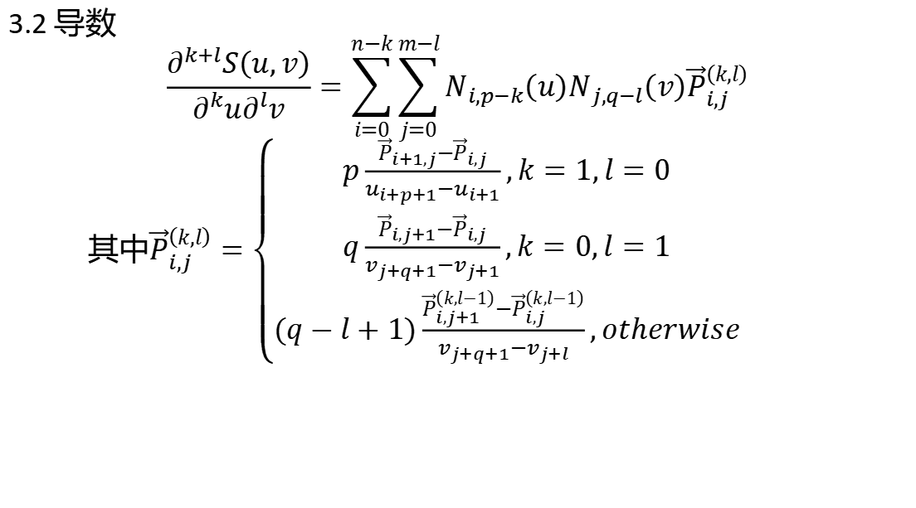
3.2 导数
$$\frac{∂^{k+l}S\left(u,v\right)}{∂^{k}u∂^{l}v}=\sum_{i=0}^{n−k}{\sum_{j=0}^{m−l}{N_{i,p−k}\left(u\right)N_{j,q−l}\left(v\right){\vec{P}}_{i,j}^{\left(k,l\right)}}}$$
其中${\vec{P}}_{i,j}^{\left(k,l\right)}=\left\{\begin{aligned}p\frac{{\vec{P}}_{i+1,j}−{\vec{P}}_{i,j}}{u_{i+p+1}−u_{i+1}},k=1,l=0 \\ q\frac{{\vec{P}}_{i,j+1}−{\vec{P}}_{i,j}}{v_{j+q+1}−v_{j+1}},k=0,l=1 \\ \left(q−l+1\right)\frac{{\vec{P}}_{i,j+1}^{\left(k,l−1\right)}−{\vec{P}}_{i,j}^{\left(k,l−1\right)}}{v_{j+q+1}−v_{j+l}},otherwise\end{aligned}\right.$

Slide 17
4.NURBS曲线

Slide 18
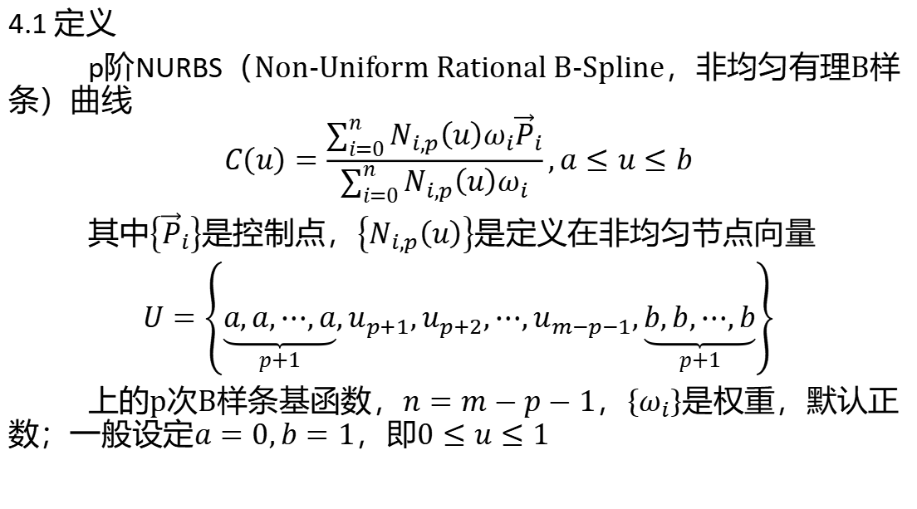
4.1 定义
p阶NURBS（Non-Uniform Rational B-Spline，非均匀有理B样条）曲线
$$C\left(u\right)=\frac{\sum_{i=0}^{n}{N_{i,p}\left(u\right)ω_{i}{\vec{P}}_{i}}}{\sum_{i=0}^{n}{N_{i,p}\left(u\right)ω_{i}}},a≤u≤b$$
其中$\left\{{\vec{P}}_{i}\right\}$是控制点，$\left\{N_{i,p}\left(u\right)\right\}$是定义在非均匀节点向量
$U=\left\{\underset{p+1}{\underbrace{a,a,⋯,a}},u_{p+1},u_{p+2},⋯,u_{m−p−1},\underset{p+1}{\underbrace{b,b,⋯,b}}\right\}$
上的p次B样条基函数，$n=m−p−1$，$\left\{ω_{i}\right\}$是权重，默认正数；一般设定$a=0,b=1$，即$0≤u≤1$

Slide 19
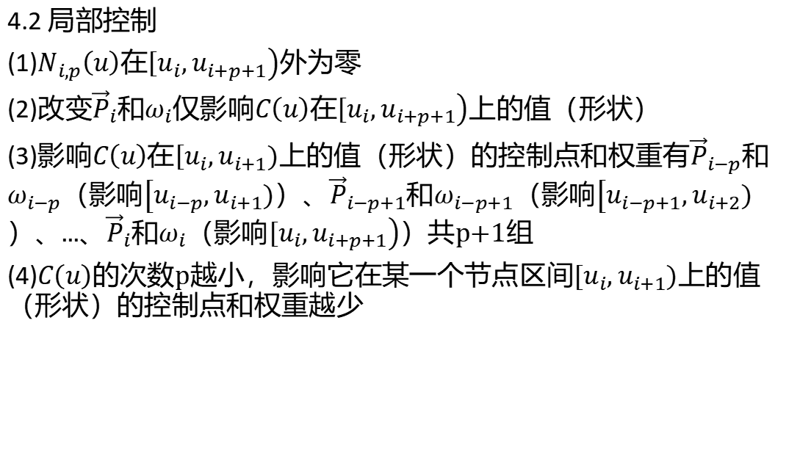
4.2 局部控制
(1)$N_{i,p}\left(u\right)$在$\left[u_{i}\right.,\left.u_{i+p+1}\right)$外为零
(2)改变${\vec{P}}_{i}$和$ω_{i}$仅影响$C\left(u\right)$在$\left[u_{i}\right.,\left.u_{i+p+1}\right)$上的值（形状）
(3)影响$C\left(u\right)$在$\left[u_{i}\right.,\left.u_{i+1}\right)$上的值（形状）的控制点和权重有${\vec{P}}_{i−p}$和$ω_{i−p}$（影响$\left[u_{i−p}\right.,\left.u_{i+1}\right)$）、${\vec{P}}_{i−p+1}$和$ω_{i−p+1}$（影响$\left[u_{i−p+1}\right.,\left.u_{i+2}\right)$）、...、${\vec{P}}_{i}$和$ω_{i}$（影响$\left[u_{i}\right.,\left.u_{i+p+1}\right)$）共p+1组
(4)$C\left(u\right)$的次数p越小，影响它在某一个节点区间$\left[u_{i}\right.,\left.u_{i+1}\right)$上的值（形状）的控制点和权重越少

Slide 20
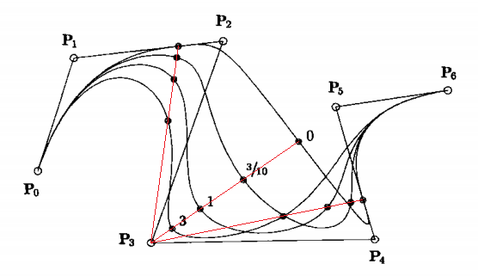
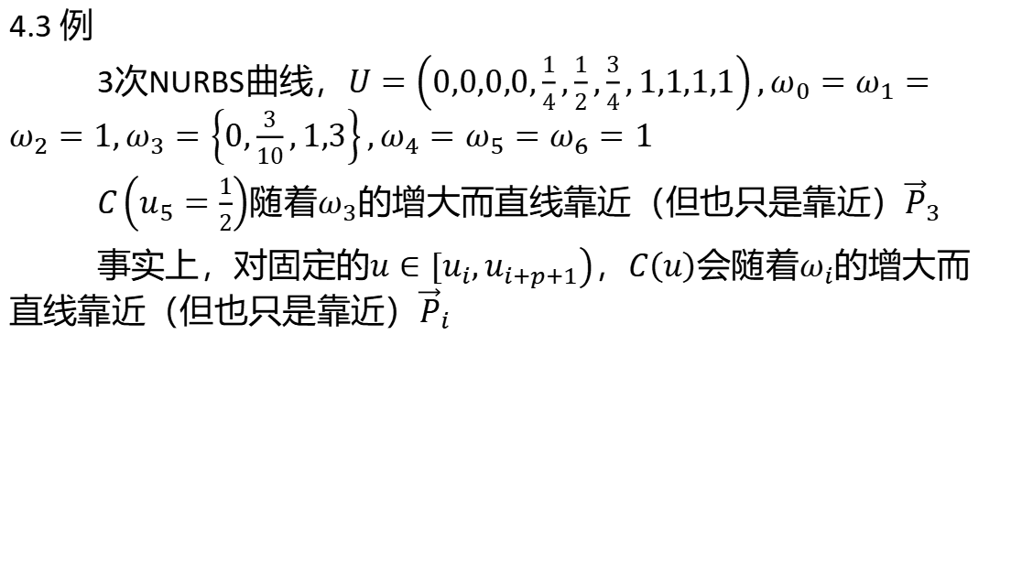
4.3 例
3次NURBS曲线，$U=\left(0,0,0,0,\frac{1}{4},\frac{1}{2},\frac{3}{4},1,1,1,1\right),ω_{0}=ω_{1}=ω_{2}=1,ω_{3}=\left\{0,\frac{3}{10},1,3\right\},ω_{4}=ω_{5}=ω_{6}=1$
$C\left(u_{5}=\frac{1}{2}\right)$随着$ω_{3}$的增大而直线靠近（但也只是靠近）${\vec{P}}_{3}$
事实上，对固定的$u∈\left[u_{i}\right.,\left.u_{i+p+1}\right)$，$C\left(u\right)$会随着$ω_{i}$的增大而直线靠近（但也只是靠近）${\vec{P}}_{i}$

Slide 21
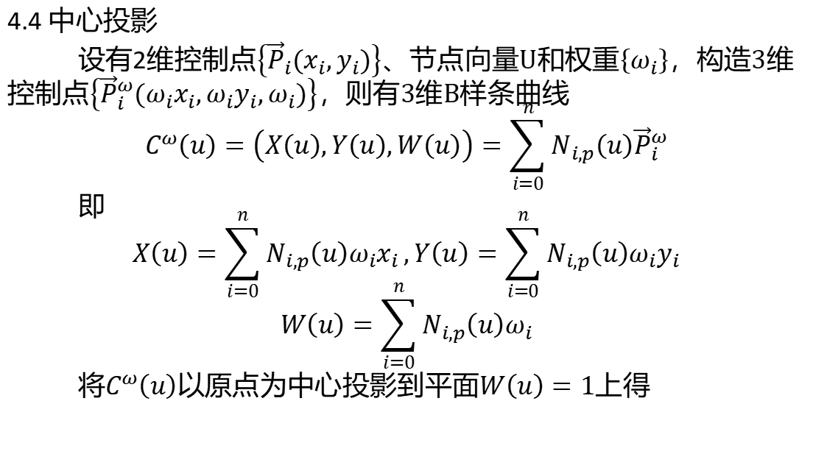
4.4 中心投影
设有2维控制点$\left\{{\vec{P}}_{i}\left(x_{i},y_{i}\right)\right\}$、节点向量U和权重$\left\{ω_{i}\right\}$，构造3维控制点$\left\{{\vec{P}}_{i}^{ω}\left(ω_{i}x_{i},ω_{i}y_{i},ω_{i}\right)\right\}$，则有3维B样条曲线
$$C^{ω}\left(u\right)=\left(X\left(u\right),Y\left(u\right),W\left(u\right)\right)=\sum_{i=0}^{n}{N_{i,p}\left(u\right){\vec{P}}_{i}^{ω}}$$
即
$$X\left(u\right)=\sum_{i=0}^{n}{N_{i,p}\left(u\right)ω_{i}x_{i}},Y\left(u\right)=\sum_{i=0}^{n}{N_{i,p}\left(u\right)ω_{i}y_{i}}$$
$$W\left(u\right)=\sum_{i=0}^{n}{N_{i,p}\left(u\right)ω_{i}}$$
将$C^{ω}\left(u\right)$以原点为中心投影到平面$W\left(u\right)=1$上得

Slide 22

$C\left(u\right)=\left(\frac{X\left(u\right)}{W\left(u\right)},\frac{Y\left(u\right)}{W\left(u\right)}\right)$
$=\left(\frac{\sum_{i=0}^{n}{N_{i,p}\left(u\right)ω_{i}x_{i}}}{\sum_{i=0}^{n}{N_{i,p}\left(u\right)ω_{i}}},\frac{\sum_{i=0}^{n}{N_{i,p}\left(u\right)ω_{i}y_{i}}}{\sum_{i=0}^{n}{N_{i,p}\left(u\right)ω_{i}}}\right)$
$=\frac{\sum_{i=0}^{n}{N_{i,p}\left(u\right)ω_{i}{\vec{P}}_{i}}}{\sum_{i=0}^{n}{N_{i,p}\left(u\right)ω_{i}}}$
表示2维有理B样条曲线

Slide 23
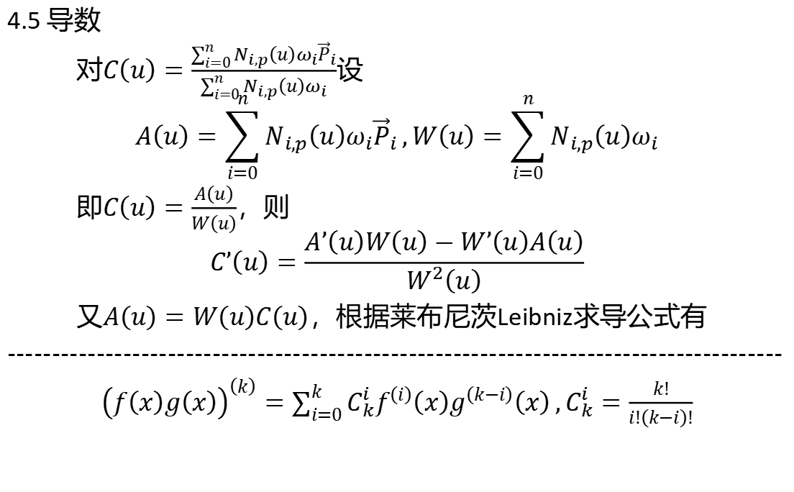
4.5 导数
对$C\left(u\right)=\frac{\sum_{i=0}^{n}{N_{i,p}\left(u\right)ω_{i}{\vec{P}}_{i}}}{\sum_{i=0}^{n}{N_{i,p}\left(u\right)ω_{i}}}$设
$$A\left(u\right)=\sum_{i=0}^{n}{N_{i,p}\left(u\right)ω_{i}{\vec{P}}_{i}},W\left(u\right)=\sum_{i=0}^{n}{N_{i,p}\left(u\right)ω_{i}}$$
即$C\left(u\right)=\frac{A\left(u\right)}{W\left(u\right)}$，则
$$C’\left(u\right)=\frac{A’\left(u\right)W\left(u\right)−W’\left(u\right)A\left(u\right)}{W^{2}\left(u\right)}$$
又$A\left(u\right)=W\left(u\right)C\left(u\right)$，根据莱布尼茨Leibniz求导公式有
---------------------------------------------------------------------------------------
${\left(f\left(x\right)g\left(x\right)\right)}^{\left(k\right)}=\sum_{i=0}^{k}{C_{k}^{i}f^{\left(i\right)}\left(x\right)g^{\left(k−i\right)}\left(x\right)},C_{k}^{i}=\frac{k!}{i!\left(k−i\right)!}$

Slide 24
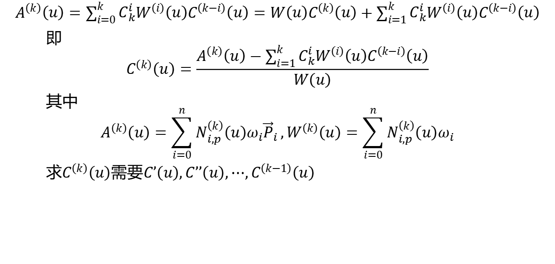
$A^{\left(k\right)}\left(u\right)=\sum_{i=0}^{k}{C_{k}^{i}W^{\left(i\right)}\left(u\right)C^{\left(k−i\right)}\left(u\right)}=W\left(u\right)C^{\left(k\right)}\left(u\right)+\sum_{i=1}^{k}{C_{k}^{i}W^{\left(i\right)}\left(u\right)C^{\left(k−i\right)}\left(u\right)}$
即
$$C^{\left(k\right)}\left(u\right)=\frac{A^{\left(k\right)}\left(u\right)−\sum_{i=1}^{k}{C_{k}^{i}W^{\left(i\right)}\left(u\right)C^{\left(k−i\right)}\left(u\right)}}{W\left(u\right)}$$
其中
$$A^{\left(k\right)}\left(u\right)=\sum_{i=0}^{n}{N_{i,p}^{\left(k\right)}\left(u\right)ω_{i}{\vec{P}}_{i}},W^{\left(k\right)}\left(u\right)=\sum_{i=0}^{n}{N_{i,p}^{\left(k\right)}\left(u\right)ω_{i}}$$
求$C^{\left(k\right)}\left(u\right)$需要$C’\left(u\right),C’’\left(u\right),⋯,C^{\left(k−1\right)}\left(u\right)$

Slide 25
5.NURBS曲面

Slide 26
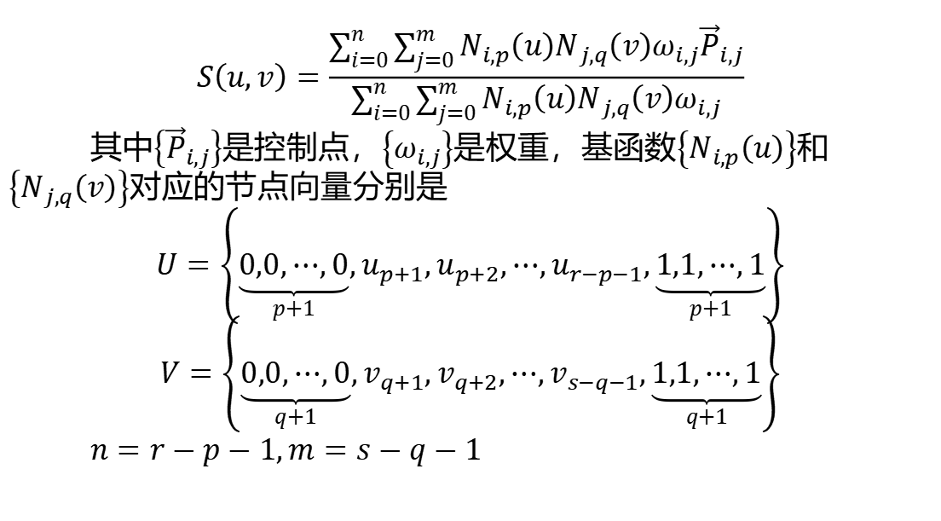
$$S\left(u,v\right)=\frac{\sum_{i=0}^{n}{\sum_{j=0}^{m}{N_{i,p}\left(u\right)N_{j,q}\left(v\right)ω_{i,j}{\vec{P}}_{i,j}}}}{\sum_{i=0}^{n}{\sum_{j=0}^{m}{N_{i,p}\left(u\right)N_{j,q}\left(v\right)ω_{i,j}}}}$$
其中$\left\{{\vec{P}}_{i,j}\right\}$是控制点，$\left\{ω_{i,j}\right\}$是权重，基函数$\left\{N_{i,p}\left(u\right)\right\}$和$\left\{N_{j,q}\left(v\right)\right\}$对应的节点向量分别是
$U=\left\{\underset{p+1}{\underbrace{0,0,⋯,0}},u_{p+1},u_{p+2},⋯,u_{r−p−1},\underset{p+1}{\underbrace{1,1,⋯,1}}\right\}$
$V=\left\{\underset{q+1}{\underbrace{0,0,⋯,0}},v_{q+1},v_{q+2},⋯,v_{s−q−1},\underset{q+1}{\underbrace{1,1,⋯,1}}\right\}$
$n=r−p−1,m=s−q−1$

