Slide 1
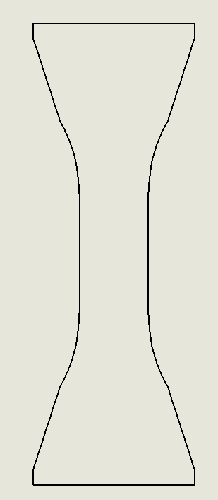
Original drawing
Added the cutlline
After conversion to G-code, the two arcs in the red circle did not convert properly, there were a number of arcs on top of each other.µ
To check the dxf, I flipped the imported file both vertical and horizontal before converting into G-code, to see of the problem area would also flip with the drawing, but this was not the case. It was always the area in the red circle that gave problems, no matter the orientation of the imported DXF file.

Slide 2
Contour looked something like this

