Slide 1
Smart Devices and Electric Vehicle Chargers for Grid Demand Response Team HAM: Ming Wang, Anthony Vu, Hongnian Yu, Arunav Singh
Advisors: Professor G.P. Li and Dr. Michael Klopfer Department of Electrical Engineering and Computer Science

Slide 2
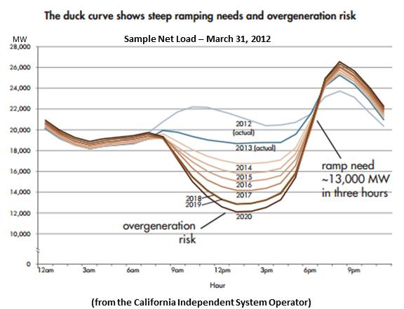
Introduction to Problem
California Energy Crisis
Aging power plants
Need clean air -> shift toward EVs
Why California?
Leading by example, shown trend across nation
Net Load Curve

Slide 3
What needs to be done?
Conservation & Zero Net Energy
Demand response
Energy produced in response to demand at any given time
Reduce and add efficiency standards
Not very significant
EVs can require more power than rest of household
Major contributor to load issue

Slide 4
Our Focus
Downside of increasing popularity of EVs
Exaggeration of Net Load Curve → Demand Response
Variance of availability of energy
Solar plentiful during day, zero during night
Wind availability across seasons, generally more at night time
Our solution
Schedule EV charging around time and energy availability
Based on individual situations across seasons and variable weather patterns

Slide 5
Vehicle Charging System
Goals
Make sure vehicles plugged in, charged by morning
Max resource efficiency
Two Parts
Proof of concept of scheduling controls engine
Bluetooth enabled OpenEVSE
IoT enabled charger

Slide 6
Charge Scheduling Algorithm
Simulate scheduling using prior data
4 different months -> 4 seasons
Solar and Wind patterns at each time of day
Effect of variable weather patterns
Changes in wind speeds -> Affect available energy
Demand Response

Slide 7
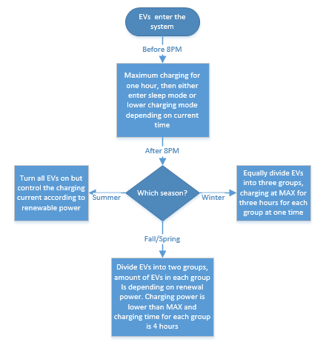
Charge Scheduling Algorithm

Slide 8
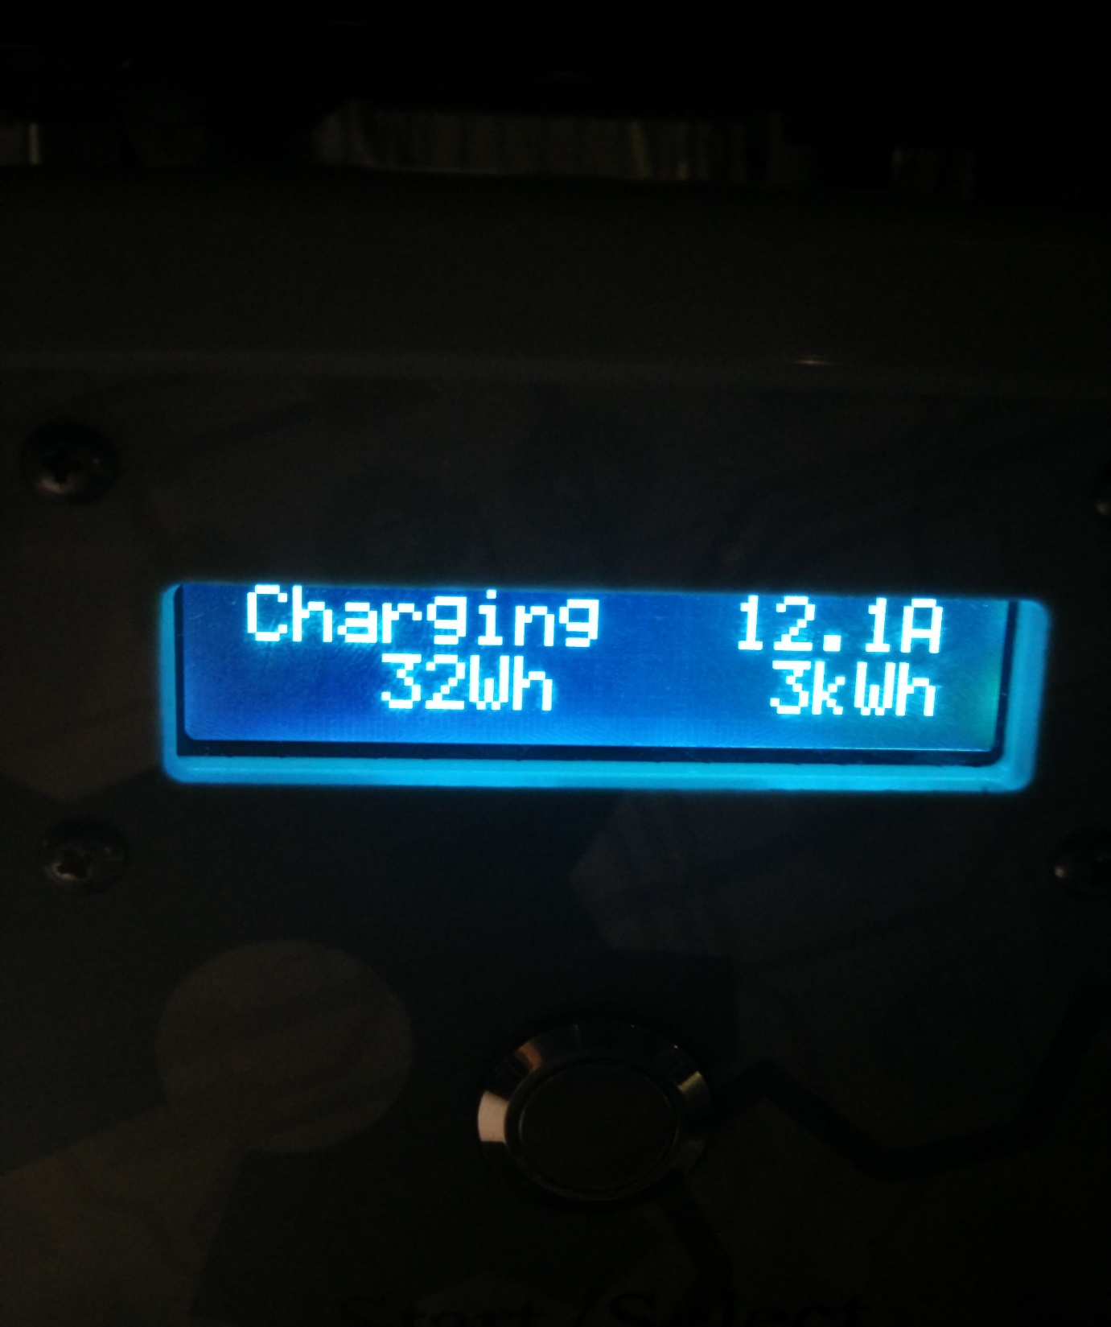
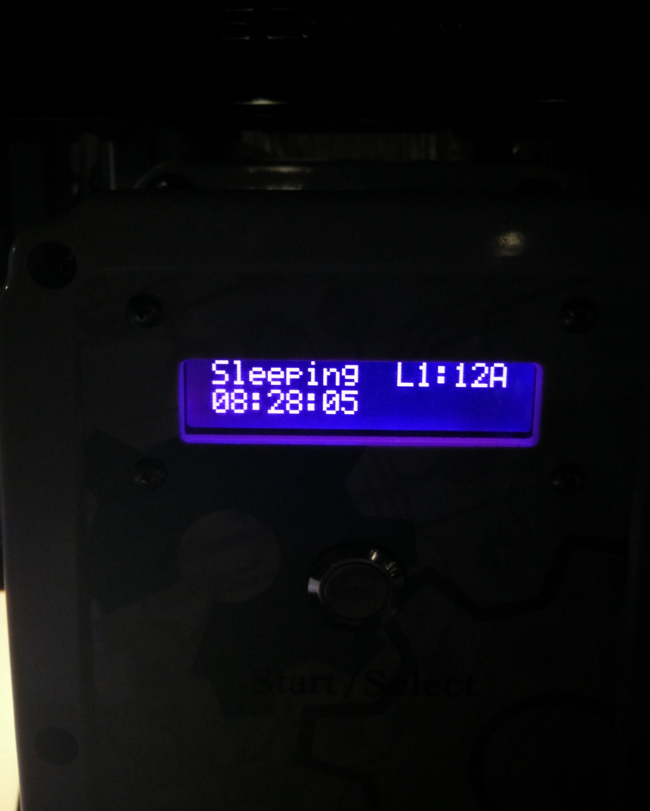

Slide 9
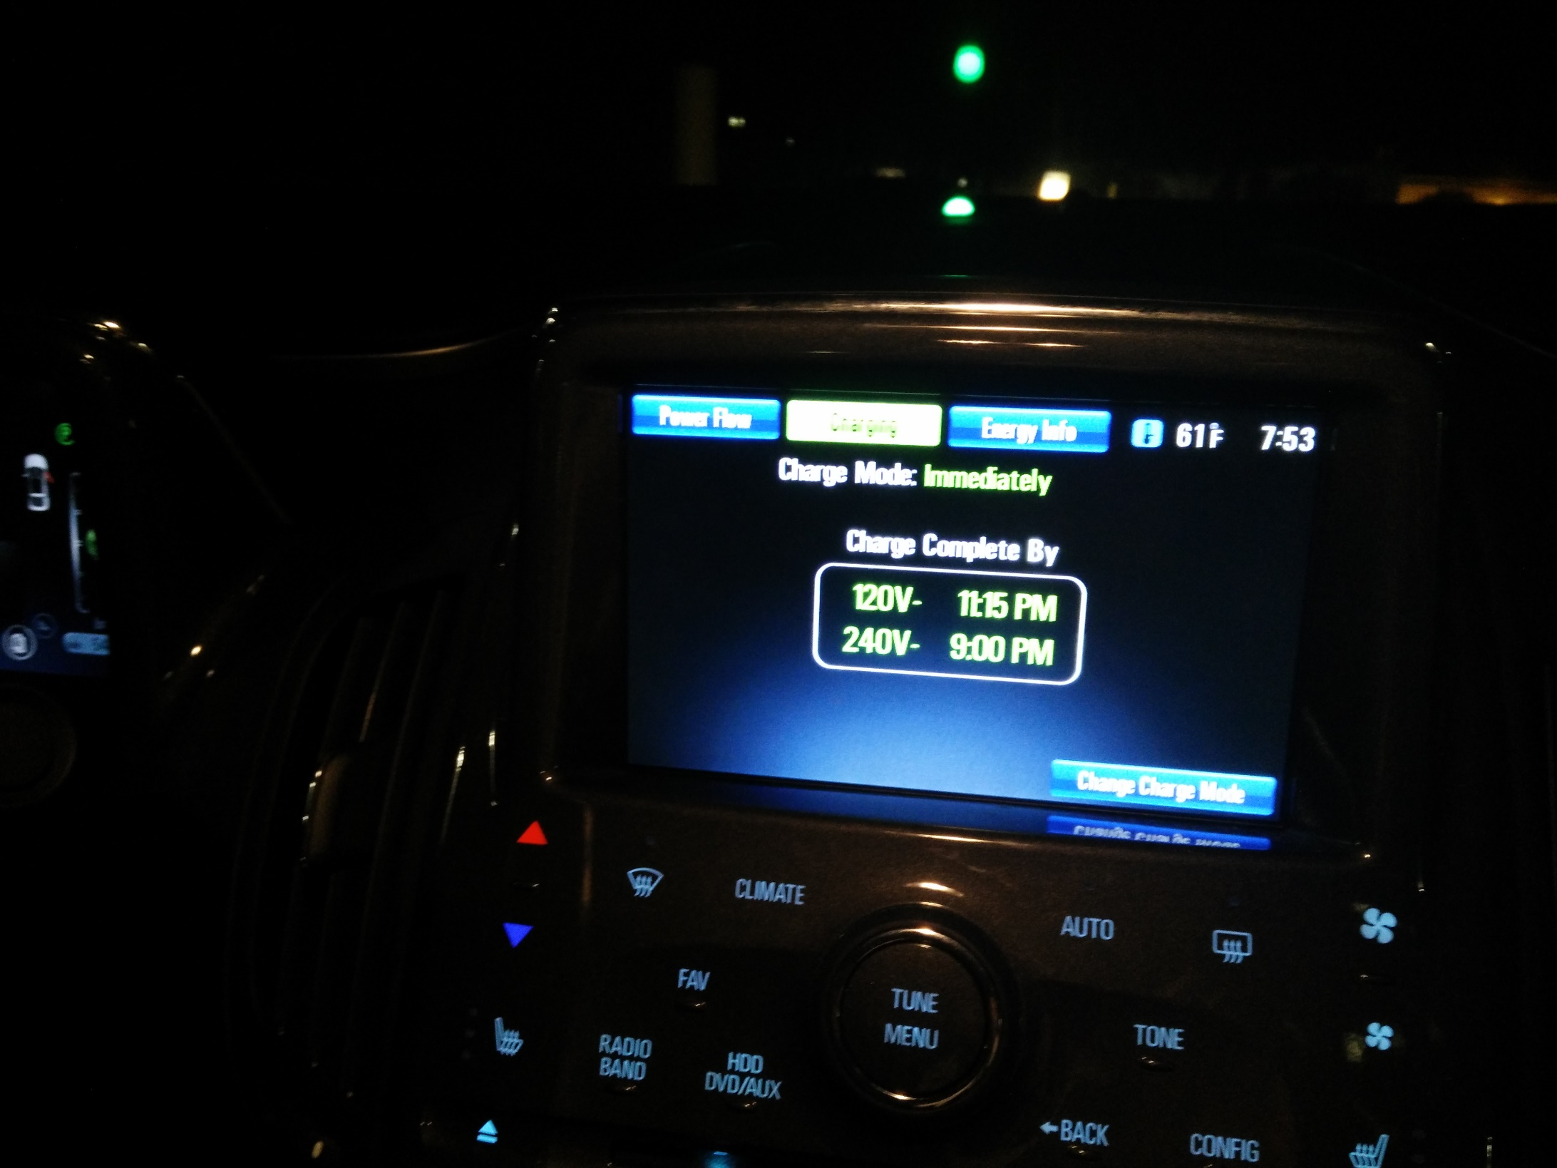

Slide 10
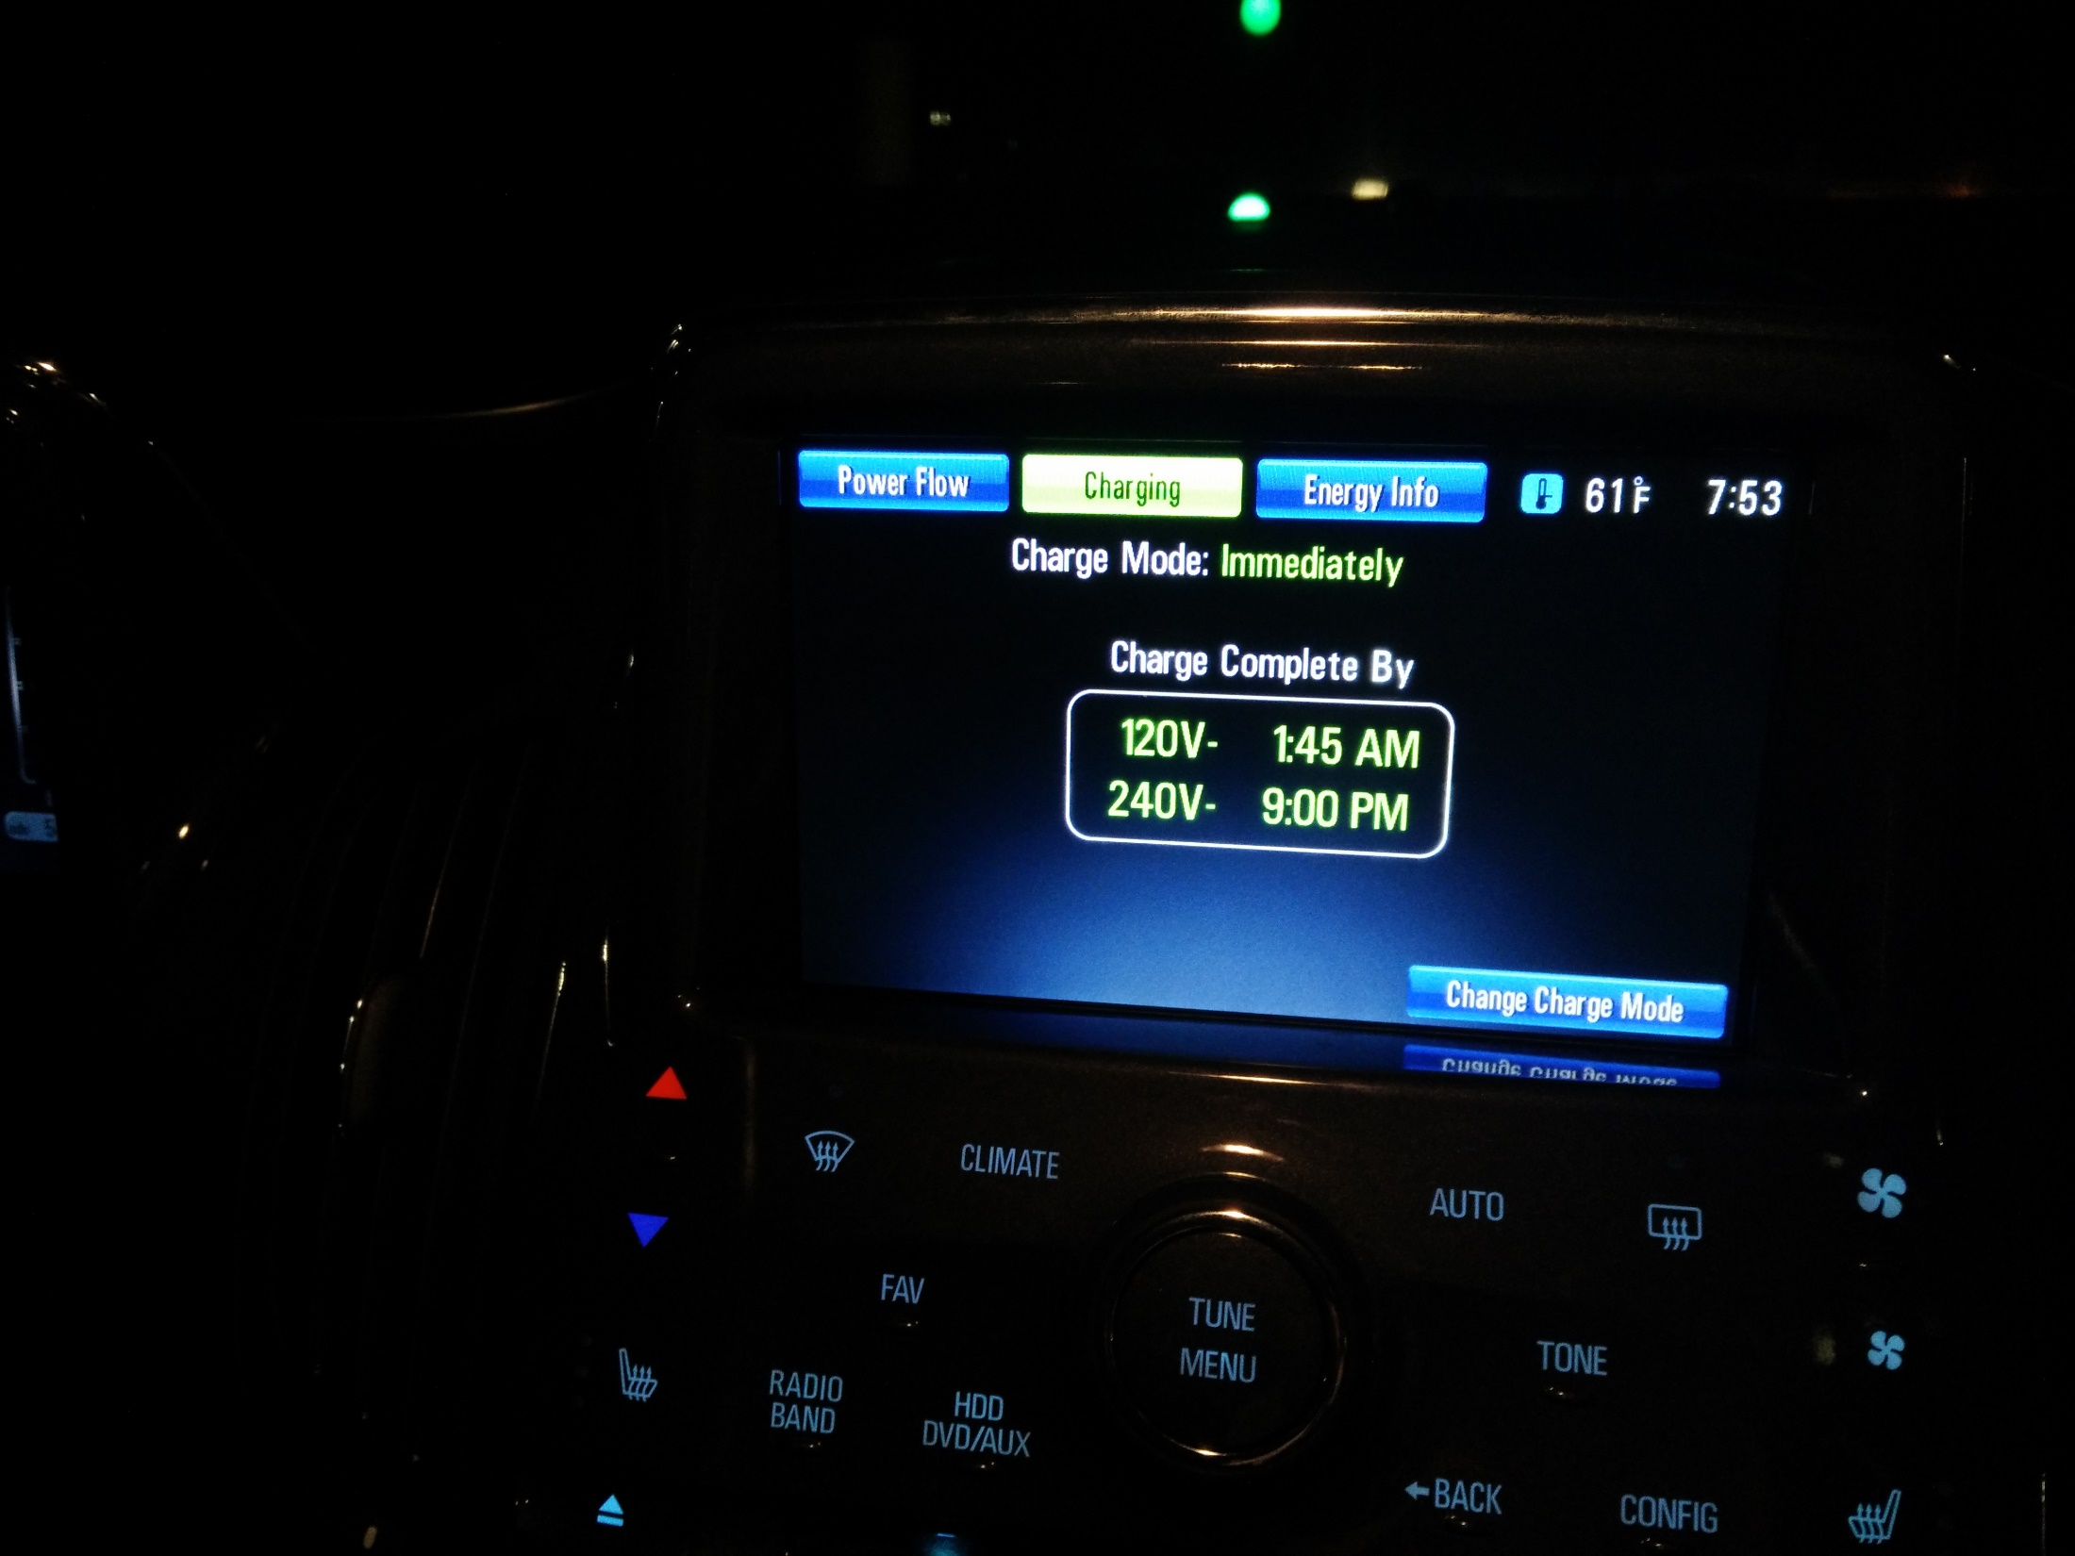

Slide 11
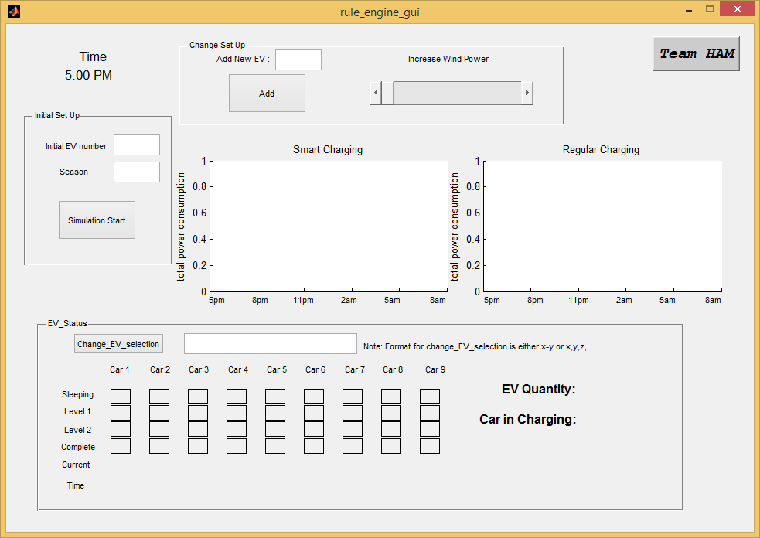
Scheduling Controls Engine
Simulation set up
5PM-8AM
Real Node/Virtual Node

Slide 12
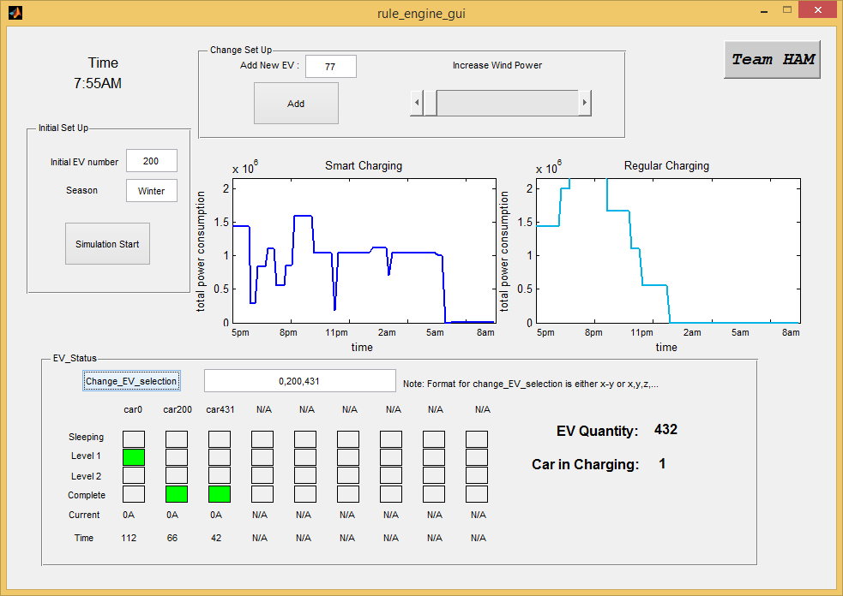
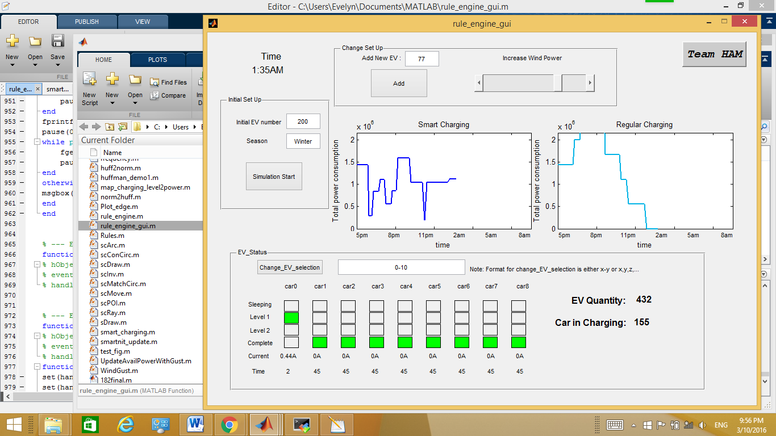
Scheduling Controls Engine
Features
Add EV
Change wind speed
Check EV status

Slide 13
Simulation Result

Slide 14
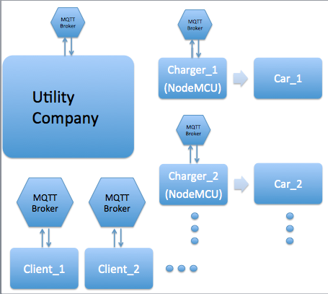
IoT Enabled OpenEVSE
Wifi-Enabled NodeMCU ESP8266
MQ Telemetry Transport
Reliable and stable control across network

Slide 15
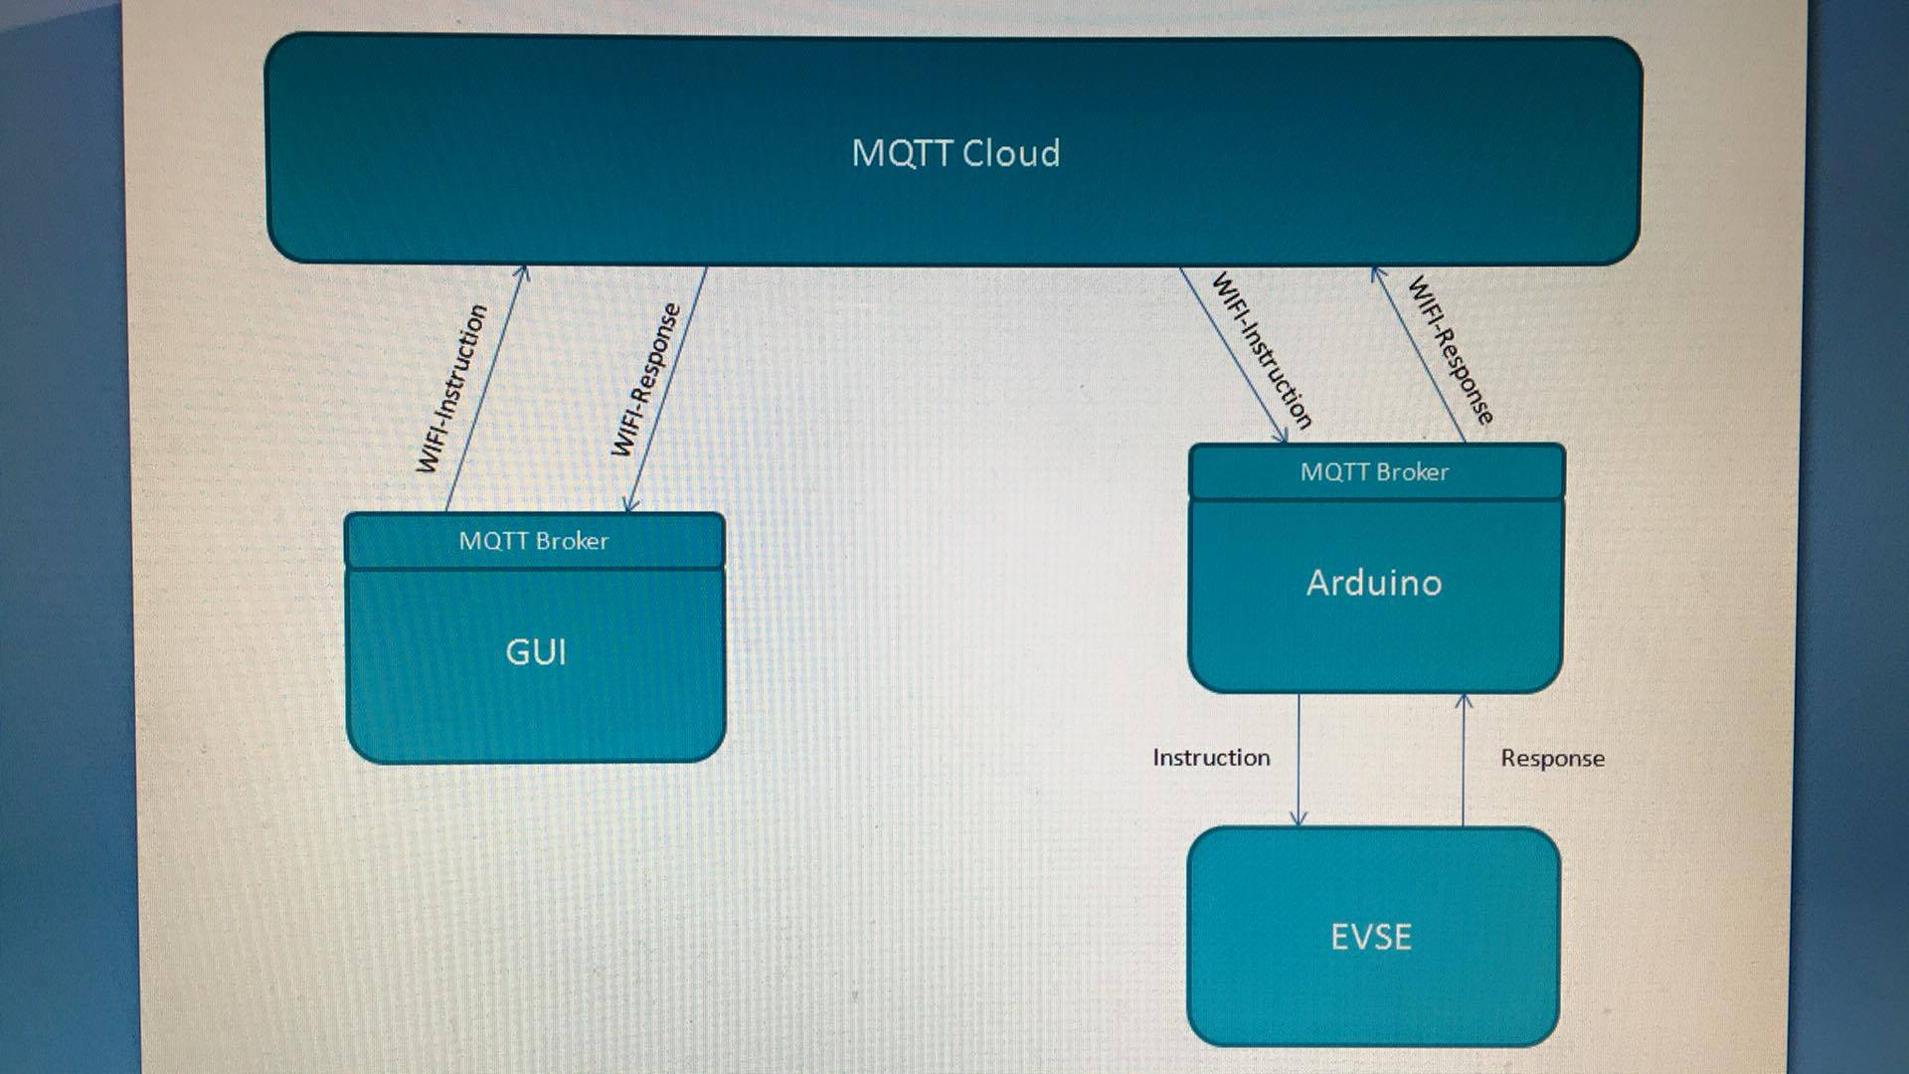

Slide 16
Further Development and Impact
In future, scheduling controls GUI will be have full control over IoT enabled devices
Merge both sides of our project
Covered by California Public Utilties commission as rebate program
Cost of unit and use

Slide 17
Competition & Alternative Solutions
AeroVironment TurboCord
No charge scheduling
No smart capability
What makes our system unique?

Slide 18
Summary
Energy climate is rapidly changing
Inherent variance in renewable energy availability
Demand response must be controlled
Energy must ALWAYS be available
EVs have great impact but…
Our System
Utilities have window into residences
True IoT system and MQTT framework
Reliable interaction

Slide 19





Acknowledgements
A big thanks to our mentors:
Professor G.P. Li and Dr. Michael Klopfer
Calit2/Calplug and Microsemi in collaboration with Smartenit LLC
for guidence and direction in our project.
Thank you to our contributors:

